Slide 1
Brain MRI classification
Baseline replication and proposed model comparison
M2 and M3 capstone evaluation
6 October 2026
Vishesh Rao, Pranay Vishwakarma and Manu Vahan
Sajjan Agarwal School of Technology, Rishihood University
01
Notes:
Source: Disci, Gurcan and Soylu (2025), DOI 10.3390/cancers17010121. https://doi.org/10.3390/cancers17010121
Measured source: results/disci2025/summary.csv and runs/. Four Colab runs, five epochs, seed 42. Saved predictions independently verified.
Opening: We establish a selected baseline and report an unfavorable proposed-model comparison honestly.

Slide 2
Introduction
Task: classify MRI slices as glioma, meningioma, no tumor or pituitary tumor.
Transfer learning provides a baseline for a limited MRI dataset.
Our experiment measures predictive performance together with model size and evaluation reliability.
02
Notes:
Source: original Phase 1 literature-survey report. Broader radiomics and explainability proposals remain future work.

Slide 3
Selected base paper
Disci, Gurcan and Soylu
Cancers 17(1), 121, 2025
Advanced Brain Tumor Classification in MR Images Using Transfer Learning and Pre-Trained Deep CNN Models
Selected baseline: Xception
Published test accuracy: 95.27%
The 98.73% headline is consistent with combined train/test accuracy, inferred from the paper tables.
03
Notes:
Source: Disci, Gurcan and Soylu (2025), DOI 10.3390/cancers17010121. https://doi.org/10.3390/cancers17010121
The source compares six CNNs. Our revised scope selects Xception as baseline, not the whole six-model comparison.

Slide 4
Correct dataset version
Masoud Nickparvar Brain Tumor MRI Dataset, version 1
Partition | Glioma | Meningioma | No tumor | Pituitary | Total
Training | 1,321 | 1,339 | 1,595 | 1,457 | 5,712
Testing | 300 | 306 | 405 | 300 | 1,311
7,023 images match the paper. The current 7,200-image version would change the experiment.
04
Notes:
Source: https://www.kaggle.com/datasets/masoudnickparvar/brain-tumor-mri-dataset/versions/1
Version 1 archive SHA256 recorded in results/disci2025/dataset_source.json. Version 2 has 7,200 images and is excluded.

Slide 5
Original and audited protocols
Protocol | Training | Validation | Testing
Paper-based | 5,712 | None | 1,311
Leakage-audited | 4,518 | 798 | 1,311
Audit: 263 training images identical to test images; 207 redundant training copies.
Audited training excludes exact overlap and redundant copies. Reliable patient IDs are unavailable.
05
Notes:
Measured source: results/disci2025/summary.csv and runs/. Four Colab runs, five epochs, seed 42. Saved predictions independently verified.
Source: results/disci2025/data_audit.json. 1,254 perceptual near-match candidates remain unresolved. No patient IDs. Test contains 30 redundant images.

Slide 6
Replicated training method
Grayscale, Gaussian blur and foreground crop. Resize to 128 × 128, replicate three channels and scale to [0,1].
ImageNet backbone with Flatten, Dropout 0.3, Dense 128 ReLU, Dropout 0.2 and four-class Softmax.
Adam 0.0001, batch 20, five epochs. Brightness and contrast factors 0.8–1.2. Final-epoch checkpoint.
Crop settings and full fine-tuning are disclosed assumptions. Foreground cropping is not validated tumor segmentation.
06
Notes:
Source: Disci, Gurcan and Soylu (2025), DOI 10.3390/cancers17010121. https://doi.org/10.3390/cancers17010121
Disclosed assumptions: Gaussian kernel 5, threshold 45, bounding-rectangle crop retaining blurred grayscale, seed 42, full backbone fine-tuning. Source leaves these choices incomplete. Crop fallback count: zero of 7,023.

Slide 7
Xception baseline accuracy
Clean accuracy is 1.60 percentage points below the paper.
This establishes an approximate baseline under disclosed assumptions.
07
Notes:
Source: Disci, Gurcan and Soylu (2025), DOI 10.3390/cancers17010121. https://doi.org/10.3390/cancers17010121
Measured source: results/disci2025/summary.csv and runs/. Four Colab runs, five epochs, seed 42. Saved predictions independently verified.
Published held-out accuracy .9527. Our clean accuracy .9366895499618612; fixed transformed .9328756674294432. The transformed view reflects the paper stated test augmentation without ensembling.

Slide 8
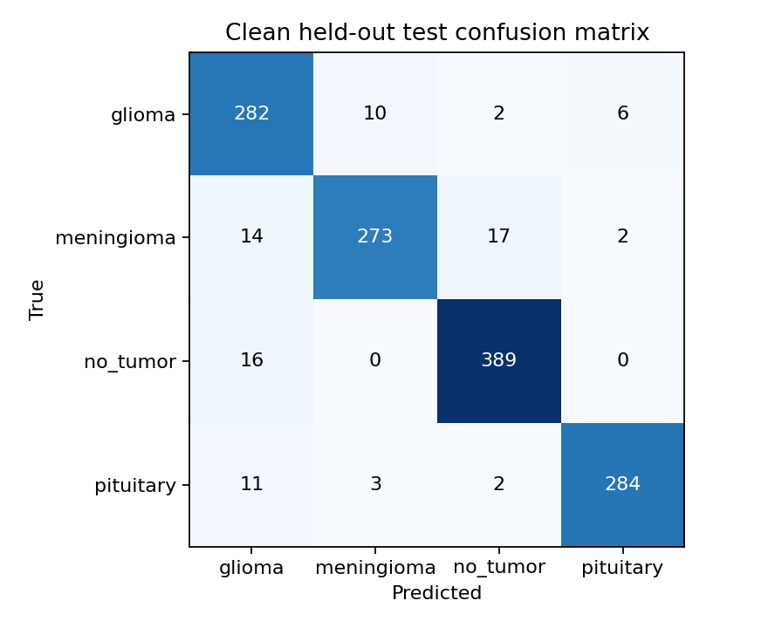
Xception test predictions
93.67% accuracy
0.9354 macro-F1
1,311 ordered test predictions.
All four classes contribute to macro-F1.
08
Notes:
Measured source: results/disci2025/summary.csv and runs/. Four Colab runs, five epochs, seed 42. Saved predictions independently verified.
Source image: results/disci2025/runs/paper_based/Xception/confusion_matrix.png. Source probabilities: predictions_clean.csv.

Slide 9
Proposed change and hypothesis
Proposed change: replace Xception with the smaller MobileNetV2.
Hypothesis: under identical audited settings, MobileNetV2 achieves macro-F1 no more than 0.02 below Xception while using fewer total parameters.
Both criteria must hold. Counts include the classifier head.
09
Notes:
Hypothesis defined before the audited comparison. It is our operational criterion, not a value taken from Disci et al. This single seed does not establish statistical non-inferiority.

Slide 10
Hypothesis not supported
Macro-F1 gap: 0.1804. Allowed margin: 0.02.
The smaller model fails the performance-preservation criterion.
10
Notes:
Measured source: results/disci2025/summary.csv and runs/. Four Colab runs, five epochs, seed 42. Saved predictions independently verified.
Audited pair: same configuration, ordered dataset fingerprint and environment. Xception macro-F1 .917584082118367; MobileNetV2 .7372277864275578. Gap .18035629569080913 > .02.

Slide 11
Resource reduction with an accuracy cost
Audited model | Parameters | Training | Median inference
Xception | 25,056,428 | 239.2 s | 10.02 ms
MobileNetV2 | 4,880,068 | 179.4 s | 5.32 ms
MobileNetV2 uses 80.52% fewer total parameters and runs faster in this experiment.
Its lower macro-F1 prevents acceptance of the joint hypothesis.
11
Notes:
Measured source: results/disci2025/summary.csv and runs/. Four Colab runs, five epochs, seed 42. Saved predictions independently verified.
Audited total parameters: 25,056,428 and 4,880,068. Reduction 80.52368837%. Training excludes downloads and final evaluation. Median inference uses 20 warmed-up, synchronized batch-1 measurements on the same Colab runtime. Timing is indicative, not universal.

Slide 12
Evaluation deliverables and next work
Ready for evaluation
Executed notebook, baseline results, audited comparison, report and saved prediction evidence.
Current limits: one seed, unspecified paper details, missing patient IDs and unresolved near-matches.
After evaluation: controlled normalization and fine-tuning experiments, repeated seeds and patient-level or external validation.
12
Notes:
Measured source: results/disci2025/summary.csv and runs/. Four Colab runs, five epochs, seed 42. Saved predictions independently verified.
References: Source: Disci, Gurcan and Soylu (2025), DOI 10.3390/cancers17010121. https://doi.org/10.3390/cancers17010121
Dataset: https://www.kaggle.com/datasets/masoudnickparvar/brain-tumor-mri-dataset/versions/1
Demo: open notebooks/disci2025_reproduction.ipynb with training disabled. Show baseline table, confusion matrix and hypothesis outcome. Cloud ZIP has no weights. Exact numerical replication and patient-independent generalization are not established.

