Slide 1
Database Systems Outline
CS 307 Database Systems
Prof. Chandrashekar R

Slide 2
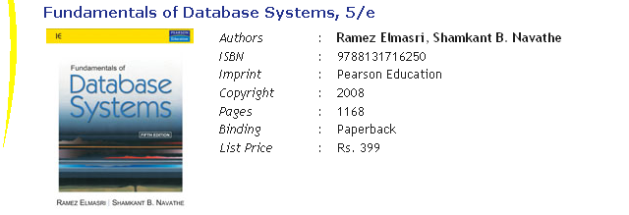
Text Book
Student Supplements can be accessed at this link

Slide 3
Module Outline
S. No. | Topic | Chapters
1 | DBMS Introduction | Ch 1, 2
2 | Conceptual Modeling (ER,OO) | Ch 3, 4
3 | Relational Data Model | Ch 5
4 | Design by Normalization | Ch 10
5 | Design by OO Transformation | Class Notes
6 | Query Processing | Ch 15
7 | Transaction Processing | Ch 17, 18
8 | XML | Ch 19, Ch 23
9 | Overview of advanced topics | Various

