Slide 1
Database Programming
DS 501 Database Systems
View in Slide Show Mode (Press F5)

Slide 2
Outline
Need for database programming
Key issues with database interfaces
Six database programming options

Slide 3
Motivation
Databases hide and protect data in proprietary hidden files and formats
Applications need specific interfaces to access and manipulate data
The interfaces must be “easy” to use
Issues
Language
Procedural vs Non-procedural
Impedance mismatch

Slide 4
Issue 1: Languages
Physical data independence requires that the format in which the data is stored is independent of the programming language that create the data or consume the data
The database must be able to provide interfaces in a varied of programming languages

Slide 5
Issue 2: Procedural vs Non-Procedural
One of the key “selling points” of database is its ability to provide data abstraction
This means that the databases need to provide a means of accessing the data without really worrying about how to go about accessing the data (i.e., should not be worried about data file formats, location, etc.)

Slide 6
Issue 2 (cont.,)
Non-procedural languages are those languages that allow users and applications to access data in a way that does not require deep understanding of the internals of the database system
SQL is an example of a non-procedural language
Languages for legacy database systems were largely procedural in nature

Slide 7
Impedance Mismatch
C Programming Model
(struct, char, int, etc.)
Mapping / conversion
Relational Model
(table, columns,
varchar,
integer, etc.)

Slide 8
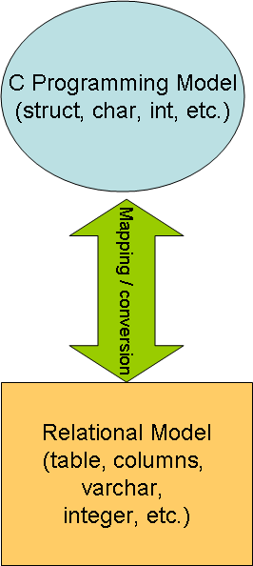
Issue 3: Impedance Mismatch
The data models of the databases and that of the programming interfaces may not be the same
This leads a lot of code being written just for converting from one model to another
E.g., converting from “recordset” to object collections in Java
This mismatch is referred to as “impedance mismatch”

Slide 9
Database Programming Approaches

Slide 10
DB Programming Approaches
SQL
Procedural Extensions to SQL
Embedded SQL
Database APIs
ODBC / JDBC variants
Database Frameworks

Slide 11
1 – SQL
DB
Application
Queries in SQL
Results

Slide 12
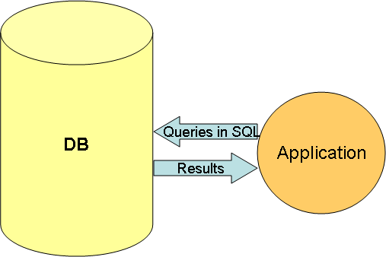
1 - SQL
SQL is the industry standard non-procedural language for relational database access
Advantages
Easy to use (for developers)
Behaves consistently across all vendor implementations (to a large extent)
Disadvantages
Difficult to use! (for end-users)
Difficult to implement complex scenarios (e.g., end user interaction, complex data validations, etc.)

Slide 13
2 – Procedural Extensions to SQL
DB
Stored Procedure
Compiled stored procedure
Application
Compilation
Invoke
Results

Slide 14
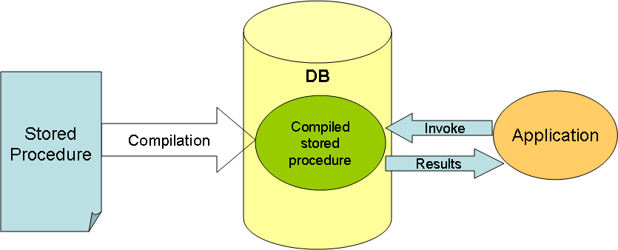
2 – Procedural Extensions to SQL
SQL is extended with imperative programming constructs (conditionals, looping, exceptions, etc.)
Typically implemented as stored procedures
Examples
PL/SQL in Oracle, T/SQL in MS SQL Server
Advantages
Finer control in processing logic
Better performance because of server-side processing
Disadvantages
Not portable across DBMS

Slide 15
Oracle PL/SQL Example
create or replace
procedure changesalary (
ide number, ch_salary number) IS
sal number;
begin
select salary
into sal
from employee
where employee.id=ide;
sal := sal+sal*ch_salary*.01
update employee
set salary=sal
where employee.id=ide;
end;
Local Variables
Assigning SQL output to local variables
Running SQL queries with run time parameters
Assignment statements
And you can include IF statements, LOOPs, EXCEPTIONS and so on

Slide 16
3 – Embedded SQL
HLL
+ embedded SQL
HLL
+
Library calls
Pre-Compilation
DB
Compilation
Application
Queries in API
Results

Slide 17
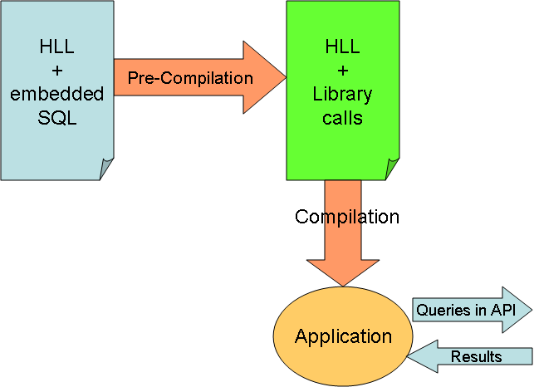
3 – Embedded SQL
SQL statements can be embedded in a general-purpose host programming language such as COBOL, C, Java
Pre-compilers convert SQL statements into database calls
Examples
Oracle’s Pro*C and SQLJ
Advantages
No need for a learning a new procedural language
Disadvantages
Not portable across DBMS
Impedance mismatch: mixing of incompatible programming paradigms

Slide 18
Pro*C Example
int loop;
EXEC SQL BEGIN DECLARE SECTION;
varchar dname[16], fname[16], …;
char ssn[10], bdate[11], …;
int dno, dnumber, SQLCODE, …;
EXEC SQL END DECLARE SECTION;
loop = 1;
while (loop) {
prompt (“Enter SSN: “, ssn);
EXEC SQL
select FNAME, LNAME, ADDRESS, SALARY
into :fname, :lname, :address, :salary
from EMPLOYEE where SSN == :ssn;
if (SQLCODE == 0) printf(“%s”, fname, …);
else printf(“SSN does not exist: “, ssn);
prompt(“More SSN? (1=yes, 0=no): “, loop);
END-EXEC
}
This is a C program with embedded SQL calls

Slide 19
4 – Database APIs
HLL
+
Library calls
DB
Compilation
Application
Queries in API
Results

Slide 20
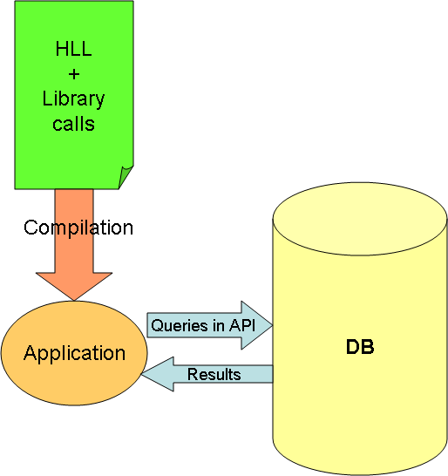
4 – Database APIs
Database vendors publish proprietary API’s that give low level access to the database
Examples
OCI (Oracle Call Level Interface)
Advantages
No impedance mismatch: no need to mix two different languages
Better performance because it is low-level
Disadvantages
Not portable across DBMS
APIs may be complex to use

Slide 21
5 – ODBC / JDBC
HLL
+
JDBC Library calls
DB
Compilation
Application
Queries in JDBC
JDBC Driver
Queries in API
Results
Results

Slide 22
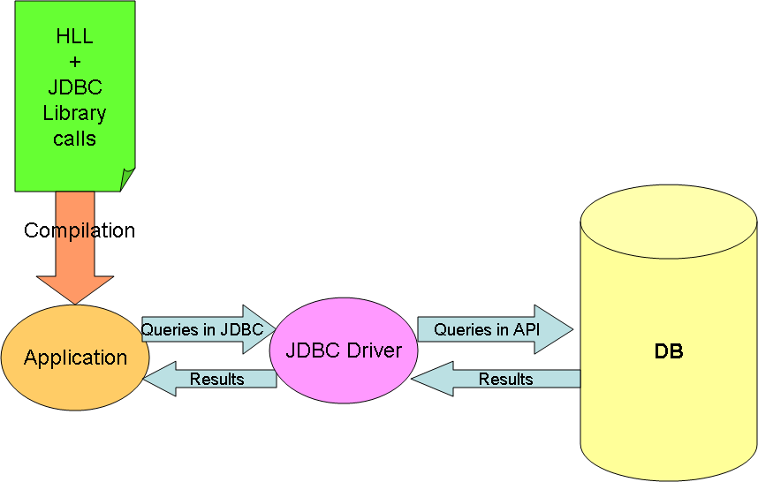
5 – ODBC / JDBC
ODBC (Open Database Connectivity) was originally proposed by Microsoft as a DBMS-independent way to connect to any compliant data source
JDBC is the java-equivalent of ODBC
The JDBC API defines interfaces and classes for writing database applications in Java
Advantages
Highly portable and standardized across DBMS
Disadvantages
Impedance mismatch in programming styles
No other significant disadvantages compared to other approaches discussed earlier

Slide 23
6 - Database Frameworks
HLL
+
Framework calls
Application
Compilation
Object access
Results
Mapping
JDBC Driver
Framework
Queries in JDBC
Results
Query
Results
DB

Slide 24
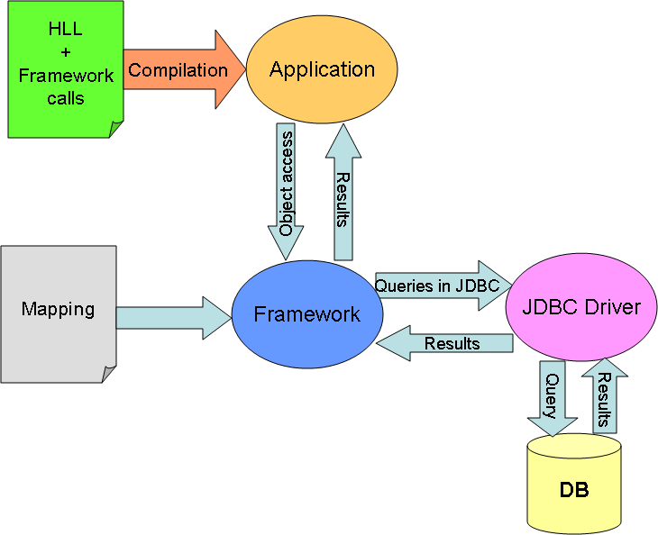
6 - Database Frameworks
Frameworks help with database access without the need to mix two different languages like Java and SQL
They primarily rely on providing automatic mapping between relational rows and objects
Examples
Hibernate
Advantages
No impedance mismatch (no need for SQL)
Disadvantages
Not portable, some times hard to debug

Slide 25
Summary
Programming interfaces are required to build real world applications
These interfaces require more capabilities than those provided by SQL
We looked at several database programming strategies
Procedural extensions to SQL, Embedded SQL, proprietary APIs, ODBC/JDBC and database frameworks

