Slide 1
Annexure: Normalization
DB 101 Data Management

Slide 2

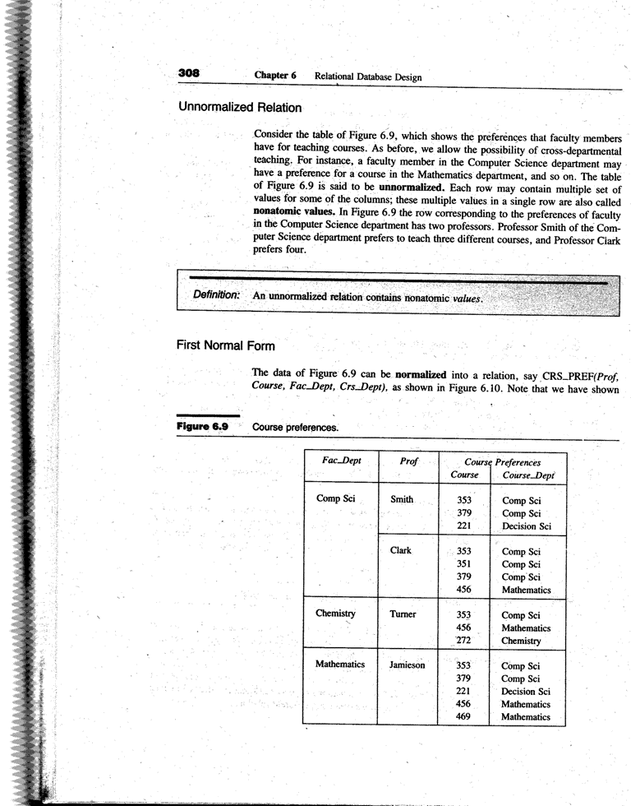
Example 1
Prof is multi-valued
Course Preferences is a nested relation

Slide 3
First Normal Form
A relation is said to be in First Normal Form if all the following DOES NOT hold:
  composite attributes
  multivalued attributes
  nested relations; attributes whose values for an individual tuple are non-atomic

Slide 4
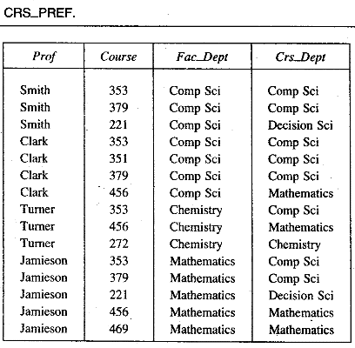
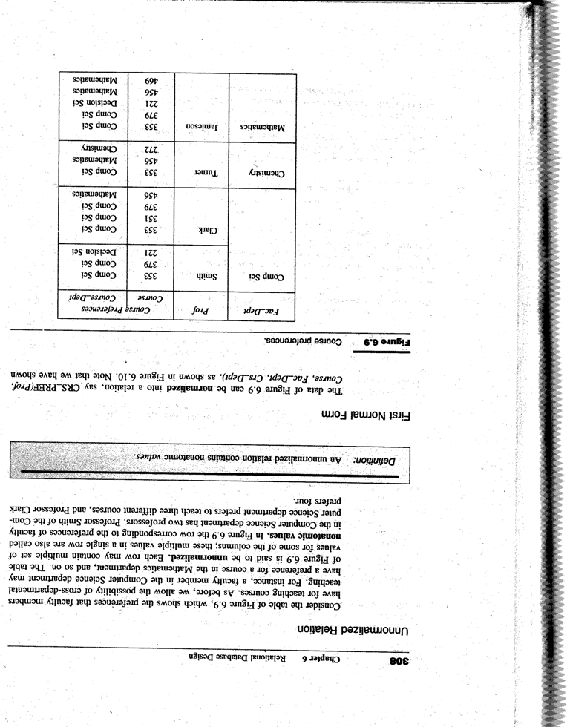
Example 1: Unnormalized → 1NF

Slide 5
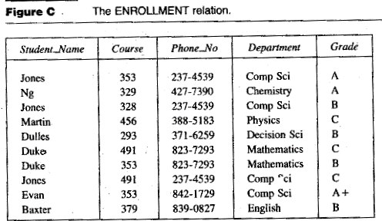
Example 2
Insertion anomalies?
Deletion anomalies?
Modification anomalies?

Slide 6
Second Normal Form
A relation schema R is in second normal form (2NF) if every non-prime attribute A in R is fully functionally dependent on the primary key

Slide 7
Example 2: Cont.,
Is this in 1NF?
Is this in 2NF?
Key is {Student_Name, Course}
FDs
  {Student_Name, Course} → {Phone_No., Department, Grade}
  {Student_Name} → {Phone_No., Department}
Non-prime attributes
  Phone_No., Department, Grade

Slide 8
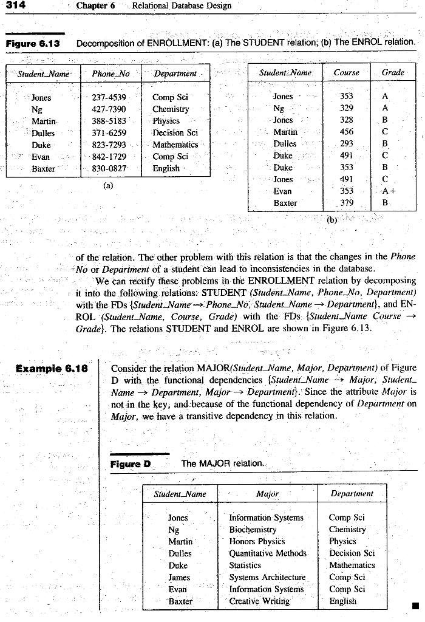
Example 2: 1NF → 2NF
Key is {Student_Name}
FDs
  {Student_Name} → {Phone_No., Department}
Non-prime attributes
  Phone_No., Department
Key is {Student_Name, Course}
FDs
  {Student_Name, Course} → {Grade}
Non-prime attributes
  Grade

Slide 9
Example 3
Insertion anomalies?
Deletion anomalies?
Modification anomalies?

Slide 10
Third Normal Form
A relation schema R is in third normal form (3NF) if it is in 2NF and no non-prime attribute A in R is transitively dependent on the primary key

Slide 11
Example 3: Cont.,
Is this in 1NF?
Is this in 2NF?
Is this in 3NF?
Key is {Student_Name}
FDs
  {Student_Name} → {Major}
  {Student_Name} → {Department}
  {Major} → {Department}
Non-prime attributes
  Major, Department

Slide 12
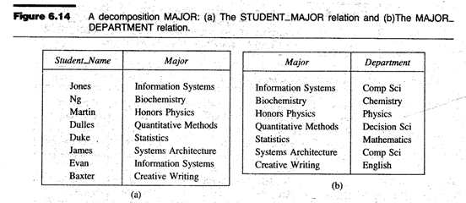
Example 3: 2NF → 3NF
Key is {Student_Name}
FDs
  {Student_Name} → {Major}
Non-prime attributes
  Major
Key is {Major}
FDs
  {Major} → {Department}
Non-prime attributes
  Department

Slide 13
Decomposition Properties - 1
Dependency preserving
  All the original functional dependencies are retained in the decomposed relations
Lossless join
  Join of the decomposed relations give the original relation: no more and no less

Slide 14
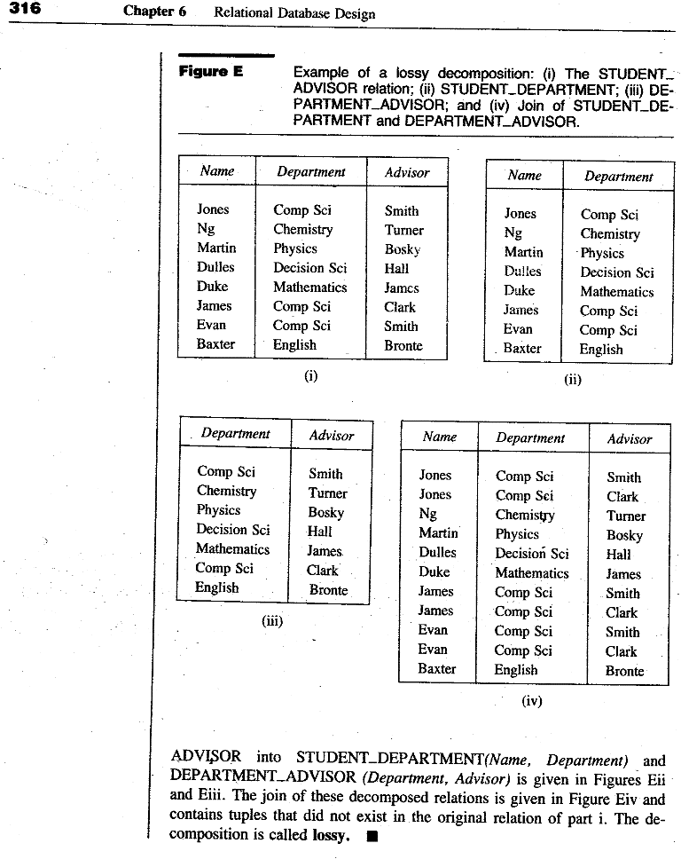
Example 4
FDs:
Name → Department
Name → Advisor
Advisor → Department
Is this lossless?

Slide 15
Example 4
Joined Table (Lossy)

Slide 16
Decomposition Properties - 2
Dependency preserving
  All the original functional dependencies can be logically derived using inference rules from decomposed relations
Lossless join
  The common attributes X of R1 and R2 form a super-key of at least one of the two relations

Slide 17
Example 4 – Proper solution
Student_Advisor (Name, Advisor)
  FD: Name → Advisor
Advisor_Dept (Advisor, Department)
  FD: Advisor → Department
Dependency preserving check
Lossless join check
  Common attribute “Advisor” is a key of Advisor_Dept
FDs:
Name → Department
Name → Advisor
Advisor → Department
Preserved?
: Yes
: Yes
: Yes

Slide 18
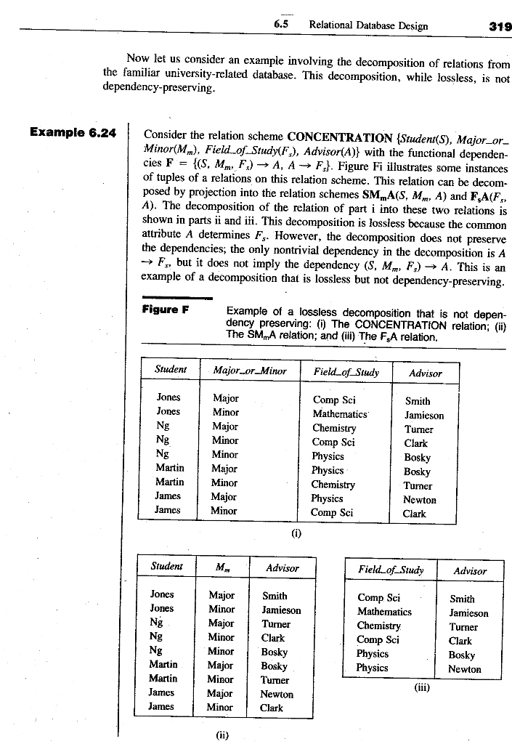
Example 5
FDs:
{S, M_or_M, F_o_S} → {Advisor}
{Advisor} → {F_o_S}
Is this lossless?
Is this dependency-preserving?
Why is it needed?
Given a student, major_or_minor and field of study, can you determine the advisor?

Slide 19
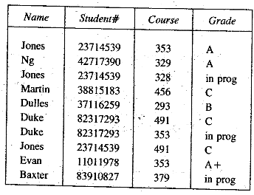
Example 6
Insertion anomalies?
Deletion anomalies?
Modification anomalies?

Slide 20
Example 6
FDs:
{Name, Course} → Grade
{Student#, Course} → Grade
{Name} → Student#
{Student#} → Name
Is this in 1NF?
Is this in 2NF?
Is this in 3NF?

Slide 21
Example 6 – BCNF
Student (Student#, Name)
  FD: Student# → Name Name → Student#
Enrolment (Student#, Course, Grade)
  FD: {Student#, Course} → Grade
Dependency preserving check
Lossless join check
  Common attribute “Student#” is a key of Student
FDs:
{Name, Course} → Grade
{Student#, Course} → Grade
{Name} → Student#
{Student#} → Name
Preserved?
: Yes
: Yes
: Yes
: Yes
Is this in 3NF too?

