Slide 1
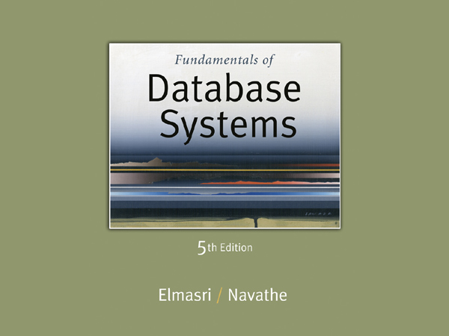

Slide 2
Chapter 1
Introduction: Databases and Database Users

Slide 3
Outline
Types of Databases and Database Applications
Basic Definitions
Typical DBMS Functionality
Example of a Database (UNIVERSITY)
Main Characteristics of the Database Approach
Database Users
Advantages of Using the Database Approach
When Not to Use Databases

Slide 4
Types of Databases and Database Applications
Traditional Applications:
Numeric and Textual Databases
More Recent Applications:
Multimedia Databases
Geographic Information Systems (GIS)
Data Warehouses
Real-time and Active Databases
Many other applications
First part of book focuses on traditional applications
A number of recent applications are described later in the book (for example, Chapters 24,26,28,29,30)

Slide 5
Basic Definitions
Database:
A collection of related data.
Data:
Known facts that can be recorded and have an implicit meaning.
Mini-world:
Some part of the real world about which data is stored in a database. For example, student grades and transcripts at a university.
Database Management System (DBMS):
A software package/ system to facilitate the creation and maintenance of a computerized database.
Database System:
The DBMS software together with the data itself. Sometimes, the applications are also included.

Slide 6
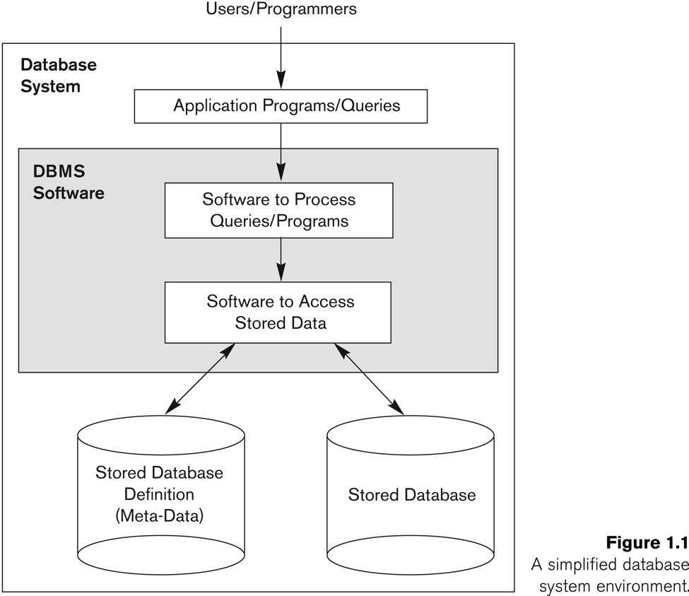
Simplified database system environment

Slide 7
Typical DBMS Functionality
Define a particular database in terms of its data types, structures, and constraints
Construct or Load the initial database contents on a secondary storage medium
Manipulating the database:
Retrieval: Querying, generating reports
Modification: Insertions, deletions and updates to its content
Accessing the database through Web applications
Processing and Sharing by a set of concurrent users and application programs – yet, keeping all data valid and consistent

Slide 8
Typical DBMS Functionality
Other features:
Protection or Security measures to prevent unauthorized access
“Active” processing to take internal actions on data
Presentation and Visualization of data
Maintaining the database and associated programs over the lifetime of the database application
Called database, software, and system maintenance

Slide 9
Example of a Database (with a Conceptual Data Model)
Mini-world for the example:
Part of a UNIVERSITY environment.
Some mini-world entities:
STUDENTs
COURSEs
SECTIONs (of COURSEs)
(academic) DEPARTMENTs
INSTRUCTORs

Slide 10
Example of a Database (with a Conceptual Data Model)
Some mini-world relationships:
SECTIONs are of specific COURSEs
STUDENTs take SECTIONs
COURSEs have prerequisite COURSEs
INSTRUCTORs teach SECTIONs
COURSEs are offered by DEPARTMENTs
STUDENTs major in DEPARTMENTs
Note: The above entities and relationships are typically expressed in a conceptual data model, such as the ENTITY-RELATIONSHIP data model (see Chapters 3, 4)

Slide 11
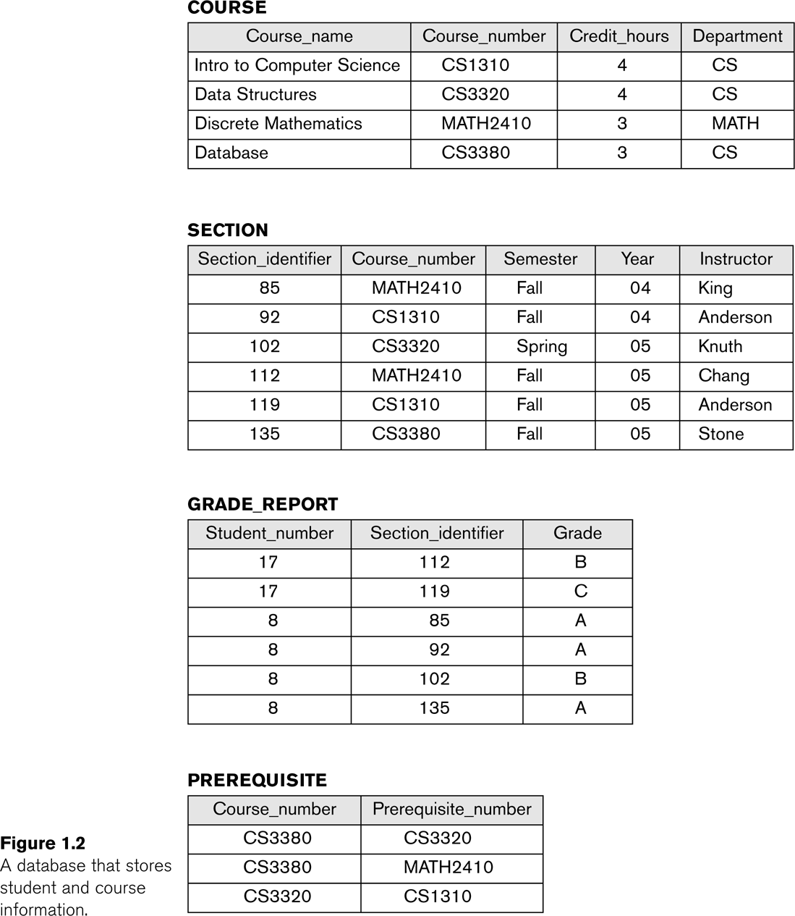
Example of a simple database

Slide 12
Main Characteristics of the Database Approach
Self-describing nature of a database system:
A DBMS catalog stores the description of a particular database (e.g. data structures, types, and constraints)
The description is called meta-data.
This allows the DBMS software to work with different database applications.
Insulation between programs and data:
Called program-data independence.
Allows changing data structures and storage organization without having to change the DBMS access programs.

Slide 13
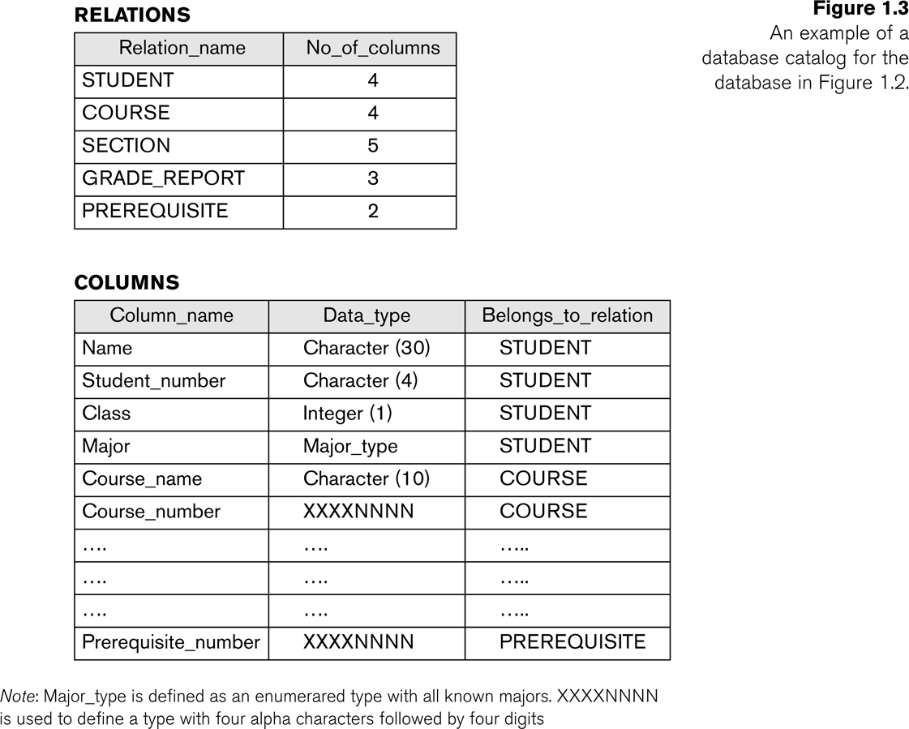
Example of a simplified database catalog

Slide 14
Main Characteristics of the Database Approach (continued)
Data Abstraction:
A data model is used to hide storage details and present the users with a conceptual view of the database.
Programs refer to the data model constructs rather than data storage details
Support of multiple views of the data:
Each user may see a different view of the database, which describes only the data of interest to that user.

Slide 15
Main Characteristics of the Database Approach (continued)
Sharing of data and multi-user transaction processing:
Allowing a set of concurrent users to retrieve from and to update the database.
Concurrency control within the DBMS guarantees that each transaction is correctly executed or aborted
Recovery subsystem ensures each completed transaction has its effect permanently recorded in the database
OLTP (Online Transaction Processing) is a major part of database applications. This allows hundreds of concurrent transactions to execute per second.

Slide 16
Database Users
Users may be divided into
Those who actually use and control the database content, and those who design, develop and maintain database applications (called “Actors on the Scene”), and
Those who design and develop the DBMS software and related tools, and the computer systems operators (called “Workers Behind the Scene”).

Slide 17
Database Users
Actors on the scene
Database administrators:
Responsible for authorizing access to the database, for coordinating and monitoring its use, acquiring software and hardware resources, controlling its use and monitoring efficiency of operations.
Database Designers:
Responsible to define the content, the structure, the constraints, and functions or transactions against the database. They must communicate with the end-users and understand their needs.

Slide 18
Categories of End-users
Actors on the scene (continued)
End-users: They use the data for queries, reports and some of them update the database content. End-users can be categorized into:
Casual: access database occasionally when needed
Naïve or Parametric: they make up a large section of the end-user population.
They use previously well-defined functions in the form of “canned transactions” against the database.
Examples are bank-tellers or reservation clerks who do this activity for an entire shift of operations.

Slide 19
Categories of End-users (continued)
Sophisticated:
These include business analysts, scientists, engineers, others thoroughly familiar with the system capabilities.
Many use tools in the form of software packages that work closely with the stored database.
Stand-alone:
Mostly maintain personal databases using ready-to-use packaged applications.
An example is a tax program user that creates its own internal database.
Another example is a user that maintains an address book

Slide 20
Advantages of Using the Database Approach
Controlling redundancy in data storage and in development and maintenance efforts.
Sharing of data among multiple users.
Restricting unauthorized access to data.
Providing persistent storage for program Objects
In Object-oriented DBMSs – see Chapters 20-22
Providing Storage Structures (e.g. indexes) for efficient Query Processing

Slide 21
Advantages of Using the Database Approach (continued)
Providing backup and recovery services.
Providing multiple interfaces to different classes of users.
Representing complex relationships among data.
Enforcing integrity constraints on the database.
Drawing inferences and actions from the stored data using deductive and active rules

Slide 22
Additional Implications of Using the Database Approach
Potential for enforcing standards:
This is very crucial for the success of database applications in large organizations. Standards refer to data item names, display formats, screens, report structures, meta-data (description of data), Web page layouts, etc.
Reduced application development time:
Incremental time to add each new application is reduced.

Slide 23
Additional Implications of Using the Database Approach (continued)
Flexibility to change data structures:
Database structure may evolve as new requirements are defined.
Availability of current information:
Extremely important for on-line transaction systems such as airline, hotel, car reservations.
Economies of scale:
Wasteful overlap of resources and personnel can be avoided by consolidating data and applications across departments.

Slide 24
Historical Development of Database Technology
Early Database Applications:
The Hierarchical and Network Models were introduced in mid 1960s and dominated during the seventies.
A bulk of the worldwide database processing still occurs using these models, particularly, the hierarchical model.
Relational Model based Systems:
Relational model was originally introduced in 1970, was heavily researched and experimented within IBM Research and several universities.
Relational DBMS Products emerged in the early 1980s.

Slide 25
Historical Development of Database Technology (continued)
Object-oriented and emerging applications:
Object-Oriented Database Management Systems (OODBMSs) were introduced in late 1980s and early 1990s to cater to the need of complex data processing in CAD and other applications.
Their use has not taken off much.
Many relational DBMSs have incorporated object database concepts, leading to a new category called object-relational DBMSs (ORDBMSs)
Extended relational systems add further capabilities (e.g. for multimedia data, XML, and other data types)

Slide 26
Historical Development of Database Technology (continued)
Data on the Web and E-commerce Applications:
Web contains data in HTML (Hypertext markup language) with links among pages.
This has given rise to a new set of applications and E-commerce is using new standards like XML (eXtended Markup Language). (see Ch. 27).
Script programming languages such as PHP and JavaScript allow generation of dynamic Web pages that are partially generated from a database (see Ch. 26).
Also allow database updates through Web pages

Slide 27
Extending Database Capabilities
New functionality is being added to DBMSs in the following areas:
Scientific Applications
XML (eXtensible Markup Language)
Image Storage and Management
Audio and Video Data Management
Data Warehousing and Data Mining
Spatial Data Management
Time Series and Historical Data Management
The above gives rise to new research and development in incorporating new data types, complex data structures, new operations and storage and indexing schemes in database systems.

Slide 28
When not to use a DBMS
Main inhibitors (costs) of using a DBMS:
High initial investment and possible need for additional hardware.
Overhead for providing generality, security, concurrency control, recovery, and integrity functions.
When a DBMS may be unnecessary:
If the database and applications are simple, well defined, and not expected to change.
If there are stringent real-time requirements that may not be met because of DBMS overhead.
If access to data by multiple users is not required.

Slide 29
When not to use a DBMS
When no DBMS may suffice:
If the database system is not able to handle the complexity of data because of modeling limitations
If the database users need special operations not supported by the DBMS.

Slide 30
Summary
Types of Databases and Database Applications
Basic Definitions
Typical DBMS Functionality
Example of a Database (UNIVERSITY)
Main Characteristics of the Database Approach
Database Users
Advantages of Using the Database Approach
When Not to Use Databases

