Slide 1
Servlet & Jsp

Slide 2
INTRODUCTION TO WEB. INTRODUCTION TO SERVLETS. SERVLET ARCHITECTURE. GENERIC SERVLETS. SESSION TRACKING. INTRODUCTION TO JSP. STEPS TO CREATE JSP. JSP SCRIPTING & DIRECTIVE ELEMENTS. JAVA BEAN CLASS. HANDS ON.

Slide 3
Introduction to Web and Http
Web is a different type of documents. Like as html, css, javascript, xml etc.
Collection of all these documents which can be distributed all over the world what we called is Web.
Http is stand for hyper text transfer protocol . What is Protocol? Protocol is set of rules.
In internet when we communicating with different computer then some set of rules that we are using that's what is protocol.
Hyper text transfer protocol the set of rules used for transferring the data from one system to another system from one browser to server .
Http is protocol that clients and servers use on the web to communicate.
For communication from client to server we are using HTTP request and response

Slide 4
HTTP Request & Response
Http Request is a packet of information that one computer sends to another computer to communicate. (open browser and send the request as google.com) what is a server?
A server is something which providing services to the client is called as a server
Above we request from client to google (https://www.google.com) and we got in response google page. So this is what we talk about web application.
So here server is providing services to the client. And client is accessing the services provided by the server.
Web application is request response application or a client server application

Slide 5
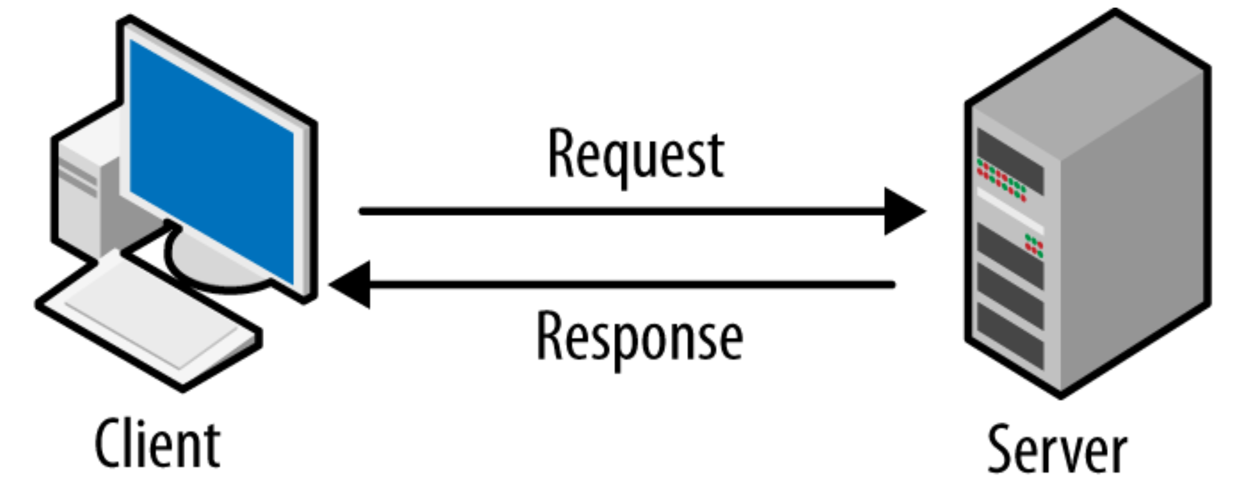
HTTP Request & Response
Http Response is the packet of information sent by Server to the Client in response to an earlier request made by client.
A combination of request and response is what we call it as web transaction
Note: Whenever we request from client that time http protocol will create Http Request object.

Slide 6
Difference Between HTTP GET & POST
GET | POST
Data is sent in header Limited data can be sent Not secured Can be bookmarked | Data is sent in request body Large amount of data can be sent It is secured Cannot be bookmarked

Slide 7
Introduction to Servlets
What are Servlets?
It is used for creating web application.
Servlets are the server side applications that we developed using java language.
(php, asp, asp.net included jsp as well)
Server-side application to be placed in a web server or it should be placed in an application server.
What is Web Application?
Web application is a client server or request and response application.

Slide 8
Introduction to Servlets
Robust and Scalable
Create Web Application
JAVA
Servlet
Provides Interfaces and Classes
Deployed to Create Web Page
Responds to any incoming Request
Must we Implemented to Create Servlet

Slide 9
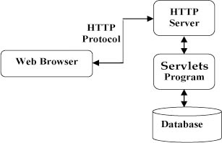
Servlet Architecture

Slide 10
Servlet Life Cycle
Starting point of execution is in a stand alone java program is public static void main(){}.
But in the case of web application it has got life cycle.
Lifecycle of a Servlet – is declared in javax.servlet.Servlet{interface}
1) Initialization – public void init(ServletConfig) throws ServletException
This will happen only once a servlet will be instantiated only once
2) Servicing – Process the request of the client and to give the response back
Public void service(HttpServletRequest, HttpServletResponse)
3) Destroy - public void destroy();
Note: A servlet will get instantiated only once.

Slide 11
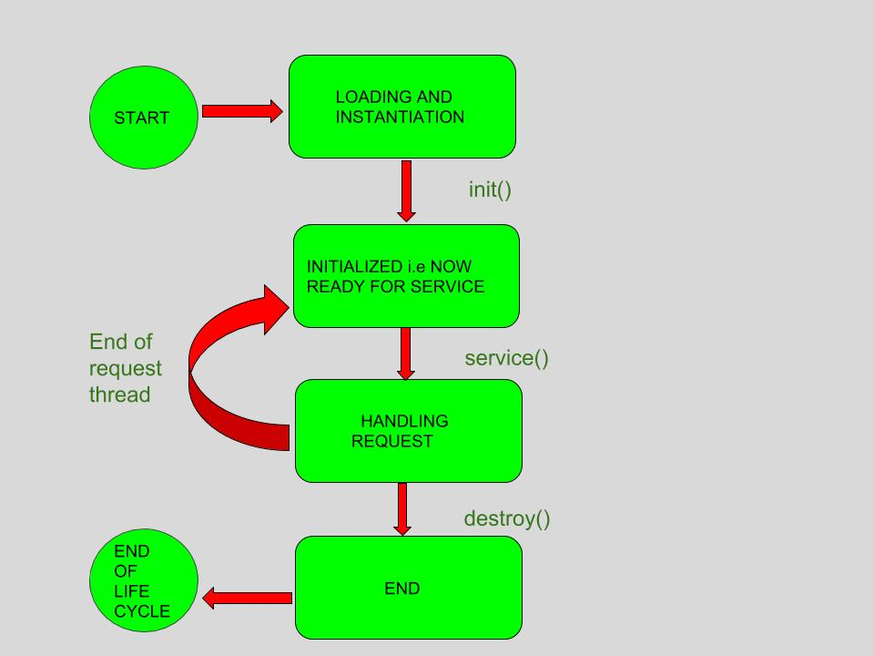
Servlet Life Cycle

Slide 12
Servlet Life Cycle
Load Servlet Class
Create a new instance
calls Init(…) method
Calls service(…., ….)
Client
Request
MyServlet.class
Response
Request
Object
Client
Response
Web Server

Slide 13
Types Of Servlet
1) GenericServlet
2) HttpServlet
3)FilterServlet
public abstract class GenericServlet implements javax.servlet.Servlet

Slide 14
Steps To Create Servlets
1.Create and Compile simple servlet Code
2.Adding mappings to web.xml file (Web Deployment Descriptor File)
3.Start Apache TomCat
4.Start Web Browser and Request Servlet

Slide 15
Generic Servlet
A generic servlet is a protocol independent Servlet that should always override the service() method to handle the client
Generic Servlet is easier to write (ServletRequest and ServletResponse)
It has a very simple life cycle methods
To write Generic Servlet you just need to extends javax.servlet.GenericServlet and override the service() method
HttpServletRequest: An object of ServletRequest is used to provide the client request information to servlet such as content type, content length,parameter names and values, header informations attribute etc.
HttpServletResponse: An object of ServletResponse is used to write the information back to the client

Slide 16
Servlet Classes and Intefaces
Servlet | Declares life cycle method of servlet
ServletConfig | Allows Servlet to get initialization methods
ServletContext | Enables Servlet to log access and access information
ServletRequest | Used to read data from client request
ServletResponse | Used to write data from client response
GenericServlet | Implements servlet and servlet config interface
ServletInputStream | Provides input stream to read requests from the client
ServletOutputStream | Provides output stream to write responses to the client
ServletException | Indicates Servlet error has occured
Unavailable Exception | Indicates Servlet is not available
HttpServlet | Provides methods to handle Http request and response
HttpServletRequest | Enables servlets to read data from Http Request
HttpServletResponse | Enables servlet to write data to Http Response

Slide 17
Thank You

