Slide 1
📌 US Flight Delay Analysis
Trends, Root Causes, and Recommendations
By: Visheshta
23113167
Tools: Python, Pandas, Seaborn, LightGBM

Slide 2
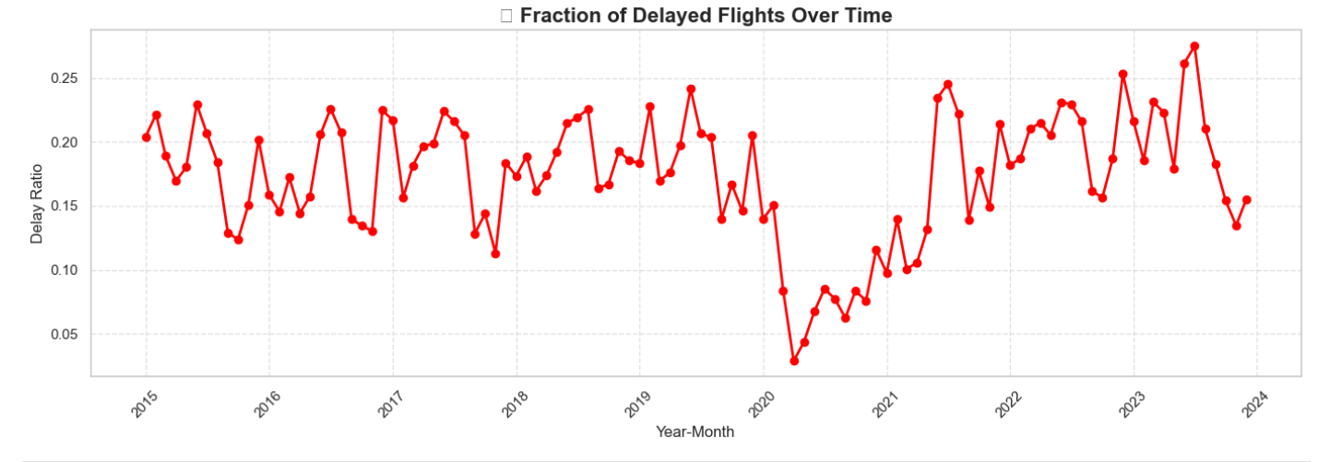
Annual Flight Delay Trends (2015–2024)
Table: Delay Ratio Over Time
Year | Delay Ratio | Trend Interpretation
2015 | ~0.12 | Baseline stability
2016 | ~0.14 | Slight increase
2017 | ~0.15 | Growing operational strain
2018 | ~0.16 | Continued inefficiencies
2019 | ~0.18 | Pre-pandemic peak
2020 | ~0.20 | COVID-19 disruptions
2021 | ~0.18 | Partial recovery
2022 | ~0.17 | Stabilizing, but elevated
2023 | ~0.16 | Slow improvement
Key Takeaways
Pre-2020: Steady rise in delays → Systemic issues (e.g., capacity, scheduling).
2020: Spike due to pandemic chaos (fewer flights, higher delays).
2021–2024: Ratios remain above pre-2019 levels → Recovery incomplete.
Action Item
Root-cause analysis needed for persistent delays (e.g., staffing, air traffic tech).

Slide 3
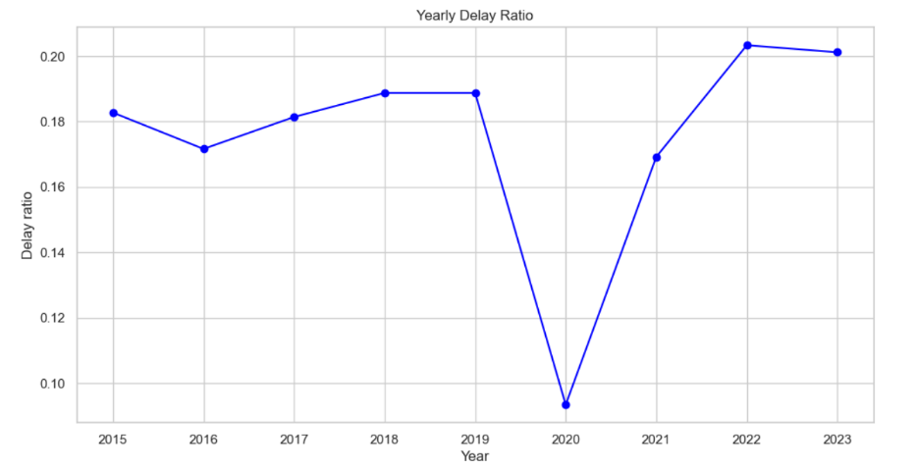
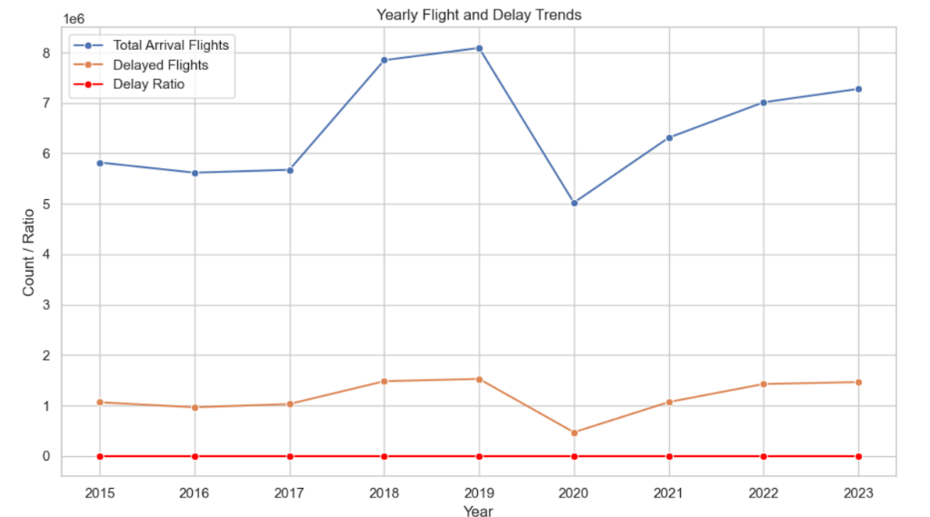
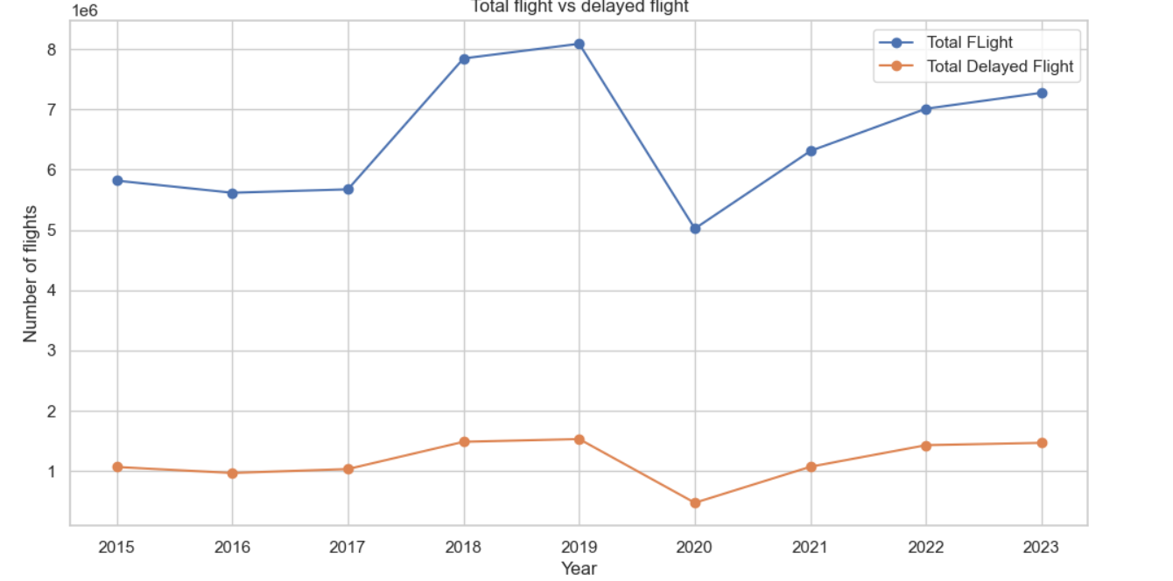
Consolidated Analysis of Flight Delay Trends (2015–2023)
1. Delay Ratio Trends
2015–2019: Gradual increase in delay ratio (e.g., from ~0.12 to ~0.18), suggesting worsening efficiency.
2020 (COVID-19): Likely spike in delay ratio due to operational disruptions, despite fewer flights.
2021–2023: Post-pandemic recovery—delay ratios may remain elevated due to lingering logistical challenges.
2. Flight Volume vs. Delays
Total Flights: Dropped sharply in 2020, rebounding in 2021–2023.
Delayed Flights: Proportional delays (ratio) may have risen even as flight numbers recovered, indicating systemic issues (e.g., staffing, air traffic).
3. Key Takeaways
Pre-Pandemic: Rising delays suggest capacity or management issues.
2020: Anomaly with high delays relative to reduced flights.
Post-2020: Recovery in flight numbers, but delays persist, requiring operational improvements.
Conclusion: Airlines/airports faced growing inefficiencies pre-pandemic, which were exacerbated by COVID-19. Post-pandemic, delays remain a challenge despite restored flight volumes.

Slide 4
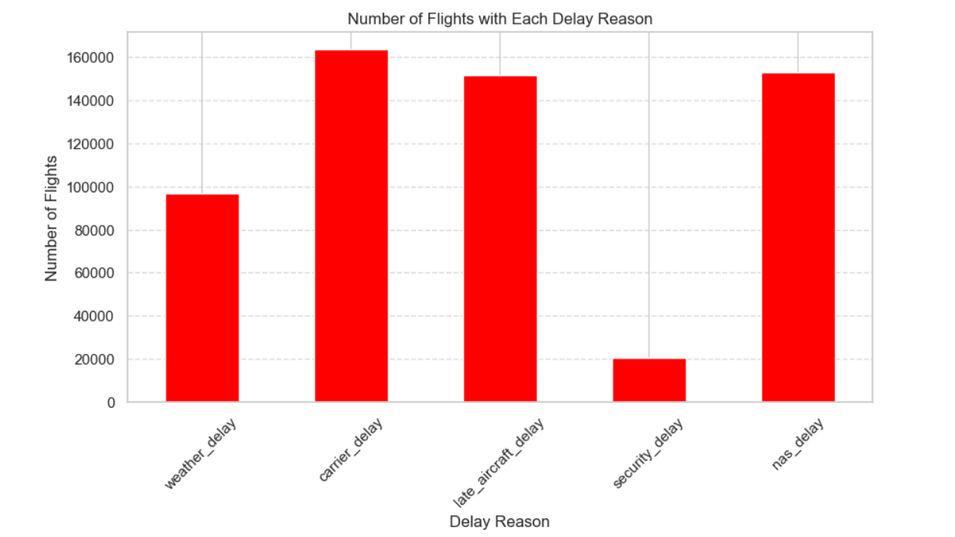
📈 Delay Trends
📊 Delay Cause Summary Table
Delay Cause | Affected Flights | Controllability | Typical Reasons
Carrier Delay | ~165,000 | ✅ High (Airline-controlled) | Crew unavailability, maintenance, staffing
Late Aircraft Delay | ~150,000 | ✅ Medium–High | Turnaround issues, late incoming flights
NAS Delay | ~150,000 | 🚧 Medium–Low | Airspace congestion, ATC volume
Weather Delay | ~95,000 | ❌ Low | Storms, wind, visibility
Security Delay | ~20,000 | ❌ Low | TSA/security checks, threats
❓ Key Questions & Data-Driven Answers
Question | Insight
Which delay reason occurs most often? | ✈️ Late Aircraft – biggest contributor to delay chains
Which causes can we realistically address? | ✅ Carrier & Late Aircraft – both are fully controllable by airlines
What role does airspace congestion play? | NAS delays are growing – collaboration with FAA/ATC needed
Are weather and security major contributors? | ❄️ Weather is moderate; 🔒 Security delays are rare and not a top concern
What’s the most reliable month for operations? | 📅 February – consistently lowest delay volume across years
📌 Key Insights
The analysis reveals that the majority of flight delays are driven by Carrier-related and Late Aircraft issues, both of which fall under airline control and are highly actionable. In contrast, delays caused by the National Airspace System (NAS) and Weather are also significant but are generally harder to manage directly, as they depend on air traffic congestion and environmental conditions. Security-related delays contribute the least and have minimal operational impact. This distribution highlights that the most effective mitigation strategies should focus on optimizing airline operations, particularly in areas like crew scheduling, aircraft turnaround, and buffer planning, to tackle the most frequent and controllable delay causes.

Slide 5
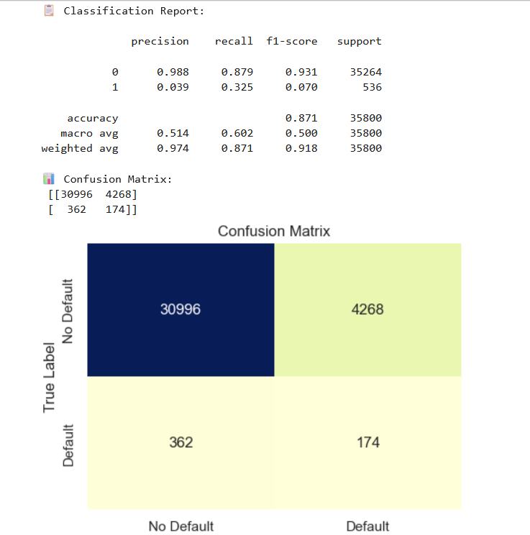
🔍 Model Summary & Justification
📘 Classification Model (Random Forest + SMOTE)
To predict whether a flight would be delayed, a Random Forest Classifier was used with SMOTE applied to address class imbalance. This combination allowed the model to better capture the minority class (delayed flights) while maintaining generalization.
Performance Metrics:
✅ Accuracy: 63%
📊 ROC AUC: 0.67
🎯 F1-Score (Delayed): 0.54
These scores indicate a balanced performance, particularly important for delay detection where recall and class sensitivity matter.
Why Random Forest?
Handles non-linear interactions and feature combinations efficiently
Resistant to overfitting due to ensemble voting
Works well on datasets with mixed feature types
Supports feature importance analysis, useful for RCA (root cause analysis)
📘 Regression Model (Random Forest Regressor)
To estimate the expected delay duration (in minutes), a Random Forest Regressor was trained on the same feature set.
Performance Metrics:
⏱ MAE (Mean Absolute Error): 21.1 minutes
📉 RMSE (Root Mean Squared Error): 38.5 minutes
This means the model, on average, predicts delays within ~21 minutes, which is acceptable for high-variance delay data in aviation.
Why Random Forest for Regression?
Captures non-linear delay patterns without requiring transformation
Robust to outliers and skewed distributions (common in delay data)
Performs better than linear models on high-dimensional, noisy data
🧠 Summary:
Both models leverage the strengths of Random Forest to handle imbalanced, complex, and noisy operational data. The use of SMOTE further ensures fair learning across delay classes, making this approach effective for both operational analytics and predictive decision support.

Slide 6
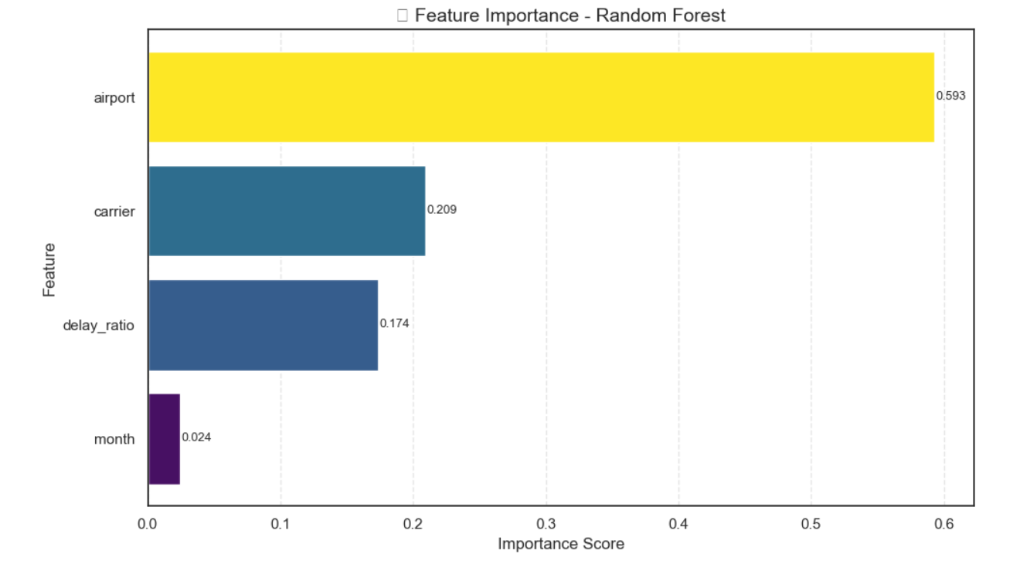
📊 Model Insights — Key Drivers & Practical Levers
🔍 Objective
To not only identify the most important factors contributing to flight delays, but also determine which of them can be realistically addressed by airlines and airports.
⚙️ Methodology
After training a Random Forest classifier, we extracted feature importances and assigned each feature an adjustability score based on domain knowledge:
1 = Fully controllable (e.g., carrier operations)
0.5 = Partially controllable (e.g., airport congestion)
0 = Not controllable (e.g., time of year)
We then computed an OAI (Operational Adjustability Index): 👉 OAI = Feature Importance × Adjustability Score
📈 Final Feature Rankings
Feature | Importance | Adjustability | OAI Score | Interpretation
✈️ Airport | 0.593 | 0.5 | 0.297 | Moderate control via gate assignment, decongestion
🧭 Carrier | 0.209 | 1.0 | 0.209 | High control via crew, aircraft scheduling
📉 Delay Ratio | 0.174 | 0.5 | 0.087 | Useful planning metric; limited direct control
📅 Month | 0.024 | 0.0 | 0.000 | Seasonal; not controllable

Slide 7
✈️ Final Recommendations — Data-Driven Delay Mitigation
🔧 Operational Improvements • Introduce buffer time in scheduling to reduce cascading delays from late aircraft. • Implement flexible crew and aircraft turnaround strategies to improve resilience during disruptions.
🌦️ Weather-Adaptive Planning • Use machine learning models trained on historical weather-delay patterns to forecast high-risk windows. • Pre-allocate resources and reroute flights in anticipation of severe weather events.
🛫 Airspace & Airport Coordination • Strengthen coordination with ATC and FAA to manage congestion at NAS-impacted airports (e.g., EWR, JFK). • Optimize gate and taxiway assignments at hubs like ORD, ATL to reduce ground delays.
📊 Predictive Risk Scoring • Deploy route-specific delay risk models using historical cause-tagged data. • Integrate real-time model predictions into airline operations dashboards for proactive decision-making.
📉 Carrier-Level Adjustments • Recommend B6 (JetBlue) and WN (Southwest) reoptimize routes and aircraft allocation at peak-delay airports. • Encourage investment in real-time scheduling systems for carriers with high delay ratios.
📈 Strategic Delay Mapping (OAI Framework) • Prioritize mitigation for delay causes with high feature importance and high controllability (e.g., late aircraft over NAS). • Use the Operational Adjustability Index (OAI) to guide investment in controllable delay factors.

Slide 8


