Slide 1
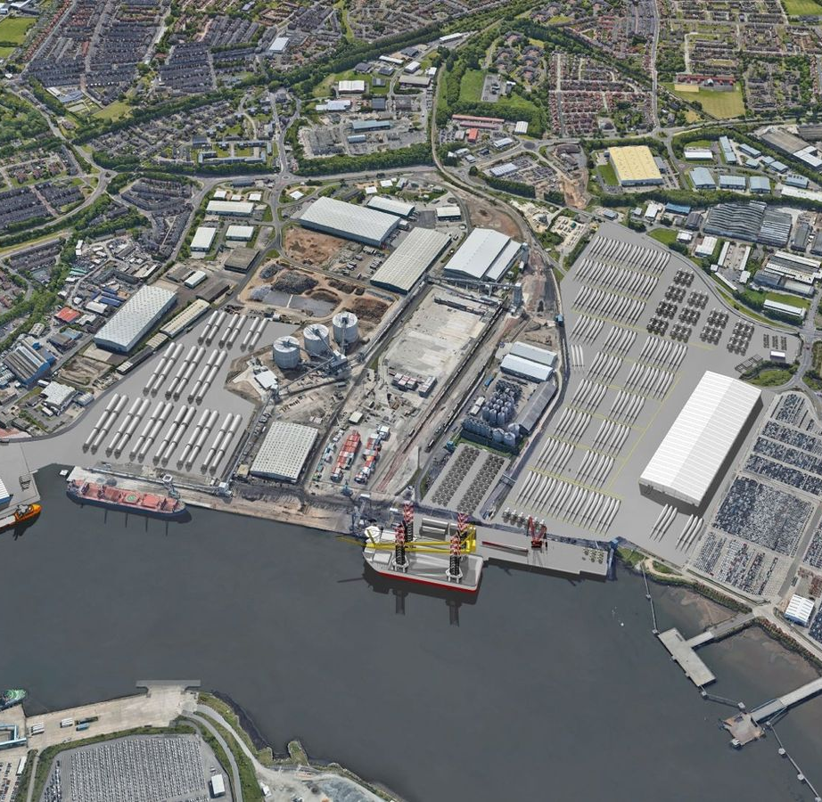
Port of Tyne
Maritime Innovation Week
TEAM ‘BRO CODE’
Vishesh Gupta
Parth Shah
Syed Mohib Raza

Slide 2


Port of Tyne wants to have reliable solutions for Decarbonizing their supply chain
CO₂ footprints for Container Operation - CO₂ per TEU
CO₂ footprints for Transport Operation - CO₂ per Mi/Km travelled , CO₂ per gal/L
Notes:
One of their projects included working with Carnegie UK Trust to develop a Wellbeing Framework
to allow for the assessment of wellbeing across the North of Tyne area.
This framework consists of 51 indictors.
Their problem, which they have posed to us, is that they do not have data sources for 6 of the indictors: Education attainment gap, childcare affordability, childcare availability, litter, tolerance and diversity, participatory democracy.

Slide 3
Port of Tyne wants to have reliable solutions for
Improving their operational efficiencies
Exploratory Data Analysis on:
Transport
Route Optimization
Driver-Delivery Management & Visualization
Effective Container Management
Tracking Machine Consumption & Usage
Notes:
One of their projects included working with Carnegie UK Trust to develop a Wellbeing Framework
to allow for the assessment of wellbeing across the North of Tyne area.
This framework consists of 51 indictors.
Their problem, which they have posed to us, is that they do not have data sources for 6 of the indictors: Education attainment gap, childcare affordability, childcare availability, litter, tolerance and diversity, participatory democracy.

Slide 4
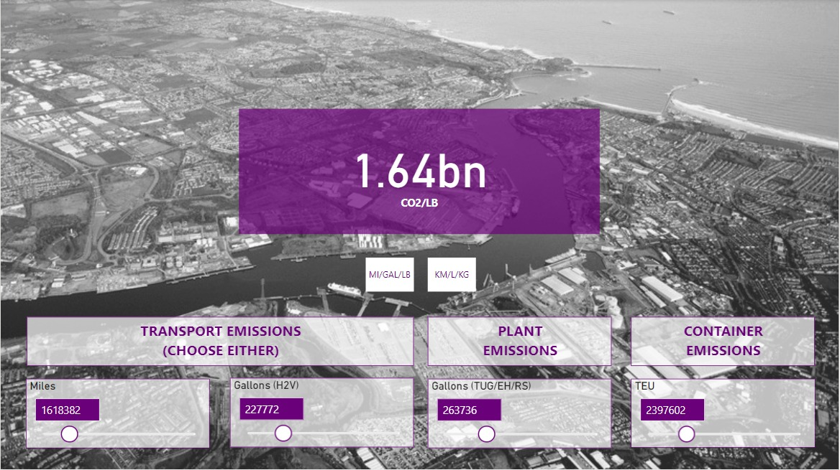

Carbon footprint Calculator across operation
Implementation pipeline
Power BI Dashboard
Import Libraries
Retrieve Data
Manipulate Data
Save Data
Connect data to
Power BI
Notes:
RUN SCRIPT: Run script for each outcome: Updates in pre-determined time intervals
RETRIEVE DATA: Web scrape indicator data from source website: Pulls data from websites like: NOMIS, National Office of Statistics
Manipulate data: Automating data cleaning and/or selection like: Quality Assurance – null values, empty cells, etc. (e.g., could use existing libraries such as YData Quality); Selection/filtering: MACROs
SAVE DATA: Save data on OneDrive/SharePoint

Slide 5
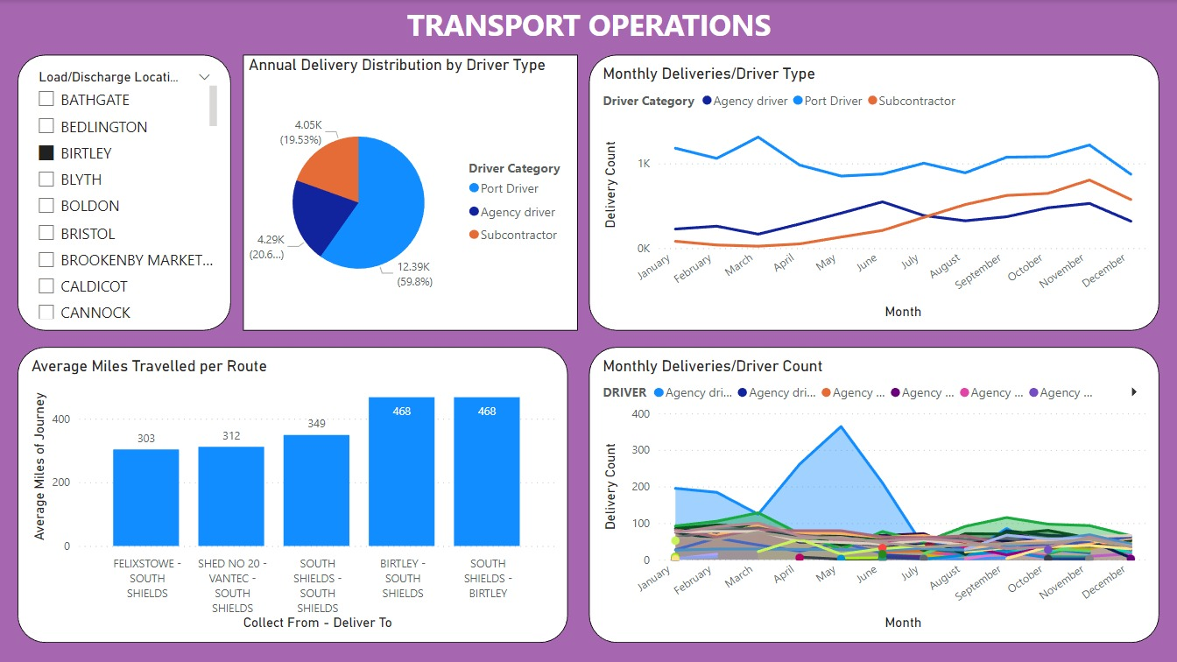
-Displays Driver Activity over time for better resource management and prediction
-Optimal Route Chart suggest best collect and drop location for transport vehicles based on Load/Discharge Location

Slide 6
Customer Journey
Current Container Management
Container Reaches Terminal
RS shuffles Containers to deliver desired container
Tug Takes Container to Stack
Need to Access
Lower Containers
arises
Reach Staker
Stacks Container vertically

Slide 7
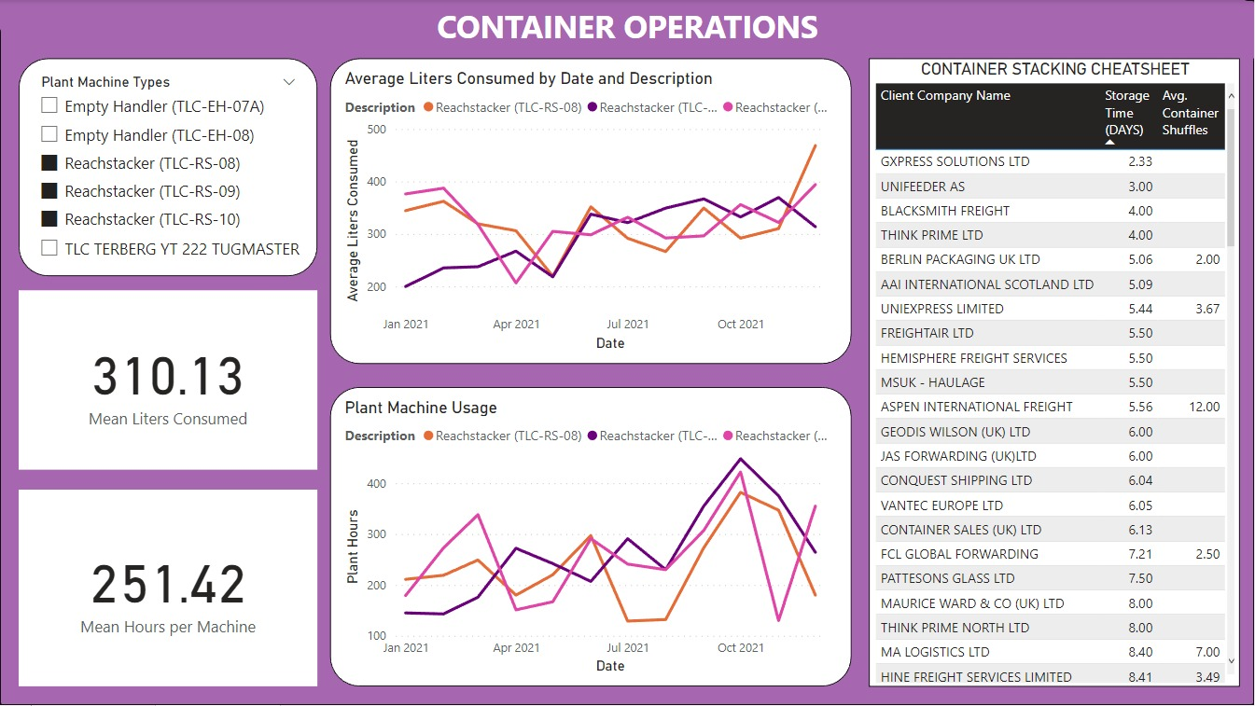
-Displays Fuel Consumption and Hours of Plant Machinery Used
-Container Stacking Cheatsheet guides suggested Stacking solutions. Higher the rank, higher the container!

Slide 8
Energy Consumption Solution
Customer
Merging data
Time-date Sorting
Group-by
Measurable Customer statistic
Container Storage days
Container Shuffles

Slide 9
DATA BARRIERS
Missing Data
Unknown Vehicle Make
Decarbonizing their supply chain
BARRIERS
Missing Meta Data to Merge Datasets
Improving their operational efficiencies
More information on Plant Machinery desired
Lack of shuffle & storage data for each Customer
Time for more in-depth Analysis

Slide 10
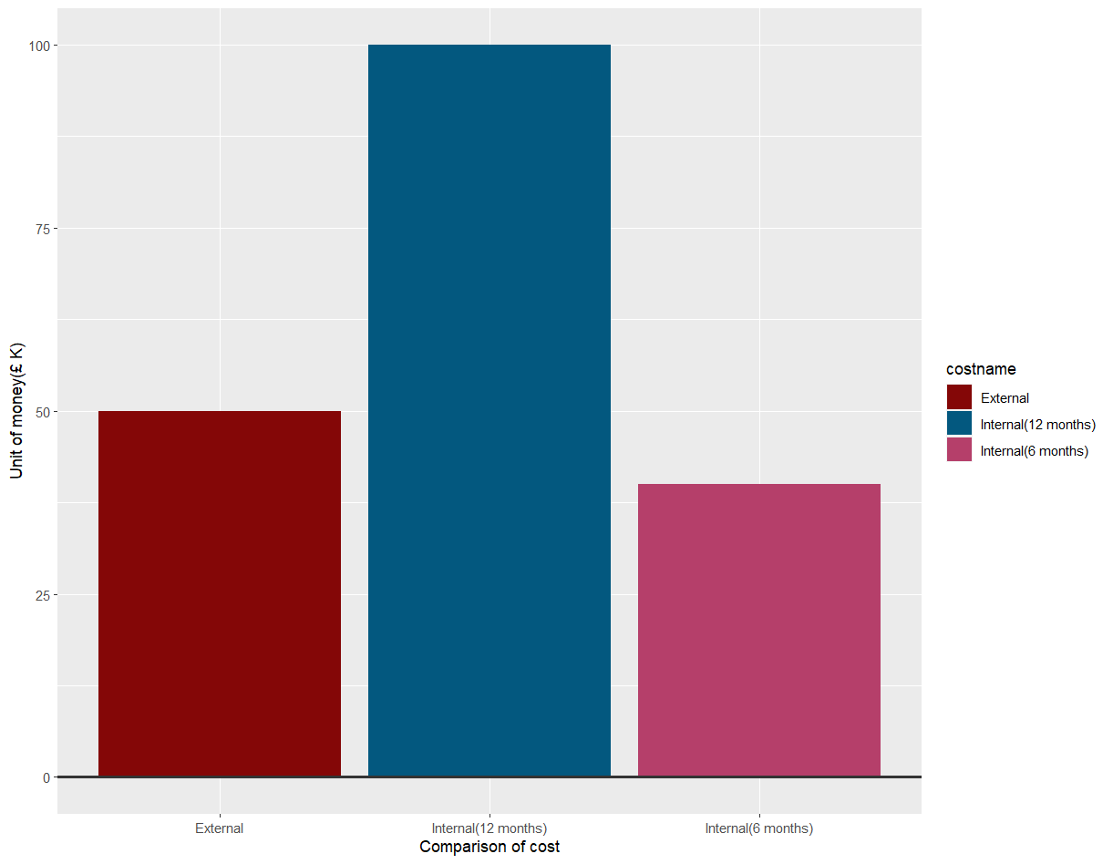
Future Developments
Training
£5.1K three employees (£1.7K per person)

Slide 11
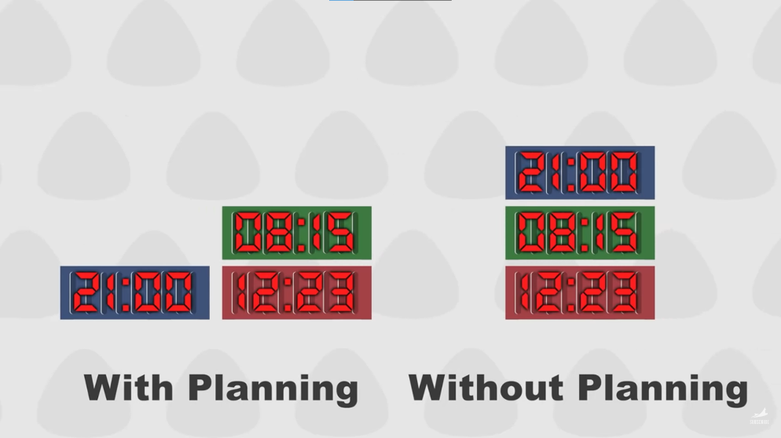
Port of Rotterdam, Netherlands
Remote crane operation
Automated terminal trucks
Automated stacker crane
– Optimized using logistics planning augmented by computers.
20% reduction in emissions by 2030.

Slide 12
One of the most researched method is through heuristic/probabalistic models. Lot of research on Container stacking and rearrangement and handling (CSRP) has been done.
Shipping Port
Container stacking & Rearanging
Container loading & Unloading
Offshore Transportation

Slide 13
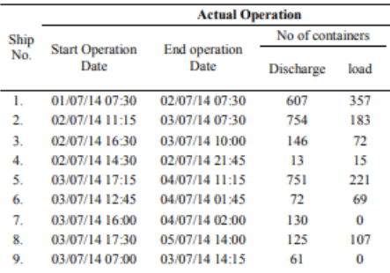
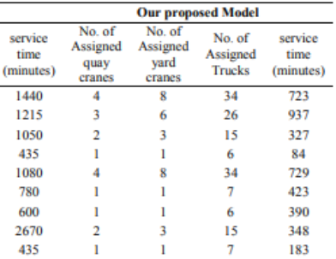
Ship’s Start/End operation
Proposed Methodology for Container Handling is using Heuristic Algorithms is a promising opportunity.
With ref to the article from Procedia Computer Science, results 56% reduction in ship service time (loading/unloading.
Service Time
Loading/Discharging Containers
Total number of containers to load and discharge
Total Machines respective of their types
Optimized allocation of the resources to reduce service time
https://www.sciencedirect.com/science/article/pii/S1877050915028409

Slide 14
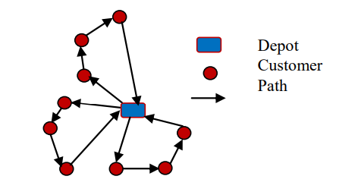
Optimising Vehicle Routing
Scalable Quick Customizable
Studies have shown that freight transportation contributes to approximately 5.5% of global greenhouse gas (GHG) emissions.
VRP will help in optimizing offshore transportation of cargo and bring down carbon emissions.
Official site of port of Rotterdam mentions that there focus on co2 reduction heavily relies on optimizing transport routes and container handling and we believe that with given research the above techniques are best suited for this role.
An instance of the problem is shown below, which depicts CVRP with 3 vehicles and 9 customers.
McKinnon A (2010) Green Logistics: the Carbon Agenda. Electronic Scientific Journal of Logistics 6: 1–9.
Syed et al. (2020) Vehicle Routing Problem using Reinforcement Learning: Recent Advancements

Slide 15
Thank You! Any Questions?

