Slide 1
2
Image
Pdf
Converter App
Team members:
Samiksha [RA2311003040055]
Prateek Sharma [RA2311003040080]
Priangshu Sen [RA2311003040068]

Slide 2
Features
Image Importing: Support for importing images from device storage, camera, or cloud services.
Multi-Image Selection: Allow users to select multiple images at once for batch conversion.
Intuitive UI: User-friendly design for easy navigation and operation.
Offline Functionality: Allow users to convert images to PDF without an internet connection.
Fast Processing: Coverts image to PDF within a click of a button.

Slide 3
Software used
Python 3.11.4
Tkinter (GUI toolkit)
Pillow 10.4.0 (Image processing library)
ReportLab (PDF library)
Visual Studio Code

Slide 4
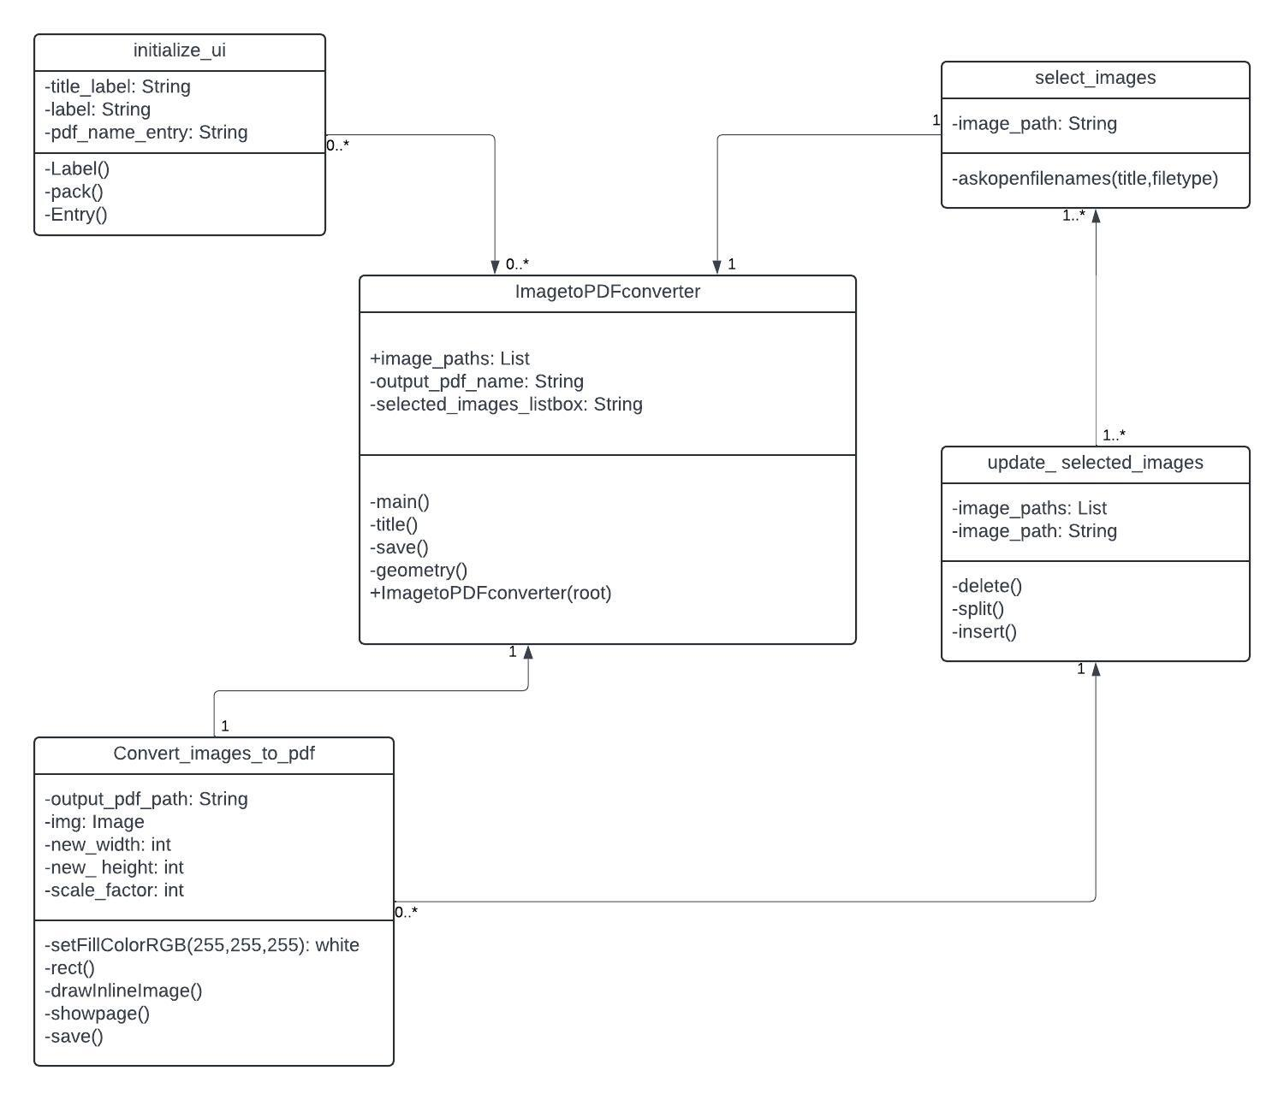
Class diagram

