Slide 1
HOUSE PRICE PREDICTION PROJECT

Slide 2
Business Problem
A US-based housing company named Surprise Housing has decided to enter the Australian market. The company uses data analytics to purchase houses at a price below their actual values and flip them at a higher price. For the same purpose, the company has collected a data set from the sale of houses in Australia.
The company is looking at prospective properties to buy houses to enter the market.

Slide 3
MOTIVATION FOR THE PROJECT
Based on data provided from our client database, a properties price of is assessed based on different factors. By building the model, we can predict the value of the prospective properties and help the company decide whether to invest in them or not.

Slide 4
ANALYTICAL PROBLEM FRAMING
For the given project, based on various parameters we need to predict sale price of a property
This is a regression problem. There are wide varieties of regression models like linear regression,Lasso Regression and ridge regression.
The data has been provided by client in two different comma separated values(.csv) format files.
The two files are train and test files,We will be training our model on train.csv and making predictions on test file.
This data set has around 1168 rows and 81 columns.

Slide 5
EXPLORATORY DATA ANALYSIS
Data preprocessing is a technique of converting raw data into useful format.
Data cleaning is a part of pre-processing technique where missing values will be dealt.
Id column will be dropped as Identification number of customer and it wont impact the price predictions.

Slide 6
I have created separate list for object and numeric columns for both train and test data frames.As it would be easy to address both the types of data separately.
When checked for nulls, more no.of object columns have nulls.
Checked for the unique values of object type columns, can notice that there is no NA entry at all.NA indicates that particular data is not available.
So, replaced the missing object type column values with NA.
As far the numeric columns missing values are concerned,replaced them with KNN Imputer.

Slide 7
Mssubclass,over all quality and over all condition columns are converted into object columns with their values to gain better insights.
The columns years built,year remodelling added,year sold, garage year built- these columns have year values stored in them,so converted them into corresponding no.of years for each column.

Slide 8
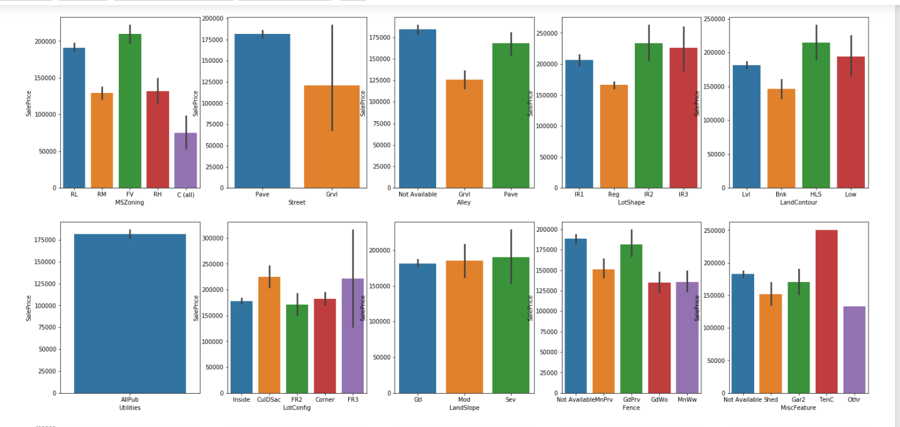
Visualizations

Slide 9
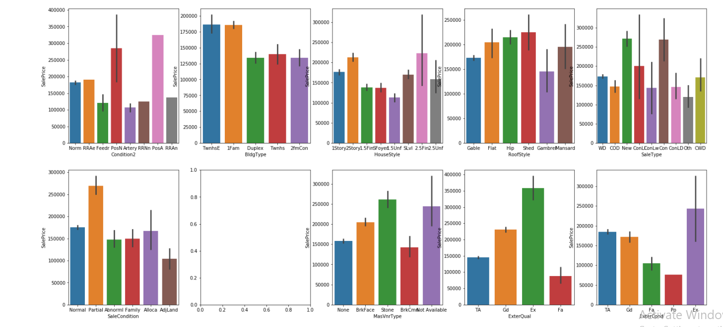

Slide 10
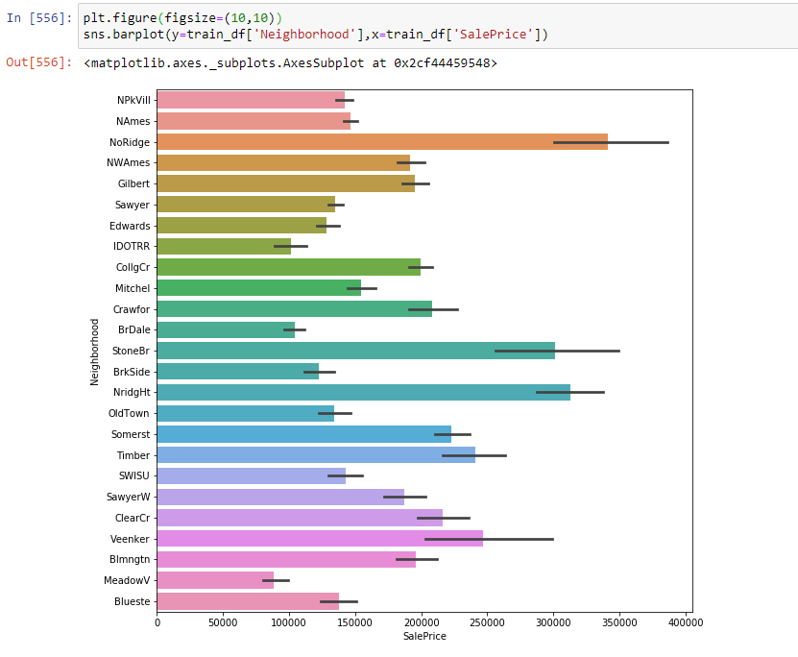

Slide 11
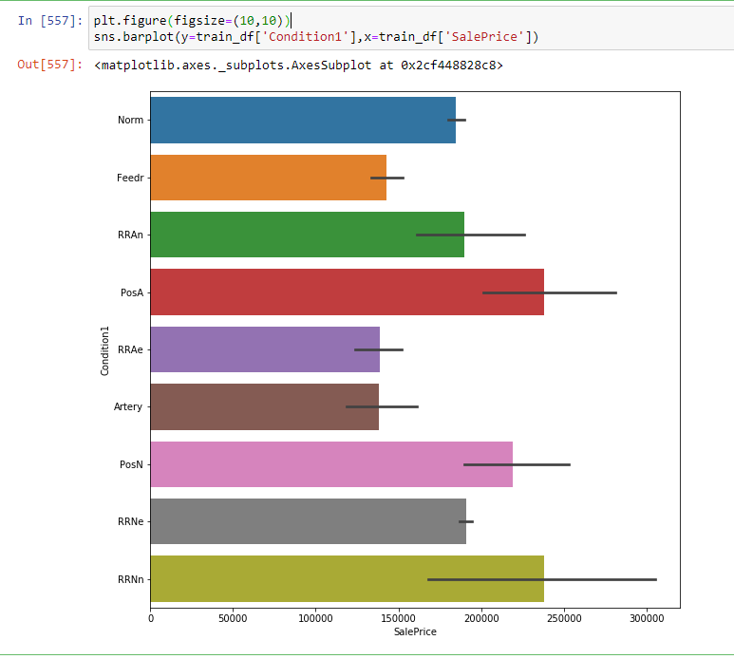

Slide 12
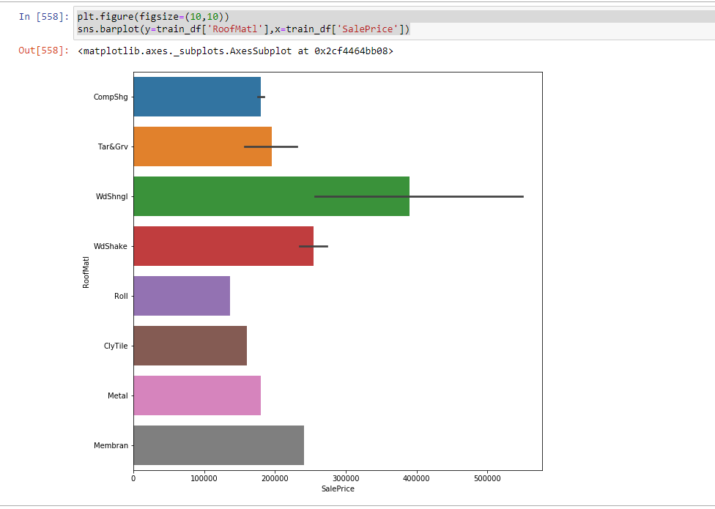

Slide 13
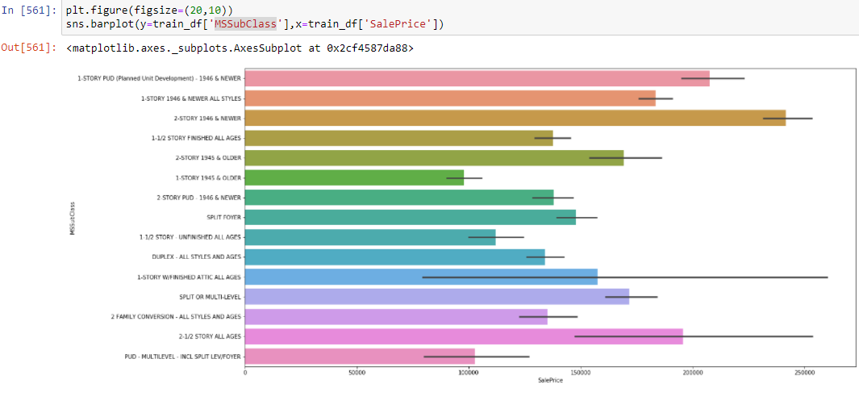

Slide 14
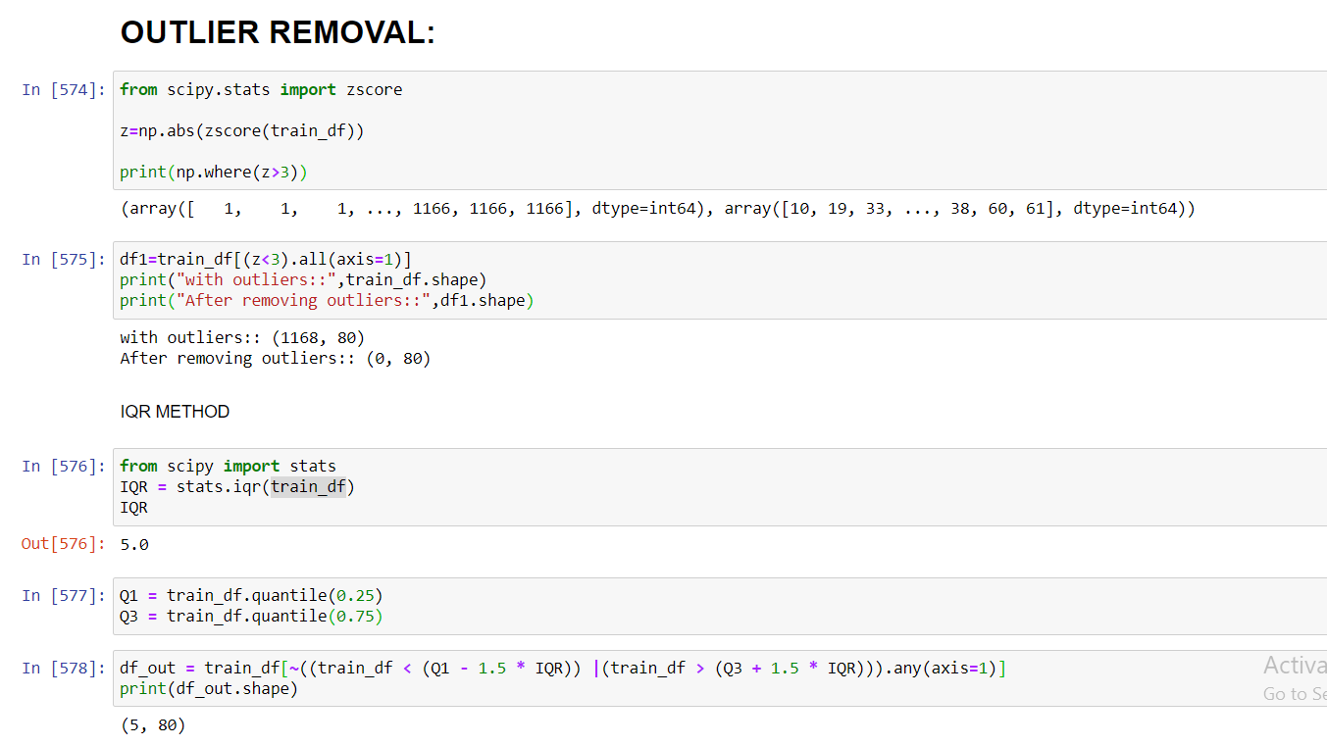
Different approaches for outlier removal:
1->Z score

Slide 15
Mostly outliers are removed by either z score or IQR(Inter Quartile Range).Tried both these approaches first but, the data loss is high in both these approaches.So applied capping technique which is also called as winsorization.
Another technique is replacing the outlier data with mean or median.But when we obserfve this data set there is a huge difference between minimum and maximum values.If we calculate mean or median it wont give appropriate values as it includes the outlier value(maximum ones).So not using this approach.
As we are not dropping the outliers, another approach is capping or winsorization of outliers.
using percentile capping. Values that are less than the value at 10th percentile are replaced by 10th percentile value , and values greater than 90th percentile are replaced by 90th percentile value.

Slide 16
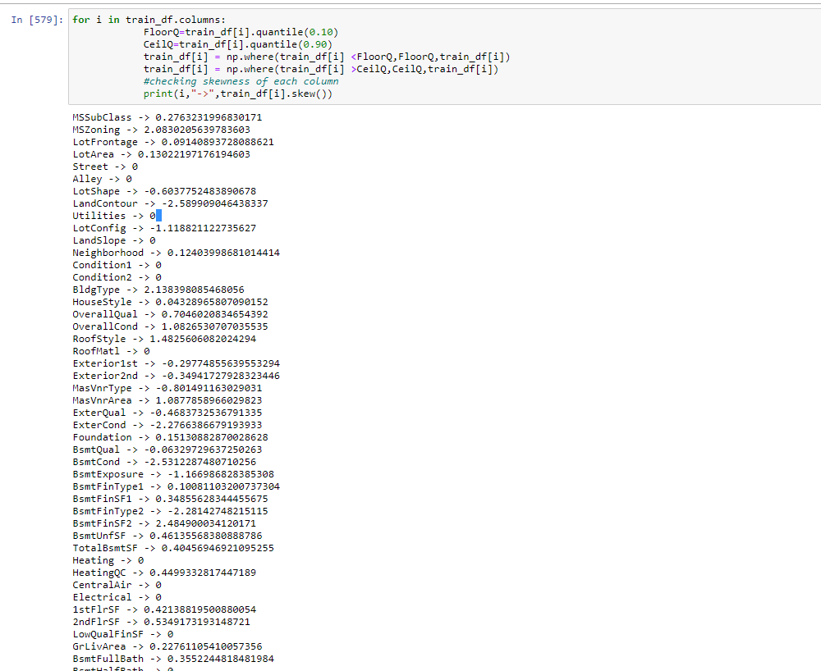

Slide 17
Steps before building model
Data should be segregated into x and y
scaling of x values should be done.
skewness removal needs to be done before splitting into train and test sets.

Slide 18
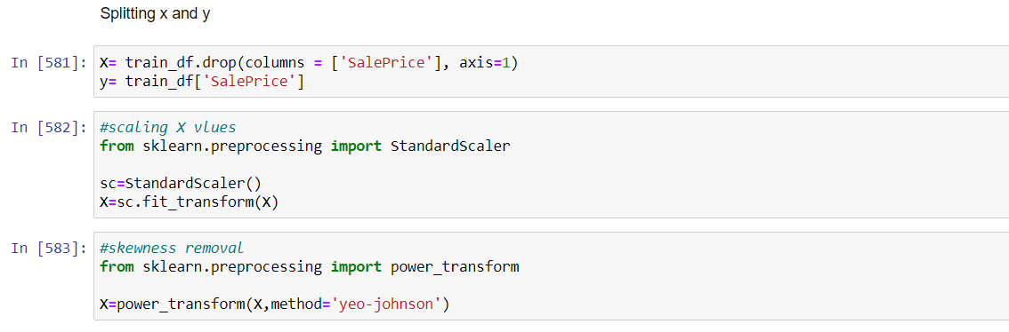

Slide 19
Algorithms used
I have tried different regression algorithms to check which algorithm performs best.
I did cross validation before fitting a model to avoid over fitting and cross validation also determines a models ability to predict on new data.
List of algorithms used:
Linear Regression
Lasso Regression
Ridge Regression

Slide 20
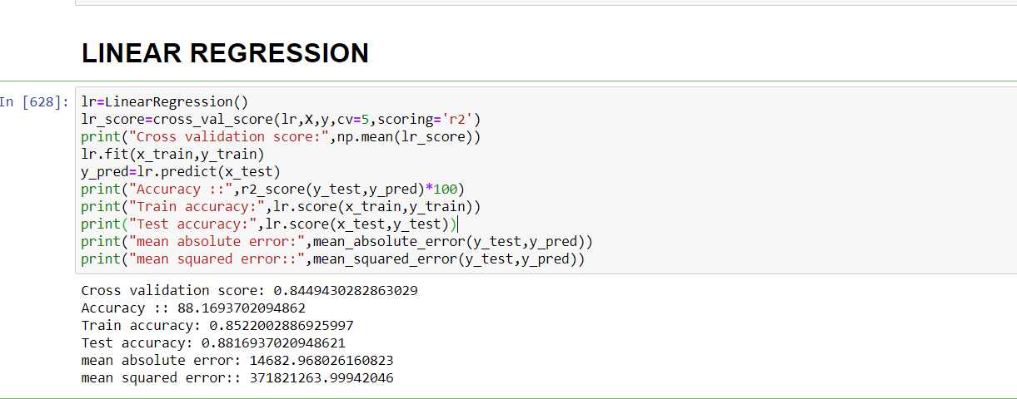

Slide 21
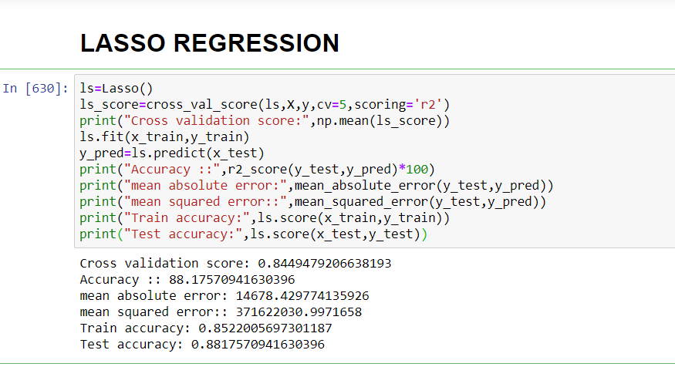

Slide 22
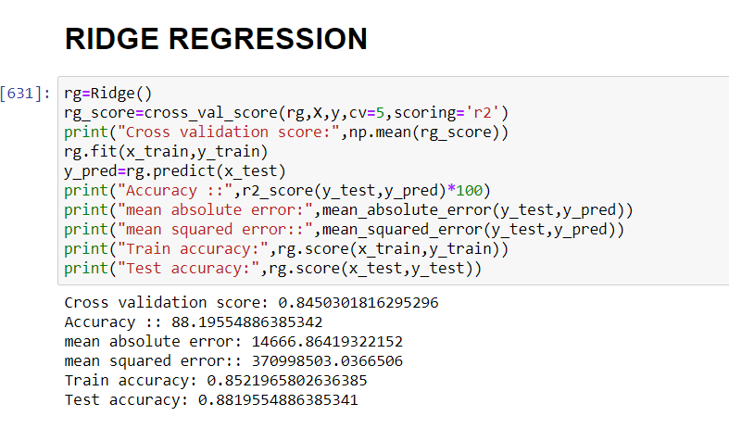

Slide 23
Choosing the Algorithm
The algoritms are evaluated on different criteria like r2 score,mean absolute error,mean squared error
I have choosen Ridge regression because the accuracy is high and there is less difference between train and test accuracies which indicates there will be no over or under fittings.

Slide 24
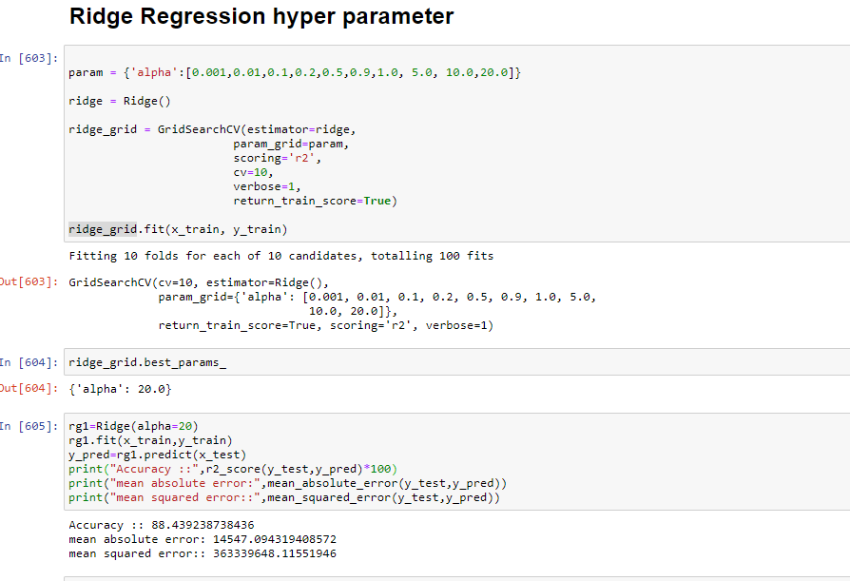
Hyper Parameter Tuning
Hyper parameter tuning is used toincrease the performance of the algorithm
Hyper parameter tuning tends to reduce over fitting as well.

Slide 25
CONCLUSION
The model we built predicts whether the sale price of an property with an accuracy of 88%.
The following are top 10 characteristics that positively influence the saleprices:
Above grade (ground) living area square feet,
Total square feet of basement area
Overall quality
Number of fireplaces
Second floor square feet
Type 2 finished square feet
Rating of basement finished area (if multiple types)
Size of garage in square feet
Lot size in square feet
Exterior covering on house (if more than one material)
The following are top 10 characteristics that negatively influence saleprices:
Interior finish of the garage
No.of Bedrooms above ground
Kitchen quality
Basement quality
Fireplace quality
Building type
Exterior quality
Years since built
Years since remodeling has been done.

