Slide 1
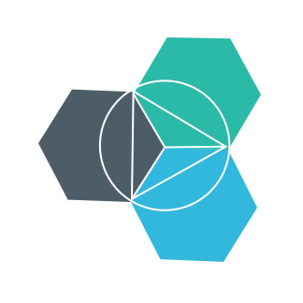


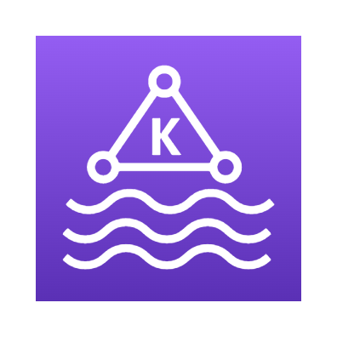

Planned/Proposed
Architecture
Client Apps
API Gateways / BFF
Identity Microservices
Event Bus (RabbitMQ / Kafka / Service Bus)
SQL Server
Mobile
React Native
Aggregator Web
Server Side
MVC
Razor
Blazor Server
Payment Microservices
Aggregator Mobile
Event Bus
SPA
Angular
ReactJS
Vue JS
Blazor WASM
Orders Microservices
MySQL
Discount Microservices
PostgreSQL
Basket Microservices
Admin Services
Redis
SPA
Admin UI
Health Check
Webhooks
Alerts / Monitoring
Products Microservices
Mongo

Slide 2
Information
I am still a learner. Apologize if I do any mistake.
All the sessions will be hands on.
Will have parking lots for queries and other topics.
Some of the concepts we will introduced and revisited in next sessions.
There are multiple ways to do, we will use one of the ways.
The focus was more on concepts and demos are kept simple.
Dot Net Learners House

Slide 3
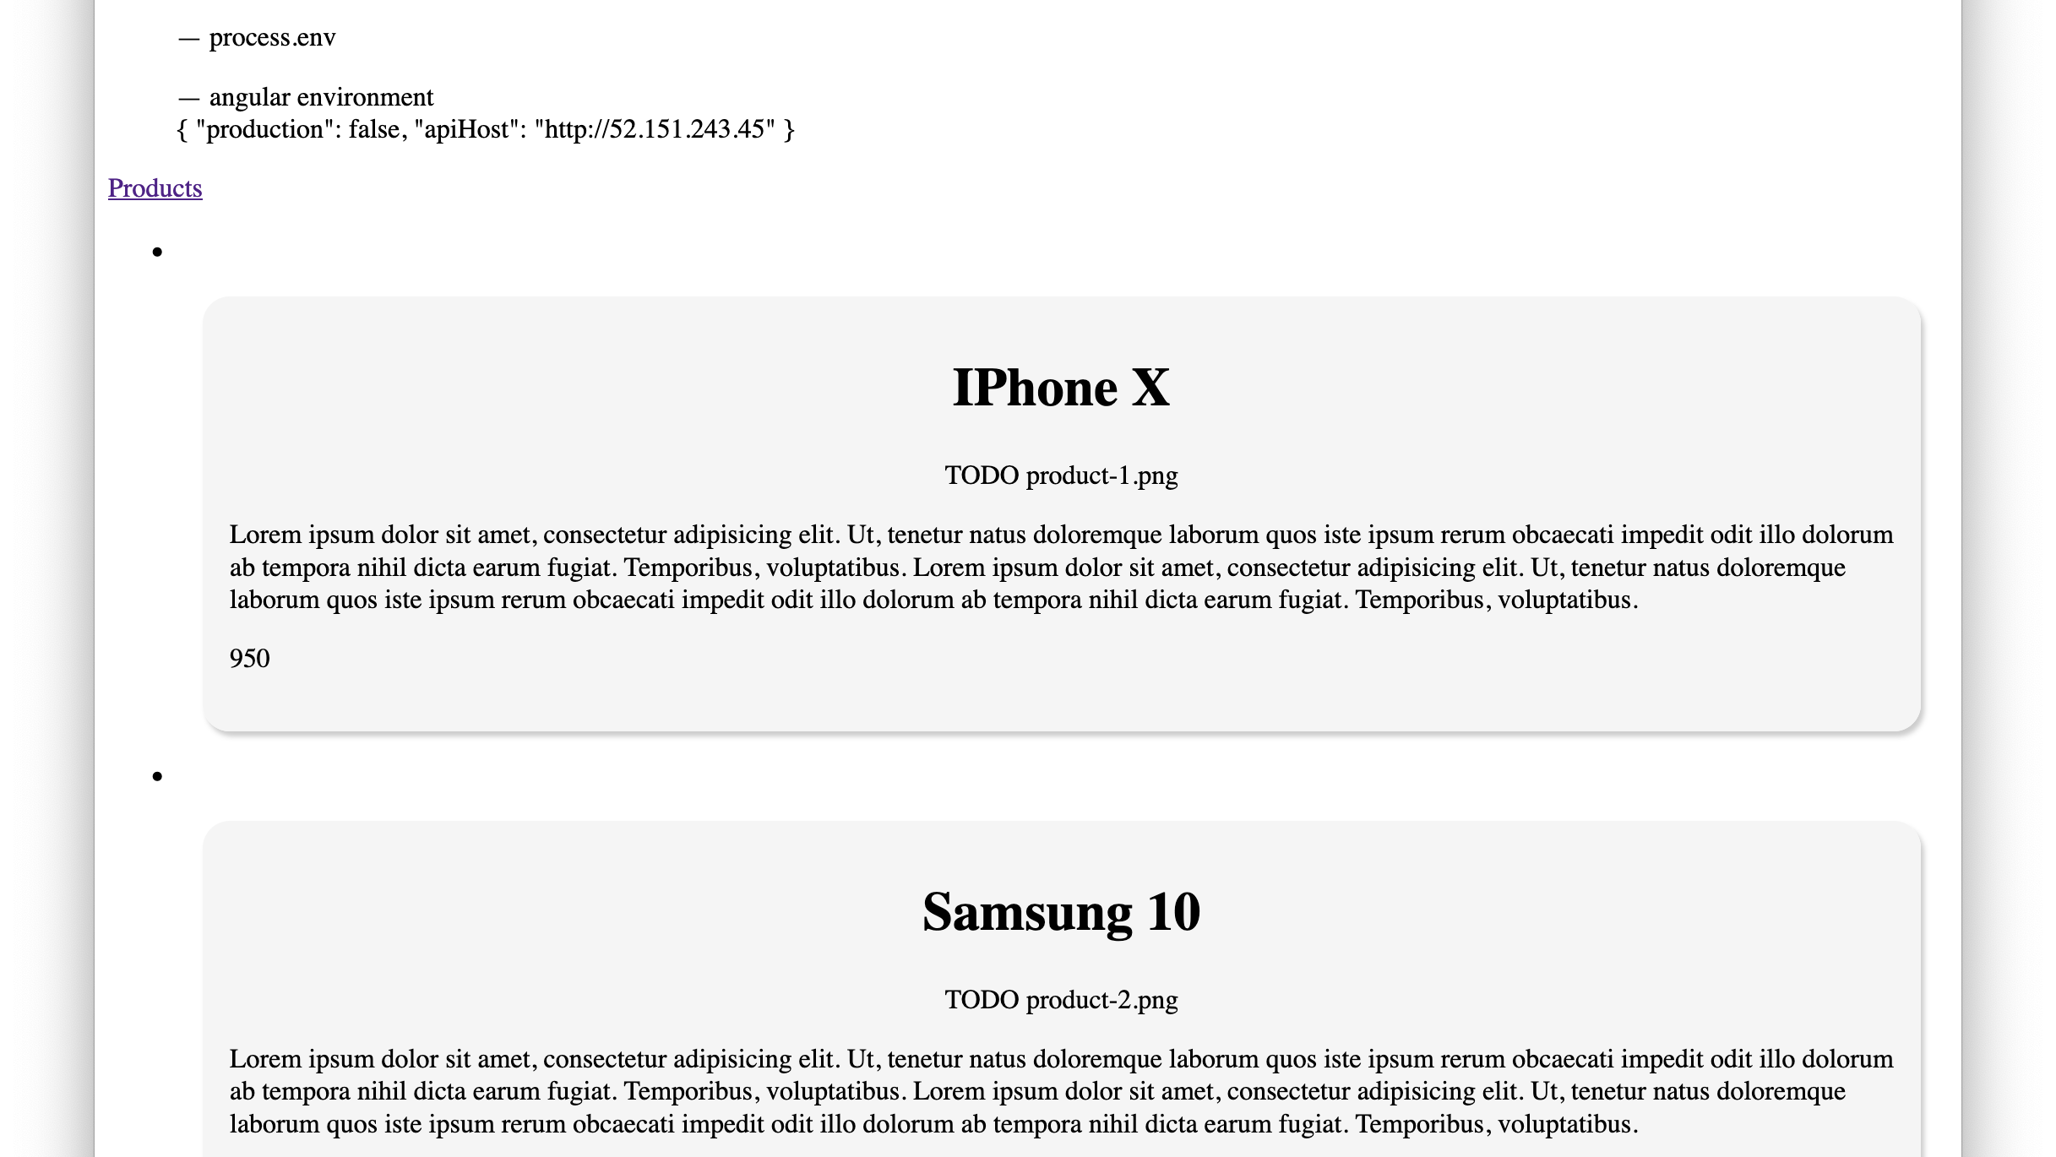

Slide 4
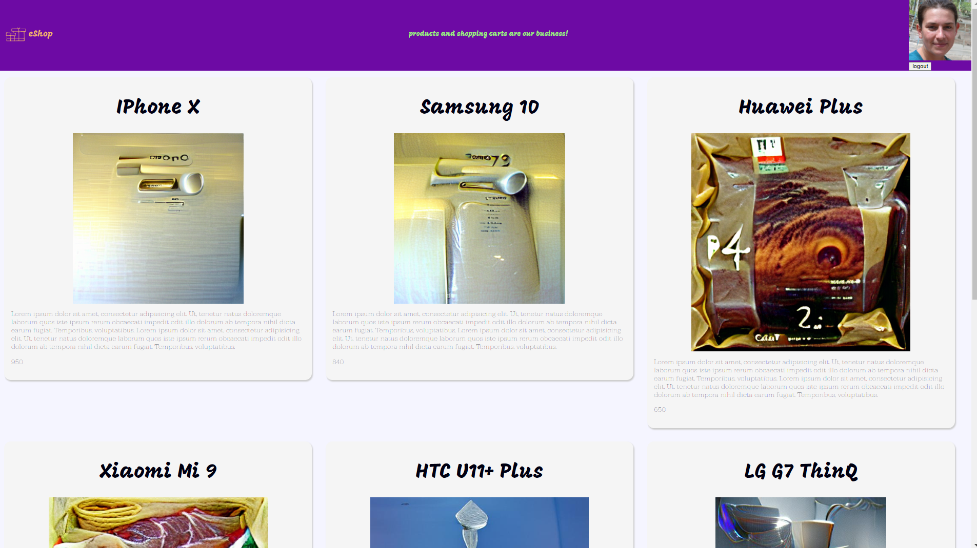

Slide 5
2
Only Image Data
API Gateway
API Products
Mongo
Db
1
Upload Image
Admin
UI Browser
4
CD to Q
1
2
3
Products DTO with Image GUID
Rabbit MQ
4
Image Created
Temp to Dest
Orphan Removal
Az Func
Temporary Image Storage
Clean Up Job
Destination Blob Storage
3
Creates Image in Storage

Slide 6
API Gateway
Iden
Service
Mongo
Db
Browser
Client
UI
API Products
Config
Service
Nginx
Client

Slide 7
GitHub Actions
Step 1: Terraform deploys Infrastructure
Step 2: Use .yaml to deploy MongoDb, and Products API into AKS
Step 2.A: Write config into K8s Secret Store [Pending]
Step 3: Use .yaml to deploy MSSQL, and Iden Server into AKS
Step 3.A: Write config into K8s Secret Store [Pending]
Step A: We have all the details into AKS Secret Store [FYI]
Step B: Use .yaml to deploy Config Server into AKS [Pending]
Step C: Use .yaml to deploy eShop Angular Client [Pending]
Step C.1: Build Pipeline should replace token of Config Server in environment.ts file. [Pending]
Wish Lists:
Reading the configuration live.
API Products
Nginx
Client
Mongo
Db
Config
Service

Slide 8
1. K8s: is a Container Orchestration System/Tool. 2. Cluster: All the machines collectively can be thought of as the entire running system.
K8s Cluster
3. Node (Worker or Master): May be a VM or a physical machine.
4. Master Node: runs the System PODs. Also called as Control Plane.
5. Worker Node: includes software to run containers managed by Kubernetes control plane. Our application related PODs.
6. Control plane: is a set of APIs and software that Kubernetes users interact with. These APIs and software are collectively referred to as master components.
Worker Node
Services
Container
Shared Volumes
Kubelet
Kube Proxy
Shared IP
Master Node
Container Runtime
Container
Client Machine
POD
Scheduler
Kube Controller Manager
Cloud Controller Manager
Kubectl
HTTPS
ETCD
Container
Shared Volumes
Container
Shared Volumes
HTTPS
API Server
Shared IP
Shared IP
Container
Container
Services
Container
Shared Volumes
POD
POD
10. kubectl (cube control): we can issue commands that are at a high level of abstraction with each command, translating into the appropriate API server request. With cube control, we can also access clusters locally, as well as remote.
Kubelet
Shared IP
Worker Node
Kube Proxy
Container
Container Runtime
POD
Services
Container
Shared Volumes
Container
Shared Volumes
Container
Shared Volumes
Kubelet
Kube Proxy
Shared IP
Shared IP
Shared IP
Container Runtime
Container
Container
Container
POD
POD
POD
7. Pods: may include one or more containers. All containers in a Pod run on the same node.
8. Services: define networking rules for exposing Pods to other Pods or to the internet.
9. Deployment: Control Rollout and Rollback of Pods. Also, to manage the deployment configuration and changes to running Pods as well as horizontal scaling.
Container
Shared Volumes
Container
Shared Volumes
Shared IP
Shared IP
Container
Container
POD
POD

Slide 9
Frontends
Server-side Websites
CDN content
BFF /
API Gateways
Middle Tiers
Products
Identity
Basket
Data Stores
SQL
Mongo
PostgreSQL
DMZ

Slide 10
BFF /
API Gateways
Middle Tiers
Products
Identity
Basket
Data Stores
SQL
Mongo
PostgreSQL
Frontends
Static Websites
CDN content
DMZ

Slide 11
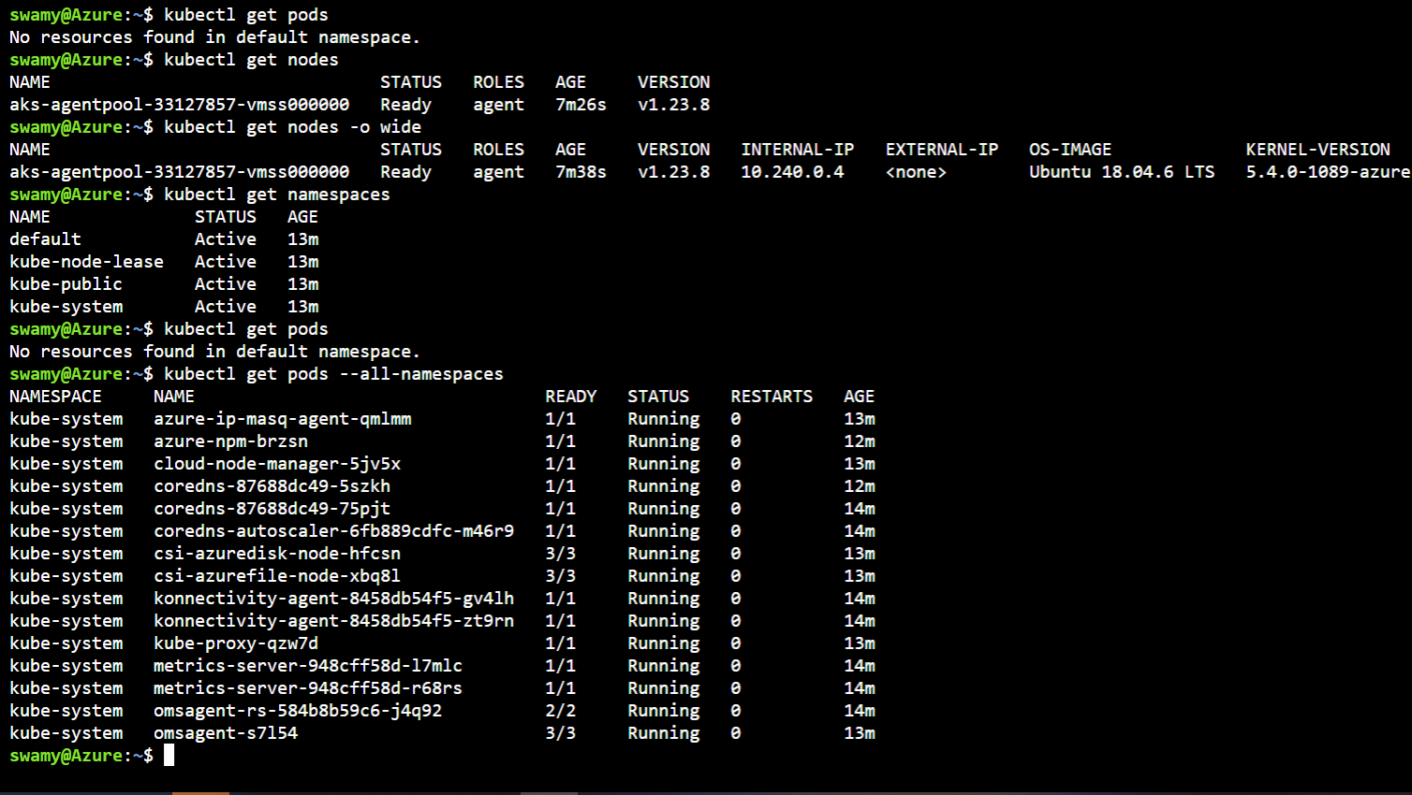

Slide 12
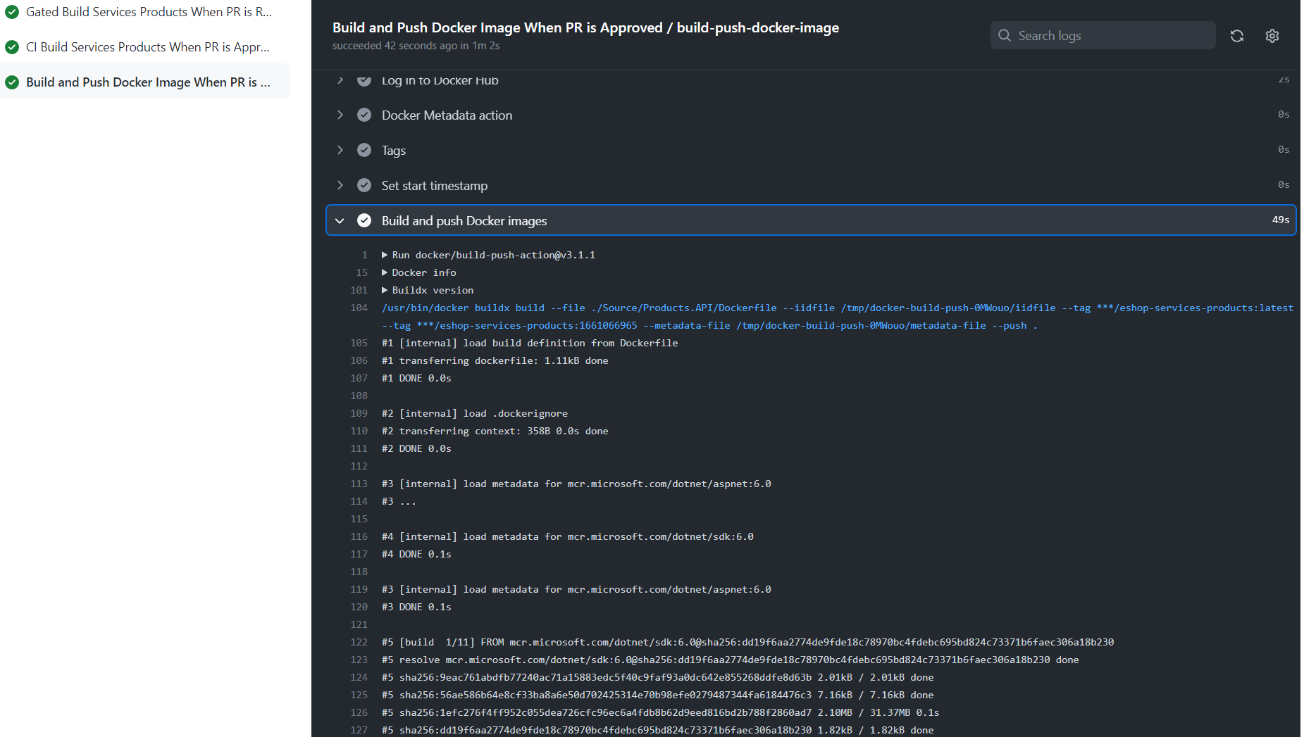
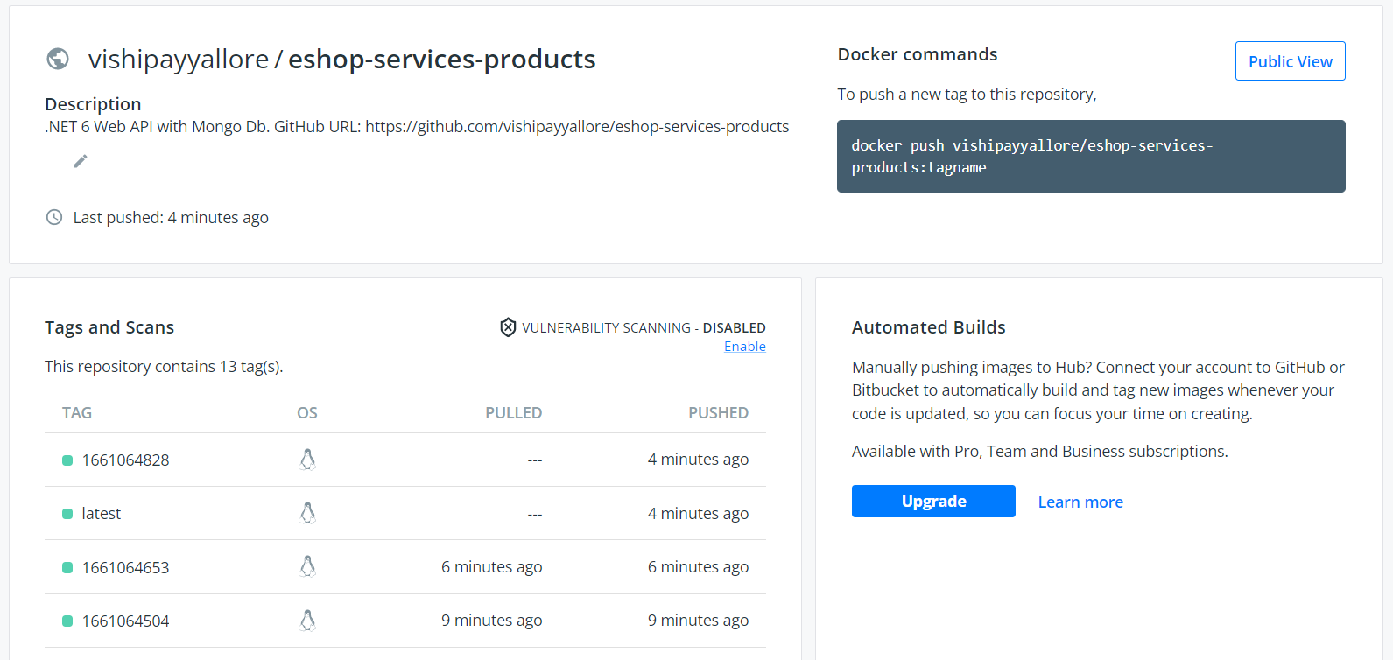

Slide 13
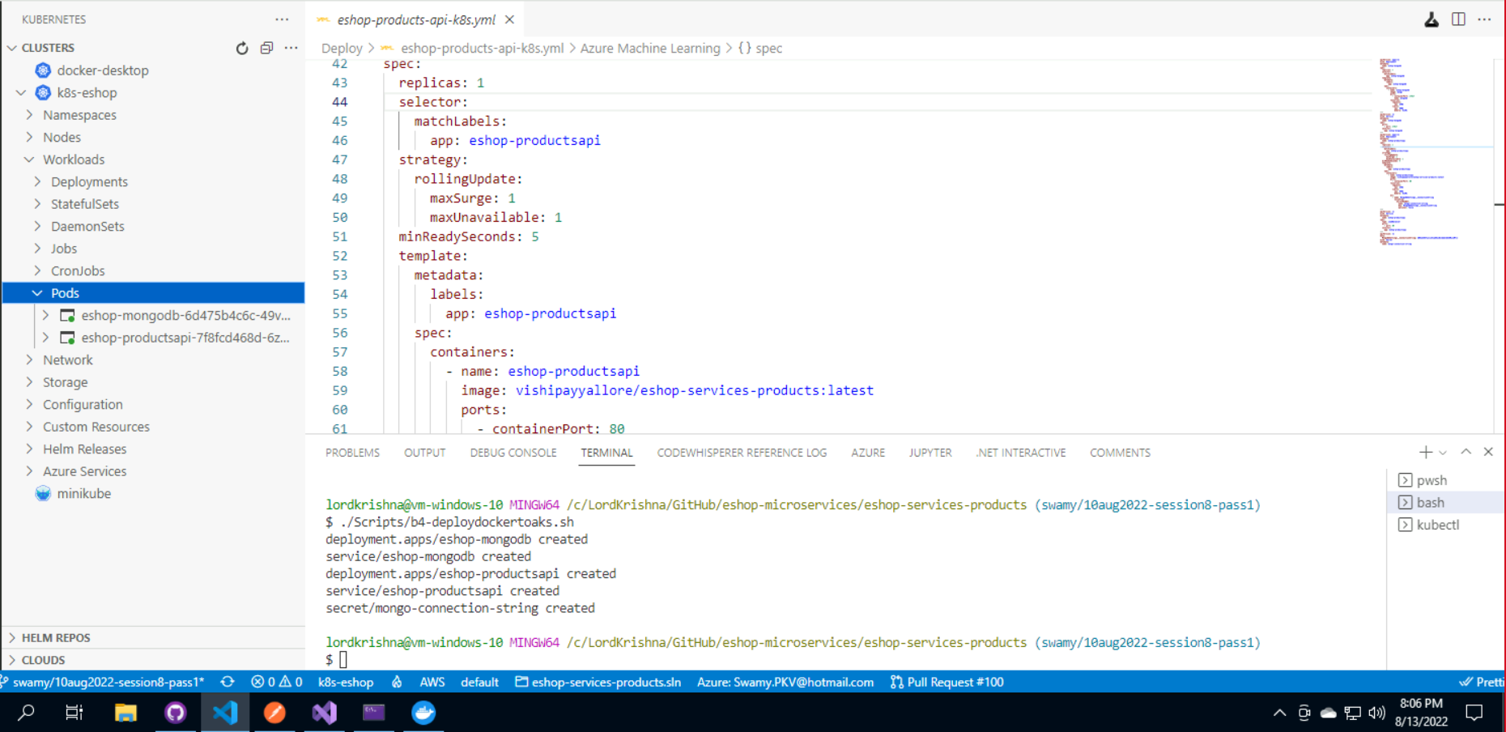
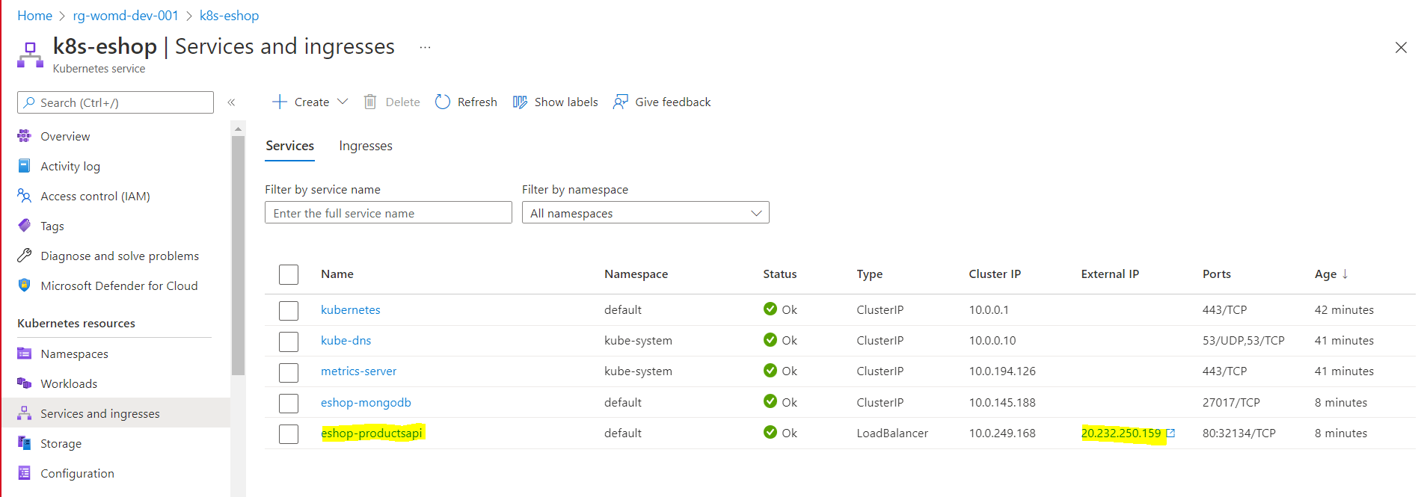

Slide 14
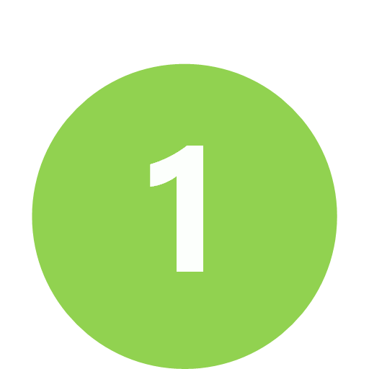
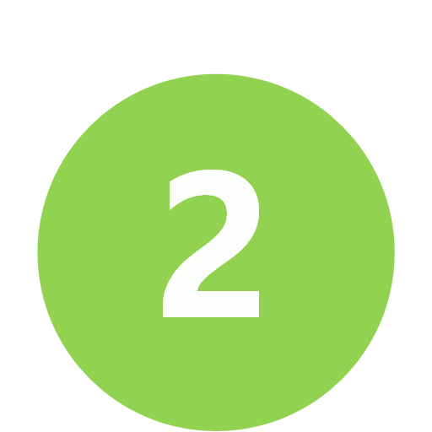
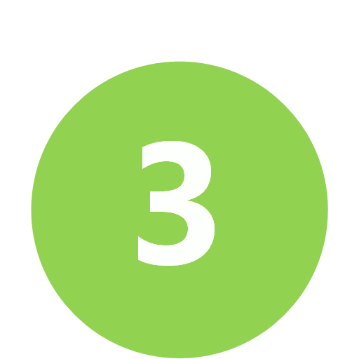
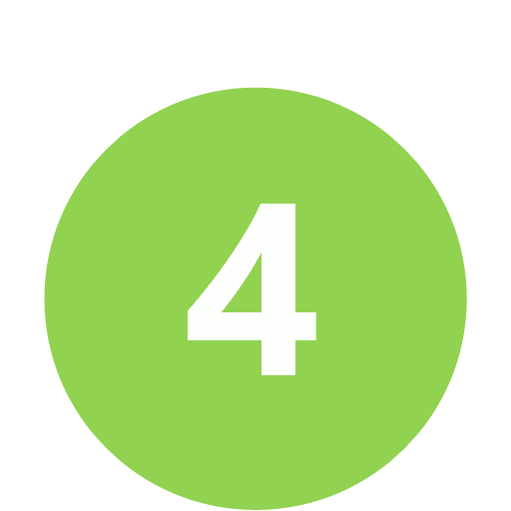
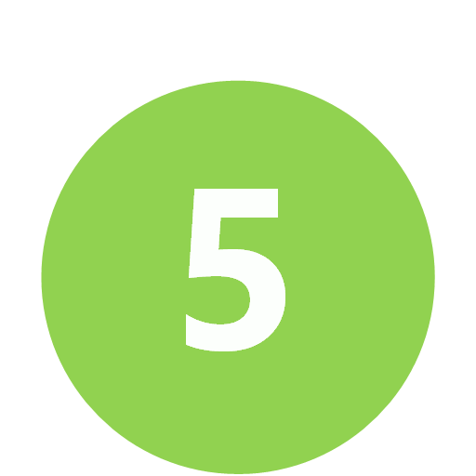
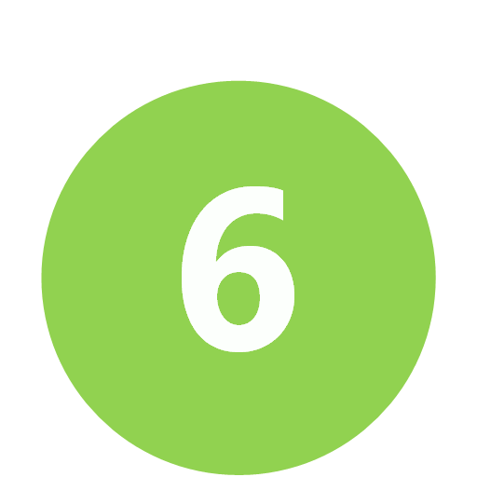

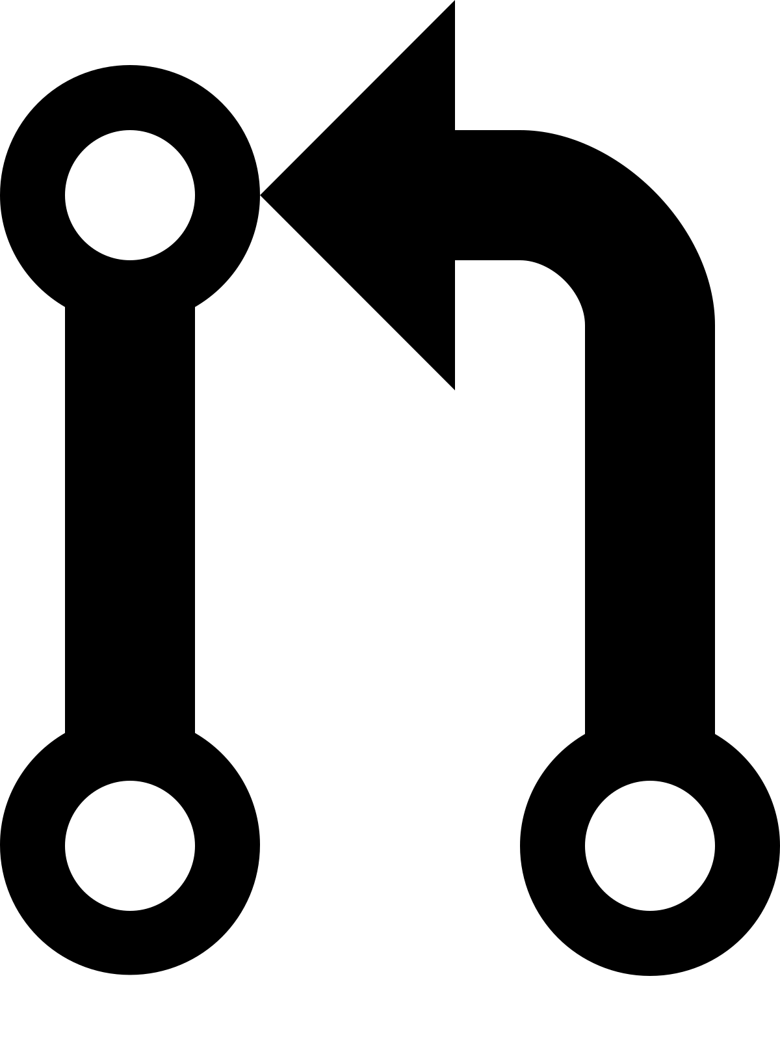

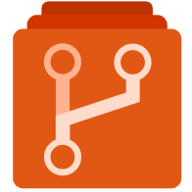
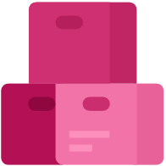
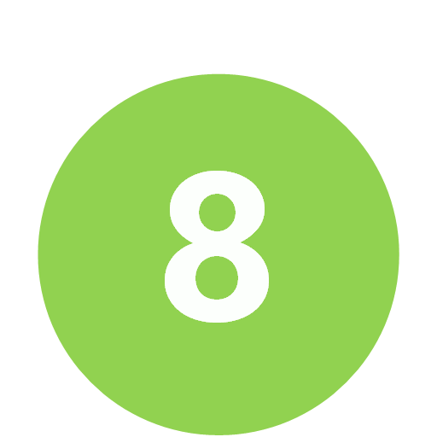
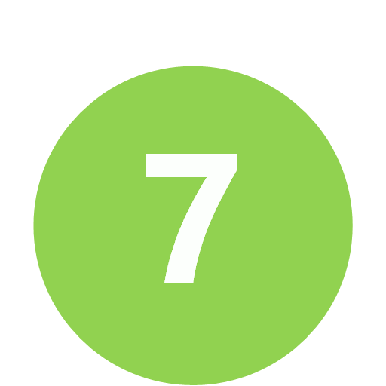
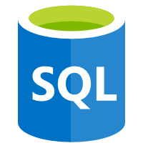
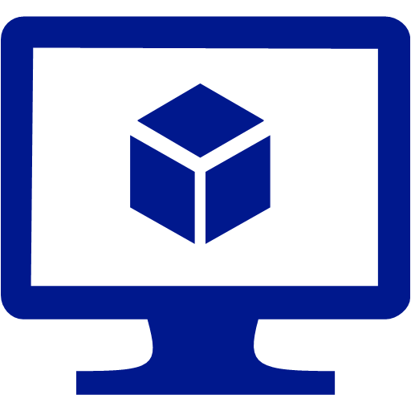
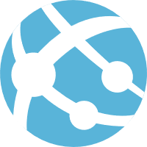
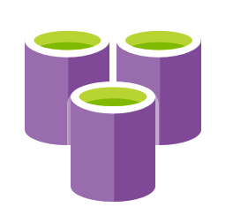
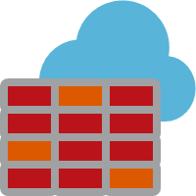
PR Process, CI, CD
Feature Branch
Code
Pull Request
Gated Build
Master Branch
CI Build
Artefacts drop
Environment A
Release
Dot Net Learners House

Slide 15
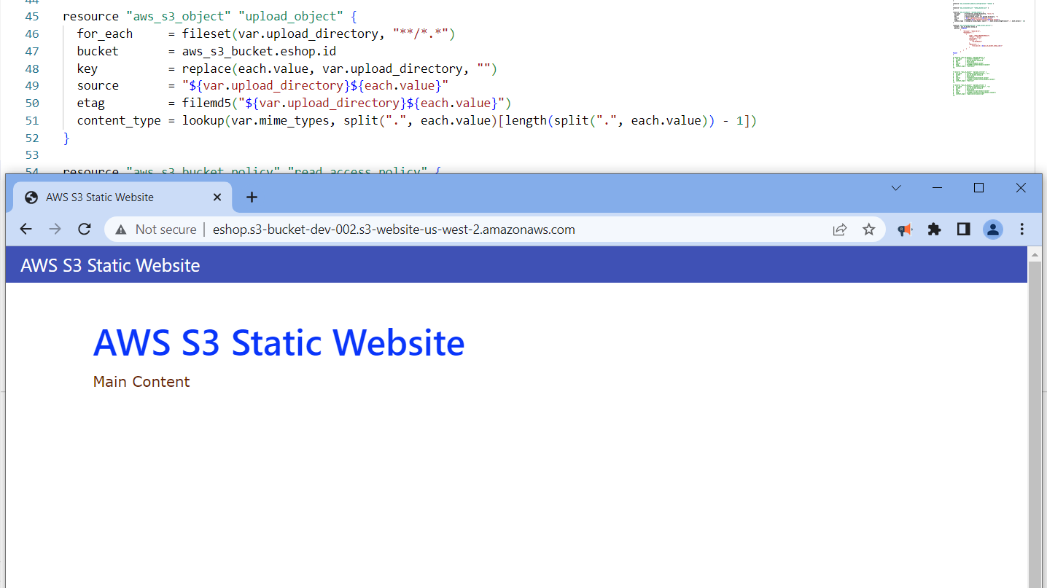

Slide 16
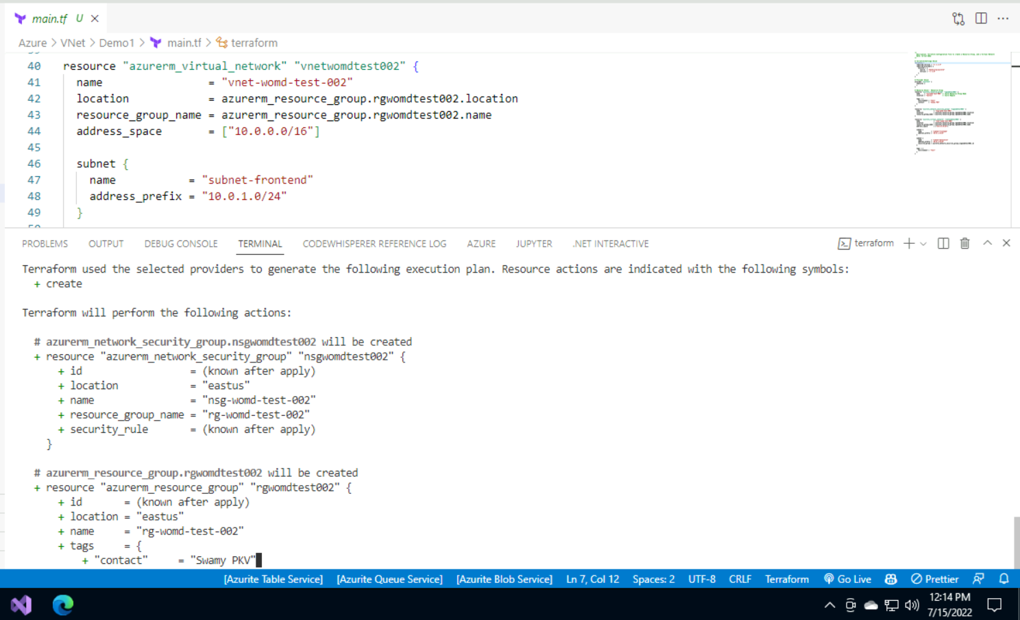

Slide 17
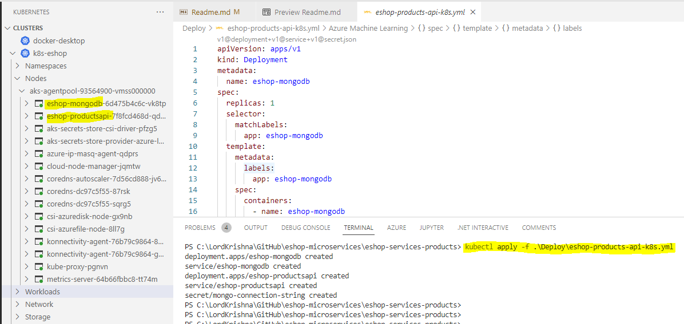

Slide 18
Kubectl
Worker
Services
HTTPS
Kubelet
Container
Shared Volumes
Kube Proxy
API Server
Container Runtime
Shared IP
Container
Services
Kubelet
PODS
Container
Shared Volumes
Kube Proxy
Container
Shared Volumes
Container
Shared Volumes
Shared IP
Container Runtime
Shared IP
Shared IP
Container
Container
Container
PODS
PODS
PODS
Worker
Services
Container
Shared Volumes
Container
Shared Volumes
Kubelet
Container
Shared Volumes
Shared IP
Kube Proxy
Shared IP
Container Runtime
Shared IP
Container
Container
Container
PODS
PODS
PODS
Master
Note: Runs only System Pods (Control Plane)
Container
Shared Volumes
Container
Shared Volumes
Shared IP
Shared IP
Container
Container
PODS
PODS

Slide 19
1. K8s: is a Container Orchestration System/Tool. 2. Cluster: All the machines collectively can be thought of as the entire running system.
K8s Cluster
3. Node (Worker or Master): May be a VM or a physical machine.
4. Master Node: runs the System PODs. Also called as Control Plane.
5. Worker Node: includes software to run containers managed by Kubernetes control plane. Our application related PODs.
6. Control plane: is a set of APIs and software that Kubernetes users interact with. These APIs and software are collectively referred to as master components.
Worker Node
Services
Container
Shared Volumes
Kubelet
Kube Proxy
Shared IP
Master Node
Container Runtime
Container
Client Machine
POD
Scheduler
Kube Controller Manager
Cloud Controller Manager
Kubectl
HTTPS
ETCD
Container
Shared Volumes
Container
Shared Volumes
HTTPS
API Server
Shared IP
Shared IP
Container
Container
Services
Container
Shared Volumes
POD
POD
10. kubectl (cube control): we can issue commands that are at a high level of abstraction with each command, translating into the appropriate API server request. With cube control, we can also access clusters locally, as well as remote.
Kubelet
Shared IP
Worker Node
Kube Proxy
Container
Container Runtime
POD
Services
Container
Shared Volumes
Container
Shared Volumes
Container
Shared Volumes
Kubelet
Kube Proxy
Shared IP
Shared IP
Shared IP
Container Runtime
Container
Container
Container
POD
POD
POD
7. Pods: may include one or more containers. All containers in a Pod run on the same node.
8. Services: define networking rules for exposing Pods to other Pods or to the internet.
9. Deployment: Control Rollout and Rollback of Pods. Also, to manage the deployment configuration and changes to running Pods as well as horizontal scaling.
Container
Shared Volumes
Container
Shared Volumes
Shared IP
Shared IP
Container
Container
POD
POD

Slide 20
Worker Node
Shared Volumes
Services
Container
Shared Volumes
Kubelet
Kube Proxy
Shared IP
Shared IPs
Container Runtime
Container
Shared Volumes
POD
Container
Container
Shared Volumes
Container
Shared Volumes
Shared IP
Shared IP
Container
Shared IPs
Container
Container
POD
POD
Worker Node
Services
Container
Container
Shared Volumes
Kubectl
Container
Shared Volumes
Shared Volumes
Kube Proxy
Kubelet
Shared IP
Kube Proxy
Shared IP
Container
Container Runtime
Shared IPs
Container Runtime
Container
Container
POD
POD
Container
Container
Shared Volumes
Shared Volumes
Container
Shared Volumes
Shared IP
Shared IP
Shared IP
Container
Container
Shared Volumes
Container
Shared Volumes
Container
Container
POD
Shared IPs
Shared IPs
POD
POD
Container
Container

Slide 21
SQL
Queue
UI
Web Site
API
Web Job
Blob

Slide 22
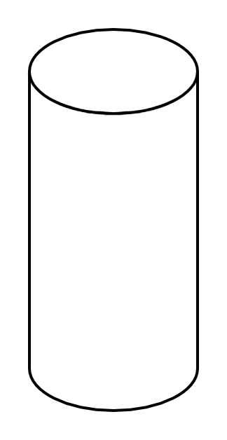

Client Apps
API Gateways / BFF
Identity Microservices
Event Bus (RabbitMQ / Kafka / Service Bus)
SQL Server
Mobile
React Native
Aggregator Web
Server Side
MVC
Razor
Blazor Server
Payment Microservices
Aggregator Mobile
Event Bus
SPA
Angular
ReactJS
Vue JS
Blazor WASM
Orders Microservices
MySQL
Discount Microservices
PostgreSQL
Basket Microservices
Admin Services
Redis
SPA
Admin UI
Health Check
Webhooks
Alerts / Monitoring
Products Microservices

