Slide 1
Information
I am still a learner. Apologize if I do any mistake.
All the sessions will be hands on.
Will have parking lots for queries and other topics.
Some of the concepts we will introduced and revisited in next sessions.
There are multiple ways to do, we will use one of the ways.
The focus was more on concepts and demos are kept simple.
Microsoft Reactor Bengaluru

Slide 2
Information
I am still a learner. Apologize if I do any mistake.
All the sessions will be hands on.
Will have parking lots for queries and other topics.
Some of the concepts we will introduced and revisited in next sessions.
There are multiple ways to do, we will use one of the ways.
The focus was more on concepts and demos are kept simple.
Dot Net Learners House

Slide 3
Information
I am still a learner. Apologize if I do any mistake.
All the sessions will be hands on.
Will have parking lots for queries and other topics.
Some of the concepts we will introduced and revisited in next sessions.
There are multiple ways to do, we will use one of the ways.
The focus was more on concepts and demos are kept simple.
C# Corner

Slide 4


















PR Process, CI, CD
Feature Branch
Code
Pull Request
Gated Build
Master Branch
CI Build
Artefacts drop
Environment A
Release
Dot Net Learners House

Slide 5
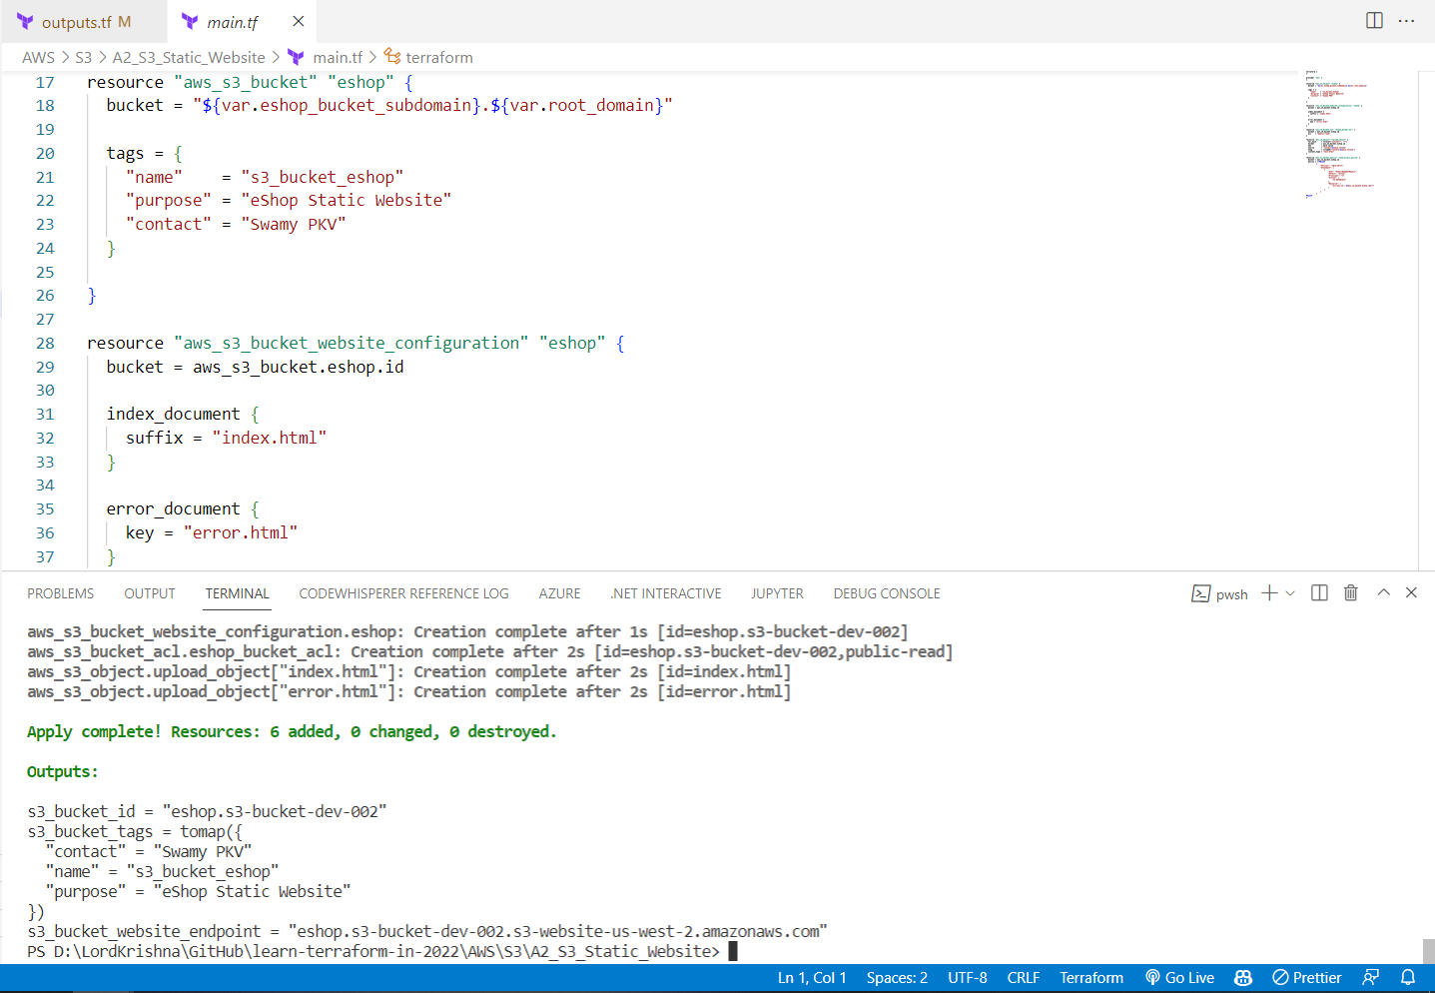

Slide 6





6
Ubuntu VM
5
Windows VM
Razor App inside IIS
1
Ng 12 App
2
Web API
Azure SQL
3
Postman
4
Microsoft Reactor Bengaluru

Slide 7
6
Ubuntu VM
5
Windows VM
Razor App inside IIS
1
Ng 12 App
2
Web API
Azure SQL
3
Postman
4
Microsoft Reactor Bengaluru

Slide 8
4
Windows VM
Install IIS and deploy Web App
1
Web API
Azure SQL
2
5
Ubuntu VM
Postman
3
Microsoft Reactor Bengaluru

Slide 9
4
Windows VM
1
Web API
Azure SQL
2
5
Ubuntu VM
Postman
3
Microsoft Reactor Bengaluru

Slide 10
1
Web API
Azure SQL
2
Postman
3
Microsoft Reactor Bengaluru

Slide 11
1
Web API
Microsoft Reactor Bengaluru

Slide 12
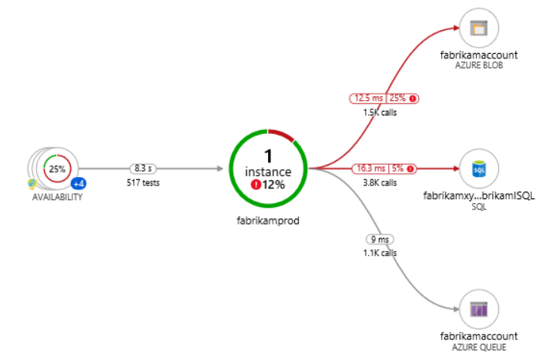







9
Azure Key Vault
6
Azure Redis Cache
8
Blazor WASM
1
2
JWT
4
5
API Mgmt
Web API
7
3
Azure SQL Server
Auth0
High Lights:
Blazor WASM UI get authenticated and pass the JWT to APIM.
APIM Validates the JWT and routes the request to Web API.
SQL Server, and Redis Cache’s credentials are stored in Azure Key Vault.
Web API investigates Azure Redis Cache before hitting SQL Azure. (Cache Aside Pattern)
We will preform Dacpac (.sqlproj) for deployment of SQL Data Store.

Slide 13
9
Azure Key Vault
6
Azure Redis Cache
8
Blazor WASM
1
2
JWT
4
5
API Mgmt
Web API
7
3
Azure SQL Server
Auth0
High Lights:
Blazor WASM UI get authenticated and pass the JWT to APIM.
APIM Validates the JWT and routes the request to Web API.
SQL Server, and Redis Cache’s credentials are stored in Azure Key Vault.
Web API investigates Azure Redis Cache before hitting SQL Azure. (Cache Aside Pattern)
We will preform Dacpac (.sqlproj) for deployment of SQL Data Store.

Slide 14


Azure Key Vault
5
1
2
3
4
6
Canvas App
Custom Connector
Web API
Azure SQL Server

