Slide 1

REST Web API using .Net 5
Viswanatha Swamy
LinkedIn: https://www.linkedin.com/in/viswanatha-swamy-b57326128/
Twitter: https://twitter.com/vishipayyallore
Dot Net Learners House

Slide 2
Information
I am still a learner. Apologize if I do any mistake.
All the sessions will be hands on.
Will have parking lots for queries and other topics.
Some of the concepts we will be introduced and revisited in next sessions.
There are multiple ways to do, we will use one of the ways.
The focus was more on concepts and demos are kept simple.
Dot Net Learners House

Slide 3




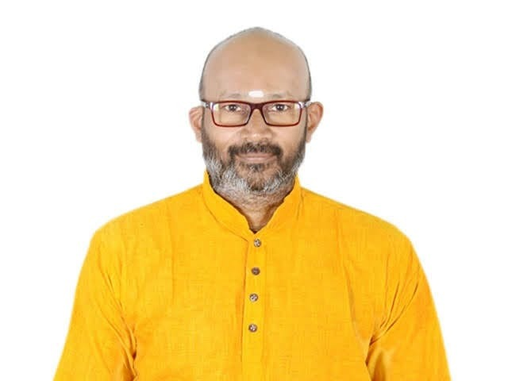
Dotnet Learners House
.NET 7 on AWS - MS SQL Server 2022 on AWS ECS using Fargate
Wed, Mar 29, 2023
09:00 AM (IST)
.NET 7 on AWS - MS SQL Server 2022 on AWS ECS using Fargate
Viswanatha Swamy
Architect - AIS
Event URL: http://bit.ly/3ZtFE3U

Slide 4
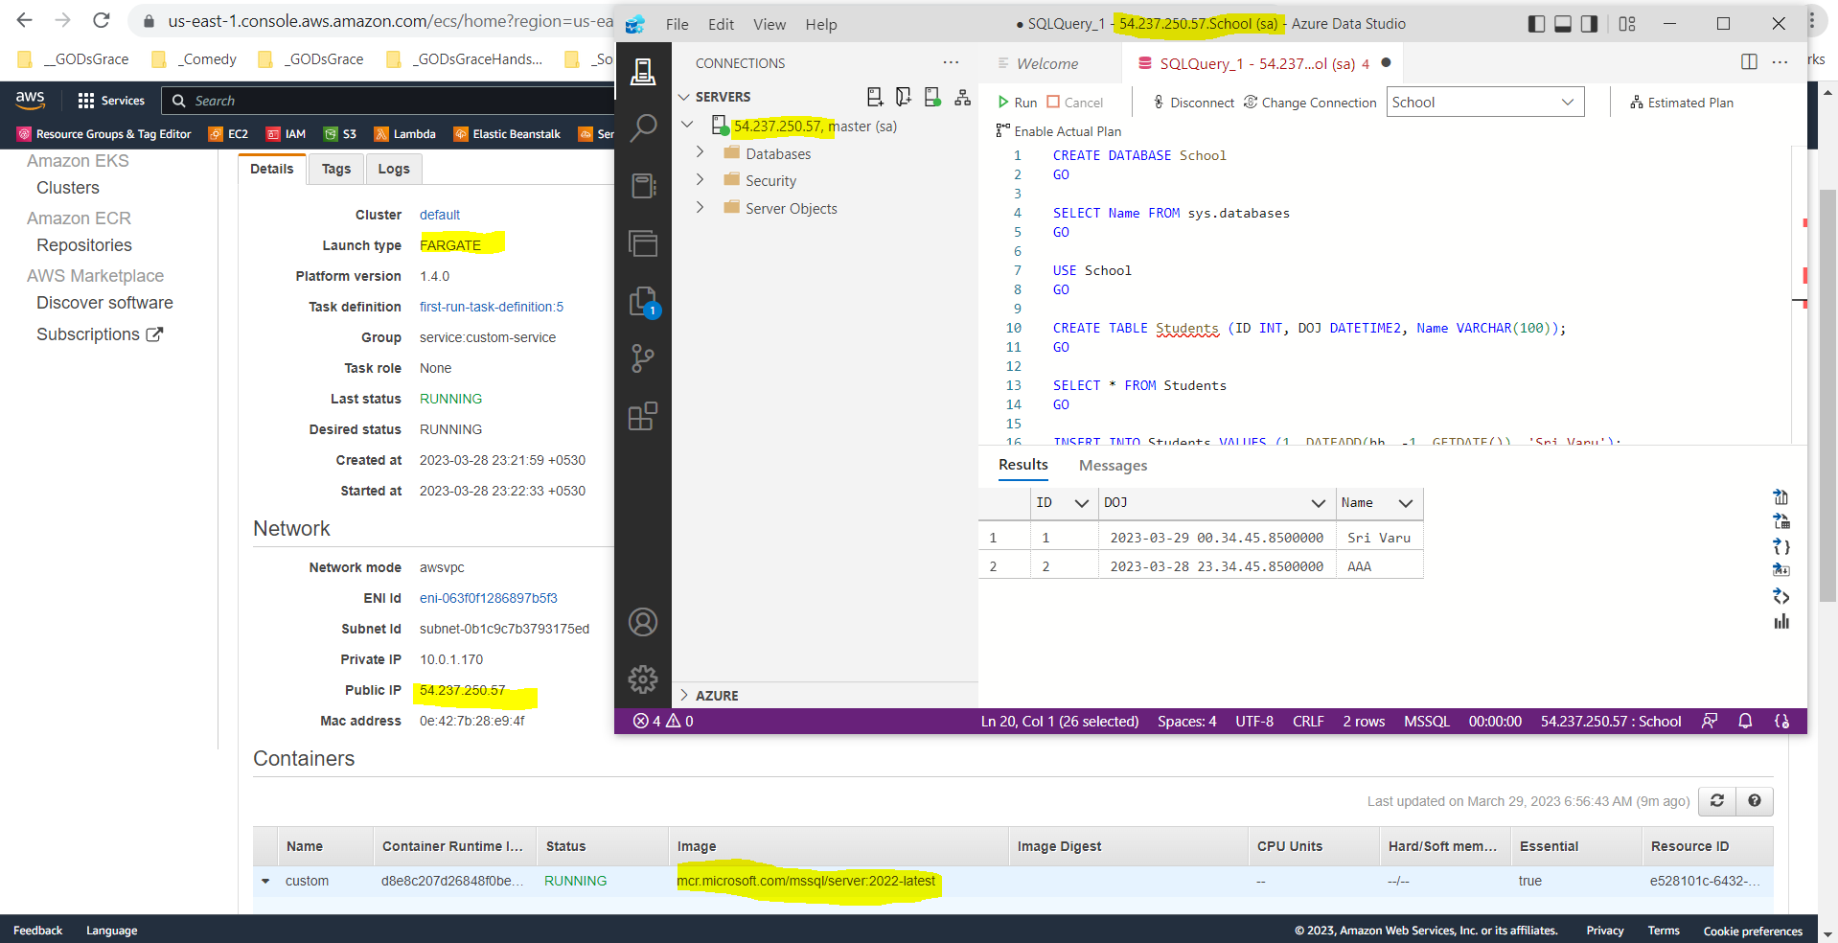

Slide 5
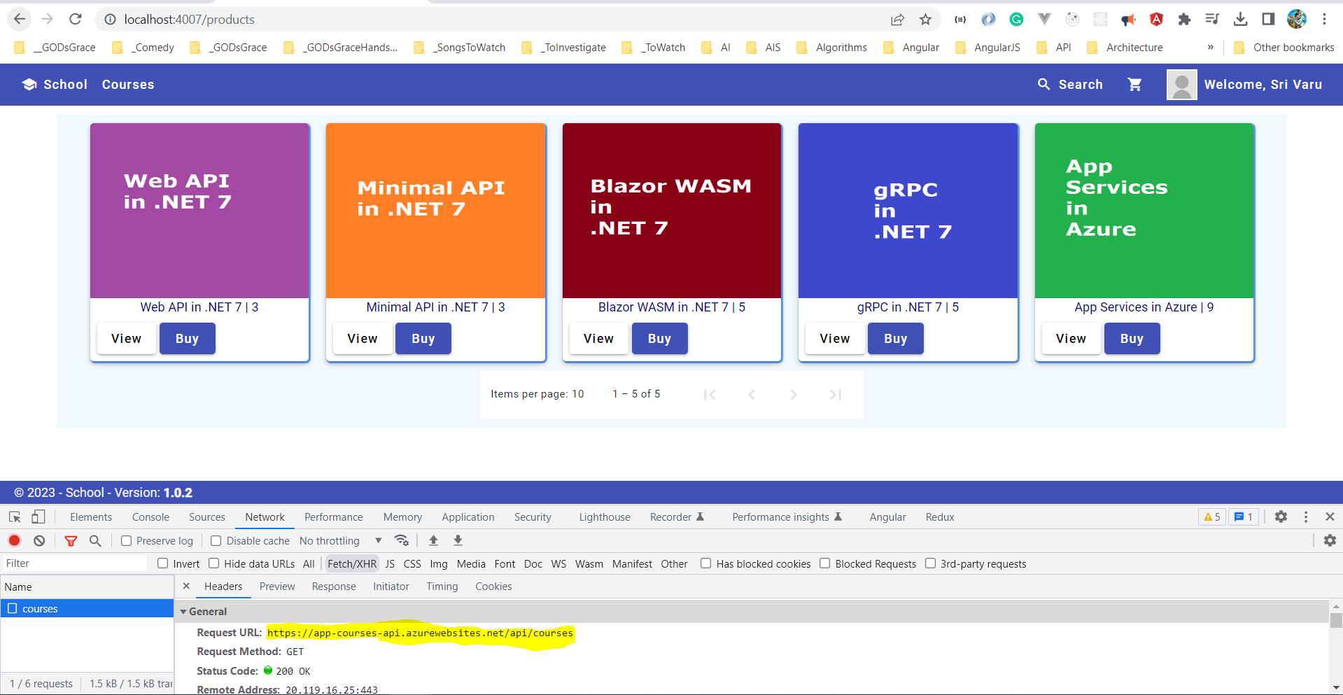

Slide 6
Dotnet Learners House
Minimal API Swagger, Repository, Business, and GitHub Actions
Sunday, Mar 12, 2023
09:00 AM (IST)
Minimal API Swagger, Repository, Business, and GitHub Actions
Viswanatha Swamy
Architect - AIS
Event URL: http://bit.ly/3KHHb2z

Slide 7
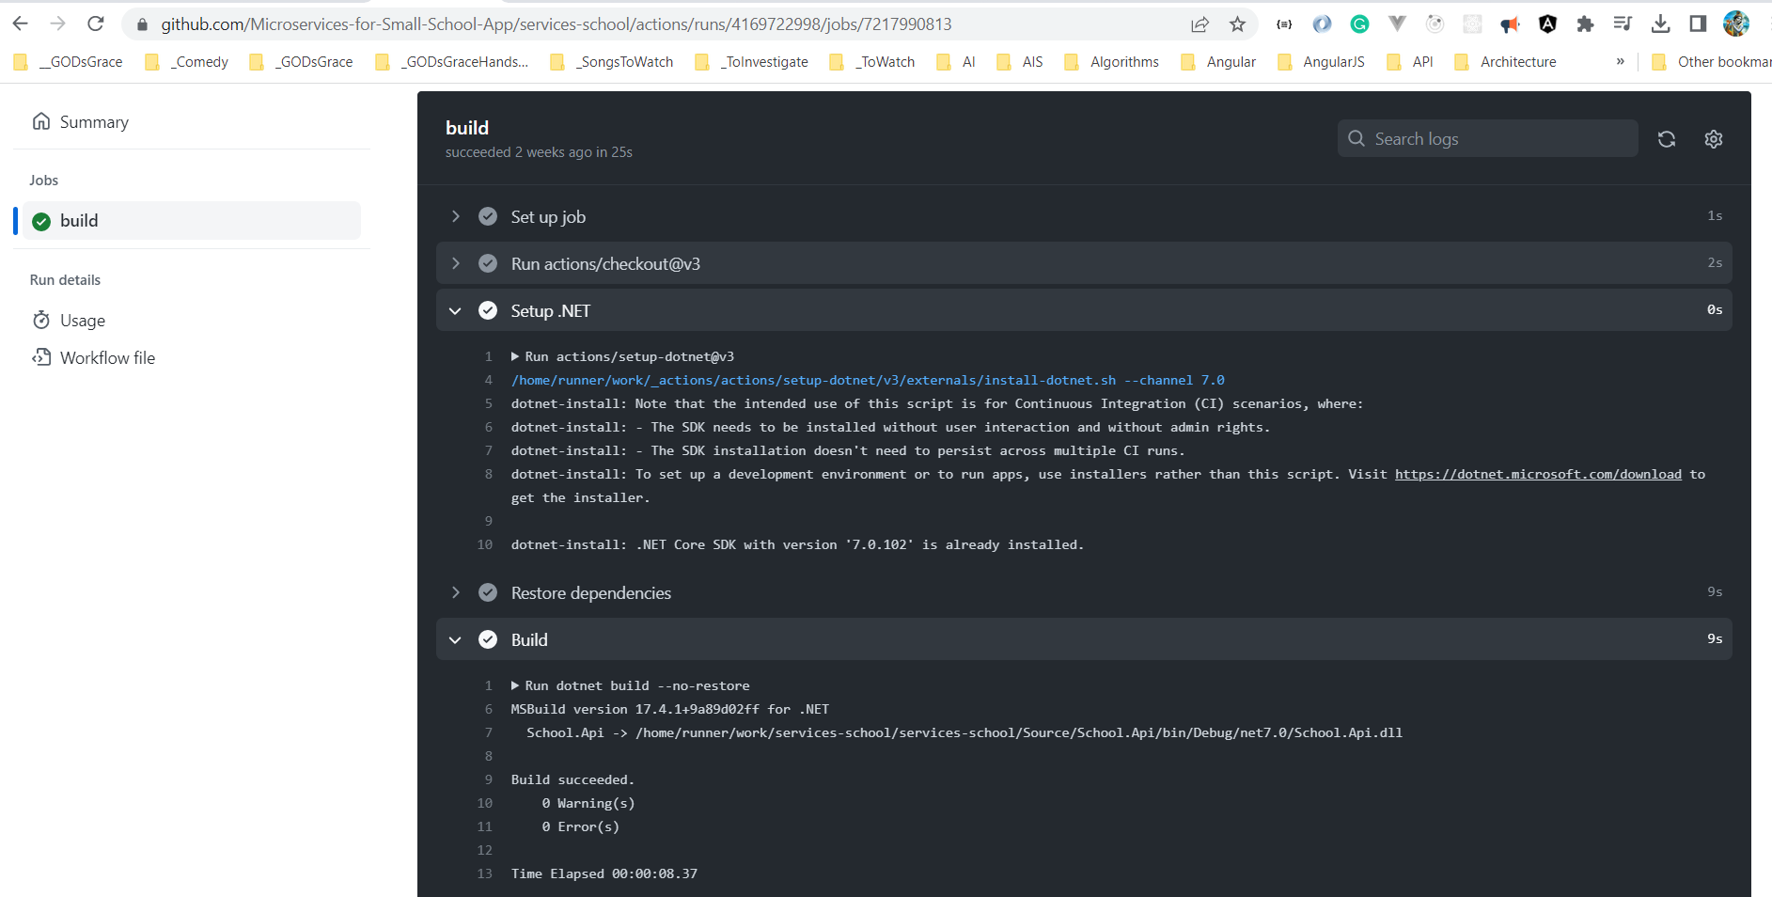

Slide 8
Dotnet Learners House
.NET 7 Minimal API DI, IOC, record, DTOs, Auto Mapper
Sunday, Feb 19, 2023
09:00 AM (IST)
.NET 7 Minimal API DI, IOC, record, DTOs, Auto Mapper
Viswanatha Swamy
Architect - AIS
Event URL: https://bit.ly/40udZl6

Slide 9
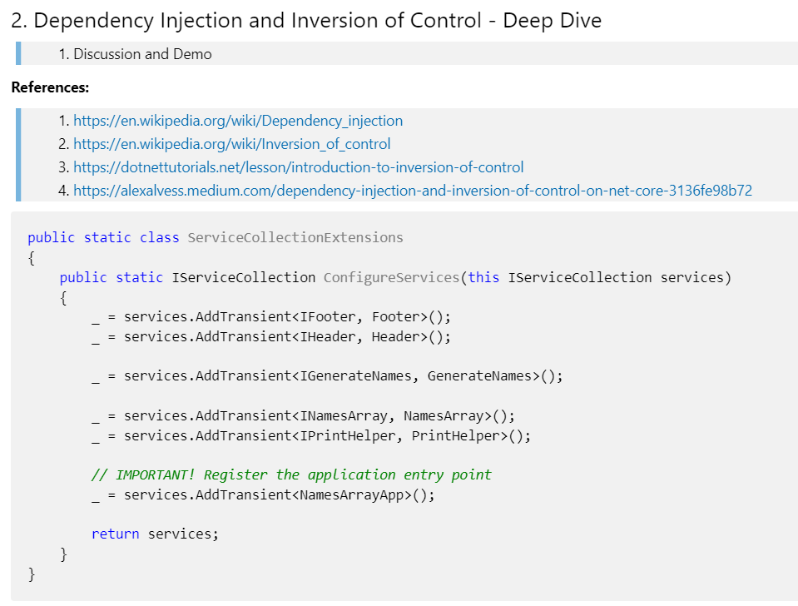

Slide 10
Dotnet Learners House
.NET 6 AWS Creating Docker Images, Deploying to ECS / Fargate
Sunday, Feb 12, 2023
09:00 AM (IST)
.NET 6 AWS Docker Images, Deploying to ECS Fargate
Viswanatha Swamy
Architect - AIS
Event URL: http://bit.ly/3K0gUMM

Slide 11
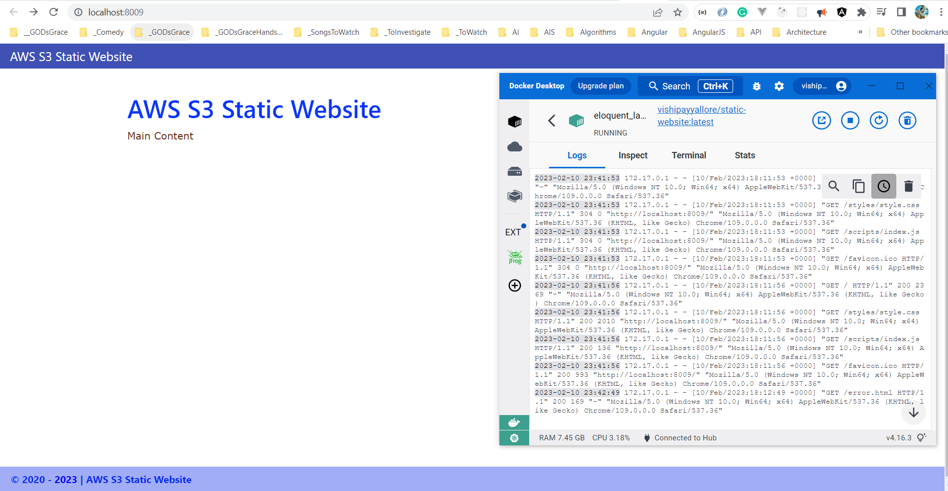

Slide 12
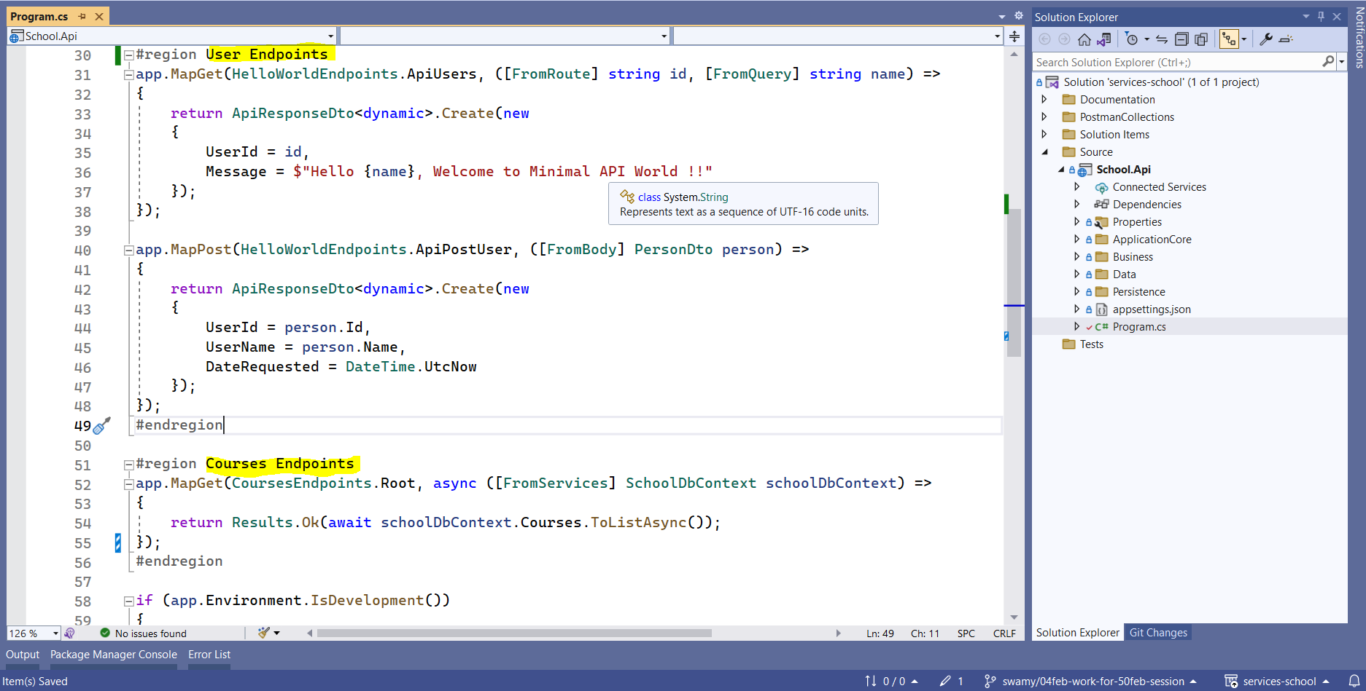

Slide 13
Dotnet Learners House
C# (.NET 6) on AWS - Getting Started With Fargate and ECS
Sunday, Jan 29, 2023
09:00 AM (IST)
C# .NET 6 AWS - Getting Started With Fargate and ECS
Viswanatha Swamy
Associate Architect - AIS
Event URL: http://bit.ly/3XJ7IQB

Slide 14
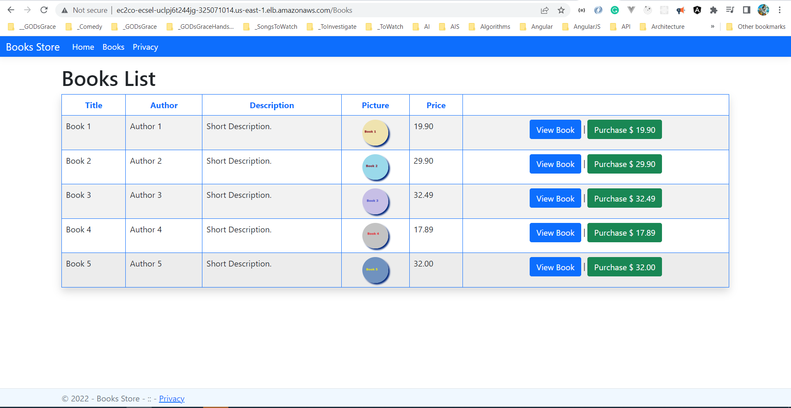

Slide 15
Dotnet Learners House
.NET 7 - Hands on Minimal API with ASP.NET Core, and Static data
Friday, Jan 20, 2023
06:30 AM (IST)
.NET 7 – Hands-on Minimal API with ASP.NET Core
Viswanatha Swamy
Associate Architect - AIS
Event URL: http://bit.ly/3VMeKlX

Slide 16
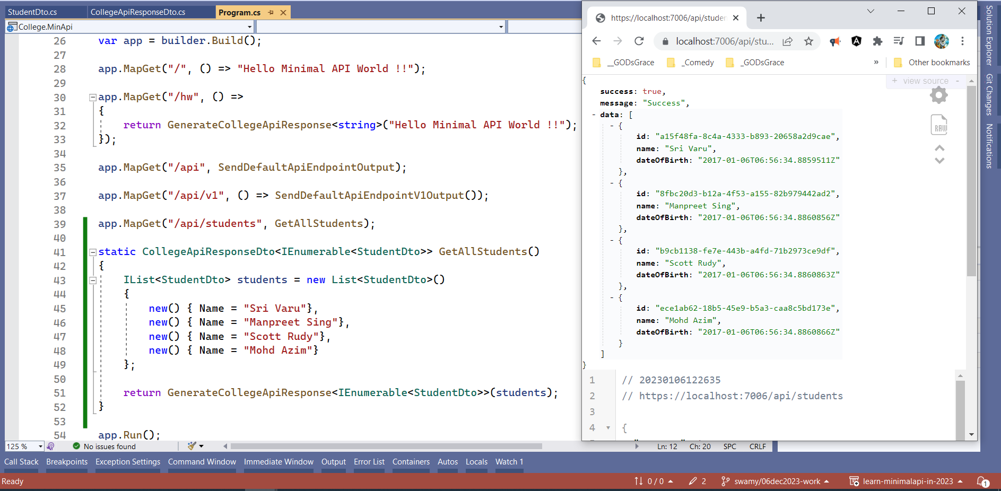

Slide 17
Dotnet Learners House
Lambda Integration S3, SQS, SNS using .NET 6 and C#
Sunday, Dec 25, 2022
10:00 AM (IST)
Lambda Integration S3, SQS, SNS in C# (.NET 6)
Viswanatha Swamy
Associate Architect - AIS
Event URL: https://bit.ly/3WnFNoS

Slide 18
Information
I am still a learner. Apologize if I do any mistake.
All the sessions will be hands on.
Will have parking lots for queries and other topics.
Some of the concepts we will introduced and revisited in next sessions.
There are multiple ways to do, we will use one of the ways.
The focus was more on concepts and demos are kept simple.
C# Corner

Slide 19
Information
I am still a learner. Apologize if I do any mistake.
All the sessions will be hands on.
Will have parking lots for queries and other topics.
Some of the concepts we will introduced and revisited in next sessions.
There are multiple ways to do, we will use one of the ways.
The focus was more on concepts and demos are kept simple.
Pune Tech Community

Slide 20
Front End
Middle Tier
Backend
Core
SQL
Blazor WASM
Angular
ReactJS
Vue.js
APP
API
/
gRPC
BLL
DAL
DMZ

Slide 21




Azure Key Vault
4
1
2
3
5
User
Blazor WASM
Web API
Azure SQL Server
August 2021 Version

Slide 22


Basket API
+
Data Store
API
Gateway
Discount API
+
Data Store
Orders API
+
Data Store
Identity API
+
Data Store

Slide 23
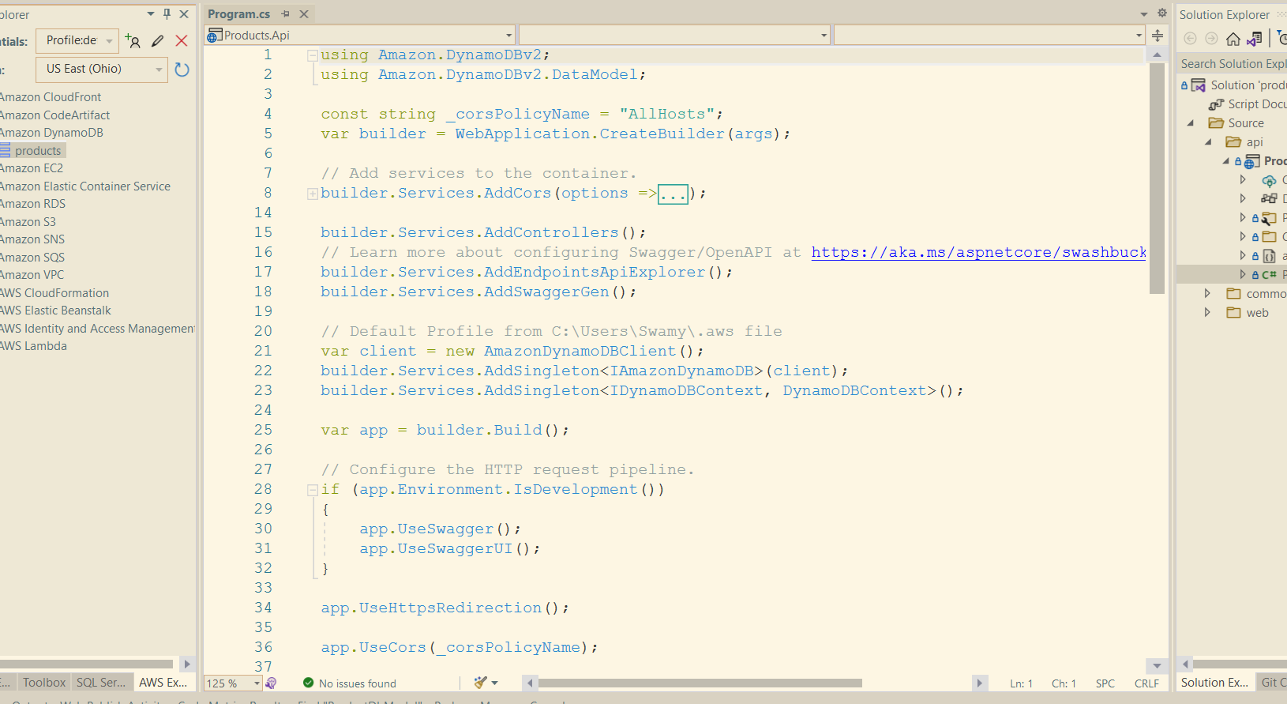
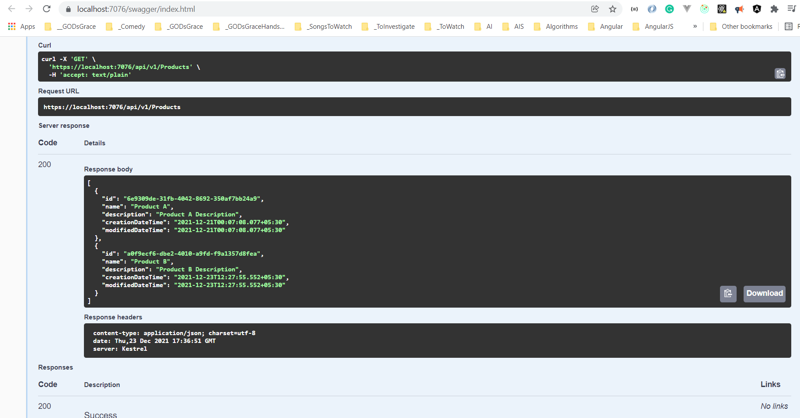
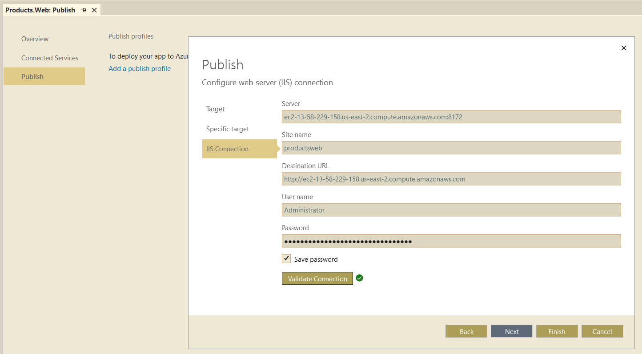
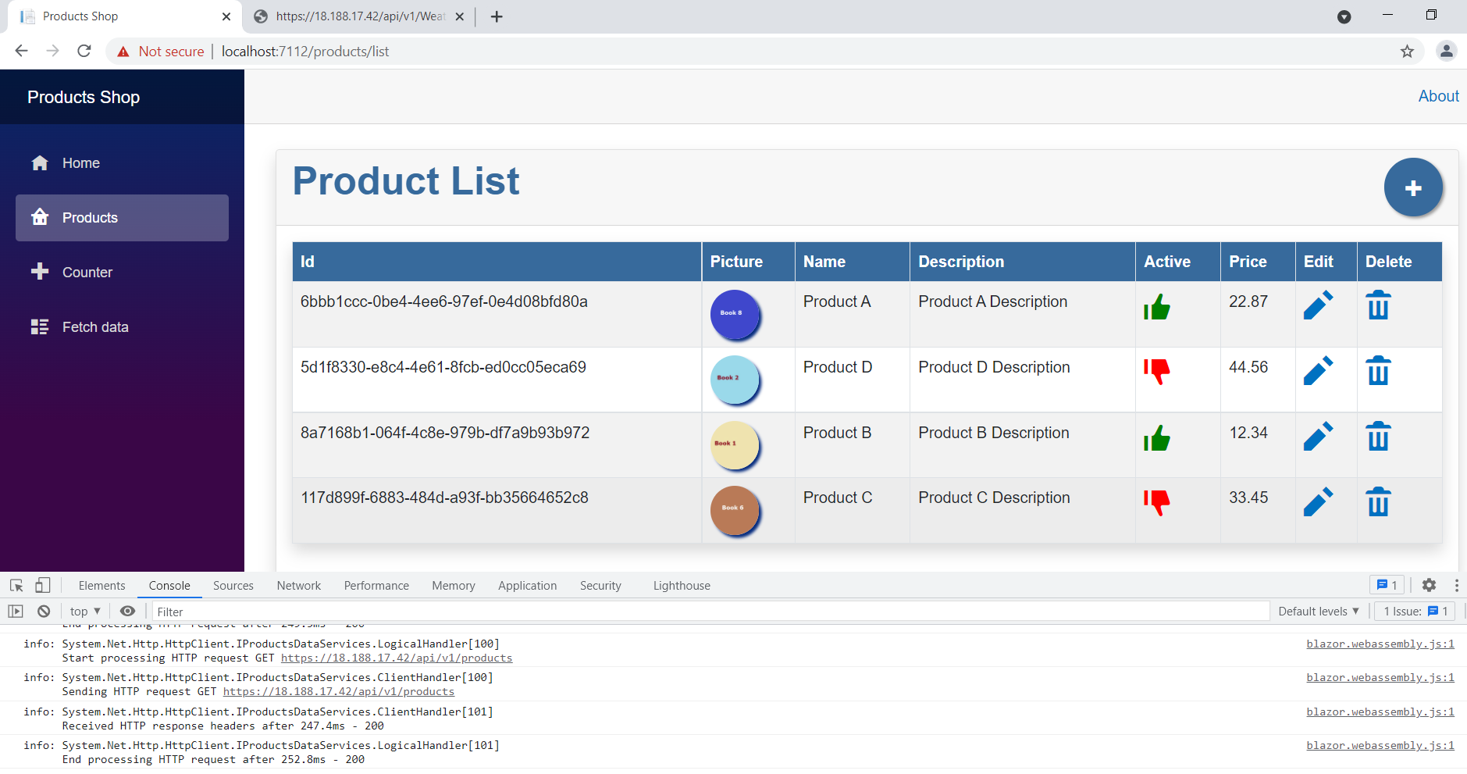

Slide 24
Information
I am still a learner. Apologize if I do any mistake.
All the sessions will be hands on.
Will have parking lots for queries and other topics.
Some of the concepts we will introduced and revisited in next sessions.
There are multiple ways to do, we will use one of the ways.
The focus was more on concepts and demos are kept simple.
Dot Net Learners House

Slide 25




Slide 26
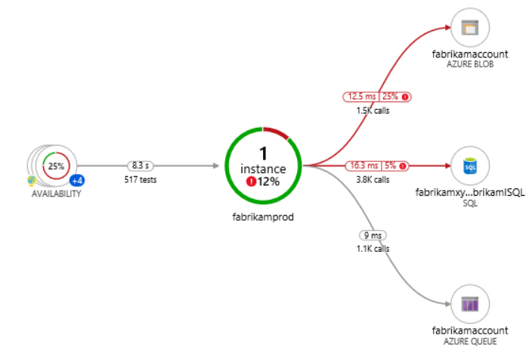





9
Azure Key Vault
6
Azure Redis Cache
8
Blazor WASM
1
2
JWT
4
5
API Mgmt
Web API
7
3
Azure SQL Server
Auth0
High Lights:
Blazor WASM UI get authenticated and pass the JWT to APIM.
APIM Validates the JWT and routes the request to Web API.
SQL Server, and Redis Cache’s credentials are stored in Azure Key Vault.
Web API investigates Azure Redis Cache before hitting SQL Azure. (Cache Aside Pattern)
We will preform Dacpac (.sqlproj) for deployment of SQL Data Store.

Slide 27
9
Azure Key Vault
6
Azure Redis Cache
8
Blazor WASM
1
2
JWT
4
5
API Mgmt
Web API
7
3
Azure SQL Server
Auth0
High Lights:
Blazor WASM UI get authenticated and pass the JWT to APIM.
APIM Validates the JWT and routes the request to Web API.
SQL Server, and Redis Cache’s credentials are stored in Azure Key Vault.
Web API investigates Azure Redis Cache before hitting SQL Azure. (Cache Aside Pattern)
We will preform Dacpac (.sqlproj) for deployment of SQL Data Store.

Slide 28
Information
All the sessions will be hands on.
Will have parking lots for queries and other topics.
Some of the concepts we will introduced and revisited in next sessions.
There are multiple ways to do, we will use one of the ways.
The focus was more on concepts and demos are kept simple.
I am still a learner. What!!! … wait … Yes, I am still a learner.
Microsoft Reactor Bengaluru

Slide 29
Information
I am still a learner. What!!! … Yes, I am still a learner. Apologize if I do any mistake.
All the sessions will be hands on.
Will have parking lots for queries and other topics.
Some of the concepts we will introduced and revisited in next sessions.
There are multiple ways to do, we will use one of the ways.
The focus was more on concepts and demos are kept simple.
Power Platform Classmates

Slide 30
Information
All the sessions will be hands on.
Will have parking lots for queries and other topics.
Some of the concepts we will introduced and revisited in next sessions.
There are multiple ways to do, we will use one of the ways.
The focus was more on concepts and demos are kept simple.
I am still a learner. What!!! … wait … Yes, I am still a learner.
Global Azure 2021 - India

Slide 31
Information
I am still a learner. Apologize if I do any mistake.
All the sessions will be hands on.
Will have parking lots for queries and other topics.
Some of the concepts we will introduced and revisited in next sessions.
There are multiple ways to do, we will use one of the ways.
The focus was more on concepts and demos are kept simple.
https://www.azconf.dev

Slide 32










This Photo by Unknown Author is licensed under CC BY-SA-NC
This Photo by Unknown Author is licensed under CC BY
This Photo by Unknown Author is licensed under CC BY
This Photo by Unknown Author is licensed under CC BY
This Photo by Unknown Author is licensed under CC BY-SA
This Photo by Unknown Author is licensed under CC BY-NC-ND

Slide 33
Information
All the sessions will be hands on.
Will have parking lots for queries and other topics.
Some of the concepts we will introduced and revisited in next sessions.
There are multiple ways to do, we will use one of the ways.
The focus was more on concepts and demos are kept simple.
I am still a learner. What!!! … wait … Yes, I am still a learner.
AIS

Slide 34
Information
All the sessions will be hands on.
Will have parking lots for queries and other topics.
Some of the concepts we will introduced and revisited in next sessions.
There are multiple ways to do, we will use one of the ways.
The focus was more on concepts and demos are kept simple.
I am still a learner. What!!! … wait … Yes, I am still a learner.
mobconf

Slide 35
Information
All the sessions will be hands on.
Will have parking lots for queries and other topics.
Some of the concepts we will introduced and revisited in next sessions.
There are multiple ways to do, we will use one of the way.
The focus was more on concepts and demos are kept simple.
I am still a learner. What!!! … wait … Yes, I am still a learner.
BDotNet

Slide 36
Information
All the sessions will be hands on.
Will have parking lots for queries and other topics.
Some of the concepts we will introduced and revisited in next sessions.
There are multiple ways to do, we will use one of the way.
The focus was more on concepts and demos are kept simple.
I am still a learner. What!!! … wait … Yes, I am still a learner.
Hyderabad Power Apps and Power Automate UG

Slide 37
Information
All the sessions will be hands on.
Will have parking lots for queries and other topics.
Some of the concepts we will introduced and revisited in next sessions.
There are multiple ways to do, we will use one of the way.
The focus was more on concepts and demos are kept simple.
I am still a learner. What!!! … wait … Yes, I am still a learner.
The Tech Platform

Slide 38
Information
All the sessions will be hands on.
Will have parking lots for queries and other topics.
Some of the concepts we will introduced and revisited in next sessions.
There are multiple ways to do, we will use one of the way.
The focus was more on concepts and demos are kept simple.
I am still a learner. What!!! … wait … Yes, I am still a learner.
Angular Hyderabad

Slide 39
Please fasten
your
seat belt !!!
Dot Net Learners House

Slide 40
Q & A
Dot Net Learners House

Slide 41
Thank You
Viswanatha Swamy
LinkedIn: https://www.linkedin.com/in/viswanatha-swamy-b57326128/
Twitter: https://twitter.com/vishipayyallore
Dot Net Learners House

