Slide 1


Behavioral
(Ownership)
Prem

Slide 2

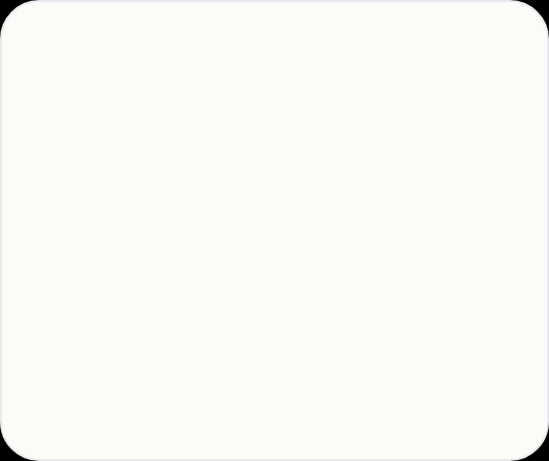




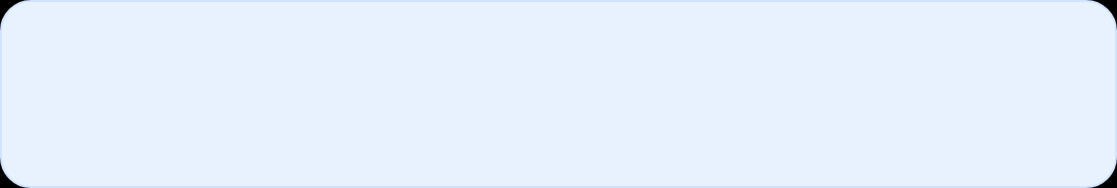
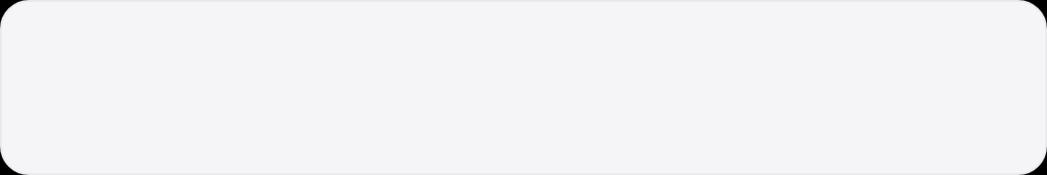


01 // HOW THIS ROUND IS SCORED
4–5 questions in 30 min. Each story ≤5 min, aim 3:00–4:30. Going over costs volume. Rehearse aloud with timer.
Ownership — What Meta Scores
VISIBLE KEY — OWNERSHIP
TIMING RULE
RESULT FORMAT
PRACTICE
I, not we
STAR 30·30·120·30s
%, $, hrs, ms
Timer Drill
Lead with your actions. Name what you designed, wrote, drove. Trade-off = yours.
End measurable. Then what you'd change — growth signal.
Silent prep hides mumbles. Record, listen for “we” vs “I”.
Situation ≤30s, Task ≤30s, Action ≤2m, Result ≤30s. No filler.
Before → After
Day before: 4 back-to-back
I designed · I drove · I wrote
3:30 target
≠
No heroes vs villains
!
Follow-ups are scored
Frame as trade-offs, not personalities. Learning > blame. “I would've raised earlier” lands.
“What if manager said no?” — have partner drill. Ownership lives in follow-ups, not opener.

Slide 3
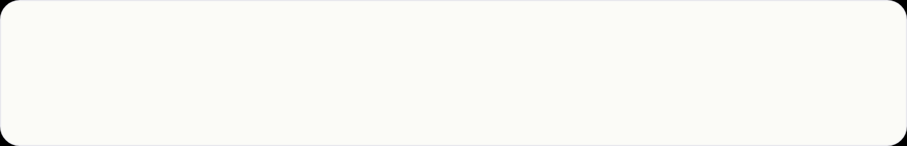

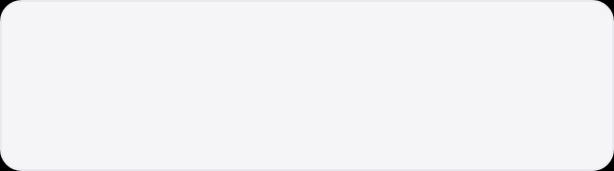

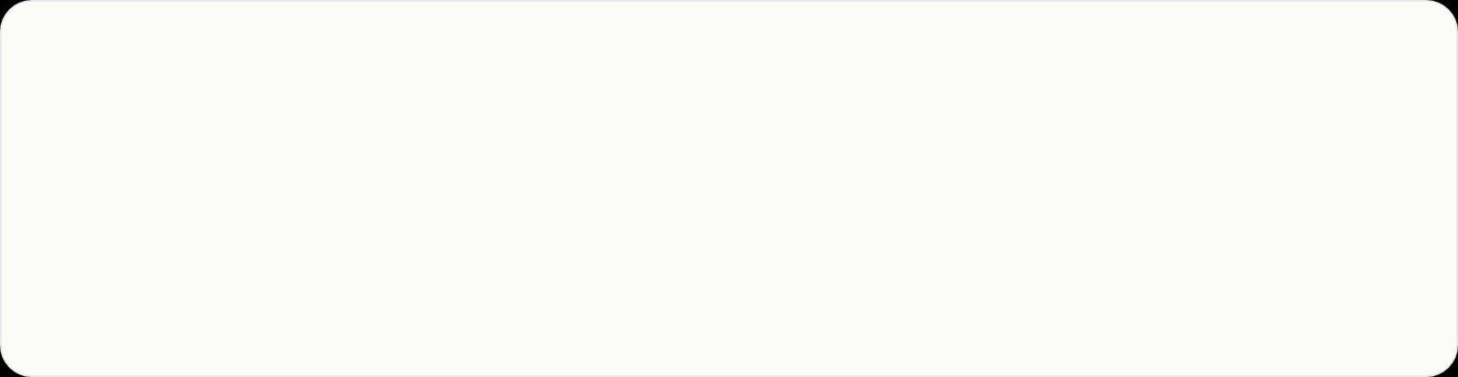

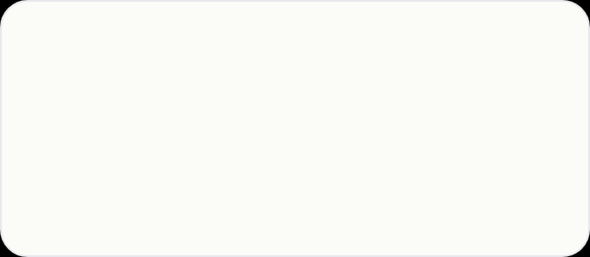





STORY 1 — OWNERSHIP · END-TO-END
Led Project End-to-End
S
SITUATION ≤30S
Analytics dashboards 12% gap vs OLTP, finance losing trust. 3 product teams depend on table. Lead DE on recon project, 4-month span.
Prompt: Tell me about a time you led a project end-to-end.
Use when: ownership, delivery, proudest project. Real: data-quality reconciliation.
T
TASK ≤30S
Owned daily recon job end-to-end — schema, diff logic, alert routing, rollout. Done = gap <0.5% + finance sign-off.
MEASURABLE OUTCOME
0.3%
12%
→
A
ACTION ≤2M — I, NOT WE
Finance trust restored. Retired old report 60 days later. Row-hash job <10 min on 2B rows.
I designed row-hash vs full diff (2B rows <10 min). I wrote alert only >0.5%, not transient blips. I drove rollout: shadow 2 weeks, weekly finance report, single approval gate before decommission old report.
Job runtime (2B rows)
<10 min
Alert threshold
0.5% only
Shadow mode
2 weeks
Stakeholders
3 teams + Finance
R
RESULT ≤30S + CHANGE
Scoped + Owned
Cross-functional
Gap 12% → 0.3%, finance regained trust, retired old report 60 days later. What I'd change: push back on 2-week shadow — would've caught bug a sprint earlier.
Row-hash trade-off
Reflective

Slide 4
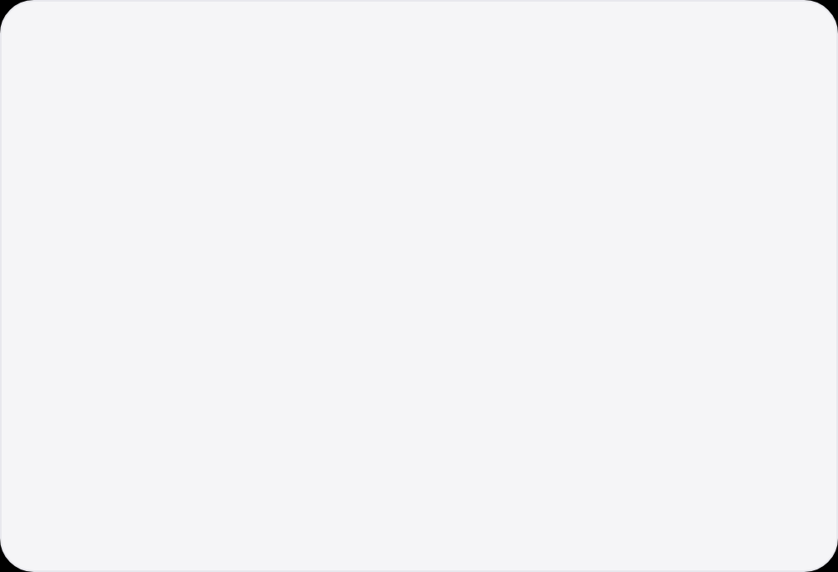
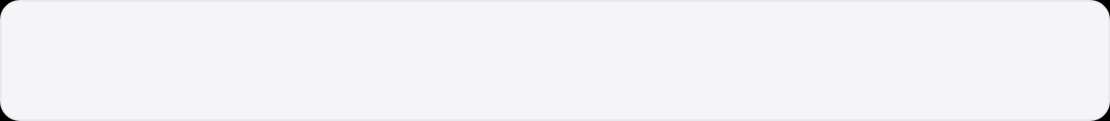
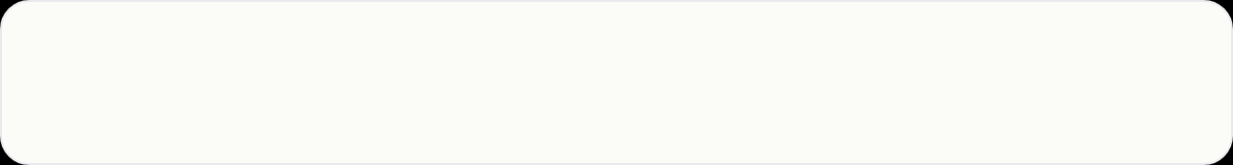

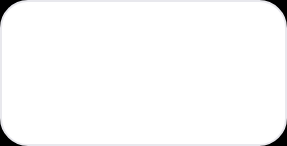
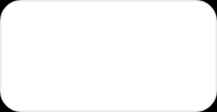




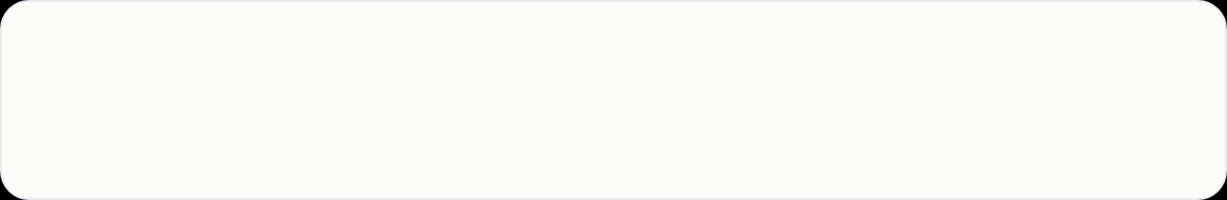

STORY 2 — DISAGREED & RESOLVED · FRICTION
Disagreed on
Big-Bang Cutover
1-PAGER I BROUGHT — HOMEWORK, NOT OPINION
Blast radius counted
150 / 40 / 30
Prompt: Tell me about a time you disagreed with your manager.
Use when: conflict, pushback, influence without authority. Real: Redshift → Snowflake, ~150 tables, hard contract deadline.
12 highest-risk tables
Rows + models + users
Window: big-bang vs phased
8h vs 3h
S
SITUATION ≤30S
Hard cap proposed
6 weeks, no extensions
Manager wanted single big-bang before quarter end. ~150 tables, 40 dbt models, 30 dashboards all dark if 1 breaks. No quick rollback.
5 wks
3
0
FULL MIGRATION
WAVES
DOWNTIME
T
TASK ≤30S
I owned cutover — validation, dbt port, dashboard rewiring. If big-bang fails, I'm on rollback at 2am.
What This Proves — Visible Keys
A
ACTION ≤2M — 1-PAGER + MIDDLE PATH
Didn't say “no.” I profiled 12 highest-risk tables + 8-hour freeze cost vs 3-hr windows. Built strangler-fig plan: dual-write both warehouses, dual-materialized dbt, dashboards team-by-team, lowest-stakes first. Booked 30-min with manager + skip, acknowledged deadline, proposed 6-week hard cap + per-wave rollback (config flip).
• Disagreed with evidence + concrete alternative
• Respected hard constraint, proposed cap
• Per-wave rollback = config change, not fire drill
• Framing: “We can do this with less risk and still hit date”
Reflection line: “Same pushback a week earlier saves a week of rushed work. I was nervous to push — burned a week.”
R
RESULT ≤30S + CHANGE
5 weeks, 3 waves, zero downtime. First 2 waves surfaced 6 issues that would've been catastrophic under big-bang. Hit contract +1 week spare. Change: raise day proposal landed, not week before kickoff.

Slide 5
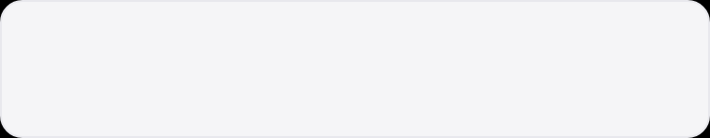

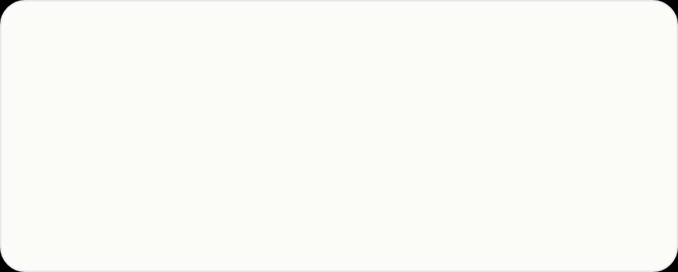


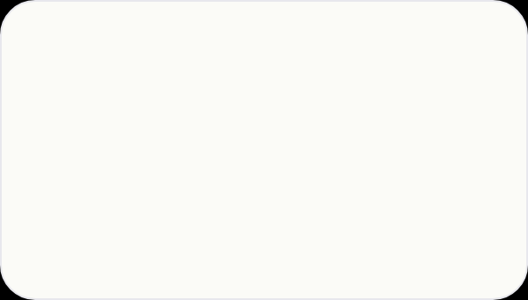
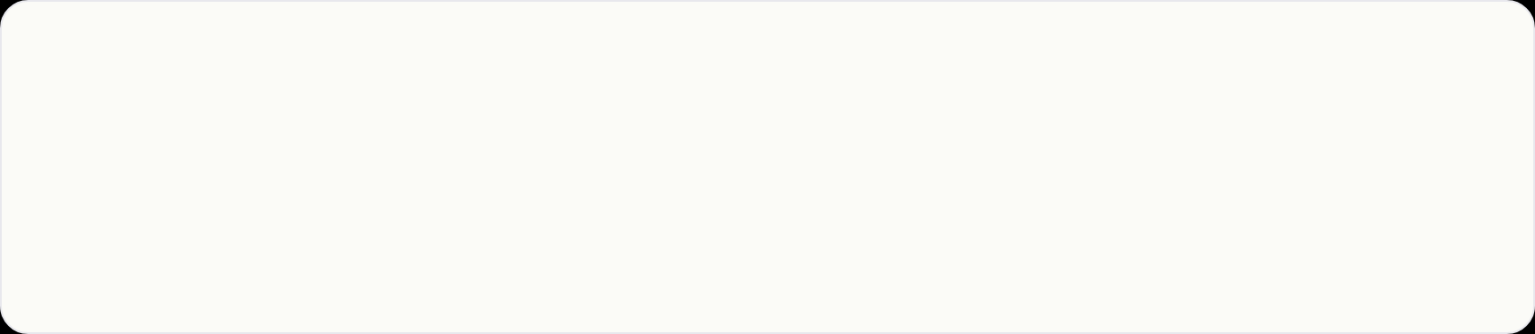

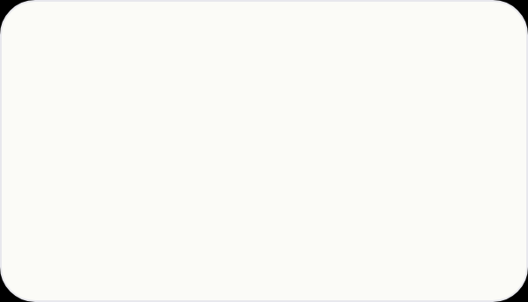


STORY 3 — PROCESS WIN · FRAMEWORK
Prompt: Tell me about a process you improved.
Use when: how you make team better, platform work adopted. Real: 30 one-off pipelines → config-driven framework.
Built Reusable Ingestion Framework
S
SITUATION ≤30S
T
TASK ≤30S
TIME TO NEW SOURCE
30 one-off pipelines, 2 weeks each. Custom Airflow DAG, schema logic, tests. Half no tests, ⅓ silently dropped rows on drift. On-call hours/week chasing.
Only eng on framework. Users = downstream teams. Own single abstraction teams can point at source & ship in days.
2 wk → 2 d
90% reduction. YAML config only: source, schedule, contract, target.
A
ACTION ≤2M — DIAGNOSIS → FIX → ROLLOUT
ON-CALL & QUALITY
Catalogued 3 patterns (REST API, relational DB, SFTP = ~90%). Built config-driven: YAML → idempotent S3 Parquet, schema-drift detection, Great Expectations, dbt scaffolding, retries/backoff, PagerDuty+Slack. Built on Airflow+dbt, no new learning. I dogfooded orders + customers feeds myself before asking anyone. Wrote 1-page README + worked example + 30-min lunch-and-learn with numbers.
70% ↓ pages
3 schema drifts caught auto. Previously silent loss.
ADOPTION IN 3 MONTHS
R
RESULT + WHAT I'D CHANGE ≤30S
8 / 30 migrated
2 weeks → 2 days, 8 pipelines in 3 months, on-call ↓70%, 3 drifts auto-caught. What I'd change: instrument row-count + freshness day 1 — added month 2, had 2 quiet stale-data incidents gap broke dashboards.
3 teams adopted in first month, pull not push. Dogfooded 2 highest-traffic.

Slide 6
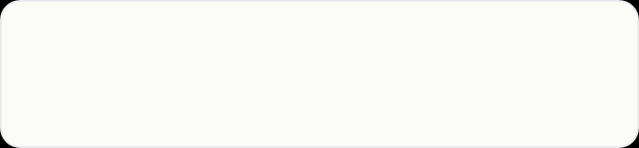
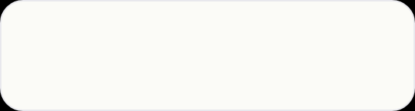




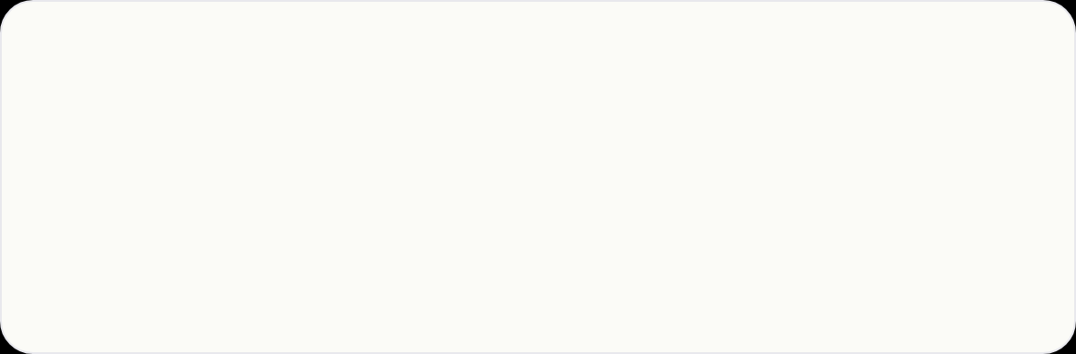
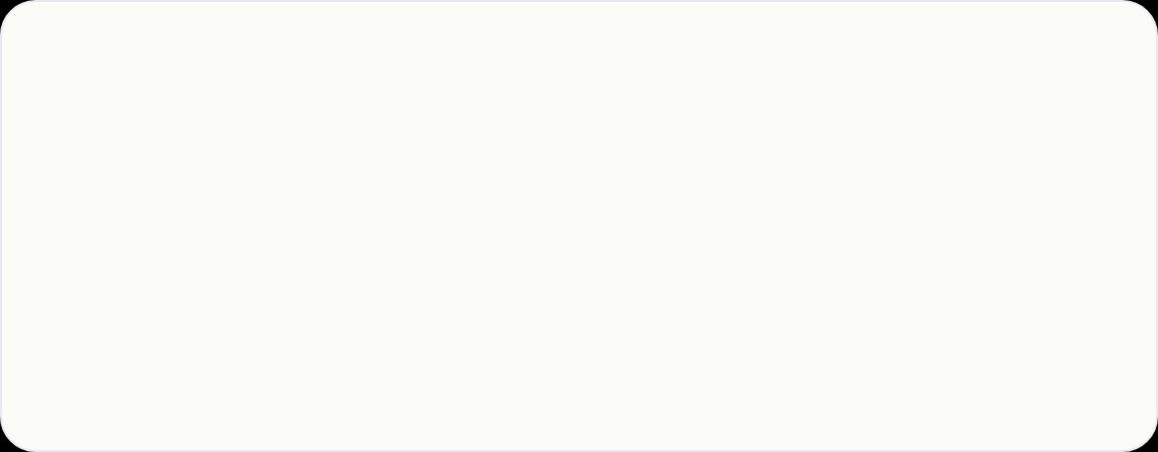

STORY 4 — LEARNING AGILITY · RAMP-UP SPEED
Prompt: Learn new tool quickly & deliver
Tool: dbt + Snowflake from scratch, 6 weeks, revenue dataset for quarter sign-off
Scope discipline: 4 models, not 10. Tests day 1.
Learned New System & Delivered
Docs + rebuild
Daily office hrs · 2 wks
Scoping 4 not 10
On-time + Template
3d
Rebuilt existing pipeline as learning exercise
1h
With analytics eng for first 2 weeks
4→
Models + tests day 1, paired finance every 2d
✓
Finance sign-off, became template for next 2
S — SITUATION ≤30S
T — TASK ≤30S
Team adopted dbt + Snowflake 6 weeks before finance close. Never used either. Deliverable was reconciled revenue dataset quarter sign-off.
I owned dbt models + Snowflake ingestion — whole pipeline, hard deadline. Done = finance signs.
A — ACTION ≤2M — RAMP + SCOPE
R — RESULT + CHANGE ≤30S
I spent 3 days reading docs, rebuilt one existing pipeline. I booked daily office hrs 2 weeks with analytics eng. I scoped aggressively: 4 models not 10, tests every model day 1 because didn't trust own output. I paired 1h /2d with finance to validate definitions, not vacuum.
Delivered on time, finance sign-off, became template for next 2 pipelines. What I'd change: 30-min kickoff doc upfront — spent day re-litigating definitions that quick convo would've resolved.

Slide 7


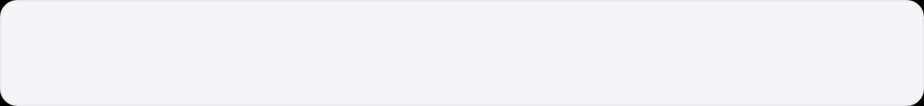

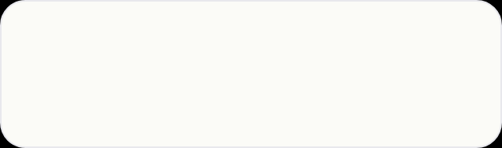
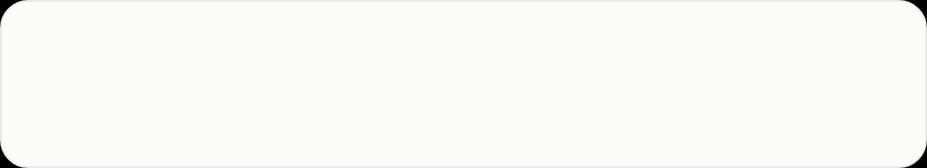

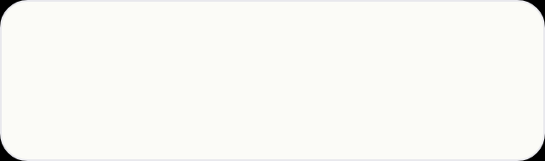
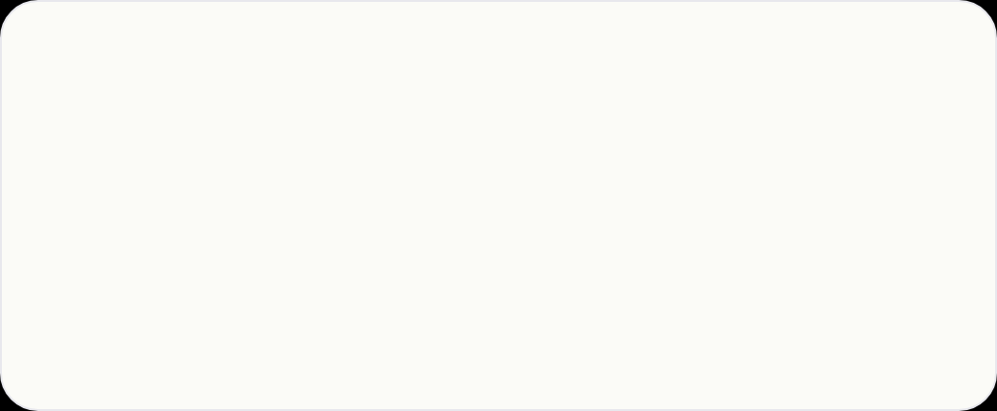


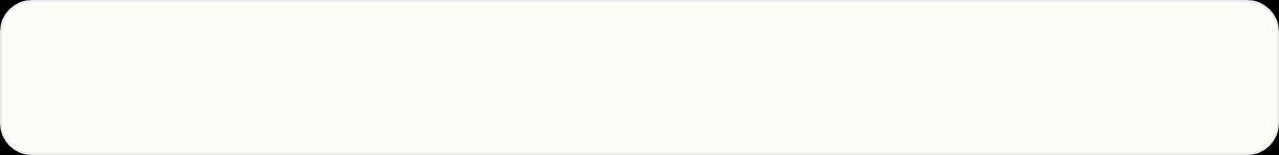



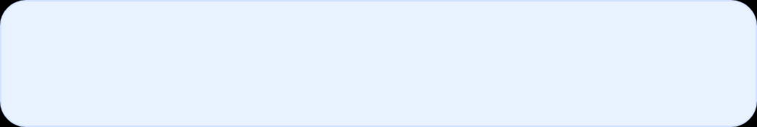
STORY 5 — LEARNING AGILITY · GO REWRITE
ACTION — ≤2M — 20% OF GO THAT SHIPS
Learned Go + Rebuilt Databricks Integration
A
Week1: Tour of Go + Databricks REST docs. Picked 4 endpoints only (run-now, get, list, cancel), built CLI with curl first. Week2: slice submit→poll→return using net/http, context.Context everywhere for cancel, thin client with retries + backoff + shared http.Client. 2×1h pairing with senior Go eng saved week. Scope: no auth refactor, no multi-cloud — drop-in + /healthz. Week3: JSON logs + Prometheus metrics. Week4: shadow-mode behind Python, then cutover.
Prompt: Learn new tool quickly & deliver
Use when: polyglot, backend service, cost reduction. Real: Python tangled scripts → Go service, 4-week hard deadline.
MEMORY
COST
R
RESULT — ≤30S + CHANGE
1/10th
–40%
Shipped on time, 1/10th mem, –40% cost, p95 3s→300ms, 3 teams adopted in month. Change: shadow-mode week2 not week4 — burned weekend on polling bug caught day3 in integration.
vs Python service — static binary
job-run cost via conn reuse + cancel zombies
LATENCY P95
ADOPTION
HOW I LEARNED GO FAST — VISIBLE KEYS
3s → 300ms
3 teams / 1mo
1
20% that ships: structs, interfaces, goroutines, channels, context, net/http. CLI before service.
Shared http.Client, no TLS handshake per poll
Default API to trigger Databricks
2
Stdlib first: no heavy framework = fewer surprises. Context cancel kills zombie jobs.
S
SITUATION — ≤30S
3
Senior leverage: 2×1h reviews on concurrency + error handling.
Python service triggering Databricks jobs: slow, expensive, tangle of scripts, no owner. Never written Go before — Python+Java only.
4
Instrument day 1: metrics show where money goes. Shadow early catches what unit tests don't.
T
TASK — ≤30S
Volunteered: rewrite in Go — tiny service, clean REST API, thin SDK wrapper. Production-ready 4wks, zero-downtime replace, cut cost.
WHY GO FOR THIS?
Single static binary, great stdlib for HTTP, low mem, fast startup — perfect control-plane service orchestrating Databricks. Buy-in via shadow-mode numbers, not rewrite pitch.

Slide 8
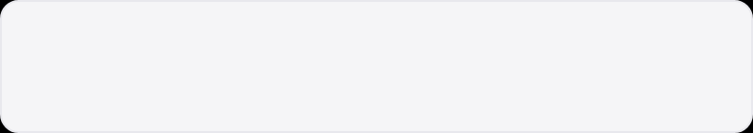
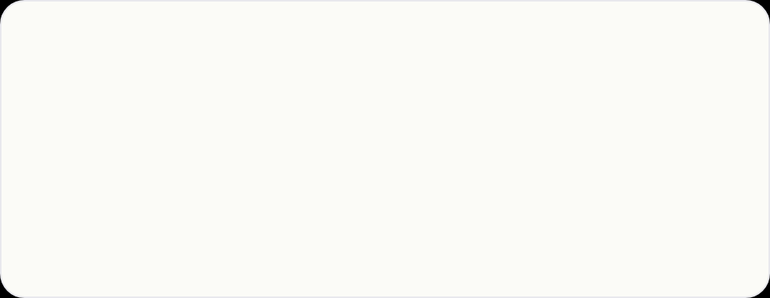



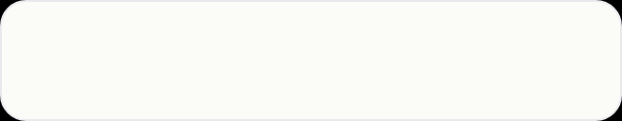

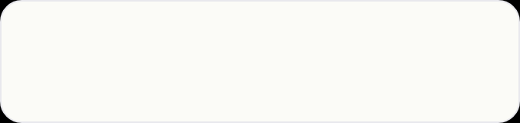

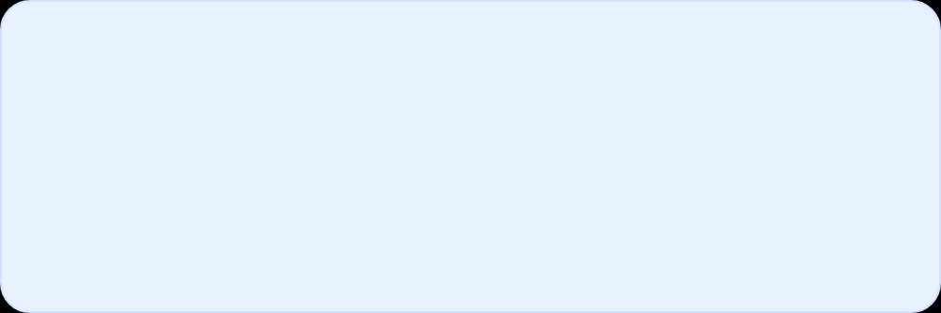
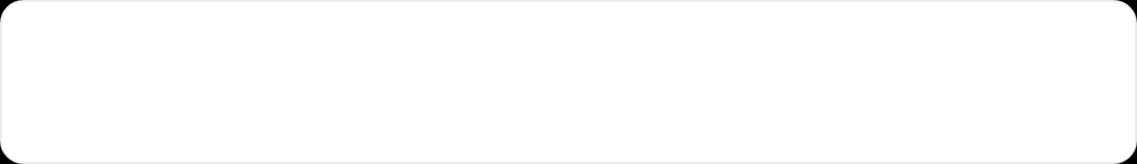


ALTERNATE STORIES — WHEN YOU NEED SCALE
Use when platform-lead / 10+ engineers. Same STAR but scale proof. Small-scope = Story 1 recon (12%→0.3%). Large-scope = this variant.
Unified Platform at Lazada · 5 → 1
STORY 6 — LED END-TO-END AT SCALE
Campaign freshness
24h → 60s
STORY 7 & 8 — SAME FRAMEWORK, ALTERNATE SAMPLES
Real-time + Campaign Data
Last-mile breach
6h → <2m
Story 7 = Disagreement (hard deadline)
Schema registry
Producer contracts
Streaming-first
Key: “Which deadline matters — contract or cutover?” Phased still hits contract team-by-team. Rollback = config flip.
Attribution
1w → 1h query
Story 8 = Process (framework scratch)
5 stacks
→ 1 in 4 mo
Key: “I didn't pitch framework — migrated 2 real, showed numbers, teams came to me. Pull, not push.”
S — SCATTERED
T — TECH LEAD
When to use which
5 stacks (orders, inventory, campaigns, last-mile, marketing). Campaign 24h delay, last-mile 6h+, join = 1 week ad-hoc.
Owned arch, governance, migration across 5, rollout 10+ eng. Done = one ingestion, contracts write-time, single API.
Small ownership → Story 1 (12%→0.3%). Platform-lead → this Lazada variant. Same STAR timing.
A — ENFORCEMENT TRADE-OFF
R + CHANGE
PROBING — IF ASKED DEEPER
Central registry + reject at write-time with 1-week grace. RFC + 3 incidents cost. Streaming Kafka for real-time, batch for finance. Sat week each with hardest teams.
60s campaign, <2m SLA, 5→1, 10+ migrated. Change: shadow registry month earlier — 2 producers built during design retrofit.
Why contracts not registry?
Registry = docs. Contract = enforcement. Drift back in sprint without it. Grace made it land.
Handle pushback?
RFC with 3 incidents + week-per-analysis cost + shadow pilot on my pipeline first. Data > opinion.
PHASED — 3 PHASES 4 MONTHS
Streaming vs batch?
Phase 1
Registry + contracts shadow — observability only.
By consumer: sub-min → streaming, nightly → batch. Not one size.
Phase 2
Last-mile + campaign live, dual-writes for rollback.
Phase 3
Orders, inventory, marketing, deprecate 5 legacy.

Slide 9
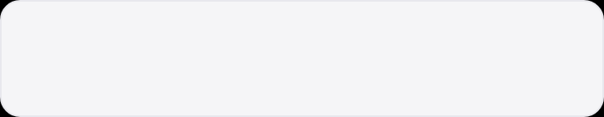



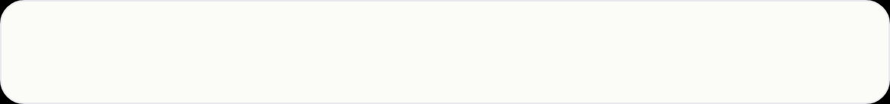




08 // UNIVERSAL RULES
Universal Rules
For Every Story
Apple rule: simple, visible, no clutter — same as your slides. Measurable + reflective + I not we. Every story ends with what you'd change.
I
WHAT TO DO
!
WHAT TO AVOID
I
Lead with I, follow with specifics
⚖
No heroes vs villains — trade-offs
“I designed schema” not “we worked on it.” Name trade-off, name scope, name decision.
Frame conflict as engineering trade-off, not personalities. Learning > blame.
⏱
≤5 min, target 3:00–4:30
◑
Silent prep fails — rehearse aloud
4–5 questions in 30 min. Overrun costs volume. Time it aloud, record on phone.
Record, listen for we vs I and filler. Mumbles hide in silent prep, not timed aloud.
%
Measurable outcome: %, $, hrs, latency
?
Practice drill-down: “What if manager said no?”
12%→0.3%, 2wk→2d, 70%↓ pages, p95 3s→300ms. If can't quantify, say how you'd measure now.
Follow-ups are where ownership is scored. Have partner ask hard follow-up per story.
◰
Own narrative: S=business, T=your DoD
↻
End with what you'd change — growth signal
S=business + stakeholders, T=your definition of done, A=milestones+trade-off+comms, R=measurable+reflective.
Rehearse closing line until natural, not rehearsed. Reflection = ownership.
Interview formula: Situation = business problem + why mattered. Task = your scope + done. Action = I milestones. Result = numbers + change.
Visible keys = what interviewer scores, not slides you show

Slide 10





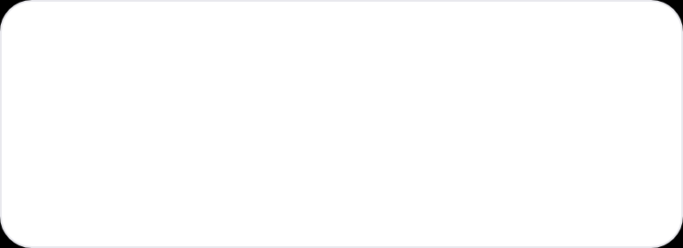
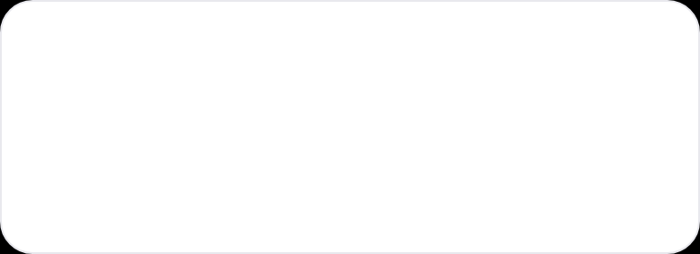





09 // PRACTICE PROTOCOL — SHIP IT
Own The Narrative. Ship It.
Story 1: Led End-to-End (12%→0.3%)
Story 2: Disagreed Phased (5w 0 downtime)
Story 3: Framework (2wk→2d)
Story 4: Learned dbt+Snowflake
Story 5: Learned Go (1/10th mem, –40% cost)
01
02
03
Tailor to your real history
Time aloud: 3:00–4:30
Listen for we vs I
Replace samples with your GitHub. Real schema, real DAGs, real numbers. No fabrication — they probe.
Not 5:00. Record on phone. Overrun costs you question volume. Aim 3:30 sweet spot.
Count “we did” without your part. Rewrite to “I designed / I drove / I wrote / I profiled 12 tables”.
04
05
06
Drill 1 follow-up per story
Rehearse closing line
Day before: 4 stories back-to-back
“What if manager said no?” “Why framework not template?” Follow-ups = where ownership is scored.
“One thing I'd change…” until natural, not rehearsed. Growth signal. Natural > perfect.
Under 20 min total. No notes. Final rep. Then stop — over-rehearsal kills presence.
✓
Apple rule: simple, visible, no clutter — same as your slides. S = business + stakeholders, not tech first.
5-MINUTE CAP MATTERS. GOING OVER
COSTS YOU QUESTION VOLUME.

