Slide 1








RETAIL GOVERNED ANALYTICS • PLAIN TEXT TO SQL
Text-to-SQL for Retail Governed Analytics Assistant
Frontend → API Gateway → Backend Orchestrator → LLM Gateway → Validator → Semantic Views → Warehouse → Explanation. Business user asks in plain text, no SQL knowledge needed, safe enterprise design.
Sales
Margin
Store
Inventory
Read-only
Audited

Slide 2




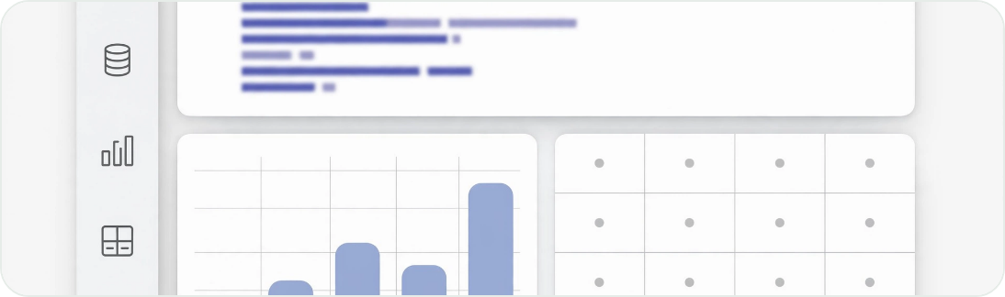
User experience - plain text to answer
BUSINESS USER ENTERS
Analytic Assistant
• Fresh 08:00 ICT
“Show total sales and margin by store in Bangkok last week”
Store A — Siam
฿5.2M · 13.1%
APPLICATION RETURNS
Store B — Sukhumvit
฿4.8M · 12.4%
฿125.4M
12.8%
Store C — Bangkapi
฿4.1M · 11.9%
Bangkok sales last week
Gross margin
Chart • Table • SQL • Assumptions • Confidence 0.91
↗
Top stores: Store A • Store B • Store C • No direct DB access, no SQL knowledge needed
Answer + Evidence + Freshness + SQL if authorized — chart, table, SQL used, dataset used, freshness, download, follow-up box
Key principle: user never writes SQL. LLM proposes, deterministic services validate. Trust comes from showing evidence, not just fluent answer.

Slide 3




Easy memory - the golden path
User → API Gateway → Backend → Semantic Context → LLM Gateway → LLM proposes SQL → Validator approves SQL → Database executes SQL → LLM explains result → User sees evidence
KEY DISTINCTION
LLM reasons and proposes. Deterministic backend services authorize, validate, execute. This separation makes Text-to-SQL safe for enterprise data. Frontend is untrusted. LLM never has DB credentials.
TRUST BOUNDARY
Every step versioned: model_version + dataset_version + policy_version + trace_id + user_scope
Response = Answer + Chart/Table + SQL + Freshness + Dataset + Assumptions + Confidence

Slide 4




Frontend - React / Next.js + TypeScript
WHAT IT DOES - LIMITED AND TRUSTED BOUNDARY
WHAT IT DOES NOT DO - BACKEND PERSPECTIVE UNTRUSTED
Authenticate via corporate SSO (Entra ID), attach access token and conversation_id
Never store DB credentials, warehouse tokens
Never hold LLM API keys or system prompt
Capture question – plain text, response_mode: chart_and_table
Never execute SQL or decide authorization
Stream progress via SSE or WebSocket, render table/chart, SQL if authorized
Never calculate business logic or cost
Show evidence: freshness, dataset, assumptions, confidence, download, feedback
Never bypass API Gateway – all via validated tokens
POST /v1/chat/query
{ "question": "Show sales by store in Bangkok last week", "conversation_id": "conv-789", "response_mode": "chart_and_table" }
Frontend is untrusted. Safety relies on backend validation, not UI controls. If UI can be spoofed, backend still enforces SELECT-only + row-level.
Stack: Next.js, TypeScript, Charting, SSO

Slide 5











FIRST BACKEND ENTRY • PROTECTS YOUR APP APIS
API Gateway - protects your application APIs
FRONTEND → GATEWAY → BACKEND
EXAMPLE ENDPOINTS
Web / Teams
API GW
Orchestrator
POST /v1/chat/query
→ async
Frontend is untrusted. Gateway is policy enforcement point before any business logic. No SQL, no LLM key ever passes here.
GET /v1/query/{id}/status
SSE / WS
GET /v1/query/{id}/result
table+chart
HANDLES
POST /v1/feedback
thumbs up/down
Auth validation, TLS termination, CORS, WAF
Rate limiting, request-size limits, timeout controls
Versioning, routing, trace_id / request_id injection
IMPLEMENTATION OPTIONS
Basic audit logging — who asked what, when
Azure APIM
AWS API GW
Kong
Apigee
NGINX
Tencent GW
Choose managed. Don't build auth/rate-limit yourself. Gateway never sees DB credentials or LLM prompts — only token + question reference.

Slide 6













Application backend - FastAPI orchestrator, the brain
Use FastAPI for AI orchestration, keep security deterministic. Never ask LLM to do everything in one prompt — use controlled state machine.
STACK CHOICE
Orchestrator does 12 steps — deterministic
TRACE_ID • AUDIT
Python FastAPI
Spring Boot alt
Pydantic validation
Validate user & request
Load permissions
1
SSO token, schema of question
2
Roles, row/col level, region
LangGraph optional
Security deterministic — parser, allowlist, Unity Catalog, not LLM
3
Classify intent
4
Retrieve semantic metadata
SQL vs RAG vs API vs clarify
Relevant views only, not full catalog
LLM is proposer only — backend authorizes, validates, executes
Build controlled context
Request structured SQL plan
5
Tables, metrics, joins, examples
6
JSON via LLM Gateway
12 steps logged with trace_id — auditable, replayable
7
Validate generated SQL
8
Execute scoped read-only
Parser + policy engine + cost
User OAuth, timeout, LIMIT
WHY NOT SINGLE PROMPT?
Validate result
Summarize evidence only
Single prompt = unsafe. Skips auth, sends full catalog, no validation, no cost control. State machine guarantees validator cannot be bypassed.
9
Empty? Abnormal? Truncated?
10
Rows + definitions → answer
11
Return answer + evidence
12
Write audit events
Chart, table, SQL, freshness
Trace, tokens, cost, policy decision
Each transition logged. If any validation fails → CLARIFICATION or ERROR with safe message. No credentials ever reach LLM.

Slide 7


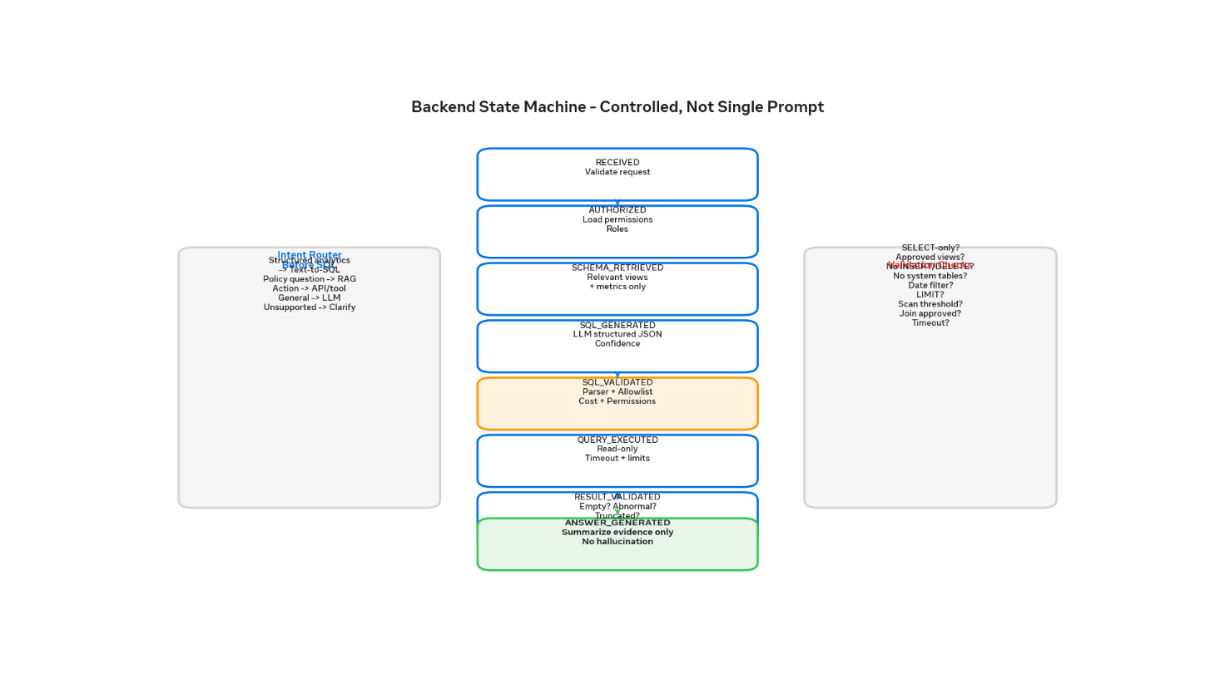





State machine - RECEIVED to ANSWER
Don't ask LLM to do everything in single prompt. Use controlled state machine — each transition logged with trace_id. Prevents LLM skipping validation, ensures auditability.
WHY DETERMINISTIC?
RECEIVED → AUTHORIZED → SCHEMA_RETRIEVED → SQL_GENERATED → SQL_VALIDATED → QUERY_EXECUTED → RESULT_VALIDATED → ANSWER_GENERATED
If any validation fails → CLARIFICATION or ERROR with safe message. Optional LangGraph, but keep control in code.
INTENT FIRST
→
Structured analytics → Text-to-SQL, Policy/doc → RAG, Action → approved API, Chat → general LLM
Validation checks in center box: SELECT-only? Approved views? No system tables? Date filter? LIMIT? Cost threshold? Join approved? Timeout? Row access?
OBSERVABILITY
Each state emits: trace_id, latency, tokens, policy_decision, sql_hash, row_count, user_scope_version. Immutable audit trail.
Security gate — SQL_VALIDATED uses parser + allowlist + permission + cost + explain-plan. Orange state in diagram.
Hallucination firewall — RESULT_VALIDATED checks empty, abnormal, truncated before ANSWER_GENERATED summarizes evidence only.
L6 mindset — Technical completion ≠ business readiness. State machine forces checkpoints, not just one LLM call.

Slide 8












Intent router - classify first
Before generating SQL, route the question. Prevents LLM from doing RAG when it should do SQL, or doing SQL when it should do an approved API. Same rule: RAG for documents, Text-to-SQL for structured data, APIs for actions.
STRUCTURED ANALYTICS
POLICY / DOCUMENT
ACTION REQUEST
Text-to-SQL
RAG
Approved API / Tool
“Sales by store last week” → vw_sales_summary
“What is return policy?” → vector search over docs
“Update price to ฿99” → pricing API with approval
→ CERTIFIED VIEWS
→ KNOWLEDGE BASE
→ GOVERNED ACTION
GENERAL
UNSUPPORTED
Normal LLM
Clarification
“Why did sales decline?” → SQL + controlled workflow
Vague, ambiguous, missing scope → ask for region / date / metric
→ OBSERVATION ONLY
→ SAFE FALLBACK
Why this matters: Prevents one-prompt-does-all anti-pattern. Router uses smaller cheaper model. Only structured analytics goes to expensive SQL generation model with semantic context.
Implementation: LangGraph node or simple classifier prompt. Log intent + confidence. If confidence < 0.72 → clarification. Trace_id preserved across router → SQL gen.

Slide 9





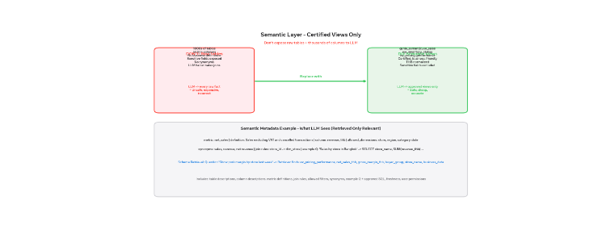
Semantic layer - certified views only
Don't expose raw tables + thousands of columns to LLM — replace with exclusive business-friendly interface
DON'T: RAW TABLES
DO: CERTIFIED VIEWS
1000s tables, 5000+ columns, no definitions
genie_semantic.vw_sales_summary, vw_inventory_status, vw_pricing_performance
Sensitive fields exposed, no synonyms
Certified, business-friendly, THB normalized, standard dates, sensitive excluded
LLM hallucinates joins, expensive scans
last_updated field, row filters embedded, versioned
Unsafe, expensive, incorrect
LLM → approved views only = Safe, cheap, accurate
LLM → every raw fact = 3 failures
METRIC EXAMPLE
WHAT LLM SEES
metric: net_sales
definition: Sales excl VAT & cancelled
column: revenue_thb
allowed_dims: store, region, category, date
synonyms: sales, revenue
join: store_id → dim_store
example Q: 'Sales by store in Bangkok' → SELECT ...
retrieval: only relevant context
Schema retrieval: Question "Show pork margin by store last week" → Retriever finds vw_pricing_performance, net_sales_thb, gross_margin_thb, buyer_group. Includes table desc, column desc, metric defs, join rules, allowed filters, synonyms, approved SQL, freshness, permissions.

Slide 10








Schema retrieval - send only relevant context
Don't send complete catalog to model on every question — use retrieval. Vector search over schemas, metric definitions, approved SQL examples. Cheaper, safer, more accurate.
WHY RETRIEVAL, NOT FULL DUMP?
QUESTION
1000s tables + 5000 cols = token bloat, hallucinated joins, sensitive leak, $ cost
"Show pork margin by store last week"
Retriever finds — relevant only
RAG for tables: question → retriever finds 2-3 views + 6-8 columns only
vw_pricing_performance
net_sales_thb
Scoped by permission — user can only retrieve views they have access to
Freshness aware — includes last_updated, so LLM can warn about stale
gross_margin_thb
buyer_group
store_name
business_date
RETRIEVED CONTEXT INCLUDES
Then send only that context to LLM — not 200 tables. LLM sees certified business definitions, not raw fact tables.
Pattern: Embedding model indexes metric registry + view DDL + approved queries. Cosine search at query time, re-rank by permission.
Table & column descriptions
Metric definitions (net_sales = excl VAT)
Join rules (store_id → dim_store)
Allowed filters + enums
Synonyms: sales, revenue, net
Example Q + approved SQL
Data freshness version
User permission scope

Slide 11





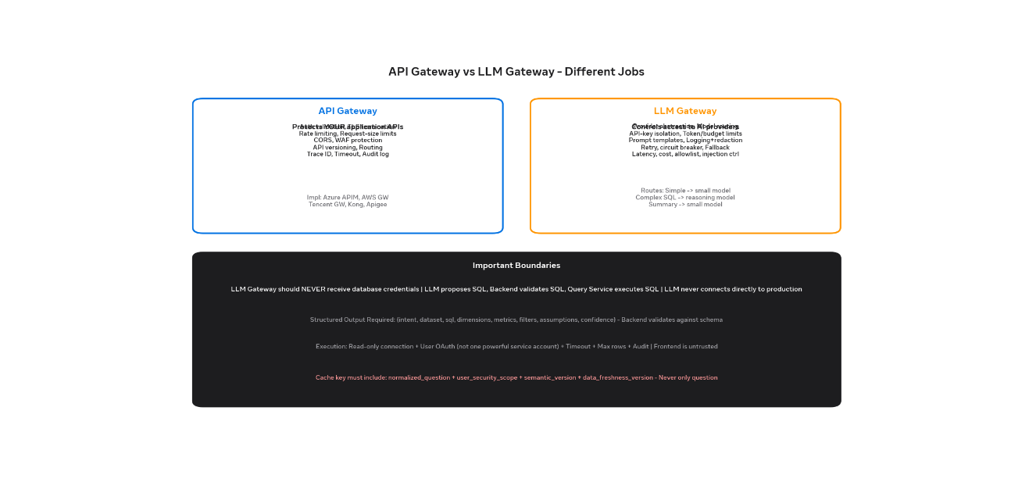

DIFFERENT JOBS — DON'T CONFUSE
LLM Gateway - controls access to AI providers
BOUNDARY
GATEWAY PROVIDES
API Gateway
LLM Gateway
Provider abstraction & routing
API-key isolation
Protects YOUR app APIs
Controls AI providers
Token + budget limits per user/team
Prompt templates & redaction logging
Retry + circuit breaker + fallback
Latency, cost, token metrics
Architecture: Text-to-SQL Backend → LLM Gateway → Azure OpenAI / OpenAI / Gemini / DeepSeek / Qwen. Backend never gives DB creds to gateway.
Model allowlist
Content & prompt-injection controls
ROUTING EXAMPLE
Simple intent classification
Small cheap model
Complex SQL generation
Strong reasoning
Result summarization
Small model
Sensitive workload
Private regional endpoint
Critical: LLM Gateway should NEVER receive database credentials. Flow: LLM proposes SQL → Backend validates SQL → Query Service executes SQL. LLM never connects directly to production.

Slide 12




Require structured JSON — validate before use
Pydantic • JSON Schema
WHY STRUCTURED MATTERS
LLM OUTPUT CONTRACT — NOT FREE TEXT
{
"intent": "analytics_query",
"dataset": "genie_semantic.vw_sales_summary",
"sql": "SELECT store_name, SUM(revenue_thb) ..." ,
"dimensions": ["store_name"],
"metrics": ["revenue_thb"],
"filters": [{
"field": "region_name",
"operator": "=",
"value": "Bangkok"
}],
"assumptions": ["Sales means net sales excl VAT"],
"confidence": 0.91
}
Backend validates object against schema before using — no mixed prose + SQL parsing
Assumptions must be shown to user — transparency builds trust
Confidence routing — if < 0.72 threshold → clarification, not execution
Auditable — dataset, dimensions, filters logged separately from SQL
Anti-pattern to avoid: LLM returns “Here is your SQL: SELECT ...” with explanation woven in. Backend extracts via regex → brittle, injectable.
Instead: System prompt says “Respond only with valid JSON matching schema. No markdown, no comments.”
IMPLEMENTATION
Use OpenAI function calling / structured output mode, or JSON mode + Pydantic validation. Retry once on schema error with validator message. Log prompt hash, not prompt with PII.

Slide 13
















SQL validation layer - mandatory, not optional
Generated SQL must pass all checks before execution. SELECT-only enforced via role + parser + policy layer. Syntax, operation, permission, cost, explain-plan.
VALIDATION CHECKLIST - EVERY QUERY MUST PASS
1
Parser & allowlist (sqlparse)
FAST • LOCAL
SELECT-only? No INSERT/UPDATE/DELETE/DROP/ALTER/MERGE
Approved catalogs/views? Only genie_semantic.*
Parses AST, blocks forbidden keywords, validates only allowed views/columns/joins, rejects comments, ensures LIMIT & date filter.
No unauthorized columns & hidden system tables
No comments / multi-stmt — single statement only
2
Read-only warehouse
CREDENTIAL
Date filter + LIMIT present for large tables
Join route approved? No Cartesian join
Databricks SQL Warehouse with read-only service role, query timeout, max rows/bytes, concurrency limits. User OAuth where possible.
Scan < threshold — estimated bytes / rows + timeout
User row/col access? Region, store, sensitive fields
3
Unity Catalog permissions
GOVERNANCE
Row & column level security, sensitive-field exclusion, region/store scoping, lineage + audit. Final gate even if parser bypassed.
Fail closed: any check fails → CLARIFICATION / ERROR with safe message, never raw DB error. Logged with policy_version + trace_id.

Slide 14






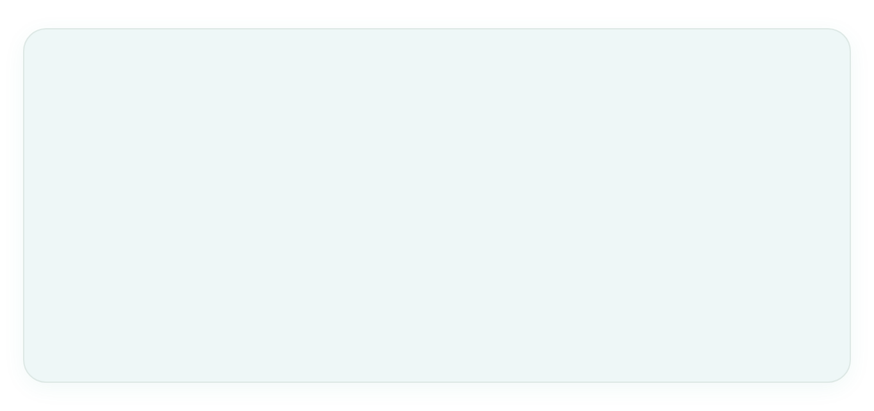




Execution - read-only, scoped, audited
After validation: Backend → Query Service → Databricks SQL Warehouse → Semantic Views. Supports stateful NL querying + programmatic integration (Genie Agents API pattern).
PRODUCTION FLOW
QUERY SERVICE ENFORCES
Backend
Query Service
SQL Warehouse
Read-only connection
Parameterized filters — no injection
Timeout + max rows / bytes scanned
Concurrency limits per user/team
Semantic Views
Result-size limits + truncation check
Cancellation + audit record
No direct DB access from LLM. Service account has SELECT-only role + timeout. Query runs under mapped user scope where possible.
SAFER: USER OAUTH, NOT ONE SERVICE ACCOUNT
OBSERVABILITY + AUDIT
Every execution logs: trace_id, sql_hash, dataset_version, policy_version, execution_time, bytes_scanned, row_count, timeout_flag, user_scope, warehouse_id. Enables cost control + lineage.
User OAuthQuery runs with user-level or mapped role permissions. Store/region scoping via Unity Catalog. Different users see different rows — cache key must include security scope.
One powerful SAAll users get same access = over-privileged, audit fails, cache leaks across security scopes. Never use.
Read-only credential
Result validator next

Slide 15





Summarization - use only supplied rows
LLM explains result, not invents result. Input to summary model is validated evidence only. Prevents hallucination of causes or missing values.
INPUT TO SUMMARY MODEL - EVIDENCE ONLY
Output example - observation only
Store A had highest net sales at ฿5.0M, followed by Store B at ฿4.2M. Data refreshed at 08:00 Bangkok time.
{
"question": "Show sales by store in Bangkok last week",
"metric_definition": "Net sales excl VAT",
"sql": validated SQL,
"rows": [
{"store": "A", "sales": 5000000},
{"store": "B", "sales": 4200000}
],
"freshness": "2026-10-12T08:00:00+07:00"
}
Includes chart + table + freshness + dataset + assumptions + SQL if authorized.
SUMMARY PROMPT MUST SAY
Use only supplied rows — do not invent causes
Do not invent missing values or estimates
Distinguish observation from explanation
Mention incomplete or stale data explicitly
🔒
LLM never sees raw DB. Only rows that passed validation + policy + row-level filter.
WHY THIS MATTERS FOR L6
Trust = evidence + freshness + assumptions, not fluent answer. If rows empty → say empty, not “no sales because…”. If truncated → warn. Explain failure modes.

Slide 16













Caching - never cache across security scopes
Use Redis or controlled cache, but cache key must include security scope + version. Never use only question as key — two users can have different permissions.
WHAT TO CACHE (4 LAYERS)
CACHE KEY MUST INCLUDE — SECURITY AWARE
Semantic metadata
Schema retrieval
normalized_question
user_security_scope
semantic_version
Views, metrics, joins, synonyms
Vector search results per question
data_freshness_version
Common aggregates
LLM responses
Anti-pattern: key = md5(question). User A in Bangkok sees User B in Chiang Mai data. Row-level leak. Cross-scope cache = security incident.
Short-lived query results
Non-sensitive identical prompts only
Safe pattern: key = hash(normalized_q + role_hash + region_hash + store_scope + sem_ver + data_ver)
TTL GUIDANCE
METADATA
QUERY RESULTS
LLM RESPONSE
• Redis namespace per dataset
• PII never in cache value
• Short-lived results only — no long TTL for sensitive metrics
• Observability: cache hit rate by scope, not global
1 hour
5-15 min
30 min
semantics, schemas
freshness matters
non-sensitive only
Redis + semantic_version + data_freshness_version invalidation. On model or dataset version bump, flush relevant keys. Log cache hit/miss with trace_id.

Slide 17














END-TO-END • AUDITED • VERSIONED
Complete production flow - 13 steps
1
User signs in SSO
2
Frontend sends query
3
API Gateway
4
Backend auth + intent
Entra ID, roles, region, store scope
question + conversation_id + token
Validates token, rate-limits, trace_id
Verify roles, classify: SQL / RAG / API
5
Metadata retriever
6
LLM Gateway call 1
7
LLM proposes SQL
8
SQL Policy Engine
Relevant certified views + metrics only
Question + controlled semantic context
Structured JSON + assumptions + 0.91 conf
Parser, allowlist, cost, permissions
9
Query Service executes
10
Result validator
11
LLM Gateway call 2
12
Frontend renders
Read-only, User OAuth, timeout, LIMIT
Empty? Abnormal? Truncated? Row caps
Summarize evidence only, no invention
Answer + chart + table + SQL + freshness
13
Observability
trace, model, tokens, cost, latency, feedback
VERSIONING & AUDIT
model_version + dataset_version + policy_version + feature_version + semantic_version + trace_id + user_scope — every recommendation replayable. Logs redact PII, hash SQL.
GOLDEN RULE
LLM reasons, backend authorizes. Two LLM calls only: SQL proposal + evidence summary. Validator between them cannot be skipped. Frontend untrusted.

Slide 18










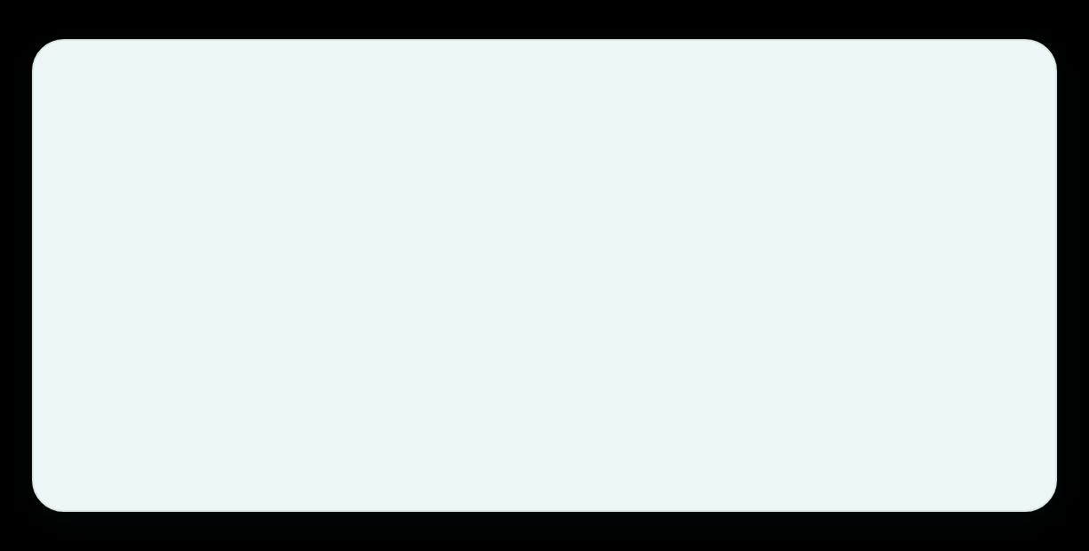
Recommended retail stack — generic, governed, proven
No company names. Generic implementation you can run on Azure / AWS / Tencent. Front → Gateway → Orchestrator → Semantic Warehouse.
FRONTEND & ACCESS
BACKEND & AI ORCHESTRATION
Web: React / Next.js + TypeScript, charting, SSE / WebSocket
Backend: Python FastAPI, Pydantic, deterministic state machine
Identity: Entra ID / enterprise IdP, OAuth, corporate SSO
Orchestration: RECEIVED → ANSWER states, optionally LangGraph
API control: Azure APIM / Kong / Apigee / Tencent GW
LLM Gateway: Provider abstraction, routing, budgets, redacted logging
TLS
Rate limit
WAF
trace_id
GPT
Gemini
DeepSeek
Qwen
SEMANTIC & DATA PLANE
INFRA, CACHE & OBSERVABILITY
Metadata: Unity Catalog + semantic registry (genie_semantic.*)
Cache: Redis — metadata 1h, results 5-15m, LLM 30m, key = question + scope + version + freshness
Retrieval: Vector search over schemas, metrics, approved SQL
SQL: Databricks SQL Warehouse — certified views only, read-only, User OAuth
Observability: OpenTelemetry + logs + MLflow / eval store — trace, tokens, cost, policy
Certified views enforce THB norm, standard dates, sensitive-field exclusion, last_updated freshness.
Deploy: Docker + Kubernetes, secrets in Key Vault / cloud secret manager

Slide 19
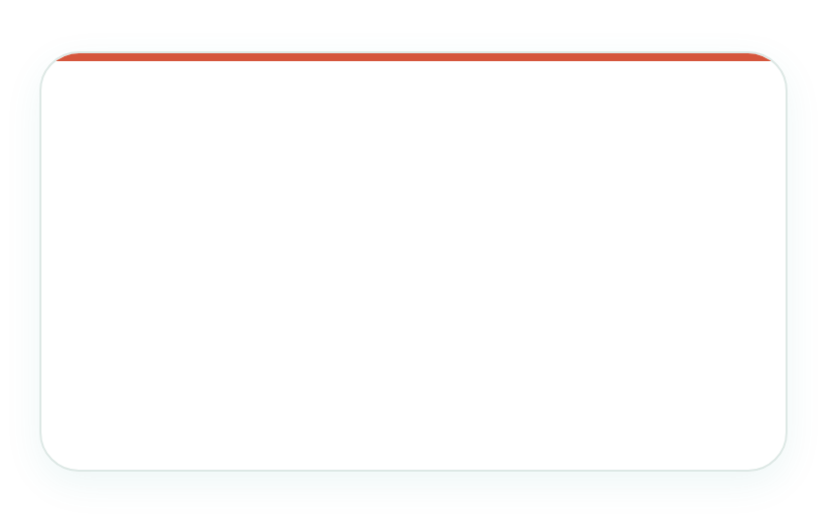
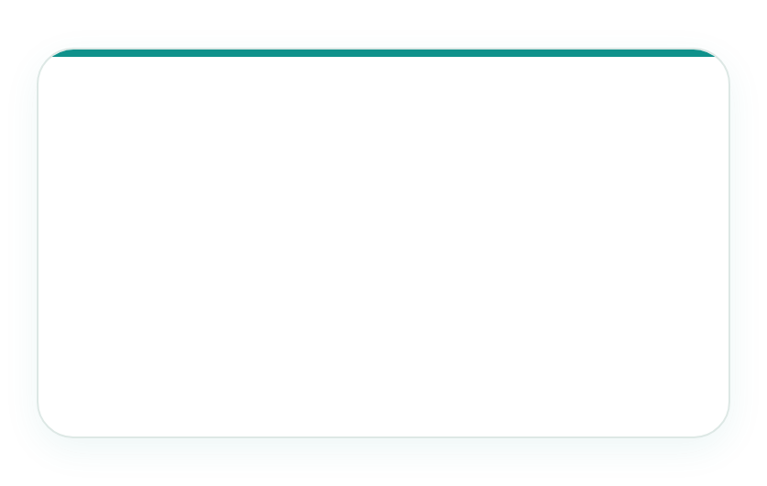





What I would NOT do - production killers
Each anti-pattern is a security, cost, or trust failure. Avoiding them is what makes Text-to-SQL safe enough for enterprise retail data.
SECURITY KILLERS
DATA & COST KILLERS
TRUST & COMPLIANCE KILLERS
Frontend calling LLM directly
Leaks API keys, bypasses auth, no audit
LLM querying raw prod tables
1000s cols, sensitive fields, hallucinated joins
Executing arbitrary SQL
No parser/allowlist/cost check → injection, scan bomb
LLM holding DB credentials
Model never connects to production warehouse
Sending entire catalog each prompt
Token bloat, cost, slower, less accurate
Trusting fluent answer without evidence
Show chart/table/SQL/freshness/assumptions
One unrestricted SA for every user
Over-privileged, audit fails, cache leaks
Allowing write SQL
INSERT/UPDATE/DELETE/DROP — must be SELECT-only
Logging PII / caching across scopes
key ≠ question only, redact logs
Easy memory: User → API Gateway → Backend → Semantic Context → LLM Gateway → LLM proposes SQL → Validator approves → DB executes → LLM explains evidence. LLM reasons, deterministic services authorize/validate/execute.
If you do one thing right: Enforce 3-level validation (parser → read-only role → Unity Catalog) + User OAuth + structured JSON. Never let frontend be trusted.

Slide 20










CLOSING — PRODUCTION READY
Key principles for retail Text-to-SQL
1
LLM reasons & proposes, backend authorizes
2
Semantic layer is exclusive interface
Read-only assistant, human-in-the-loop for high-stakes. Deterministic services validate & execute — LLM never has DB creds.
Certified genie_semantic views only — business-friendly, THB normalized, versioned, sensitive fields excluded.
3
Retrieval, not full catalog dump
4
Structured output + 3-level validation
Vector search over schemas + metrics + approved SQL. Send only relevant context — cheaper, safer, accurate.
JSON contract → Parser/allowlist → Read-only warehouse → Unity Catalog row/col. SELECT-only, LIMIT, cost, timeout.
5
Versioning & auditability by design
6
Success = adoption + evidence + trust
model_version + feature_version + dataset_version + policy_version + trace_id + user_scope. Replayable, no PII in logs.
Monitor 4 layers: data quality, model quality, decision quality, business outcomes + cost. Answer with evidence, freshness, assumptions.
Easy memory: User → API GW → Backend → Semantic Context → LLM Gateway → LLM proposes SQL → Validator → Warehouse → LLM explains → User sees evidence. Security = User OAuth + security-aware cache (question+scope+version) + never cache across scopes.

