Slide 1

600M Events a DayTiered storage & serving from Kafka to four clocks
ONE LOG • FOUR SLAS • ZERO FULL SCANS

Slide 2









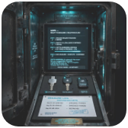
The ask: one stream, four clocks
SCALE MATH
PERSONALIZATION • ONLINE
FRAUD • STREAM
6,944
35K
Latest activity in seconds
Purchase events in minutes
avg eps
peak eps
<3s Flink → ScyllaDB • p95 <15ms
<2m Filter 5% • 5-min window
VOLUME
0.9 — 1.2 TB / day raw
1.5KB Avro vs 3KB JSON, ZSTD
RETENTION
ANALYTICS • LAKEHOUSE
TRAINING • BATCH
2 years = 438 — 650 TB in S3 ZSTD
Dashboards accept 15 min lag
Next-day features T+1
vs 2.6 PB in Kafka RF3 → 17x cost
15m StarRocks on Gold • was scanning 2y
T+1 Iceberg time-travel • Feast offline
PARTITIONS
72 partitions @ ~500 eps each
key=user_id, acks=all, idempotent
COMPLIANCE • DELETION STAGE
Right-to-erasure fans out to every store
<1h online, <24h lake • crypto-shred + equality deletes

Slide 3


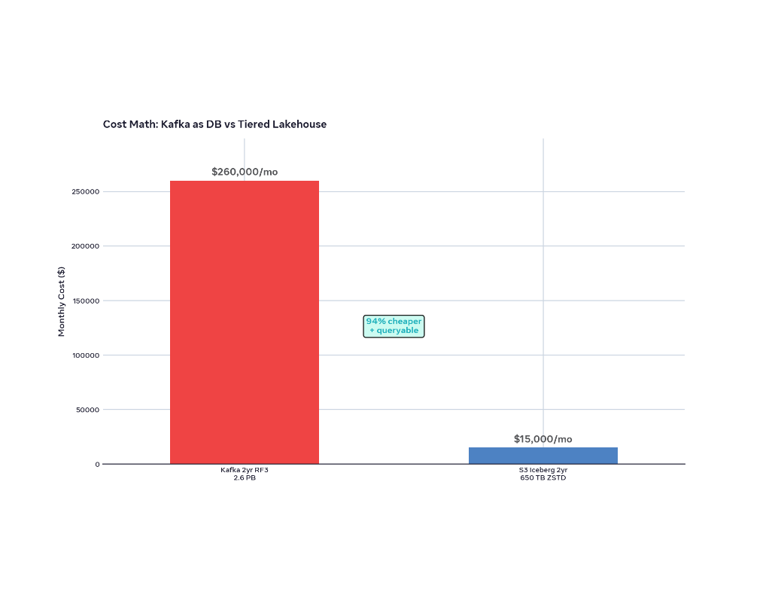






Anti-pattern: Kafka as database
BEFORE • 2YR RF3 IN KAFKA
COST
2.6 PB in Kafka (1.2 TB × 730 × 3) = $260k/mo
vs 650 TB S3 ZSTD = $15k/mo → 94% more
QUERY
No partition pruning, no predicate pushdown
WHERE event_date='2026-10-01' scans full 2 years
GDPR
Log deletion by key impossible
Tombstones don't remove data, compacted topics leak PII
OPS
7-day hot + Tiered Storage is the fix
Kafka = transport, S3 = truth • replay from Bronze
retention.ms=7d
confluent.tier.enable=true
local.retention.ms=604800000
remote.storage.enable=true
AFTER • 7-DAY HOT + S3 ICEBERG
Kafka keeps 7 days hot locally, tiered to S3 via KIP-405. Flink S3 sink builds Bronze. Iceberg Silver gives days(event_time) hidden partitioning + Parquet stats.
Result: 650TB → 50GB scanned, 3-5 sec Athena.

Slide 4





3 principles for 600M / day
01 TIER EVERYTHING
02 SEPARATE SPEED & TRUTH
03 ERASURE BY DESIGN
Hot → Warm → Cold, not hot forever
Flink for seconds, lakehouse for 15 min / T+1
Deletion is a stream, not a script
Per-user DEK encrypted PII + equality deletes. One request fans out everywhere.
Kafka holds 7 days hot, tiered to S3 after. S3 is truth. Small files die by compaction.
No single store can do p95 10ms and scan 650 TB. Split the clocks.
Kafka topic user_deletion_requests
Kafka 7d local + Tiered S3 remote 2y
Speed: ScyllaDB / Cassandra upsert
Iceberg equality delete files, merge at read
Bronze raw 128MB / Silver 512MB Parquet ZSTD
Truth: Iceberg Silver days(event_time)
KMS shred: instant unreadable
Manifest pruning = skip 99.99%
Serving: StarRocks Gold 15m dbt
BONUS
Avro + Schema Registry + ZSTD = 60% smaller than JSON — 3KB → 1.5KB, 0.9TB/day not 1.8TB, faster SerDe, evolution safe
event_id uuid / user_id str / type enum / pii_encrypted bytes

Slide 5


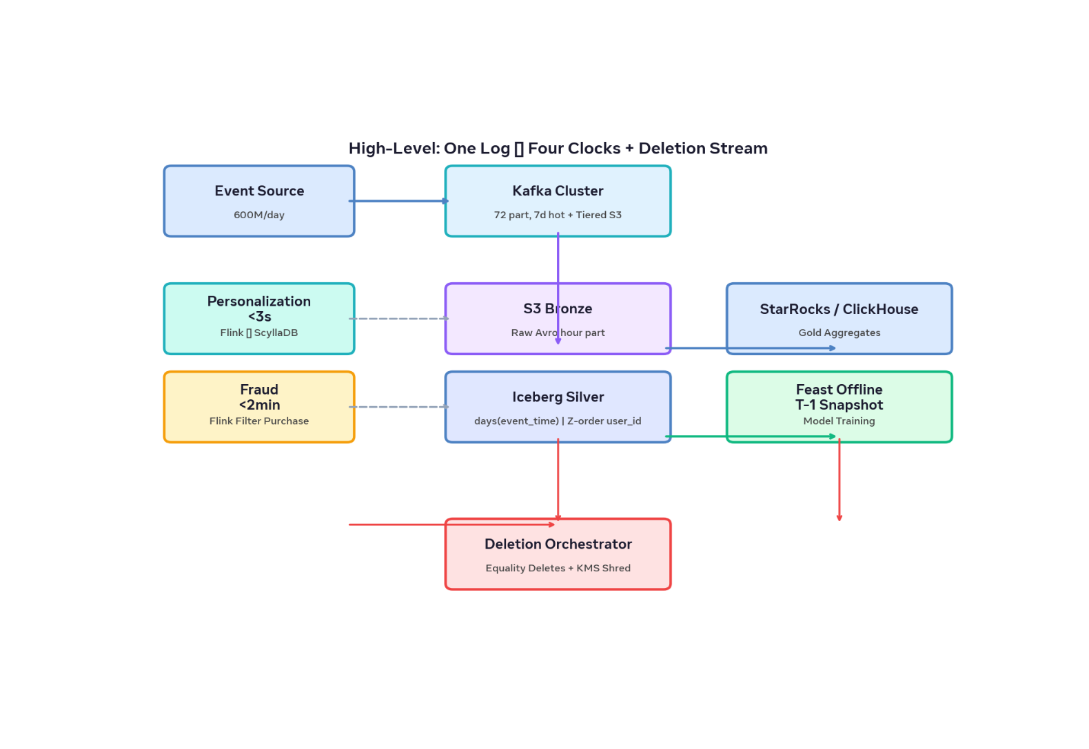












End-to-end flow
One log → four clocks + deletion stream • 72 partitions keyed by user_id
KAFKA → S3 BRONZE → ICEBERG SILVER → SERVING • TIERED 7D HOT + S3
✓ EXACTLY-ONCE FLINK → S3
PATH A • PERSONALIZATION <3S
ScyllaDB online feature store
Kafka → Flink keyBy(user_id) RocksDB last 20 → upsert user_activity
Flink
ScyllaDB p95 10ms
PATH B • FRAUD <2MIN
Filtered purchase stream
WHERE type='purchase' ~30M/day • velocity check • alert
Flink filter
Cassandra audit
PATH C • ANALYTICS 15M
Iceberg Silver + StarRocks Gold
S3 Bronze 60s rolling → days(event_time) → Gold aggregates 15min dbt
Parquet ZSTD 512MB
StarRocks
PATH D • TRAINING T+1
Iceberg snapshot → Feast offline
FOR TIMESTAMP AS OF T-1 → offline store → Spark train
Time travel
Feast
DELETION ORCHESTRATOR
Equality deletes + KMS crypto-shred
user_deletion_requests topic fans out to all 5 stores

Slide 6








Kafka as shock absorber • 72 partitions
Cluster: MSK / Confluent, 3 AZ, r6g.xlarge
72 partitions keyed by user_id % 72, acks=all, idempotent, compression.type=zstd. 35K eps peak is trivial — 500 eps per partition.
Schema: Avro + Registry + field-level encryption
Per-user DEK, KEK in KMS. pii_encrypted bytes. Envelope keeps GDPR shred instant. 1.5KB vs 3KB JSON = 60% smaller.
Tiered Storage: 7d hot, 2y remote
0.9-1.2 TB/d
7d → S3
local.retention.ms 7d, tiering to S3. Kafka = transport, S3 = truth. Replays from Bronze, not Kafka log.
RAW INGEST ZSTD
HOT → TIERED
topic: ecommerce.events
partitions=72, key=user_id
retention.ms=7d + tiered
Avro + Schema Registry
DEK per user → KMS KEK
compression=zstd
Exactly-once: Flink checkpoints to S3
Transactional sink, checkpointing 2-min. Bottleneck is downstream compaction, not ingest.

Slide 7











User's latest activity in seconds
PATH A • PERSONALIZATION <3S
SCYLLADB USER_ACTIVITY
PK user_id — LWW
Kafka → Flink keyBy(user_id) → ScyllaDB
Flink keeps last 20 events per user in RocksDB state. On each event, upsert with TTL 2y. Truth stays in Iceberg Silver.
COLUMNS
READ PATH
last_event_ts
last_event_type
last_20_events list<json>
session_id
API → ScyllaDB
GraphQL federated
Cache-Control no-cache
Fan-out: Iceberg source-of-truth
stream.keyBy(e => e.user_id)
.process(RocksDB Last20)
.addSink(ScyllaUpsert)
checkpoint: 2min S3 exactly-once
p95 10ms
p99 25ms
35K
SCYLLA READ
API EDGE
PEAK RPS TRIVIAL
ALTERNATIVE
Redis Cluster <5ms but 5x cost
Scylla gives wide-row, LSM, lower $/GB for 600M writes/day. Use Redis only for top 1% VIP if needed.

Slide 8








Purchase stream in minutes
Kafka 72p → Flink SQL Filter → Enrich → 5-min window → Dual sink • SLA 2 min checkpoint
SINK 1 • SYNC
P50 <80MS
FILTER • 5% OF STREAM
Fraud API
POST /v1/fraud/check
velocity features → score
1
WHERE type='purchase' → 30M / day
600M × 0.05 = 30M purchases. Flink SQL pushdown, no custom code.
SINK 2 • AUDIT
CASSANDRA
2
ENRICH • ASYNC I/O
CREATE TABLE purchases_by_user (
user_id text,
purchase_time timestamp,
amount decimal,
PRIMARY KEY (user_id, purchase_time)
) WITH CLUSTERING ORDER BY (purchase_time DESC);
Async lookup ScyllaDB velocity
Purchases last 10 min, last device, geo drift. Timeout 20ms, retries bounded.
3
STATEFUL • TUMBLING WINDOW
5-min window keyBy(user_id), count > threshold → Alert
RocksDB state backend, checkpoint interval 2 min. Exactly-once to sinks.
THROUGHPUT MATH
30M/DAY
347
1.7K
avg eps purchases
peak eps purchases

Slide 9












Lakehouse — bronze → silver → gold
FIX FULL SCANS • 15-min freshness, 50 GB scanned not 650 TB
PARTITION EVOLUTION • HIDDEN DAYS(EVENT_TIME) • Z-ORDER USER_ID • MANIFEST PRUNING
FLINK 60S ROLLING • SPARK REWRITE 512 MB
BRONZE • RAW LANDING
SILVER • SOURCE OF TRUTH
GOLD • SERVED AGGREGATES
S3 raw Avro hour= part
Iceberg silver.events
dbt → daily_kpi, funnel_hourly
Flink S3 sink exactly-once, 60s rolling, 128 MB files. Handles late data, replayable from any hour.
Hidden partitioned by days(event_time), sorted by user_id. ZSTD Parquet 512 MB target.
dbt jobs every 15 min materialize into StarRocks / ClickHouse Gold. No dashboard hits Silver directly.
s3://lake/bronze/
hour=2026-10-13-14/
file-128MB-0001.avro
PARTITIONED BY days(event_time)
SORTED BY user_id
TBLPROPERTIES (format=parquet, codec=zstd)
manifest pruning • stats pruning
gold.daily_kpi
gold.funnel_hourly
gold.feature_agg
→ StarRocks primary key
1.2 TB / day
Avro + ZSTD
Compaction 15m
Time travel T-1
15-min dbt
Sub-sec dashboards

Slide 10



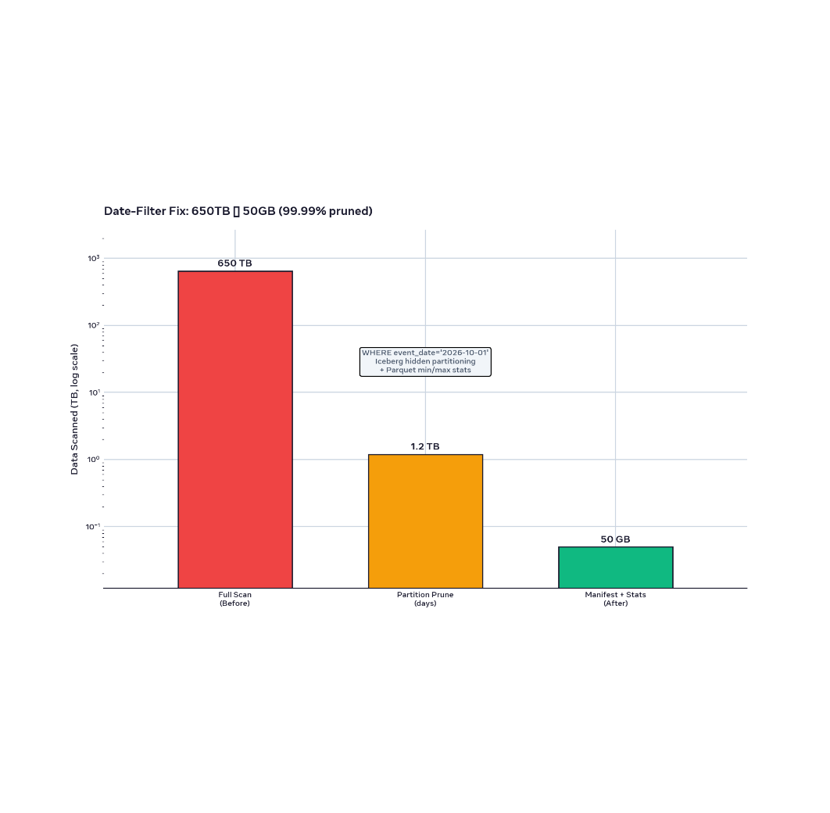




From full scan to 50GB
BEFORE • NO PRUNING
AFTER • ICEBERG PRUNING
DATE-FILTER FIX: 650TB → 50GB (LOG SCALE)
✓ PRUNED
650 TB scanned
50 GB scanned
WHERE event_date='2026-10-01' scans 2 years, no partition.
days(event_time) hidden + min/max stats → 99.99% pruned.
1
Partition pruning
650→1.2TB
Iceberg hidden partitioning days(event_time) • 1 day out of 730
2
Manifest + column pruning
1.2TB→50GB
Parquet min/max for user_id, event_time • file & column stats
3
Dashboard cache on Gold
3-5 sec
Gold aggregates in StarRocks, not Silver. 3-5 sec Athena/Trino ad-hoc.
SQL: PARTITIONED BY days(event_time) SORTED BY user_id • TBLPROPERTIES write.format='parquet' codec='zstd'

Slide 11













Serving: dashboards & training
ANALYTICS • 15 MIN LAG
TRAINING • T+1 BATCH
Gold tables in StarRocks / ClickHouse / Pinot
Iceberg time travel → Feast offline → Spark
Dashboards read gold.daily_kpi, funnel_hourly — 512MB Parquet → dbt every 15 min. Sub-second queries, decoupled compute/storage.
Training never hits online. Reads T-1 snapshot deterministically, exports to offline store. No impact on Scylla/StarRocks.
-- StarRocks on s3://lake/gold/
SELECT date, COUNT(*) FROM gold.daily_kpi
WHERE date = CURRENT_DATE - 1 • p95 120ms
SELECT * FROM silver.events
FOR TIMESTAMP AS OF '2026-10-12'
-- → s3://features/offline/dt=2026-10-12/
Trino on Silver for ad-hoc
Manifest pruning 99.9%
No full scan
Snapshot isolation
Replay any day
Zero skew
15m
<1s
$ / TB
T-1
Feast
Spark
DBT FRESHNESS
DASHBOARD P95
COMPUTE SEPARATE
ICEBERG SNAPSHOT
ONLINE/OFFLINE CONSISTENCY
TRAINING CLUSTER
API layer: GraphQL federated over Scylla (online p95 10ms) + StarRocks (offline aggregates)
S3 $15k/mo 650TB
vs Kafka $260k/mo
StarRocks computes separate
personalization → Scylla, analytics → StarRocks, feature flag routes by latency SLO • cache gold, not silver

Slide 12


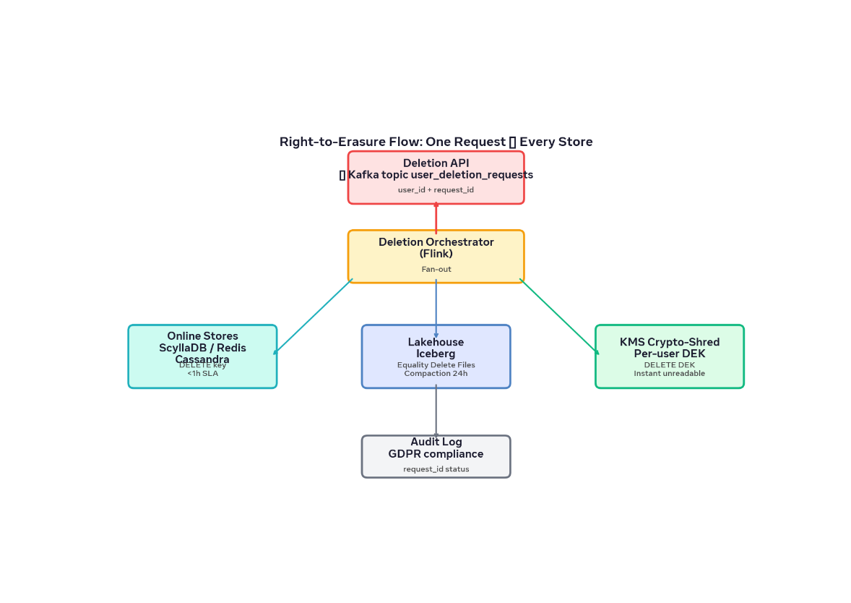









Erasure is a stream, not a script
TOPIC: USER_DELETION_REQUESTS
ONE REQUEST → EVERY STORE
API → Kafka user_deletion_requests {user_id, request_id, requested_at}
Orchestrator (Flink) fans out • Audit log gdpr_audit(request_id, stores_purged)
1
ONLINE STORES • <1H SLA
DELETE Scylla / Redis / Cassandra keys
Scylla user_activity PK user_id, purchases_by_user
2
LAKEHOUSE • EQUALITY DELETES
Iceberg delete files → merged at read
Nightly rewrite_data_files physical removal • manifest pruning intact
3
KMS • CRYPTO-SHRED INSTANTANEOUS
DELETE KMS DEK per user
PII bytes already encrypted • key deletion = unreadable in 7d+ tiered S3 too
<1h
<24h
7d
ONLINE
LAKE COMPACTION
KAFKA RETENTION SOLVES
Crypto-shred • DEK per user
KEK in KMS • field-level PII bytes = instant unreadable when DEK deleted. Tombstone not enough.

Slide 13











Why this stack?
Every choice optimizes for one clock while keeping erasure auditable. Iceberg wins for GDPR because equality deletes and partition evolution are first-class.
STREAMING • TRANSPORT
LAKE • TRUTH
ONLINE • SPEED
Kafka + Flink
S3 + Iceberg Silver
ScyllaDB / DynamoDB
Exactly-once checkpoints to S3, SQL filter, 72 partitions @ 500 eps. Low latency, backpressure aware.
Hidden partitioning days(event_time), Z-order user_id, equality deletes, time travel.
Scylla p95 10ms at 600M writes/day, 5× cheaper than Redis. DynamoDB if managed is priority.
> Kinesis: vendor lock, no RocksDB state. > Spark streaming: 2-min > Flink 10-sec.
> Delta/Hudi: delete-by-rewrite, no native equality. Iceberg = GDPR compliant, partition evolution.
> Redis: cost explodes at 1.2 TB/day. Scylla = LSM, wide rows, TTL 2y.
OLAP • 15M DASHBOARDS
FEATURES • CONSISTENCY
StarRocks / ClickHouse / Pinot
Feast online + offline
StarRocks = MySQL compat + separate compute, 12 min freshness on Gold. ClickHouse for speed, Pinot for real-time.
One definition for online Scylla and offline Iceberg T-1 snapshot. No skew training/serving.
Gold aggregates dbt every 15m, not Silver. Trino for ad-hoc on Silver.
Iceberg FOR TIMESTAMP AS OF T-1 → offline store s3://features/offline/
✓
Kappa for transport + Lakehouse for truth + Online for speed. One event lands in Scylla in 2 sec, StarRocks in 12 min, T-1 snapshot tomorrow — without ever scanning 2 years.

Slide 14

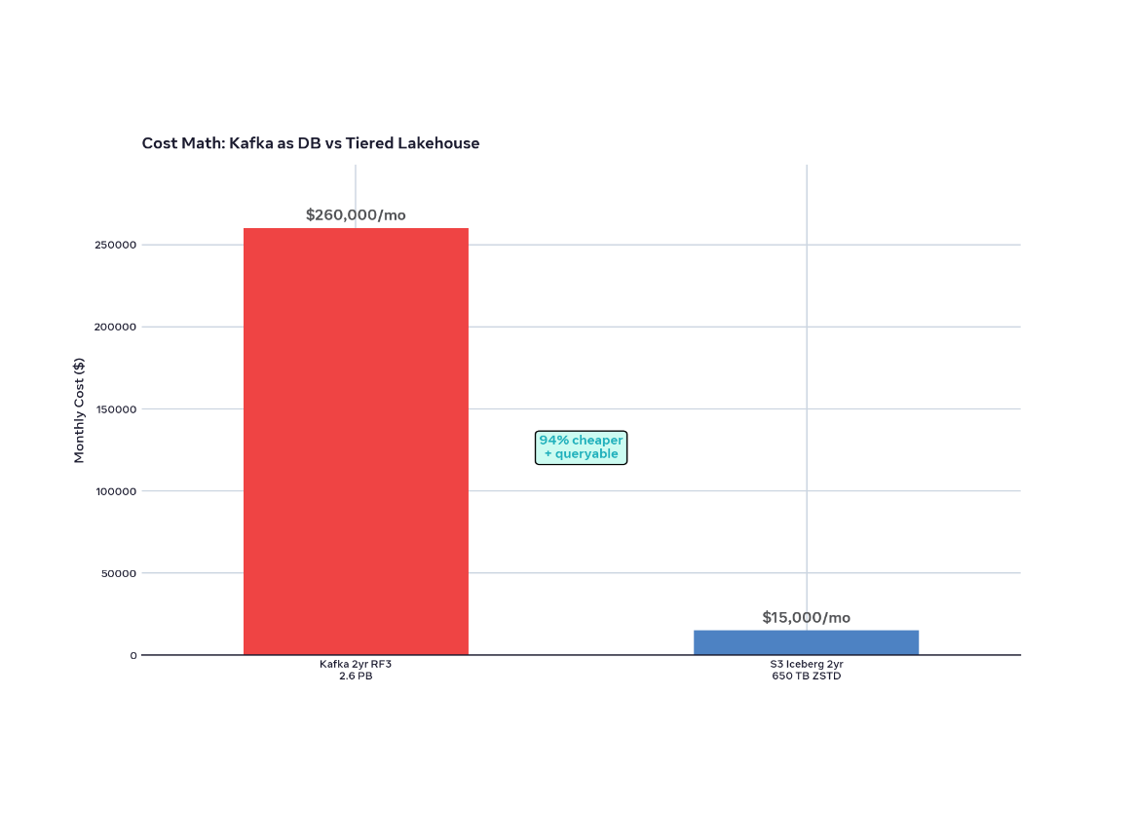









Cost, monitoring, failure modes
S3 650 TB $15k/mo vs Kafka 2.6 PB $260k/mo
94% CHEAPER + QUERYABLE
SMALL FILES SOLVED
Flink 60s rolling → 128 MB, Spark rewrite 512 MB
Target 512 MB Parquet reduces manifest from 50k → 1.3k files/day. Auto compact every 15 min.
LAG MONITORING • 4 CLOCKS
Flink backpressure, consumer lag, snapshot age, p95
consumer_lag{topic=events} < 2m
iceberg_snapshot_age < 15m
scylla_p95{tbl=user_activity} < 15ms
REPLAY FROM ANY DATE
Reprocess Bronze → Silver via Iceberg time travel
FOR TIMESTAMP AS OF '2026-10-01' → rewrites Silver slice. No replay through Kafka tiered log.
$260,000/mo
$15,000/mo
KAFKA 2YR RF3 2.6 PB • $100/TB • NO PRUNING, NO SQL
S3 ICEBERG 650 TB ZSTD • $23/TB • DAYS() PRUNING + STATS

Slide 15


One log, four SLAs, zero full scans
We built 7-day Kafka + Tiered S3 + Flink speed layer + Iceberg lakehouse + StarRocks serving + deletion stream. Transport stays hot, truth lives in S3, speed lives in Scylla.
PERSONALIZATION
FRAUD
ANALYTICS
GDPR
<3s to Scylla
<2min filtered
15min, 50GB not 650TB
Erasure as stream
p95 10ms, last 20 events
30M purchase/day, 5-min window
days(event_time) pruning
equality deletes + KMS shred
NEXT • POC
Replay 1 day Bronze → Silver, benchmark partition pruning Trino 3-5 sec, load test Scylla 35K rps, write first equality delete file, validate KMS per-user DEK
Approve stack
Start with Bronze/Silver + personalization path → fraud filter → Gold aggregates 15m

