Slide 1






PRODUCTION ARCHITECTURE • OMNICHANNEL RETAIL
Retail Price
Recommendation
Platform
Human-in-the-loop, not auto-pricing.
Built for item-store-week decisions with mandatory buyer approval.
Databricks Lakehouse
Demand Response
Constrained Optimization
Guardrails
Experimentation
Item × Store × Week • Portal + Commercial Hub • Versioned & Auditable

Slide 2






For every
Item × Store
× Pricing Cycle
OUTPUT 1
OUTPUT 2
1 Recommended price
2 Expected demand
Candidate from valid price ladder, not arbitrary extrapolation
Demand(item,store,week | price) from response model
Platform does not start with "maximize price". It starts with decision support. Buyer retains final decision. System provides evidence.
OUTPUT 3
OUTPUT 4
3 Expected margin
4 Expected sales
⚙️
Objective is configurable: Margin, Revenue, Inventory, Volume — not single metric
(price − effective cost) × demand, with funding
Revenue impact vs current: $Δ and %Δ
OUTPUT 5
OUTPUT 6
🛡️
Approval mandatory: No recommendation publishes without buyer review
5 Volume change
6 Competitor position
Predicted unit movement, inventory days cover
Gap to matched competitor, availability flag
7 — CONFIDENCE
8 — REASON
High / Medium / Low
Why this price?
Driven by data freshness, model certainty, inventory risk
"Gap reduced + volume improves + margin above threshold"

Slide 3







Optimization objective — configurable by strategy
MAXIMIZE — WEIGHTED
SUBJECT TO — GUARDRAILS
Maximize: expected gross margin + revenue contribution + inventory objective + strategic volume objective
Not "maximize price". Trade-off explicit, tunable per business strategy, versioned.
①
price ≥ effective cost + minimum margin (effective-date-aware)
②
movement ≤ approved category limit (±5% weekly typical)
③
must use approved price endings & ladder
WHY SCORING VS HARD RULES
Scoring allows trade-off, explainable, tunable per category. Hard rules block invalid, scoring ranks within allowed candidate set. Policy table stores weights w1-w6.
④
KVI, legal, supplier agreement, store cluster rules
⑤
inventory availability + shrinkage/expiry
⑥
valid competitor match, no stale cost, buyer approval mandatory
Versioned: cost_version + competitor_snapshot + policy_version + guardrail_version
MARGIN STRATEGY
VOLUME RECOVERY
INVENTORY CLEARANCE
MARKET PROTECTION
Higher w1 on gross margin. Use when cost pressure high.
Higher w on units + competitiveness. Close gap.
Higher w3 sell-through + expiry avoidance. Fresh.
Higher penalty on competitor gaps. KVI trust.

Slide 4


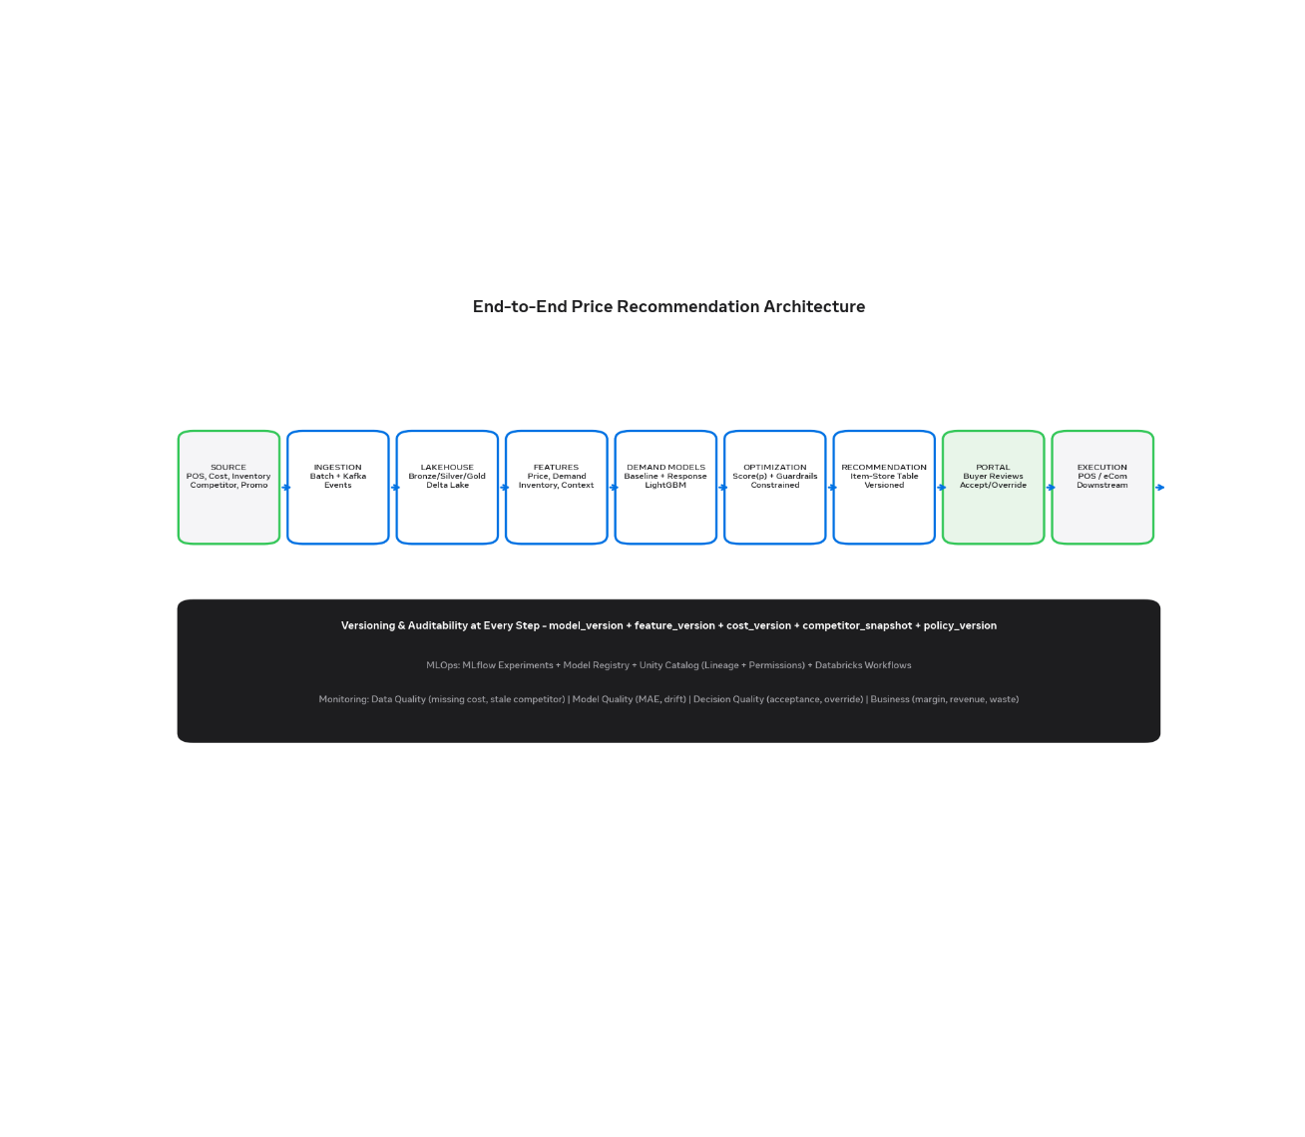




END-TO-END • VERSIONED & AUDITABLE
Architecture — source to outcome
1
Source Systems
POS, cost (effective-date), inventory, competitor, promo, supplier funding, buyer overrides
2
Ingestion (Batch + Events)
Workflows / Auto Loader + Kafka cost stream. Freshness + full reconciliation.
3
Databricks Lakehouse Bronze / Silver / Gold
Immutable history → conformed entities → decision-ready
4
Feature → Demand → Optimization
Predict quantity per candidate, score with weighted objective + guardrails
5
Recommendation → Portal → Buyer → Execution → Measurement
Portal review mandatory, no auto-publish. Outcome tracked.
VERSIONING AT EVERY STEP
MLOPS FOUNDATION
model_version + feature_version + cost_version + competitor_snapshot + policy_version + guardrail_version
MLflow + Unity Catalog (lineage) + Workflows + Delta. Answers: Why 182?

Slide 5








Source systems — what feeds pricing
Every source needs ingestion_timestamp + business_effective_timestamp + version. For cost, upload time ≠ effective time. Keep both. Immutable history is truth.
POS SALES
◧
COST
$
INVENTORY
⊞
PROMOTIONS
%
item-store-date qty, revenue, discounts
Unit cost effective-date aware
On-hand, days cover, OOS rate
Calendar, display, coupon, funding
Primary demand signal. Store cluster seasonality. 2+ years history for baseline.
Most critical. Margin = f(cost active for recommendation period). Retain upload vs effective.
Shrinkage, expiry risk, lead time. Fresh needs more weight on waste avoidance.
Regular vs promo must be separated. Funding impacts effective margin.
PRODUCT
⬙
COMPETITOR
◎
SHRINKAGE
◐
BUYER OVERRIDES
✦
Hierarchy, brand, private label, KVI
Matched item, gap, availability
Fresh waste, markdown risk
History of decisions & reasons
KVI flag drives competitor policy. Brand ladder influences price endings.
Match quality validation required. Stale feed must block recommendation.
Expiry curve + waste %. Clearance strategy uses this heavily.
Feedback loop. Override rate is key decision quality metric. Never overwrite.
✓ source_system + source_record_id
✓ ingestion_timestamp vs effective_timestamp
✓ event_version + raw_payload kept in Bronze

Slide 6


Ingestion strategy — freshness + trust
Retail pricing fails on stale cost. Margin = (price − effective cost) × demand. Need both business effective timestamp and ingestion timestamp. One pipeline gives freshness, other gives trust.
BATCH — RECONCILIATION & HISTORY
EVENT-DRIVEN — CRITICAL PATH
Nightly full reconciliation
Cost change is critical event Kafka
•
POS sales, product hierarchy, promotion calendar, inventory snapshots
Cost Tool
→
Kafka event
→
Streaming ingest
→
Validation
→
Recompute impacted item-store
•
Shrinkage, competitor refresh, price / cost history, Funding
•
Fixes missed events, deduplication, late arrivals
•
Why: margin depends on cost active for recommendation period
Databricks Workflows / Lakeflow • Spark SQL + PySpark • Delta Lake • Auto Loader • Unity Catalog lineage
•
Keep upload_ts vs effective_ts — they are different
•
Only recompute affected pairs, don't rerun full portfolio
RECOMMENDATION
Stream gives freshness, batch repairs missed events. Event stream = incremental freshness < 15min for cost. Nightly batch = trusted reconciliation point. Both write Bronze with ingestion_timestamp + business_effective_timestamp + event_version.

Slide 7





Bronze — source history, little transformation
Immutable, append-only, full history. Keep both ingestion time and business effective time — critical for cost. Don't clean yet.
BRONZE TABLES — RAW PAYLOAD RETAINED
EVERY RECORD MUST INCLUDE
bronze.pos_sales
item-store-day qty, revenue
SOURCE_SYSTEMPOS / RMS / CostTool / Supplier feed
SOURCE_RECORD_IDOriginal PK for lineage
bronze.cost_history
RMS cost + effective_date
INGESTION_TIMESTAMPWhen we received it (Upload time)
BUSINESS_EFFECTIVE_TIMESTAMPWhen cost is active (Effective time)
bronze.cost_events
Kafka stream, tool events
bronze.inventory_snapshot
on-hand, expiry risk
EVENT_VERSIONCancellation / supersession handling
RAW_PAYLOADJSON / original row, no loss
bronze.promotions
calendar, display, coupon
⚠️
Critical for margin: Upload timestamp ≠ Effective timestamp. For cost, retain both. If effective is future, margin calc for recommendation period must use correct future cost, not today's cost. Bronze makes this audit possible.
bronze.competitor_prices
matched competitor item
bronze.buyer_decisions
history of overrides

Slide 8











LAKEHOUSE • SILVER LAYER • CONFORMED, CLEANED, DEDUPLICATED
Silver — Conformed retail entities
SILVER TABLES
8
100%
conformed entities feeding Gold — single source of truth for item-store
effective-date-aware — margin depends on cost active for recommendation period
silver.item_store_sales_dailyPOS daily grain, deduped by store+item+date
silver.item_store_cost_effectiveCost active for pricing cycle — critical
CDC
Audit
silver.item_store_inventoryOn-hand, days cover, OOS rate, expiry risk
silver.item_store_competitor_priceMatched competitor item + availability
Deduplication via Delta MERGE + QUALIFY window logic
ingestion_ts + effective_ts + source_updated_ts + version retained
silver.item_store_promotionCalendar, display, coupon, funding flag
silver.item_supplier_fundingBack-margin, supplier support per item
Common mistake: Picking latest ingestion_ts for cost. That breaks margin. You need effective_date for when cost is active, plus updated_ts for latest business version. Retain both.
silver.price_historyApproved price + endings validated
silver.buyer_price_decisionImmutable buyer actions, versioned
QUALITY CHECKS IN SILVER
COST EFFECTIVE LOGIC — NOT LATEST INGESTION
• No future effective_date without approval • No overlapping effective periods for same business key • Cost >0 and within supplier contract • Inventory snapshot = latest per store-day • Competitor match score > threshold
Business key: item_id + store_id + supplier_id + effective_date
Latest: ORDER BY source_updated_timestamp DESC
Take: approved + active + not cancelled + not superseded
Choose correct business-effective record, not newest ingestion. Consider cancellation, supersession, approval, activation status.

Slide 9












LAKEHOUSE • GOLD • DECISION-READY & AUDITABLE
Gold — decision-ready tables
GOLD TABLES (6)
GOLD.PRICE_RECOMMENDATION — BUYER MUST SEE ALL BELOW
gold.pricing_features_item_store_week
IDENTITY & CYCLE
PREDICTION & IMPACT
CONFIDENCE & GOVERNANCE
gold.demand_forecast_item_store_week
▸recommendation_id / pricing_cycle
▸predicted_units_current → recommended
▸confidence_score H/M/L
▸item_id + store_id + supplier
▸predicted_revenue_change / Δ%
▸recommendation_reason (NL)
▸current_price / final_price
▸predicted_margin_change / Δ%
▸guardrail_status / decision_status
gold.price_candidate_simulation
▸supplier_recommended_price
▸inventory_days_cover / expiry risk
▸model_version / feature_version
▸competitor_price + gap
▸decision_timestamp / buyer_id
gold.price_recommendation ← core
gold.price_decision_audit
Immutable history: Never overwrite. Every system rec + supplier input + buyer override = own version. Buyer may freeze to earlier version — need version management.
Serving: Portal / Commercial Hub reads latest approved version per item-store-week. Downstream execution reads buyer_final_price only after approval flag = true.
gold.pricing_experiment_results
Full audit trail required for every row:
model_version + feature_snapshot_version + cost_version + competitor_snapshot_time + optimization_policy_version + guardrail_version → Answer: Why 182?

Slide 10


















FEATURE LAYER • DECISION-READY, AUDITABLE, VERSIONED
Feature layer — what model sees
gold.pricing_features_item_store_week
Organized around price, demand memory, supply, commercial, context. All price-dependent features recalculated per candidate.
$
PRICE
◧
DEMAND MEMORY
⊞
SUPPLY & INVENTORY
%
COMMERCIAL
◐
CONTEXT
current_price
lag_1, lag_2, lag_4
stock_on_hand
unit_cost (effective)
store_cluster, region
candidate_price
rolling_4w, rolling_8w
days_of_supply
supplier_funding
week_of_year, holiday
log_candidate_price
sales_momentum
out_of_stock_rate
promotion, display
payday, channel
price_change_%
historical_price_percentile
shrinkage, expiry_risk
minimum_margin, brand
category
price_vs_competitor
store cluster seasonality
lead_time
private_label, KVI_flag
competitor_availability
price_index, discount_depth
!
Critical: For each candidate price, recalc price_vs_competitor, price_change_%, discount_depth, price_index. Model scores demand(item,store,week | candidate). Version feature_snapshot_version per recommendation.

Slide 11
















CORE PRINCIPLE • PREDICT-THEN-OPTIMIZE
Don't predict best price directly — predict demand, then optimize
Demand model + price simulation + constrained optimization + business guardrails. Direct price prediction is unstable and not explainable. Response model is testable and tunable.
A
BASELINE DEMAND FORECAST — WITHOUT PRICE CHANGE
B
PRICE-RESPONSE MODEL — CORE ELASTICITY
Qbaseline = f(history, seasonality, promo, inventory, store)
Demand(item, store, week | candidate price)
Qbaseline = f(
historical sales, seasonality,
holidays, promotions, inventory,
store cluster, category, weather,
recent demand, payday flag
)
Estimate elasticity, not price point. For each candidate, recalculate price-dependent features, then predict.
log_candidate_price
price_vs_competitor
discount_depth
price_change_%
Start with LightGBM or HistGradientBoosting + log-linear baseline for interpretability. Hierarchical forecasting for sparse long-tail. Elasticity distribution monitored.
Purpose: capture what would sell at current price. Isolate price effect from seasonality and promo lift. Baseline is needed to compute Δ vs candidate.
Why not direct? Direct "best price" model can't explain reason, can't swap objective weights, can't apply ladder constraints.
lag_1 / lag_2 / lag_4
rolling 4w / 8w
seasonality
store cluster
holiday
Recommended stack: LightGBM / HistGradientBoosting for tabular retail + log-linear baseline. CatBoost for high cardinality (store, category). Hierarchical for sparse SKUs. SHAP for reason codes.
LightGBM ★ start
HistGB
XGBoost
Log-Linear (interp)

Slide 12










CANDIDATE GENERATION • BOUNDED • LADDER-COMPLIANT
Generate only valid candidate prices
FOR EACH CANDIDATE P IN ALLOWED SET
DON'T ALLOW UNCONSTRAINED EXTRAPOLATION
PREDICTED DEMAND
REVENUE
Exploration (model training):
candidates = [
current*0.95,
current*0.975,
current,
current*1.025,
current*1.05
]
D(p) = model(p)
R(p) = p × D(p)
Demand(item,store,week|p)
Candidate price × demand
GROSS MARGIN
IMPACTS
M(p) = (p - cost) × D(p)
Vol, Rev, Margin, Inventory
Effective cost at period
+ competitor gap
PRODUCTION — REAL PRICE POINTS (PRICE LADDER)
Then select
recommended = argmax Score(p) for p in allowed_candidate_prices where guardrails pass. Score weights configurable by strategy (Margin / Volume / Clearance / Protection).
89.00
90.00 ← current
95.00
99.00
100.00
Rule: recalc price-dependent features for each p
✓
Bounded simulation prevents unrealistic -30% drops. Ladder ensures shelf price is shoppable. All simulations stored in gold.price_candidate_simulation for audit.
price_vs_competitor, discount_depth, historical_percentile, price_index all recomputed per candidate before prediction.

Slide 13




OPTIMIZATION ENGINE • CONSTRAINED SCORING, NOT UNCONSTRAINED PREDICTION
Score(p) = weighted objective — argmax over valid candidates
CORE FORMULA
HOW IT WORKS IN PRODUCTION
Score(p) =
w1 × expected_gross_margin(p)
+ w2 × expected_revenue(p)
+ w3 × inventory_clearance_value(p)
− w4 × expected_volume_loss(p)
− w5 × competitor_gap_penalty(p)
− w6 × price_change_penalty(p)
recommended_price = argmax Score(p)
for p ∈ allowed_candidate_prices
For each item × store × week, generate only valid price ladder points (89, 90, 95, 99, 100). Recalculate price-dependent features, predict demand for each p, compute margin / revenue / gap / inventory impact. Pick p with highest Score. Show reason + confidence.
Margin
Volume Recovery
w1 high — protect gross margin when cost pressure
w2+w4 — favor units + competitiveness
Clearance
Market Protect
w3 high — sell-through, expiry avoidance fresh
w5 penalty high — KVI competitor trust
Why scoring vs hard rules: allows trade-off, explainable to buyer, tunable per strategy. Hard rules filter invalid; scoring ranks valid. All weights versioned in optimization_policy.
Confidence = data freshness (cost/competitor) × model certainty (elasticity stability) × inventory risk. Low confidence → no auto rec, buyer review only.

Slide 14






BUSINESS GUARDRAILS • MORE IMPORTANT THAN ALGORITHM
Guardrails — mandatory + confidence + category policy
MANDATORY — BLOCKS INVALID RECOMMENDATION
CONFIDENCE CONTROLS — DATA + MODEL CERTAINTY
①
price ≥ effective cost + minimum margin — no margin-negative publish
HIGH
Fresh data, stable elasticity, trusted match → show preferred recommendation
②
movement ≤ approved category limit (e.g. ±5% weekly) — avoid shock
MEDIUM
Partial staleness or higher variance → show with warning + reason
③
Must use approved endings & price ladder (89, 90, 95, 99, 100)
LOW
Stale cost / invalid match / sparse history → no auto rec, buyer review only
④
KVI policy, legal, supplier agreement, inventory availability check
⑤
No stale cost, no invalid competitor match, no publish without buyer approval
CATEGORY-SPECIFIC POLICY — ONE SIZE DOES NOT FIT ALL
Fresh / Perishable
KVI — Known Value
Guardrail failure = no recommendation. Logged in guardrail_status + reason_code for audit.
Inventory, shrinkage, shelf-life matters more than margin % — prioritize waste avoidance
Competitor position & customer trust matters more — tighter gap penalty
Long-tail
Promotion
Sparse history — use pooled / category models, not individual store elasticities
Separate regular vs promo decisions — funding changes effective margin

Slide 15



















HUMAN-IN-THE-LOOP • PORTAL • BUYER RETAINS FINAL DECISION
Buyer reviews decision — UI must show evidence
CURRENT PRICE
SYSTEM RECOMMENDATION
BUYER ACTIONS — MANDATORY APPROVAL
190
182 ▼ 4.2%
✓ Accept recommendation
↗ Override price
SUPPLIER RECOMMENDATION
COMPETITOR / COST
— Hold current
✕ Reject
185
180 / 160 gap -2, margin 22
⟳ Request recalculation
PREDICTED UNITS
PREDICTED MARGIN
110 → 124 +12.7%
3,300 → 3,100 -6%, above thr
VERSIONING CRITICAL — DON'T OVERWRITE HISTORY
Every system rec + supplier input + buyer decision = immutable version. If override, capture:
CONFIDENCE
GUARDRAIL
override_price
override_reason
buyer_id
timestamp
source_rec_version
Medium
Pass • KVI ok • Ladder ok
Problem: supplier rec arrives after buyer starts review → transaction frozen to earlier version. Need version mgmt & re-review trigger.
Reason: competitor gap reduced, forecast volume improves +12 units, margin remains above threshold (cost 160 + min). Elasticity stable, cost fresh.
Rule: Must not publish without approval. Low confidence → no automated rec, buyer review only. All versions auditable via gold.price_decision_audit.

Slide 16




MLOPS • LINEAGE • AUDIT • WHY DID SYSTEM RECOMMEND 182?
MLOps — MLflow + Unity Catalog + Workflows
◧
MLflow Experiments
→ track
EVERY RECOMMENDATION MUST RECORD
Compare runs — demand MAE/WAPE, elasticity, bias per category
model_version : LightGBM v32
feature_version : snapshot 2025-05-11
cost_version : effective 2025-05-12 00:00
competitor_snapshot_time : 2025-05-11T22:00Z
optimization_policy_version : margin_strat v2
guardrail_version : KVI + ladder v4
⬙
Model Registry / Unity Catalog
→ approve
Approve production model versions — lineage + governance
⚙
Databricks Workflows
→ run
Feature, training, scoring pipelines — batch + stream
This lets you answer: "Why did system recommend 182 for this item at this store?" — full lineage from raw Bronze → Silver effective → Gold features → model → Score(p) → guardrails → buyer decision.
▤
Delta Tables (Gold)
→ serve
Features, simulations, recommendations — immutable, versioned
Unity Catalog + APIs
PERMISSIONS
REPRODUCIBILITY
◎
→ portal
Unity Catalog: buyer sees rec + reason, cannot edit model. Engineer can deploy model, cannot approve price.
Feature snapshot version pinned at inference. Re-run possible years later with same inputs.
Permissions, audit, lineage — publish to portal

Slide 17




OBSERVABILITY • 4 LAYERS BEYOND FORECAST ACCURACY
Monitoring — data + model + decision + business
Don't judge success only by forecast accuracy. Judge by decision quality + business outcome. Each layer has owner and SLA.
◧
DATA QUALITY — BLOCK BAD INPUT EARLY
◐
MODEL QUALITY — DEMAND & ELASTICITY
•
Missing cost / stale competitor price > 24h → block rec
•
Demand MAE / WAPE, bias per category & store cluster
•
Duplicate item-store, invalid price, missing inventory
•
Elasticity distribution drift, feature drift, prediction drift
•
Late promotion data, unmatched competitor item
•
Low data flag → pooled / category model fallback
✦
DECISION QUALITY — BUYER ADOPTION
%
BUSINESS OUTCOMES — REAL IMPACT
•
Acceptance rate, override rate, avg price movement
•
Gross margin, revenue, units, basket value
•
Guardrail rejection rate, stability, time-to-decision
•
Market-price index, waste / shrinkage, stockouts, complaints
•
Override reason clustering → policy tuning
•
Measured via controlled pilot only, not offline sim
!
Rule: Low confidence or stale cost → no automated rec, buyer review only. Alert owner: data eng for data, DS for model, product for decision, merch for business.

Slide 18
















EXPERIMENT DESIGN — PROVE CAUSALITY
Never claim uplift from offline simulation alone
Offline sim = observational. Production proof = controlled pilot. Label simulated uplift as observational, not causal.
✗ WHAT NOT TO DO
✓ PRODUCTION VALIDATION
Offline simulation only
Controlled pilot — Treatment vs Control
•
Model predicts D(p) higher → claim margin +3% — not causal
T
Treatment: buyer sees model recommendations in portal
•
No buyer behavior, no inventory constraint, no competitor reaction in sim
C
Control: existing pricing process
•
Leaks future promo info into training
→
Randomize at matched store-item groups or matched store clusters to avoid contamination (same buyer, same category leakage)
EVALUATE — 6 METRICS + ADOPTION
PILOT GUARDRAILS
BUSINESS (INCREMENTAL)
DECISION QUALITY
4–6 weeks minimum for retail
gross margin Δ
revenue Δ
units Δ
buyer adoption
acceptance rate
•
Cover promotion cycle + payday + weekend seasonality
•
Limit to 1–2 categories, limited stores to start
waste Δ
stockout Δ
competitor index
override rate
time to decision
•
Buyer approval mandatory — no auto execution yet
RULE
Simulated uplift = observational label in UI. Only pilot / A/B test can be shown as incremental margin / revenue. This prevents false claims and builds buyer trust.

Slide 19









ROLLOUT • CRAWL WALK RUN — NO BIG BANG
Rollout — best practical for retail
Start manual and auditable, earn automation. Every phase keeps buyer approval and versioning.
1
CRAWL
2
WALK
3
SCALE
4
RUN
DECISION SUPPORT
BETTER OPERATIONAL INPUTS
EVENT-DRIVEN REFRESH
CONTROLLED AUTOMATION
•
1-2 categories, limited stores, weekly batch
•
Effective-date cost, competitor feed
•
Kafka cost events → recompute
✓
High confidence + stable elasticity
•
Buyer approval mandatory, no auto exec
•
Inventory, shrinkage, supplier funding
•
Impacted item-store pairs only
✓
Fresh data, no rule violations
•
Goal: trust + feedback
•
Versioned recommendations + audit
•
Don't rerun whole portfolio
✓
Repeated buyer acceptance + pilot proof
STRONGEST RECOMMENDATION
Databricks-based demand prediction + constrained optimization, fed by POS, effective cost, inventory, promo, competitor, published to portal for buyer approval and complete auditability. Not one algorithm — trusted data + response model + optimizer + versioning + workflow + experimentation + monitoring.

Slide 20










PRODUCTION READINESS • RETAIL PRICING PLATFORM
Technical centerpiece is not one algorithm
Trusted data
+
Demand response
+
Constrained optimizer
+
Version management
+
Buyer workflow
+
Experimentation
+
Monitoring & audit
Build as human-in-the-loop Price Recommendation Platform, not fully automatic AI changes shelf prices. Matches retail operating model: recommendations at item-store level, buyer sees suggestion with reason & confidence, can modify, retains final decision. All versions immutable & auditable.
◐
SUCCESS = ADOPTION
SUCCESS = MARGIN
SUCCESS = MEASURABLE CAUSALITY
Buyer acceptance + override learning
Incremental gross margin & revenue
Not offline sim uplift
If buyers don't trust, no impact
Measured via controlled pilot only
4-6 weeks pilot, matched clusters
Databricks-based • Demand prediction + constrained optimization • Fed by POS, effective cost, inventory, promo, competitor • Portal approval • Complete auditability

