Slide 1


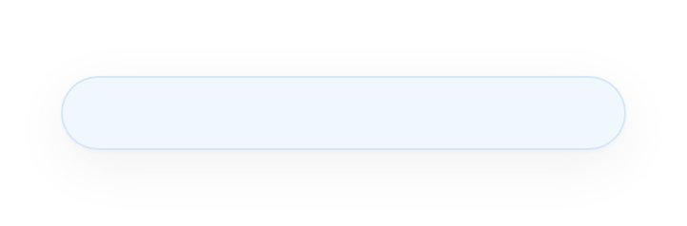
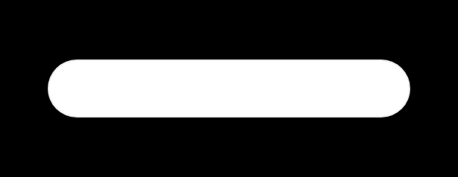
META L6 BEHAVIORAL • ACCOUNTABILITY > CORRECTION > PREVENTION
Tell me about a time you made a mistake
3 Stories: Bank • Lazada SG • Makro Retail
90-sec Script + Deep Dive + Flow

Slide 2

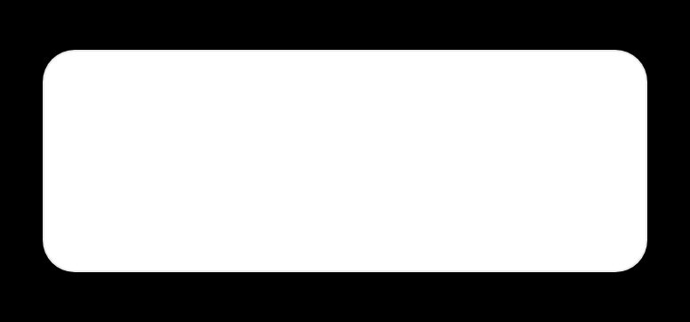





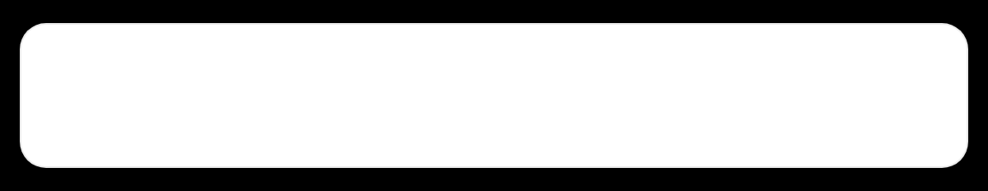
How Meta L6 scores this
INTERVIEWER CALIBRATION
Listen for scope: how many teams, how much risk, how you quantified cost of status quo. Senior = business trust, not pipeline green.
They don't want a coding bug. They want a leadership gap. L6 bar: cross-functional ownership over technical perfection. Your mistake must impact business, not just logs.
1
2
3
Accountability
Correction
Prevention System
Say “I missed” not “we missed”
What did you DO in next 24–48h?
What SYSTEM so it never repeats?
Own without blaming legacy / business
Immediate stakeholder walkthrough
RACI + 3 checkpoints + Trust Layer
Name the real gap: communication, validation, ownership
Shared deck + lineage + hypercare plan
Checklist is now mandatory on all projects
🚫
RED FLAG
✅
GREEN FLAG
“I worked too hard / I trusted others too much / Typo in prod” = junior framing. No system, no scale.
“Technical success ≠ Business success” — shows you manage dependencies, decision latency, and trust, not just code.

Slide 3

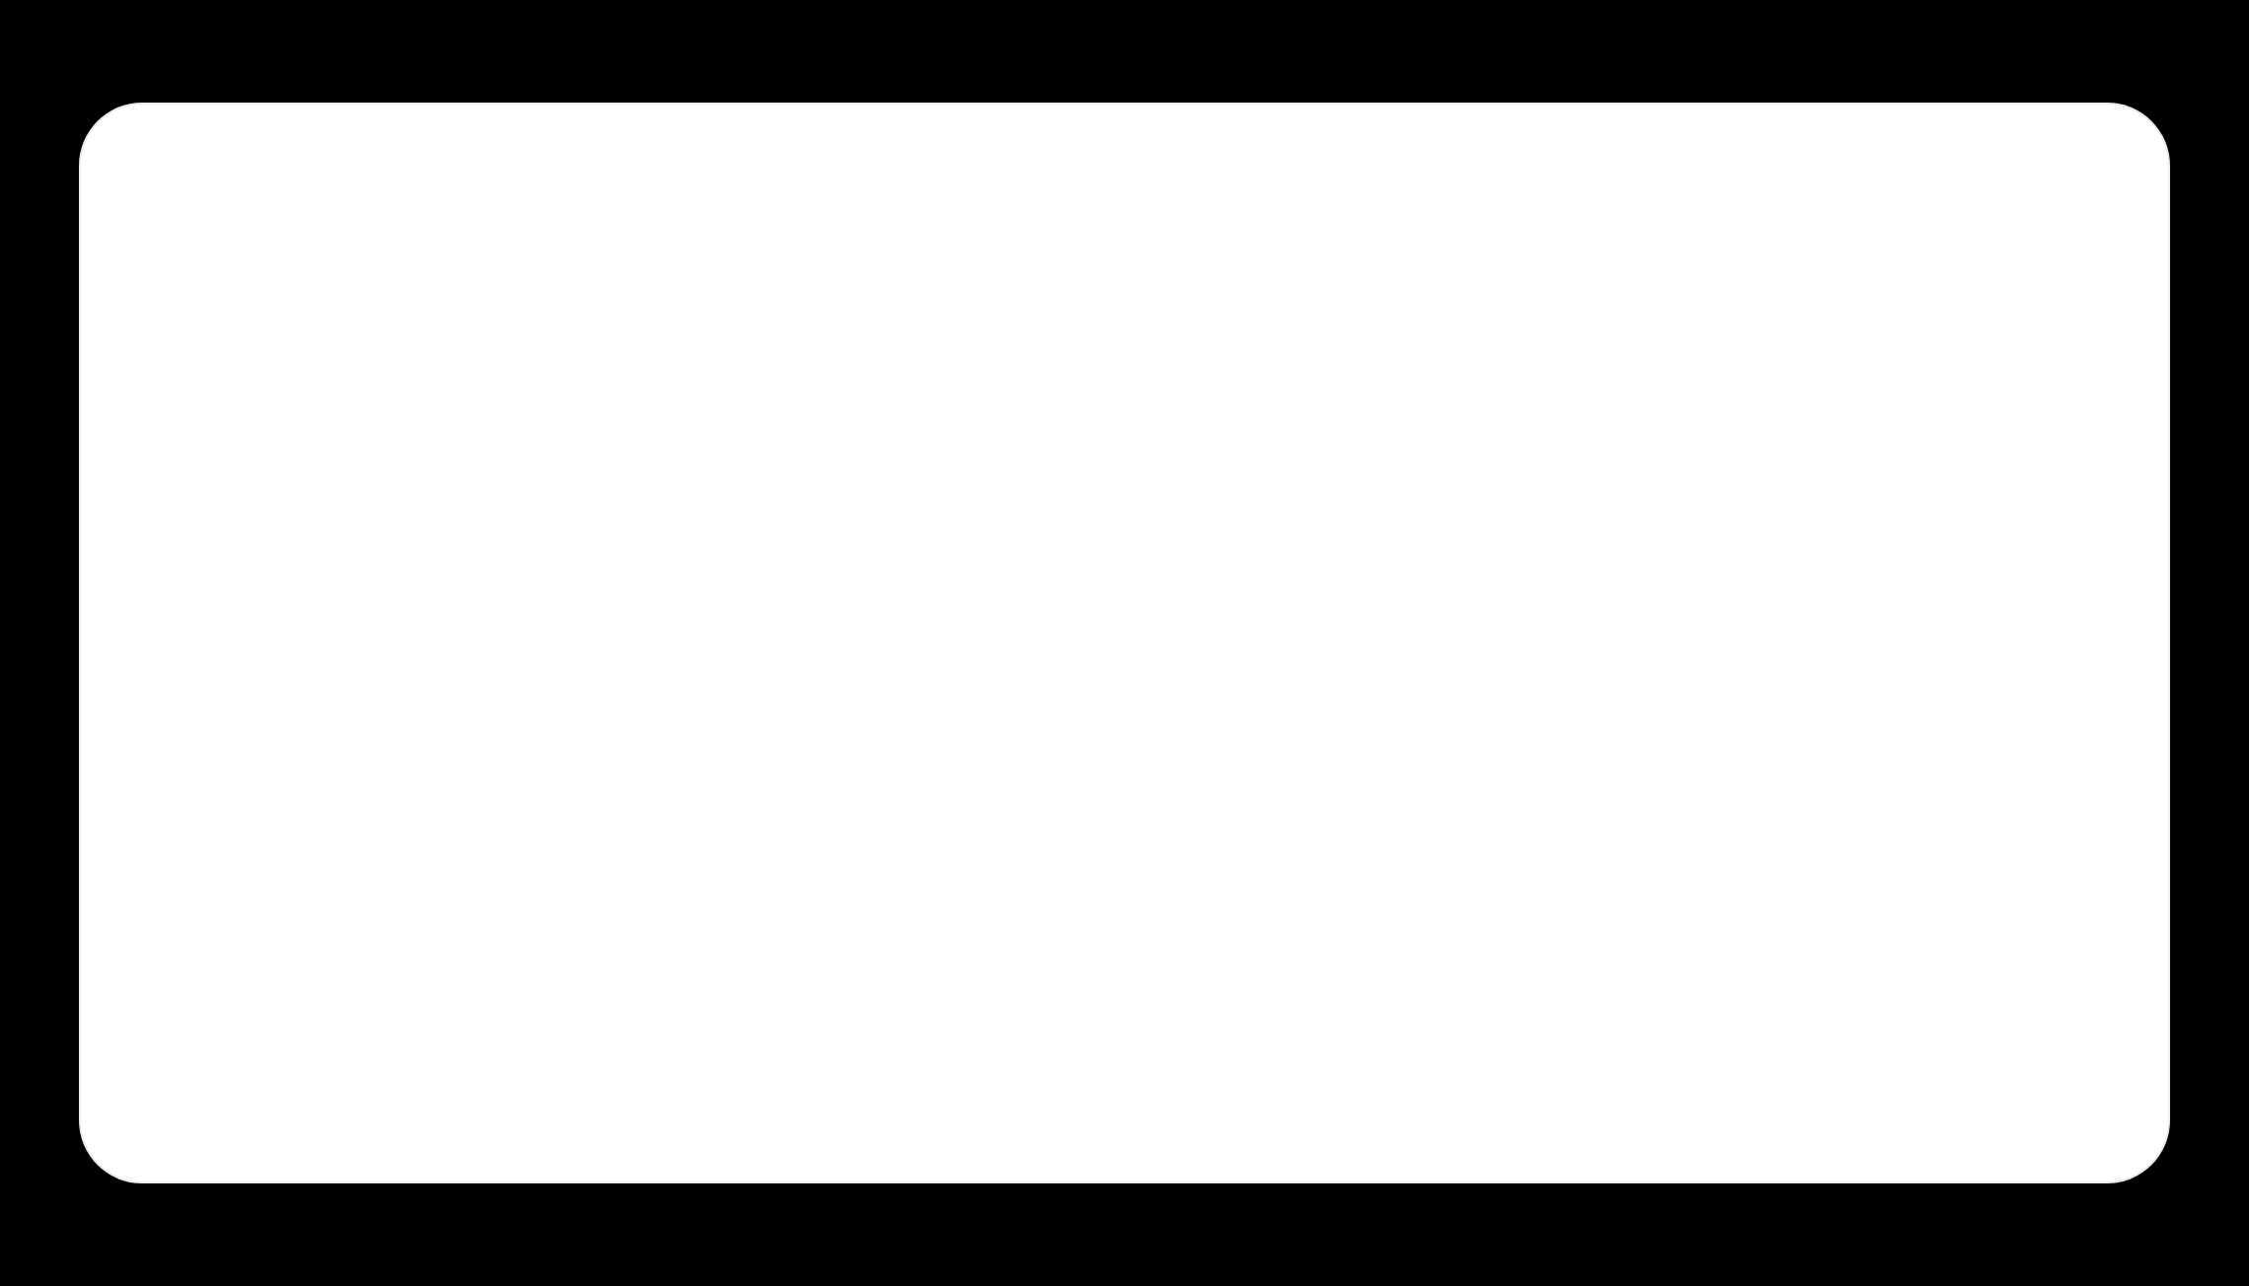




MEMORIZE THIS — FIRST 15 SECONDS = L6 SIGNAL
Start every answer like this (Meta way)
My mistake was [leadership gap]. Technically we succeeded in [X], but I failed in [Y = business impact]. I took ownership and built [Z system] so it never repeats.
▶
“My mistake was focusing on technical delivery over business readiness. Technically migration succeeded, but business didn't have visibility to plan. I owned the gap and built stakeholder checkpoint system.”
Why it works: Interviewer hears Accountability + Scope + System in 15 sec = L6 multiplier

Slide 4









TIER 1 BANK IN SINGAPORE • TERADATA TO HADOOP MIGRATION • DON'T SAY DBS NAME
Story 1 — Bank — 90 sec script
One mistake early in my career was during a Teradata-to-Hadoop migration at a Tier 1 bank in Singapore.
WHY THIS IS L6
Mistake = leadership gap, not coding bug
Impacts 12 downstream teams
From engineering side, migration was successful. We completed technical work, validated data, platform was ready.
Shows cross-functional ownership
Clear before/after system change
But I made mistake in stakeholder communication. I was so focused on technical delivery that I didn't keep business sufficiently informed.
ANCHOR PHRASE
I realized even though engineering delivered, business didn't have visibility to confidently plan around new platform.
Tech Done ≠ Business Ready
If interviewer pushes, go to Deep Dive. Script is opener only.
I took responsibility for communication gap. Lesson: technical completion and business readiness are two different things.
Since then, I identify business owners at beginning, agree success criteria, establish regular checkpoints.
DO NOT SAY
❌ DBS name • ❌ “We missed” • ❌ “Pipeline failed due to typo”
✅ “I missed” • ✅ “I owned” • ✅ “I built system”
Today, I don't consider project successful just because tech works. I consider it successful when business is informed, aligned, able to use what we delivered.
⏱ 85-90 SEC • MEMORIZE
Teradata
Sqoop • Hive • Spark
400TB • 180 jobs

Slide 5


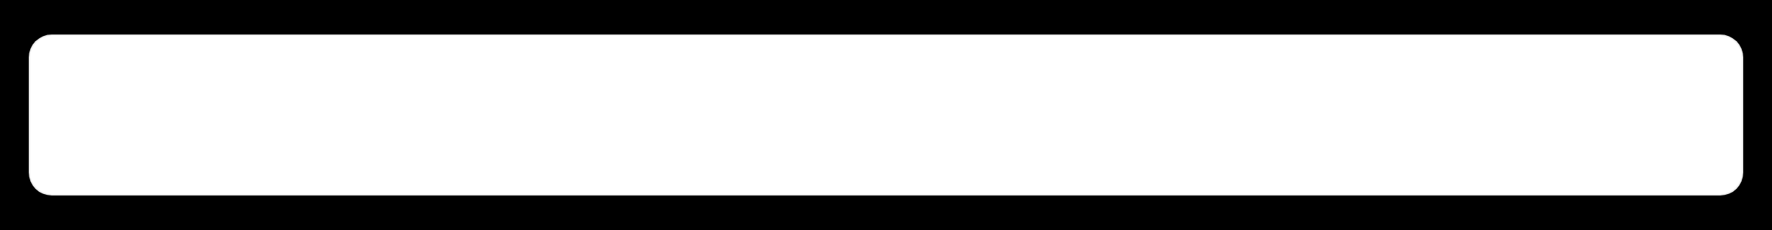



STORY 1 — TIER 1 BANK SINGAPORE (NO DBS) — TERADATA → HADOOP
Deep dive: what really happened
400TB • $2M/yr • 180 jobs • 12 teams • 6 months
SITUATION
TASK — AS DE LEAD
15+ yr Teradata legacy, cost + scale limit. Risk, Finance, Compliance depend on daily regulatory reports. Zero downtime migration to Hadoop (Sqoop/Hive/Spark/Oozie/HDFS + Impala).
Migrate 180 jobs, guarantee 100% data correctness for regulatory. I owned validation, cutover, lineage. 12 stakeholders, but I treated them as consumers, not owners.
ACCOUNTABILITY DEEP
CORRECTION — NEXT 48H
PREVENTION SYSTEM BUILT
What I built perfectly vs what I missed
What I did immediately after
How I work now (L6 artifact)
Built: row counts, checksums, schema match = 100% green
Contacted Risk Head + Finance Lead same day
RACI day 1: Business Owner / Tech Owner / Validator
Shared: status deck + validation + lineage + cutover plan
3 checkpoints: Kickoff success criteria, Mid demo, Pre-close UAT sign-off
Missed: business sign-off sheet, UAT env for business
2-hr walkthrough: old vs new tables, query + SLA changes
Missed: runbook for business users, metric mapping
Definition of Done = Tech Done + Business Valid + Docs + Handover
Business learned completion from email, not workshop → visibility gap
Aligned hypercare 1 week + rollback + support model + sign-off as exit
Lesson: Senior DE manages cross-functional dependencies, not just tech
Outcome:
Frustrated → advocates. Handover became template.
L6 gap:
Technical success ≠ Business readiness
Mantra:
Business informed, aligned, able to use.

Slide 6


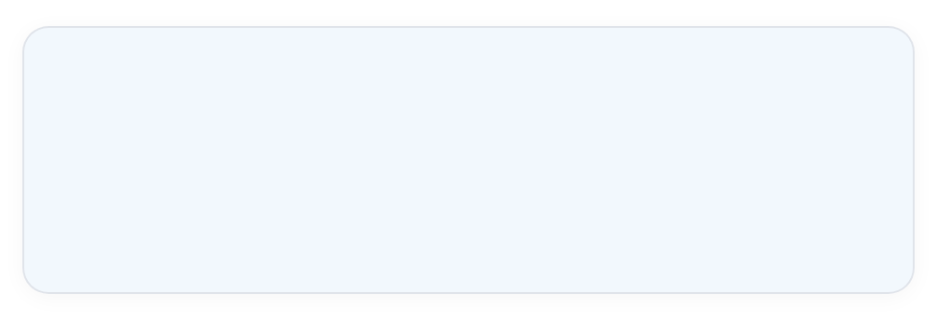
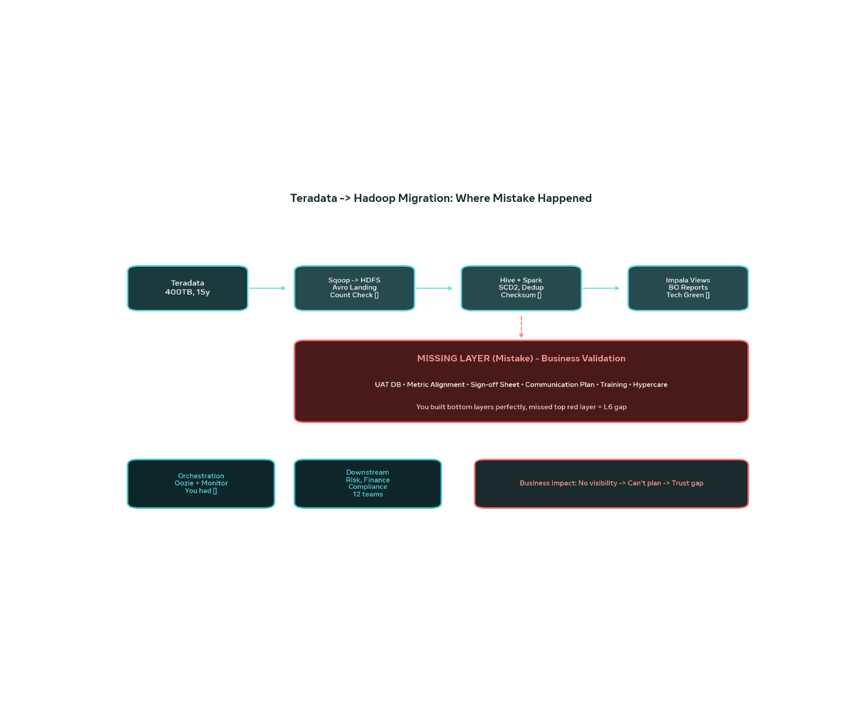



Story 1 flow — Teradata → Hadoop | Where mistake happened
400TB • 180 ETL jobs • 12 downstream risk/finance/compliance teams • You built tech perfectly, missed business layer
✅ WHAT YOU DID PERFECTLY (TECH GREEN)
• Sqoop → HDFS Avro landing + Count check
• Spark dedup + SCD2 + Checksum + Sample compare
• Impala views + BO Reports + Oozie 99.9%
• Tools: BTEQ, Sqoop incr, Parquet / Hive partitions
❌ MISSING LAYER (MISTAKE)
• UAT DB access for business
• Metric definition alignment: Risk vs Finance
• Sign-off sheet + Communication plan + Training
• Hypercare + Rollback visible to business
IMPACT
L6 SIGNAL
No visibility → Can't plan new platform → Trust gap
Tech success ≠ Business ready. 400TB green, sign-off missing = leadership gap.

Slide 7








STORY 2 • LAZADA SG E-COMMERCE • USE WHEN ASKED ABOUT SPEED / METRICS
Lazada SG — technical correct ≠ business usable
“At Lazada SG, one mistake I learned from was focusing too much on technical delivery without validating business requirements early enough.”
CONTEXT TO KEEP READY
Fast marketplace: 10M SKUs / 100K sellers
Built daily batch, business needed hourly for flash sales
“We were in fast-moving e-commerce — campaigns, vouchers, seller metrics changed daily. My assumption was once we delivered datasets and reporting logic, business would be able to use them.”
GMV: with/without returns? Active: listing vs order?
“But I learned technical correctness doesn't mean solution meets decision-making needs. Metric definition of ‘active seller’ and ‘GMV’ differed between marketing and finance.”
Shadow Category Manager during 11.11
WHY L6?
“I changed approach by involving stakeholders earlier, validating metric definitions before code, getting feedback every 3 days instead of at the end.”
Solved for scale not decision latency
Shows Decision Map thinking
Leads to Metric Dictionary system
90 SEC
Dataset: Seller Performance Mart
No blame
KEY LESSON
Frequent business validation reduces rework 60% and improves adoption — especially where speed is everything.

Slide 8



Story 2 Deep Dive — Lazada SG E-commerce
FAST-MOVING MARKETPLACE • SELLER PERFORMANCE MART • TECH CORRECT ≠ BUSINESS RIGHT
Situation + what went wrong
Correction + Prevention System
Context: 10M SKUs, 100K sellers, 3 markets (SG/TH/MY). Needed unified Seller Mart.
Fixed same week: Shadowed Category Managers 1 day during 11.11 prep – saw real decision loop.
Stack: BigQuery + Dataflow + Looker. Built perfect daily batch, scalable.
Mistake: Business needed hourly for flash sales / 11.11, not daily. Built for scale, not decision latency.
Re-prioritized: Hourly incremental for top 5% sellers (80% GMV) + daily for rest. Unblocked campaigns.
Metric gap: “GMV” – with/without returns? “Active seller” – listing vs order? Marketing vs Finance definitions differed.
Metric Dictionary: Single source of truth in Confluence, co-owned with Marketing + Finance. Signed off.
L6 signal: I optimized for tech (batch cost) not for business decision loop. No Decision Map.
Alert: If seller GMV drops 20% vs same hour yesterday → Slack alert to CatMan.
Prevention now: 1) Decision Map – who decides what, when, how often? 2) Metric Workshop before code 3) Demo every 3 days
EXPECTED
ACTUAL NEED
Daily mart
Hourly top 5%
20% → 85% WAU adoption
-60% rework
Top 5% hourly covers 80% GMV

Slide 9








STORY 3 • MAKRO WHOLESALE RETAIL • STRONGEST L6 STORY — USE FOR RECENT / SENIOR QUESTION
Makro Retail — pipeline green ≠ numbers correct
“At Makro, one important lesson came from a data-quality issue in commercial reporting.”
CONTEXT TO KEEP READY
100+ stores, B2B+B2C, back-margin rebate complex
“We were integrating data from multiple operational systems — POS, SAP, WMS — into unified platform. Initially focused on getting pipelines running and delivering on time.”
Finance reports to Netherlands HQ — month-end critical
“But we identified gap in how we validated business-level numbers across source and reporting. Pipeline success didn't mean financial numbers were correct — sales with back-margin, VAT, promotion.”
$10M POS vs $9.7M Mart = 300K missing (cancelled logic)
Business found gap at close — trust broken
“As engineering leader, I owned improving controls. Strengthened source-to-target reconciliation, added business-level checks, ownership for critical data, and monitoring to catch discrepancy early.”
WHAT YOU BUILT AFTER
3-layer recon: Source vs Staging vs Mart daily <0.1%
“Learning: reliability = business trust, not pipeline green. Since then, reconciliation + data contracts + business quality checks are core design, not optional.”
Business Rules Engine: returns, VAT, margin timing
Alert: >0.5% → PagerDuty + Slack to owner
90 SEC
POS+SAP+WMS → Snowflake+dbt
Trust Layer
Each KPI has owner: Sales=Commercial Head
WHY THIS IS L6+
Closest to leadership role. You own trust, not just DAG. Quant: errors 8/month → 0, close 5 days → 2 days.

Slide 10










STORY 3 — MAKRO THAILAND WHOLESALE • STRONGEST L6 STORY • RETAIL TRUST LAYER
Makro deep dive — pipeline green ≠ numbers correct
CORRECTION — WHAT I BUILT AFTER
Reconciliation Framework: Source vs Staging vs Mart — 3 layers, daily <0.1%
Business Rules Engine: cancelled, returns, VAT, back-margin timing — documented with Finance
Critical Data Ownership: Sales = Head Commercial owns, Margin = Finance owns
Alerting: Recon >0.5% → PagerDuty to DE + Slack to business owner
PREVENTION SYSTEM — TRUST LAYER MANDATORY
Now every pipeline: Tech tests + Business recon + Anomaly detection
WHAT BROKE
BACK-MARGIN GAP
Data Contract: If POS changes cancellation logic → must notify
Sales: POS $10M → Mart $9.7M. 300K missing = cancelled orders filtered differently.
SAP 2% vs Mart 1.6%. Timing: invoice vs accrual. Business found at month-end close — trust broken.
Monthly Business Review: Data quality score like SLA to business
8 → 0
5d → 2d
Trust ↑
👁
Root cause: only dbt tests (not_null, unique). NO FINANCE PERSON IN DESIGN. Airflow 99.9% green but business wrong.
Recon errors / month
Month-end close
Finance restored

Slide 11

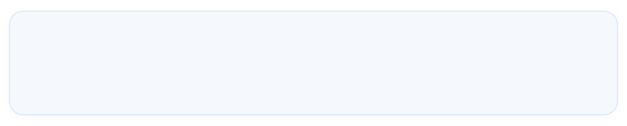





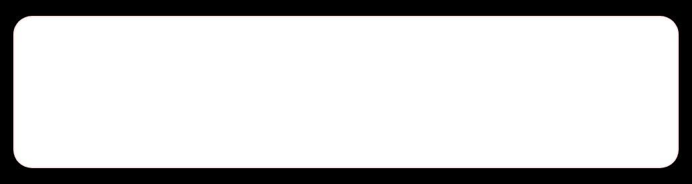



INTERVIEW STRATEGY • CHOOSE STORY BY QUESTION TYPE
Which story to choose? When to use what
1
Bank — Teradata → Hadoop — Use first (classic answer)
META L6 RULE
Clear accountability: communication gap, not coding bug. 12 downstream teams. Cross-functional gap = L6 expectation. Easy to explain, shows evolution. 85-90 sec.
Always have 1 story where business was impacted, not just logs
Never say “my mistake was pipeline failed because typo”
First choice for “Tell me about a mistake”
Own communication, ownership, trust — not just code
Start easy (Bank), then go deep tech if probed
2
Makro Retail — Sales + back-margin recon — Strongest L6
Pipeline green 99.9% but finance gap $300K (cancel logic, back-margin timing). Built Trust Layer. Use when interviewer pushes: “recent / senior / leader” mistake.
RED FLAGS TO AVOID
✕ “I worked too hard” = no system
Use when asked recent leadership
✕ Blaming legacy / business / other team
✕ Saying DBS name — say Tier 1 bank
3
Lazada SG — Seller Performance Mart — Speed story
Daily vs hourly for flash sales, metric definition GMV/active seller. Decision Map + Metric Dictionary. Use when asked about e-commerce speed or metric alignment.
Tech completion ≠ Business readiness = L6 mantra
Use when asked e-commerce / metrics

Slide 12






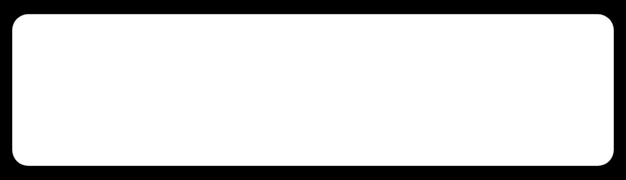



FOLLOW-UP — THEY WILL ASK THIS — PREPARE WORD FOR WORD
Deep answers ready for push questions
Meta L6 interviewer always goes deeper: correction in 48h + stakeholder reaction + prevention system. Have truthful version ready — only say what you really did.
Q1 — MOST ASKED
Q2 — STAKEHOLDER
Q3 — HINDSIGHT
What did you do immediately after realizing?
How did stakeholders react?
What would you do differently?
Bank Answer: Contacted Risk Head + Finance Lead same day. Shared migration deck + validation results + lineage + cutover plan.
Initially frustrated due to lack of visibility — learned from email, not workshop.
Identify business owner Day 1, not week 8
Agree success criteria together, not assume
After transparency + walkthrough, appreciated
Weekly 30-min checkpoint, not email at end
2-hr walkthrough: old vs new table mapping, query + SLA changes
Turned into advocates — handover template reused for next 3 migrations
Business UAT as part of Definition of Done
1-week hypercare + rollback + support. Added explicit sign-off as exit criteria
Q4 — PREVENTION
Q5 — FEEDBACK LINK
How do you prevent now?
Tell me about tough feedback?
Now start with RACI: Business Owner, Tech Owner, Validator. 3 checkpoints: Kickoff (success criteria), Mid (demo), Pre-close (UAT sign-off). No project closes without business sign-off sheet.
Feedback was: “Tech is great but business can't use it.” That stung, but changed my leadership. Now I measure success when business can decide, not just when pipeline is green. Same story, different angle.

Slide 13







YOUR L6 ARTIFACT — COPY THIS • BRING TO INTERVIEW MENTALLY
My project closure checklist — what changed since mistake
1
2
3
4
5
Kickoff DAY 1 ALIGNMENT
Build VISIBLE PROGRESS
Validation 2 LAYERS
Handover DAY 0 READY
Retro SYSTEM UPDATE
Business Owner + Tech Owner + Validator
Weekly demo, not monthly
Tech: counts, checksum, schema
Runbook + Training + Support model
What comm gap?
Metric Dictionary in Confluence
Business: UAT, sign-off, sample report review
Update this checklist
Success Criteria = business metric, not tech
UAT env ready early, shadow business
Sign-off sheet mandatory
Share learning in team demo
Tolerance <0.1% auto-check
Hypercare 1 week + rollback plan
Comm cadence: weekly 30-min
✓
FINAL DEFINITION OF DONE =
Business Informed + Aligned + Able to Use

Slide 14


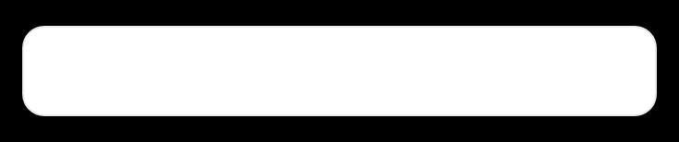
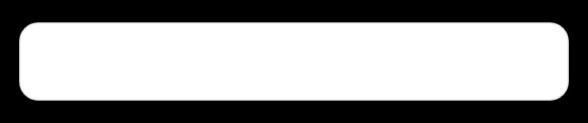




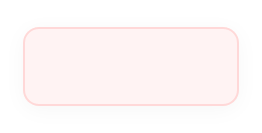
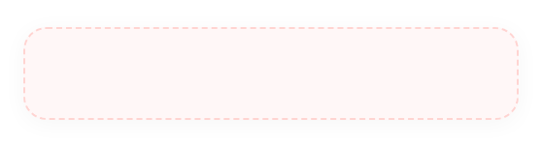
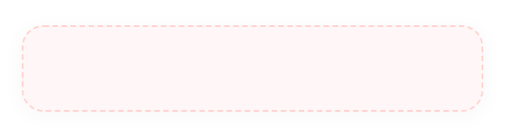


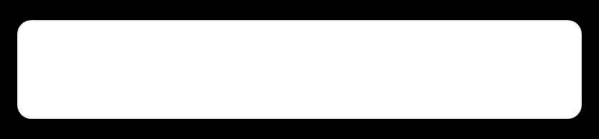
TECH DEEP • TIER 1 BANK (NO DBS) • 400TB • 180 JOBS • ZERO DOWNTIME REQUIRED
Teradata → Hadoop — end-to-end flow + where mistake happened
INGESTION
Teradata
→
Sqoop → HDFS
→
HDFS Landing
15y • BTEQ export • 400TB
Incr Avro • Count validation
Parquet • Date partition
TRANSFORM
Hive Staging
→
Spark
→
Hive Curated
→
Impala Views
Schema match 100%
Dedup window • SCD2
Checksum + Sample
Fast query for business
SERVE + OPS
BO Reports
→
Oozie + Monitor
→
12 downstream
Risk / Finance / Compliance
99.9% DAG green
Zero downtime regulatory
MISSING LAYER
(MISTAKE)
UAT DB
✕
Metric Alignment
✕
Sign-off + Comm
✕
Visibility
Access for business
Workshop: old vs new
Sheet • Training • Hypercare
Learned from email
INGESTION TOOLS
TRANSFORM DETAILS
VALIDATION YOU HAD VS MISSED
BTEQ export, Sqoop incremental by last_modified, Avro → Parquet conversion, HDFS replication 3
Hive partitioned by dt, Spark window row_number for dedup, SCD2 for regulatory history, Impala for sub-sec
Had: counts, checksum, schema. Missed: Business UAT, sign-off sheet, runbook for Risk Head
💡
Your mistake: built bottom 3 layers perfectly, missed top red layer = L6 gap. Now Definition of Done = Tech Done + Business Validation + Docs + Handover + Sign-off

Slide 15





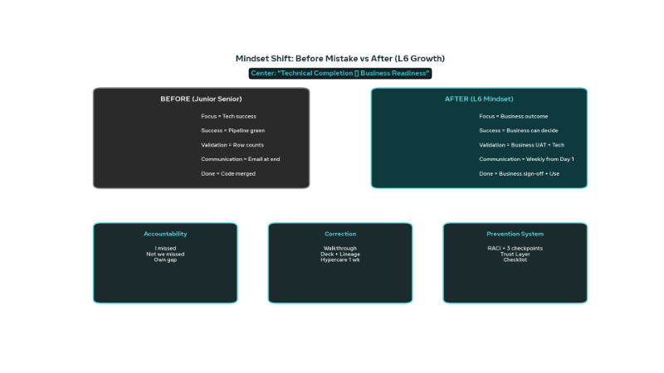


MINDSET SHIFT — EVOLUTION OF LEADERSHIP • L6 GROWTH STORY
Before mistake vs After — the interviewer wants this evolution
Technical Completion ≠ Business Readiness
BEFORE — JUNIOR SENIOR
AFTER — L6 MINDSET
FocusTech success
FocusBusiness outcome
SuccessPipeline green
SuccessBusiness can decide
ValidationRow counts
ValidationBusiness UAT + Tech
CommunicationEmail at end
CommunicationWeekly from Day 1
DoneCode merged
DoneSign-off + Able to use
ACCOUNTABILITY
CORRECTION
PREVENTION SYSTEM
Say “I missed” not “we missed”. Own communication gap, not blame legacy or business.
Walkthrough + lineage + hypercare 1 week. Did in next 48h — turned frustrated stakeholders into advocates.
RACI + 3 checkpoints + Trust Layer. Now mandatory checklist on every migration. Business informed, aligned, able to use.

Slide 16











FINAL — ONE PAGE TO MEMORIZE BEFORE INTERVIEW — 3 STORIES = 1 SYSTEM
3 stories in one page — easy remember
B
Bank Tier 1 SG
L
Lazada SG E-comm
M
Makro Retail
Teradata → Hadoop 400TB 180 jobs
BigQuery + Dataflow Seller Mart
Snowflake + dbt POS/SAP/WMS
MISTAKE
MISTAKE
MISTAKE
Stakeholder communication gap — perfect tech validation, no business visibility
Metric definition not validated — Marketing vs Finance GMV/active mismatch, daily vs hourly
No business recon — only tech tests. $10M vs $9.7M gap, back-margin timing
FIX
FIX
FIX
Walkthrough + lineage + status deck + 1 wk hypercare + sign-off as exit
Decision Map + Metric Dictionary + hourly for top 5% (80% GMV) + Slack alert
3-layer Reconciliation Framework + Business Rules Engine + KPI ownership + PagerDuty
LESSON
LESSON
LESSON
Tech Done ≠ Business Ready
Frequent validation reduces rework
Reliability = Business trust, not pipeline green
Use first • Classic L6
85-90 sec
Use for speed / metrics
20%→85% WAU
Strongest L6 • Recent leader
8→0 errors
I own gap, I correct immediately with business, I build system so never again
MANTRA • MEMORIZE

