Slide 1

AWS STORAGE
DEEP DIVE
S3 • EBS • EFS • Hybrid Storage • Interview Architecture
Instructor-ready and interview-ready | Prem Vishnoi
Notes:
[Sources] - Amazon S3 documentation: https://docs.aws.amazon.com/s3/ - Amazon EBS documentation: https://docs.aws.amazon.com/ebs/ - Amazon EFS documentation: https://docs.aws.amazon.com/efs/ - Visual on this slide was generated with Microsoft Copilot.

Slide 2
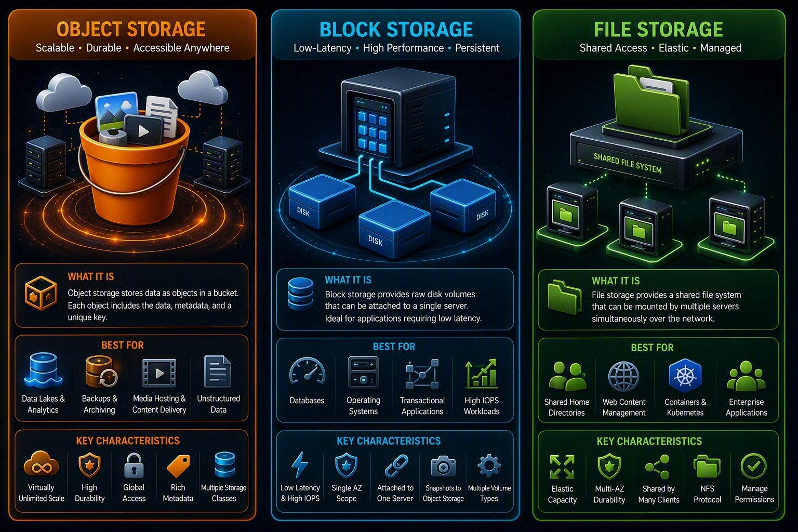
01 | MASTER MENTAL MODEL
Object vs. block vs. file
Object: S3
API-addressed objects with keys and metadata. Best for data lakes, media, backups, and static assets.
Block: EBS
Raw block device for an EC2 workload. Best for operating systems, databases, and low-latency random I/O.
File: EFS
Shared NFS file system mounted by many clients. Best for shared content and Linux file workflows.
Notes:
[Sources] - AWS storage overview: https://docs.aws.amazon.com/whitepapers/latest/aws-overview/storage.html - Visual on this slide was generated with Microsoft Copilot.

Slide 3

02 | S3 CORE
S3 is an object store, not a mounted disk
Bucket
Regional container for objects with a globally unique name within the S3 namespace.
Object
Data plus system and user metadata, identified by a key and optional version ID.
Prefix
Characters before a delimiter. Console folders are a presentation over the flat key namespace.
API model
Applications use S3 APIs rather than block-device reads and writes.
Notes:
[Sources] - S3 user guide: https://docs.aws.amazon.com/AmazonS3/latest/userguide/Welcome.html - Visual on this slide was generated with Microsoft Copilot.

Slide 4
03 | S3 CONSISTENCY
Strong read-after-write and list consistency
●
After a successful new-object write, subsequent reads receive the latest object.
●
Overwrites and deletes are strongly consistent.
●
LIST operations reflect completed writes and deletes.
●
Strong consistency is automatic and does not require application workarounds.
●
Consistency does not mean multi-object transactions. Design workflows for object-level atomicity and idempotency.
●
For data lakes, commit protocols and table formats still manage multi-file table state and concurrent writers.
Notes:
[Sources] - Amazon S3 strong consistency: https://aws.amazon.com/s3/consistency/

Slide 5
04 | S3 NAMING AND SCALE
Design keys for operations, governance, and analytics
Bucket naming
Key structure
Names are globally unique and should avoid embedding sensitive information.
Use predictable prefixes such as domain/dataset/date, but remember the hierarchy is logical.
Tags
Metadata
Use object tags for lifecycle, cost allocation, classification, and automation.
System and user-defined metadata travel with the object subject to API rules.
Multipart upload
Performance
Upload large objects in parts for parallelism, retry isolation, and resumability.
Modern S3 scales request performance by prefix automatically; load test the complete application path.
Notes:
[Sources] - S3 user guide: https://docs.aws.amazon.com/AmazonS3/latest/userguide/Welcome.html

Slide 6
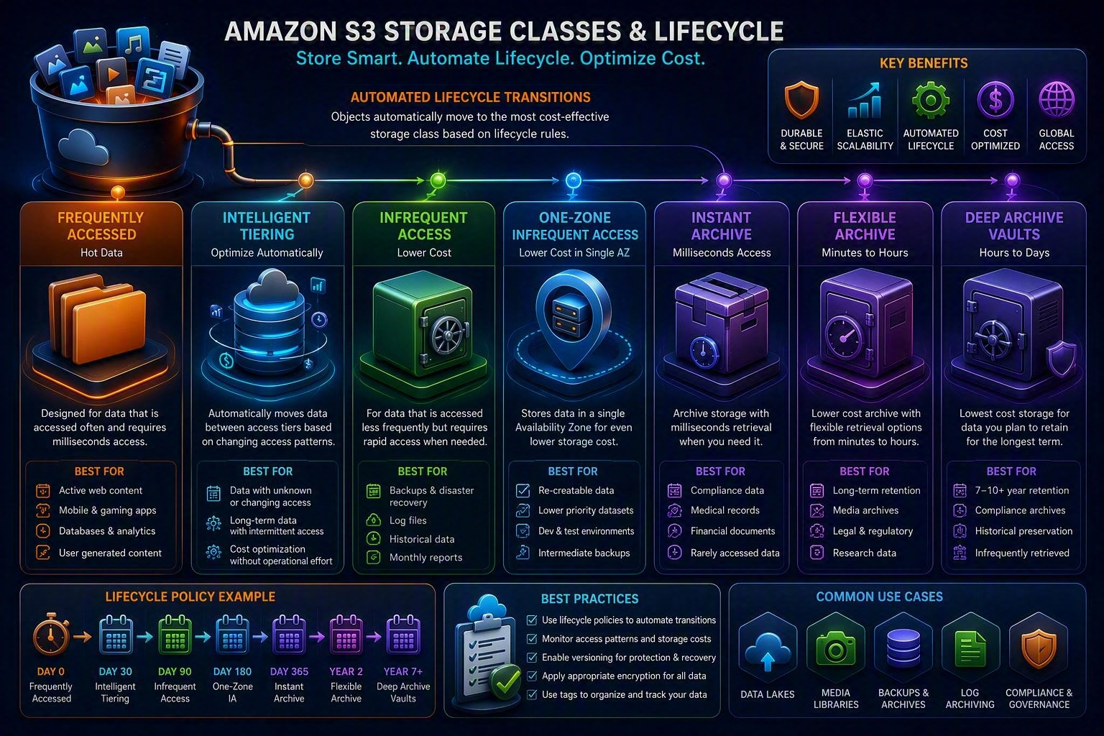
05 | STORAGE CLASSES
Choose using access frequency, retrieval time, and resilience
Hot
S3 Standard; S3 Express One Zone for specialized single-zone, latency-sensitive needs.
Unknown
S3 Intelligent-Tiering for changing or unpredictable access patterns.
Infrequent
Standard-IA or One Zone-IA depending on resilience requirements.
Archive
Glacier Instant Retrieval, Flexible Retrieval, and Deep Archive based on retrieval expectations.
Notes:
[Sources] - S3 storage classes: https://docs.aws.amazon.com/AmazonS3/latest/userguide/storage-class-intro.html - Visual on this slide was generated with Microsoft Copilot.

Slide 7
06 | LIFECYCLE AND COST
Optimize total cost, not storage price alone
●
Storage charge depends on class, object size, Region, and time stored.
●
Requests, retrievals, lifecycle transitions, data transfer, replication, inventory, and monitoring can add cost.
●
Minimum storage duration and minimum billable object size apply to selected classes.
●
Lifecycle rules can transition current and noncurrent versions and expire objects or delete markers.
●
Use Intelligent-Tiering when access is uncertain, but account for per-object monitoring and automation charges.
●
Small-object archives can be inefficient. Aggregate or compact data where the application permits.
●
Measure bytes, object counts, request mix, retrieval frequency, and egress before selecting a class.
Notes:
[Sources] - S3 storage classes: https://docs.aws.amazon.com/AmazonS3/latest/userguide/storage-class-intro.html - S3 pricing: https://aws.amazon.com/s3/pricing/

Slide 8
07 | VERSIONING AND RECOVERY
Versioning protects history, but it also grows cost
Version ID
Delete marker
Each versioned write creates a distinct object version.
A simple DELETE usually creates a delete marker rather than removing prior versions.
Recovery
Noncurrent lifecycle
Remove the delete marker or copy a previous version to restore logical availability.
Transition or expire old versions intentionally to control storage cost.
MFA Delete
Object Lock
Adds protection for selected versioning operations but has operational constraints.
WORM retention in governance or compliance mode for supported assurance requirements.
Notes:
[Sources] - S3 Versioning: https://docs.aws.amazon.com/AmazonS3/latest/userguide/Versioning.html - S3 Object Lock: https://docs.aws.amazon.com/AmazonS3/latest/userguide/object-lock.html

Slide 9
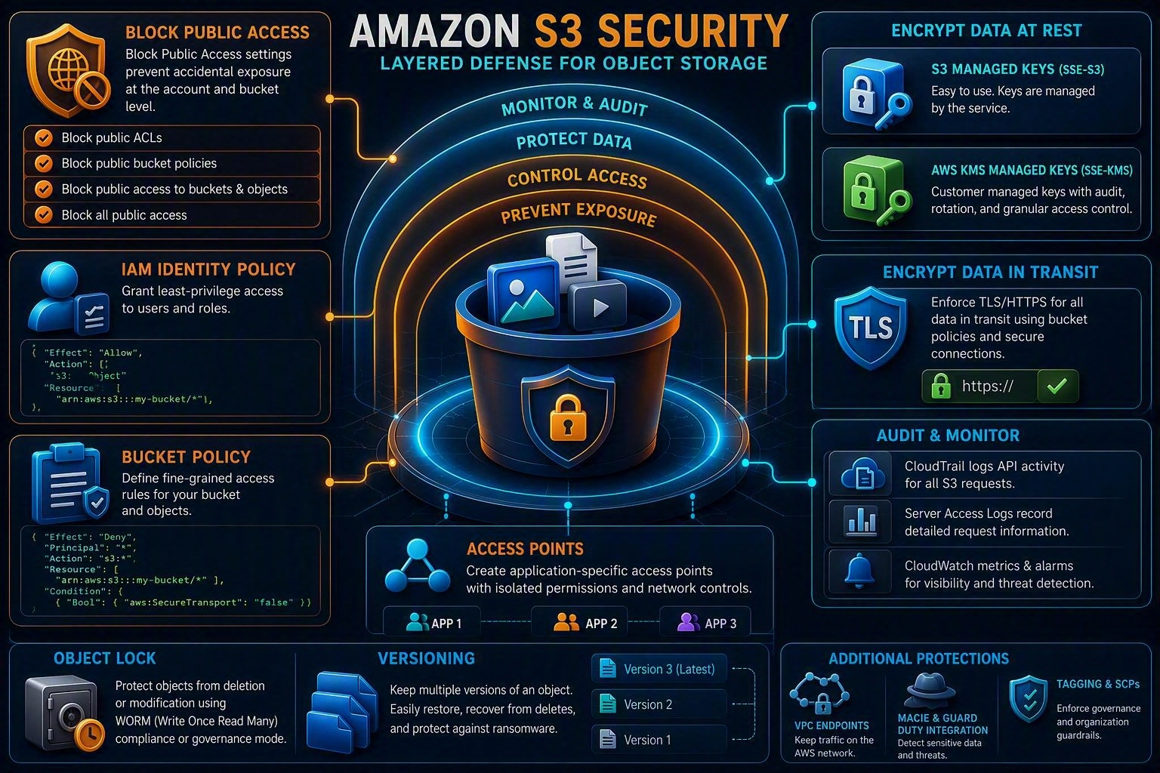
08 | S3 SECURITY
Layer controls instead of relying on one policy
Prevent exposure
Use S3 Block Public Access and Object Ownership settings.
Authorize
Combine IAM, bucket policies, access points, VPC endpoint policies, and organization guardrails.
Encrypt
Use HTTPS in transit and SSE-S3, SSE-KMS, DSSE-KMS, or client-side encryption at rest.
Audit
Use CloudTrail data events, server access logging, S3 Inventory, Config, Macie, and security monitoring as required.
Notes:
[Sources] - S3 security best practices: https://docs.aws.amazon.com/AmazonS3/latest/userguide/security-best-practices.html - Visual on this slide was generated with Microsoft Copilot.

Slide 10
09 | SSE-S3 VS SSE-KMS
Choose encryption based on control and audit requirements
SSE-S3
SSE-KMS
Client-side encryption
S3 manages the encryption keys. Simpler operations and no direct KMS request dependency for each object operation.
Uses AWS KMS keys and supports key policies, audit records, and separation of duties. KMS permissions and quotas become part of the design.
Application encrypts before upload and owns key handling. Strong control with greater operational responsibility and reduced server-side processing options.
Notes:
[Sources] - S3 encryption: https://docs.aws.amazon.com/AmazonS3/latest/userguide/UsingEncryption.html

Slide 11
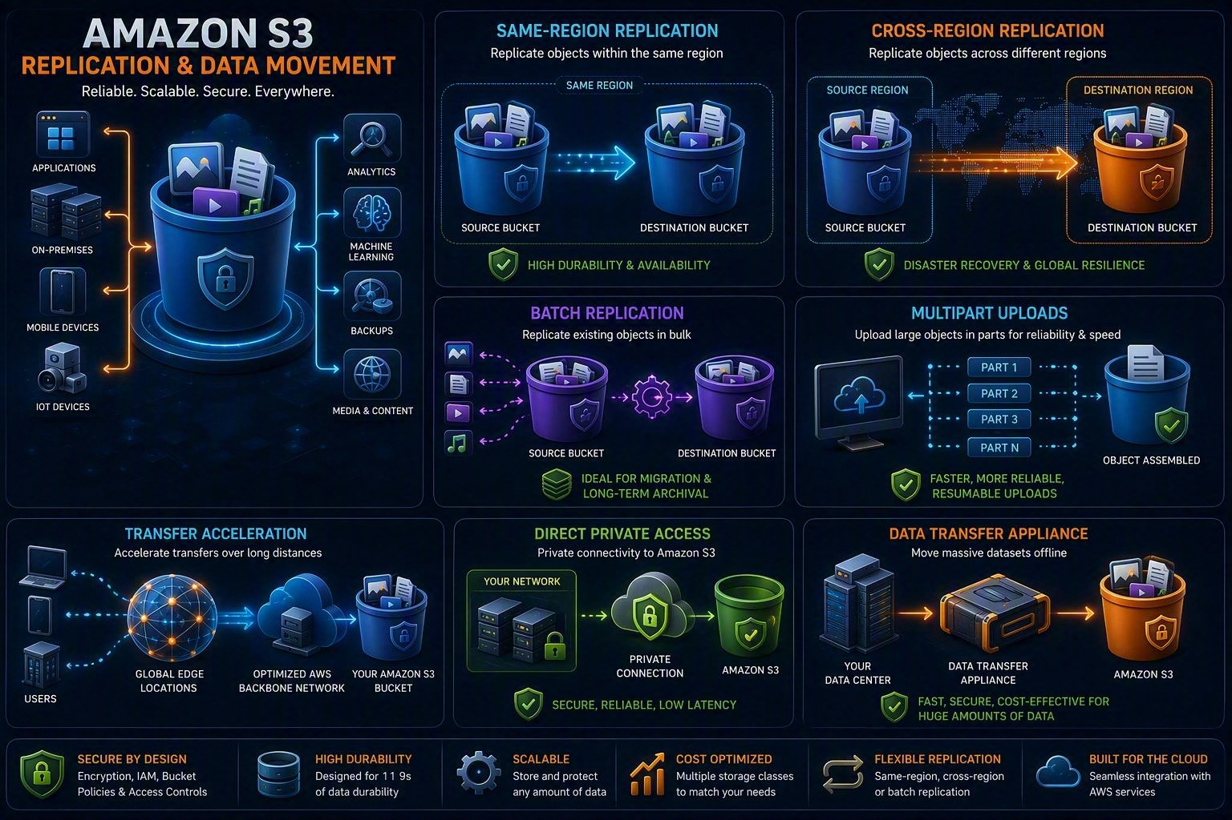
10 | REPLICATION AND MOVEMENT
Replication is a copy strategy, not an automatic backup policy
Live replication
SRR or CRR asynchronously copies new and updated objects according to rules.
Existing objects
S3 Batch Replication copies existing objects or retries failed copies.
Acceleration
Transfer Acceleration routes long-distance uploads through AWS edge infrastructure.
Private paths
Use S3 VPC endpoints, Direct Connect, VPN, DataSync, or transfer appliances based on connectivity needs.
Notes:
[Sources] - S3 replication: https://docs.aws.amazon.com/AmazonS3/latest/userguide/replication.html - Visual on this slide was generated with Microsoft Copilot.

Slide 12
11 | DATA LAKE DESIGN
Interview architecture for enterprise analytics
●
Separate raw, validated, curated, and consumption zones using accounts, buckets, or prefixes according to governance needs.
●
Use open table formats such as Apache Iceberg where ACID table semantics and concurrent writers are needed.
●
Partition by high-value query predicates without creating excessive small files.
●
Use Glue Data Catalog, Lake Formation, or an equivalent governance layer for discovery and access control.
●
Encrypt, classify, tag, inventory, and monitor access to sensitive datasets.
●
Use lifecycle policies for raw history, intermediate data, logs, and noncurrent versions.
●
Design ingestion for idempotency and include reconciliation, schema evolution, and data-quality controls.
Notes:
[Sources] - S3 data lakes: https://aws.amazon.com/s3/data-lakes/

Slide 13
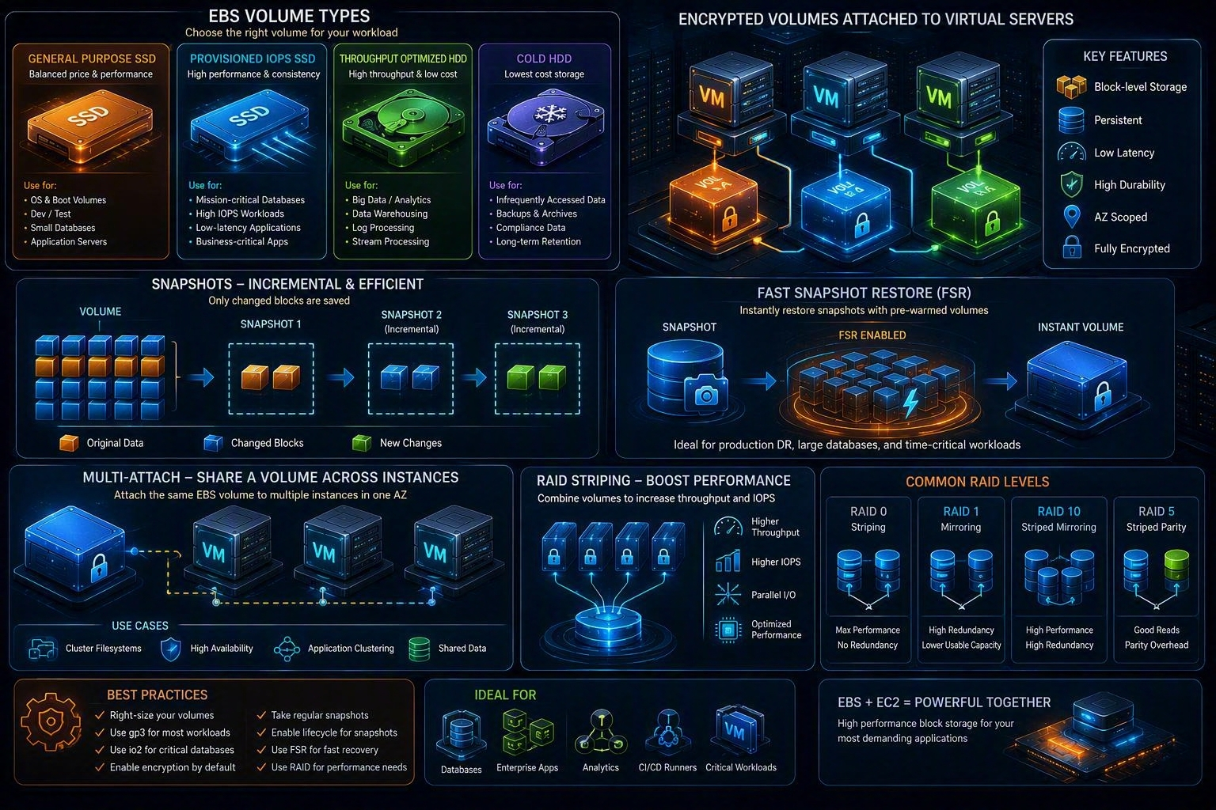
12 | EBS FUNDAMENTALS
Persistent block storage for EC2
Scope
An EBS volume and attached EC2 instance must be in the same Availability Zone.
Persistence
Volumes persist independently of instance running state subject to deletion settings.
Elastic Volumes
Modify size, IOPS, throughput, or type for supported live volumes.
Protection
Encrypt volumes and snapshots; automate snapshots and copies for recovery objectives.
Notes:
[Sources] - Amazon EBS volumes: https://docs.aws.amazon.com/ebs/latest/userguide/ebs-volumes.html - Visual on this slide was generated with Microsoft Copilot.

Slide 14
13 | EBS TYPES
Select by IOPS, throughput, latency, and cost
gp3
gp2
General-purpose SSD. Performance can be provisioned independently of volume size within service limits.
Previous-generation general-purpose SSD where performance is tied more closely to size.
io2 / io1
st1
Provisioned IOPS SSD for sustained, latency-sensitive and transaction-intensive workloads.
Throughput Optimized HDD for large sequential workloads; not a boot-volume type.
sc1
Instance bandwidth
Cold HDD for less frequently accessed, throughput-oriented data; not a boot-volume type.
Volume performance is also limited by EC2-to-EBS bandwidth and workload queue depth.
Notes:
[Sources] - EBS volume types: https://docs.aws.amazon.com/ebs/latest/userguide/ebs-volume-types.html

Slide 15
14 | EBS SNAPSHOTS AND DR
Incremental backups with regional portability
●
Snapshots are incremental after the first snapshot, so only changed blocks are stored.
●
Creating a volume from a snapshot can involve initialization as blocks are first accessed.
●
Fast Snapshot Restore can eliminate initialization latency for selected snapshots and Availability Zones.
●
Copy snapshots across Regions or accounts according to recovery, isolation, and compliance requirements.
●
Snapshot consistency is crash-consistent unless the application and file system are quiesced appropriately.
●
For RAID sets or databases, coordinate snapshots to obtain application-consistent recovery points.
Notes:
[Sources] - EBS snapshots: https://docs.aws.amazon.com/ebs/latest/userguide/ebs-snapshots.html

Slide 16
15 | EBS RAID AND MULTI-ATTACH
Know where complexity moves
RAID 0
RAID 1
Stripes I/O across volumes for aggregate performance. Loss of one volume loses the array.
Mirrors writes. AWS documentation does not generally recommend RAID 1 on EBS because EBS already replicates within an AZ and mirroring consumes bandwidth.
RAID 5/6
RAID 10
Parity write overhead consumes IOPS; AWS documentation does not recommend these configurations for EBS.
Possible at the OS layer, but evaluate cost, bandwidth, recovery, and whether managed database storage is better.
Multi-Attach
Cluster awareness
Supported for selected Provisioned IOPS volumes and Nitro instances in one AZ.
Multi-Attach requires a cluster-aware file system or application-level write coordination.
Notes:
[Sources] - EBS RAID guidance: https://docs.aws.amazon.com/ebs/latest/userguide/raid-config.html - EBS volumes and Multi-Attach: https://docs.aws.amazon.com/ebs/latest/userguide/ebs-volumes.html

Slide 17
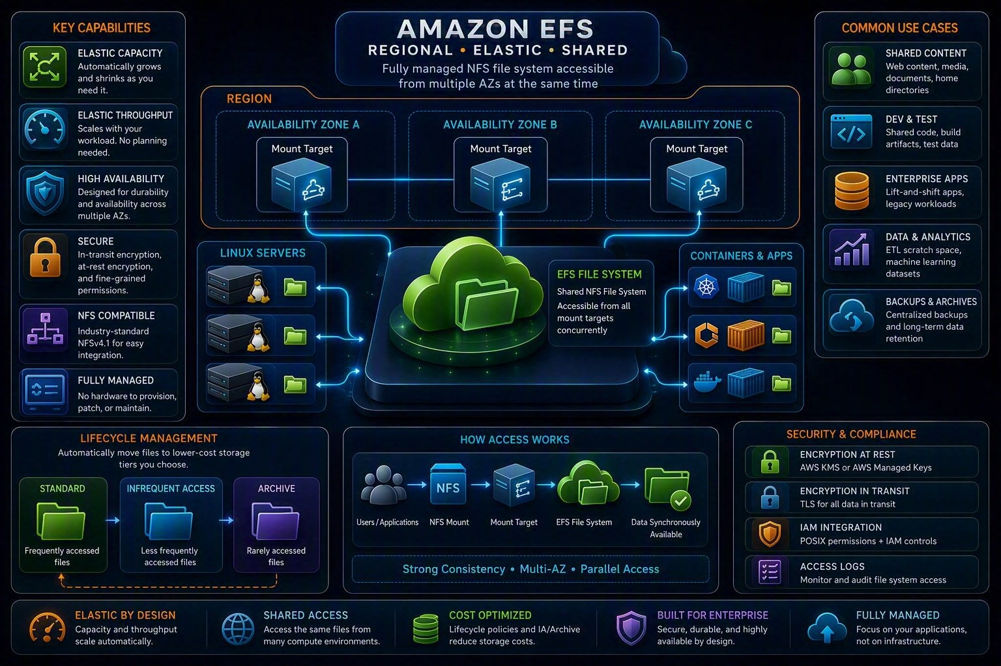
16 | EFS
Regional shared NFS storage
Shared
Many EC2, ECS, EKS, and Lambda clients can access a file system using supported integrations.
Network
Mount targets provide VPC access in selected Availability Zones.
Elastic
Storage grows and shrinks automatically; throughput mode is an independent design choice.
Lifecycle
Move files between Standard, IA, and Archive classes using lifecycle management.
Notes:
[Sources] - EFS storage classes: https://aws.amazon.com/efs/storage-classes/ - EFS performance: https://docs.aws.amazon.com/efs/latest/ug/performance.html - Visual on this slide was generated with Microsoft Copilot.

Slide 18
17 | EFS PERFORMANCE
Performance mode and throughput mode solve different problems
General Purpose
Max I/O
Recommended for faster per-operation performance and most workloads.
Previous-generation mode with higher per-operation latency; evaluate only for applicable existing or specialized workloads.
Elastic throughput
Provisioned throughput
Scales throughput with workload activity and suits changing or unpredictable demand.
Specify throughput independently when the requirement is known.
Bursting throughput
Application design
Throughput depends on stored data and burst credits.
Parallel clients and threads, I/O size, metadata operations, and directory contention materially affect performance.
Notes:
[Sources] - EFS performance: https://docs.aws.amazon.com/efs/latest/ug/performance.html - EFS performance tips: https://docs.aws.amazon.com/efs/latest/ug/performance-tips.html

Slide 19
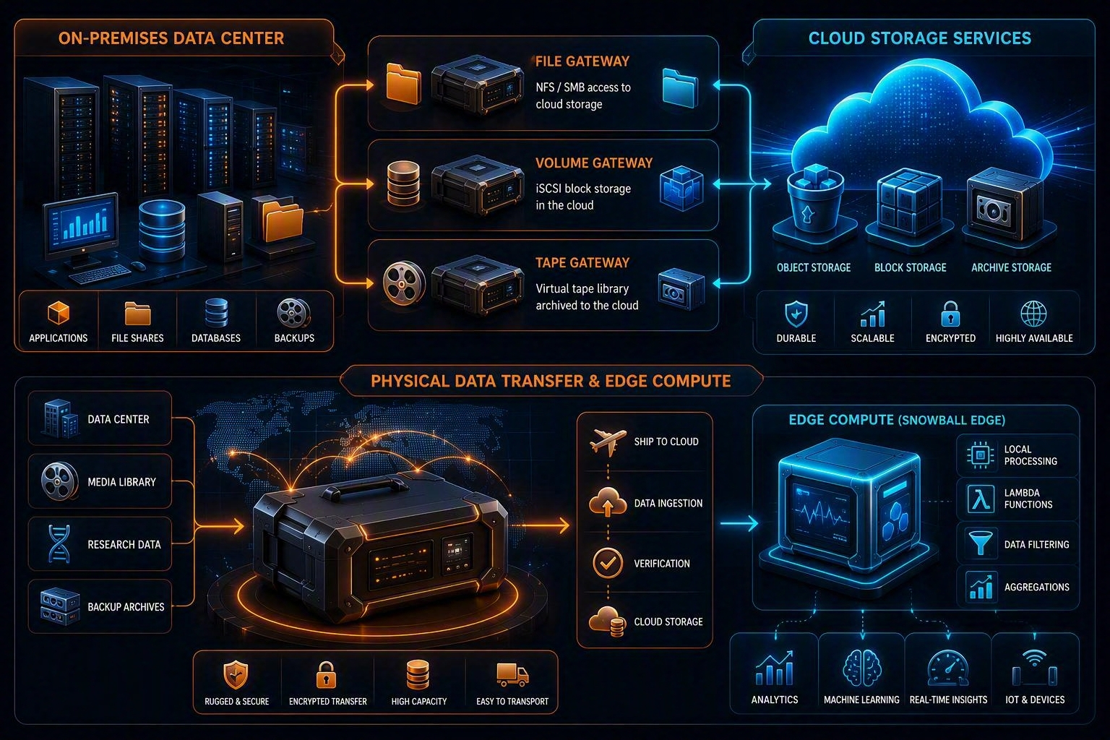
18 | STORAGE GATEWAY AND TRANSFER
Hybrid access is different from data migration
File Gateway
Expose NFS or SMB access while storing cloud-backed file data using the selected gateway type.
Volume Gateway
Expose iSCSI block volumes with cached or stored architecture options.
Tape Gateway
Present a virtual tape library to supported backup applications.
Transfer choice
Use DataSync for online movement; physical transfer options depend on current customer eligibility and service availability.
Notes:
[Sources] - AWS Storage Gateway: https://docs.aws.amazon.com/storagegateway/ - AWS Snow device update, November 12, 2024: https://aws.amazon.com/blogs/storage/aws-snow-device-updates/ - Visual on this slide was generated with Microsoft Copilot.

Slide 20
19 | INTERVIEW DECISION MATRIX
Start with access semantics
API object access, massive scale, metadata-rich data
Mounted low-latency disk for one EC2 workload
Amazon S3
Amazon EBS
Shared Linux NFS namespace across many clients
Windows SMB, Lustre, ONTAP, or OpenZFS semantics
Amazon EFS
Evaluate the appropriate Amazon FSx family.
Ongoing on-premises access to cloud-backed storage
Online migration or recurring high-speed copy
AWS Storage Gateway
AWS DataSync
Partner-managed SFTP, FTPS, or FTP into S3/EFS
Offline transfer requirement
AWS Transfer Family
Evaluate current AWS Data Transfer Terminal, eligible Snow offerings, or partner options.
Notes:
[Sources] - AWS storage overview: https://docs.aws.amazon.com/whitepapers/latest/aws-overview/storage.html - AWS Snow device update: https://aws.amazon.com/blogs/storage/aws-snow-device-updates/

Slide 21
20 | SYSTEM DESIGN ANSWER
Enterprise analytical platform
Raw and curated lake
Spark temporary storage
S3 with table formats, catalog, governance, versioning where required, and lifecycle policies.
Instance store or EBS according to durability and shuffle requirements.
Operational database volumes
Shared model or configuration files
EBS selected by latency, IOPS, throughput, and recovery objectives.
EFS when POSIX/NFS shared-file semantics are needed.
Archive and retention
Disaster recovery
S3 Glacier storage classes plus Object Lock where policy requires WORM.
Backups, cross-Region snapshot copies, S3 replication where appropriate, and tested recovery procedures.
Notes:
[Sources] - Architecture recommendations synthesized from cited AWS storage documentation.

Slide 22
21 | FAILURE ANALYSIS
What senior interviewers expect
●
Define RPO, RTO, durability, availability, latency, throughput, IOPS, and consistency separately.
●
Identify the failure domain: disk, host, Availability Zone, Region, account, credential, operator, or software corruption.
●
Explain why replication is not the same as backup: replication may propagate deletes or corruption.
●
Design access control and encryption before data lands, not after migration.
●
Model cost using storage, requests, retrieval, transition, replication, transfer, and operational overhead.
●
Describe monitoring: capacity, request errors, latency, throttling, failed replication, backup success, restore tests, and access anomalies.
●
State trade-offs and validation tests rather than claiming a single service is always best.
Notes:
[Sources] - AWS Well-Architected Reliability Pillar: https://docs.aws.amazon.com/wellarchitected/latest/reliability-pillar/welcome.html - AWS Well-Architected Cost Optimization Pillar: https://docs.aws.amazon.com/wellarchitected/latest/cost-optimization-pillar/welcome.html

Slide 23
22 | TECHNICAL CORRECTIONS
Updates to the original notes
●
AWS storage is not only object and block; file storage is a first-class model, and specialized file services also exist.
●
S3 provides strong consistency. The statement that object storage is necessarily eventually consistent is outdated for S3.
●
S3 has a flat object-key namespace; console folders are prefixes.
●
Reduced Redundancy Storage still appears in documentation but AWS recommends not using it.
●
Cross-Region Replication does not make one bucket “available in two Regions.” It asynchronously copies objects to destination bucket or buckets.
●
EBS volumes replicate across servers within one Availability Zone, not automatically across multiple AZs.
●
RAID 1, RAID 5, and RAID 6 are not recommended by AWS for common EBS architectures; RAID 0 is the documented performance pattern.
●
EFS is not specifically recommended as a message-queue database. Choose storage based on the queue product’s supported consistency and locking model.
●
Snowball Edge availability changed: effective November 7, 2025 it is limited to existing customers according to the AWS notice.
Notes:
[Sources] - S3 consistency: https://aws.amazon.com/s3/consistency/ - S3 storage classes: https://docs.aws.amazon.com/AmazonS3/latest/userguide/storage-class-intro.html - EBS RAID: https://docs.aws.amazon.com/ebs/latest/userguide/raid-config.html - AWS Snow device update: https://aws.amazon.com/blogs/storage/aws-snow-device-updates/

Slide 24
23 | KNOWLEDGE CHECK
Pass the interview scenarios
Unknown access pattern for long-lived S3 objects
Highest-control KMS audit and key-policy model for S3
S3 Intelligent-Tiering
SSE-KMS or DSSE-KMS according to requirements
Database requires sustained provisioned IOPS on EC2
Many Linux servers need the same directory tree
EBS io2 or applicable Provisioned IOPS option
EFS Regional file system
Copy existing S3 objects to a new Region
On-premises backup software expects virtual tapes
S3 Batch Replication
Tape Gateway
Need SQL on Parquet objects without managing servers
Need shared Windows SMB semantics
Athena over S3
Evaluate FSx for Windows File Server
Notes:
[Sources] - Knowledge checks created from cited AWS documentation.

Slide 25
24 | FINAL MEMORY MAP
Nine phrases to remember
S3
Objects, APIs, scale
S3 consistency
Strong after successful writes
Lifecycle
Access pattern drives class
Versioning
Recovery history plus cost
EBS
AZ-scoped block device
EBS snapshot
Incremental recovery point
EFS
Regional shared NFS
Storage Gateway
Ongoing hybrid access
DataSync
Online data movement
Interview formula: access semantics → performance → resilience → security → operations → cost.
Notes:
[Sources] - Summary created from cited AWS documentation.

