Slide 1
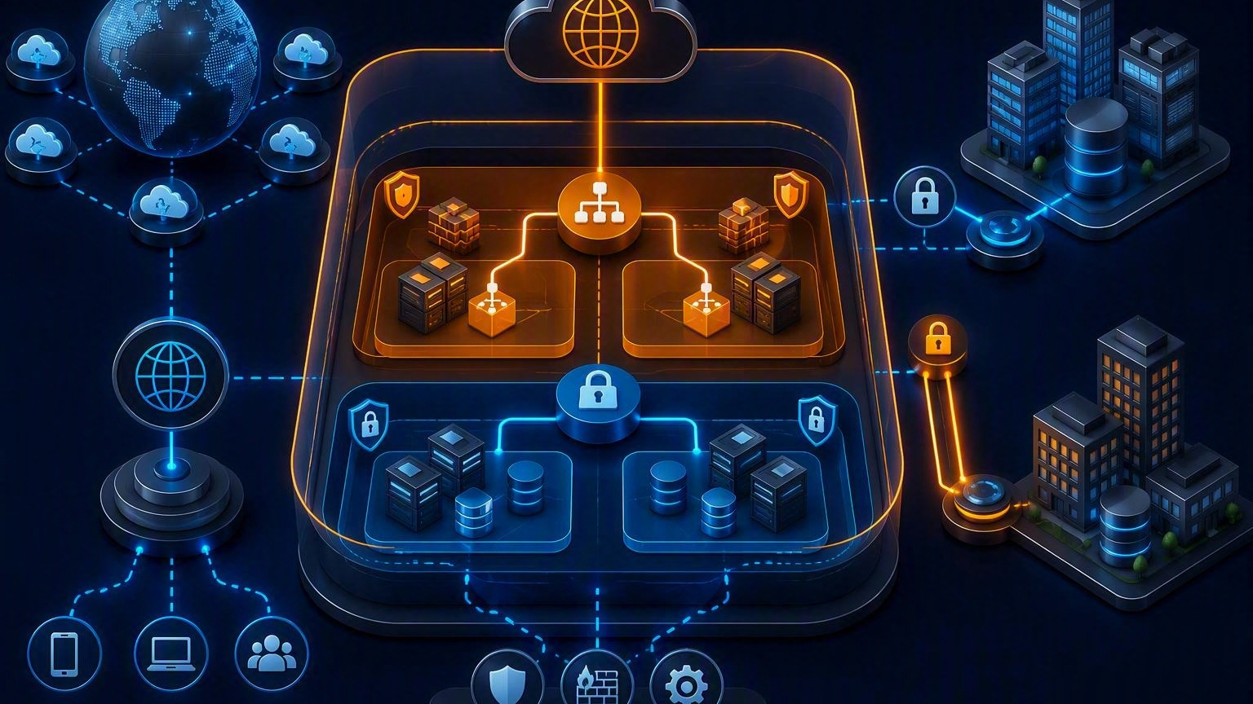
AN OVERVIEW
OF AWS
Cloud fundamentals for compute, storage, databases, and networking
Instructor-ready teaching deck
Prem Vishnoi
Notes:
[Sources] - AWS Overview whitepaper, publication date June 2, 2026: https://docs.aws.amazon.com/whitepapers/latest/aws-overview/introduction.html - Visual on this slide was generated with Microsoft Copilot.

Slide 2
01 | LEARNING OBJECTIVES
What learners should remember
●
Explain cloud computing using on-demand access and pay-as-you-go consumption.
●
Differentiate IaaS, PaaS, SaaS, and serverless by management responsibility.
●
Recognize major AWS compute, storage, database, and networking options.
●
Select a reasonable starting service for a simple business scenario.
●
Avoid common beginner misconceptions about ECS, storage classes, and managed services.
Notes:
[Sources] - AWS Cloud Essentials: https://aws.amazon.com/getting-started/cloud-essentials/

Slide 3
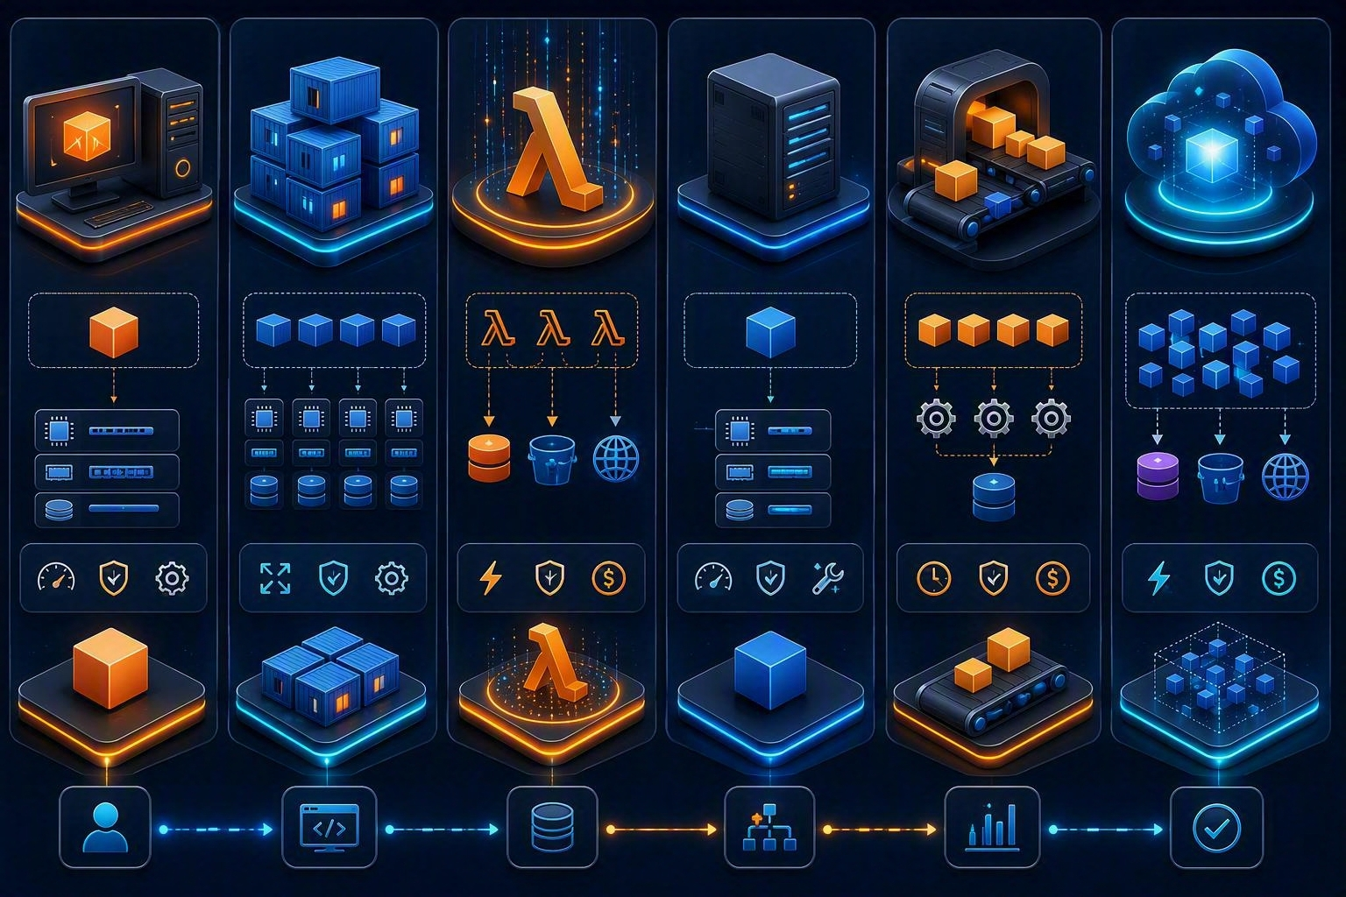
02 | CLOUD BASICS
Why organizations use cloud
On demand
Provision IT resources when needed rather than procuring hardware in advance.
Elastic
Scale capacity up or down as workload demand changes.
Pay as you go
Consume services with variable usage-based pricing rather than large upfront infrastructure expense.
Notes:
[Sources] - AWS Cloud Essentials: https://aws.amazon.com/getting-started/cloud-essentials/ - Visual on this slide was generated with Microsoft Copilot.

Slide 4
03 | SERVICE MODELS
IaaS vs. PaaS vs. SaaS
The higher the abstraction, the more operational responsibility shifts to the provider.
IaaS
PaaS / managed platform
SaaS
Provider: facilities, hardware, virtualization
Customer: OS, runtime, apps, data
Example starting point: EC2
Provider manages more of the runtime or data platform
Customer focuses on configuration, code, and data
Examples: RDS, Elastic Beanstalk
Provider delivers the finished application
Customer manages users, settings, and data usage
Example concept: business application subscription
Teaching cue: ask “Who patches the operating system?” to reveal the service model.
Notes:
[Sources] - AWS Builder Center cloud service models, published January 28, 2026: https://builder.aws.com/content/38sYwauLLJfMHBLhZ6pGHeHOsM8/detailed-guide-to-cloud-service-models-iaas-paas-saas-and-beyond

Slide 5
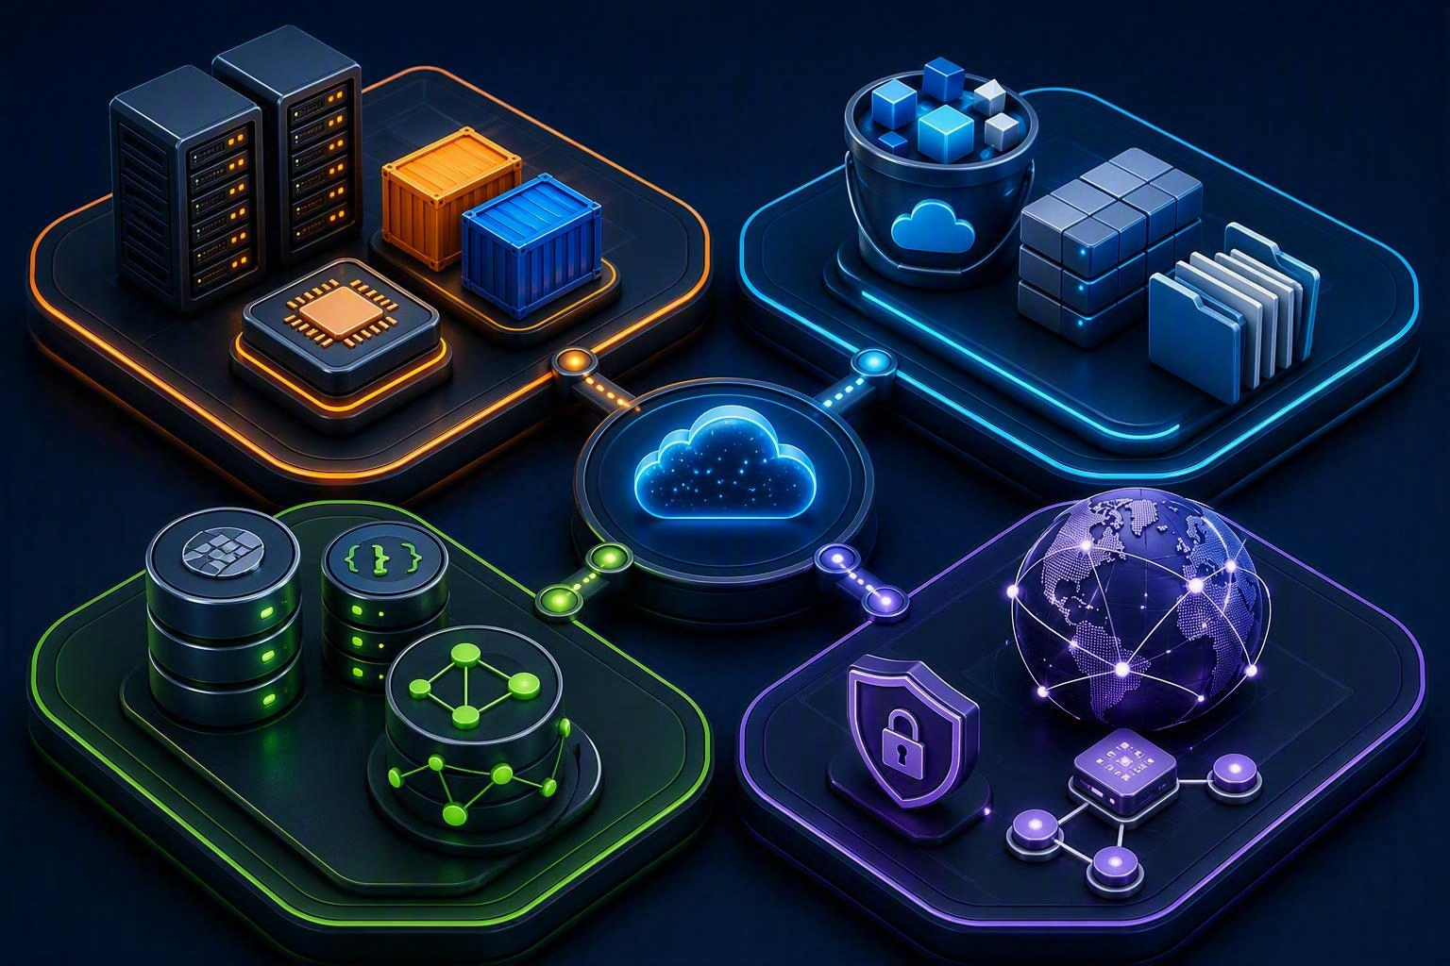
04 | AWS MAP
Four foundational service families
Compute
Storage
Run VMs, containers, functions, and batch jobs.
Store objects, blocks, files, and archives.
Database
Network
Use relational, NoSQL, graph, cache, or warehouse engines.
Isolate, connect, route, balance, and deliver traffic.
Notes:
[Sources] - AWS Overview whitepaper: https://docs.aws.amazon.com/whitepapers/latest/aws-overview/introduction.html - Visual on this slide was generated with Microsoft Copilot.

Slide 6
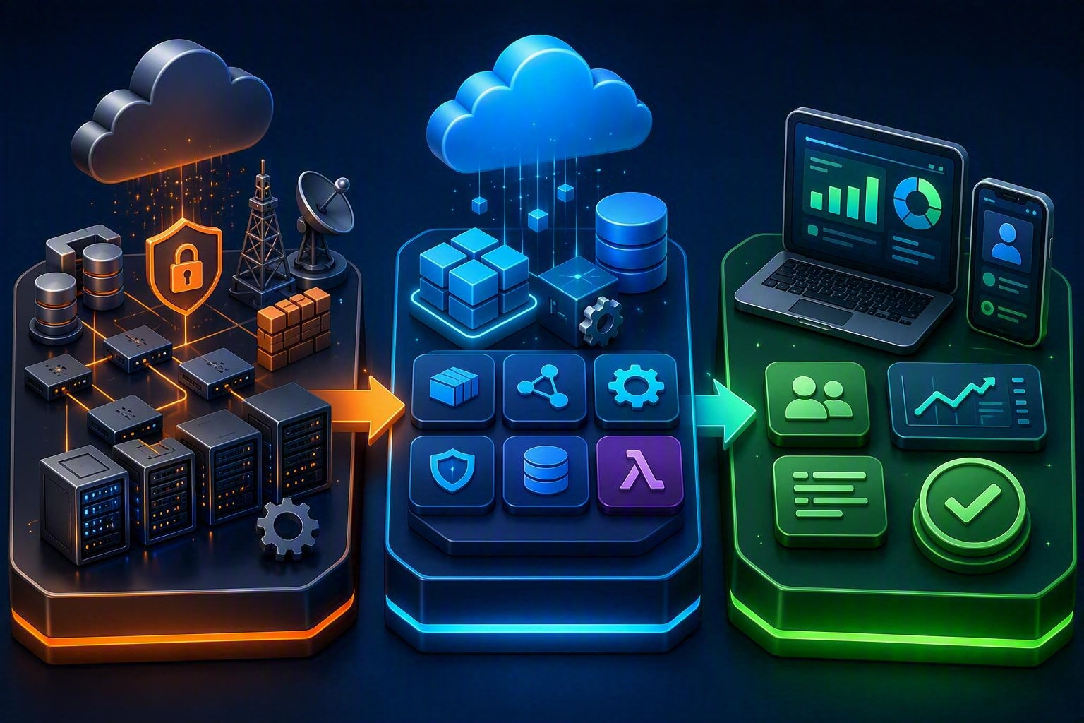
05 | COMPUTE
Choose the operating model before the instance type
EC2
Lightsail
Resizable virtual servers. You manage the guest OS and application.
Simplified virtual servers and packaged resources for straightforward workloads.
ECS / EKS
Lambda
ECS orchestrates containers. EKS is managed Kubernetes.
Run event-driven code without managing servers.
AWS Batch
Schedules batch jobs and provisions suitable compute capacity.
Notes:
[Sources] - AWS Documentation landing page: https://docs.aws.amazon.com/ - AWS Overview whitepaper: https://docs.aws.amazon.com/whitepapers/latest/aws-overview/introduction.html - Visual on this slide was generated with Microsoft Copilot.

Slide 7
06 | COMPUTE DECISION
Use the simplest model that meets control requirements
Need full OS control?
Need a simple VPS bundle?
EC2
Lightsail
Docker containers?
Kubernetes APIs and ecosystem?
ECS
EKS
Short event-driven function?
Queued batch workload?
Lambda
AWS Batch
Notes:
[Sources] - AWS Documentation landing page: https://docs.aws.amazon.com/

Slide 8
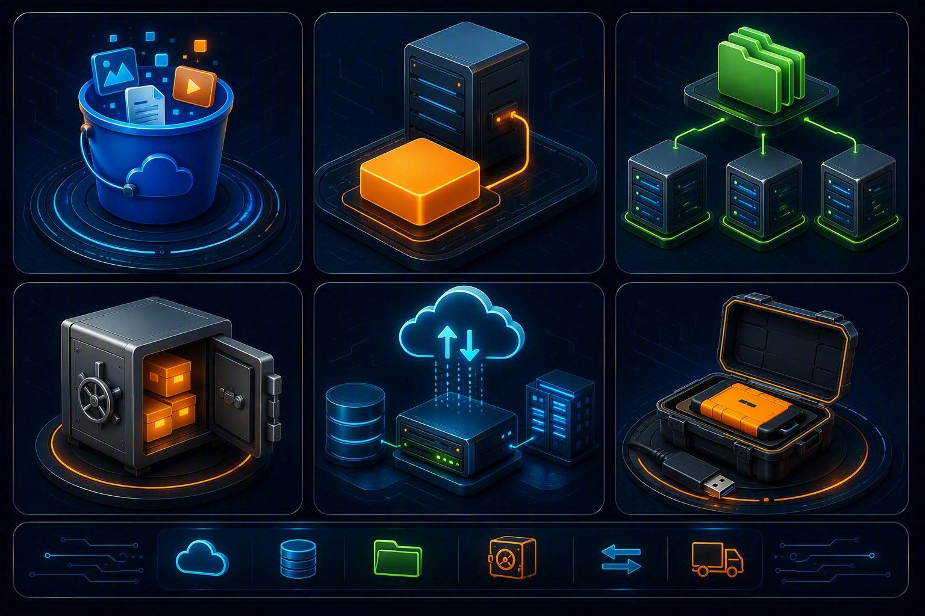
07 | STORAGE
Object, block, file, archive, hybrid, and transfer
S3
EBS
Object storage for data lakes, backups, applications, and static assets.
Block volumes commonly attached to EC2 instances.
EFS
S3 Glacier classes
Managed shared file storage that can be mounted by multiple clients.
Archive-oriented S3 storage classes with different access and retrieval characteristics.
Storage Gateway
Snow Family
Hybrid access connecting on-premises environments with AWS storage.
Physical devices and edge capabilities for data transfer and selected edge workloads.
Notes:
[Sources] - AWS Documentation landing page: https://docs.aws.amazon.com/ - AWS Overview whitepaper: https://docs.aws.amazon.com/whitepapers/latest/aws-overview/introduction.html - Visual on this slide was generated with Microsoft Copilot.

Slide 9
08 | STORAGE MEMORY AID
Match the access pattern
●
Object: “Give me an object by key” → Amazon S3.
●
Block: “Give my server a disk” → Amazon EBS.
●
File: “Share folders using a file-system interface” → Amazon EFS.
●
Archive: “Retain infrequently accessed data at lower storage cost” → S3 Glacier storage classes.
●
Hybrid: “Connect local applications to cloud storage” → AWS Storage Gateway.
●
Offline transfer: “Move very large datasets with appliances” → AWS Snow Family.
Notes:
[Sources] - AWS Documentation landing page: https://docs.aws.amazon.com/

Slide 10

09 | DATABASES
Choose by data model and access pattern
RDS
Aurora
Managed relational engines including MySQL, PostgreSQL, MariaDB, Oracle, and SQL Server.
AWS relational engine compatible with MySQL and PostgreSQL.
DynamoDB
Neptune
Managed NoSQL database designed for key-value and document workloads.
Managed graph database for relationship-centric queries.
ElastiCache
Redshift
Managed in-memory caching compatible with supported cache engines.
Managed cloud data warehouse for analytics.
Notes:
[Sources] - AWS Documentation landing page: https://docs.aws.amazon.com/ - AWS Overview whitepaper: https://docs.aws.amazon.com/whitepapers/latest/aws-overview/introduction.html - Visual on this slide was generated with Microsoft Copilot.

Slide 11
10 | DATABASE DECISION
Start with the question, not the product
●
Transactions, joins, and familiar SQL engines → RDS or Aurora.
●
Massive key-value or document access at managed scale → DynamoDB.
●
Relationship traversal such as recommendations or fraud networks → Neptune.
●
Low-latency cache to reduce pressure on a primary database → ElastiCache.
●
Large-scale analytical SQL and warehousing → Redshift.
Notes:
[Sources] - AWS Documentation landing page: https://docs.aws.amazon.com/

Slide 12

11 | NETWORKING
Build isolation, connectivity, routing, and delivery
VPC
Elastic Load Balancing
Logically isolated network with subnets, routes, and security controls.
Distributes incoming traffic across multiple targets.
Route 53
CloudFront
DNS and traffic-routing service.
Content delivery through distributed edge locations.
Direct Connect
Dedicated network connection between an environment and AWS.
Notes:
[Sources] - AWS Overview whitepaper: https://docs.aws.amazon.com/whitepapers/latest/aws-overview/introduction.html - Visual on this slide was generated with Microsoft Copilot.

Slide 13
12 | PUT IT TOGETHER
A simple three-tier web application
Route 53 + CloudFront
Load Balancer
EC2 / ECS / Lambda
RDS / DynamoDB
S3
Resolve and accelerate
→
Distribute requests
→
Run application logic
→
Persist operational data
→
Store objects and assets
Instructor prompt: Which component changes if traffic becomes unpredictable? Which component changes if relational joins are unnecessary?
Notes:
[Sources] - Teaching architecture synthesized from the AWS service descriptions in the AWS Overview whitepaper: https://docs.aws.amazon.com/whitepapers/latest/aws-overview/introduction.html

Slide 14
13 | KNOWLEDGE CHECK
Can the learner choose the service?
Q1 You need full control of a Linux guest OS.
Q2 Several servers need a shared file system.
Answer: EC2
Answer: EFS
Q3 Code should run when a file arrives.
Q4 You need managed MySQL-compatible relational storage.
Answer: Lambda
Answer: RDS or Aurora
Q5 You need DNS-based routing.
Q6 You need Kubernetes compatibility.
Answer: Route 53
Answer: EKS
Notes:
[Sources] - Knowledge-check questions created for this presentation from cited AWS service descriptions.

Slide 15
14 | CORRECTIONS
Important updates to the source notes
●
ECS is a managed container orchestration service, not “managed Kubernetes.” Amazon EKS is the managed Kubernetes service.
●
Use “Amazon EFS” or “Elastic File System,” not “Elastic file System.”
●
Use “Amazon ElastiCache,” not “ElasticCache.”
●
Use “AWS Snow Family” and “Snowball,” not “Snow Ball.”
●
Avoid fixed Glacier restore-time and price claims in teaching slides because retrieval options and pricing vary by storage class, Region, and date.
●
PaaS is best explained as a responsibility shift, not as a single rigid AWS product category.
Notes:
[Sources] - AWS Documentation landing page: https://docs.aws.amazon.com/ - AWS Builder Center cloud service models: https://builder.aws.com/content/38sYwauLLJfMHBLhZ6pGHeHOsM8/detailed-guide-to-cloud-service-models-iaas-paas-saas-and-beyond

Slide 16
15 | RECAP
The five ideas to remember
1
2
Cloud delivers IT resources on demand.
Service models differ by who manages each layer.
3
4
Compute choice begins with VM, container, function, or batch.
Storage and database choices begin with access pattern and data model.
5
Networking connects, isolates, routes, balances, and accelerates.
Teach the decision process, not only the service names.
Notes:
[Sources] - AWS Cloud Essentials: https://aws.amazon.com/getting-started/cloud-essentials/ - AWS Overview whitepaper: https://docs.aws.amazon.com/whitepapers/latest/aws-overview/introduction.html

