Slide 1

SECURE, CONNECT,
AND STAY AVAILABLE
AWS Security • Application Integration • Regions & Availability Zones
Instructor-ready teaching deck
Prem Vishnoi
Notes:
[Sources] - AWS Security services overview: https://docs.aws.amazon.com/whitepapers/latest/aws-overview/security-services.html - AWS Global Infrastructure: https://aws.amazon.com/about-aws/global-infrastructure/regions_az/ - Visual on this slide was generated with Microsoft Copilot.

Slide 2
01 | LEARNING MAP
Three questions this lesson answers
SECURE
INTEGRATE
RESILIENT
Who can access? What threats exist? How is evidence obtained?
How do distributed components communicate without tight coupling?
Where do workloads run, and how do they survive infrastructure failure?
Memory model: Secure the actors → Connect the components → Distribute the workload.
Notes:
[Sources] - Lesson structure synthesized from user-provided topics and cited AWS documentation.

Slide 3
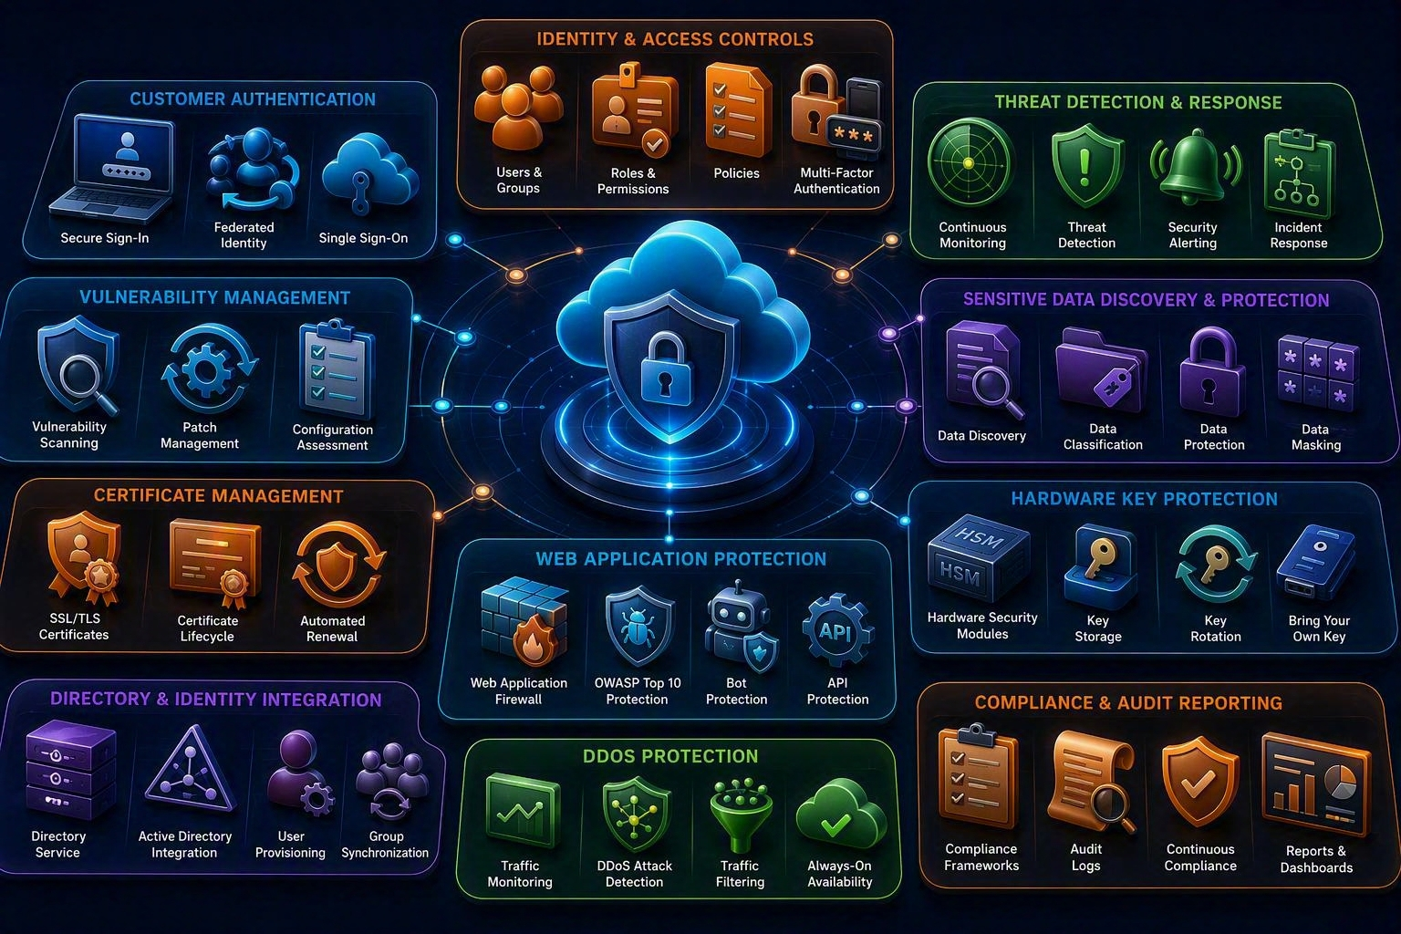
02 | SECURITY MODEL
Security, identity, and compliance are connected responsibilities
Identity
Authenticate principals and authorize only required actions.
Security
Prevent, detect, investigate, and respond to threats and vulnerabilities.
Compliance
Access reports, agreements, and evidence supporting assurance activities.
Notes:
[Sources] - AWS Security services overview: https://docs.aws.amazon.com/whitepapers/latest/aws-overview/security-services.html - Visual on this slide was generated with Microsoft Copilot.

Slide 4
03 | IAM
Control access to AWS resources
●
Principal: a user, role, workload, or federated identity making a request.
●
Authentication answers “Who are you?”
●
Authorization answers “What are you allowed to do?”
●
Policies define allowed or denied actions on resources under conditions.
●
Roles provide temporary credentials and are preferred for workloads.
●
Apply least privilege, MFA for human access, and avoid long-lived access keys.
Notes:
[Sources] - AWS Identity and Access Management in AWS security overview: https://docs.aws.amazon.com/whitepapers/latest/aws-overview/security-services.html

Slide 5
04 | IAM MEMORY AID
PARC: Principal, Action, Resource, Condition
P • Principal
A • Action
Who is making the request?
What operation is requested?
R • Resource
C • Condition
Which resource is targeted?
Under what context is access valid?
Decision rule: an explicit deny wins over an allow.
Notes:
[Sources] - IAM concept summary created for teaching from AWS IAM service description in the AWS security overview.

Slide 6
05 | IDENTITY FOR APPLICATIONS
IAM vs. Amazon Cognito
AWS IAM
Amazon Cognito
Use for workforce, administrators, AWS services, and workloads accessing AWS resources. Focuses on AWS authorization and account/resource permissions.
Adds user sign-up, sign-in, and access control to web and mobile applications. Can integrate social, SAML, or existing identity providers.
Memory cue: IAM protects AWS access. Cognito provides customer-facing application identity.
Notes:
[Sources] - Amazon Cognito description: https://docs.aws.amazon.com/whitepapers/latest/aws-overview/security-services.html

Slide 7
06 | DETECT AND PROTECT
Know the defining job of each security service
GuardDuty
Inspector
Threat detection from AWS data sources and activity signals.
Continuous vulnerability management for supported compute workloads.
Macie
ACM
Discovers and helps protect sensitive data in Amazon S3.
Provision and manage public and private SSL/TLS certificates.
CloudHSM
Directory Service
Single-tenant hardware security modules under customer control.
Managed directory options and Microsoft Active Directory integration.
Notes:
[Sources] - AWS Security services overview: https://docs.aws.amazon.com/whitepapers/latest/aws-overview/security-services.html

Slide 8
07 | EDGE AND COMPLIANCE
Protect applications and retrieve assurance evidence
AWS WAF
AWS Shield
AWS Artifact
Shared responsibility
Filters HTTP and HTTPS requests using web access-control rules. Use for application-layer traffic patterns such as malicious requests.
Managed DDoS protection. Shield Standard is automatically included for AWS customers; Shield Advanced adds expanded protections and response capabilities.
On-demand access to AWS security and compliance reports and selected agreements.
AWS secures the cloud. Customers secure their workloads, configurations, identities, and data in the cloud.
Notes:
[Sources] - AWS Security services overview: https://docs.aws.amazon.com/whitepapers/latest/aws-overview/security-services.html

Slide 9
08 | SECURITY DECISION
Which service answers the question?
●
“Who can call this API?” → IAM policy and role.
●
“How do customers sign in to the mobile app?” → Amazon Cognito.
●
“Is suspicious account activity occurring?” → Amazon GuardDuty.
●
“Which supported workloads have software vulnerabilities?” → Amazon Inspector.
●
“Where is sensitive data stored in S3?” → Amazon Macie.
●
“How do I filter malicious web requests?” → AWS WAF.
●
“Where can auditors obtain AWS compliance reports?” → AWS Artifact.
Notes:
[Sources] - AWS Security services overview: https://docs.aws.amazon.com/whitepapers/latest/aws-overview/security-services.html

Slide 10
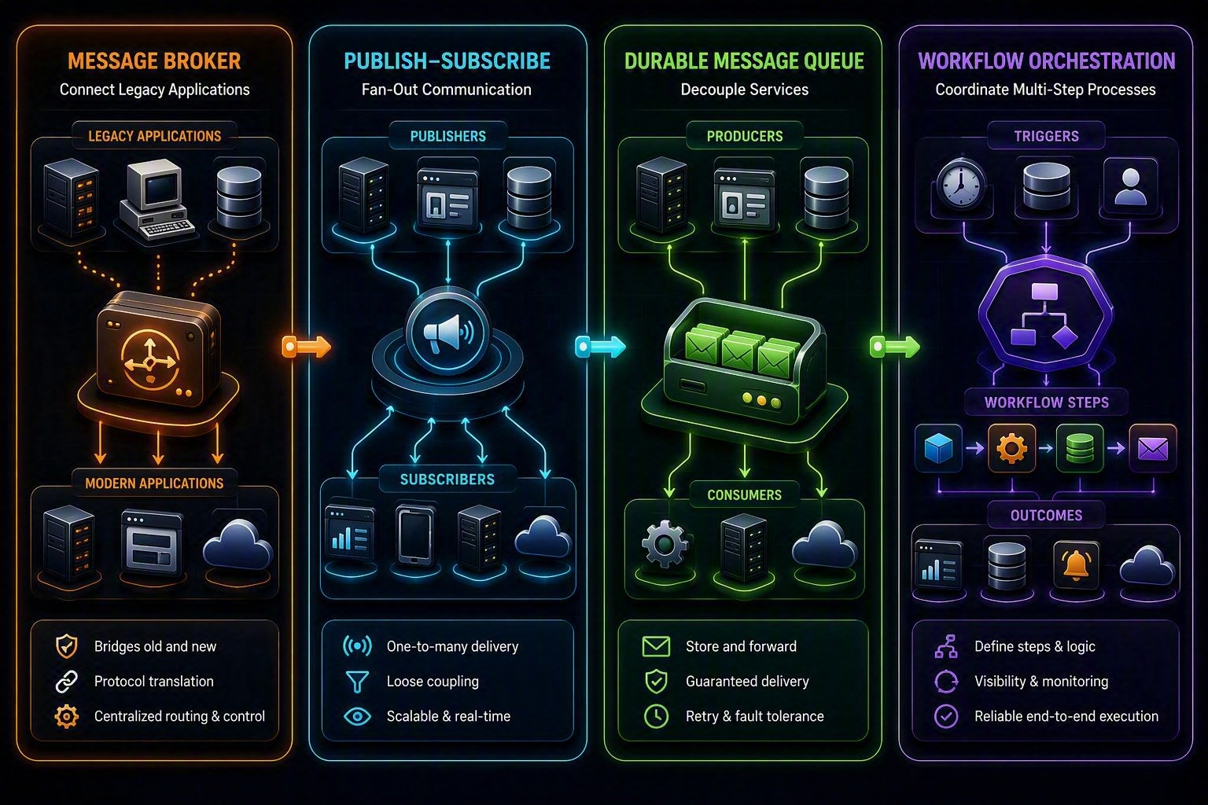
09 | APPLICATION INTEGRATION
Decouple communication from execution
Amazon MQ
Amazon SNS
Managed brokers for applications using standard messaging protocols and broker APIs.
Publish-subscribe messaging and fanout to multiple subscribers.
Amazon SQS
Step Functions
Durable queue that buffers work between producers and consumers.
Orchestrates multi-step workflows using state machines.
Amazon SWF
Workflow service for coordinating work across distributed components and workers.
Notes:
[Sources] - User-provided application integration topic - AWS Application Integration overview: https://docs.aws.amazon.com/whitepapers/latest/aws-overview/application-integration.html - Visual on this slide was generated with Microsoft Copilot.

Slide 11
10 | SQS
Queue pattern: producer → buffer → consumer
Producer
SQS queue
Consumer
Creates work and sends a message without waiting for processing to finish.
Stores messages durably and absorbs spikes between components.
Polls, processes, and deletes successful messages. Failed messages can be retried and isolated using a dead-letter queue.
→
→
Memory cue: SQS preserves work until a consumer is ready.
Notes:
[Sources] - Amazon SQS description in AWS Application Integration overview: https://docs.aws.amazon.com/whitepapers/latest/aws-overview/application-integration.html

Slide 12
11 | SNS
Fanout pattern: one publication, many subscribers
SQS queue
Each receives a copy according to the subscription configuration.
Publisher
SNS topic
Sends one message to an SNS topic.
→
Routes the publication to subscribed endpoints.
Lambda function
Each receives a copy according to the subscription configuration.
HTTP endpoint
Each receives a copy according to the subscription configuration.
Memory cue: SNS broadcasts. SQS buffers.
Notes:
[Sources] - Amazon SNS description in AWS Application Integration overview: https://docs.aws.amazon.com/whitepapers/latest/aws-overview/application-integration.html

Slide 13
12 | MQ AND WORKFLOWS
Broker compatibility vs. process orchestration
Amazon MQ
AWS Step Functions
Amazon SWF
Choose when migrating or integrating applications that already use broker protocols or APIs such as ActiveMQ or RabbitMQ patterns. The broker transports messages.
Choose for new visual, state-machine-based orchestration across AWS services. The workflow coordinates steps, branching, retries, and state.
Supports workflow coordination using deciders and activity workers. Consider existing SWF workloads and specialized external-worker patterns.
Notes:
[Sources] - AWS Application Integration overview: https://docs.aws.amazon.com/whitepapers/latest/aws-overview/application-integration.html

Slide 14
13 | INTEGRATION DECISION
Remember B-B-O: Broker, Broadcast, Buffer, Orchestrate
Broker compatibility
Broadcast one event to many targets
Amazon MQ
Amazon SNS
Buffer work and decouple producer from consumer
Orchestrate multi-step business logic
Amazon SQS
AWS Step Functions
Maintain or extend an existing SWF workflow
Amazon SWF
Notes:
[Sources] - AWS Application Integration overview: https://docs.aws.amazon.com/whitepapers/latest/aws-overview/application-integration.html

Slide 15
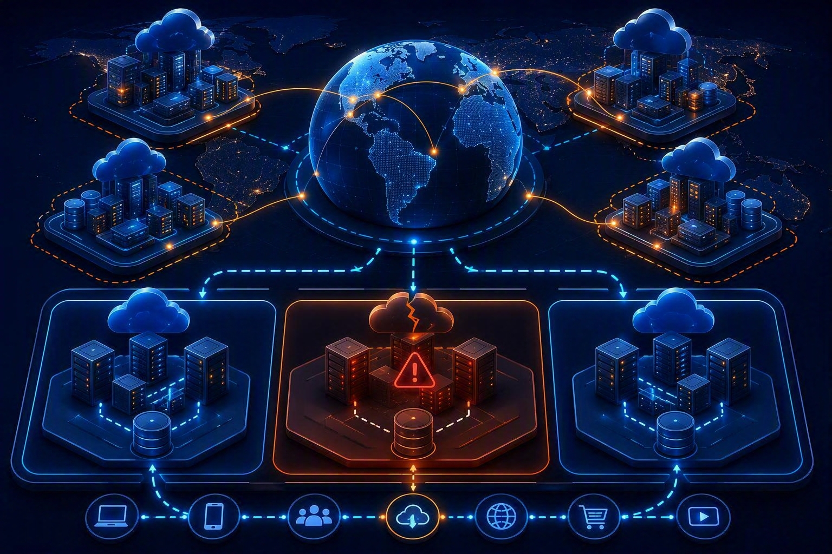
14 | GLOBAL INFRASTRUCTURE
Region, Availability Zone, and data center
Region
A physical geographic location containing multiple Availability Zones.
Availability Zone
One or more discrete data centers with independent power, networking, and connectivity.
Data center
A physical facility. An Availability Zone can contain one or more data centers.
Notes:
[Sources] - AWS Global Infrastructure Regions and AZs: https://aws.amazon.com/about-aws/global-infrastructure/regions_az/ - Visual on this slide was generated with Microsoft Copilot.

Slide 16
15 | CURRENT FOOTPRINT
Avoid memorizing stale infrastructure counts
As of September 8, 2026
The AWS global infrastructure page lists 39 geographic Regions and 124 Availability Zones, with additional announced expansion.
Teaching rule: explain the architecture concept, then verify the live AWS infrastructure page for current counts.
Notes:
[Sources] - AWS Global Infrastructure Regions and AZs, accessed September 8, 2026: https://aws.amazon.com/about-aws/global-infrastructure/regions_az/

Slide 17
16 | HIGH AVAILABILITY
Multi-AZ design reduces single-zone dependency
●
Deploy application capacity across at least two Availability Zones.
●
Use health checks and load balancing to direct traffic to healthy targets.
●
Replicate or use managed Multi-AZ database capabilities where required.
●
Keep stateless application tiers easy to replace and scale.
●
Back up data and test recovery. Multi-AZ is not the same as backup.
●
Use multiple Regions only when business requirements justify the added complexity.
Notes:
[Sources] - AWS Global Infrastructure Regions and AZs: https://aws.amazon.com/about-aws/global-infrastructure/regions_az/

Slide 18
17 | REGION SELECTION
Choose a Region using business constraints
Latency
Capabilities
Near the majority of users
Required AWS services and features are available
Compliance
Resilience
Data location and regulatory requirements
Disaster-recovery and continuity objectives
Cost
Connectivity
Regional pricing and data-transfer implications
Network paths to users, offices, and other systems
Notes:
[Sources] - AWS Regions guidance: https://docs.aws.amazon.com/global-infrastructure/latest/regions/aws-regions.html

Slide 19
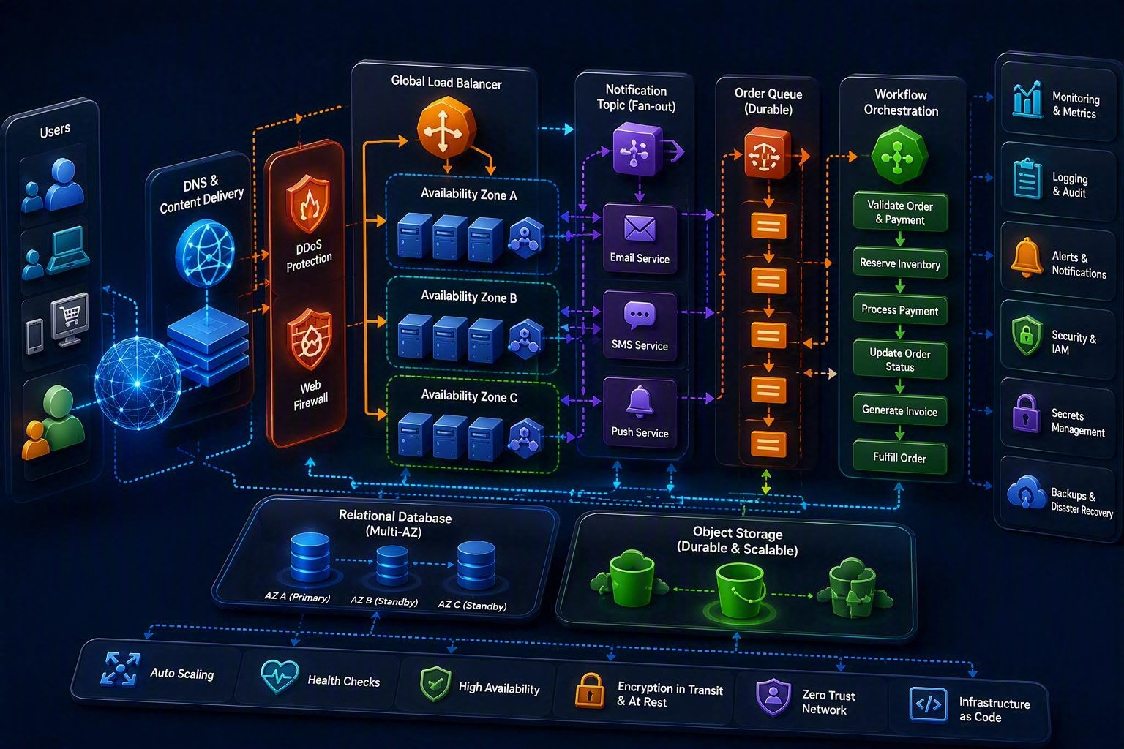
18 | PUT IT TOGETHER
A secure, decoupled, Multi-AZ order platform
Secure
Cognito or IAM, WAF, Shield, certificates, and least privilege.
Integrate
SNS distributes events, SQS buffers work, Step Functions coordinates the process.
Resilient
Load-balanced compute and data services span multiple Availability Zones.
Notes:
[Sources] - Architecture synthesized for teaching from cited AWS service descriptions - Visual on this slide was generated with Microsoft Copilot.

Slide 20
19 | KNOWLEDGE CHECK
Choose the AWS concept or service
Q1 Customer sign-up and sign-in for a mobile app
Q2 Detect suspicious AWS account activity
Answer: Cognito
Answer: GuardDuty
Q3 Discover sensitive data in S3
Q4 Broadcast an order event to many consumers
Answer: Macie
Answer: SNS
Q5 Buffer orders during a demand spike
Q6 Survive failure of one data-center zone
Answer: SQS
Answer: Multi-AZ architecture
Notes:
[Sources] - Knowledge-check questions created for this presentation from cited AWS documentation.

Slide 21
20 | CORRECTIONS
Important updates to the source notes
●
Use “Amazon Cognito,” not “Cognition.” Cognito handles application user sign-up, sign-in, and access control.
●
Amazon Inspector is continuous vulnerability management, not merely an agent installed on a VM.
●
Amazon Macie focuses on discovering and protecting sensitive data in Amazon S3, not an entire application suite.
●
AWS Certificate Manager can manage certificates for integrated AWS services; it is not limited to domains registered through Route 53.
●
AWS CloudHSM stores and uses cryptographic keys in dedicated HSMs. It is not an SSH-key storage service.
●
Do not teach old fixed Region and AZ counts. Verify the current AWS global infrastructure page.
●
For new workflow orchestration lessons, emphasize AWS Step Functions; keep SWF for existing and specialized patterns.
Notes:
[Sources] - AWS Security services overview: https://docs.aws.amazon.com/whitepapers/latest/aws-overview/security-services.html - AWS Global Infrastructure: https://aws.amazon.com/about-aws/global-infrastructure/regions_az/ - AWS Application Integration overview: https://docs.aws.amazon.com/whitepapers/latest/aws-overview/application-integration.html

Slide 22
21 | FINAL RECAP
Seven phrases to remember
IAM
AWS access
Cognito
Application users
GuardDuty / Inspector / Macie
Threats / vulnerabilities / sensitive S3 data
WAF / Shield
Web filtering / DDoS protection
SNS / SQS
Broadcast / buffer
Step Functions
Orchestrate
Region / AZ
Geography / isolated fault domain
Secure the actors. Connect the components. Distribute the workload.
Notes:
[Sources] - Summary created from cited AWS documentation.

