Slide 1


SMART BLOG
AI-DRIVEN CONTENT AND PUBLISHING SYSTEM
TEAM No: A23
SUPERVISED BY :
Mrs. HemaPrabha AP/CSE , SIET
PRESENTED BY :
Dinesh J - (714023104022)
Dinesh kumar S - (714023104023)
Hamanth k - (714023104032)
Kathir S - (714023104046)
Date:28/4/2026
Sri Shakthi.ac.in

Slide 2

OBJECTIVES
SMART BLOG
Develop an AI-driven blogging platform for intelligent content creation.
Provide real-time content suggestions using advanced LLMs (LLaMA, Mixtral).
Enable SEO optimization for improved visibility and search ranking.
Integrate analytics dashboards for data-driven decision making.
Create a unified platform combining writing, design and publishing.
Ensure secure authentication using JWT and role-based access control.
Improve content quality, productivity, and user experience.
Build a scalable and extensible system for future AI enhancements.
Sri Shakthi.ac.in
2

Slide 3
ABSTRACT
SMART BLOG
AI-powered platform for intelligent content creation and publishing.
Integrates LLMs (LLaMA, Mixtral via Groq) for real-time assistance.
Provides content generation, enhancement, and SEO optimization.
Built with Node.js, React, and MongoDB for scalability.
Features analytics dashboards for performance tracking.
Includes design studio for visual content creation.
Ensures secure authentication (JWT + role-based access).
Eliminates workflow fragmentation with a unified platform.
Enhances productivity, content quality, and user experience.
Sri Shakthi.ac.in
2

Slide 4
INTRODUCTION
SMART BLOG
Digital content creation is growing rapidly in modern platforms.
Traditional methods are time-consuming and inefficient.
Multiple tools create fragmented workflows and delays.
Lack of real-time feedback reduces content quality and reach.
AI and NLP enable smart content generation and optimization.
SmartBlog integrates writing, SEO, analytics, and publishing.
Provides a unified, scalable, and intelligent content platform.
Improves productivity, efficiency, and user experience.
Sri Shakthi.ac.in
2

Slide 5
SMART BLOG
LITERATURE SURVEY
YEAR | AUTHORS | TITLE | TECHNOLOGY USED | FUTURE WORK
2020 | Brown, T., Mann, B., Ryder, N., et al. | Language Models are Few-Shot Learners | Transformer Architecture, GPT-based Large Language Models, Deep Learning, NLP | Improve model accuracy, reduce computational cost, enhance explainability
Sri Shakthi.ac.in
2

Slide 6
SMART BLOG
LITERATURE SURVEY
YEAR | AUTHORS | TITLE | TECHNOLOGY USED | FUTURE WORK
2023 | Touvron, H., Lavril, T., Izacard, G., et al. | LLaMA: Open and Efficient Foundation Language Models | LLaMA Architecture, Transformer Models, | Optimize model efficiency, improve multilingual support, reduce bias
Sri Shakthi.ac.in
2

Slide 7
EXISTING SYSTEM
SMART BLOG
Uses multiple disconnected tools for writing, SEO, and analytics
No real-time AI assistance for content improvement
SEO optimization is manual and time-consuming
Lack of integrated analytics and performance tracking
Fragmented workflow reduces productivity and efficiency
Sri Shakthi.ac.in

Slide 8
PROPOSED SYSTEM
SMART BLOG
Develops an AI-powered blogging platform with real-time content generation and title suggestions
Integrates a design studio (like Canva) for creating visually rich blog content
Provides built-in SEO checker for instant optimization and better search visibility
Enables live publishing to LinkedIn directly from the platform
Sri Shakthi.ac.in
2

Slide 9
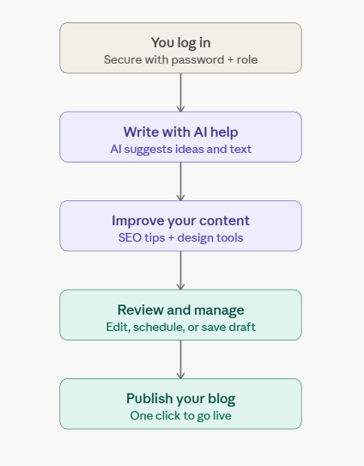
FLOW DIAGRAM
SMART BLOG
Sri Shakthi.ac.in
2

Slide 10
TECHNOLOGIES USED
SMART BLOG
E-SAMPARK PORTAL
Frontend/UI: ReactJS, Tailwind CSS
Backend: Node.js (Express.js)
Database: MongoDB
State Management: React Hooks / Context API
Sri Shakthi.ac.in

Slide 11
RESULT & ANALYSIS
SMART BLOG
E-SAMPARK PORTAL
System shows fast response time with real-time AI suggestions.
AI module improves content quality and readability.
SEO engine provides accurate optimization recommendations.
Analytics dashboard enables data-driven decision making.
User interface is responsive, simple, and easy to use.
System handles multiple users efficiently (scalable).
Security ensures safe access and data protection.
Unified workflow reduces time and effort significantly.
Sri Shakthi.ac.in

Slide 12
CONCLUSION
SMART BLOG
E-SAMPARK PORTAL
Smart Blog provides an AI-powered solution for modern content creation.
Integrates content writing, SEO, analytics and publishing in one platform.
Enhances productivity, content quality and user experience.
Real-time AI assistance enables faster and smarter content development.
Scalable architecture ensures reliability and future growth.
Reduces dependency on multiple tools and manual processes.
Supports data-driven decision making through analytics.
Serves as a future-ready intelligent blogging system.
Sri Shakthi.ac.in

Slide 13
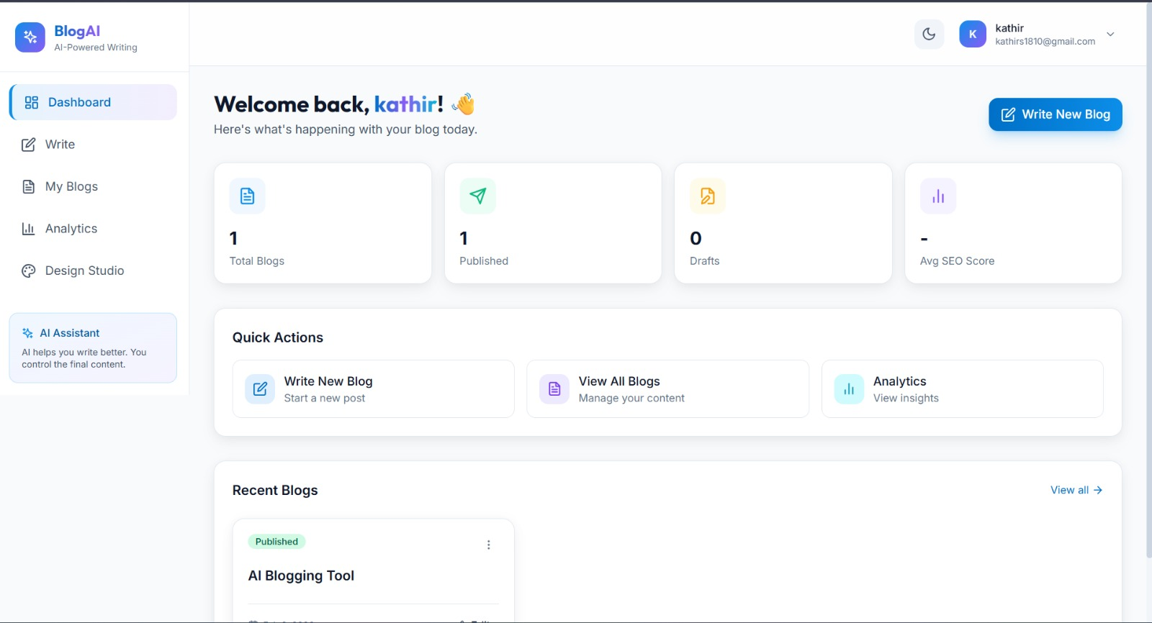
OUTPUT
SMART BLOG
Sri Shakthi.ac.in

Slide 14
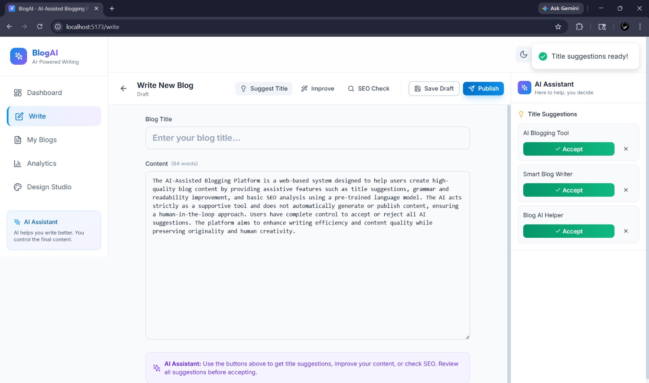
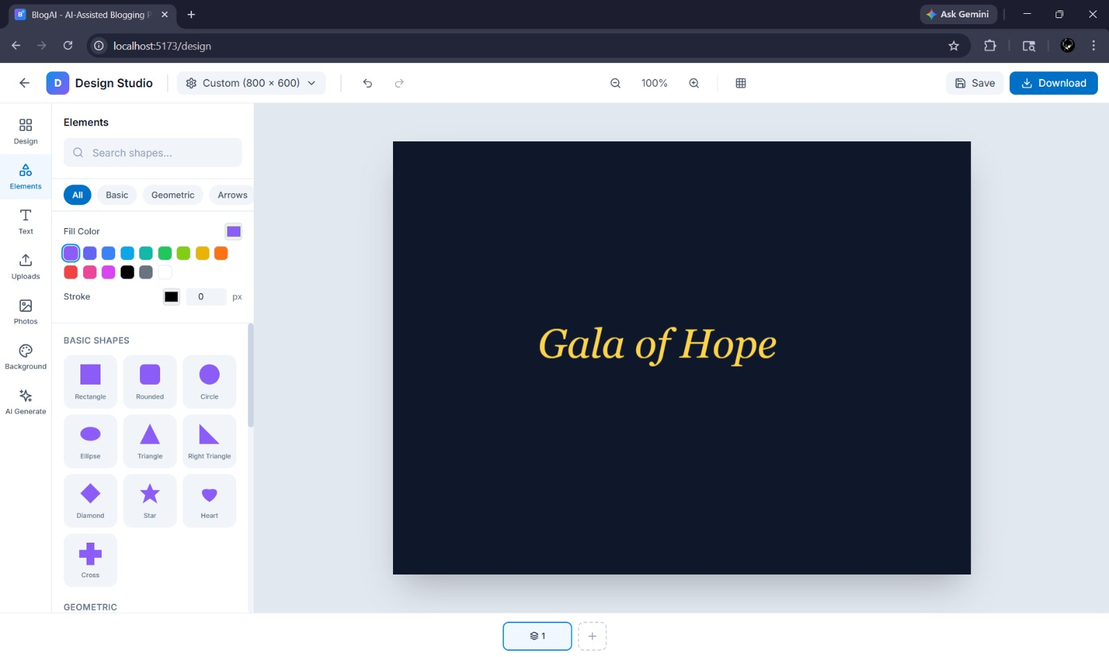
OUTPUT
SMART BLOG
Sri Shakthi.ac.in

Slide 15
SMART BLOG
REFERENCES
Frost, B. & Storm, J. (2017), “Atomic Design Methodology for Scalable Design Systems,” UX Design Conference Proceedings, ISSN: N/A, 2017.
Gallagher, S. & Leung, K. (2012), “Content Management Systems: Evolution and Architecture,” International Journal of Information Systems, Vol. 8, No. 2, ISSN: N/A, 2012.
German, D., Hassan, A. & Mockus, A. (2013), “The Evolution of Open-Source Software Ecosystems,” IEEE Software, Vol. 30, No. 4, ISSN: 0740-7459, 2013.
Sri Shakthi.ac.in
2

Slide 16
SMART BLOG
REFERENCES
Backlinko (2023), “Search Engine Ranking Correlation Study,” Backlinko Research Reports, ISSN: N/A, 2023.
Brown, T., Mann, B., Ryder, N., et al. (2020), “Language Models are Few-Shot Learners,” Advances in Neural Information Processing Systems (NeurIPS), Vol. 33, ISSN: N/A, 2020.
Cattell, R. (2011), “Scalable SQL and NoSQL Data Stores,” ACM SIGMOD Record, Vol. 39, No. 4, ISSN: 0163-5808, 2011.
Sri Shakthi.ac.in
2

Slide 17
SMART BLOG
THANK YOU
Sri Shakthi.ac.in
2

