Slide 1
Sorting Algorithms
Data Structures · Week 6

Slide 2
Why sorting matters
Searching is faster on sorted data
Many algorithms assume sorted input

Slide 3
Bubble sort
Repeatedly swap adjacent out-of-order elements
O(n²) comparisons in the worst case

Slide 4
Insertion sort
Build the sorted prefix one element at a time
O(n) on nearly sorted input

Slide 5
Merge sort
Divide the array in half, sort each half, merge
O(n log n) always
Needs O(n) extra memory

Slide 6
Quicksort
Pick a pivot, partition, recurse
O(n log n) on average, O(n²) worst case
In-place

Slide 7
Comparison
Algorithm | Average | Worst
Bubble | O(n²) | O(n²)
Merge | O(n log n) | O(n log n)
Quick | O(n log n) | O(n²)

Slide 8
Stability
A stable sort keeps equal keys in their original order
Merge sort is stable; quicksort is not

Slide 9
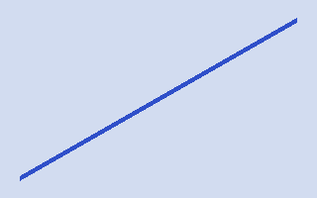

Slide 10
Summary
Use insertion sort for tiny arrays
Merge sort when stability matters
Quicksort is fast in practice

