Slide 1
Using Big Data Techniques for Analysis Yelp Data and Generate Useful Insights
Harmankaranjit Singh Lohiya–QO38890
Meghalini Gurram–CN74252
Vishnu –UE50213

Slide 2
Project Description
Goal: To analyze historical yelp data to understand better about restaurant data and to generate useful insights for restaurant owners for improvements.
Input Data: Yelp dataset
( URL : https://www.yelp.com/dataset/download )
Input Data Specifications: The raw data is in the form of JSON files classified based on years corresponding to the data. The total size of the data is around 10 GB.
Expected Output: To perform sentiment analysis using transformers and completing topic modeling using LDA, using both labels' data to generate good insights to restaurant owners.

Slide 3








Implementation of Architecture.
Visualizations
Storage
Processing
Input Data Source
Text Mining
Spark MLLib

Slide 4
Project goal and Importance
Goal: To analyze historical yelp data to understand better about restaurant data and to generate useful insights for restaurant owners for improvements.
Importance :
Customer Perception
Competitive Advantage
Identifying Trends and Patterns
Personalized Customer Experiences

Slide 5
Understanding the Data
The data is divided into 5 JSON files representing historical business data. ( Reviews, Business, Users, Check-in, tips.)
The combined size of the data is approximately 10 GB.
The Reviews data file has around 70 million rows, while the Users data file has around 20 million rows, making them the main datasets.
Reviews information spans from Feb 2005 to Jan 2022.
Tip information spans from Apr 2009 to Jan 2022.
Business and reviews files are merged for visualizations and topic modeling.
Some of the key features from this dataset are text, ratings and review count.

Slide 6
Processing of Data - Using PySpark
Data was added to AWS S3 and accessed dynamically from a Python notebook.
Version mismatch errors were encountered, highlighting the need for matching versions of Spark and Spark Jars.
Less useful columns were dropped, and data types of certain columns were changed.
Null value rows were removed during the cleaning and pre-processing phase, except for the Users dataset.
The Users dataset contained 198 null values in the name column, but these rows might still hold valuable information.
Sanity checks were performed, confirming that each entry in the dataset had check-in information for a specific business.

Slide 7
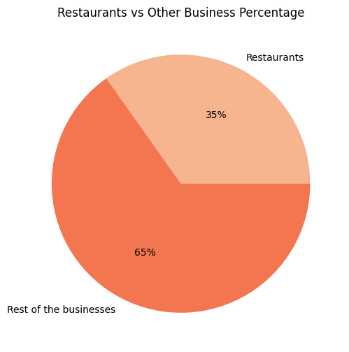
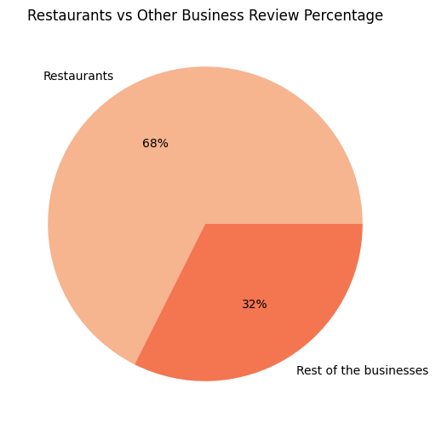
Insights and Visualisations Businesses and Review

Slide 8
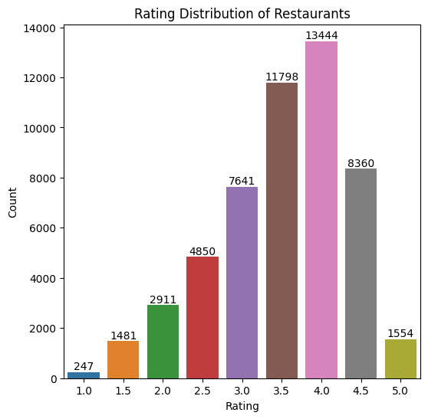
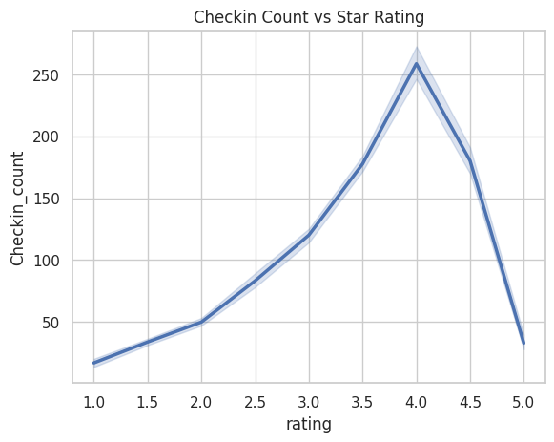
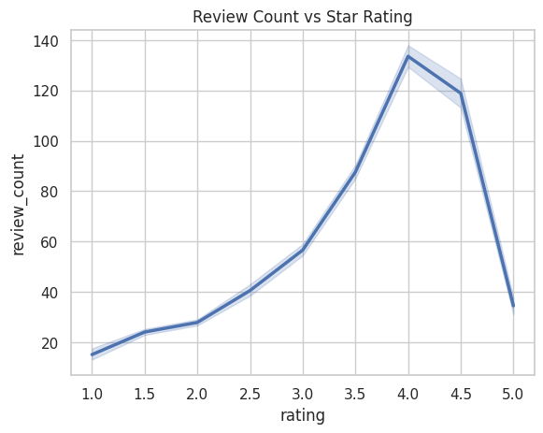
Insights and Visualisations Star Ratings and Review checks

Slide 9
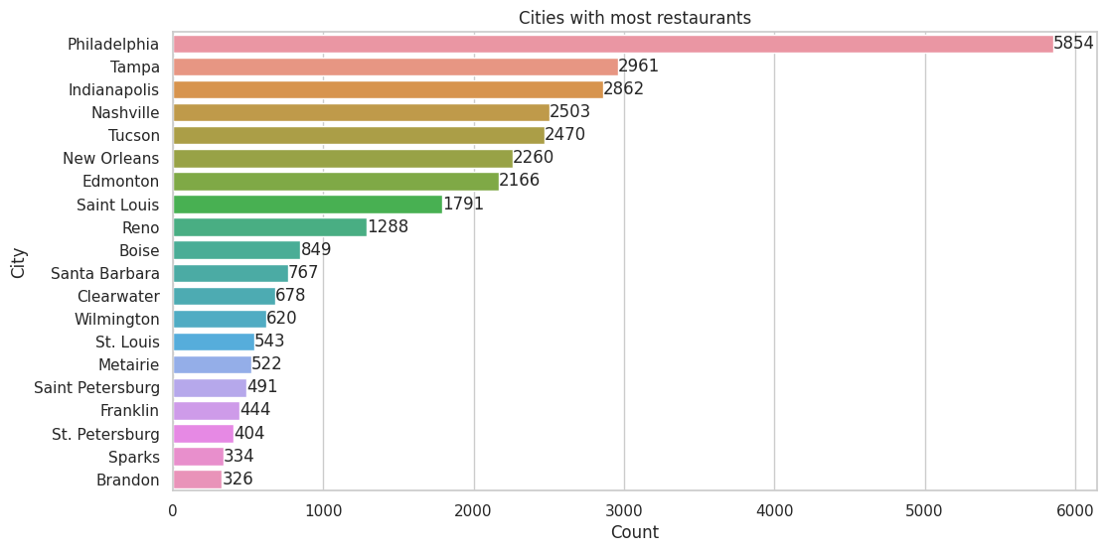
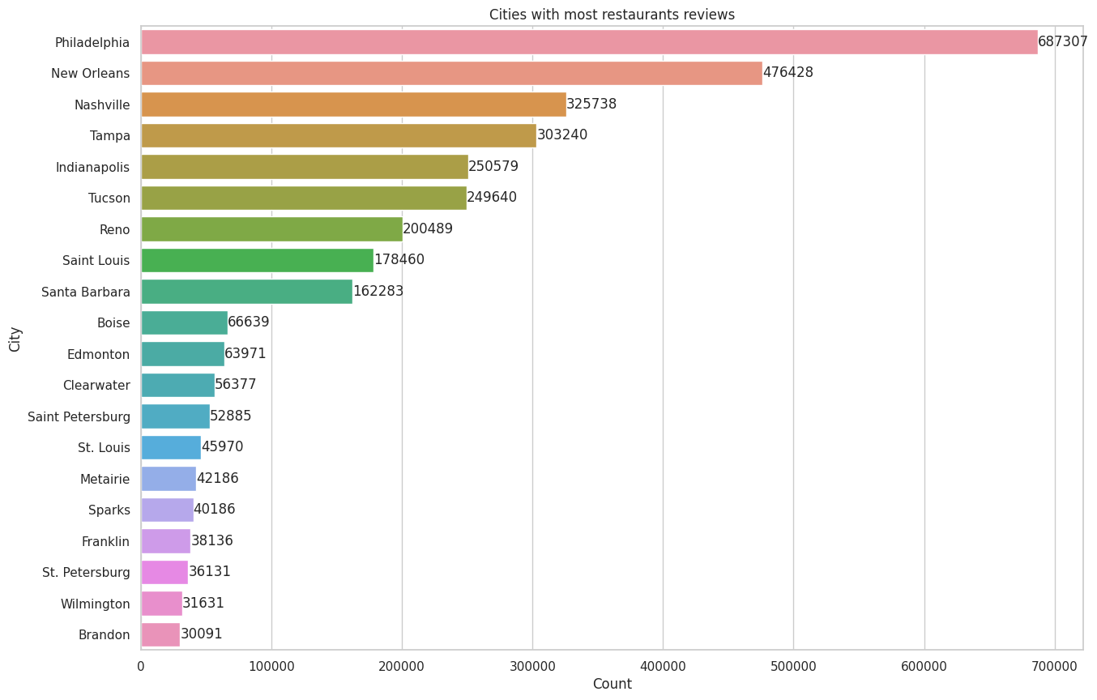
Insights and Visualisations – Restaurants and Review with cities wise

Slide 10
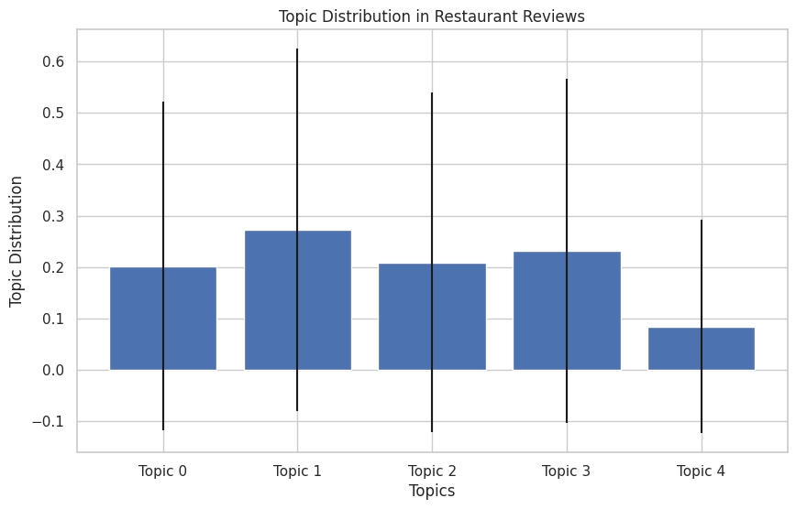
Insights and Visualisations Topic modelling distributions

Slide 11
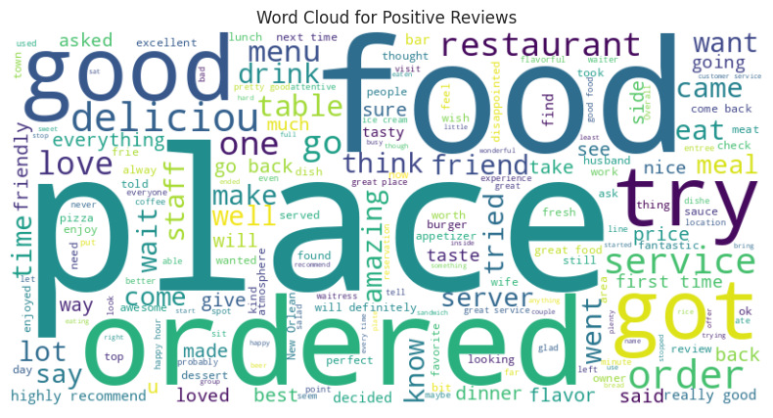
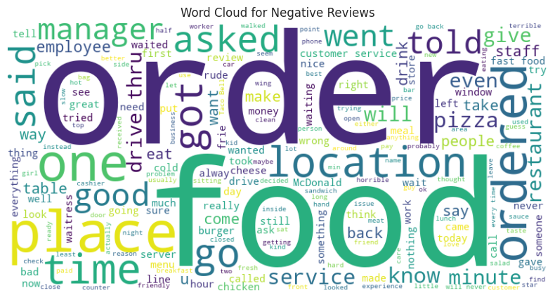
Insights and Visualisations Whole Text Data Word cloud

Slide 12
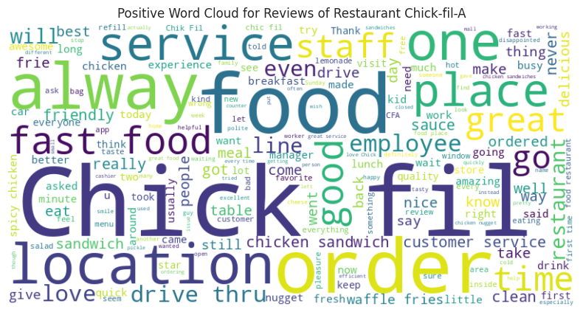
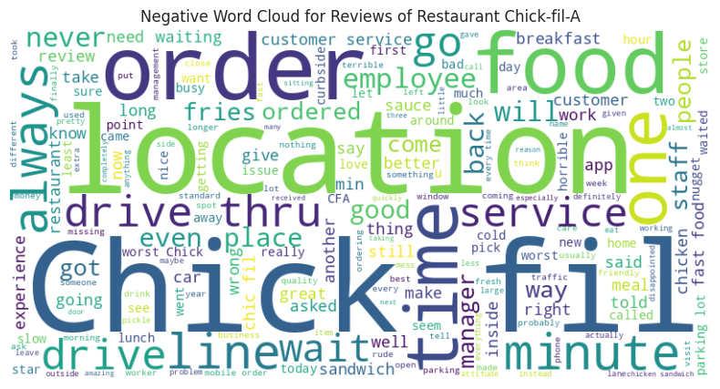
Insights and Visualisations Chick-fil-A Specific Results – Word cloud

Slide 13
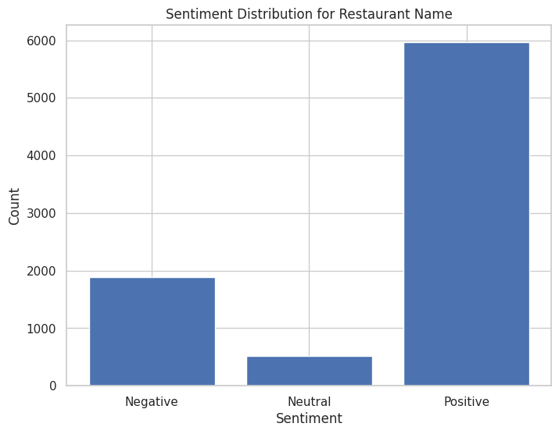
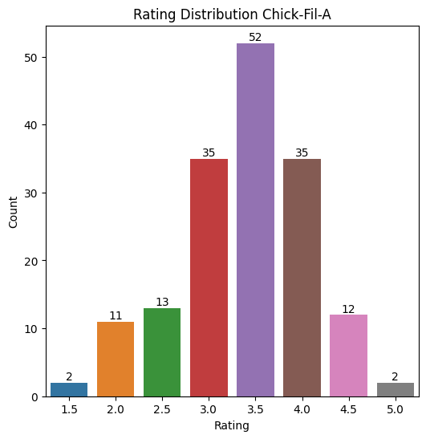
Insights and Visualisations Chick-fil-A Specific Results

Slide 14
Conclusion
We finished with labelling sentiments and completing with topic modelling.
We cross checked this sentiment data with main datasets data, and we got same conclusions from that also.
Satisfied most of the criteria for big data 6-V’s:
Value: Every owner will likely to use their feedbacks for improvements.
Veracity: Authenticity of data used - verified from yelp.com.
Volume: Over 70 million rows of data used.
Variability: Variation of data at different phases and text data.
Variety: In yelp data there are various businesses, we can explore.

Slide 15
Future scope and possible upgrades
We completed Sentiment labelling and generated respected columns in data frame.
To reach our goal, we need to perform advanced text cleaning (resulting specific details) and some automations like building models to give insights for owner requirement, like location based and food types.
We encountered with time complexity while generating visualization of sentiment labelled data. We need to build more refined and efficient way models to overcome time complexity. Like using transformers just as we initially thought, but we faced some errors while dealing with that so we went for NLTK SentimentIntensityAnalyzer.

Slide 16
Key Takeaways - Learning:
Power of PySpark - Utilization of RAM for super-fast processing.
Clearly understand the difference in performance Spark provides over the alternate tools/frameworks using only Python.
As learnt in class, big data tools, provide the ability to harness the use of commodity hardware for the technologies used.
Specifically, upgrades in personal machine computational capabilities allowing users to run a local setups over cloud or server based setups.
We were able to process, millions of rows of data and also build complex text models using MLLib and PySpark.

Slide 17
Thank You
Any Questions ?

