Slide 1
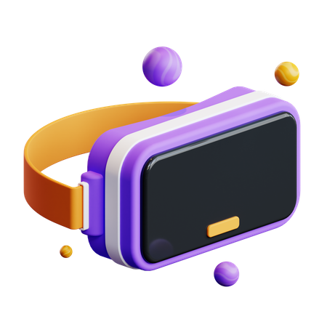
Projects on Virtual and Augmented Reality
By CXR

Slide 2
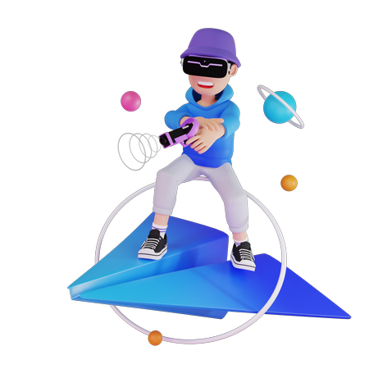


Overview:
We have done the VR & AR projects using unity and Blender.
Our target platforms are meta quest 2,mobilephone.
Mainly every project consists of scene building, scripting and animations.

Slide 3
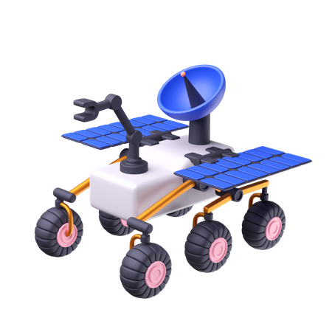
Project Rover:
Project Mars is an augmented reality app in which a rover is presented in real world.
We can see the dismantle of parts of the rover.
We can view the name of each part of rover.

Slide 4
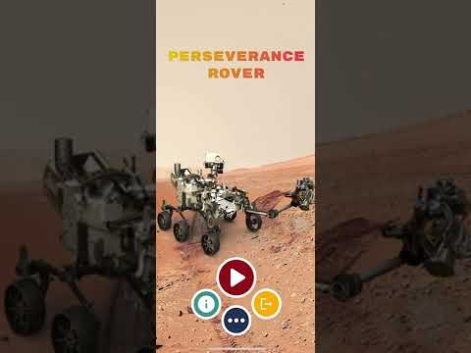

Slide 5
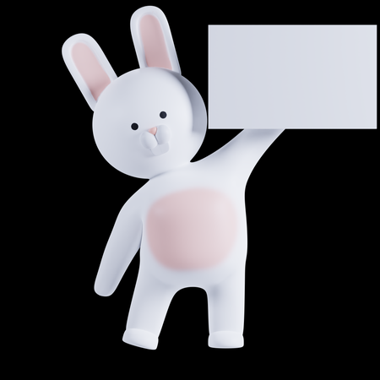
Project-M:
Project-M is an virtual reality application in which we can do drug testing on a rabbit eye with a device called oculus quest2.
The scene consists of a pharmacology lab with the required apparatus.
We can pick the torch, cotton and dropper and test them on rabbit eye.
Project - M

Slide 6
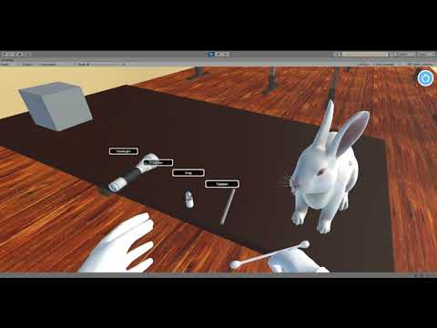

Slide 7
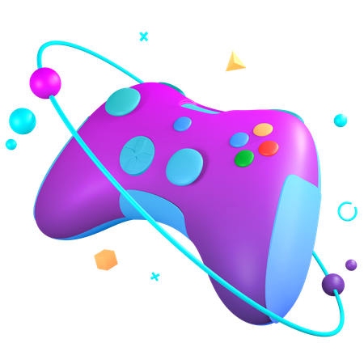
Project Breakdown:
Project Breakdown is a marker-based augmented reality application.
When a marker is scanned,then the game will be placed over it.
When all the blocks are destroyed then the game is over.

Slide 8
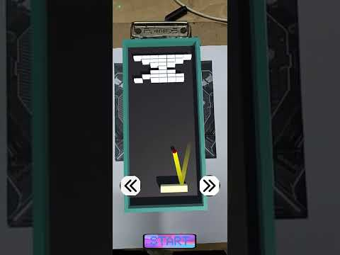

Slide 9
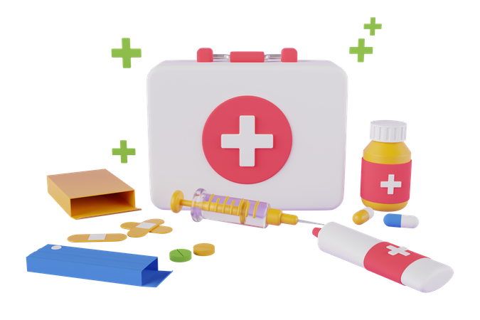
Project CPR:
Project CPR is a virtual reality application in which we can see the product visualization of prototype.
We can see the functionality of prototype in a VR environment.
We can also see the scaling of the organ.

Slide 10


