Slide 1
Vishnu N Walmart Sales Analysis Report
Video Link
LinkedIn
GitHub Link

Slide 2
Vishnu N Walmart Sales Analysis Report
LinkedIn
GitHub Link

Slide 3

Introduction
Walmart, a major retail chain, operates across several cities, offering a wide range of products. The dataset provided contains detailed transaction data, including customer demographics, product lines, sales figures, and payment methods.
This project will use advanced SQL techniques to uncover actionable insights into sales performance, customer behavior, and operational efficiencies.
Business Problem:
Walmart wants to optimize its sales strategies by analyzing historical transaction data across branches, customer types, payment methods, and product lines.
To achieve this, advanced MySQL queries will be employed to answer challenging business questions related to sales performance, customer segmentation, and product trends.

Slide 4
Overview
The dataset Walmart sales contains several features in the dataset.
Like the basic details of the customers, Customer ID, Customer type, Total Sales contribution of each customer, Number Quantity of the products that they have purchased, Date, Time, City, Tax invoice ID, COGS, 5% of tax and etc.

Slide 5
Task 1: Identifying the Top Branch by Sales Growth Rate
Walmart wants to identify which branch has exhibited the highest sales growth over time.
Analyze the total sales for each branch and compare the growth rate across months to find the top performer.

Slide 6
Task 1 Query
with monthly_sales as ( select Branch, date_format ( str_to_date ( Date, '%d-%m-%Y’ ) , '%Y-%m’ ) as
month_year, SUM( Total ) as monthly_sales
from walmart_sales group by Branch, month_year ),
sales_with_growth as
( select Branch, month_year, monthly_sales, lag ( monthly_sales )
Over ( partition by Branch order by month_year ) as previous_month_sales,
( ( monthly_sales - lag( monthly_sales )
over( partition by Branch order by month_year ) ) / lag( monthly_sales )
Over ( partition by Branch order by month_year ) ) * 100 as growth_rate
from monthly_sales ) select Branch, round( avg ( growth_rate ), 2 ) as avg_growth_rate
from sales_with_growth group by Branch order by avg_growth_rate DESC limit 1;
Branch | Avg_growth_rate
A | 1.66

Slide 7
Task 2: Finding the Most Profitable Product Line for Each Branch
Walmart wants to segment customers based on their average spending behavior.
Classify customers into three tiers: High, Medium, and Low spenders based on their total purchase amounts.

Slide 8
Task 2 Query:
with profit_with_branch as
(select Branch, `Product line`, round( SUM ( cogs - `gross income` ), 2 )
as Total_profit
from walmart_sales group by Branch,`Product line`
order by Total_profit desc)
select Branch , `Product line` , Total_profit, row_number ()
over(partition by Branch) as rank_based_on_profit
from profit_with_branch
order by Branch, Total_profit desc;

Slide 9
Based on the Output of the Task 2 Query the distribution is displayed on the below Column chart.

Slide 10
Task 3: Analyzing Customer Segmentation Based on Spending
Walmart needs to determine which product line contributes the highest profit to each branch.
The profit margin should be calculated based on the difference between the gross income and cost of goods sold.

Slide 11
Task 3 Query:
with Average_sales_per_person as
(select `Customer ID`, SUM(Total) as Sales, count(*) as Total_sales,
SUM(Total) / count(*) as Average_sales_of_person
from walmart_sales
group by `Customer ID`)
select `Customer ID`,round(Sales,2) as
Sales, Total_sales, round(Average_sales_of_person,2) as Avg_sales_of_Person,
Case
when Average_sales_of_person < 300 then 'Low’
when Average_sales_of_person between 300 and 350 then 'Medium’
else 'High' end as 'Class’
from Average_sales_per_person
order by `Customer ID`,Avg_sales_of_Person;

Slide 12
Based on the Output of the Task 3 Query the distribution is displayed on the below Area chart.

Slide 13
Task 4: Detecting Anomalies in Sales Transactions
Walmart suspects that some transactions have unusually high or low sales compared to the average for the product line.
Identify these anomalies.

Slide 14
Task 4 Query:
with Product_line_with_z_score as
(select `Product line`,round( avg ( Total ), 2 ) as Average_sales, round( stddev ( Total ) , 2 ) as
Standard_deviation
from walmart_sales
group by `Product line` ), sales_with_zscore as ( select ws.`Product line`,
ws.Total, ( ( ws.Total - ps.Average_sales ) / ps.Standard_deviation ) as Z_score
from walmart_sales as ws
inner join Product_line_with_z_score ps on ws.`Product line` = ps.`Product line` )
select `Product line`,Total,Z_score ,
Case
when Z_score > 3 or Z_score < -3 then 'Anamoly’
else 'Normal' end as Anomaly_statusfrom sales_with_zscore
order by Anomaly_status ,`Product line`, Total;

Slide 15
The reason we use 3 in the Z-score is based on the Empirical Rule (68-95-99.7 Rule) in statistics.
According to the Empirical Rule:
About 68% of data points lie within 1 standard deviation from the mean.
About 95% of data points lie within 2 standard deviations from the mean.
About 99.7% of data points lie within 3 standard deviations from the mean.

Slide 16
Based on the Output of the Task 4 Query the distribution is displayed on the below Column chart.

Slide 17
Task 5: Most Popular Payment Method by City
Walmart needs to determine the most popular payment method in each city to tailor marketing strategies.

Slide 18
Task 5 Query:
with city_Ewallet as ( select City, count ( Payment ) as Payment
from walmart_sales
where Payment = 'Ewallet’ group by City),
city_Cash as ( select City , count ( Payment ) as Payment
from walmart_sales where Payment = 'Cash’ group by City),city_Credit_Card as (select City, count(Payment) as Payment
from walmart_sales where Payment = 'Credit card’
group by City)
select e.City, e.Payment as Ewallet, c.Payment as Cash, cc.Payment as Credit_card
from city_Ewallet e
inner join city_Cash c on e.City = c.City
inner join city_Credit_Card cc on e.City = cc.Citygroup by e.City;
Output Table
City | Ewallet | Cash | Credit_Card
Yangon | 126 | 110 | 104
Mandalay | 113 | 110 | 109
Naypyitaw | 106 | 124 | 98

Slide 19
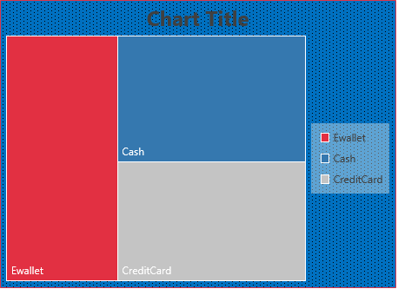
Based on the Output of the Task 5 Query the distribution is displayed on the below Tree map.

Slide 20
Task 6: Monthly Sales Distribution by Gender
Walmart wants to understand the sales distribution between male and female customers on a monthly basis.

Slide 21
Task 6 Query:
with gender_monthly_sales_distribution as
(select Gender
,date_format (str_to_date ( Date,'%d-%m-%Y’ ) , '%M’ )
as
Month_wise, round ( sum ( Total ) , 2 ) as Sales
from walmart_sales
group by Month_wise,Gender
order by Gender)
select * from gender_monthly_sales_distribution;
Output Table
Gender | Month_wise | Sales
Female | January | 59138.98
Female | March | 52408.39
Female | February | 56335.56
Male | March | 57047.12
Male | January | 57152.89
Male | February | 40883.82

Slide 22
Based on the Output of the Task 6 Query the distribution is displayed on the below Column map.

Slide 23
Task 7: Best Product Line by Customer Type
Walmart wants to know which product lines are preferred by different customer types(Member vs. Normal).

Slide 24
Task 7 Query:
Output Table
Customer Type | Product line | Rating
Member | Health and beauty | 7.08
Member | Food and beverages | 7
Member | Electronic accessories | 6.95
Member | Fashion accessories | 6.95
Member | Home and lifestyle | 6.87
Member | Sports and travel | 6.82
Normal | Food and beverages | 7.25
Normal | Fashion accessories | 7.11
Normal | Sports and travel | 7.03
Normal | Health and beauty | 6.93
Normal | Electronic accessories | 6.9
Normal | Home and lifestyle | 6.8
with Product_lines_based_on_types_of_customers
as (select `Customer type`,`Product line`,
round ( avg ( rating ) , 2 ) as Rating
from walmart_sales
group by `Customer type`, `Product line`
order by `Customer type`, Rating DESC )
select * from
Product_lines_based_on_types_of_customers;

Slide 25
Task 7 Query:
For displaying only the Top Product lines from both of the customer types.
with Members as (select `Customer type`, `Product
line`, round ( avg ( rating ) , 2 ) as Rating
from walmart_sales
group by `Customer type`, `Product line`
having `Customer type` = 'Member’
order by `Customer type`, Rating DESC limit 1),
Normal as ( select `Customer type`, `Product line`, round ( avg ( rating ) , 2 ) as Rating
from walmart_sales
group by `Customer type`, `Product line` having `Customer type` = 'Normal’
order by `Customer type`, Rating DESC limit 1 )
select * from Members union all select * from Normal;
Output Table
Customer Type | Product line | Rating
Member | Health and beauty | 7.08
Normal | Food and beverages | 7.25

Slide 26
Task 8: Identifying Repeat Customers
Walmart needs to identify customers who made repeat purchases within a specific time frame (e.g., within 30days).

Slide 27
Task 8 Query:
with Repeat_Customers_For_the_Whole_difference
as (select cp1.`Customer ID`, cp1.Date as Current_Purchase, cp2.Date
as Previous_Purchase , datediff ( str_to_date ( cp1.Date, '%d-%m-%Y’ ), str_to_date ( cp2.Date, '%d-%m-%Y’ ) ) as Days_Between
from walmart_sales cp1
join walmart_sales cp2 on cp1.`Customer ID` = cp2.`Customer ID`
and STR_TO_DATE ( cp1.Date, '%d-%m-%Y') > STR_TO_DATE(cp2.Date, '%d-%m-%Y’))
select `Customer ID`, Current_Purchase, Previous_Purchase, Days_Between
from Repeat_Customers_For_the_Whole_difference
where Days_Between = 30
order by `Customer ID`, Current_Purchase;

Slide 28
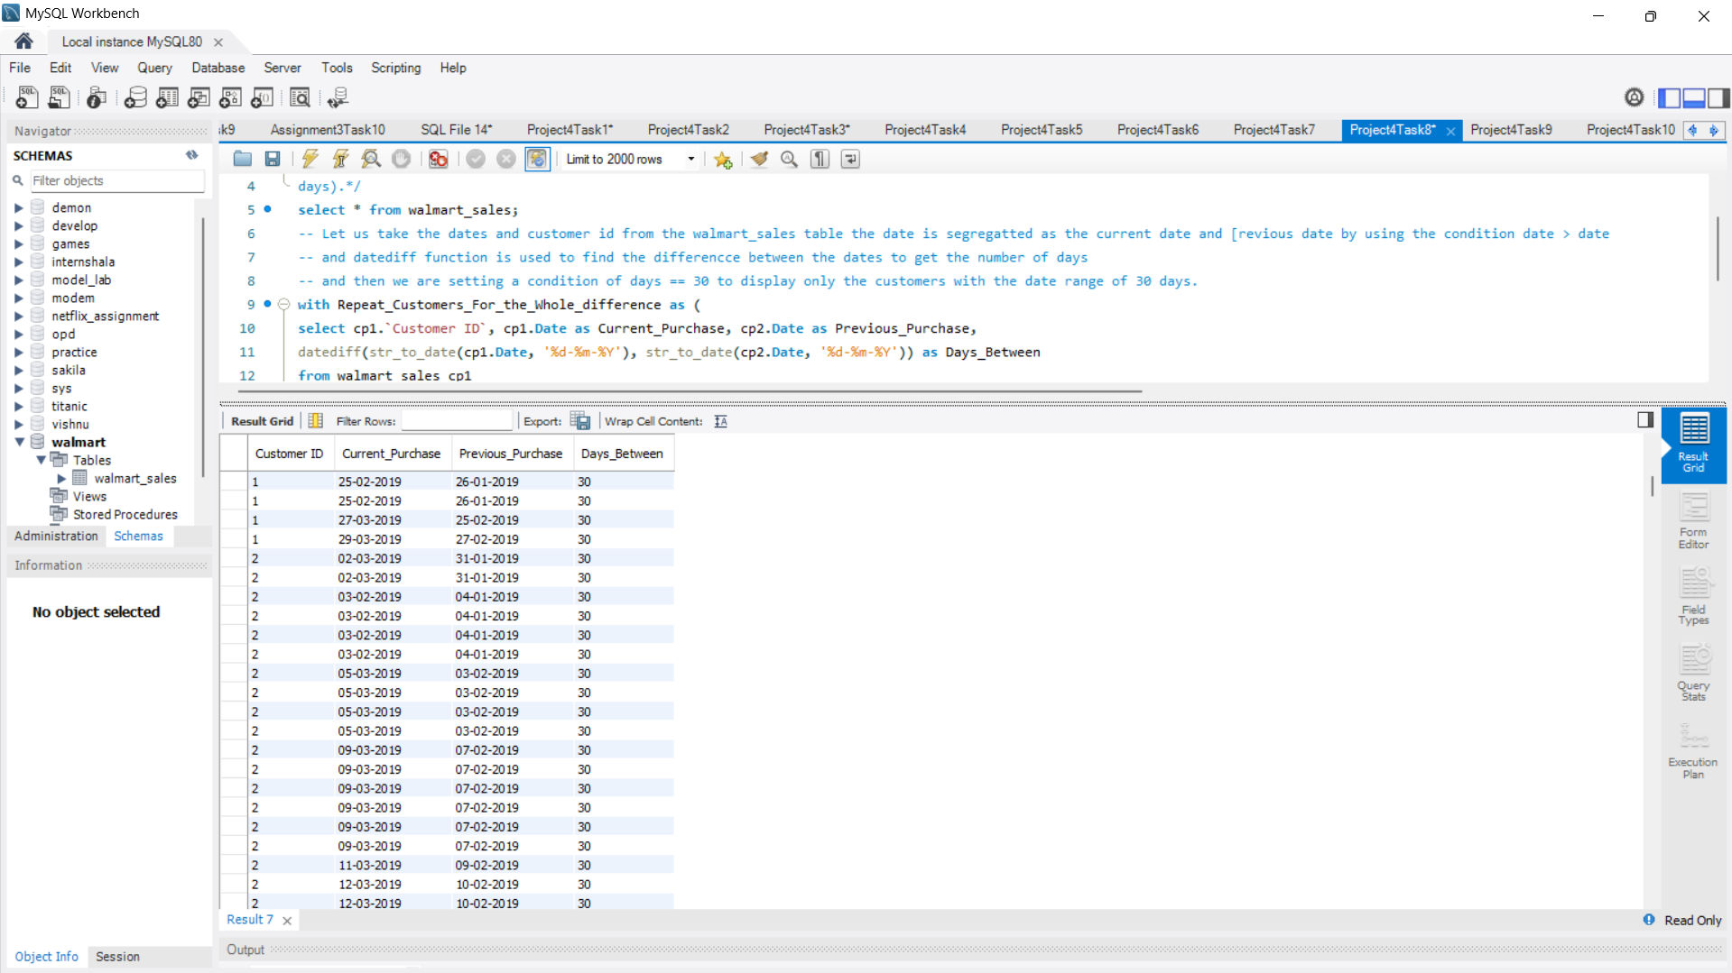
Task 8 Output:

Slide 29
Task 9: Finding Top 5 Customers by Sales Volume
Walmart wants to reward its top 5 customers who have generated the most sales Revenue.

Slide 30
Task 9 Query:
Output Table
select `Customer ID`, round ( sum ( Total ) ,2 )
as Total_Sales
From walmart_sales
group by `Customer ID`
order by Total_Sales
DESC limit 5;
Customer ID | Total Sales
8 | 26634.34
3 | 23402.26
2 | 23392.28
15 | 22674.46
1 | 22634.55

Slide 31
Task 10: Analyzing Sales Trends by Day of the Week
Walmart wants to analyze the sales patterns to determine which day of the week brings the highest sales.

Slide 32
Task 10 Query:
Output Table:
Day_of_the_week | Tales_sales
Saturday | 56120.81
Friday | 43926.34
Sunday | 44457.89
Monday | 37899.08
Thursday | 45349.25
Wednesday | 43731.14
Tuesday | 51482.25
select
date_format (str_to_date ( Date, '%d-%m-%Y’), '%W’ )
as Day_of_the_week,
round ( sum ( Total ) , 2 ) as Total_sales
from walmart_sales
group by Day_of_the_week;

Slide 33
Based on the Output of the Task 10 Query the distribution is displayed on the below area chart.

Slide 34
Conclusion
Hence, I have provided the SQL queries and Visualizations for all possible outputs, for all the 10 Tasks are made by using pivot tables in the MS Excel.
While working on these tasks I got a deep understanding in the structure of the SQL.

Slide 35
THANK YOU…
INTERNSHALA

Slide 36
THANK YOU…
INTERNSHALA
LinkedIn
GitHub Link

