Slide 1
Hewlett Packard Enterprise
KEY CAPABILITIES
🔴 Alert Intelligence
🔍 Deep Investigation
🔌 Network Correlation
💥 Blast Radius Analysis
📈 Capacity Forecasting
📖 Runbook Search
🛠️ Guided Remediation
(7 of 11 tools shown)
HPE AI Autopilot
Intelligent IT Operations — From Alert to Resolution in Minutes
AI Innovation Demo | March 2026
Vishnu Dutt Kidambi
Hewlett Packard Enterprise
1 / 11
Internal Use Only

Slide 2
Why AI Autopilot?
THE CHALLENGE
AI AUTOPILOT SOLUTION
✗ Alert Fatigue
Operators sift through hundreds of alerts manually to find what matters
✓ Natural Language Ops
Ask questions in plain English — the AI calls the right tools automatically
✗ Slow Triage
Root cause identification takes 30-60 min across multiple consoles
✓ End-to-End Investigation
Alerts → Server → Network → Blast Radius in one conversation
✗ Siloed Data
Server metrics, network telemetry, and incidents live in separate tools
✓ Unified Correlation
Cross-layer analysis: OpsRamp metrics + Juniper network telemetry
✗ Manual Runbooks
Engineers search wikis and PDFs for resolution steps under pressure
✓ Instant Runbooks & Remediation
AI retrieves procedures and generates CLI fix commands on demand
⚡ MTTR Reduction Target: 30-60 minutes → under 5 minutes with AI-assisted triage and guided remediation
Hewlett Packard Enterprise
2 / 11
Internal Use Only

Slide 3
Architecture & Data Sources
ARCHITECTURE
DATA SOURCES
User
Web UI / MCP Client (VS Code, Claude Desktop) / Terminal REPL
OpsRamp APIs — Mocked
Based on the public OpsRamp V3 developer API:
https://develop.opsramp.com/v3
Alerts, Resources, Incidents, and Metric History are mocked in-memory using realistic schemas matching the V3 API response format.
↓
LLM Agent
Ollama (llama3.1) — Tool-calling orchestration loop with streaming
↓
11 Tools
Alerts • Resources • Resource Details • Incidents • Investigation • Summary • Capacity • KB Search • Network Correlation • Blast Radius • Remediation
Juniper Mist APIs — Mocked & Simulated
Modeled after the Juniper Mist Switch Stats API: Not sure about the validity of the API’s
GET /api/v1/sites/{site_id}/stats/devices?type=switch
Ref: Juniper Mist API (community ref: doc.mist-lab.fr)
Covers: EX switch stats, port errors, packet loss, CRC errors, link flaps, latency/jitter, and dependency graph for blast radius.
↓
Data Layer
OpsRamp API (mocked) | Juniper Mist API (simulated) | PDF Runbooks (RAG)
📖 PDF Runbooks — Real PDFs ingested via RAG pipeline (chunking → embedding → vector search)
Hewlett Packard Enterprise
3 / 11
Internal Use Only

Slide 4
11 AI Tools — Data & Investigation
The LLM autonomously picks which tools to call based on the user’s question
#
Tool
What It Does
Data Source
1
search_alerts
Find alerts by severity, priority, resource, or keyword
OpsRamp Alerts API (mocked)
2
search_resources
Find servers/VMs by cloud, region, type, tags, or keyword
OpsRamp Resources API (mocked)
3
get_resource_details
Deep-dive on one resource: config, CPU/mem/disk metrics, tags
OpsRamp Resources API (mocked)
4
search_incidents
Find incidents by status, priority, or keyword search
OpsRamp Incidents API (mocked)
5
investigate_resource
One-call investigation: resource + alerts + incidents + metrics
OpsRamp (all APIs combined)
6
get_environment_summary
Dashboard overview: resource counts, alert/incident breakdown
OpsRamp (aggregated)
These 6 tools query and retrieve data — the next 5 tools analyze, correlate, and generate actionable output
Hewlett Packard Enterprise
4 / 11
Internal Use Only

Slide 5
11 AI Tools — Analysis & Remediation
These tools cross-correlate data from OpsRamp + Juniper and produce actionable insights
#
Tool
What It Does
How It Works
7
predict_capacity
Forecast when CPU/memory/disk hits threshold
30-day metric history → linear regression → predicts exhaustion date per resource
8
search_knowledge_base
Search runbook PDFs for procedures & fixes
PDF → chunk (500 chars) → embed with nomic-embed-text → cosine similarity search
9
correlate_network
Check if a server issue is caused by the network
Resolve server IP → find Juniper switch port → analyze: packet loss, CRC, link flaps, jitter
10
blast_radius
Map the full impact of an infrastructure failure
BFS traversal of dependency graph: server → apps → downstream → user groups
11
get_remediation_plan
Generate step-by-step fix with CLI commands
Detects issue type → builds Junos CLI steps (clear counters, bounce port, force duplex, etc.)
Hewlett Packard Enterprise
5 / 11
Internal Use Only

Slide 6
OpsRamp ↔ Juniper: How Data Connects
IP ADDRESS = THE JOIN KEY
WHEN OPSRAMP ↔ JUNIPER MAPPING WORKS
OpsRamp Resource
Name: "app-server-prod-02" IP: 10.0.1.103
──── IP 10.0.1.103 ────▶
Juniper Switch Port
Switch: sw-dc-east-01 Port: ge-0/0/3 IP: 10.0.1.103
The agent looks up a server’s IP in OpsRamp, finds the matching switch port in Juniper, and cross-correlates metrics from both.
✓ Two Prerequisites for Correlation
1. Juniper Switches in the DC
Physical switch fabric connecting servers — provides port stats, packet loss, link flaps, CRC errors
2. OpsRamp Collector Deployed
Collector gathers server-side metrics (CPU, memory, disk, alerts, incidents) from the same infra
→ When both are present, OpsRamp server stats can be
correlated with Juniper switch stats via IP → port mapping
PORT MAPPING SCENARIOS
Example: HPE GreenLake DC
• HPE-managed datacenter with Juniper EX switches
• OpsRamp collector monitors K8s nodes, VMs, and apps
• Node IP (e.g. 10.0.4.24) maps to switch port ge-0/0/5
• AI correlates: high HTTP latency → port packet loss → link flaps
1 Server → 1 Port
Standard. Each physical server has one NIC cabled to one switch port. Direct correlation.
K8s Pod → Node IP
Pods have overlay IPs (10.244.x.x) invisible to switch. Correlation uses Node IP → switch port.
N VMs → 1 Port
Hypervisor host on one port. Many VMs share it. Correlation is host-level, not per-VM.
Hewlett Packard Enterprise
6 / 11
Internal Use Only

Slide 7
End-to-End: "Why is GreenLake Portal Slow?"
💬 User types: "Why is greenlake portal slow?"
1
search_alerts
Finds 2 critical alerts on k8s-node-04 (HPE GreenLake): container restart loop (P0) + HTTP response 6.2s (P1)
OpsRamp
↓
investigate_resource
Deep-dives k8s-node-04: CPU 60%, memory 65%, disk 45%, 2 active alerts, 1 open incident — server metrics look OK
2
OpsRamp
↓
correlate_network
Resolves greenlake-portal → k8s-node-04 → IP 10.0.4.24 Finds sw-dc-east-04:ge-0/0/5: 8.3% loss, 156K errors, 100Mbps half-duplex, link flaps
3
Juniper
↓
blast_radius
BFS traversal: k8s-node-04 → 9 apps including greenlake-portal, aruba-central, dscc-console → 5,200 users affected, $75K+/hr revenue at risk
4
Dependency Graph
↓
search_knowledge_base
RAG search finds runbook: 'Switch Port Troubleshooting' — Junos CLI commands for link flap diagnosis & cable replacement
5
PDF / RAG
↓
get_remediation_plan
Generates 8-step fix: verify port → clear counters → check optics → force duplex → bounce port → replace cable — with exact Junos CLI
6
Juniper
⚡ Result: Root cause = link flaps + duplex mismatch on ge-0/0/5, business impact = 5,200 users across 9 apps, and 8-step CLI fix — all in one conversation, under 2 minutes
Hewlett Packard Enterprise
7 / 11
Internal Use Only

Slide 8
Technology Stack
KEY TECHNOLOGIES
Technology
Usage in HPE AI Autopilot
Go (Golang)
Core application language — agent orchestrator, HTTP server, tool execution, MCP server
Ollama + llama3.1
Local LLM inference engine with native tool-calling support for autonomous multi-step reasoning
MCP (Model Context Protocol)
Open standard by Anthropic — exposes 11 tools to external clients (VS Code Copilot, Claude Desktop) via stdio/HTTP
RAG (Retrieval-Augmented Generation)
PDF runbook ingestion pipeline: text extraction → chunking (500 chars, 100 overlap) → embedding → cosine similarity vector search
SSE (Server-Sent Events)
Real-time streaming of LLM responses and tool progress indicators to the browser — no WebSockets needed
HTML / CSS / JavaScript
Embedded single-page web UI with ReadableStream SSE parsing and live markdown rendering
Docker + Docker Compose
Containerized deployment — Ollama + agent in separate containers, supports both native and Docker workflows
mcp-go
Go library (mark3labs/mcp-go) for implementing MCP servers — converts tool definitions to MCP protocol format
Hewlett Packard Enterprise
8 / 11
Internal Use Only

Slide 9
What’s Next — Roadmap
From innovation demo to strategic initiative — the path to production
NEAR-TERM
✓ Real OpsRamp API Integration
Replace mocked data layer with live OpsRamp V3 API calls — authenticate via OAuth, query real alerts/resources/incidents
✓ Real Juniper Mist API
Connect to production Juniper Mist cloud for live switch stats, port telemetry, and network event correlation
✓ Expanded Runbook Library
Ingest additional PDF/Markdown runbooks covering server, network, storage, and application troubleshooting
✓ LLM Model Upgrades
Evaluate larger models (llama3.1 70B, Mixtral) for improved tool-calling accuracy and reasoning depth
Hewlett Packard Enterprise
9 / 11
Internal Use Only

Slide 10
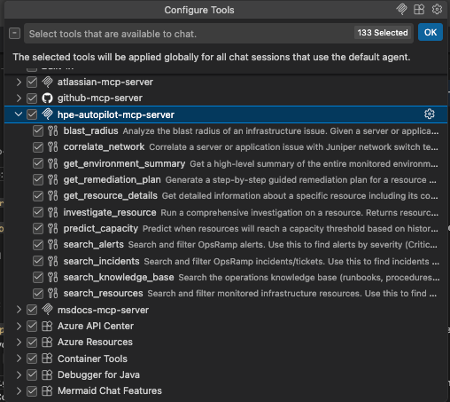
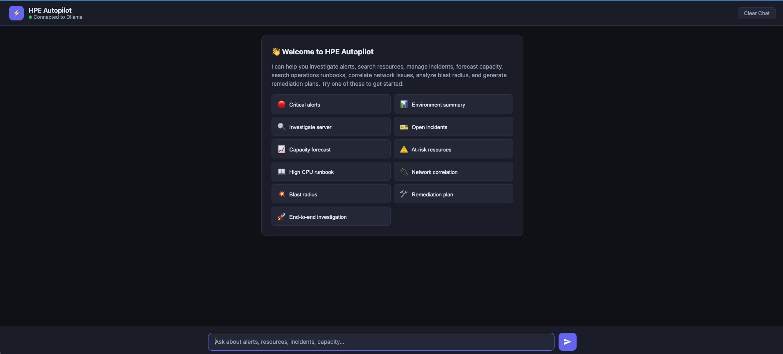
UI Preview — AI Autopilot in Action
Web UI conversation flow and MCP server integration with VS Code / Claude Desktop
WEB UI
MCP SERVER
Streaming conversation with tool call indicators and live markdown
MCP protocol exposes all 11 tools to VS Code Copilot and Claude Desktop
Hewlett Packard Enterprise
10 / 11
Internal Use Only

Slide 11
Live Demo
HPE AI Autopilot — Local Demo
http://localhost:8080
Thank You
Vishnu Dutt Kidambi
Questions & Discussion
Hewlett Packard Enterprise
11 / 11

