Slide 1
EV Charging Demand Prediction
and Usage Pattern Analysis
DATA ANALYSIS AND MACHINE LEARNING PROJECT
72,088 charging sessions · Sep 2021 – Sep 2022
K Vishnu Kashyap
Notes:
Introduce the project in one line: I analysed one year of EV charging sessions to understand usage patterns, predict the energy a session will use, flag high-demand sessions and forecast daily demand. The flow of this presentation follows the order I worked in, from understanding the data to the Streamlit dashboard.

Slide 2
Business problem and objectives
INTRODUCTION
1
Predict session demand (regression)
The problem
EV charging demand is growing, but operators don’t know when and where demand will be high.
2
Classify high-demand sessions (classification)
Result: queues at busy chargers while other chargers sit idle.
3
Forecast future demand (time series)
4
Explain the driving factors (SHAP, LIME)
5
Support business decisions (dashboard)
Notes:
The problem: operators don’t know when and where demand will be high, so some chargers have queues while others sit idle. I set five objectives: predict how much energy a session will use, classify whether a session will be high demand, forecast daily demand, explain which factors drive demand, and turn this into a dashboard that supports decisions.

Slide 3
Dataset at a glance
01 · DATA UNDERSTANDING
72,856
13
1 year
charging sessions (raw)
columns
Sep 2021 – Sep 2022
2,337
2,119
14
users
chargers
location types
Key columns
Demand (kWh) · target
Duration (min)
Start / End datetime
Location
ChargerType (0/1)
ChargerCompany (0/1)
UserID
ChargerID
Notes:
Each row is one charging session. Demand is the energy used in the session, most likely in kWh, and it is my main target. Dates were stored as text, so they needed converting. ChargerType and ChargerCompany only have values 0 and 1; the dataset doesn’t say what they mean, which I worked out later in EDA. I also built a data dictionary with each column’s type, description and role.

Slide 4
Project workflow
APPROACH
01
02
03
04
05
Understanding
Data quality
Cleaning
EDA
Features
Shape, types, data dictionary
Nulls, duplicates, invalid values, outliers
Fix every issue found in 02
13 questions: uni, bi, trend, multivariate
Time and history features
06
07
08
09
10
Regression
Classification
Time series
Save models
Streamlit
Predict Demand (kWh)
High vs Normal demand
Forecast daily demand
joblib pipelines
Interactive dashboard
Light cards = data preparation and analysis · Dark cards = machine learning · Green = final app
Notes:
This is the order I worked in, and the rest of the slides follow it. Steps 1 to 5 prepare and understand the data. Steps 6 to 9 are the machine learning part: regression, classification, time series and saving the final models. Step 10 is the Streamlit dashboard that brings everything together.

Slide 5
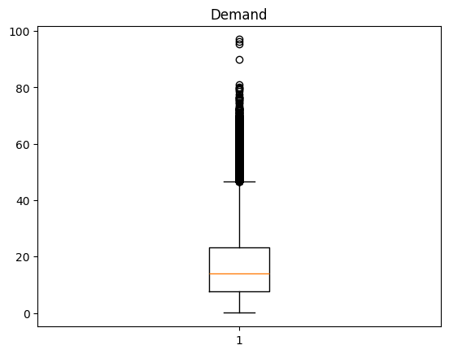
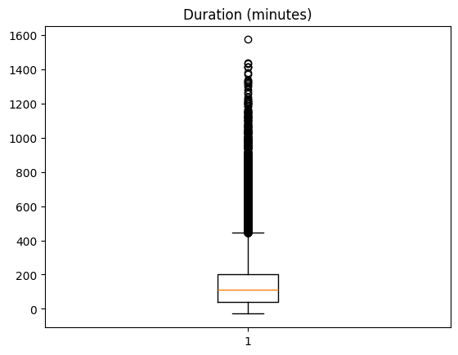
What the quality checks found
02 · DATA QUALITY ANALYSIS
Check | Found | Action
Missing values | 0 | None needed
Exact duplicates | 13 | Remove
Same-session duplicates | 21 | Keep higher Demand
Negative duration | 17 (all market) | Remove
Zero duration | 718 | Remove
Power above 350 kW | 8 | Remove
Redundant date/time columns | 4 | Drop
Sessions past midnight | ~10,800 | Keep (normal)
Outliers (IQR rule)
Demand 3,444 · Duration 3,924
Kept: they are real long or heavy charging sessions, not errors.
Notes:
No nulls, and both datetime columns converted without errors. 13 rows were exact copies, and 21 sessions were recorded twice with the same user, charger and start time. 17 sessions ended before they started, all at market locations, so it looks like a recording error. 718 sessions had zero duration with almost no energy, so they look like failed plug-ins. 8 sessions implied charging faster than 350 kW, which no real charger can do. StartDay plus StartTime matched StartDatetime, so those four columns were redundant. About 10,800 sessions go past midnight; that’s normal overnight charging. Outliers by IQR were kept because they are real long or heavy sessions.

Slide 6
Cleaning steps
03 · DATA CLEANING
# | Step | Rows removed
1 | Convert Start/End datetime from text | 0
2 | Remove exact duplicates | 13
3 | Remove same-session duplicates (keep higher Demand) | 21
4 | Remove negative duration | 17
5 | Remove zero duration | 709
6 | Remove power above 350 kW | 8
7 | Drop StartDay, StartTime, EndDay, EndTime | –
Rows
72,856 → 72,088
Columns
13 → 9
Saved as charging_clean.csv
Why remove zero durations, not fill them? Filling with the median would create charging time that never happened.
Notes:
I fixed every issue from the quality notebook in order. Zero duration shows 709 here instead of 718 because some of them were already removed as duplicates. For same-session duplicates I kept the row with higher Demand, because the other row was usually a failed plug-in. I removed zero durations instead of filling them, because a median would invent charging time. The final checks confirmed no nulls, no duplicates and no zero or negative durations, and the maximum power dropped to about 306 kW.

Slide 7
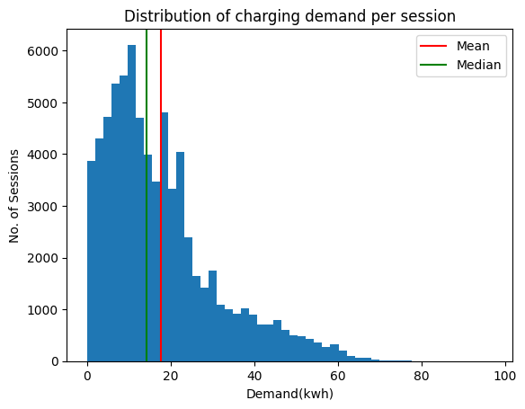
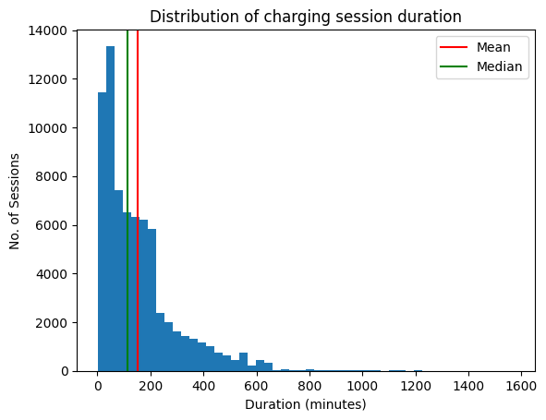
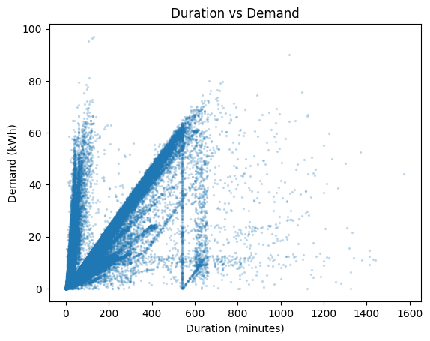
Demand and duration
04 · EDA · Q1, Q2, Q7
Demand distribution
Duration distribution
Duration vs Demand
Right-skewed (1.2). Median 14.26 kWh vs mean 17.57. About 84% use 30 kWh or less.
Right-skewed (1.9). Median 114 min vs mean 153. 48% last 1–4 hours.
Correlation 0.66 (slow 0.80, fast 0.47). Flattens once the battery is full.
Notes:
Demand is right-skewed: a few large sessions pull the mean above the median, so I used the median in most comparisons. Duration is also right-skewed; most people charge for a short stop or a few hours, and a small group leaves the car plugged in, likely overnight. Duration and demand are strongly related, but the relationship flattens after a few hours because the battery is full and the car just stays plugged in.

Slide 8
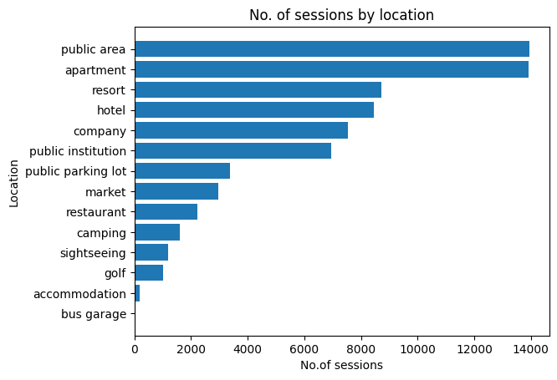
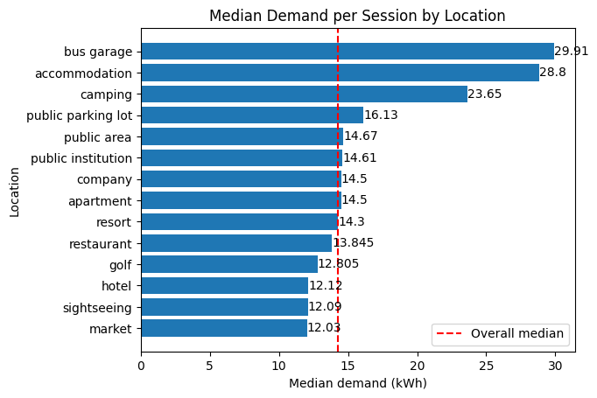
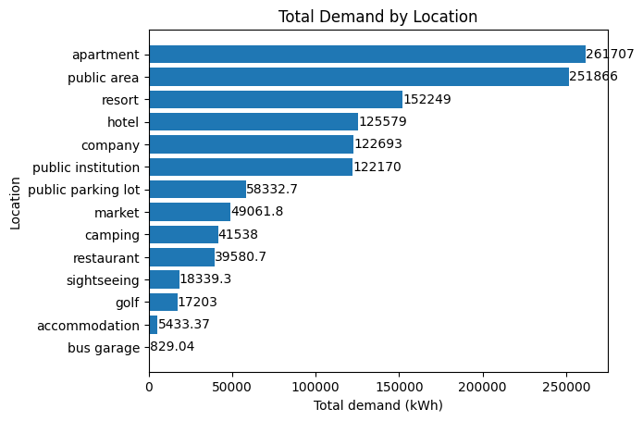
Where charging happens
04 · EDA · Q3, Q4
Sessions by location
Median demand per session
Total demand
Public area and apartment lead (19.3% each). Top 6 locations cover about 82%.
Long stays use most: accommodation 28.8, camping 23.7 kWh. Short stops lowest (~12).
Apartments (~262k kWh) and public areas (~252k) are far ahead.
Notes:
Charging is concentrated in places where cars stay parked for a long time, plus tourist places. Per session, long-stay places like camping and accommodation use the most energy; bus garage is highest at 29.9 kWh but it has only 29 sessions, and accommodation only 185, so those two are less reliable. Short stops like market, sightseeing and hotel are around 12 kWh. In total demand, apartments and public areas win because they have the most sessions, so that’s where extra capacity helps most.

Slide 9
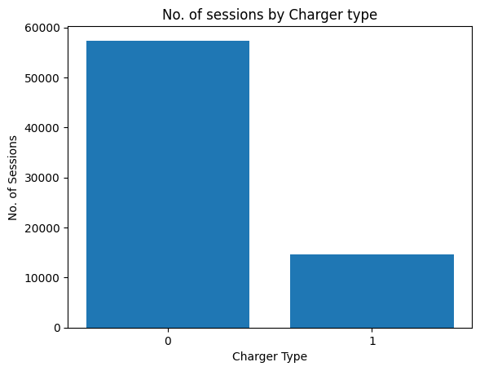
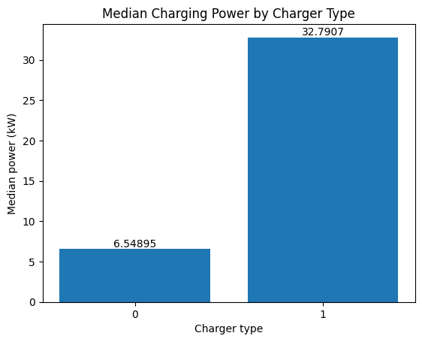
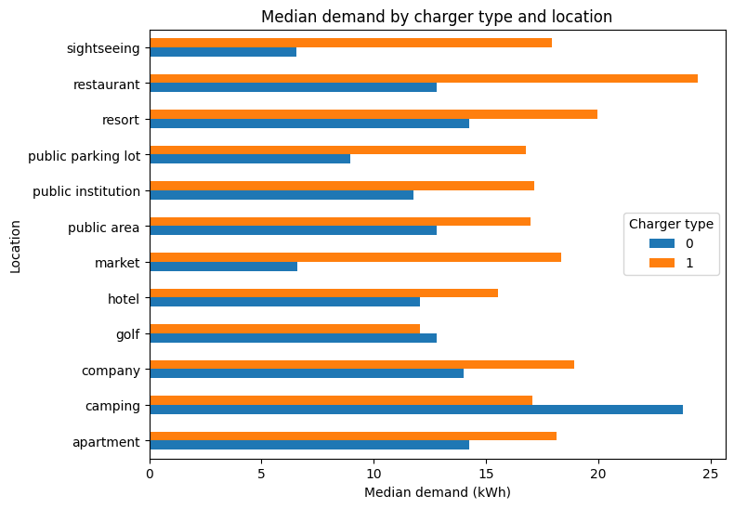
Charger type
04 · EDA · Q3, Q5, Q12
Sessions by type
Median charging power
Type × location
Type 0: about 80% of sessions. Type 1: about 20%.
Type 1: ~33 kW vs 6.6 kW. More energy in less time, so likely the fast charger.
Biggest gap at market, restaurant, sightseeing (~11–12 kWh): short stops.
Notes:
The dataset doesn’t say what type 0 and 1 mean, so I derived power as Demand divided by hours. Type 1 sessions use more energy (median 17.3 vs 13.2 kWh) in much less time (37 vs 151 minutes), at about 33 kW versus 6.6 kW, so type 1 is most likely a fast charger. All type 1 chargers belong to company 0. The type-by-location chart shows fast chargers matter most at short-stop places, while at hotels and resorts slow chargers are enough.

Slide 10
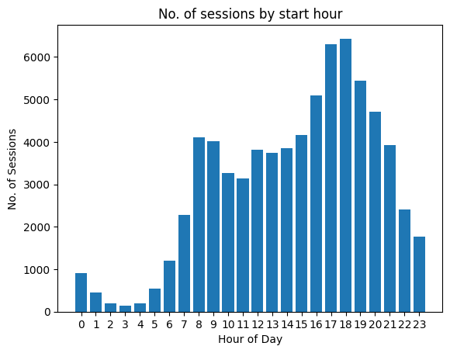
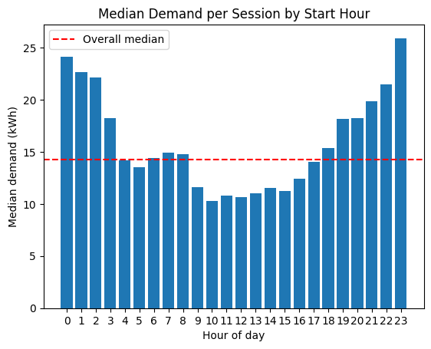
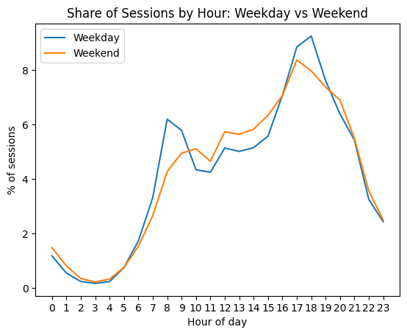
When charging happens
04 · EDA · Q6, Q8
Sessions by start hour
Median demand by hour
Weekday vs weekend
Main peak 5–6 pm, smaller peak 8–9 am.
Late-night starts use most (~24–26 kWh); late morning least (~10–11).
Same energy per session; only the timing changes.
Notes:
Chargers are busiest in the evening, when people get home, with a smaller morning peak. Late-night sessions use the most energy per session because cars are left to charge for long. Weekdays have more sessions than weekends, but median demand and duration are almost the same; weekday sessions peak in the morning and evening, while weekend sessions spread across late morning and afternoon.

Slide 11
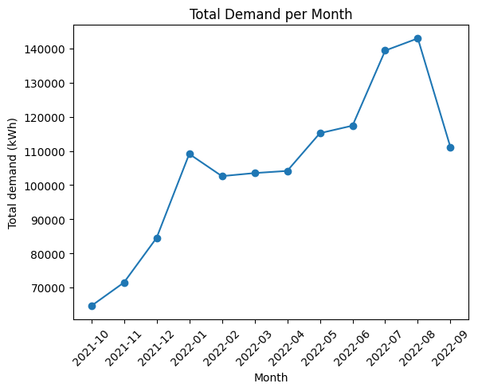
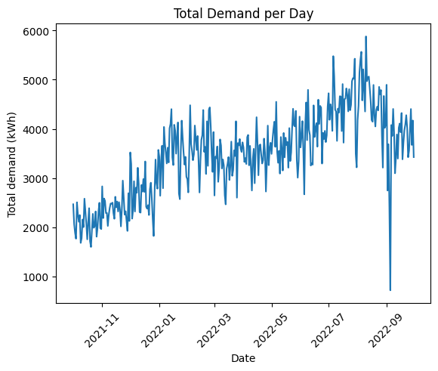
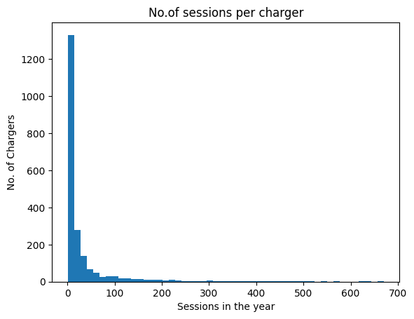
Growth over the year and charger usage
04 · EDA · Q9, Q10
Total demand per month
Total demand per day
Sessions per charger
From ~65k kWh (Oct 2021) to ~143k (Aug 2022). Step-up in January.
~2,000–2,500 kWh/day rising to ~4,500, with a weekly up and down.
Median 9 a year; busiest ~670. 804 chargers (38%) had 5 or fewer.
Notes:
Demand roughly doubled over the year, with a clear step-up in January 2022 and the highest months in July and August. The daily line goes up and down every few days, which is the weekly pattern: weekdays busier, Sunday lowest. For usage, UserID 0 alone has 31,210 sessions, 43% of the data, across 309 chargers, so it’s likely unregistered or guest users. Charger use is very uneven, and the chargers with very few sessions are worth reviewing.

Slide 12
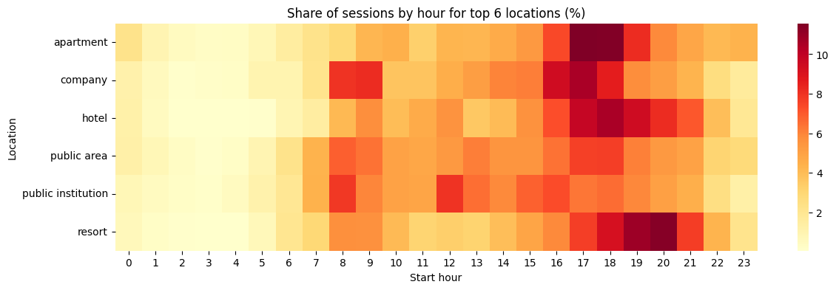
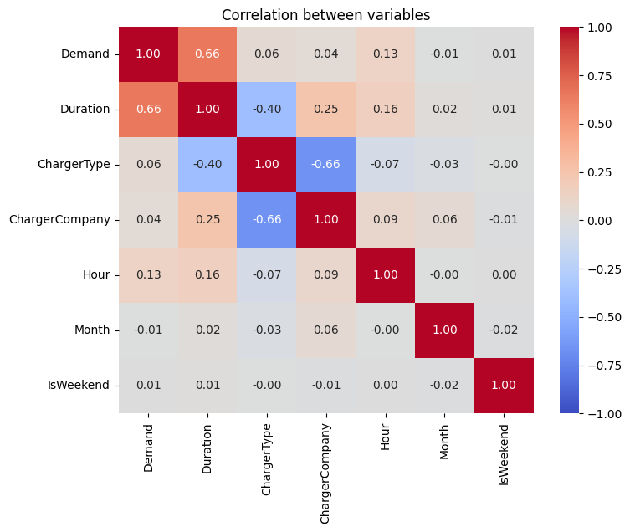
Location × hour, and what drives demand
04 · EDA · Q11, Q13
Share of sessions by hour, top 6 locations
Apartment: 5–6 pm
Company: 8–9 am and 4–5 pm
Hotel, resort: evening
Public institution: 8 am, noon
Correlation
Public area: all day
All locations: quiet 1–5 am
Only Duration is strong (0.66). Others are weak alone; demand depends on combinations.
Notes:
Each location has its own busy hours: apartments when people get home, companies when staff arrive and leave, public institutions during office and visiting hours, hotels and resorts in the evening, and public areas spread through the day. So planning and pricing should be set per location, not one rule for all. In the correlation heatmap, only Duration is strongly related to demand. Hour looks weak at 0.13, but demand clearly changes by hour; correlation only measures a straight-line relationship. ChargerType and ChargerCompany are strongly related to each other (−0.66) because type 1 exists only in company 0.

Slide 13
Features created for the models
05 · FEATURE ENGINEERING
Feature | How | Why
Hour, Weekday, IsWeekend | From StartDatetime | Demand changes by time
IsGuest | UserID = 0 | Guests have no history
UserPastSessions, UserPastAvgDemand | Count and average of the user’s earlier sessions | Driver’s own habits and car
ChargerPastSessions, ChargerPastAvgDemand | Same, per charger | Site behaviour
Dropped: UserID, ChargerID, EndDatetime | IDs, or known only after the session | Avoid leakage
Only past sessions used
Duration excluded
Output
Data sorted by time first, so no future information leaks in.
Known only after the session ends, so it can’t be an input.
model_ready.csv · 72,088 × 14
Notes:
I sorted sessions from oldest to newest, then created time features, a guest flag and history features. The history features use cumcount and cumsum minus the current session, so each row only sees earlier sessions; that avoids leakage. Guests have their past average set to missing because UserID 0 is many different people. Duration is the strongest single variable, but it’s only known after the session ends, so using it would be data leakage; I excluded it from the models.

Slide 14
Same process for regression and classification
06 – 07 · MODELLING APPROACH
1
2
3
Time-based split
Pipeline
TimeSeriesSplit CV
First 80% train (57,670) · last 20% test (14,418)
Median impute · scale numbers · one-hot Location
3 folds, always train on the past
4
5
6
Compare models
Tune top 2
Test once, then explain
Against a simple baseline
RandomizedSearchCV, 10 combinations
Feature importance · SHAP · LIME
Why a time-based split? A random split would let the model learn from future sessions and look better than it really is.
Notes:
Both supervised tasks used the same process. I split by time: the first 80% of sessions for training and the last 20% for testing. Preprocessing is inside a pipeline, so it’s fitted only on training folds. Cross-validation used TimeSeriesSplit, which always trains on earlier data and validates on later data. I compared all models against a baseline, tuned the top two with RandomizedSearchCV, tested the final model once on the unseen test set, and explained it with feature importance, SHAP and LIME.

Slide 15
Model comparison and test result
06 · REGRESSION · PREDICT DEMAND (KWH)
Cross-validation (TimeSeriesSplit, 3 folds)
Tuned LightGBM on test
Model | Train MAE | Val MAE | Val RMSE | Val R²
Baseline (median) | 9.79 | 10.15 | 13.85 | −0.053
Linear Regression | 8.07 | 8.21 | 11.12 | 0.321
Decision Tree | 7.35 | 8.21 | 11.44 | 0.281
Random Forest | 6.30 | 7.88 | 10.85 | 0.354
Gradient Boosting | 7.49 | 7.81 | 10.72 | 0.369
XGBoost | 6.11 | 8.21 | 11.34 | 0.293
LightGBM (best) | 6.99 | 7.69 | 10.65 | 0.377
8.12
MAE (kWh) · baseline 10.54
11.16
0.354
RMSE
R²
Tuning: CV MAE 7.69 → 7.66
Notes:
All models beat the median baseline, so the features carry real information. LightGBM was best in cross-validation, with Gradient Boosting close behind. XGBoost and Random Forest have a big gap between train and validation error, which means overfitting. Linear Regression is weaker because the relationships are non-linear. Tuning LightGBM gave a small gain. On the unseen test set the error is slightly higher than in CV because later months differ a little, but it still clearly beats the baseline. R² is modest because the strongest driver, Duration, isn’t known in advance.

Slide 16
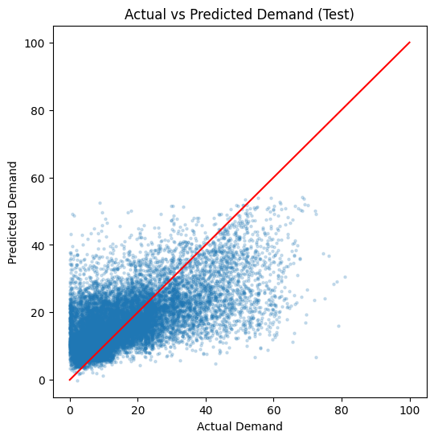
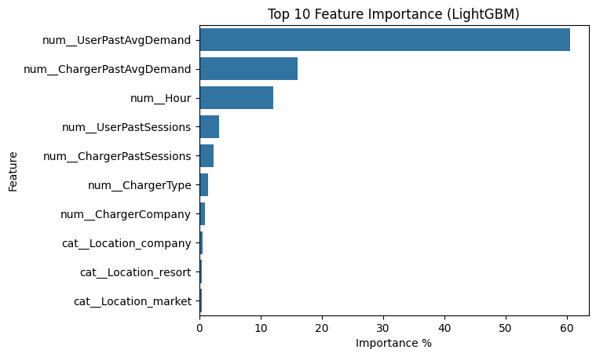
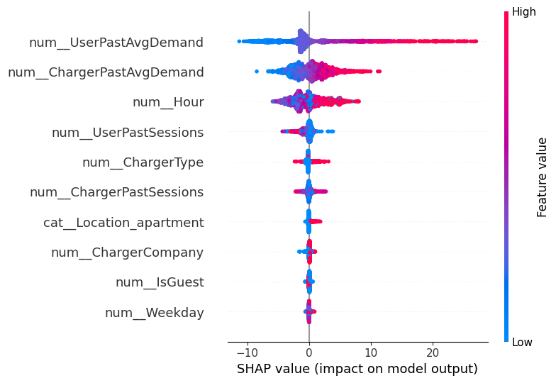
What the regression model learned
06 · REGRESSION · EXPLAINABILITY
Actual vs predicted
Feature importance
SHAP summary
Large sessions under-predicted, small ones over-predicted.
UserPastAvgDemand 60.6%, ChargerPastAvgDemand 16.0%, Hour 12.1%.
Same ranking: heavy past users get much higher predictions.
Notes:
Without Duration, predictions move towards typical values, so very large sessions are under-predicted and very small ones over-predicted. The user’s own past average demand is by far the strongest factor: it captures their car, battery size and habits. The charger’s past average and the hour come next. SHAP gives the same ranking and shows direction: high past averages push predictions up. LIME on a single session, a heavy user at a public institution with actual demand 64.4 kWh, confirmed the same reason at the single-session level.

Slide 17
Model comparison
07 · CLASSIFICATION · HIGH VS NORMAL DEMAND
Cross-validation (TimeSeriesSplit, 3 folds)
Target
Model | Val Acc | Val F1 | Train AUC | Val AUC
Dummy | 0.498 | 0.665 | 0.500 | 0.500
Logistic Regression | 0.698 | 0.705 | 0.764 | 0.780
Decision Tree | 0.714 | 0.722 | 0.819 | 0.777
Random Forest | 0.736 | 0.742 | 0.883 | 0.817
KNN | 0.713 | 0.714 | 0.843 | 0.789
SVM (Linear) | 0.696 | 0.702 | 0.762 | 0.778
XGBoost | 0.725 | 0.731 | 0.901 | 0.805
LightGBM | 0.731 | 0.741 | 0.853 | 0.814
High = Demand ≥ 14.35 kWh (train median). Classes balanced.
SMOTE check
No gain (Val AUC 0.813 vs 0.814), so not used.
Tuned top 2 (AUC)
RF 0.819 · LightGBM 0.817. LightGBM chosen: much lighter to save, faster to explain.
Notes:
I turned Demand into a yes/no target: High if it’s at or above the training median of 14.35 kWh, using the train set only so the test set doesn’t leak. The classes came out balanced, so I didn’t need resampling; I still checked SMOTE and it gave no gain. Random Forest and LightGBM were the top two and almost equal. XGBoost and Random Forest overfit, with a big train–validation gap. Linear models were weakest, so the relationships are non-linear. After tuning, both scored almost the same, and I picked LightGBM because it’s much lighter to save and faster to explain.

Slide 18
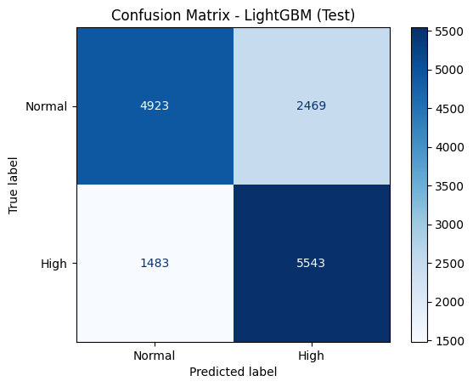
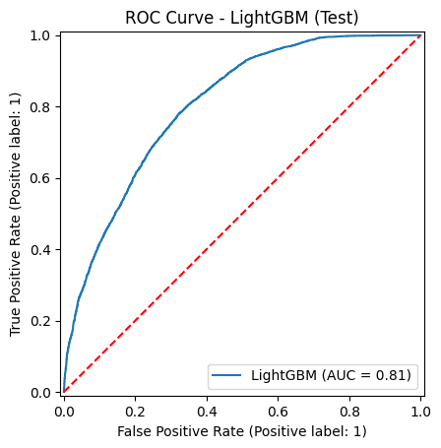
Tuned LightGBM on unseen data
07 · CLASSIFICATION · TEST SET
0.726
0.806
Accuracy
ROC-AUC
0.692
0.789
Precision
Recall
0.737
0.487
F1
Baseline accuracy
Confusion matrix
ROC curve
Catches most High sessions; some Normal ones flagged as High.
Well above the random line: good separation.
Notes:
On the unseen test set the tuned LightGBM reaches accuracy 0.726 and ROC-AUC 0.806, against a baseline accuracy of 0.487 from always predicting the most common training class. Recall is higher than precision: the model catches most high-demand sessions but also flags some normal ones as high. For load planning that is the safer mistake, because it’s better to prepare for a high session that turns out normal than to miss one.

Slide 19
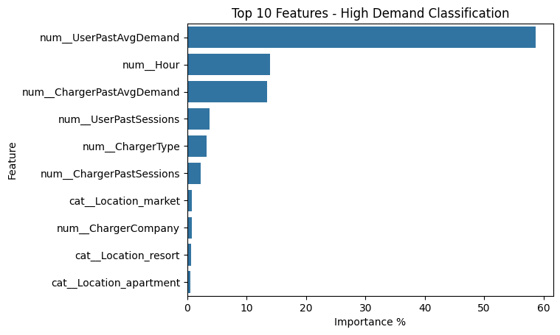
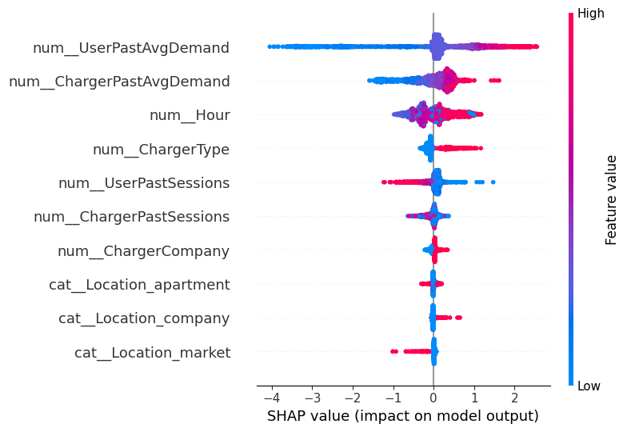
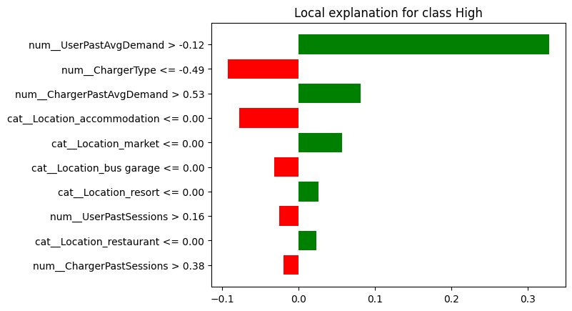
What drives a High Demand session
07 · CLASSIFICATION · EXPLAINABILITY
Feature importance
SHAP summary
LIME, one session
UserPastAvgDemand 58.7%, Hour 14.0%, ChargerPastAvgDemand 13.4%.
Night and late-evening sessions and fast chargers lean towards High.
Actual 64.4 kWh; model gives P(High) 0.89, mainly from the user’s past average.
Notes:
Feature importance, SHAP and LIME all agree: the user’s past average demand is the strongest signal, followed by the hour and the charger’s past average. SHAP also shows direction: night and late-evening sessions and fast chargers push towards High Demand. LIME explains one real session: it was actually 64.4 kWh, and the model gave it a 0.89 probability of being High, mainly because of the user’s high past average.

Slide 20
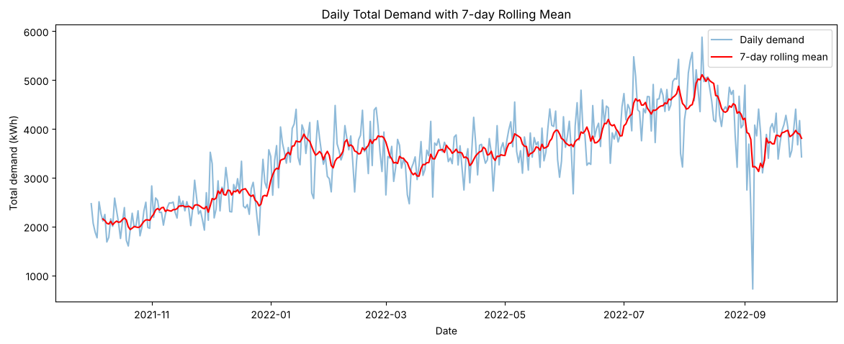
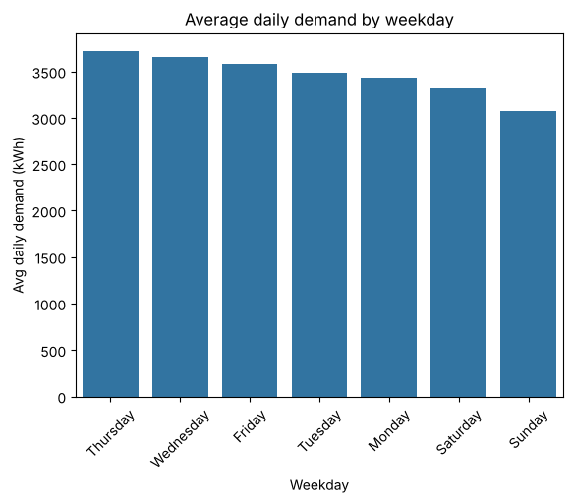
Trend and weekly pattern
08 · TIME SERIES · DAILY TOTAL DEMAND
Daily demand with 7-day rolling mean
Average by weekday
365 days. The rolling mean shows the trend: rising, peak in summer, drop in September.
Thursday highest (3,724), Sunday lowest (3,069).
Biggest monthly changes:
Jan +29.1%
Jul +14.9%
Mar −8.9%
Sep −19.8%
Notes:
I converted the sessions into one value per day: the total demand, using resample by day. The first day only had a few evening sessions, so I dropped it, leaving 365 full days. The 7-day rolling mean smooths the daily ups and downs and shows the trend. The weekday averages show a clear weekly pattern, which is the seasonality. Month-on-month change shows the periods of increase and decrease: the biggest rise was January and the biggest drop was September.

Slide 21
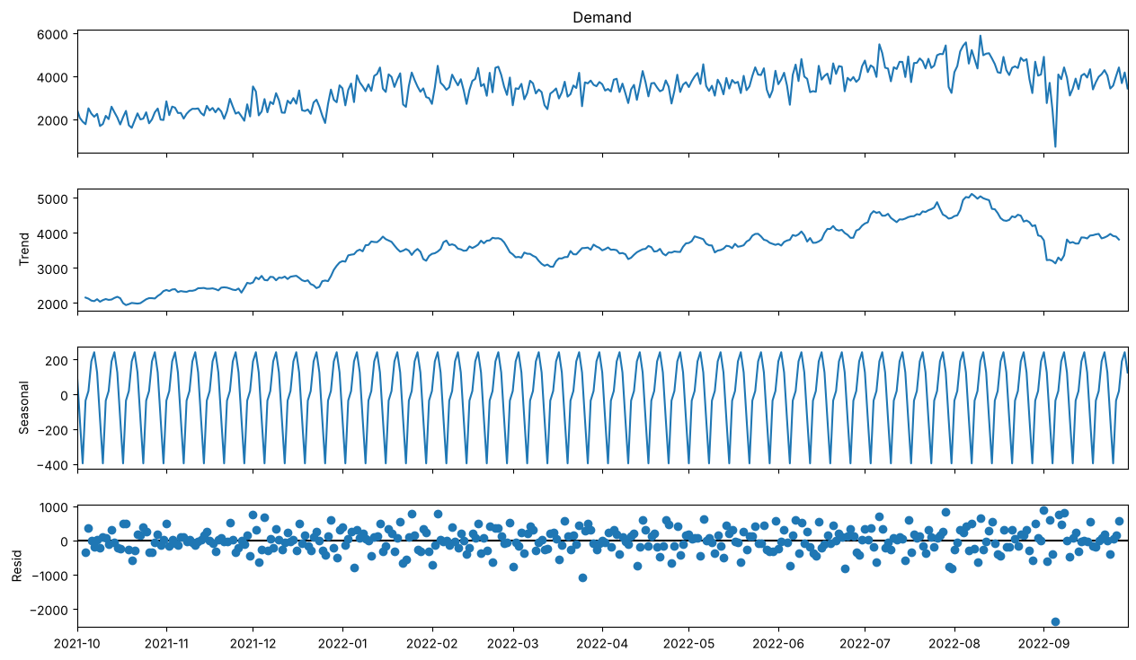
Trend, seasonality and noise
08 · TIME SERIES · DECOMPOSITION AND STATIONARITY
Trend
Steps up in January, peaks in August, drops in September.
Seasonal (period 7)
The same weekly wave repeats all year.
Residual (noise)
Random around 0. Biggest outlier: 5 Sep 2022.
ADF, original: −1.86, p = 0.352 → not stationary
ADF, after differencing: −8.08, p ≈ 0 → stationary
Notes:
Decomposition splits the series into three parts. The trend is the long-term direction. The seasonal part is the repeating weekly pattern, with period 7; its low point is Sunday and its peak is midweek. The residual is the leftover noise; it’s randomly scattered around zero, which means trend plus weekly seasonality explain most of the structure, and the biggest outlier is 5 September 2022. Stationary means the mean and variance stay the same over time. The ADF test says the original series is not stationary, because p is above 0.05, and after differencing, today minus yesterday, it becomes stationary.

Slide 22
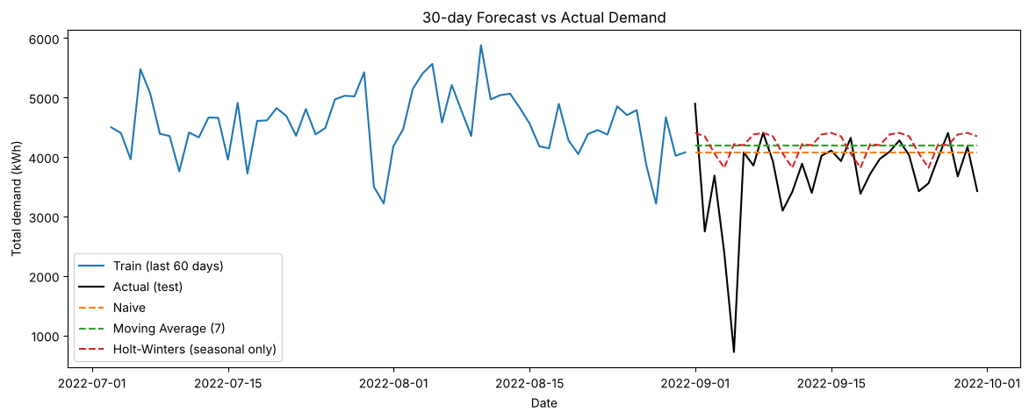
Forecasting models
08 · TIME SERIES · 30-DAY FORECAST
Train 335 days · Test = last 30 days (Sep 2022)
Model | MAE | RMSE
Naive (best) | 514.5 | 835.7
Holt-Winters, seasonal only | 576.1 | 866.0
Moving Average (7) | 580.2 | 891.9
Simple Exp Smoothing | 617.4 | 923.7
Holt-Winters, trend + seasonal | 696.2 | 951.9
Holt (trend) | 742.6 | 1012.9
Forecast vs actual, September 2022
Demand dropped in September after summer growth.
Why simple models won
Chosen for the app
Trend models kept forecasting growth, so they over-forecast the drop.
Holt-Winters, seasonal only: close to best and keeps the weekly pattern.
Notes:
I kept the last 30 days, September 2022, as the test set and compared Moving Average and Exponential Smoothing models using MAE and RMSE. Naive repeats the last known day; Moving Average uses the mean of the last 7 days; Simple Exponential Smoothing gives recent days more weight; Holt adds a trend; Holt-Winters adds trend and weekly seasonality. The honest finding is that simple models won, because September dropped unexpectedly after summer growth and the trend models kept predicting growth. I chose Holt-Winters with weekly seasonality only for the app, because it’s close to the best and keeps the weekly pattern, which a flat naive forecast can’t show.

Slide 23
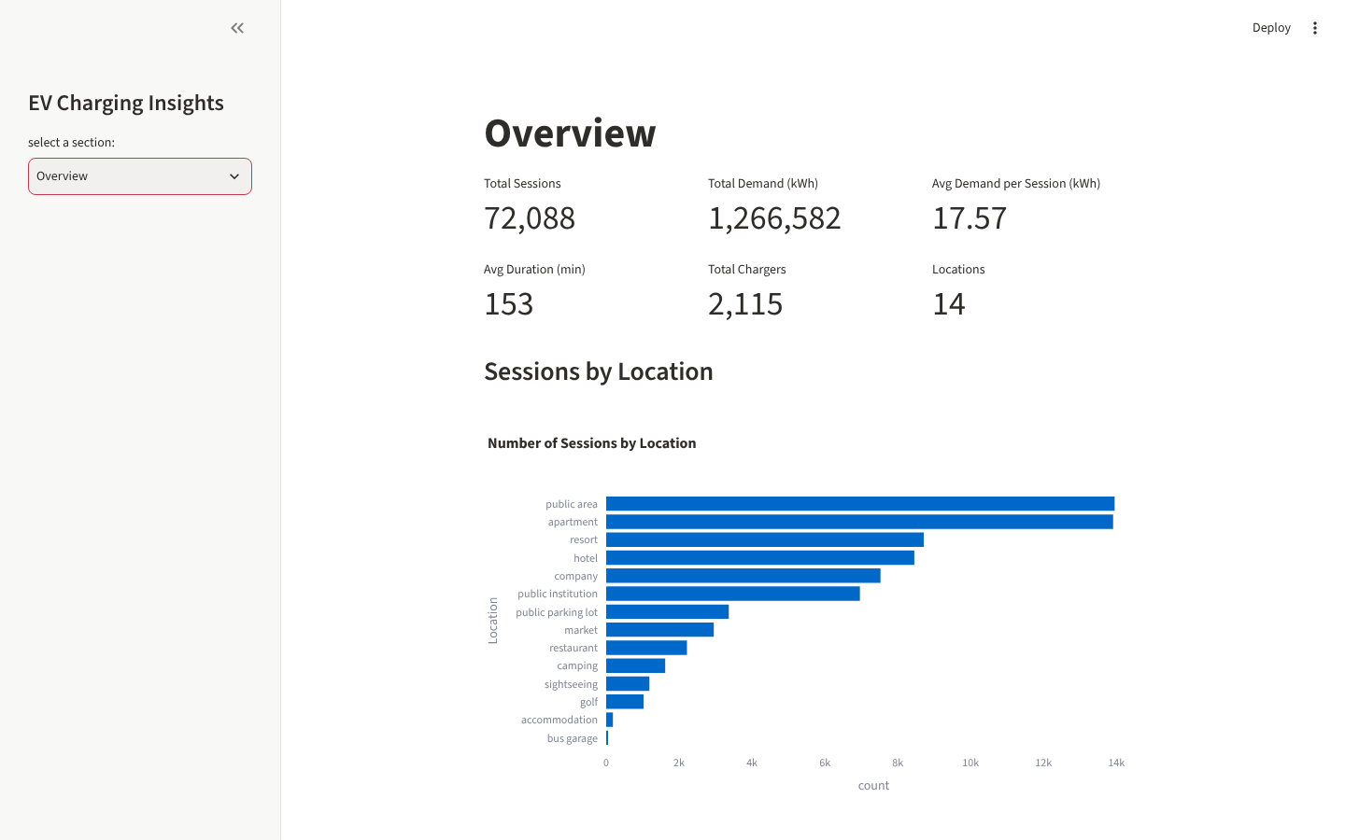
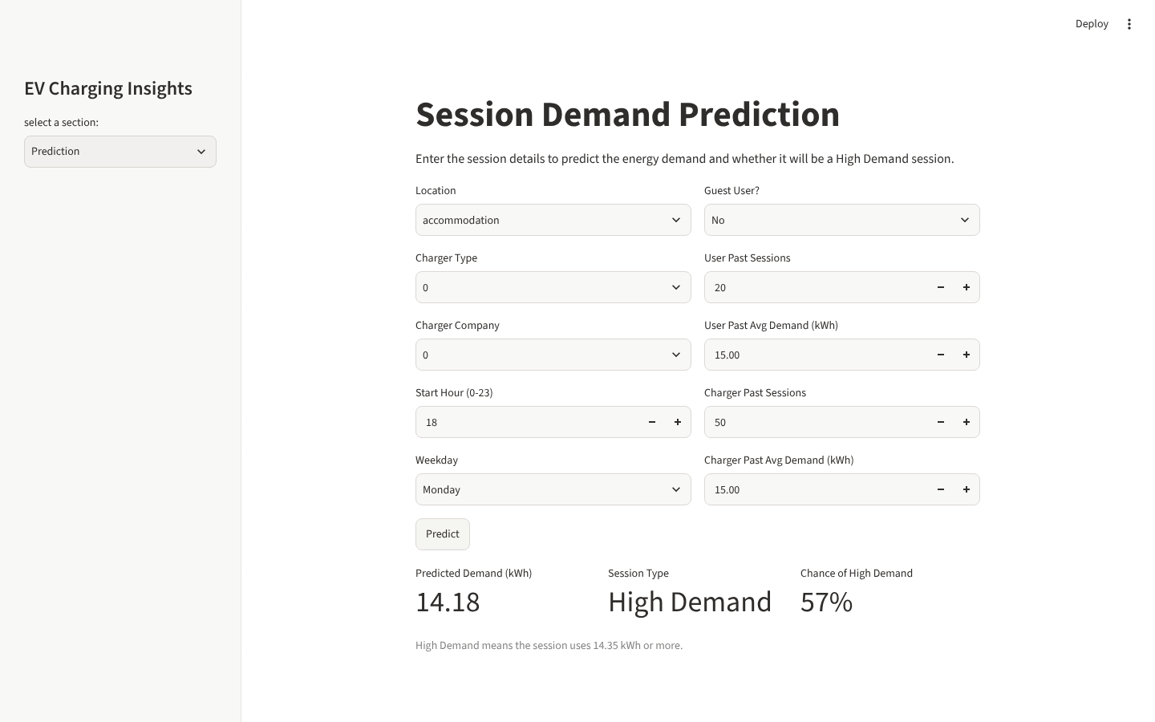
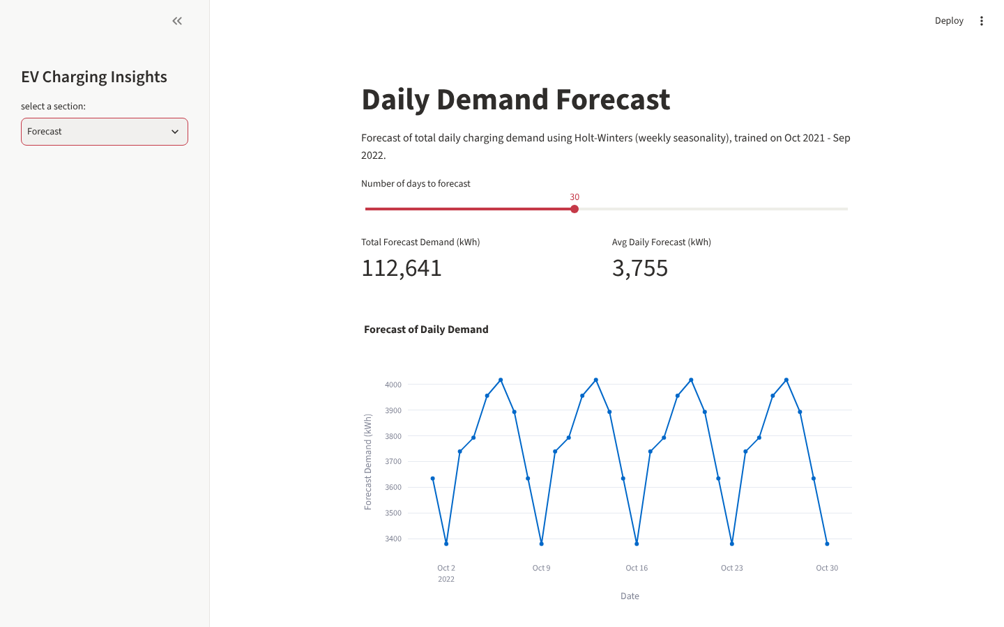
Interactive dashboard
09 – 10 · SAVED MODELS AND STREAMLIT
Overview
Prediction
Forecast
KPI cards, sessions by location, monthly demand.
One form: predicted kWh, High or Normal, and its probability.
Pick 7–60 days; chart and table of daily forecast.
6 sections:
Home
Overview
Demand Patterns
Prediction
Forecast
Model Insights
Models: retrained on all data and saved with joblib; the app loads them.
Notes:
After testing, I retrained the chosen pipelines on all the data and saved them with joblib, along with the High Demand threshold. The Streamlit app loads those files. It has six sections: Home, Overview with KPIs, Demand Patterns by hour, weekday, location and charger type, Prediction where you enter session details and get the predicted kWh plus High or Normal, Forecast with a slider for the number of days, and Model Insights with the test results and feature importance. I can demo it live.

Slide 24
Key insights
SUMMARY
01
02
03
Evening peak
Where demand is
Type 1 = fast
5–6 pm busiest; each location has its own peak; 1–5 am quiet.
Apartments and public areas lead total demand.
~33 kW vs 6.6 kW; matters most at short stops.
04
05
06
Growing demand
History predicts best
Best models
Roughly doubled in a year, with a weekly pattern.
User’s past average is the top factor in both models.
LightGBM for regression and classification; Holt-Winters for forecasting.
Notes:
To sum up: chargers are busiest in the evening and every location has its own peak hours. Total demand is concentrated at apartments and public areas. Type 1 behaves like a fast charger and makes the biggest difference at short-stop places. Demand roughly doubled over the year with a weekly pattern. For prediction, a user’s own history is the strongest signal. LightGBM was the final model for both regression and classification, and Holt-Winters with weekly seasonality for forecasting.

Slide 25








Recommendations
BUSINESS VALUE
Plan chargers and pricing per location
Add capacity at apartments and public areas
Fast chargers at markets, restaurants, sightseeing
Idle fees at apartments in the evening peak
Maintenance at 1–5 am and on Sundays
Review underused chargers (location, visibility, price)
Encourage app login, so guests get a history
Plan for growth; refresh forecasts often
Notes:
Each location peaks at a different time, so planning and pricing should be set per location. Apartments and public areas have the highest total demand, so that’s where extra capacity helps most. Fast chargers make the biggest difference at short-stop places. Idle fees during the apartment evening peak stop full cars from blocking chargers. Maintenance fits between 1 and 5 am, and Sunday is the lowest day. Chargers with very few sessions should be reviewed. Guests are 43% of sessions and have no history, so encouraging app login would improve predictions. Demand roughly doubled in a year, so plan capacity ahead and refresh forecasts often.

Slide 26
Limitations and next steps
HONEST VIEW
Limitations
Next steps
Duration, the strongest driver, is unknown at plug-in
Guest sessions (43%) have no personal history
Only one year of data: one cycle of seasons
No queue or occupancy data
Charger type and company meanings are inferred
Collect planned departure time at plug-in
Add more months of data and retrain regularly
Add occupancy data to confirm where to add chargers
Forecast per location, not just in total
Notes:
The biggest limitation is that Duration drives demand but isn’t known when the car plugs in, which is why R² is modest. If operators collected the planned departure time, predictions would improve a lot. Guests are 43% of sessions and have no history. One year of data means the models have seen each season only once, which is part of why the September drop wasn’t predictable. There’s no queue or occupancy data, so recommendations to add chargers should be confirmed with that. And the meaning of charger type and company was inferred from the data, not given.

Slide 27
Thank you
Questions?
Code, notebooks and app: github.com/vishnu-kashyap-k/ev-charging-demand-prediction
Notes:
Thank the evaluator and invite questions. Be ready to open the notebooks or demo the Streamlit app live.

