Slide 1


MandiMitra
Explainable mandi price intelligence
Does AI really beat “same as today” for wholesale onion and tomato prices? We tested it — properly.
Vishnu Keer · Vivekananda Global University, Jaipur
Live app
Code + data
mandimitra.streamlit.app · github.com/vishnu-keer/mandimitra
Notes:
Hi, I'm Vishnu. MandiMitra asks a question most price-prediction apps skip: does the AI actually beat the simplest forecast — tomorrow's price equals today's — when you test it honestly? Scan the left code for the live app, the right one for the code and data. Everything I show is reproducible from those links.

Slide 2
Price-prediction claims reach farmers unchecked
1
Farmers
Rs. 600
→ Rs. 4,500
Sell today or hold? A confident wrong forecast costs real money.
per quintal: Jaipur wholesale onion, June → 21 October 2013, then back to about Rs. 800 by December
2
Traders
How noisy is this market, and how stale is the quoted price?
Official Department of Consumer Affairs series
Students & analysts
3
Was this model tested in a way that could have shown it fails?
Notes:
Mandi prices swing hard — Jaipur onion went from about six to nine hundred rupees a quintal in June 2013 to four and a half thousand in October. Apps now promise AI forecasts to farmers and traders. The people who would act on them can't check how they were tested. That's the gap.

Slide 3
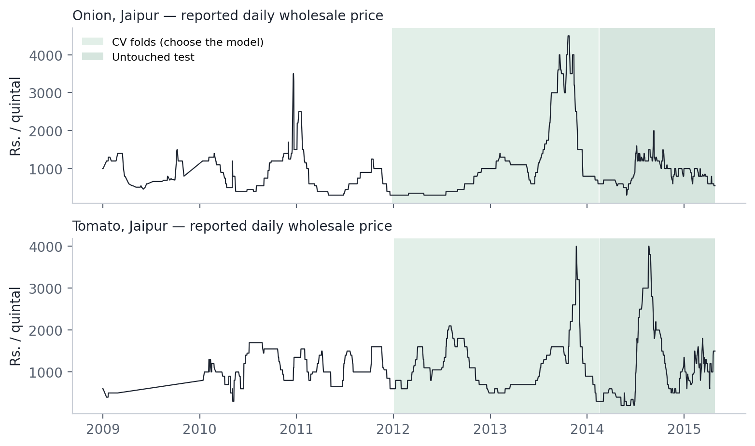
Prices move in rare jumps that price history alone cannot see
84.8%
of reported Onion/Jaipur days quote exactly the previous price (Tomato: 82.8%)
~55%
of calendar days have a reported price at all (2009–2015)
Data: Dept. of Consumer Affairs via data.gov.in (GODL-India). Related evidence: onion price volatility is linked to market-arrivals uncertainty (Birthal, Negi & Joshi, 2019, JADEE 9(3)).
Notes:
This is the real series. Most days the quoted price doesn't change at all — eighty-five percent of reported onion days. Then it jumps. Research on Indian onion prices links that volatility to uncertainty in market arrivals, which isn't in the price history. So a price-only model has very little to work with — and that should be tested, not assumed.

Slide 4
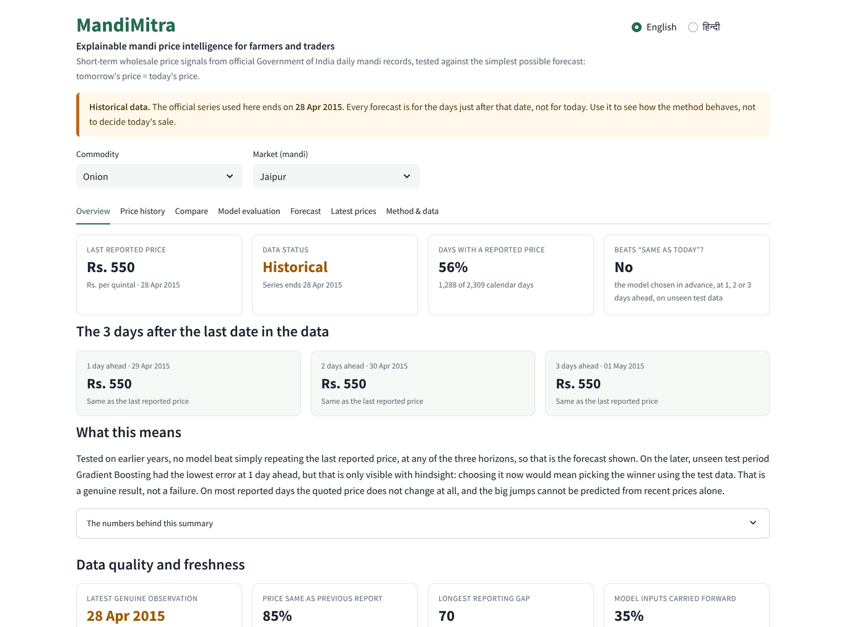
An honest dashboard, not a model leaderboard
Strong reference first
Every forecast is shown next to “same as today” and the last reported price.
Freshness and quality
Latest genuine observation, stale-quote rate, reporting gaps — on screen.
Honest uncertainty
Ranges are drawn only if they held up on unseen data. They didn't, so we say so.
English + हिन्दी
Plain-language views in Hindi; CSV downloads; works on a phone.
Notes:
MandiMitra is built around trust. The forecast always sits beside the simplest reference. Data freshness and stale quotes are on the first screen. If an uncertainty band didn't hold up on unseen data, we don't draw it — we tell you. And the plain-language views are in Hindi.

Slide 5
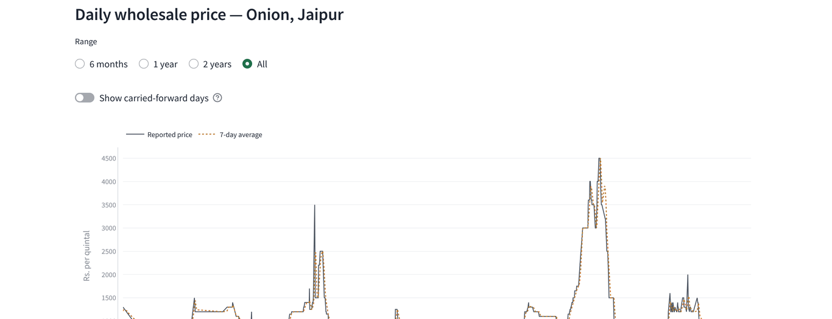
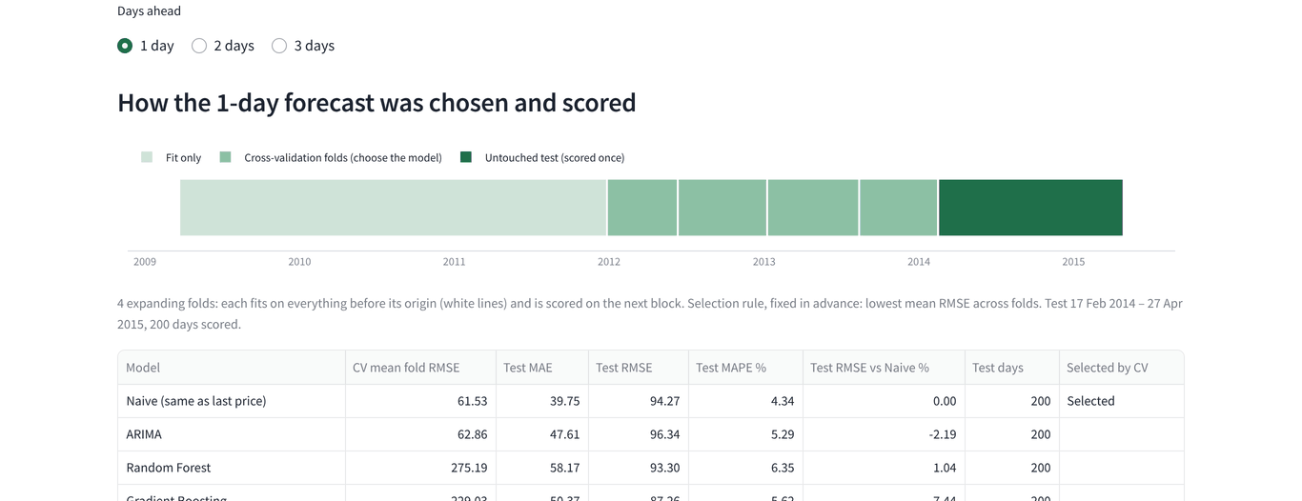
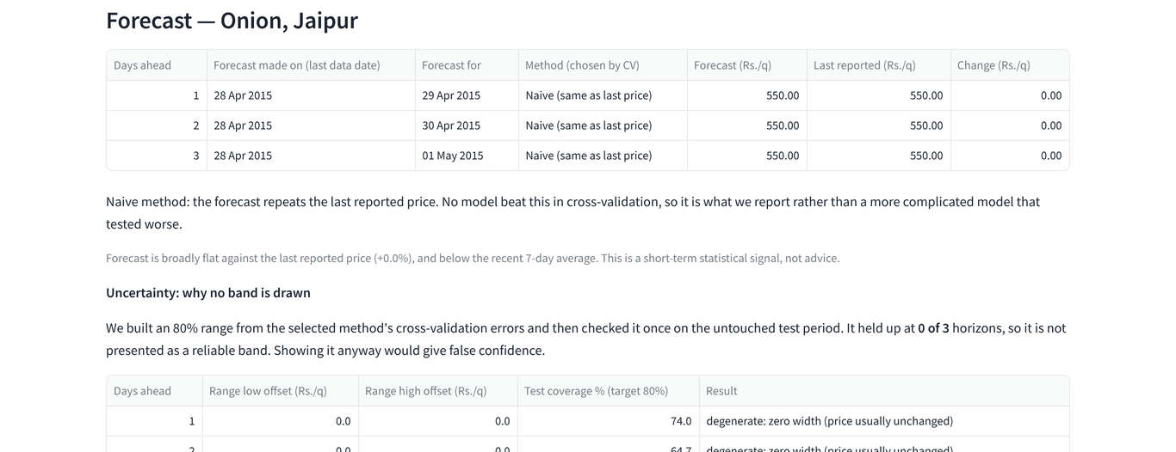
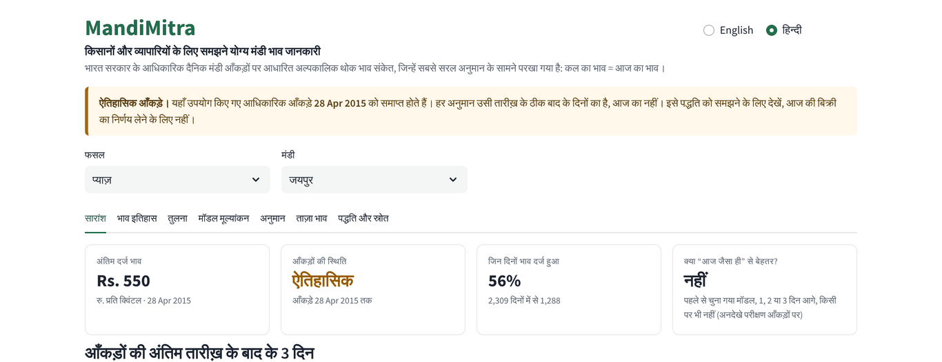
It works today: seven views, every number traceable to a file
Price history: reported vs carried-forward days
Model evaluation: chosen by CV, every model on the same days
Forecast: origin and target dates, no fake confidence band
Hindi view for farmers
Notes:
Live demo here if the network allows — otherwise these are the real screens. Price history marks the days the mandi didn't report. Model evaluation shows how the model was chosen before the test period. The forecast tab shows the date it was made and the dates it is for. Same app in Hindi.

Slide 6
A pipeline that refuses to write a misleading result
Official CSVs
Clean + calendar
Features ≤ day t
Choose by CV
Test once
Dashboard
untouched, SHA-256
0 = missing
leakage-proofed
4 rolling folds
~200 unseen days
read-only
154
2 gates
Byte-identical
automated tests: leakage, chronology, embargo, identical rows, provenance, ingestion
pipeline exits with FAIL rather than publish a broken comparison
rebuild from the government files on Python 3.11 and 3.12; CI on every push
Notes:
Under the hood: official files kept untouched and hashed; a real daily calendar so 'yesterday' means yesterday; features that only use what was known at the end of the day; the model is chosen on earlier years; the test period is scored once. A hundred and fifty-four tests and two gates stop the pipeline if any of that breaks.

Slide 7
The model is chosen before the test data is ever scored
Fit only
4 cross-validation folds — choose the model
Untouched test, scored once
~200 unseen days per horizon
2009 → early 2014: development period
Feb 2014 → Apr 2015
Naive
ARIMA
Random Forest
Gradient Boosting
RF-delta
tomorrow = today
classical time series
tabular ML
tabular ML
predicts the change
Selection rule written in advance: lowest mean RMSE across the four folds.
Every model scored on identical days; only days the mandi really reported are scored.
Training rows whose target date crosses a boundary are removed (embargo).
Significance: Diebold–Mariano tests vs Naive, Holm-adjusted.
Notes:
This is the part most projects skip. The test period is locked away. Five candidates, from 'same as today' to tree models that predict the price change, are compared on four rolling folds of earlier data, and the rule for picking the winner was written before we saw the results. Then the test is scored once.

Slide 8
The model chosen in advance never beat “same as today”
0 of 48
significance tests found any model more accurate than Naive
p = 0.505
for our first version's “+7.33%” — it came from picking the winner on the test set
Naive also had the lowest error on an ordinary day (MAE) at all six.
Onion: CV chose Naive at all horizons. Tomato: 1d RF-delta −5.66%, 2d ARIMA −0.53%, 3d ARIMA −0.31% vs Naive. Files: outputs/best_model.csv, outputs/experiments/dm_test.csv.
Notes:
Here's the result. For onion, cross-validation chose 'same as today' at every horizon. For tomato it chose other models, and each was slightly worse on unseen data. Across forty-eight significance tests, none found a model better than Naive. Our own first version claimed a 7.33% win — it came from choosing the winner on the test data, and the gap has p = 0.505. That correction is the finding.

Slide 9
No user evidence yet — this is exactly how we will get it
What we can claim today
Next 4 weeks: consented user study
A working, tested, reproducible product.
A measured, significance-tested result on official data.
No farmer interviews, user counts, savings or income effects — none have been measured.
5–10 traders and farmers at a Jaipur mandi, with informed consent, no names stored.
Measure: can they read the forecast, the reference and the warning correctly?
Measure: which screen would change a decision, and how?
Publish the anonymised findings — whatever they are.
Notes:
I want to be precise here: we have not tested this with farmers yet, so we make no impact claims. The plan is ready — a short, consented study at a Jaipur mandi, measuring whether people read the forecast and its warnings correctly. We'll publish what we find.

Slide 10
Rs. 0 to run, open data, and built to add markets
Rs. 0
GODL-India
GitHub + Actions, Streamlit Community Cloud, data.gov.in. No paid service anywhere.
Government open data with attribution; code MIT. Licences kept separate.
Live-ready
Gate-based
Validated client for the official AGMARKNET daily price API — waiting only for a free access key.
New market = add its official file. The 400-row gate decides; nothing is forced.
Notes:
It costs nothing to run. The data is government open data with attribution. The live-price client for the official AGMARKNET API is built and tested — it needs only a free access key. Adding a market means adding its official file; the data gate decides if it's usable.

Slide 11
What this does not show yet — and the next milestones
Limitation | Next milestone
Data ends April 2015 | Connect the official daily API (key); check a CEDA daily mirror's terms
One mandi, two commodities | Run more Rajasthan and national centres through the gate
Price history only | Add arrivals and rainfall — where a real edge is more plausible
Back-test only | Score live forecasts against prices published afterwards
No user evidence | Consented study with 5–10 traders and farmers
Notes:
Limits, stated plainly: historical data, one mandi, prices only, back-testing only, and no user evidence yet. Each has a concrete next step on the right.

Slide 12
Trust before prediction
We ask for:
Mentors in agricultural economics and forecasting
Introductions to a mandi committee or FPO for a consented pilot
Feedback on what traders would actually use
Live app
Code + data
Vishnu Keer · Vivekananda Global University, Jaipur
Notes:
Before anyone trusts a price prediction, it should beat the simplest reference on data it never saw. MandiMitra makes that check visible, reproducible and bilingual. We'd welcome mentors, an introduction to a mandi or FPO for a consented pilot, and feedback from traders. Thank you.

