Slide 1



2023 International Conference on Computer Communication and Informatics, Jan 23-25, 2023, Coimbatore, India
RECURRENT GASTRIC CANCER PREDICTION USING MACHINE LEARNING CLASSIFIER
PAPER ID : CS489
PRESENTED BY
Vedhapriyaa S
Vishal Rupak V R
Vishnu M K
Department of Computer Science and Engineering

Slide 2
INTRODUCTION
The global incidence of gastric cancer is the fourth in malignant tumors and the second in mortality
The prognosis of early gastric cancer is good, but the clinical symptoms are atypical and the signs are not obvious
The purpose of the present study was to improve the accuracy of a prediction model for the development of gastric cancer using patient’s clinicopathological data and machine learning algorithms

Slide 3
OBJECTIVE
To predict recurrent gastric cancer prediction using Machine learning model and a optimization technique
Machine Learning model used for predicting cancer is Random Forest Model
Using Scikit-Learn’s Randomized Search CV method, Optimization is performed

Slide 4
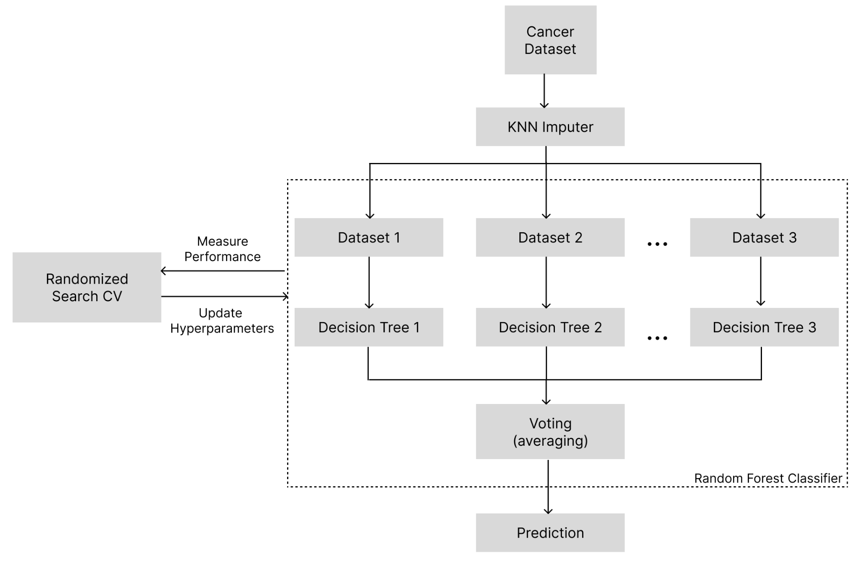
ARCHITECTURE DIAGRAM

Slide 5
PROBLEM STATEMENT
When gastric cancer recurs after the operation, some chemotherapy and immunotherapy can be used in close cooperation to control cancer and reduce necrosis, to create conditions and strive for operation
Predicting the recurring cancer can play a major role in prevention

Slide 6
LITERATURE SURVEY
S.NO | PAPER | AUTHOR | YEAR | METHOD AND ALGORITHM | ACCURACY
1 | PAAP: a web server for predicting antihypertensive activity of peptides | Thet Su Win.et al | 2018 | This study introduces predictor of antihypertensive activity of peptides constructed using random forest classifier as a function of various combinations of amino acid, dipeptide and pseudoamino acid composition descriptors. | 84.73%
2 | HemoPred : a web server for predicting the hemolytic activity of peptides | Thet Su Win.et al | 2017 | This study describes a sequence-based predictor based on a random forest classifier using amino acid composition, dipeptide composition and physicochemical descriptors (named HemoPred ). | 95%
3 | Prediction of recurrence of early gastric cancer after curative resection | Ji Fu Lai.et al | 2009 | Logistic regression was performed to identify independent risk factors for overall recurrence and early recurrence (recurred within 24 months after resection) of EGC. | 79%

Slide 7
LITERATURE SURVEY
S.NO | PAPER | AUTHOR | YEAR | METHOD AND ALGORITHM | ACCURACY
4 | Feature selection using genetic algorithm for breast cancer diagnosis: experiment on three different datasets | S. Aalaei, H. Shahraki, A. Rowhanimanesh, S. Eslami | 2016 | To evaluate effectiveness of proposed feature selection method, we employed three different classifiers artificial neural network (ANN) and PS-classifier and genetic algorithm based classifier (GA-classifier) on Wisconsin breast cancer datasets include Wisconsin breast cancer dataset (WBC), Wisconsin diagnosis breast cancer (WDBC), and Wisconsin prognosis breast cancer (WPBC). | 84.73%
5 | Multimodal Fusion for Multimedia Analysis: a Survey | P.K. Atrey, M.A. Hossain, A. El Saddik, M.S. Kankanhalli | 2010 | In this section, we provide an overview of the different fusion methods that have been used by the multimedia researchers to perform various multimedia analysis tasks. The advantages and the drawbacks of each method are also highlighted. The fusion methods are divided into the following three categories: rule-based methods, classification-based methods, and estimation-based methods | 46.949%
6 | Brainstorm Optimization Algorithm: A Review | S. Cheng, Q. Qin, J. Chen, Y. Shi | 2016 | For swarm intelligence algorithms, each individual in the swarm represents a solution in the search space, and it also can be seen as a data sample from the search space. Based on the analyses of these data, more effective algorithms and search strategies could be proposed. Brain storm optimization (BSO) algorithm | 78.909%

Slide 8
LITERATURE SURVEY
S.NO | PAPER | AUTHOR | YEAR | METHOD AND ALGORITHM | ACCURACY
7 | Support Vector Machines Combined with Feature Selection for Breast Cancer Diagnosis | M.F. Akay | 2009 | Feature selection methods are used to select a subset of features from data, therefore only the useful information can be mined from the samples to get better accuracy and improves the computational efficiency of the learning model. Moth-flame Optimization (MFO) algorithm is a population-based approach, that simulates the behavior of real moth in nature, one drawback of the MFO algorithm is that the solutions move toward the best solution | 99.796%
8 | A Comprehensive Survey of Brainstorm Optimization Algorithms | S. Cheng, Y. Sun, J. Chen, Q. Qin, X. Chu, X. Lei, Y. Shi | 2017 | The development, implementation, variant, and future directions of a new swarm intelligence algorithm, brain storm optimization (BSO) algorithm, are comprehensively surveyed. | 78.909%
9 | Fuzzy Data Mining for Interesting Generalized Association Rules | T.P. Hong, K.Y. Lin, S.L. Wang | 2003 | A fuzzy mining algorithm based on Srikant and Agrawal's method is proposed for extracting implicit generalized knowledge from transactions stored as quantitative values. It integrates fuzzy-set concepts and generalized data mining technologies to achieve this purpose. | 83.828%

Slide 9
LITERATURE SURVEY
S.NO | PAPER | AUTHOR | YEAR | METHOD AND ALGORITHM | ACCURACY
10 | Particle Swarm Optimization Feature Selection for Breast Cancer Recurrence Prediction | S.B. Sakri, N.B.A. Rashid, Z.M. Zain | 2018 | It embeds a particle swarm optimization as feature selection into three renowned classifiers, namely, naive Bayes, K-nearest neighbor, and fast decision tree learner, with the objective of increasing the accuracy level of the prediction model. | 88.93%
11 | Prediction of Periventricular Leukomalacia. Part I: Selection of Hemodynamic Features using Logistic Regression and Decision Tree Algorithms | B. Samanta, G.L. Bird, M. Kuijpers, R.A. Zimmerman, G.P. Jarvik, G. Wernovsky, C. Nataraj | 2009 | SVM type classifier to predict periventricular leukomalacia (PVL) in neonates | 60.907%
12 | Hybridizing ReliefF, MRMR filters, and GA Wrapper Approaches for Gene Selection | S.S. Shreem, S. Abdullah, M.Z.A. Nazri, M.A.L.E.K. Alzaqebah | 2012 | A graph-based gene selection method for medical diagnosis problems using a many-objective PSO algorithm | 97.824%

Slide 10
PROPOSED SYSTEM
With the use of machine learning techniques, the tumor recurrence of gastric cancer in patients after operation can be predicted
The patient’s clinicopathological dataset is used to train and test the model
Missing values are imputed using the mean value from nearest neighbors found in the training set
Optimization algorithms can be used to improve the accuracy of the machine learning models

Slide 11
MODULES
Data Pre-processing
Optimization
ML algorithms
Evaluation

Slide 12
DATA PRE-PROCESSING
The proposed work is evaluated on the patient’s clinicopathological dataset
It has 2012 patient records in dataset
We have selected 15 attributes to work with
Missing values are filled using KNN-Imputer using mean (K = 5)

Slide 13
S. No | Attribute name | Description
1 | Serial_no | serial number
2 | sex | Sex Of patient (Male: 0, Female: 1)
3 | age(year) | Age Of Patient
5 | weight(kg) | weight of patient
6 | height(cm) | height of patient
7 | BMI(Kg/m^2) | Body mass index
8 | operation time(min) | Time Taken For Operation
9 | Recurrence | Number of Recurrent patients
10 | Location | Tumor Location
11 | Tumor size(cm) | Size of cell
12 | chemotherapy | Chemotherapy is a drug treatment
13 | dissection | dismembering of the body of a deceased animal or plant
14 | death | The patient died during surgery
15 | circumference | Size of cell

Slide 14
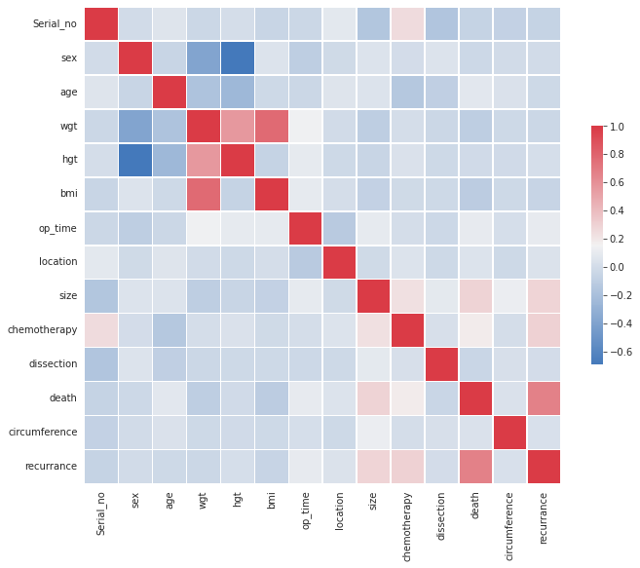
CORRELATION ANALYSIS

Slide 15
OPTIMIZATION
Random Search Cross Validation
Machine learning models contain hyperparameters that must be set in order for the model to be customized to your dataset
Define a grid of hyperparameter ranges, and randomly sample from the grid, performing K-Fold CV with each combination of values
The result of a hyperparameter optimization is a single set of well-performing hyperparameters that you can be used to configure your model
Scikit-Learn’s RandomizedSearchCV method can be used to set the hyperparameters optimally
Random Forest model is optimized using RandomizedSearchCV method

Slide 16
ML ALGORITHMS
RandomForestClassifier from sklearn.ensemble is used to implement Random Forest Classifier
DecisionTreeClassifier from sklearn.tree is used to implement Decision Tree
GradientBoostingClassifier from sklearn.ensemble is used to implement Gradient Boosted Decision Tree
LGBMClassifier from lightgbm is used to implement Light Gradient Boosting Machine
LogisticRegression from sklearn.linear_model is used to implement Linear Regression

Slide 17
EVALUATION METRICS
The performance is calculated in terms of following measures,
Accuracy
Sensitivity
Specificity
Precision
AUC - ROC (Area under the receiver operating characteristic curve)

Slide 18
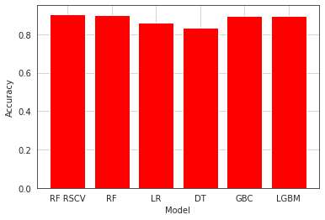
PARAMETER FOR EVALUATION
ACCURACY:
Accuracy = (True Positive+True Negative) / (True Positive + False Positive + False Negative + True Negative)

Slide 19
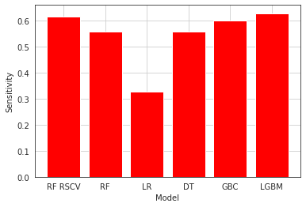
^{SENSITIVITY :}
Sensitivity= True Negative / (True Negative + False Positive)

Slide 20
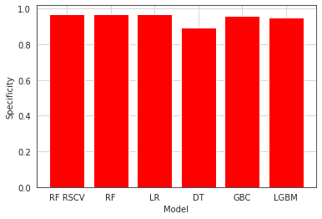
SPECIFICITY:
Specificity=True Negative / ( True Negative + False Positive )

Slide 21
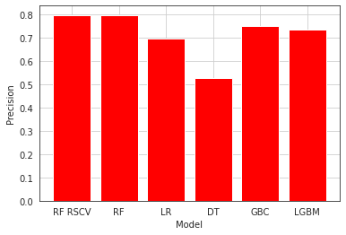
PRECISION:
Precision = TruePositive/ (TruePositive + FalsePositive)

Slide 22
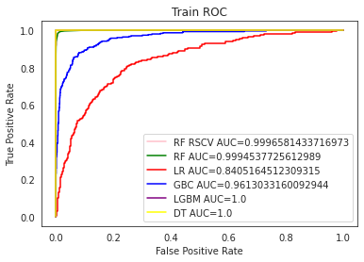
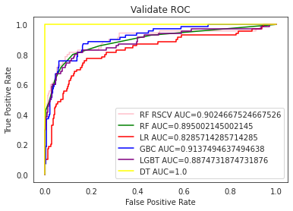
AUC - ROC (Area under the receiver operating characteristic curve) :
AUC-ROC is a performance metric for classification issues that is based on varying threshold values. ROC stands for Receiver Operating Characteristic. ROC is a probability curve, and AUC is a measure of separability

Slide 23
Performance comparison
S.No | Model | Accuracy | Specificity | Precision | Sensitivity
1 | Random Forest with Random Search CV | 90.57 | 96.70 | 79.63 | 61.43
2 | Random Forest | 89.83 | 97.00 | 79.59 | 55.71
3 | Logistic Regression | 85.86 | 97.00 | 69.7 | 32.86
4 | Light Gradient Boosting Machine | 89.58 | 95.20 | 73.33 | 62.86
5 | Gradient Boosting Classifier | 89.58 | 95.80 | 75.00 | 60.00
6 | Decision Tree | 83.62 | 89.49 | 52.70 | 55.71

Slide 24
REFERENCE
Noh, S.H.et al. Adjuvant capecitabine plus oxaliplatin for gastric cancer after D2 gastrectomy (CLASSIC): 5-year follow-up of an open-label, randomised phase 3 trial. Lancet Oncol. 15, 1389–1396. https://doi.org/10.1016/s1470-2045(14)70473-5 (2014).
Wu, B., Wu, D., Wang, M. & Wang, G. Recurrence in patients following curative resection of early gastric carcinoma. J. Surg. Oncol. 98, 411–414. https://doi.org/10.1002/jso.21133 (2008).
Tahmassebi, A.et al. Impact of machine learning with multiparametric magnetic resonance imaging of the breast for early prediction of response to neoadjuvant chemotherapy and survival outcomes in breast cancer patients. Investig. Radiol. 54, 110–117. https ://doi.org/10.1097/rli.0000000000000518 (2019).

Slide 25
REFERENCE
Uhlig, J. et al. Novel breast imaging and machine learning: predicting breast lesion malignancy at cone-beam CT using machine learning techniques. Am. J. Roentgenol. 211, W123–W131. https://doi.org/10.2214/ajr.17.19298 (2018).
Wong, N. C., Lam, C., Patterson, L. & Shayegan, B. Use of machine learning to predict early biochemical recurrence after robot-assisted prostatectomy. BJU Int. 123, 51–57. https://doi.org/10.1111/bju.14477 (2019).
Cuocolo, R., Caruso, M., Perillo, T., Ugga, L. & Petretta, M. Machine learning in oncology: a clinical appraisal. Cancer Lett. 481, 55–62 (2020).

Slide 26
TRUE POSITIVE RATE:
It represents the percentage of the number of records correctly identified over the total number of anomaly records
T P R =True Positive / (True Positive + False Negative) THANK YOU

