Slide 1
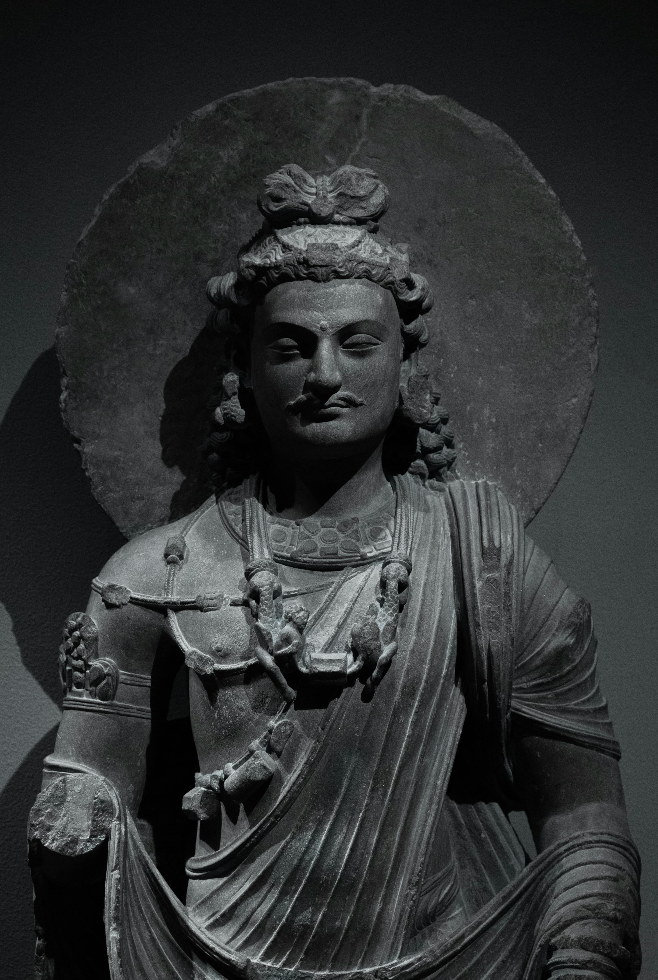
Sample Image

Slide 2
This is the sample text
Hi my name is Aman Bhatt

Slide 3
This is the hyperlink sample
Python Module

Slide 4
This is sample table
Serial Number | First Name | Last Name
1 | Aman | Bhatt
2 | Priyanshu | Kumar
3 | Piyush | Bhandari
4 | Harsh | Morya
5 | Vishnu | Pillai
6 | Cherav | Goyal

