Slide 1

Introduction with Hyperlinks
Heading: "Introduction to Data Analytics"
Text: Data analytics is the process of examining datasets to draw conclusions about their information. It is increasingly automated and widely used in various industries.
Hyperlink: Learn more on Wikipedia about Data Analytics.
Text: We will explore key topics related to data analytics in the following pages.
Table: A comparison table for the different types of data analytics:
Type | Description | Example use case
Descriptive | Summarizes past data | Sales reports
Predictive | Forecasts future trends | Stock price prediction
Prescriptive | Provides recommendations | Marketing campaign strategies

Slide 2
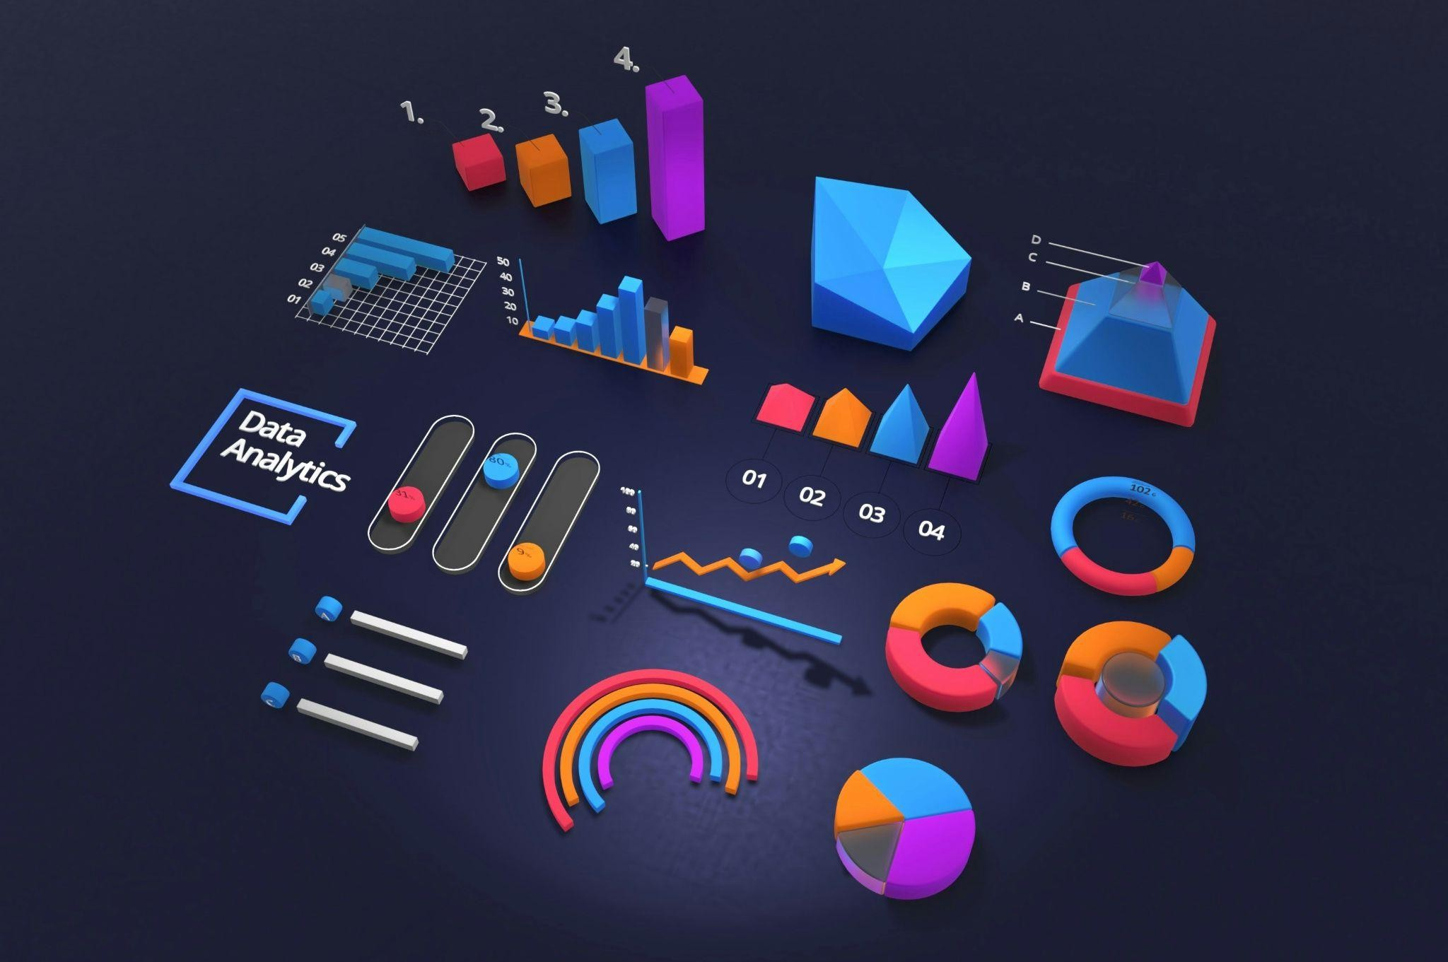
Key Tools in Data Analytics
Heading: "Popular Tools for Data Analytics"
Text: Various tools are available for performing data analytics, ranging from programming languages to software packages.
Hyperlink: Visit the Python Official Website to explore how Python is used in analytics.
Table: A comparison of data analytics tools:
Tool | Type | Usecase
Python | Programming | Machine learning, data processing
R | Programming | Statistical analysis
Tableau | Software | Data Visualization

Slide 3

Applications of Data Analytics
Heading: "Real-World Applications of Data Analytics"
Text: Data analytics is used in various industries, from finance to healthcare. Below are a few examples of how it’s applied.
Hyperlink: Explore case studies on IBM Data Analytics.
Table: Applications of data analytics:
Industry | Example Applications | Key insights
Healthcare | Predicting patient outcomes | Improved treatment plans
Finance | Fraud detection | Reduced financial risk
Retail | Customer behavior analysis | Personalized shopping experience

