Slide 1
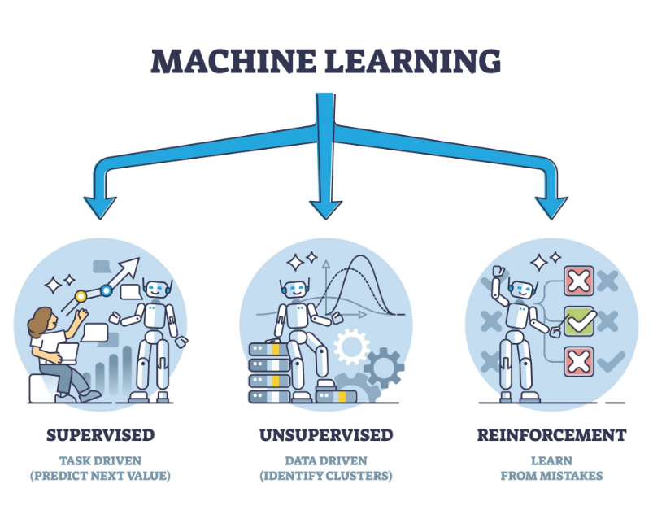
Decision Trees, Random Forest, SVM
MBA 2025-27

Slide 2
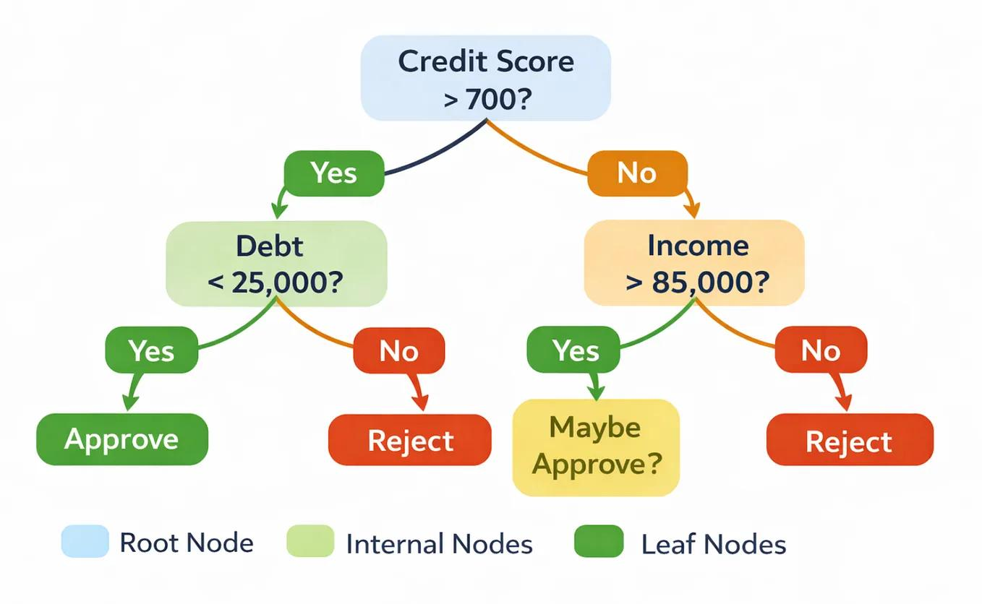
What Is a Decision Tree?
A Decision Tree is a supervised machine learning algorithm used for classification and regression.
It makes predictions by following a sequence of questions or rules.
Each question divides the dataset into smaller groups.
The final outcome is displayed at the end of the tree.
Example: Loan Approval
A bank wants to predict whether a loan applicant is likely to repay a loan.
The model may ask:
Is the applicant's income above ₹50,000?
Is the applicant's credit score above 700?
Does the applicant have existing debt?
Based on the answers, the model predicts whether the applicant is likely to repay the loan.
Key takeaway: A Decision Tree works like a flowchart that makes decisions using data.

Slide 3
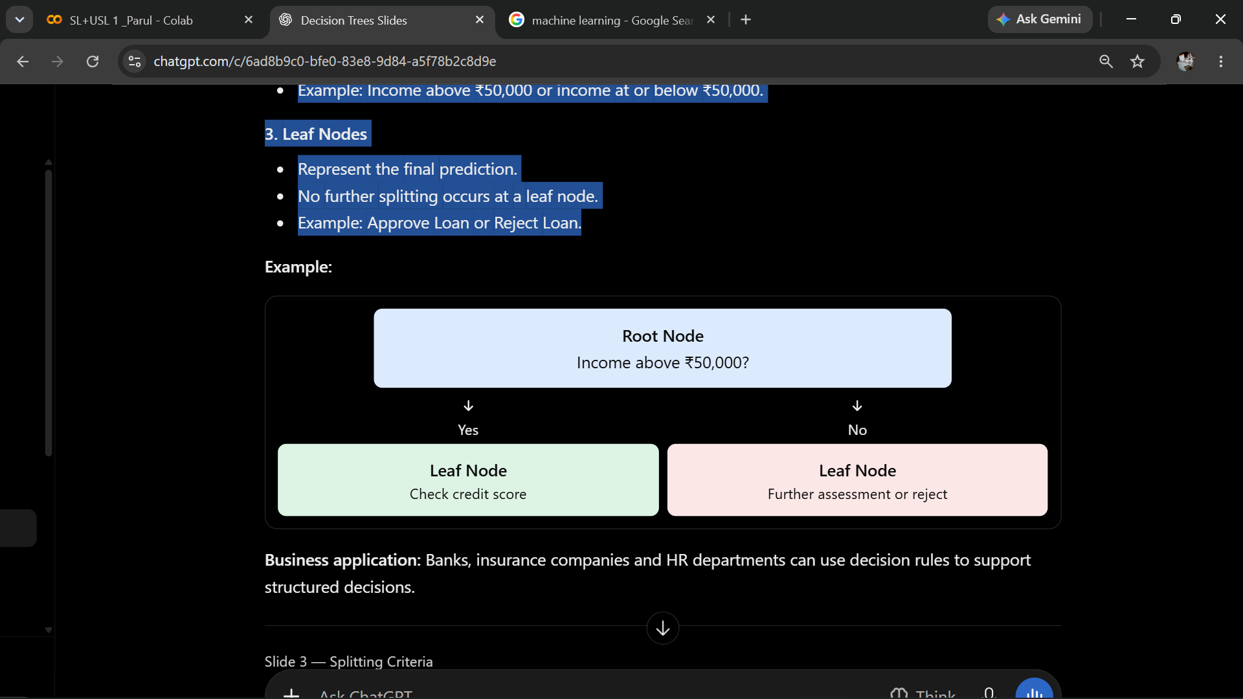
Root Nodes, Branches and Leaf Nodes
A Decision Tree consists of three main components.
1. Root Node
The starting point of the tree.
Represents the entire dataset.
Contains the first splitting question.
2. Branches
Represent the possible outcomes of a question.
Divide the dataset into smaller groups.
Example: Income above ₹50,000 or income at or below ₹50,000.
3. Leaf Nodes
Represent the final prediction.
No further splitting occurs at a leaf node.
Example: Approve Loan or Reject Loan.
Application: Banks, insurance companies and HR departments can use decision rules to support structured decisions.

Slide 4
How Does a Decision Tree Choose a Split?
A Decision Tree must decide which question should be asked at each node.
This process is called splitting.
The algorithm evaluates different possible splits and selects one that creates the most useful groups.
A good split generally:
Separates different outcomes clearly.
Makes the resulting groups more homogeneous.
Reduces impurity in classification problems.
Example: Customer Churn
A telecom company wants to predict whether customers will leave.
Possible splitting questions include:
Is the monthly bill above ₹1,500?
Has the customer contacted customer support more than three times?
Is the customer on a monthly contract?
The algorithm compares these options and selects a split based on a criterion such as Gini impurity or entropy.

Slide 5
Understanding Gini Impurity
Gini impurity measures how mixed the classes are within a group.
Gini = 0: The group contains only one class.
Higher Gini: The group contains a mixture of classes.
A Decision Tree generally prefers splits that reduce the weighted Gini impurity of the resulting groups.
Example: Loan Repayment
Suppose a group contains 10 loan applicants:
10 will repay their loans.
0 will default.
This group has zero impurity because every applicant belongs to the same class.
Now consider another group:
5 will repay their loans.
5 will default.
This group has greater impurity because the outcomes are evenly mixed.
For a two-class problem, Gini impurity is calculated as:
Gini = 1-[(p1)^2+(p2)^2)]
Here, (p1) and (p2) are the proportions of the two classes.
Interpretation: A bank prefers splits that separate low-risk and high-risk borrowers into clearer groups.

Slide 6
Understanding Entropy
Entropy measures the uncertainty or disorder in a group.
Entropy = 0: There is no uncertainty because the group contains only one class.
Higher entropy: There is greater uncertainty about the class of an observation.
A Decision Tree can use entropy to identify splits that produce a large reduction in uncertainty.
The reduction in entropy is called Information Gain.
IG = H(Parent)-Weighted H(Children)
Ex : Marketing Campaign
A company wants to predict whether customers will respond to a campaign.
If a group contains only customers who responded, the outcome is certain and entropy is zero.
If half responded and half did not, uncertainty is high.
The algorithm looks for a question, such as customer age group or past purchase history, that reduces this uncertainty.

Slide 7
Gini vs. Entropy
Gini Impurity | Entropy
Measures class impurity | Measures uncertainty
Uses squared class probabilities | Uses logarithms of class probabilities
Lower values are better for a resulting group | Lower values are better for a resulting group
Commonly used for efficient splitting | Commonly used with information gain
Key takeaway: Both criteria help a Decision Tree identify useful splits. They often produce similar trees.

Slide 8
What Is Tree Depth?
Tree depth refers to the number of decision levels between the root and a node.
Shallow tree: Uses fewer decision levels and simpler rules.
Deep tree: Uses more decision levels and more detailed rules.
Ex: Customer Churn
A shallow tree may predict churn using only contract type and customer tenure.
A deeper tree may also consider monthly charges, support calls, payment history and numerous combinations of these factors.
Advantages of a shallow tree
Easy to explain.
Faster to interpret.
Less likely to memorize the training data.
Advantages of a deeper tree
Can capture complex patterns.
Can identify detailed customer segments.
May fit the training data more closely.

Slide 9
What Is a Random Forest?
Random Forest is a supervised machine learning algorithm that combines multiple Decision Trees to make a prediction.
Instead of depending on one tree, it builds many trees and combines their results.
Example: Loan Default Prediction
A bank trains 100 Decision Trees to predict whether a borrower will default.
72 trees predict No Default.
28 trees predict Default.
The Random Forest predicts No Default using majority voting.
The final prediction depends on the combined decisions rather than a single tree.
Key takeaway: Random Forest uses a collection of trees to produce a more robust prediction.
How it works:
Create multiple samples from the training dataset.
Train a Decision Tree on each sample.
Introduce randomness in the features considered for splitting.
Combine the predictions from all trees.

Slide 10
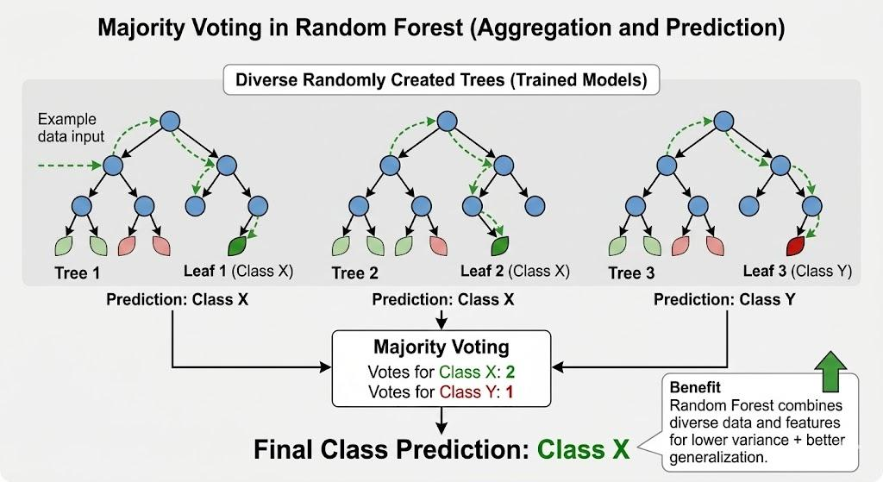
What Is a Random Forest?

Slide 11
How Does Random Forest Make Its Final Prediction?
Random Forest combines the predictions of its individual trees.
For classification: Majority voting
Example: Predict whether a customer will leave.
Final prediction: Churn, because 3 out of 5 trees predict churn.
For regression: Average prediction
Suppose five trees predict monthly sales of:
₹90,000, ₹1,00,000, ₹95,000, ₹1,05,000 and ₹1,10,000.
The final prediction is their average:
[ 90+100+95+105+110] / 5 =100 ]
Final predicted sales = ₹1,00,000.
Key takeaway: Classification usually combines votes or class probabilities, while regression usually averages numerical predictions.
Tree | Prediction
Tree 1 | Churn
Tree 2 | Stay
Tree 3 | Churn
Tree 4 | Churn
Tree 5 | Stay

Slide 12
What Is a Support Vector Machine?
Support Vector Machine (SVM) is a supervised machine learning algorithm primarily used for classification.
SVM attempts to find a decision boundary that separates classes while maximizing the margin between them.
Ex : Loan Risk Classification
A bank wants to classify customers as:
Low risk
High risk
Using features such as income and debt ratio, SVM attempts to identify a boundary that separates the two groups.
Key characteristics:
Uses a decision boundary to separate classes.
Focuses on the margin around that boundary.
Can model nonlinear boundaries through kernel functions.
Often benefits from feature scaling.
Key takeaway: SVM aims to find a boundary that separates classes with a large margin.

Slide 13
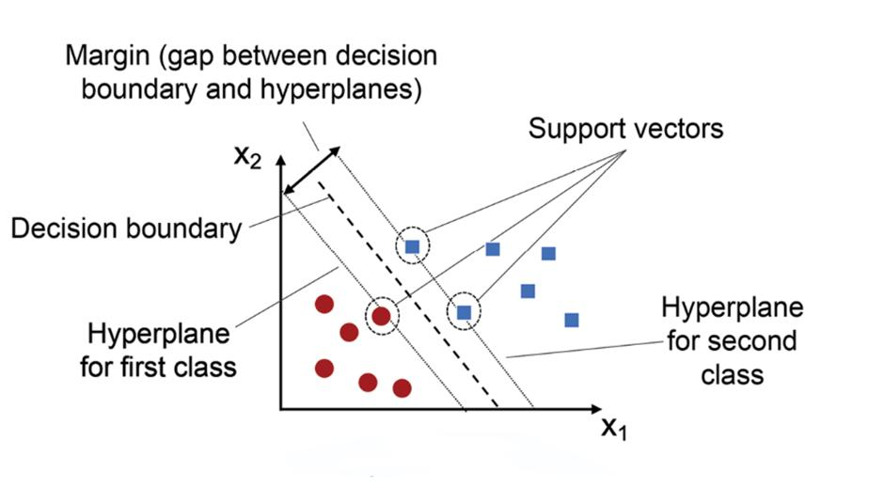
What Is a Support Vector Machine?

Slide 14
Understanding Classification Boundaries
A classification boundary is the line, plane or higher-dimensional surface used to separate different classes.
Example: Marketing Response Prediction
A company predicts whether a customer will respond to a campaign using:
X-axis: Monthly spending
Y-axis: Number of previous purchases
Each customer is represented as a point.
SVM attempts to draw a boundary that separates responders from non-responders.
Depending on the data, the boundary may be:
A straight line in two dimensions.
A plane in three dimensions.
A more complex surface in higher dimensions.
Important: Real-world data may not be perfectly separable. SVM can use a soft margin to allow some classification errors rather than forcing every point to be correctly separated.

Slide 15
What Are Support Vectors?
Support vectors are the training observations that determine or constrain the position of the SVM decision boundary.
They are generally the observations closest to the boundary or within the margin region.
Example: Loan Classification
Imagine two groups of loan applicants: low-risk and high-risk.
Most applicants may be far from the decision boundary. A smaller number of applicants near the boundary are more influential in determining its position.
Those influential observations are the support vectors.
Why are they important?
They help determine the location of the decision boundary.
Their positions influence the maximum margin.
Moving or removing certain support vectors can change the fitted boundary.
Key takeaway: SVM's boundary is especially influenced by the observations near the class separation, not equally by every training observation.

Slide 16
What Is the Kernel Concept in SVM?
Sometimes, two classes cannot be separated effectively by a straight line in the original feature space.
A kernel allows SVM to model nonlinear decision boundaries by computing relationships that correspond to a higher-dimensional feature representation, without necessarily constructing that representation explicitly.
Example: Customer Purchase Prediction
Suppose customers who make a purchase form a circular cluster surrounded by non-purchasing customers.
A straight line may not separate these groups effectively.
A nonlinear kernel may help SVM create a curved boundary that better separates the classes.
Common kernel types:
Linear kernel: Suitable when a linear boundary is appropriate.
Polynomial kernel: Can model certain nonlinear relationships.
RBF (Radial Basis Function) kernel: Can model flexible nonlinear boundaries.

Slide 17
SVM — Advantages and Limitations
Advantages | Limitations
Effective in high-dimensional feature spaces | Can be difficult to explain to non-technical stakeholders
Can model linear and nonlinear boundaries | Kernel and parameter selection can be challenging
Uses a maximum-margin principle | Training can become computationally expensive on large datasets
Can perform well when classes have a clear margin | Performance may suffer when classes overlap heavily
Supports classification and regression | Requires careful feature scaling in many applications

Slide 18
Decision Tree vs. Random Forest vs. SVM
Criteria | Decision Tree | Random Forest | SVM
Basic idea | A sequence of decision rules | An ensemble of randomized trees | Maximum-margin decision boundary
Interpretability | Usually high for small trees | Lower than a single tree | Often lower, especially with nonlinear kernels
Nonlinear patterns | Yes | Yes | Yes, with suitable kernels
Feature scaling | Usually not required | Usually not required | Generally important
Overfitting risk | Can be high for deep trees | Often lower than for a single tree | Depends on kernel, regularization and data
Feature importance | Available through split-based methods | Available through several importance methods | No equivalent built-in measure in the same general sense
Typical business use | Explainable rules and approvals | Churn, risk and classification tasks | Text classification and high-dimensional classification

