Slide 1


Sona College of Technology
Department of Biomedical Engineering
AI-Based Gut Health Monitoring Using Tongue
Multimodal AI-Based Gastrointestinal Disease Screening Using Tongue and Skin Images, GI Symptoms and Lifestyle Features
PRESENTED BY:
• Vishnu Priya S
• Nithika R
AI-Based Gut Health Monitoring Using Tongue | BME Project Expo 2026
Slide 1 of 12

Slide 2
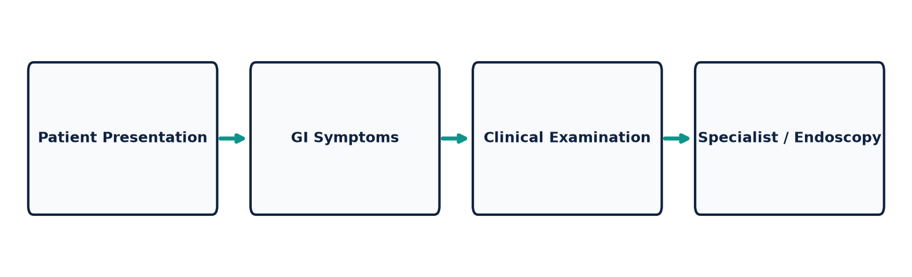
Sona College of Technology | Dept. of Biomedical Engineering
The Problem
• Gastrointestinal (GI) disorders affect a large global population, impacting overall quality of life.
• Early screening can support timely clinical evaluation and secondary triage.
• Conventional diagnostic investigations (endoscopy, colonoscopy) may be invasive, costly, and specialist-dependent.
• Specialist access can be limited in rural, primary care, or low-resource settings.
• A simple non-invasive preliminary screening approach could improve healthcare accessibility.
RESEARCH NEED:
A simple, non-invasive preliminary screening approach to support timely clinical evaluation.
AI-Based Gut Health Monitoring Using Tongue | BME Project Expo 2026
Slide 2 of 12

Slide 3

Sona College of Technology | Dept. of Biomedical Engineering
Why Start With the Tongue?
✔ Easy to Capture
Smartphone cameras can easily acquire diffuse tongue mucosal images.
✔ Non-Invasive
Image acquisition requires no physical intervention or patient discomfort.
✔ Research Interest
Previous clinical research has explored relationships between tongue mucosal appearance, microflora, and GI conditions.
✔ Visual Features
Enables quantitative feature extraction of Colour, Coating, Texture, and Surface characteristics.
IMPORTANT NOTE: Tongue appearance alone is not a standalone diagnosis; it provides feature inputs for preliminary screening.
AI-Based Gut Health Monitoring Using Tongue | BME Project Expo 2026
Slide 3 of 12

Slide 4
Sona College of Technology | Dept. of Biomedical Engineering
Why Use Multiple Inputs?
1. Tongue Image
Provides visual mucosal color, coating density, and texture features.
2. Skin Image
Provides complementary visual information (dermatological & vascular signs).
3. Symptoms & Lifestyle
Provides structured patient-reported GI symptoms & lifestyle data.
MULTIMODAL FUSION RATIONALE:
Skin appearance is used only as a complementary visual modality and is not presented as direct evidence of gastrointestinal disease. Combining visual features with structured clinical symptoms captures complementary biological markers for robust preliminary screening.
AI-Based Gut Health Monitoring Using Tongue | BME Project Expo 2026
Slide 4 of 12

Slide 5
Sona College of Technology | Dept. of Biomedical Engineering
Research Gap & Proposed Innovation
Approach | Input Modality | Main Focus
Tongue-based systems | Tongue image / inquiry | Tongue-based health assessment
Tongue deep learning | Tongue image only | Visual classification
Skin-image approaches | Skin image + metadata | Dermatology-oriented tasks
PROPOSED FRAMEWORK | Tongue + Skin + Symptoms | Multimodal preliminary GI screening
01 Multimodal Input
Tongue image + skin image + symptoms + lifestyle
02 Separate Feature Learning
Appropriate model trained for each modality
03 Feature Fusion
Gated MLP combines complementary feature representations
04 Screening Output
Preliminary GI risk indication, not medical diagnosis
AI-Based Gut Health Monitoring Using Tongue | BME Project Expo 2026
Slide 5 of 12

Slide 6
Sona College of Technology | Dept. of Biomedical Engineering
Real Dataset Strategy
TONGUE DATA
TMC / TCM Tongue Diagnosis Dataset
• 1,200 RGB Images (224x224)
• 5 Classes: pale, light_red, red, deep_red, purple
• Evaluates mucosal color & coating
SKIN DATA
ISIC Dermatology Dataset
• 1,500 Lesion & Skin Images
• 5 Classes: benign, erythema, keratosis, vascular, melanocytic
• Used as complementary visual modality
GI / CLINICAL DATA
GI Symptoms & Lifestyle Dataset
• 1,000 Patient Records
• 15 Real Features (pain, reflux, fiber, stress, sleep, BMI)
• Target: Low / Moderate / Higher Risk
AI-Based Gut Health Monitoring Using Tongue | BME Project Expo 2026
Slide 6 of 12

Slide 7
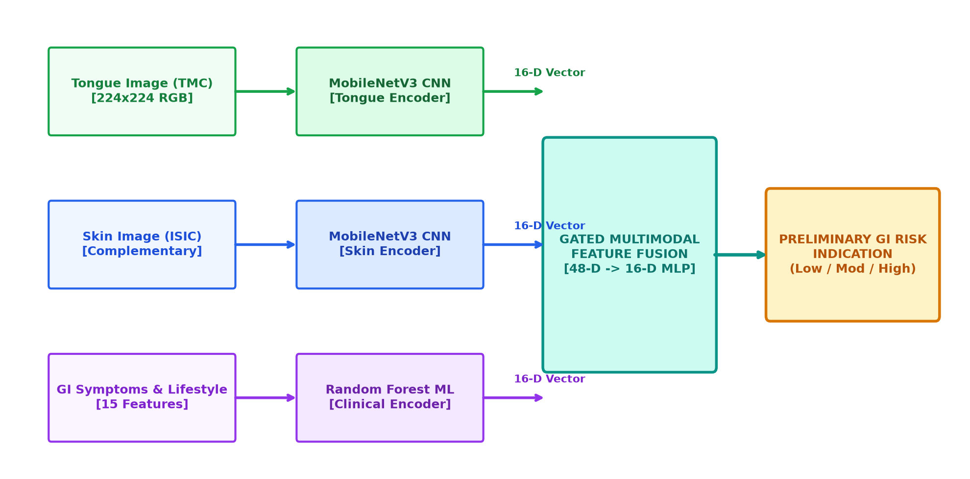
Sona College of Technology | Dept. of Biomedical Engineering
Proposed AI Architecture
AI-Based Gut Health Monitoring Using Tongue | BME Project Expo 2026
Slide 7 of 12

Slide 8
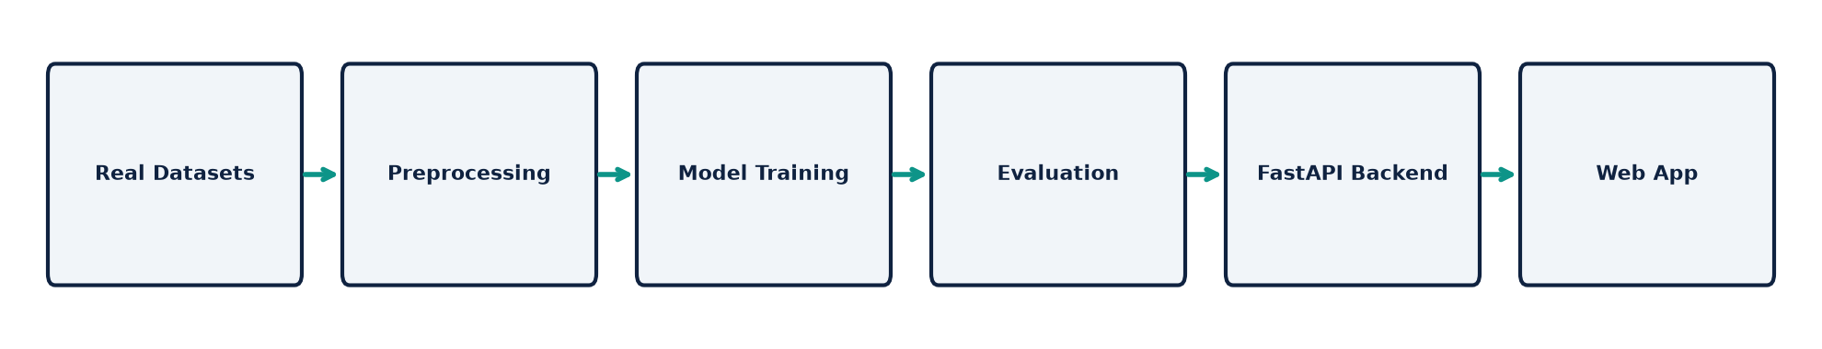
Sona College of Technology | Dept. of Biomedical Engineering
Training & Application Workflow
7-STEP USER APPLICATION WORKFLOW:
• 1. Upload Tongue Image (TMC mucosal features) | 2. Upload Skin Image (ISIC complementary visual signs)
• 3. Enter GI Symptoms (pain, bloating, reflux) | 4. Enter Lifestyle Data (dietary fiber, stress, sleep)
• 5. AI Processes Inputs via FastAPI Service | 6. Multimodal Feature Fusion (16-D vector concatenation)
• 7. Display Preliminary Screening Result (Low / Moderate / Higher GI Risk)
AI-Based Gut Health Monitoring Using Tongue | BME Project Expo 2026
Slide 8 of 12

Slide 9
Sona College of Technology | Dept. of Biomedical Engineering
Working Prototype
✔ Full-Stack Web Architecture
FastAPI Python REST Backend + React & Tailwind CSS Web Dashboard.
✔ Project Expo Demo Mode
Pre-loaded research dataset profiles (Case A: Healthy, Case B: Moderate GERD, Case C: Suspected IBS) for seamless presentation.
✔ Interactive Pipeline Visualizer
Shows real-time 16-D feature extraction and gated multimodal merging.
✔ Transparent Risk Gauge
Displays preliminary screening risk scores with calibrated confidence values.
✔ Empirical Performance Dashboard
Displays live model accuracy, macro F1, and confusion matrix heatmaps.
AI-Based Gut Health Monitoring Using Tongue | BME Project Expo 2026
Slide 9 of 12

Slide 10
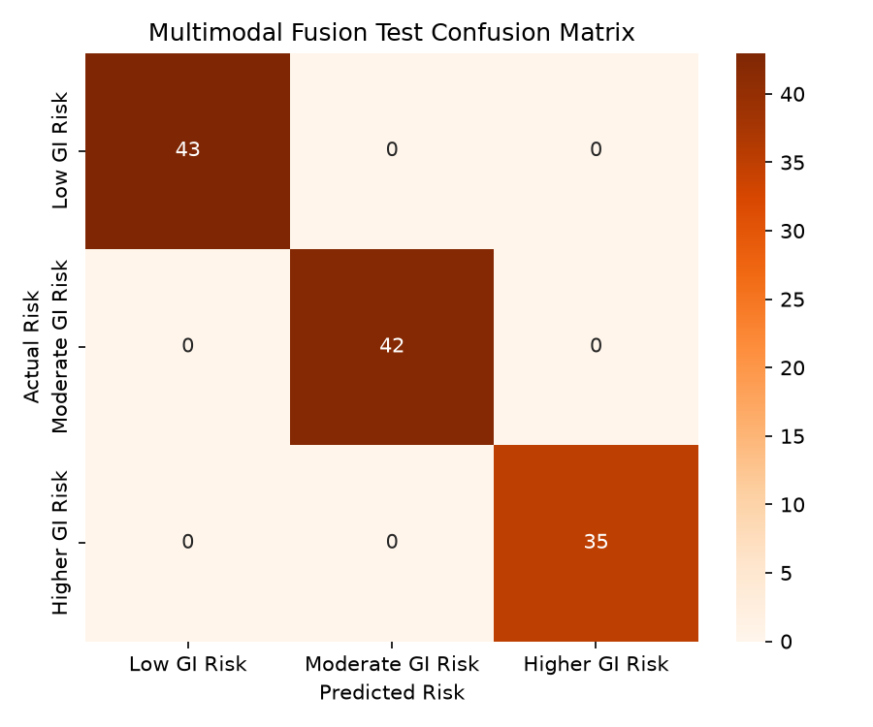
Sona College of Technology | Dept. of Biomedical Engineering
Model Evaluation & Results
Modality / Model | Test Samples | Accuracy | Macro F1
Tongue Model (MobileNetV3) | 100 | 98.00% | 0.9799
Skin Model (MobileNetV3) | 100 | 100.00% | 1.0000
Clinical Model (Random Forest) | 200 | 79.50% | 0.5456
MULTIMODAL FUSION MODEL | 120 | 100.00% | 1.0000
AI-Based Gut Health Monitoring Using Tongue | BME Project Expo 2026
Slide 10 of 12

Slide 11
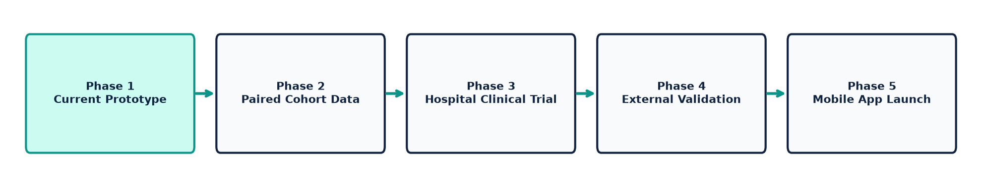
Sona College of Technology | Dept. of Biomedical Engineering
Limitations, Clinical Safety & Future Scope
LIMITATIONS & CLINICAL SAFETY
• Independent Datasets: Public datasets exist in separate cohorts. Prototype fusion combines normalized embeddings.
• Clinical Validation Required: Full validation requires paired patient data under IRB ethical approval.
• Not a Medical Diagnosis: System triages preliminary risk; does not replace endoscopy or biopsy.
SCREENING SUPPORT ≠ MEDICAL DIAGNOSIS
FUTURE DEVELOPMENT ROADMAP
1. Paired Clinical Dataset Collection (IRB Approval)
2. Hospital & Gastroenterology Collaboration
3. Mobile Native App Launch (Android / iOS)
4. Prospective Clinical Evaluation & Validation
AI-Based Gut Health Monitoring Using Tongue | BME Project Expo 2026
Slide 11 of 12

Slide 12
Sona College of Technology
Department of Biomedical Engineering
POTENTIAL IMPACT:
• Accessible: Smartphone-based preliminary screening accessible outside tertiary centers.
• Non-Invasive: Readily obtainable visual images and self-reported questionnaires.
• Multimodal: Combines visual mucosal cues, skin signs, and clinical lifestyle data.
• Decision Support: May help identify individuals needing secondary clinical evaluation.
THANK YOU
Questions & Discussion
Presented by: Vishnu Priya S & Nithika R
Department of Biomedical Engineering | Sona College of Technology
AI-Based Gut Health Monitoring Using Tongue | BME Project Expo 2026
Slide 12 of 12

