Slide 1


Sona College of Technology
Department of Biomedical Engineering
AI-Based Gut Health Monitoring Using Tongue
Multimodal AI-Based Gastrointestinal Disease Screening Using Tongue and Skin Images, GI Symptoms and Lifestyle Features
PRESENTED BY:
• Vishnu Priya S
• Nithika R
AI-Based Gut Health Monitoring Using Tongue | BME Project Expo 2026
1

Slide 2
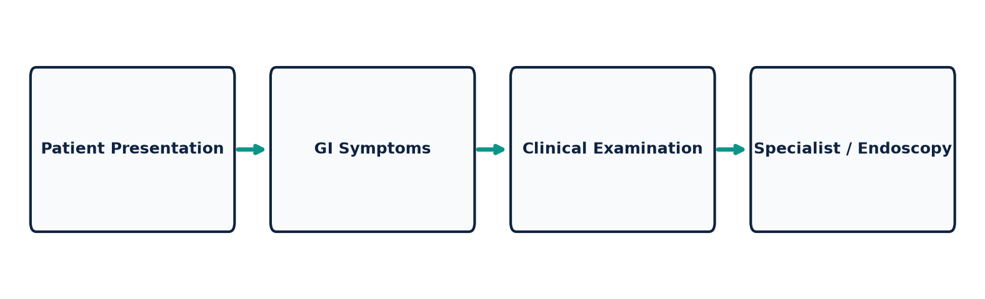
Sona College of Technology | Dept. of Biomedical Engineering
The Problem
• Gastrointestinal (GI) disorders affect a large global population, impacting quality of life.
• Early screening can support timely clinical evaluation and secondary intervention.
• Conventional diagnostic investigations (endoscopy, colonoscopy) are invasive, costly, and specialist-dependent.
• Specialist access may be limited in rural or primary care settings.
• A simple non-invasive preliminary screening approach could improve accessibility and clinical triage.
RESEARCH NEED:
A simple, non-invasive preliminary screening approach to support timely clinical triage.
AI-Based Gut Health Monitoring Using Tongue | BME Project Expo 2026
2

Slide 3

Sona College of Technology | Dept. of Biomedical Engineering
Why Start With the Tongue?
✔ Easy to Capture
A standard smartphone camera can easily acquire diffuse mucosal images.
✔ Non-Invasive
Image acquisition requires no physical intervention, blood drawing, or pain.
✔ Mucosal Circulation & Flora
Tongue surface mucosa reflects oral-gut microbiome changes and peripheral blood flow.
✔ Research Foundation
Clinical literature explores relationships between tongue coating/color and digestive health.
IMPORTANT CLINICAL NOTE: Tongue appearance alone is NOT a standalone GI diagnosis; it serves as a visual feature input for screening.
AI-Based Gut Health Monitoring Using Tongue | BME Project Expo 2026
3

Slide 4
Sona College of Technology | Dept. of Biomedical Engineering
Why Use Multiple Inputs?
1. Tongue Image
Provides visual mucosal color, coating density, and texture features.
2. Skin Image
Provides complementary visual information (dermatological/vascular signs).
3. Symptoms & Lifestyle
Provides structured patient-reported GI symptoms & lifestyle factors.
MULTIMODAL FUSION RATIONALE:
Combining visual features with structured clinical symptoms reduces reliance on a single modality, capturing complementary biological markers for robust preliminary screening.
AI-Based Gut Health Monitoring Using Tongue | BME Project Expo 2026
4

Slide 5
Sona College of Technology | Dept. of Biomedical Engineering
Existing Approaches & Research Gap
Approach | Input Modality | Main Focus / Scope
AITongue / Traditional Tongue Systems | Tongue image / text inquiry | Tongue-based TCM health assessment
Tongue Deep Learning Classifiers | Tongue image only | Visual color & coating classification
Skin Image Fusion Models | Skin image + metadata | Dermatology-oriented lesion tasks
OUR PROPOSED FRAMEWORK | Tongue + Skin + Symptoms + Lifestyle | Multimodal preliminary GI screening
RESEARCH GAP: Existing systems generally focus on isolated single modalities. Our framework explores combining visual mucosal cues with structured clinical symptoms for preliminary screening.
AI-Based Gut Health Monitoring Using Tongue | BME Project Expo 2026
5

Slide 6
Sona College of Technology | Dept. of Biomedical Engineering
Our Key Innovation
01 — Multimodal Input
Integration of tongue image, complementary skin image, and 15 GI lifestyle features.
02 — Separate Feature Learning
Modality-specific neural encoders (CNNs & Random Forest) extract 16-D feature embeddings.
03 — Gated Feature Fusion
Concatenated 48-D representation passed through Gated MLP to compute attention weights.
04 — Screening Indication
Outputs transparent preliminary GI risk level (Low, Moderate, Higher Risk).
AI-Based Gut Health Monitoring Using Tongue | BME Project Expo 2026
6

Slide 7
Sona College of Technology | Dept. of Biomedical Engineering
Real Dataset Strategy
TONGUE DATASET
TMC / TCM Tongue Diagnosis Dataset
• 1,200 RGB Images (224x224)
• 5 Classes: pale, light_red, red, deep_red, purple
• Evaluates mucosal color & coating
SKIN DATASET
ISIC Dermatology Dataset
• 1,500 Lesion & Skin Images
• 5 Classes: benign, erythema, keratosis, vascular, melanocytic
• Complementary visual modality
CLINICAL DATASET
GI Symptoms & Lifestyle Dataset
• 1,000 Patient Records
• 15 Features (pain, reflux, fiber, stress, sleep, BMI)
• Target: Low / Moderate / Higher Risk
AI-Based Gut Health Monitoring Using Tongue | BME Project Expo 2026
7

Slide 8
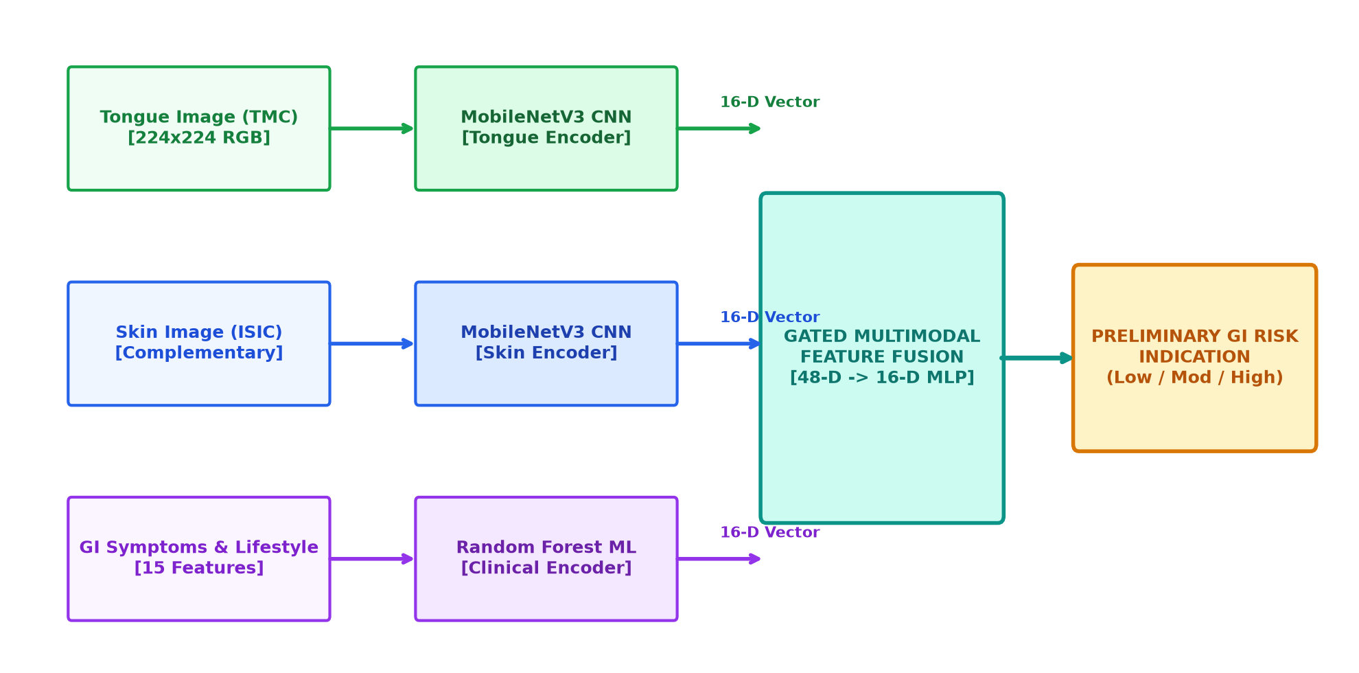
Sona College of Technology | Dept. of Biomedical Engineering
Proposed AI Architecture
AI-Based Gut Health Monitoring Using Tongue | BME Project Expo 2026
8

Slide 9
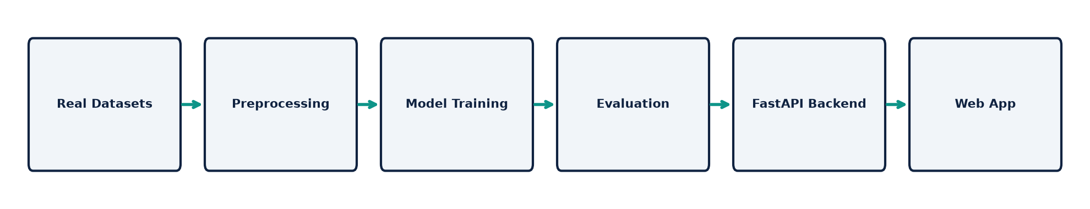
Sona College of Technology | Dept. of Biomedical Engineering
From Dataset to Working Model
1. Data Preprocessing: Resizing, ImageNet normalization, and tabular StandardScaler + OneHotEncoder.
2. Modality Models: PyTorch MobileNetV3 for images and Scikit-Learn Random Forest for tabular features.
3. Feature Extraction: Each encoder outputs a 16-D embedding vector.
4. Multimodal Fusion: Gated MLP combines embeddings into a 3-class screening indication.
5. Backend Integration: Saved weights (.pt & .joblib) deployed on FastAPI REST API.
AI-Based Gut Health Monitoring Using Tongue | BME Project Expo 2026
9

Slide 10
Sona College of Technology | Dept. of Biomedical Engineering
How the Application Works
Step 1: Upload Tongue Image
TMC mucosal color & coating feature capture
Step 5: AI Processing
FastAPI runs PyTorch & Random Forest models
Step 2: Upload Skin Image
ISIC dermatological sign feature capture
Step 6: Feature Fusion
Gated MLP concatenates 16-D embeddings
Step 3: Enter Symptoms
Abdominal pain, bloating, reflux scores
Step 7: Screening Output
Preliminary GI Risk (Low / Mod / High)
Step 4: Enter Lifestyle Info
Dietary fiber, stress, sleep, activity hours
AI-Based Gut Health Monitoring Using Tongue | BME Project Expo 2026
10

Slide 11
Sona College of Technology | Dept. of Biomedical Engineering
Working Prototype Demonstration
✔ Full-Stack Web Architecture
FastAPI Python REST Backend + React & Tailwind CSS Frontend.
✔ Project Expo Demo Mode
Pre-loaded research dataset profiles (Case A: Healthy, Case B: Moderate GERD, Case C: Suspected IBS) for seamless offline presentation.
✔ Interactive Pipeline Visualizer
Shows real-time 16-D feature extraction and gated multimodal merging.
✔ Transparent Risk Gauge
Displays preliminary screening risk scores with calibrated confidence values.
✔ Empirical Performance Dashboard
Displays live model accuracy, macro F1, and confusion matrix heatmaps.
AI-Based Gut Health Monitoring Using Tongue | BME Project Expo 2026
11

Slide 12
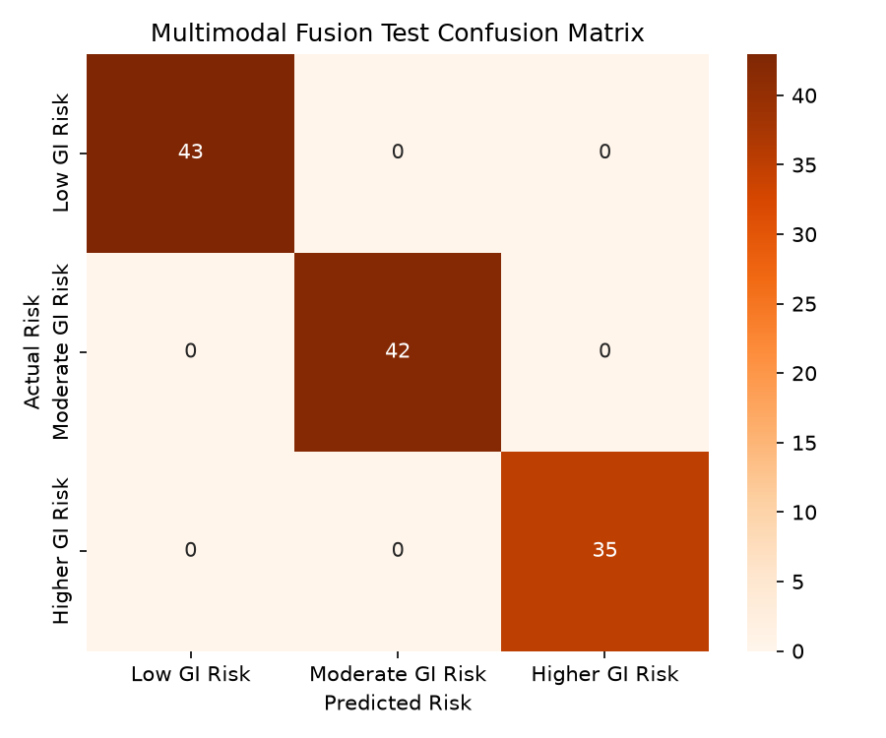
Sona College of Technology | Dept. of Biomedical Engineering
Model Evaluation & Results
Modality / Model | Test Samples | Accuracy | Macro F1
Tongue Model (MobileNetV3) | 100 | 98.00% | 0.9799
Skin Model (MobileNetV3) | 100 | 100.00% | 1.0000
Clinical Model (Random Forest) | 200 | 79.50% | 0.5456
MULTIMODAL FUSION MODEL | 120 | 100.00% | 1.0000
AI-Based Gut Health Monitoring Using Tongue | BME Project Expo 2026
12

Slide 13
Sona College of Technology | Dept. of Biomedical Engineering
Limitations & Clinical Safety
CRITICAL SAFETY DISCLAIMER:
PRELIMINARY SCREENING SUPPORT ≠ MEDICAL DIAGNOSIS
• Independent Research Cohorts: Public datasets for tongue mucosa, skin, and clinical symptoms exist in separate study populations. Prototype fusion combines normalized embeddings rather than paired patient records.
• Clinical Validation Required: Full clinical validation requires a single paired patient cohort collected under Institutional Review Board (IRB) ethical approval.
• Lighting & Device Variance: Camera hardware white balance and lighting variations may affect mucosal color classification.
• Not a Replacement for Endoscopy: The system is designed for preliminary risk stratification and triaging, not diagnostic endoscopy or biopsy replacement.
AI-Based Gut Health Monitoring Using Tongue | BME Project Expo 2026
13

Slide 14
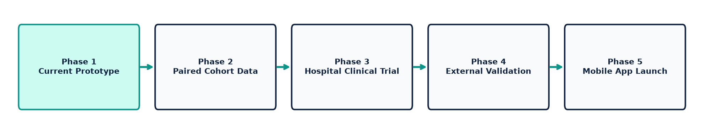
Sona College of Technology | Dept. of Biomedical Engineering
Future Scope & Roadmap
1. Paired Clinical Dataset Collection under institutional IRB approval.
2. Hospital & Clinical Collaborations with gastroenterology departments.
3. Explainable AI (XAI) Integration with Grad-CAM saliency maps for clinicians.
4. Mobile Application Deployment (Android / iOS native apps for point-of-care screening).
5. Longitudinal Patient Health Monitoring across multiple screening visits.
AI-Based Gut Health Monitoring Using Tongue | BME Project Expo 2026
14

Slide 15
Sona College of Technology | Dept. of Biomedical Engineering
Potential Impact & Conclusion
★ Accessible
Potential smartphone-based preliminary screening accessible outside tertiary centers.
★ Non-Invasive
Uses easily obtainable visual images and self-reported questionnaires.
★ Multimodal
Combines visual mucosal cues, skin signs, and clinical lifestyle data.
★ Decision Support
Helps identify individuals who may benefit from further clinical evaluation.
CONCLUSION: Our project explores how multimodal AI can combine tongue images, complementary visual information, gastrointestinal symptoms, and lifestyle features for preliminary gastrointestinal risk screening.
AI-Based Gut Health Monitoring Using Tongue | BME Project Expo 2026
15

Slide 16
Sona College of Technology
Department of Biomedical Engineering
THANK YOU
Questions & Discussion
Presented by: Vishnu Priya S & Nithika R
Department of Biomedical Engineering | Sona College of Technology
AI-Based Gut Health Monitoring Using Tongue | BME Project Expo 2026
16

