Slide 1
Histogram of oriented gradients

Slide 2
Theory Step 1:
Here are the most important aspects of HOG:
HOG focuses on the structure of the object. It extracts the information of the edges magnitude
as well as the orientation of the edges.
It uses a detection window of 64x128 pixels, so the image is first converted into (64,128) shape.
The image is then further divided into small parts, and then the gradient and orientation of each part is calculated.
It is divided into 16x16 cells into blocks with 50% overlap,
so there are going to be 7x15 = 105 blocks in total, and each block consists of 2x2 cells with 8x8 pixels.
We take the 64 gradient vectors of each block (8x8 pixel cell) and put them into a 9-bin histogram

Slide 3
Step 2
The next step is to calculate the gradient for every pixel in the image. Gradients are the small change in the x and y directions
We will extract a patch of pixels and calculate the gradient :
Change in X direction(Gx)
Change in Y direction(Gy)
This process will give us two new matrices – one storing gradients in the x-direction and the other storing gradients in the y direction.
The same process is repeated for all the pixels in the image. The next step would be to find the magnitude and orientation using these values.

Slide 4
Step 3
Total Gradient Magnitude = √[(Gx)2+(Gy)2]
Next, calculate the orientation (or direction) for the same pixel. We know that we can write the tan for the angles:
tan(Φ) = Gy / Gx
Step 4
The histograms created in the HOG feature descriptor are not generated for the whole image. Instead, the image is divided into 8×8 cells, and the histogram of oriented gradients is computed for each cell.
By doing so, we get the features (or histogram) for the smaller patches which in turn represent the whole image. We can certainly change this value here from 8 x 8 to 16 x 16 or 32 x 32.
If we divide the image into 8×8 cells and generate the histograms, we will get a 9 x 1 matrix for each cell.

Slide 5
Step 5: Normalize gradients in 16×16 cell (36×1)
Although we already have the HOG features created for the 8×8 cells of the image, the gradients of the image are sensitive to the overall lighting. This means that for a particular picture, some portion of the image would be very bright as compared to the other portions.
We cannot completely eliminate this from the image. But we can reduce this lighting variation by normalizing the gradients by taking 16×16 blocks.
We would have 105 (7×15) blocks of 16×16. Each of these 105 blocks has a vector of 36×1 as features. Hence, the total features for the image would be 105 x 36×1 = 3780 features.

Slide 6
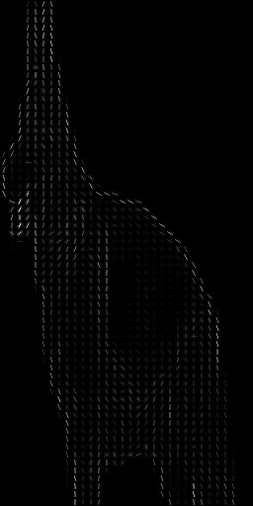
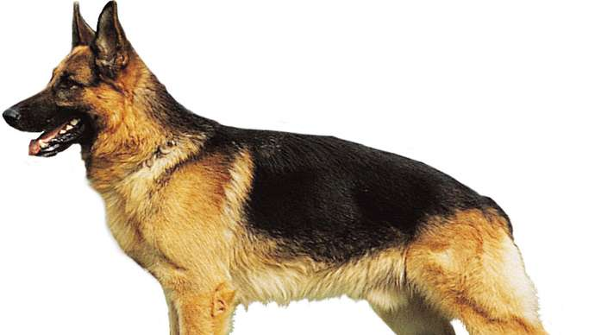

Slide 7
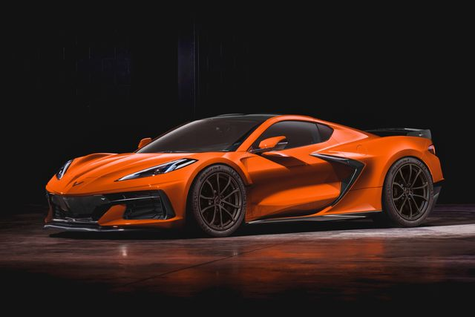
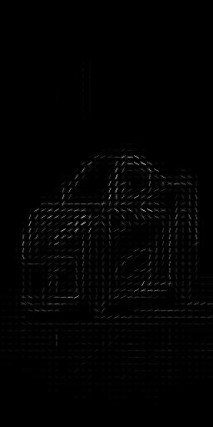

Slide 8
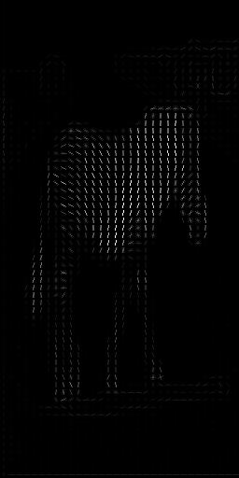
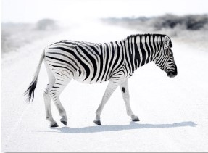

Slide 9
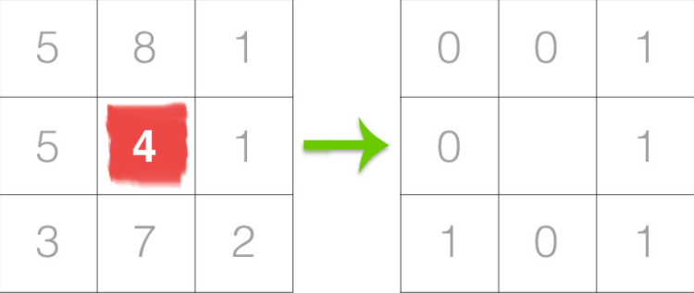
Local Binary Pattern
The first step in constructing the LBP texture descriptor is to convert the image to grayscale. For each pixel in the grayscale image, we select a neighborhood of size r surrounding the center pixel. A LBP value is then calculated for this center pixel and stored in the output 2D array with the same width and height as the input image.
In the above figure we take the center pixel (highlighted in red) and threshold it against its neighborhood of 8 pixels. If the intensity of the center pixel is greater-than-or-equal to its neighbor, then we set the value to 1; otherwise, we set it to 0. With 8 surrounding pixels, we have a total of 2 ^ 8 = 256 possible combinations of LBP codes.

Slide 10
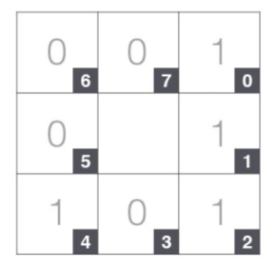

The decimal value will be 23.
Now we need to calculate the LBP value for the center pixel. We can start from any neighboring pixel and work our way clockwise or counter-clockwise, but our ordering must be kept consistent for all pixels in our image.
The results of this binary test are stored in an 8-bit array, which we then convert to decimal, like this:
For Eg:

Slide 11
This process of thresholding, accumulating binary strings, and storing the output decimal value in the LBP array is then repeated for each pixel in the input image.
The last step is to compute a histogram over the output LBP array. Since a 3 x 3 neighborhood has 2 ^ 8 = 256 possible patterns, our LBP 2D array thus has a minimum value of 0 and a maximum value of 255, allowing us to construct a 256-bin histogram of LBP codes as our final feature vector:
However, being able to capture details at such a small scale is also the biggest drawback to the algorithm — we cannot capture details at varying scales, only the fixed 3 x 3 scale!

Slide 12

Neural networks
Neural networks are artificial systems that were inspired by biological neural networks. These systems learn to perform tasks by being exposed to various datasets and examples without any task-specific rules. The idea is that the system generates identifying characteristics from the data they have been passed without being programmed with a pre-programmed understanding of these datasets.
If we had one hidden layer, it would look like:
where a is the activation nodes and comprises of the hidden layer.

Slide 13
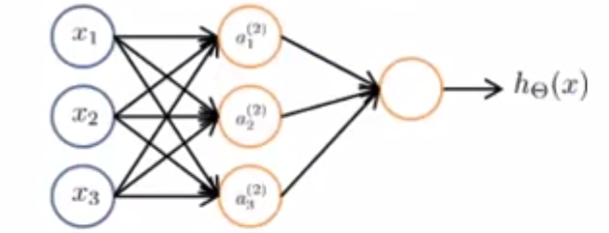
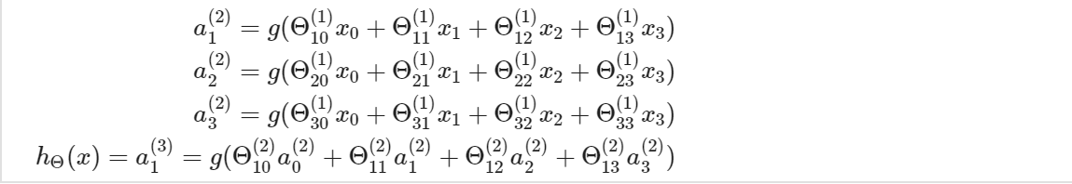

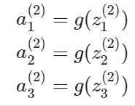


The values for each of the "activation" nodes is obtained as follows:
If network has sj​ units in layer j and sj+1​ units in layer j+1, then Θ(j) will be of dimension sj+1​×(sj​+1).

Slide 14
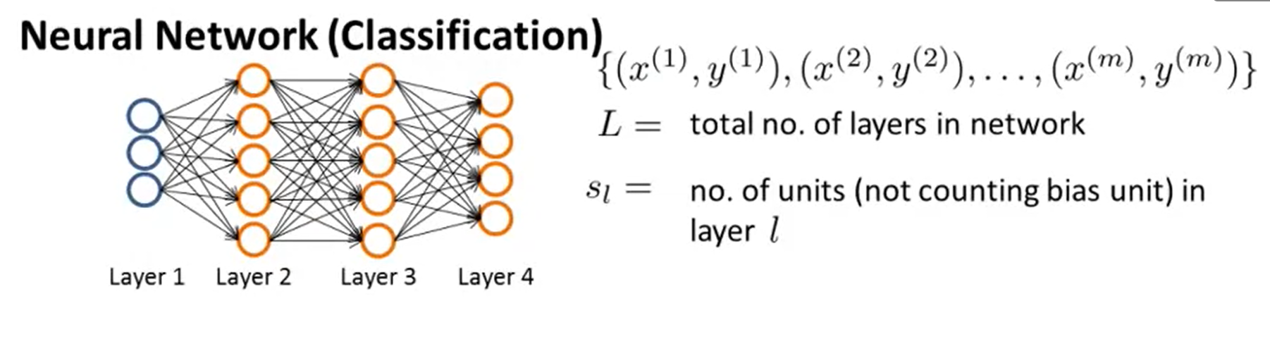
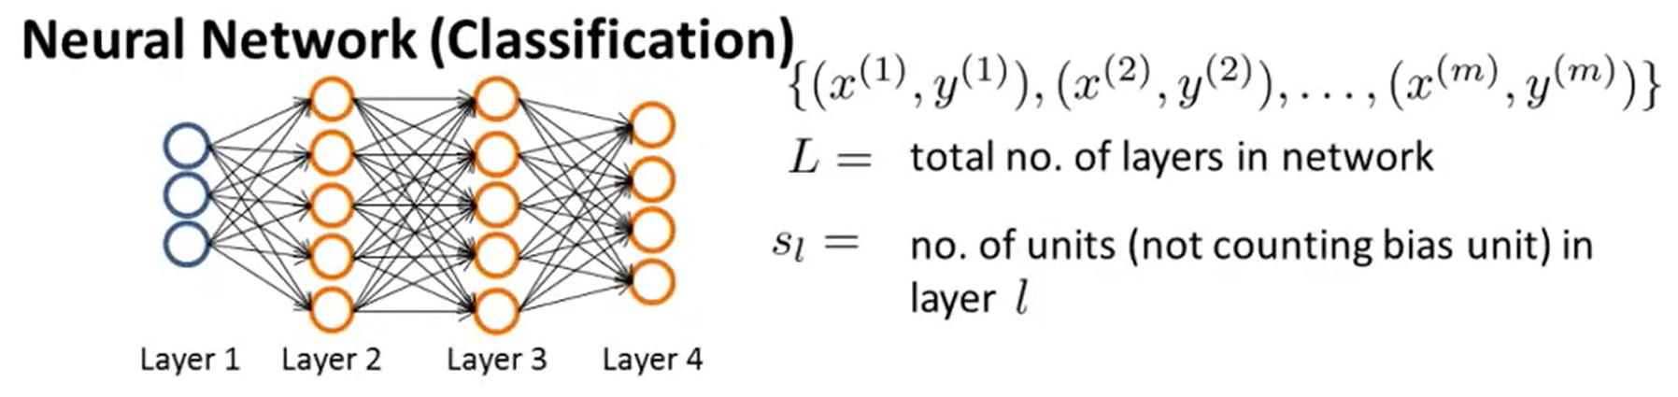
Cost function:

Slide 15
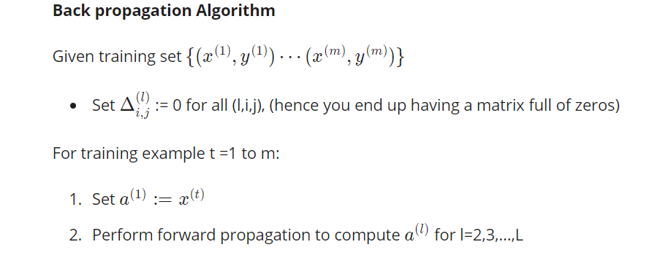
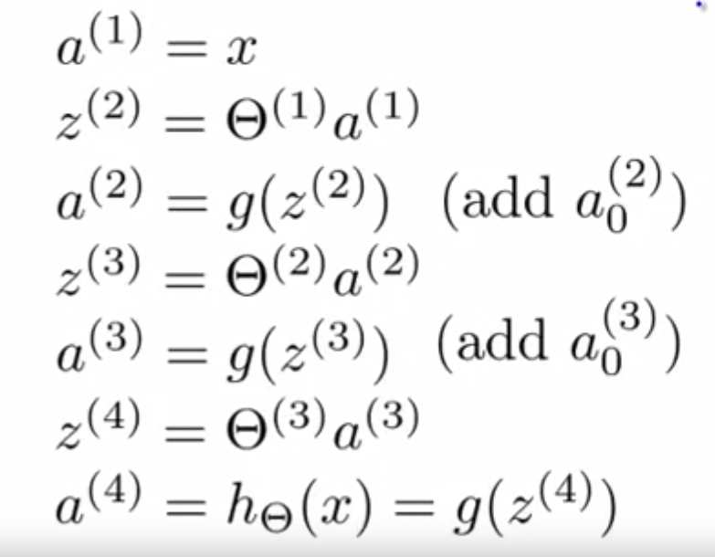

Slide 16

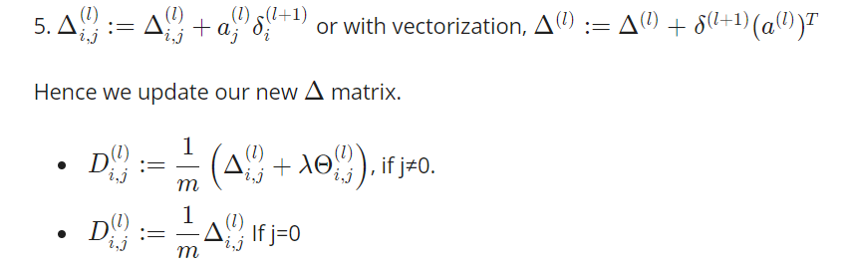

The back propagation algorithm is used to calculate the partial derivatives and help in minimising our cost function

Slide 17

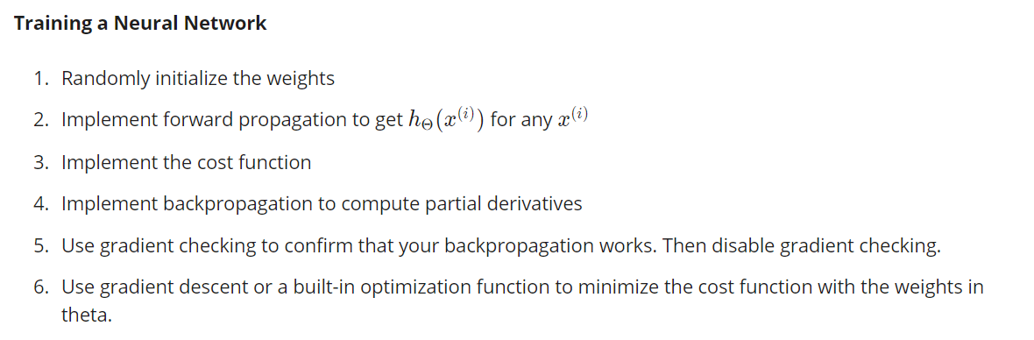
Gradient checking
With multiple theta matrices, we can approximate the derivative with respect to Θj​ as follows:
RECAP
First, pick a network architecture; choose the layout of your neural network, including how many hidden units in each layer and how many layers in total you want to have.

