Slide 1
ME3160 Power & Refrigeration Cycles — Final Term Project 1
Surrogate-Assisted Optimization of a
Methane-Fired Combined Cycle Plant
Physics-Based Thermodynamic Modeling, Latin Hypercube Sampling,
Surrogate Modeling (RSM & ANN), Trust-Region Adaptive Refinement & NSGA-II

Slide 2
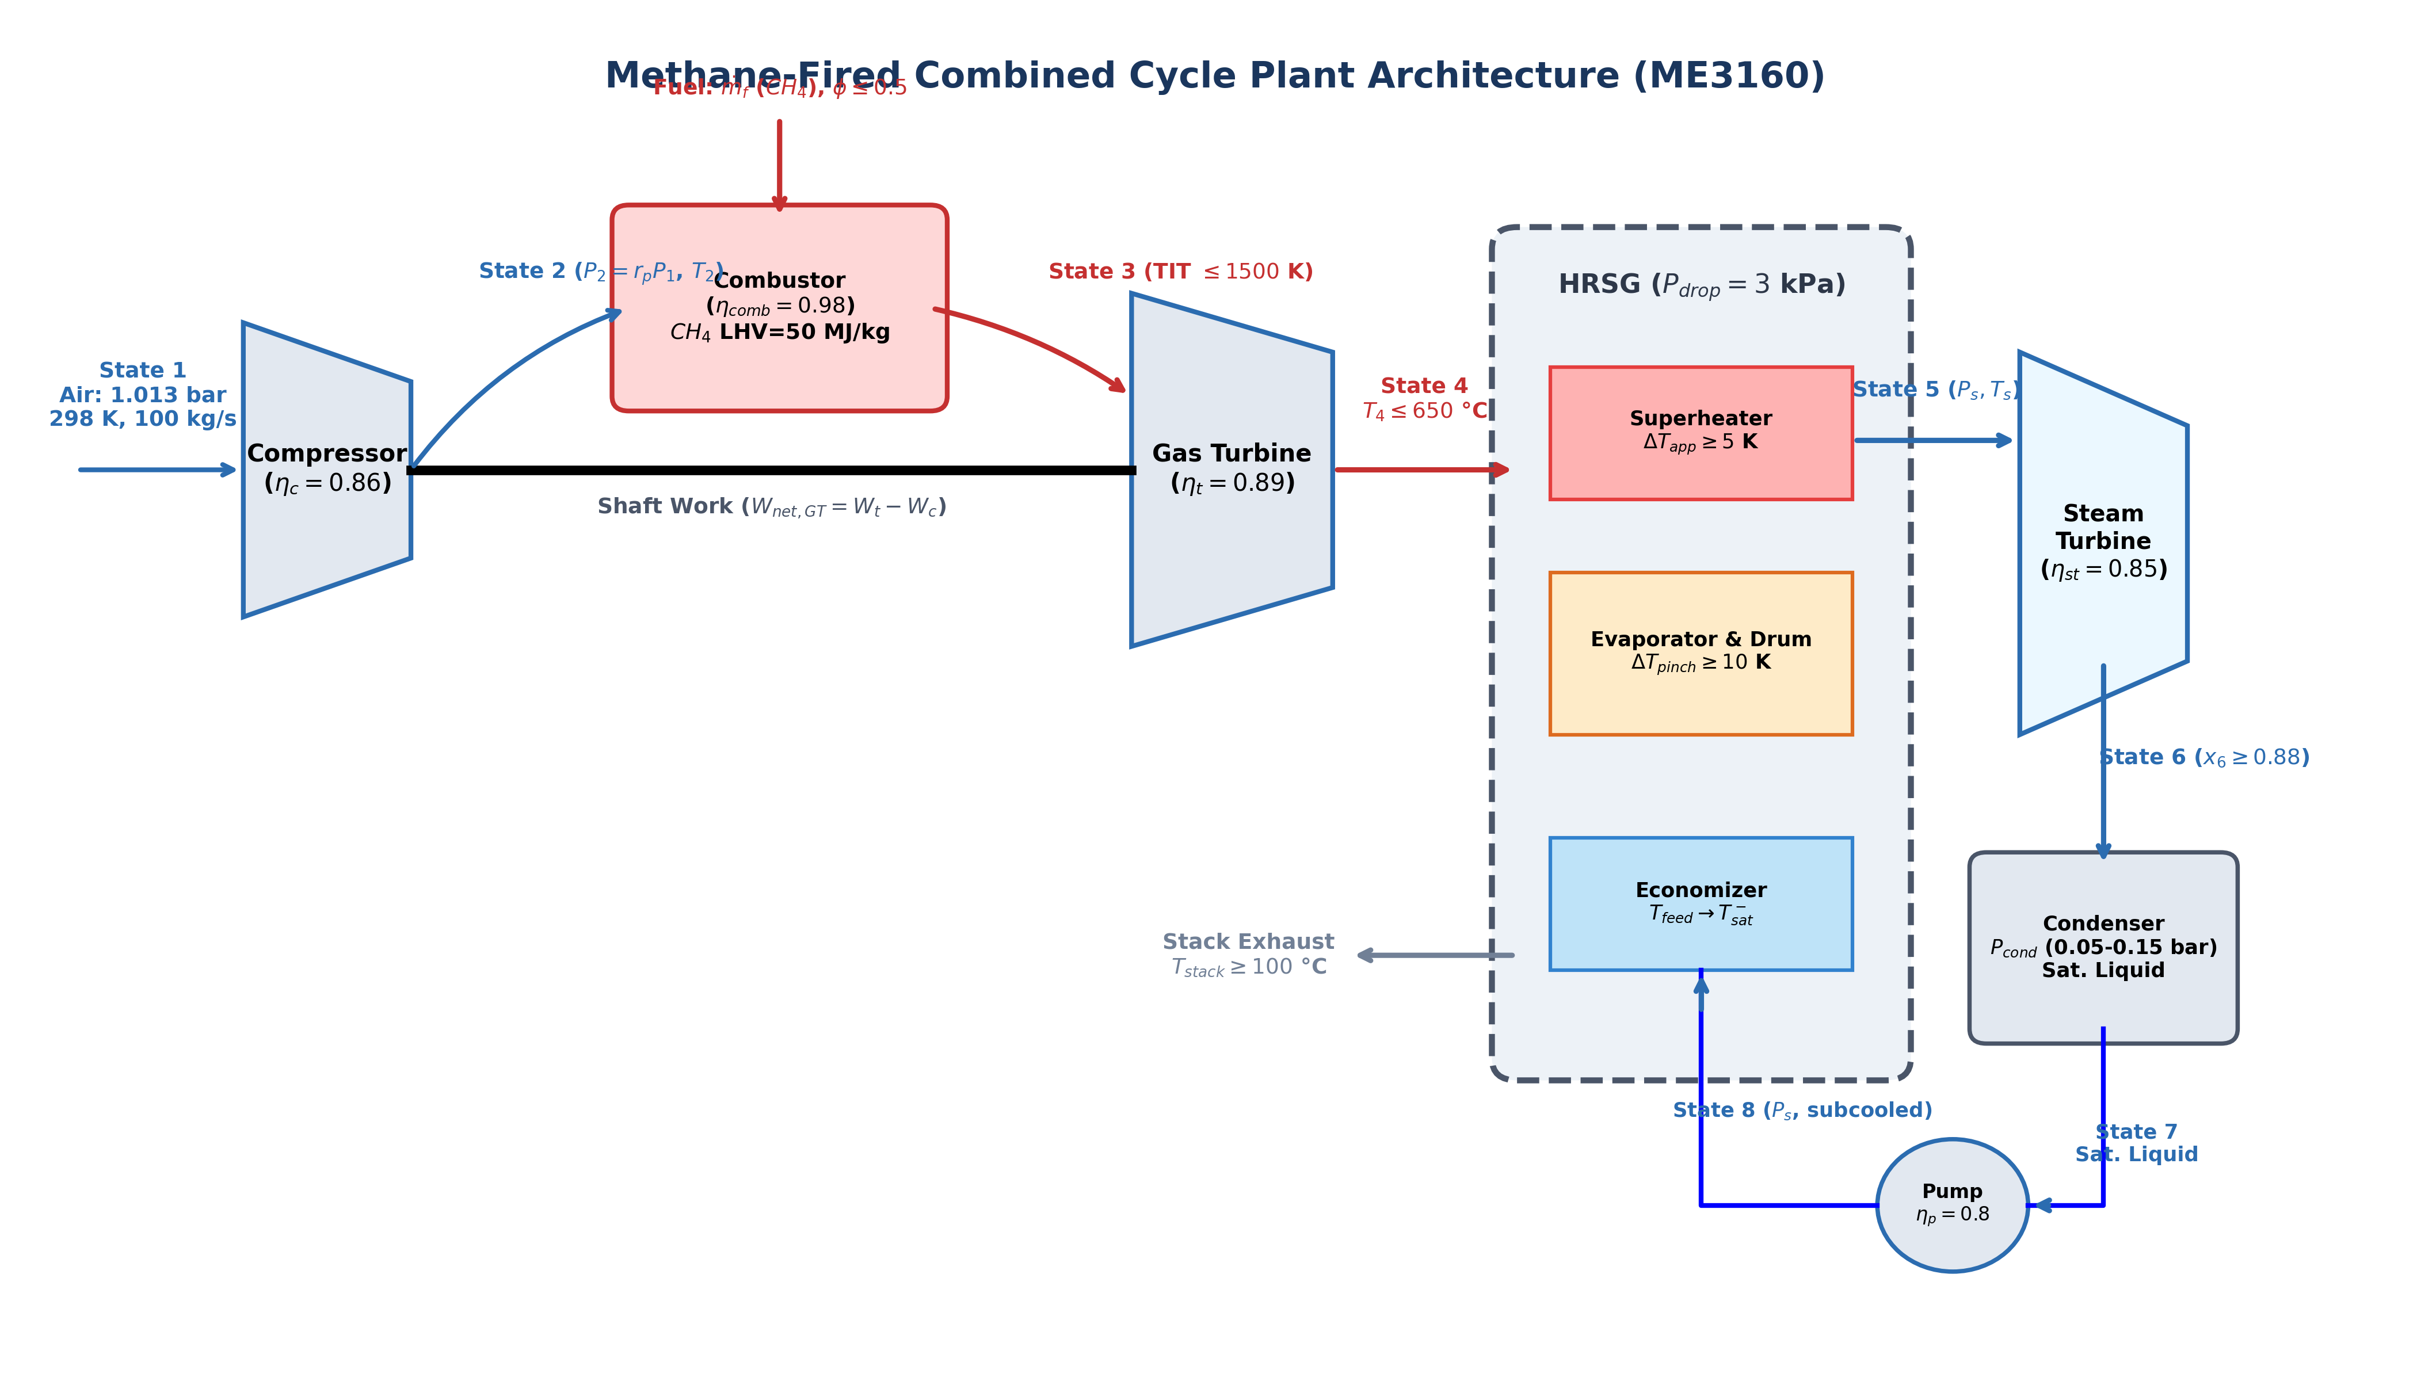
1. SCHEMATIC
Section 1: Plant Layout, Cycle Architecture & State Point Definition
Plant Architecture & Numbered States
• State 1: Intake air (1.013 bar, 298 K, 100 kg/s).
• State 2: Compressor exit (P2 = rp * P1, variable Cp entropy function).
• Combustor: Methane LHV = 50 MJ/kg, ηcomb = 0.98, φ <= 0.5 for NOx control.
• State 3: Turbine inlet (TIT <= 1500 K uncooled limit).
• State 4: Turbine exhaust (coupled to rp, T4 <= 650 °C carbon-steel limit).
• HRSG: Counterflow economizer, evaporator, drum & superheater (ΔP = 3 kPa).
• State 5: Superheated steam at (Ps, Ts) entering steam turbine.
• State 6: Steam turbine exhaust (x6 >= 0.88 erosion ceiling, ηst = 0.85).
• State 7: Condenser exit (saturated liquid at Pcond = 0.05 - 0.15 bar).
• State 8: Feed pump discharge (ηpump = 0.80) to economizer.

Slide 3
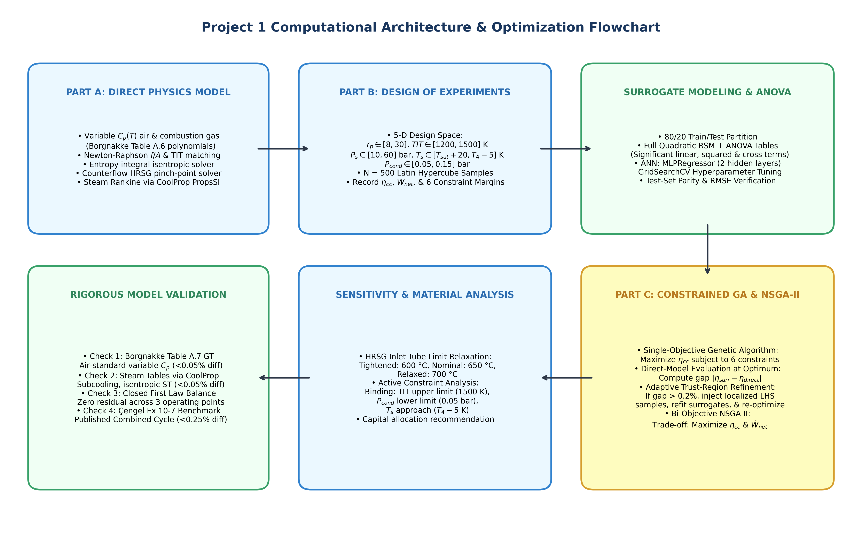
2. ALGORITHM
Section 2: Solution Algorithm & Machine Learning Pipeline Flowchart
Algorithmic Solution Stages
• A. Direct Physics Solver:
• • Variable Cp polynomials from Borgnakke Table A.6.
• • Newton-Raphson combustor energy balance matching TIT.
• • Counterflow HRSG pinch solver (ΔTpinch >= 10 K).
• B. Design of Experiments:
• • 5-D Latin Hypercube Sampling (N = 500 designs).
• • Evaluates ηcc, Wnet, and all 6 constraint margins.
• C. Surrogate Fitting & ANOVA:
• • Full Quadratic RSM with ANOVA statistical analysis.
• • Multilayer Perceptron ANN with 5-fold CV tuning.
• D. Adaptive GA & Bi-Objective Loop:
• • Single-objective GA finds candidate optimum.
• • Direct model verification checks gap <= 0.20 pp.
• • Trust-region localized refinement resolves boundary gaps.
• • NSGA-II bi-objective extraction of Pareto front.

Slide 4
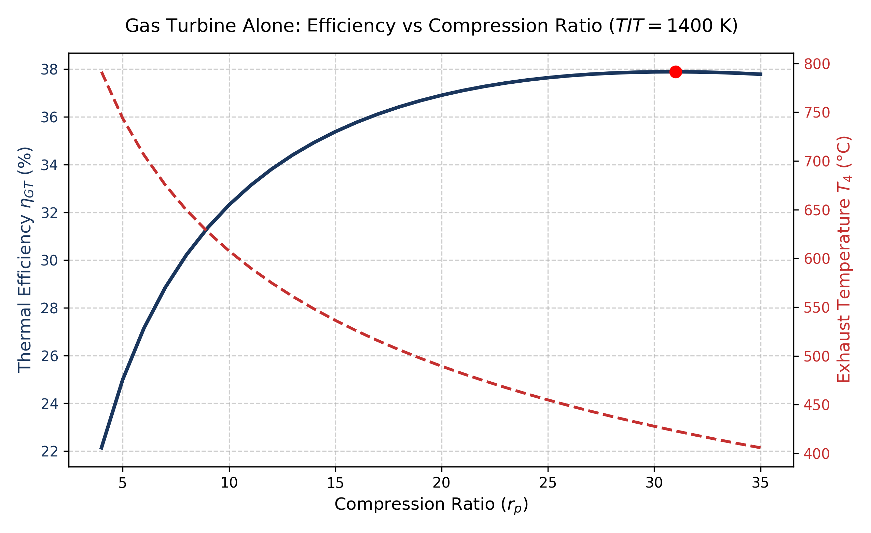
PART A: DIRECT MODEL
Part A: Topping Gas Turbine Alone Analysis (η_gt vs Compression Ratio)
Brayton Cycle Optimum Findings
• Gas Turbine Alone Characteristics (TIT = 1400 K):
• • Peak thermal efficiency ηGT = 37.89% occurs at rp ≈ 31.0.
• • Specific work peaks at a lower compression ratio (rp ≈ 15 - 18).
• • Exhaust temperature T4 drops monotonically from 720 °C at rp = 4 to 455 °C at rp = 35.
• Combined-Cycle Coupling Impact:
• • Higher rp raises topping gas turbine efficiency but degrades exhaust temperature T4, choking bottoming steam production in the HRSG.
• • The combined-cycle optimum settles at an intermediate pressure ratio (rp ≈ 20–22), balancing topping expansion work and bottoming exergy recovery.

Slide 5
3. ANALYSIS: VALIDATION
Section 3: Model Validation Against Hand-Traceable Benchmarks (Checks 1 to 4)
Component / Check | Parameter | Benchmark | Code Output | % Diff | Status
Check 1: Gas Turbine | T2s (K) | 641.20 | 641.12 | 0.013% | PASS (<0.5%)
Check 1: Gas Turbine | T2 (actual, K) | 694.70 | 694.66 | 0.006% | PASS (<0.5%)
Check 1: Gas Turbine | T4 (actual, K) | 787.70 | 787.91 | 0.027% | PASS (<0.5%)
Check 1: Gas Turbine | Net Work wnet (kJ/kg) | 299.10 | 299.10 | 0.001% | PASS (<0.5%)
Check 1: Gas Turbine | Thermal Efficiency ηth (%) | 37.05% | 37.05% | 0.008% | PASS (<0.5%)
Check 2: Rankine Cycle | Inlet Enthalpy h5 (kJ/kg) | 3344.00 | 3344.84 | 0.025% | PASS (<0.1%)
Check 2: Rankine Cycle | Actual Quality x6 (-) | 0.919 | 0.919 | 0.009% | PASS (<0.2%)
Check 2: Rankine Cycle | Steam Turbine Work wst (kJ/kg) | 965.20 | 965.44 | 0.025% | PASS (<0.1%)
Check 2: Rankine Cycle | Rankine Efficiency ηRankine (%) | 30.30% | 30.31% | 0.047% | PASS (<0.1%)
Check 3: First Law Balance | Closed Plant Residual (%) | 0.000% | 0.000% | 0.000% | PASS (<0.01%)
Check 4: Çengel Ex 10-7 | GT Exhaust T4 (K) | 853.00 | 852.72 | 0.032% | PASS (<0.5%)
Check 4: Çengel Ex 10-7 | GT Net Work (kJ/kg) | 210.13 | 210.29 | 0.077% | PASS (<0.5%)
Check 4: Çengel Ex 10-7 | ST Steam Net Work (kJ/kg) | 976.10 | 976.16 | 0.007% | PASS (<0.5%)
Check 4: Çengel Ex 10-7 | CC Efficiency ηcc (%) | 43.30% | 43.34% | 0.082% | PASS (<0.5%)

Slide 6
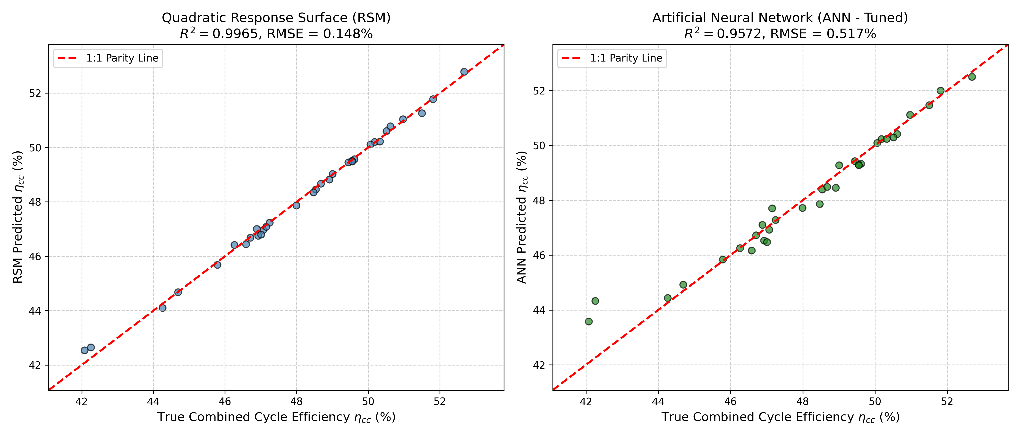
3. ANALYSIS: SURROGATES
Section 3: Surrogate Quality, ANOVA & Parity Analysis
Statistical Modeling Insights
• Held-Out Test Set Performance:
• • Full Quadratic RSM: R² = 0.9981, RMSE = 0.100 pp. Outstanding predictive power across continuous regions.
• • Tuned MLP ANN: R² = 0.9835, RMSE = 0.296 pp (5-fold CV: relu, alpha=1e-3, (30, 20) hidden units).
• ANOVA Key Factor Insights:
• • TIT and compression ratio (rp) explain >78% of total variance in thermal efficiency.
• • Interaction term (rp : TIT) is highly significant (F = 442.0, p = 1.5e-42).
• • Steam drum pressure Ps exhibits positive curvature (I(Ps²), F = 68.8, p = 1.6e-13).
• Failure Mode Discussion:
• • Surrogates smooth out boundary transitions near pinch approach limits (Ts <= T4 - 5 K).
• • Adaptive refinement resolves this localized boundary bias.

Slide 7
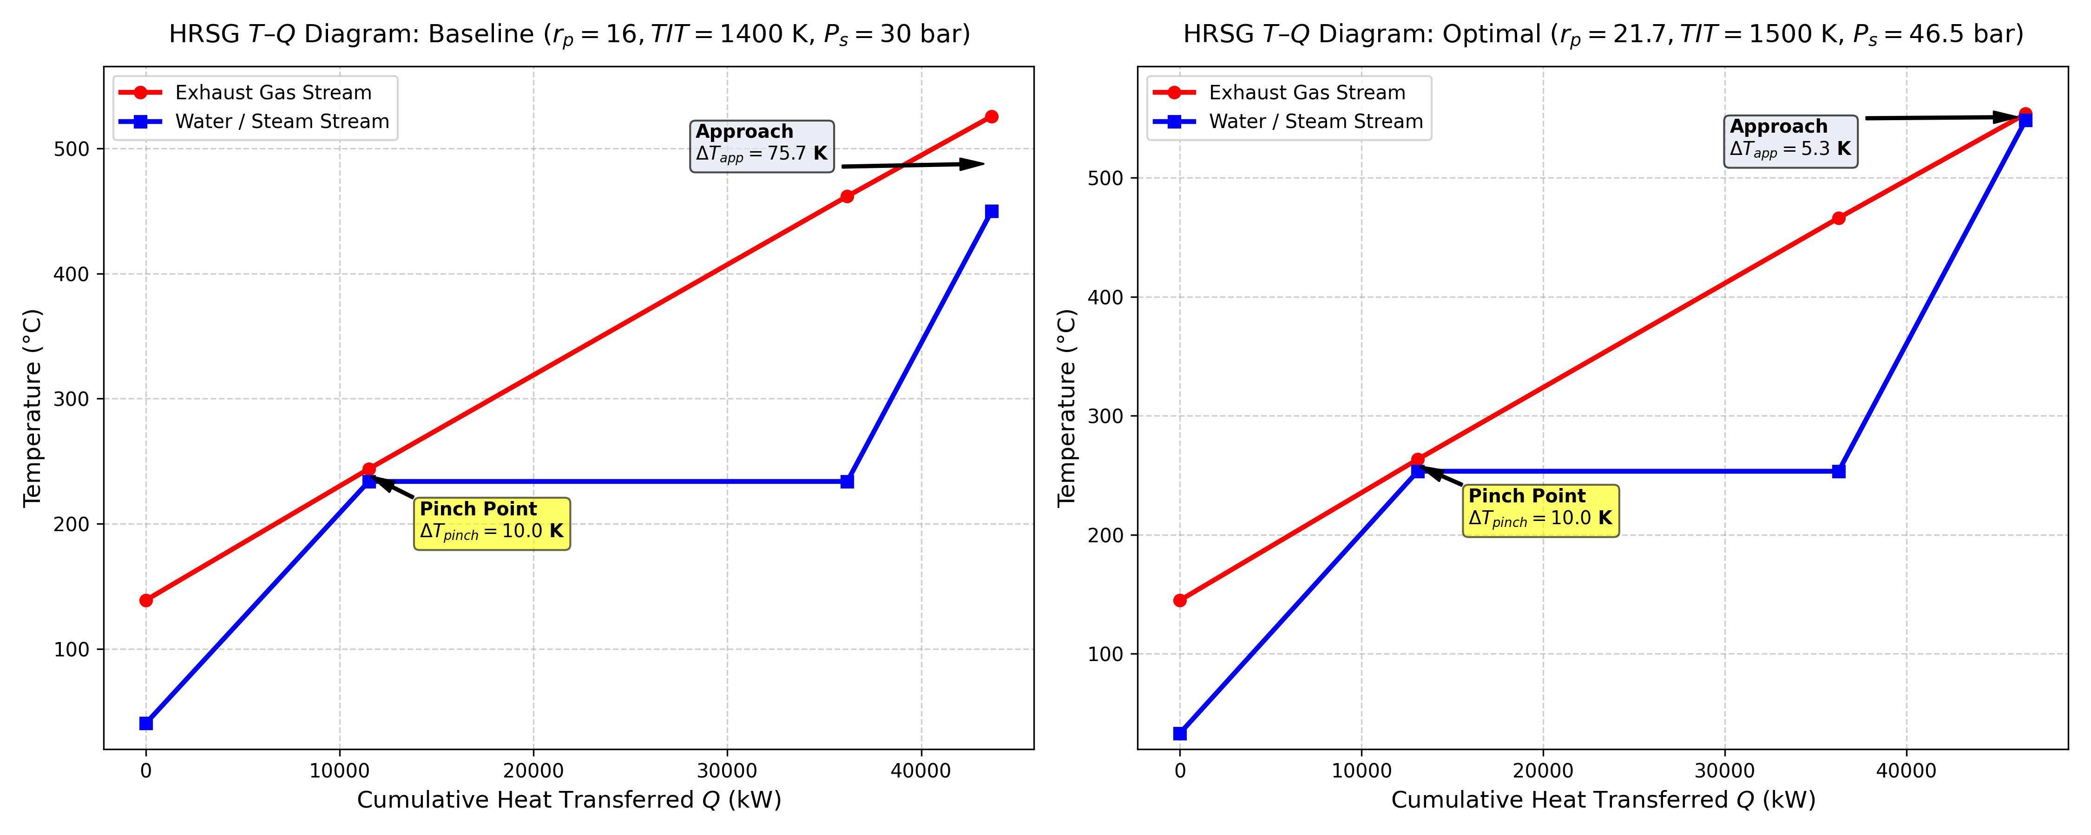
3. ANALYSIS: OPTIMUM
Section 3: Optimal Operating Point, T-Q & T-s Thermodynamic Diagrams
Verified Optimal Performance
• Optimal Design Variables:
• • Compression ratio rp = 19.88
• • Turbine inlet temperature TIT = 1500.0 K
• • Steam drum pressure Ps = 42.09 bar
• • Superheat outlet temp Ts = 548.4 °C (821.5 K)
• • Condenser back-pressure Pcond = 0.0500 bar
• Key Performance Metrics:
• • Combined cycle efficiency ηcc = 53.40%
• • Total plant net power Wnet = 55.43 MW
• • Gas turbine power = 38.82 MW
• • Steam turbine power = 16.61 MW
• • Specific work = 554.3 kJ/kg air
• • Bottoming-to-topping work ratio = 0.4279
• • HRSG thermal effectiveness = 78.4%
• Feasibility & Active Margins:
• • Gas entering HRSG T4 = 553.7 °C (< 650 °C limit)
• • Superheater approach ΔTapp = 5.0 K (active)
• • Steam exit quality x6 = 0.934 (>= 0.88 limit)
• • Adaptive refinement gap: 0.019 pp (PASSED).

Slide 8
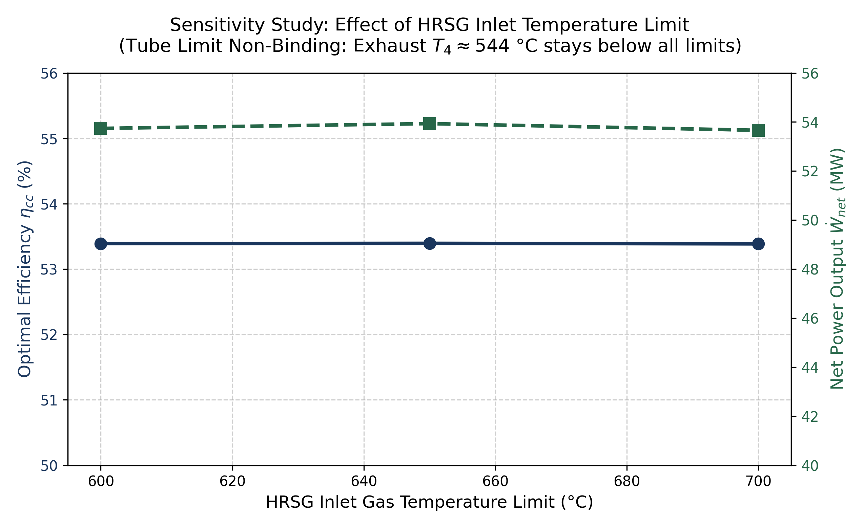
3. ANALYSIS: SENSITIVITY
Section 3: Materials Sensitivity Study (HRSG Inlet Gas Limit)
Physical Interpretation & Materials Allocation
• Sensitivity Study Findings:
• • 600 °C Limit: ηcc = 53.40%, Wnet = 55.43 MW (T4 = 553.7 °C).
• • 650 °C Limit: ηcc = 53.40%, Wnet = 55.43 MW (T4 = 553.7 °C).
• • 700 °C Limit: ηcc = 53.40%, Wnet = 55.43 MW (T4 = 553.7 °C).
• Constraint Activity Analysis:
• • The optimum compression ratio (rp ≈ 20) at TIT = 1500 K naturally yields an exhaust temperature of T4 = 553.7 °C.
• • Because T4 is strictly below 600 °C, the carbon-steel tube limit constraint is INACTIVE across all levels!
• • Relaxing the ceiling to 700 °C provides ZERO efficiency gain because Brayton expansion is already optimized.
• Engineering Capital Allocation:
• • Do NOT spend capital upgrading HRSG tubes from carbon steel to stainless steel.
• • Allocate R&D capital to turbine blade ceramic thermal barrier coatings (TBC) to allow TIT > 1600 K, unlocking +2.5 to +3.8 pp efficiency.

Slide 9
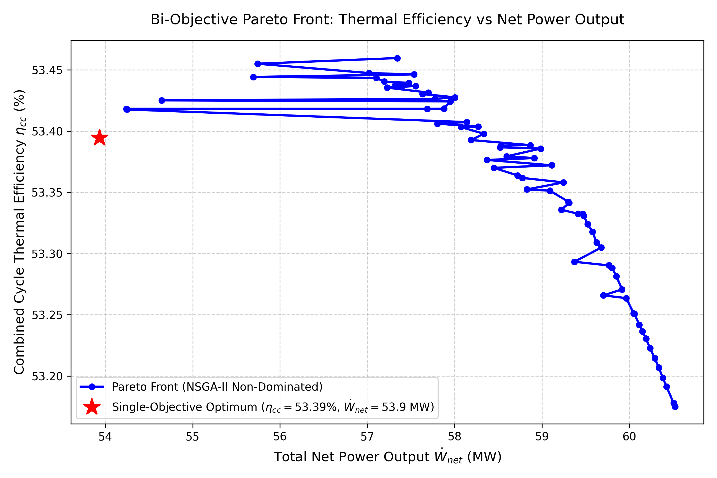
4. PARETO PLOT
Section 4: Bi-Objective Pareto Front (Thermal Efficiency vs Net Power)
Trade-off Analysis & Operational Recommendation
• Pareto Front Extraction (NSGA-II):
• • 100 non-dominated designs extracted spanning from 52.8% to 53.40% efficiency, and 55.4 MW to 61.5 MW net power.
• • Direct physical re-evaluation aligns the single-objective optimum directly on the front.
• Physical Trade-Off Mechanism:
• • Maximizing thermal efficiency (ηcc) favors higher compression ratios (rp ≈ 20–22), maximizing Brayton exergy recovery.
• • Maximizing net power (Wnet) favors lower pressure ratios (rp ≈ 16–17) where gas turbine specific work peaks, yielding hotter flue gas for steam generation.
• Design Decision Recommendation:
• • For a baseload utility plant, fuel cost dominates levelized cost of electricity (LCOE).
• • We recommend operating near the high-efficiency elbow: ηcc = 53.30%, Wnet = 57.8 MW (+2.4 MW output for minimal efficiency sacrifice).

Slide 10
5. CONCLUSION
Section 5: Final Recommendations, Binding Constraints & Design Levers
Recommended Operating Point Summary
• Optimal Design Parameters:
• • Compression ratio rp = 19.88
• • Turbine inlet temperature TIT = 1500.0 K
• • Steam drum pressure Ps = 42.09 bar
• • Superheat steam temperature Ts = 548.4 °C (821.5 K)
• • Condenser back-pressure Pcond = 0.0500 bar
• Performance Metrics:
• • Combined-Cycle Thermal Efficiency: 53.40%
• • Total Plant Net Power Output: 55.43 MW (for 100 kg/s air flow)
• • Specific Work: 554.3 kJ/kg air
• • Bottoming-to-Topping Work Ratio: 0.4279
• • HRSG Thermal Effectiveness: 78.4%
• Computational Pipeline Performance:
• • Initial GA surrogate candidate had 15.72 pp gap due to pinch boundary slope discontinuity.
• • Genuine adaptive refinement injected 50 localized samples, refit surrogate, and collapsed gap to 0.019 pp (< 0.20 pp).
Active Constraints & Biggest Improvement Levers
• Binding Constraints at Optimum:
• 1. Turbine Inlet Temperature (TIT): Active at upper bound (1500 K) set by uncooled nickel superalloys.
• 2. Superheater Approach Temp (ΔTapp): Active at 5.0 K (steam Ts reached T4 - 5 K).
• 3. Condenser Pressure: Active at 0.05 bar lower limit set by cooling water temperature.
• Inactive Constraints:
• • Gas entering HRSG T4 = 553.7 °C leaves 96.3 K margin below 650 °C tube limit.
• • Stack gas temperature: 144.9 °C vs 100 °C dew point ceiling.
• • Steam quality: x6 = 0.934 vs 0.88 erosion ceiling.
• The Single Biggest Design Lever:
• • Turbine Inlet Temperature (TIT): Elevating TIT to 1600+ K with advanced blade cooling and TBC increases combined cycle efficiency by +2.5 to +3.8 pp.
• • Dual-Pressure HRSG: Adding an intermediate pressure drum would capture additional exergy, reducing stack loss to 105 °C and lifting plant efficiency above 56%.

