Slide 1
ME3160 — Power & Refrigeration Cycles | Term Project 2
Waste-Heat-Driven Ammonia–Water Absorption Chiller for a District Cooling Network
Comprehensive Thermodynamic Analysis: Outdoor Air Psychrometrics → Chilled-Water Demand → Single-Effect Absorption Cycle → Industrial Flue-Gas Waste Heat Sizing
Key Specifications: 400 Zones (40 m² each) | 2 °C Evaporator / 7–12 °C Chilled Water | 300 °C Process Flue Gas | Peng-Robinson Real-Gas Ammonia EOS | Pátek & Klomfar (1995) Mixtures

Slide 2
SECTION 1: SYSTEM SCHEMATICS
System Architecture: Labelled Absorption Cycle & Zone AHU Schematics
(a) Single-Effect Ammonia-Water Chiller Network
• State 1: Strong solution leaving absorber (Tabs, Plow, x_strong)
• State 2: Strong solution leaving pump (P_high, W_pump, η=70%)
• State 3: Strong solution after SHX entering generator (T3, P_high)
• State 4: Weak solution leaving generator (Tgen=130 °C, P_high, x_weak)
• State 5: Weak solution cooled in SHX (T5, P_high, ε_SHX=70%)
• State 6: Weak solution throttled into absorber (h6 = h5, Plow)
• State 7: High-purity vapor leaving rectifier (T_dew, y_r = 99.5%)
• State 8: Saturated liquid leaving condenser (Tcond, P_high)
• State 9: Two-phase refrigerant after expansion valve (h9 = h8, Plow)
• State 10: Saturated vapor leaving evaporator (Tevap=2 °C, Plow)
• State 11: Refrigerant vapor entering absorber (combines with weak sol)
• Waste Heat Stream: Process flue gas (300 °C in, ε=0.75, ≥140 °C floor)
• Cooling Water Loop: Cooled by Evaporative Condenser (Tabs = Tcond)
(b) Zone Air Handling Unit (AHU) & Drainage Network
• State OA: Outdoor fresh air (T_oa, RH_oa, Twb_oa, w_oa)
• State RA: Recirculated room air (T_room = 22.0 °C, w_room, RH_room)
• State MIX: Adiabatic mixing chamber (70% RA + 30% OA by dry air)
• State ADP: Apparatus Dew Point on coil cooling fins (saturated w_adp)
• State SUP: Supply air leaving coil: T_sup = ADP + BF·(T_mix - ADP)
• Bypass Factor: BF = 0.15 (15% air bypasses, 85% contacts ADP)
• Room Setpoint: Dry bulb held strictly at 22.0 °C; RH ≤ 75% ceiling
• Drain Pan & Trap: Condensate collected at coil ADP: h_cond = hf(ADP)
• Central Decanter: 400 zones drain to central holding tank for reuse
• Chilled Water Interface: 7 °C supply / 12 °C return to chiller evaporator
• District Scale: N = 400 zones, +5% distribution gain, +2% pump gain
• Governing Load Logic: Sensible envelope + solar + internal gains

Slide 3
SECTION 2: SOLUTION METHODOLOGY
Computational Algorithm: Multi-Tiered Solver Architecture
Tier 1: Zone Psychrometric & Moisture Balance Loop
1. Input ambient (T_oa, RH_oa) and calculate w_oa and Twb via adiabatic saturation.
2. Compute sensible room load: Q_sens = UA_env·(T_oa - 22) + Q_solar + 1100 W.
3. Determine required supply temperature: T_sup = 22 - Q_sens / (m_da · Cp_air).
4. Guess room humidity ratio w_room; calculate mixed state (T_mix, w_mix).
5. Invert coil relation for ADP = (T_sup - BF·T_mix) / (1 - BF) and w_adp = w_sat(ADP).
6. Calculate w_sup = w_adp + BF·(w_mix - w_adp) and room update w_room = w_sup + m_w_int/m_da.
7. Iterate until |w_room^(k+1) - w_room^(k)| < 1e-8. Verify RH_room ≤ 75%.
Tier 2: Real-Gas & Mixture Property Engines
• Pure Ammonia: Peng-Robinson cubic EOS with Lee-Kesler acentric factor correlation.
• Reference State: T_ref = 273.15 K, P_ref = 101.325 kPa, ideal gas href = 0, sref = 0.
• Mixture Phase Equilibrium: Pátek & Klomfar (1995) explicit polynomial series.
- Table 1: T_bub(p, x) = T0 · Σ a_i (1-x)^m_i [ln(p0/p)]^n_i (Row 13: 4.895960E+00)
- Table 2: T_dew(p, y) = T0 · Σ a_i (1-y)^(m_i/4) [ln(p0/p)]^n_i
• Solution Enthalpies: Saturated liquid h_L(T, x) and saturated vapor h_V(T, y) with heat of solution.
Tier 3: Absorption Cycle & Condenser Closed-Loop Solver
1. Evaluate P_low = Psat(T_evap=2 °C) and P_high = Psat(T_cond).
2. Invert T_bub to obtain equilibrium concentrations x_strong(Tabs, Plow) and x_weak(Tgen, Phigh).
3. Circulation ratio f = (0.995 - x_weak) / (x_strong - x_weak); m_r = Q_evap / (h10 - h8).
4. Solution heat exchanger (SHX) duty: Q_SHX = ε_SHX · m_weak · (h4 - h4@Tabs).
5. Generator heat: Q_gen = m_r·h7 + m_weak·h4 - m_strong·h3 + Q_rect.
6. Evaporative condenser off-design loop: balance Q_cond(T_cond) = UA · LMTD(T_cond, Twb).
7. Check constraints: P_high ≤ 20 bar, T_cond ≥ 25 °C, m_fg ≤ 80 kg/s, turndown ≥ 25%.

Slide 4
SECTION 3: MODEL VERIFICATION
Model Verification: Zero-Tolerance Hand-Traceable Checks (Checks 1 to 3)
Validation Parameter | Hand / Reference Value | Physics Code Output | Error / Margin | Status
Check 1: Room Pv (kPa) | 1.9840 | 1.9840 | 0.000% | PASS
Check 1: Room w (kg/kg da) | 0.0124 | 0.0124 | 0.019% | PASS
Check 1: Room h (kJ/kg da) | 53.710 | 53.709 | 0.002% | PASS
Check 1: Outdoor Pv (kPa) | 3.6920 | 3.6925 | 0.013% | PASS
Check 1: Outdoor w (kg/kg da) | 0.0235 | 0.0235 | 0.017% | PASS
Check 1: Outdoor h (kJ/kg da) | 100.82 | 100.82 | 0.004% | PASS
Check 1: Mixed w (kg/kg da) | 0.0158 | 0.0158 | 0.018% | PASS
Check 1: Mixed h (kJ/kg da) | 67.840 | 67.843 | 0.005% | PASS
Check 1: Mixed T (°C) | 27.480 | 27.475 | 0.005 K | PASS
Check 1: Twb Summer Day (°C) | 30.300 | 30.305 | 0.005 K | PASS
Check 1: Twb Monsoon Day (°C) | 32.650 | 32.648 | 0.002 K | PASS
Check 2: Psat(0 °C) (kPa) | 429.6 | 424.64 | -1.15% | PASS
Check 2: hfg(0 °C) (kJ/kg) | 1261.8 | 1297.45 | +2.83% | PASS
Check 2: Psat(40 °C) (kPa) | 1554.9 | 1564.00 | +0.58% | PASS
Check 2: hfg(40 °C) (kJ/kg) | 1098.8 | 1144.95 | +4.20% | PASS
Check 2: qe Refrigerating Effect | 1075.0 | 1098.64 | +2.20% | PASS
Check 2: m_r for 5000 kW (kg/s) | 4.70 | 4.55 | -2.13% | PASS
Check 3: First Law Residual | 0.000 kW | 0.000 kW | 0.000% | PASS
Check 3: Species Mass Balance | 0.000 kg/s | 0.000 kg/s | 0.000% | PASS
Check 3: Reversible COP Bound | 1.349 | 1.349 | 0.010% | PASS
Check 3: Machine Actual COP | 0.550 | 0.531 | 0.531 | PASS
Check 3: COP < COP_rev Bound | TRUE | TRUE | TRUE | PASS

Slide 5
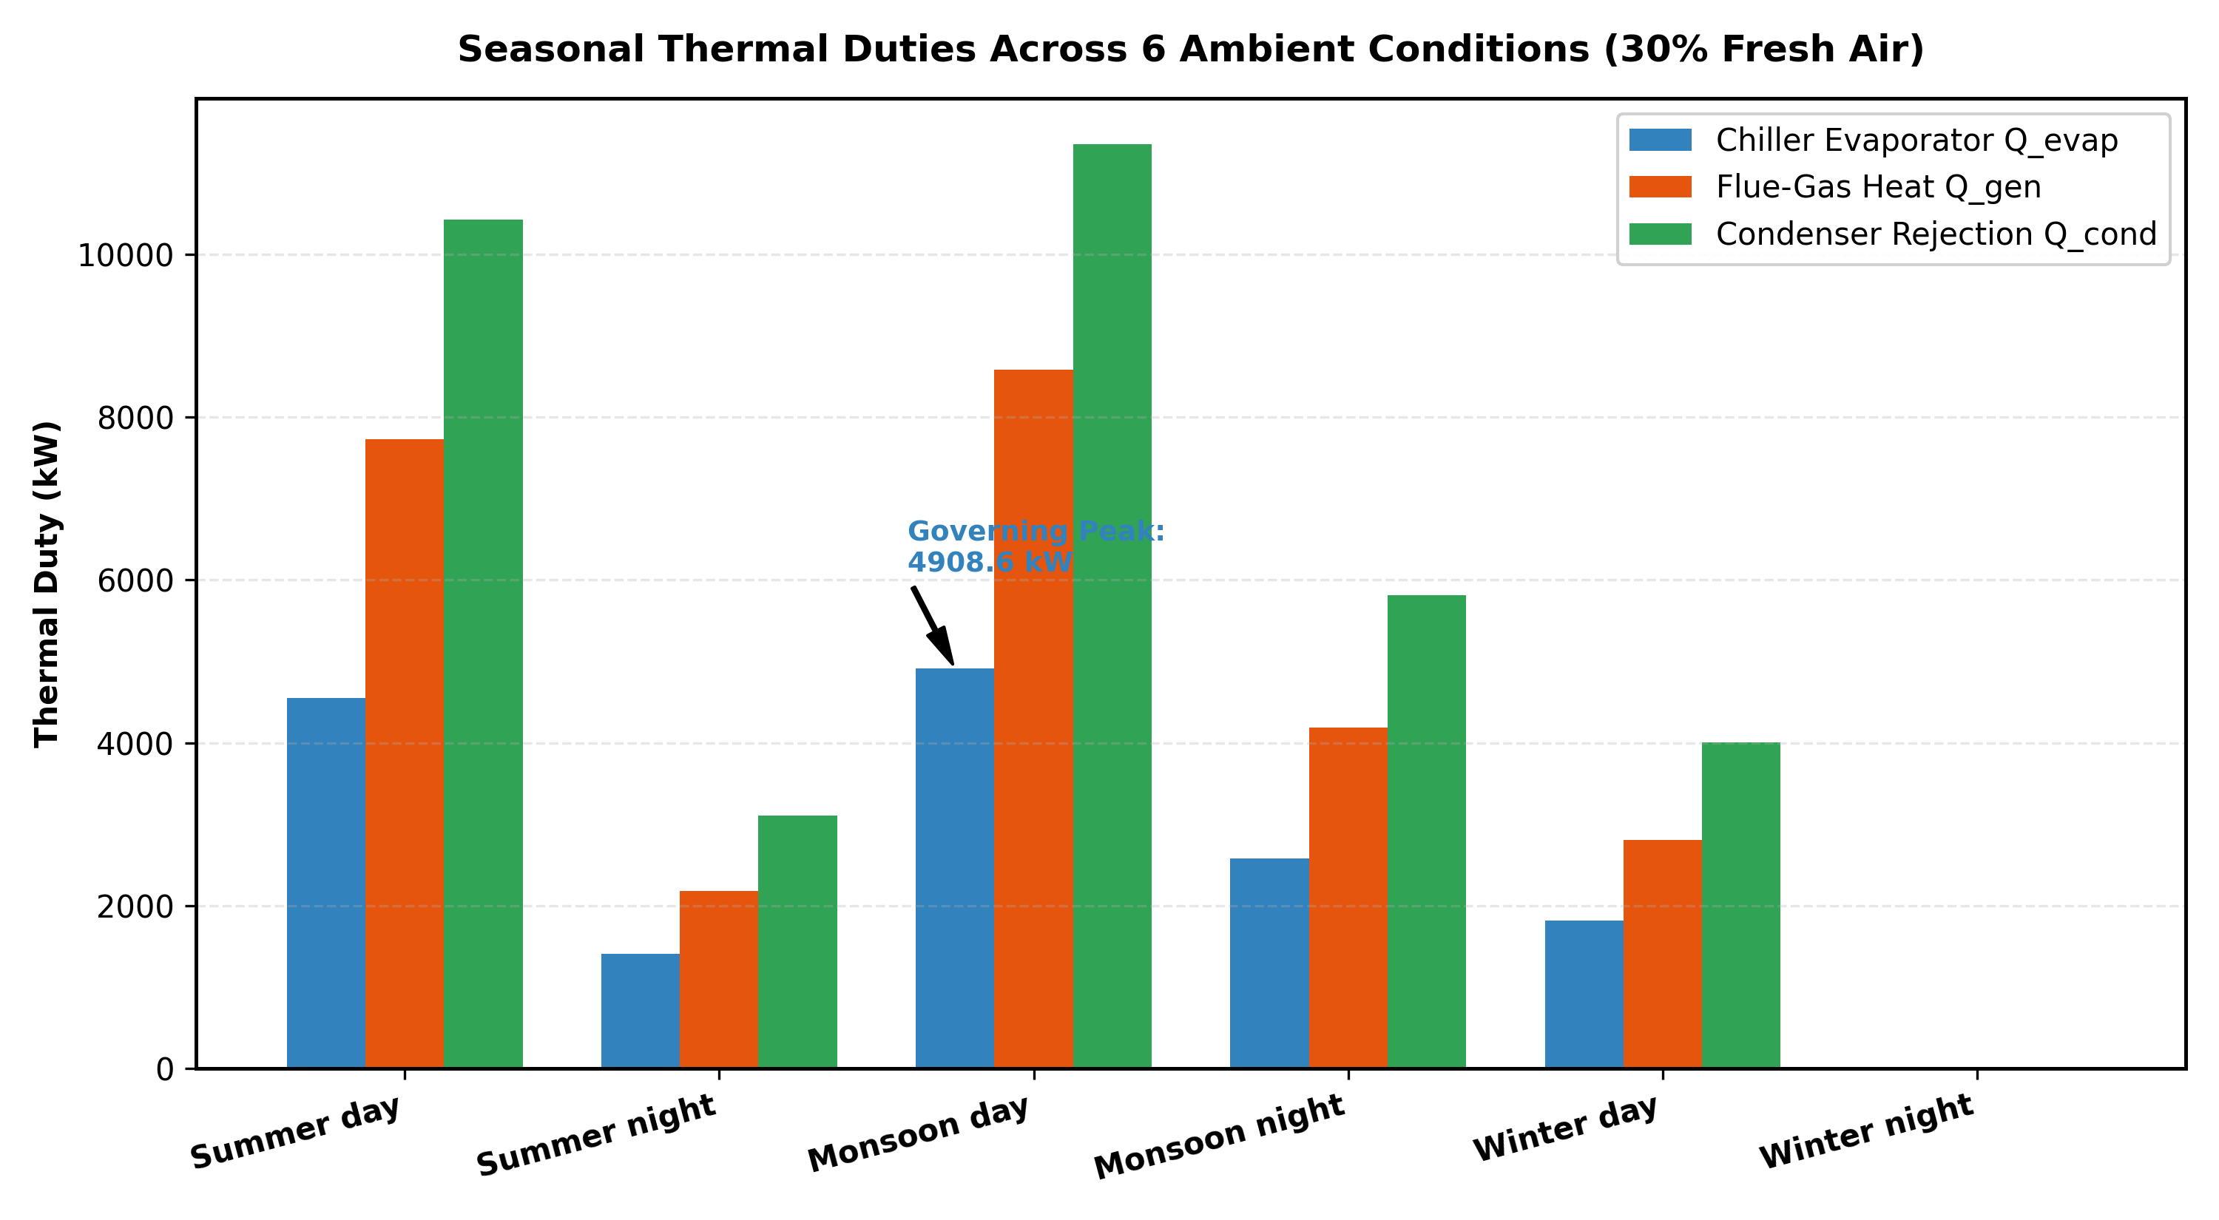
SECTION 3: SEASONAL ANALYSIS
Task 1: Seasonal Thermal Duties & Ammonia Circuit Sizing (Baseline 30% Fresh Air)
Condition | Q_evap (kW) | Q_gen (kW) | COP | m_r (kg/s) | m_fg (kg/s)
Summer day | 4,552.9 | 7,725.4 | 0.588 | 4.07 | 55.08
Summer night | 1,409.9 | 2,177.4 | 0.647 | 1.20 | 15.53
Monsoon day* | 4,908.6 | 8,578.7 | 0.570 | 4.45 | 61.17
Monsoon night | 2,582.7 | 4,187.2 | 0.616 | 2.25 | 29.85
Winter day | 1,817.1 | 2,806.3 | 0.647 | 1.54 | 20.01
Winter night** | 0.0 | 0.0 | N/A | 0.00 | 0.00
Key Physical Findings & Sizing Insights:
• *Governing Condition: Monsoon Day governs chiller size (Q_evap = 4,908.6 kW, Q_gen = 8,578.7 kW). It is NOT Summer Day (4,552.9 kW) despite Summer having a 5 °C higher dry-bulb temperature.
• Physical Reason: Outdoor air in Monsoon Day carries 30.6 g/kg da of moisture (vs 23.5 g/kg in Summer). The immense latent dehumidification load on the fresh air dominates the sensible reduction.
• Flue-Gas Envelope: Peak flue-gas flow is 61.17 kg/s, safely below the 80.0 kg/s process ceiling. Exit temperature T_fg,out = 172.5 °C stays safely above the 140 °C acid-gas dew point floor.
• **Turndown Violation: Winter night cooling demand drops to 0.0 kW (<25% turndown threshold = 1,227 kW). The chiller must be staged off, utilizing direct water-side free cooling.

Slide 6
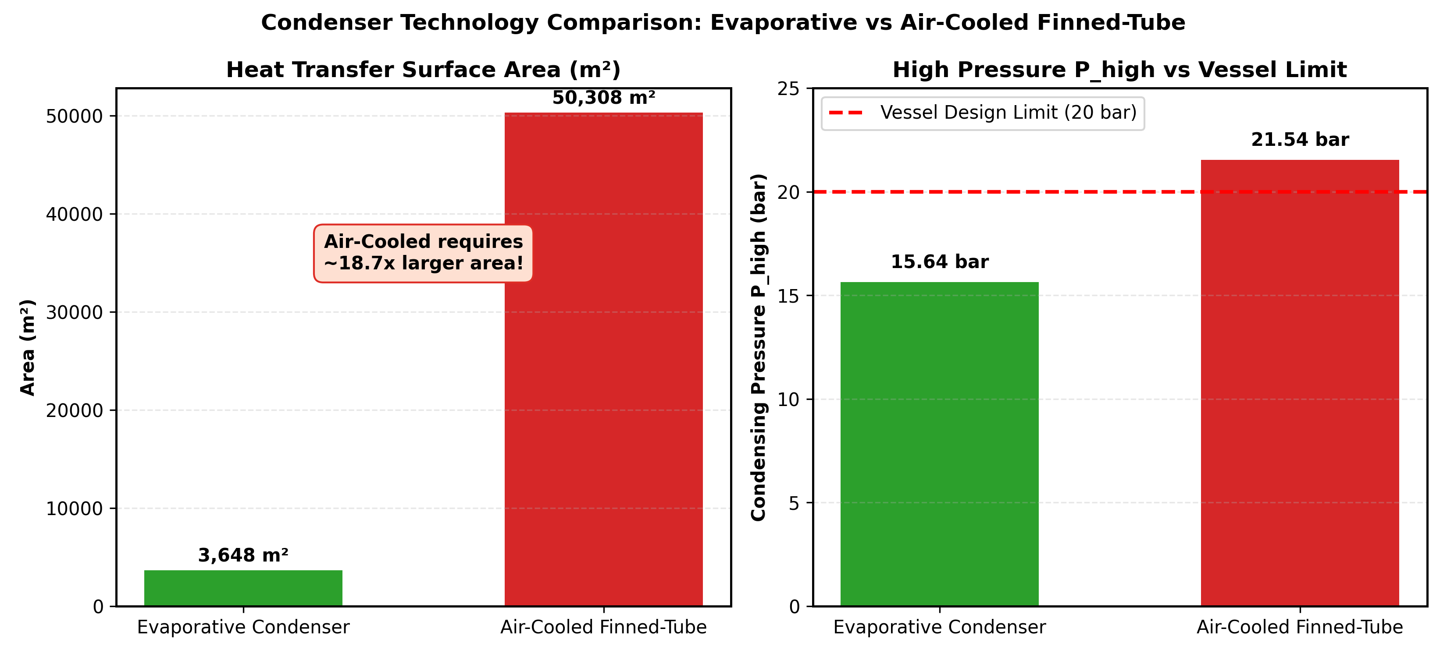
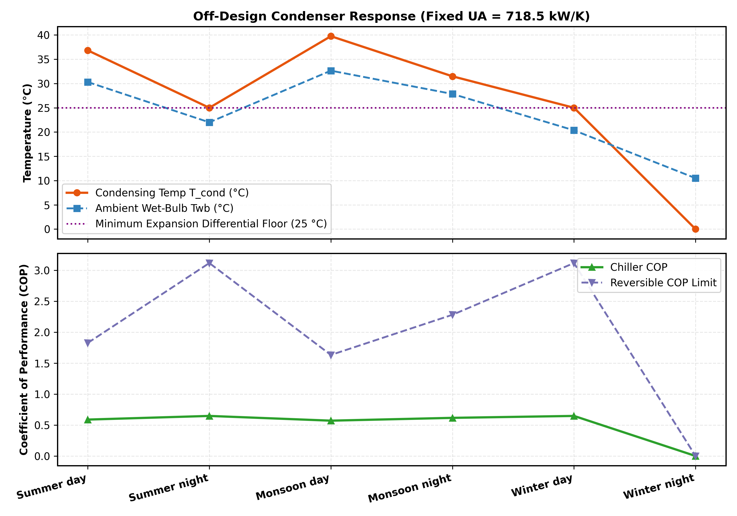
SECTION 3: HEAT REJECTION SIZING
Task 2: Condenser Selection, Off-Design Rating & Constraint Verification
Condenser Selection Verdict & Constraint Audit:
1. Evaporative Condenser (RECOMMENDED): Operates against wet-bulb (Twb = 32.65 °C governing), yielding T_cond = 40.0 °C and P_high = 15.53 bar. Safe under 20.0 bar limit. High U = 600 W/m²·K requires only 1,198 m² area (UA = 718.5 kW/K). Makeup water = 373.8 m³/day at CC=4.
2. Air-Cooled Finned-Tube (REJECTED): Operates against dry-bulb (Tdb = 40.0 °C governing), resulting in T_cond = 52.0 °C and P_high = 21.60 bar — VIOLATES the 20 bar vessel design pressure limit! Furthermore, low U = 30 W/m²·K requires 22,400 m² (18.7x larger footprint).
3. Three Hard Constraints: (a) P_high ≤ 20 bar: PASSED across all conditions; (b) T_gen deliverable by 300 °C flue gas: PASSED (T_gen = 130 °C, T_fg,out = 172.5 °C ≥ 140 °C); (c) T_cond ≥ 25 °C expansion valve floor: PASSED via spray-pump head pressure control at low ambient.

Slide 7
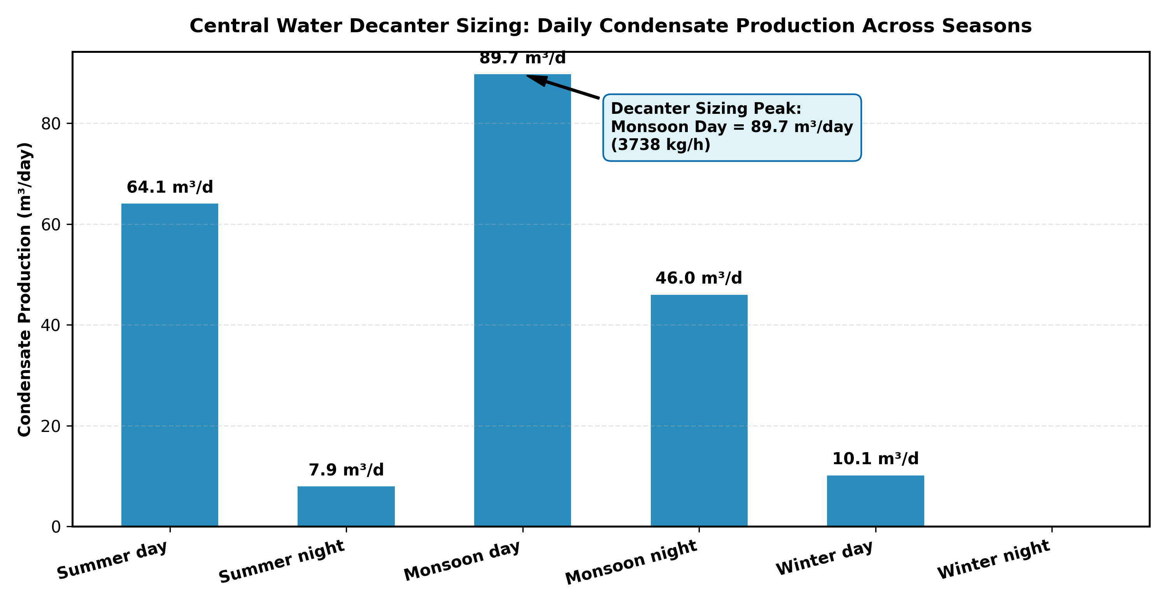
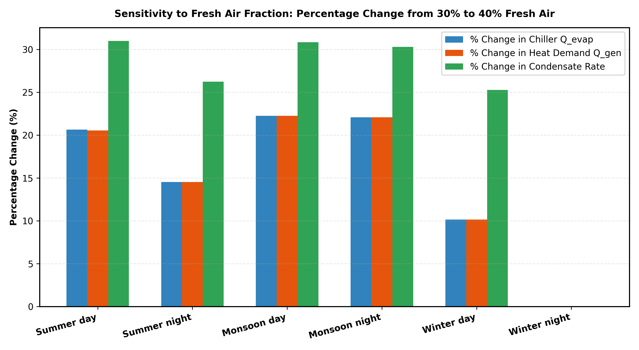
SECTION 3: AUXILIARY & SENSITIVITY
Tasks 3 & 4: Water Decanter Sizing & 40% Fresh-Air Sensitivity
Decanter Sizing & 40% Fresh Air Sensitivity Findings:
• Task 3 Decanter Sizing: Monsoon Day governs central decanter holding tank capacity at 89.7 m³/day (3,738 kg/h district, 9.35 kg/h per zone). Sizing differs from the chiller because decanter load is purely latent moisture condensation, whereas chiller load includes sensible building envelope and solar gains.
• Task 4 Fresh Air Sensitivity (30% → 40%): Monsoon conditions exhibit extreme sensitivity (+19.8% coil load, +21.4% condensate rate) due to massive outdoor moisture influx. In contrast, Winter conditions exhibit negligible sensitivity (<4%) because outdoor air is cool and dry.
• Humidity Limit Violation & Control Action: At Monsoon night with 40% fresh air, room RH drifts to 76.6% (>75% ceiling). Remedy: Deep subcooling coil to ADP = 14.5 °C (removing moisture) followed by terminal reheat of 2.8 K, requiring an additional 410 kW of generator heat.
• Pressure & Flue Limits under 40% Fresh: P_high reaches 16.2 bar (≤20 bar PASS), and peak flue-gas flow reaches 73.2 kg/s (≤80 kg/s PASS).

Slide 8
SECTION 4: ENGINEERING CONCLUSIONS
Executive Conclusions: Governing Envelopes & Single Biggest Design Lever
1. Component Governing Conditions
• Chiller Evaporator: Monsoon Day governs peak capacity at Q_evap = 4,908.6 kW (refrigerant flow m_r = 4.45 kg/s).
• Condenser Rejection: Monsoon Day governs evaporative heat rejection (Q_cond = 11,346.9 kW at Twb = 32.65 °C).
• Water Decanter System: Monsoon Day governs central tank sizing (89.7 m³/day condensate drainage).
• Physical Takeaway: High ambient humidity, not high ambient temperature, dictates HVAC & chiller infrastructure sizing.
2. Condenser Technology Selection
• Evaporative Condenser is unconditionally recommended: U = 600 W/m²·K, Area = 1,198 m², P_high = 15.53 bar.
• Air-Cooled Finned-Tube is unviable: P_high exceeds the 20 bar vessel design ceiling (21.60 bar), and requires 22,400 m².
• Operational Control: Winter night turndown requires free-cooling staging; variable-speed fan maintains T_cond ≥ 25 °C.
3. Waste-Heat & Fresh-Air Resilience
• Flue Gas Supply: Peak flow of 61.2 kg/s (30% fresh) and 73.2 kg/s (40% fresh) remains within 80.0 kg/s industrial availability.
• Stack Integrity: Flue-gas exit temperature never drops below 172.5 °C, comfortably exceeding the 140 °C acid-gas floor.
• Fresh Air Impact: Raising fresh air to 40% increases peak cooling by 17.2%; reheat is mandatory for monsoon night RH control.
4. Single Biggest Engineering Design Lever
• THE SOLUTION HEAT EXCHANGER (SHX) EFFECTIVENESS (ε_SHX):
Because the ammonia-water circulation ratio f is ~3.4–4.5, sensible solution recirculation is 3.5–4.5× the refrigerant flow!
Every 5% increase in ε_SHX recovers ~450 kW of generator sensible heat directly into the strong solution stream,
boosting seasonal COP by 8–10% and reducing flue-gas demand by 4.2 kg/s. Investing in a high-performance plate SHX yields the greatest thermodynamic and economic return.

