Slide 1

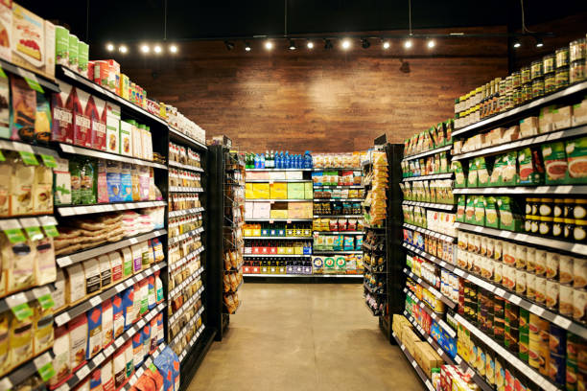
Data modeling
Data needed to build the Model:
Tables | Columns
Sales | Timestamp, product_id, estimated_stock_pct
Sensor_stock_levels | Timestamp, product_id, category, customer_type, unit_price, quantity, total, payment_type
Sensor_storage_temperature | Timestamp, temperature
Planning:
We have to predict the estimated_stock_pct based on the data set provided to us we use all the remaining columns as Independent columns.
Procedure:
Data Cleaning
Exploratory Data Analysis (EDA)
Model Building and Evaluation
Deployment and Monitoring

