Slide 1
Prediction of Seismic Exertion in the Subduction Zones Using Artificial Neural Networks
Vishnu N
MY.SC.I5MCA20001
Amrita Vishwa Vidyapeetham, Mysuru Campus

Slide 2
Overview
Understanding the prediction of underwater earthquakes is important for disaster prevention. This research uses neural network models to improve predictions by leveraging their ability to solve complex data patterns. This also includes the development of new models that will be more efficient and effective in earthquake prediction. Additionally, comparisons will be made with existing systems to evaluate the effectiveness of disaster management strategies and to inform future developments.

Slide 3
Literature Reviews
Title | Methodology | Evaluation | Limitations
Application of a new machine learning model to improve earthquake ground motion predictions | New model Seismic Integrated Machine Learning (SeisEML). Using MAE and RMSE a s feature selection. Model training uses XGB, LGBM, CatB, RF, SGWO, BO, K-RR, and RR. | SeisEML outperforms GPR, Extra Tree Regressor, Random Subspace Catboost, AdaBoost, and Decision Tree models in prediction accuracy. R^2 (0.77) and MAE (0.123) compared to other single test models. | Its computational demands for training and reasoning are significant.
The Impact of Tectonic Setting on Machine Learning Approaches | Using LSTM, BiLSTM, and color-layered BiLSTM | MAE of 0.080, MSE of 0.011, RMSE of 0.106, and MAPE of 22.98%. | Focused solely on seismic data from Kansas and Puerto Rico, limiting the generalizability of findings to regions with different tectonics.
Neural network applications in earthquake prediction (1994-2019): Meta‐analytic and statistical insights on their limitations | 77 articles on the application of ANNs in earthquake prediction between 1994 and 2019. Examining accuracy, positive accuracy, negative accuracy, and R-score. | 47% of studies compare ANN performance to baseline models. 22% using bases like Poisson's null hypothesis or random data. ANN is typically preferred | Lack of repeatability due to limited samples and model quality.

Slide 4
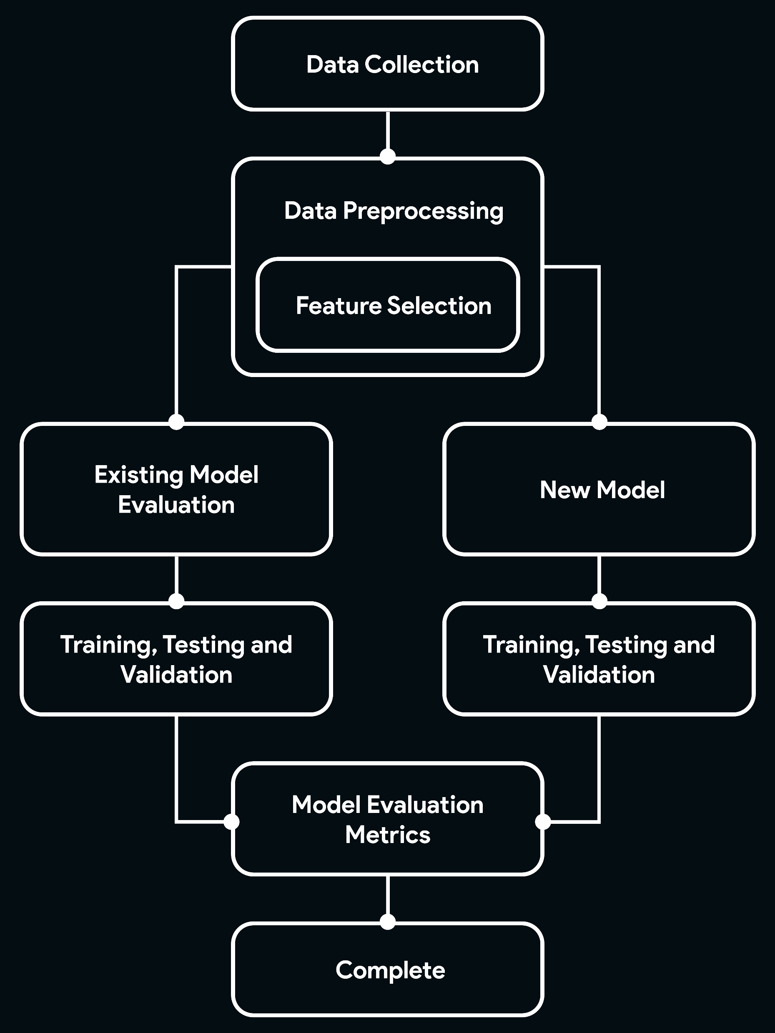
Architecture
Diagram

Slide 5
Contribution

Slide 6
Conclusion
The potential of neural network models in improving underwater earthquake prediction is clear. To improve prediction accuracy, different data need to be combined. Transfer learning becomes an important tool, especially when resources are limited. Moreover, the proposed hybrid model integration can improve the robustness of the prediction. Once the hybrid model is developed, rigorous testing using performance indicators and sensitivity analysis is essential to evaluate the performance in the underwater environment.

