Slide 1
WIMAX ARCHITECTURE

Slide 2
What is WIMAX?
WiMax stands for Worldwide Interoperability for Microwave Access. This technology is based on IEEE 802.16. It is used to provide higher data rates with increased coverage.
It is based on MAN (Metropolitan Area Network) technology. Its range is up to 50 Km.
It may provide speeds up to 70 Mbps and it can operate in Non-Line-of-Sight. This technology is fast, convenient, and cost-effective.
WiMAX communication system provides BWA (broadband wireless access) up to 50 kilometers for fixed stations and also for mobile stations from 5 to 15 km.
WiMAX operates on licensed and unlicensed frequency bands, allowing service providers to deliver internet connectivity to both residential and business users.
One of the key advantages of WiMAX technology is its ability to deliver broadband internet access at longer distances. Unlike Wi-Fi, which has a limited range, WiMAX can cover several miles, making it suitable for rural areas or regions with low population density.

Slide 3
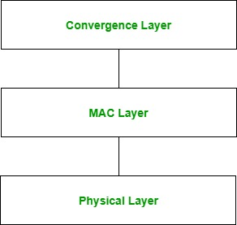
Architecture of WiMax
Physical Layer: This layer specifies frequency band, synchronization between transmitter and receiver data rate, and multiplexing scheme. This layer is responsible for encoding and decoding of signals and manages bit transmission and reception. It converts MAC layer frames into signals to be transmitted. Modulation schemes that are used on this layer include QPSK, QAM-16, and QAM-64.
MAC Layer: This layer provides an interface between the convergence layer and the physical layer of the WiMax protocol stack. It provides point-to-multipoint communication and is based on CSMA/CA (Carrier Sense Multiple Access with Collision Avoidance). The MAC layer is responsible for transmitting data in frames and controlling access to shared wireless media. The MAC protocol defines how and when a subscriber may initiate a transmission on the channel.
Convergence Layer: This layer provides the information of the external network. It accepts a higher layer protocol data unit (PDU) and converts it to a lower-layer PDU. It provides functions depending on the service being used.

