Slide 1
UPLIFTING THE FARMER THROUGH A CONNECTED ECOSYSTEM
PIP2001 Capstone Project
Review-0
Batch Number: CSE176
Under the Supervision of,
MR AFROZ ALAM
Dr./Mr./Ms./Prof.
Professor / Associate Professor / Assistant Professor
School of Computer Science and Engineering
Presidency University
Roll Number | Student Name
20211CSE0286 | KARTHIK D
20211CSE0856 | VISHNU NANDAN A R
20211CSE0855 | HEMANTH S G
Name of the Program: B-TECH
Name of the HoD: Dr ASIF MOHAMMED
Name of the Program Project Coordinator: MR
Name of the School Project Coordinators: Dr. Sampath A K / Dr. Abdul Khadar A / Mr. Md Ziaur Rahman

Slide 2
Content
Problem Statement
Github Link
Analysis of Problem Statement
Timeline of the Project
References

Slide 3
Problem Statement Number:
Organization:
Category (Hardware / Software / Both) : SOFTWARE
Problem Description: The project aims to create a connected ecosystem that provides farmers with the tools and resources they need to improve their livelihoods. This ecosystem could include technology for real-time information (e.g., weather updates, market prices), improved supply chains, access to financial services, and knowledge-sharing platforms. By connecting farmers with these critical resources, the project would empower them to increase productivity, access fair markets, and adopt sustainable farming practices.
In summary, the project seeks to improve farmers' economic well-being by building a support network that integrates technology, finance, and market access.
Difficulty Level: Complex

Slide 4
Github Link
The Github link provided should have public access permission.
Github Link

Slide 5
Analysis of Problem Statement
Technology Stack Components:
Front-End (Mobile App):
React Native
UX/UI Design Tools
Back-End:
Node.js with Express.js
Python with Django and Flask
Database:
PostGreSQL
Firebase Realtime Database
Cloud Services and Hosting:
AWS(Amazon Web Services)
Google Cloud
Database

Slide 6
Analysis of Problem Statement (contd...)
Software and Hardware Requirements:
User Interface: Simple, multilingual, offline support, push notifications.
User Management: Secure registration, role-based access control, farmer profiles.
Market Integration: Real-time market prices, buy/sell platform, payment gateways.
Real-Time Alerts: Weather forecasts, crop health, notifications.
Financial Services: Microloans, subsidies, insurance.
Supply Chain Management: Logistics, inventory tracking, warehouse integration.

Slide 7
Analysis of Problem Statement (contd...)
Key Features:
1. Farmer Registration & Profile Management
Easy sign-up with phone number and profile creation for tracking farm details like location and crop type.
2. Market Prices & Alerts
Real-time crop prices from nearby markets, with price alerts when desired levels are reached.
3. Buy/Sell Platform
Digital marketplace for farmers to sell produce and connect directly with buyers. Integrated secure payment options.
4. Farm Monitoring & IoT Integration
Optional integration with IoT sensors to monitor soil moisture and crop health, with automated alerts.

Slide 8
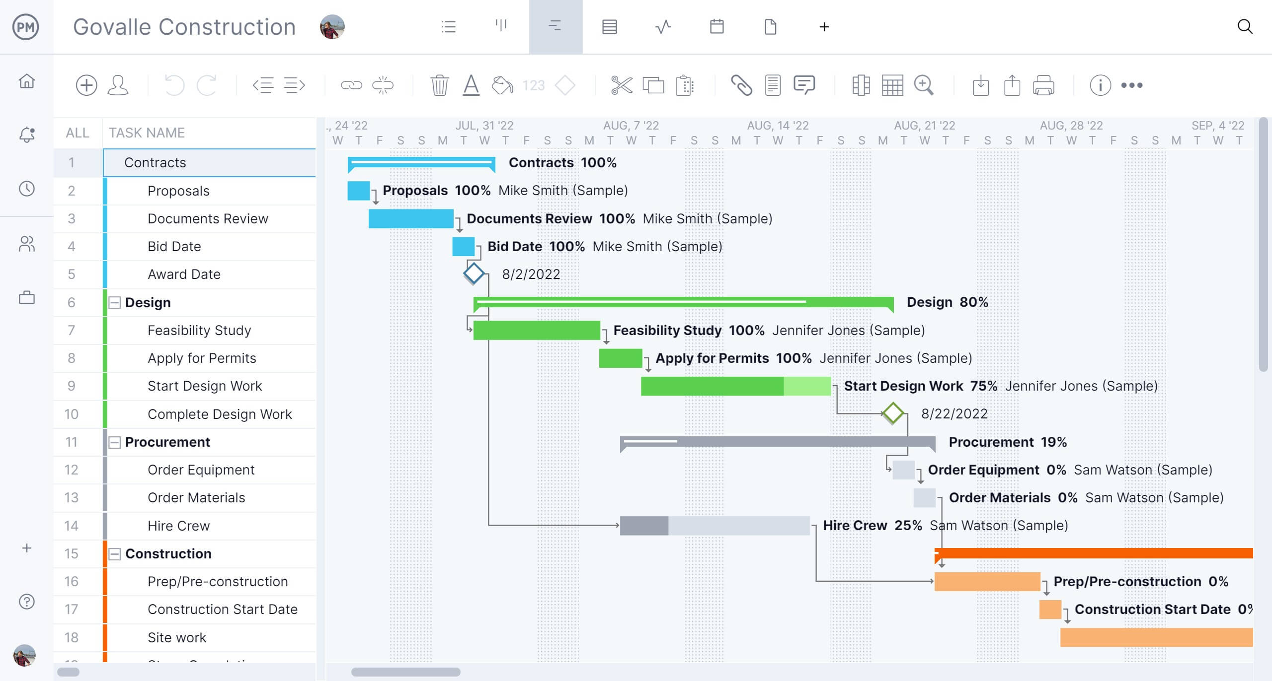
Timeline of the Project (Gantt Chart)

Slide 9
References (IEEE Paper format)
Add APA Citation for all references.
Use the below link for various APA styles :
https://www.indeed.com/career-advice/career-development/how-to-cite-a-research-paper
Uplifting Farmers Ecosystem Using App Development
https://bestprojectideas.com/agriculture-project-ideas-for-high-school/

Slide 10


