Slide 1
Malicious URL Detection using Deep Learning
Vinayakumar R, Sriram S, Soman KP, and Mamoun Alazab, Senior Fellow, IEEE
Presented by Vishnu Ranjith
1911130

Slide 2
Aim:
The objective of this work is to classify a given URL as either legitimate or malicious and classification problem is binary.
For this, a model named DeepURLDetect is proposed and it is hence compared to other pre-existing models with respect to its accuracy.

Slide 3

What is a malicious website?
Malicious Uniform Resource Locator (URL), a.k.a. malicious website is a primary mechanism to host unsolicited content, such as spam, malicious advertisements, phishing, drive-by exploits, to name few.
Email and social media resources such as Facebook, Twitter, WhatsApp, Orkut etc. are the most commonly used applications to spread the malicious URLs

Slide 4
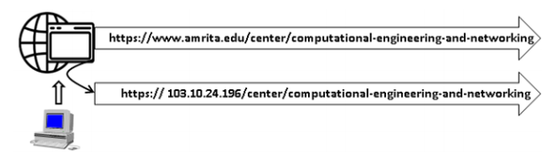
URL
A uniform resource locator (URL) is a part of uniform resource identifier (URI) which is used to identify and retrieve a resource from the internet service.
A URL is composed of three parts: The first part defines the type of protocol, for example http or https, the second part defines the domain name or IP address and the third part defines path and its parameters to a specific resource on the web.

Slide 5
Need for Deep Learning method:
Previous studies have used blacklisting, regular expression and signature matching approaches.
These approaches are completely ineffective at detecting variants of existing malicious URL or entirely newly found URL.
This issue can be mitigated by proposing the machine learning based solution.
To alleviate the aforementioned issues, this work propose christened DeepURLDetect (DUD) which uses modern machine learning typically called as ’deep learning’ with nonlinear character embedding.
They have the capability to extract optimal feature representation by itself by taking the raw inputs.

Slide 6
The proposed methodology is DeepURLDetect (DUD) in which raw URLs are encoded using characters level embedding.
There are 5 state of the art architectures investigated in this paper
Invincea
NYU
MIT
CMU
Endgame

Slide 7
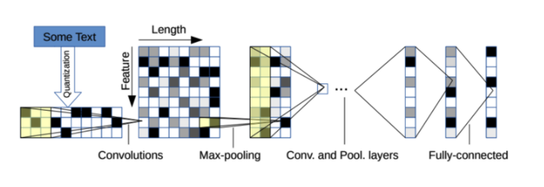
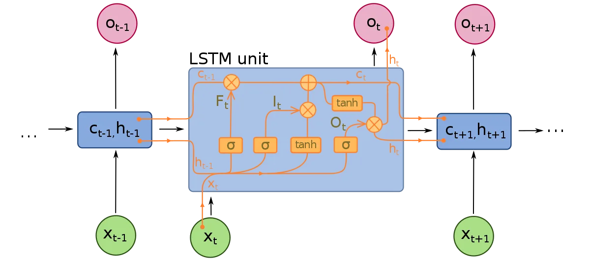
CNN:
In deep learning, a convolutional neural network (CNN, or ConvNet) is a class of deep neural networks, most commonly applied to analyzing visual imagery.
CNN-C is a character level variant of CNN that deals with 1 dimensional convolution and pooling operations.
CNN-C extracts optimal features from the character level representation of URL.
LSMT:
Long short-term memory (LSTM) is an artificial recurrent neural network (RNN) architecture used in the field of deep learning.
A common LSTM unit is composed of a cell, an input gate, an output gate and a forget gate. The cell remembers values over arbitrary time intervals and the three gates regulate the flow of information into and out of the cell.

Slide 8
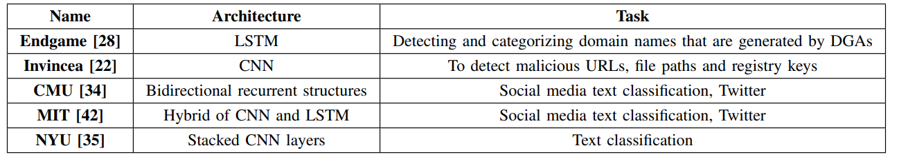

Slide 9
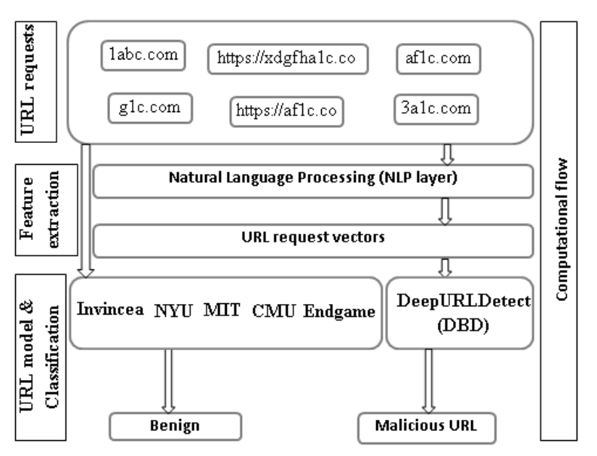
The working flow of malicious URL detection process:

Slide 10
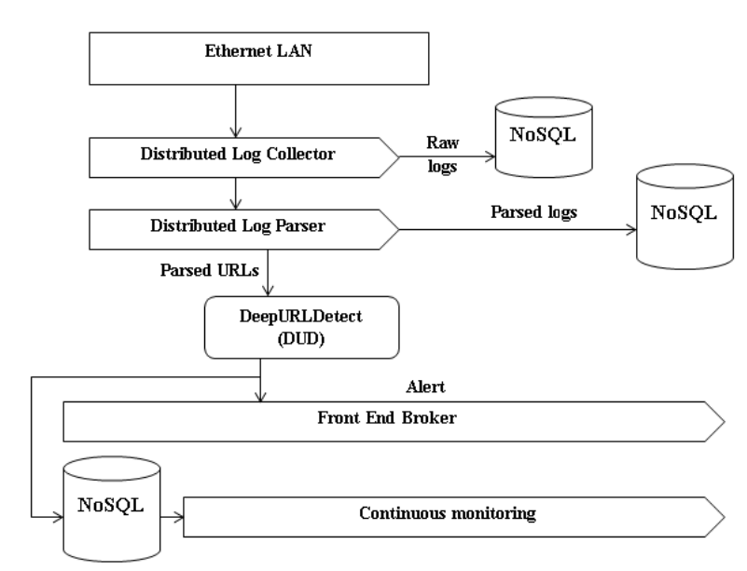
Proposed Architecture - DeepURLDetect (DUD)

Slide 11
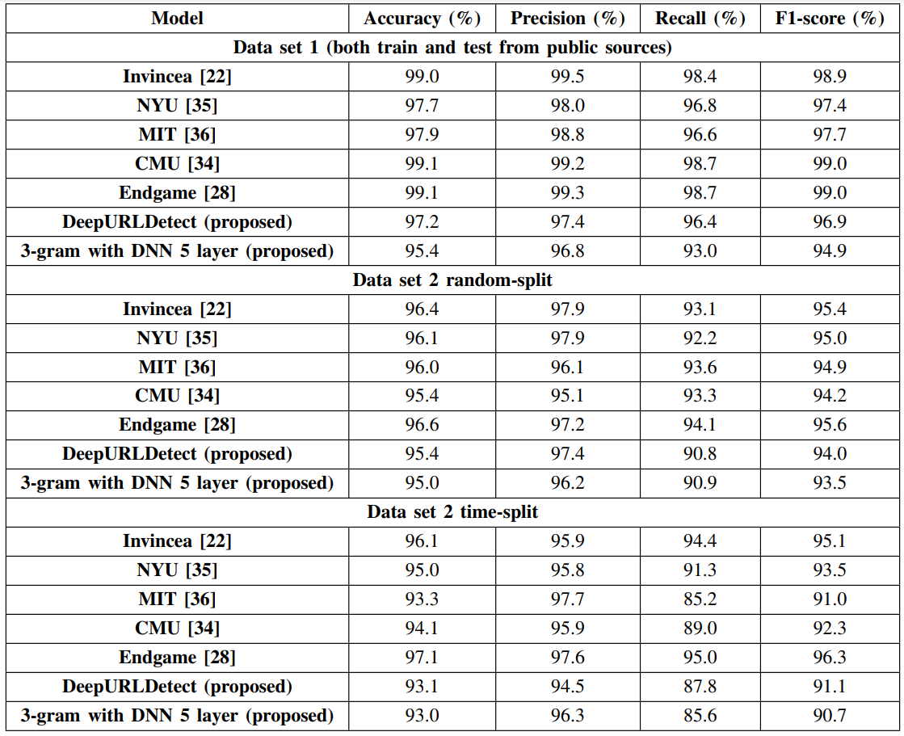
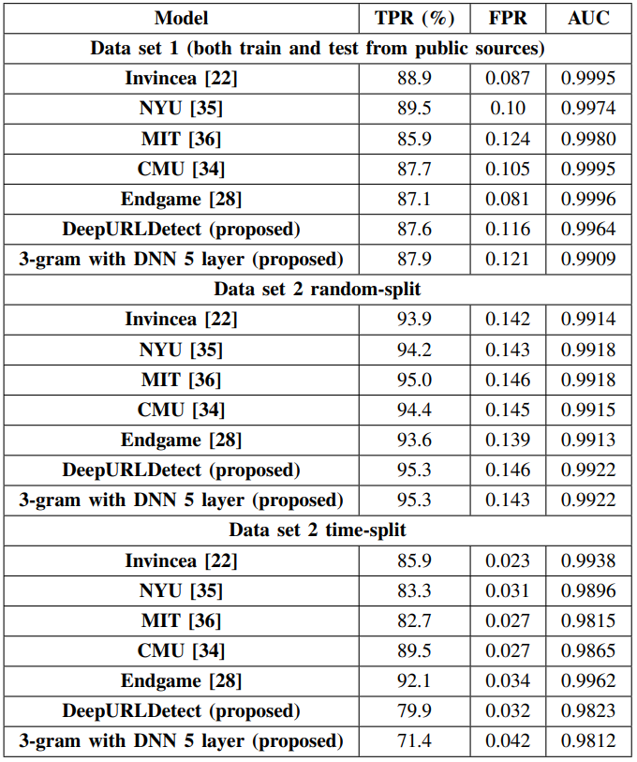
Test Results

Slide 12
Evaluation Results and Observations
Most of the models performed well on Data set 1 in comparison to the Data set 2 random-split and time-split.
Moreover, the performance of various models on Data set 2 random-split is good in comparison to the Data set 2 time-split.
This is due to the fact that the samples of test data of Data set 2 time-split is unseen during training.
Obtaining better AUC in precision-recall curve indicates that the models predicts more accurately.
The performance of all models have marginal difference in terms of accuracy and AUC and thus voting methodology can be employed to distinguish whether the URL is legitimate or malicious.

Slide 13
Conclusion
In this work, a comparative analysis of various deep learning based character level embedding models for malicious URL detection is done. All deep learning architectures have marginal difference in terms of accuracy. Among 5 models, two are based on RNN, two are based on CNN and one is based on hybrid of CNN and LSTM. All the models performed well and achieved around 93-98% malicious URL detection rate with false positive rate of 0.001. This indicates that if the deep learning based character level embedding models able to catch 970 malicious URL; they label only one benign URL as malicious.
Deep learning with embedding based malicious URL detection can be robust solution over hand crafted features with conventional machine learning based solutions.

Slide 14
Strategy of implementation
Using NLP techniques used in the paper
Creating my own neural network using Tensorflow and Keras Character Level Embedding.
Try to attain an accuracy significant enough so as to complete 30% of implementation or more

Slide 15
References:
https://www.researchgate.net/figure/Proposed-Architecture-DeepURLDetect-DUD_fig2_347776755
https://en.wikipedia.org/wiki/Wikipedia
https://towardsdatascience.com/a-comprehensive-guide-to-convolutional-neural-networks-the-eli5-way-3bd2b1164a53
https://www.kaggle.com/xwolf12/malicious-and-benign-websites

