Slide 1
Can a computer spot a hit song?
UE24CS352A MACHINE LEARNING, MINI-PROJECT 16
We rebuilt and improved HitPredict, a Stanford study that predicts Billboard Hot 100 hits from Spotify data.
[Patruni Vishnu , PES1UG24AM187] and [Piyush G Nadgir ,PES1UG24AM190]
Notes:
Good morning. We are [names]. Our project asks a simple question: can a computer look at a song and guess whether it will become a hit? We started from a student paper from Stanford called HitPredict. We rebuilt every experiment in it, checked whether its testing was fair, and then tried to improve it. In the next few minutes we will show what we found, including a few surprises in the original paper, and then give a short live demo.

Slide 2



Will this song reach the Hot 100?
THE PROBLEM
What goes in
What comes out
Why it matters
Spotify's measurements of the sound, like how danceable or energetic it is, plus one fact: has the artist had a hit before?
A yes or no: will the song reach the Billboard Hot 100? The model also gives its confidence as a percentage.
Labels spend real money promoting songs. A cheap first check helps them choose, and a false "hit" is the costly mistake.
HitPredict revisited
2 / 16
Notes:
Here is the task in plain words. On the left is what the computer gets: numbers that Spotify measures from the audio, like danceability, energy and loudness, plus one simple fact, whether the artist has had a Hot 100 hit before. In the middle is what it gives back: yes or no, will this song chart, with a confidence percentage. On the right is why anyone cares. Record labels spend a lot on promotion, so even a rough early filter is useful, and the expensive mistake is backing a song that flops.

Slide 3
The reference paper and our goals
WHERE WE STARTED
The paper: HitPredict (Stanford, 2018)
Our goals
About 4,000 songs from 1990 to 2018
Five methods, from a simple formula to a small neural network
Best result: about 76% of songs called correctly
Repeat every experiment in the paper
Check that the testing was fair
Improve it, and explain why each change helps
HitPredict revisited
3 / 16
Notes:
Our starting point was a student paper from Stanford's machine learning course in 2018, called HitPredict. The authors collected about four thousand songs, tried five methods, and their best models got about 76 percent of songs right on their check set. We set ourselves three goals. First, repeat every experiment and see if we get the same numbers. Second, check whether the way they tested was fair, meaning the score reflects how the model would do on new songs. Third, try to do better, and be able to explain why each change helps or does not.

Slide 4
4,019 songs from the authors' own files
THE DATA
1,595
What we know about each song
Danceability
Energy
Loudness
Tempo
Valence (mood)
of them were Hot 100 hits (40%)
Acousticness
Speechiness
Instrumentalness
Liveness
1990-2018
Artist score: had a hit before?
Spotify closed this data feed to new apps in 2024, so the authors' files are the only copy. Our script downloads them and checks they are unchanged.
release years covered
HitPredict revisited
4 / 16
Notes:
We used the exact data from the paper, which the authors shared with their code. That matters because Spotify closed this data feed to new users in 2024, so nobody can collect it again. After removing 21 duplicate rows there are 4,019 songs. 1,595 of them, about 40 percent, were Hot 100 hits. The rest are random songs that never charted. Each song has nine sound measurements from Spotify, shown in green, and one extra fact the authors added: whether the artist already had a hit before. Keep that last one in mind, it turns out to be the strongest clue.

Slide 5
Five steps from data to answer
THE PROCESS
1
2
3
4
5
Get the data
Rerun the paper
Test fairly
Compare models
Improve
Download the authors' files and check they are complete.
Same split, same settings, same features.
Keep whole artists out of training for the final test.
Thirteen methods, from simple rules to tree ensembles.
Four changes, added one at a time.
HitPredict revisited
5 / 16
Notes:
Our work had five steps. One, get the original data and check it. Two, rerun the paper exactly as the authors did, with the same split of the data and the same settings, to see if their numbers come back. Three, build a fair test, which we explain on the next slide. Four, compare thirteen different methods, from a one-line rule to large collections of decision trees, all tested the same fair way. Five, improve the best approach with four changes, adding them one at a time so we can see what each one is worth.

Slide 6
We test on artists the model never saw
FAIR TESTING
LEARN AND TUNE
FINAL TEST
3,015
1,004
songs by 1,597 artists
songs by 534 artists
No artist is on both sides, so the model cannot just recognise a familiar artist.
Every setting is chosen on practice rounds inside the learning set; the test is used once.
Choosing settings on the test songs, as the paper did, overstated accuracy by 1.7 points in our check.
HitPredict revisited
6 / 16
Notes:
A test is only fair if the model has not seen the answers. So we split the songs by artist. Three quarters of the artists, 3,015 songs, are for learning and tuning. The other quarter, 1,004 songs by 534 artists, is a final exam the model sees only once, at the very end. Every choice, like which settings to use, is made on practice rounds inside the learning set. The paper did not do this. It picked its settings using the same songs it reported its score on. When we copied that habit over 20 random splits, the reported score came out 1.7 points higher than the score on fresh songs, against 1.0 point when nothing is picked that way. One surprise: mixing artists on both sides barely changed the score here, by less than one point, because the artist score already carries what the artist's name would.

Slide 7
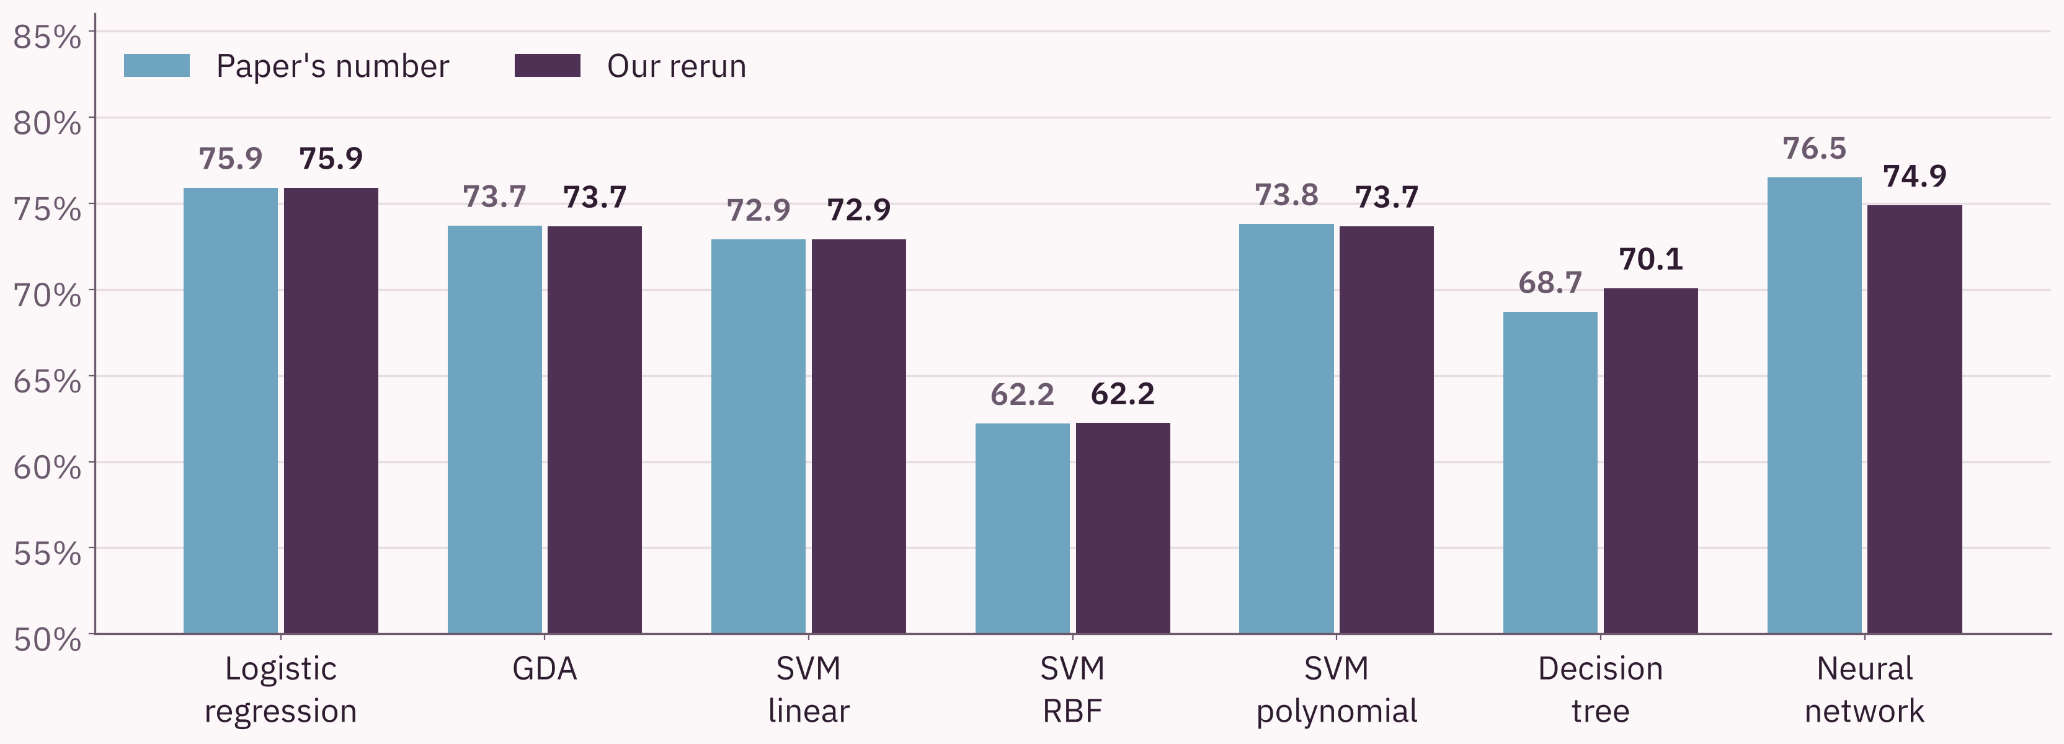
We got the paper's numbers back
EXPERIMENT 1: RERUN THE PAPER
Four of seven models match to the decimal. The others are 0.1 to 1.6 points away.
HitPredict revisited
7 / 16
Notes:
First, can we trust that we are working with the same thing as the paper? Yes. Each pair of bars is one method: light blue is the paper's number, dark purple is our rerun. For logistic regression we got exactly 75.9 percent, and even the detailed count of right and wrong answers is identical. Four of the seven methods match to the decimal. Two of them only matched after we found that a software library had quietly changed one default setting since 2018. The decision tree and the neural network are within 1.6 points, which is normal because they involve some randomness.

Slide 8
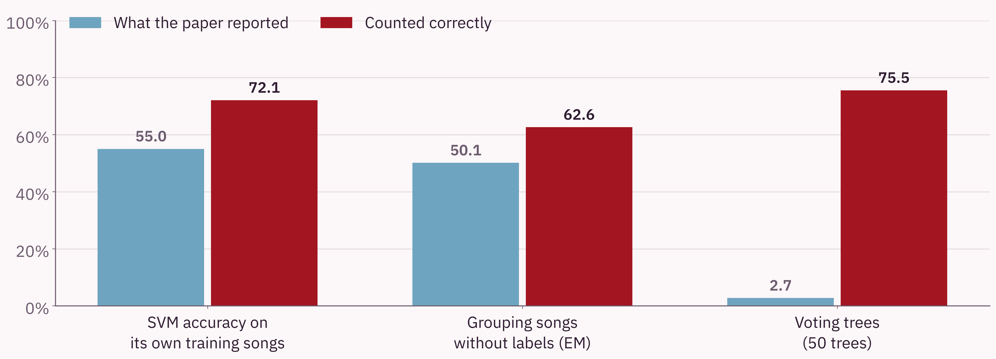
Three counting mistakes in the paper's code
EXPERIMENT 2: CHECK THE SCORING
The paper concluded that SVMs overfit and that grouping fails. Counted correctly, neither holds.
HitPredict revisited
8 / 16
Notes:
While rebuilding the paper we found three mistakes in how its code counts correct answers. Blue is what the paper reported, red is the same thing counted correctly. On the left, the paper said one method scored only 55 percent on the very songs it learned from, and concluded it was overfitting. The real figure is 72.1 percent, so there is no overfitting. In the middle, grouping songs without labels looked like a coin flip at 50 percent; correctly counted it is 62.6 percent. On the right, a group of 50 voting trees looked like it got 2.7 percent right. The code only counted a song as correct when every single tree agreed. Counted normally, it gets 75.5 percent. So some of the paper's conclusions come from these counting slips, not from the methods.

Slide 9
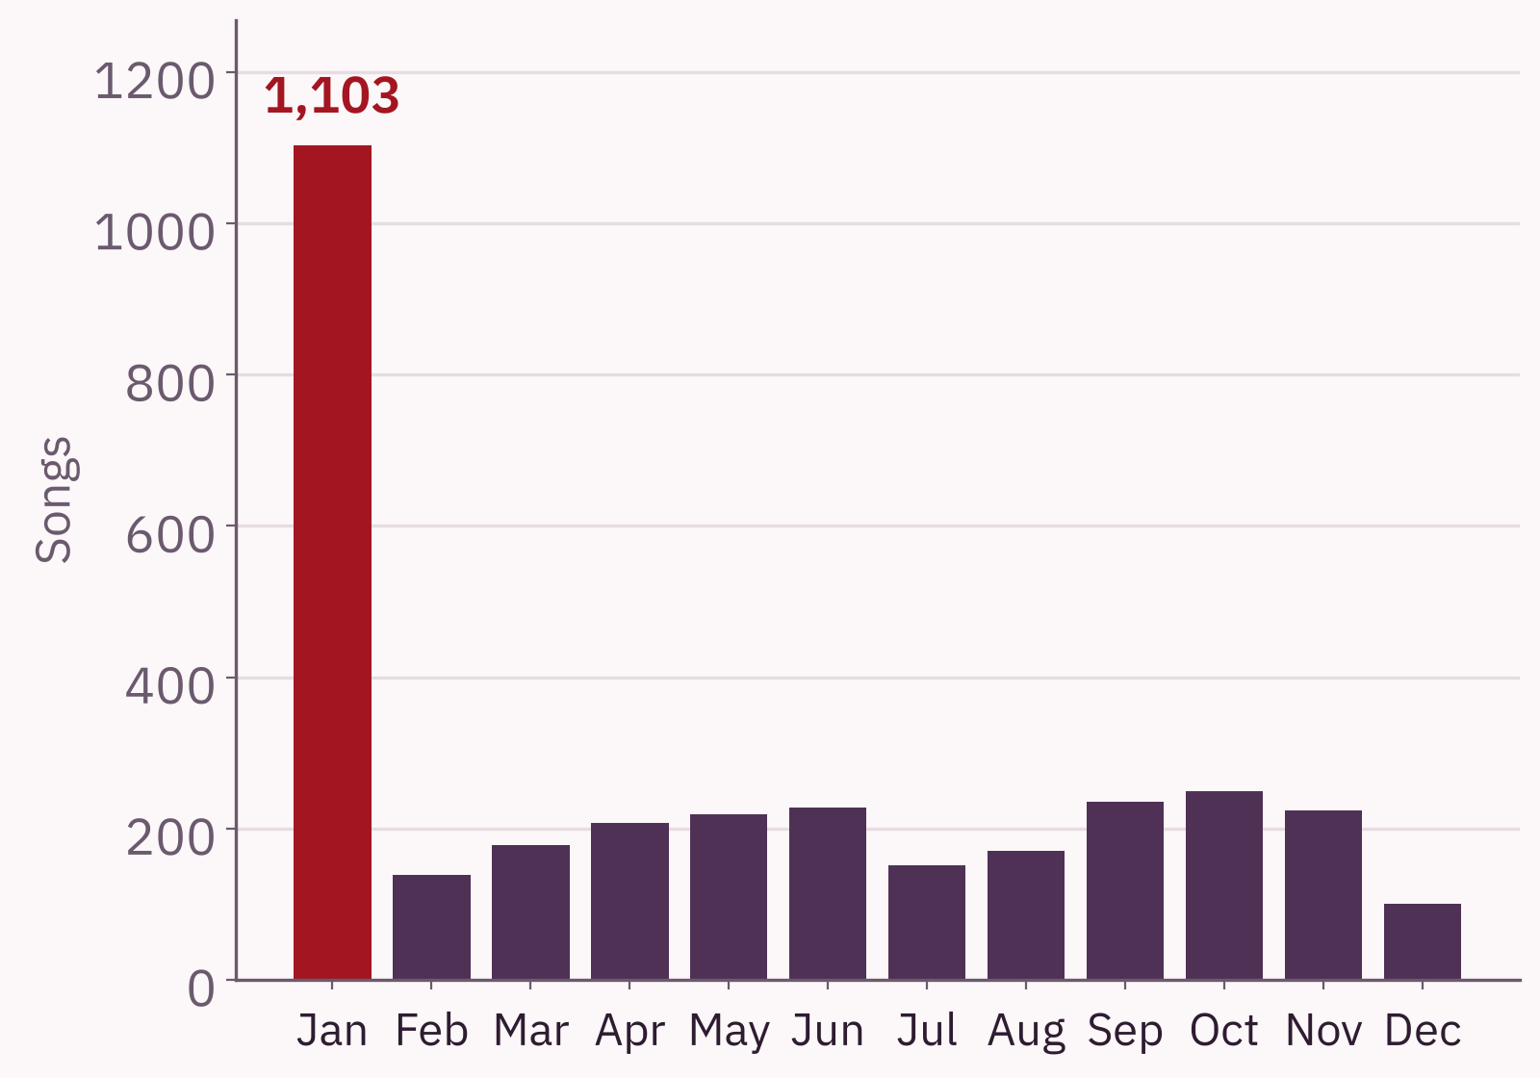
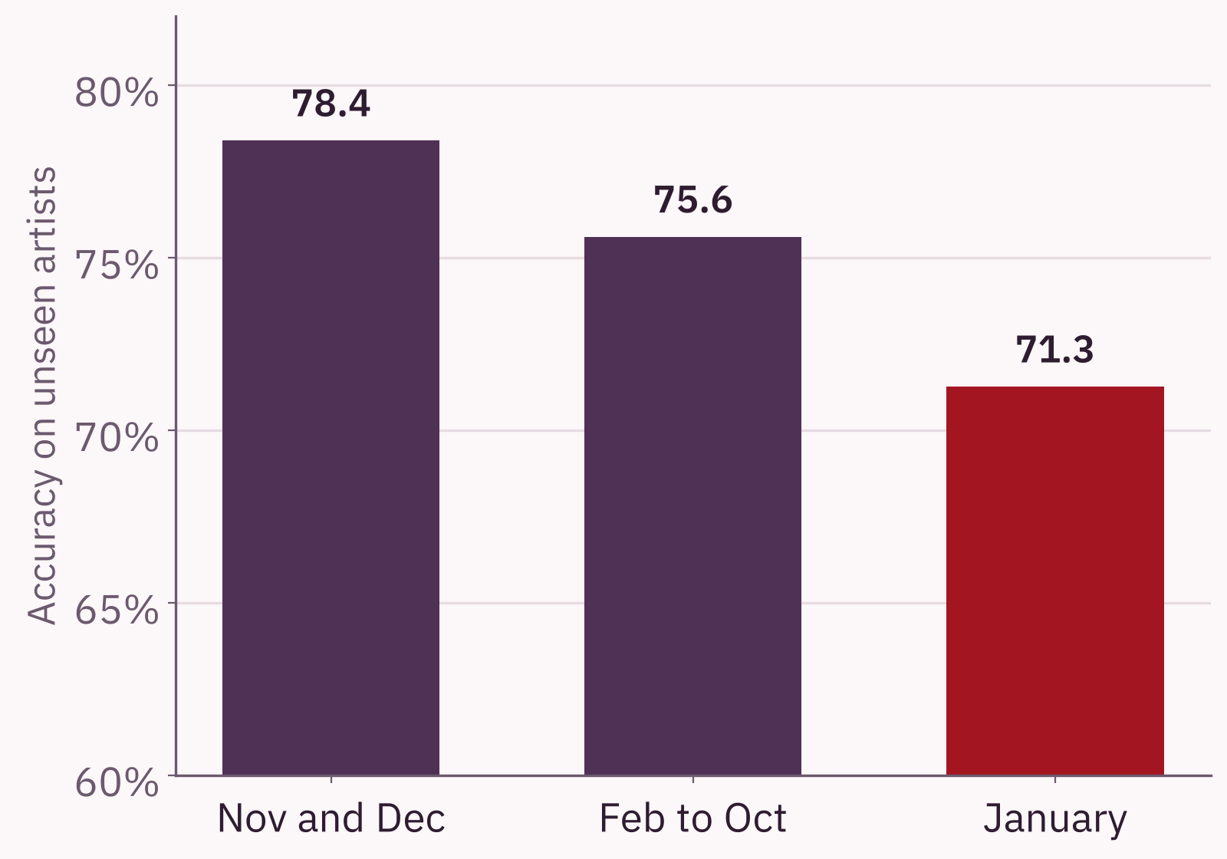
Are holiday hits different? Mostly not
EXPERIMENT 3: HOLIDAY HITS
34% of dated songs say "January"
Accuracy on unseen artists
HitPredict revisited
9 / 16
Notes:
The paper claimed that holiday hits, released November to January, are different from other hits, because its model did worse on them. We found a simpler reason. Look at the left chart: a third of all songs are dated January. That is because when Spotify only knows the year of a release, it stores it as the first of January. So the "holiday" group is mostly songs with an unknown month. On the right, when we test fairly, songs really released in November and December are predicted better than average, 78.4 percent. The weak spot is January at 71.3 percent, which is mostly the group of unknown dates. So the holiday effect is mostly a data glitch.

Slide 10
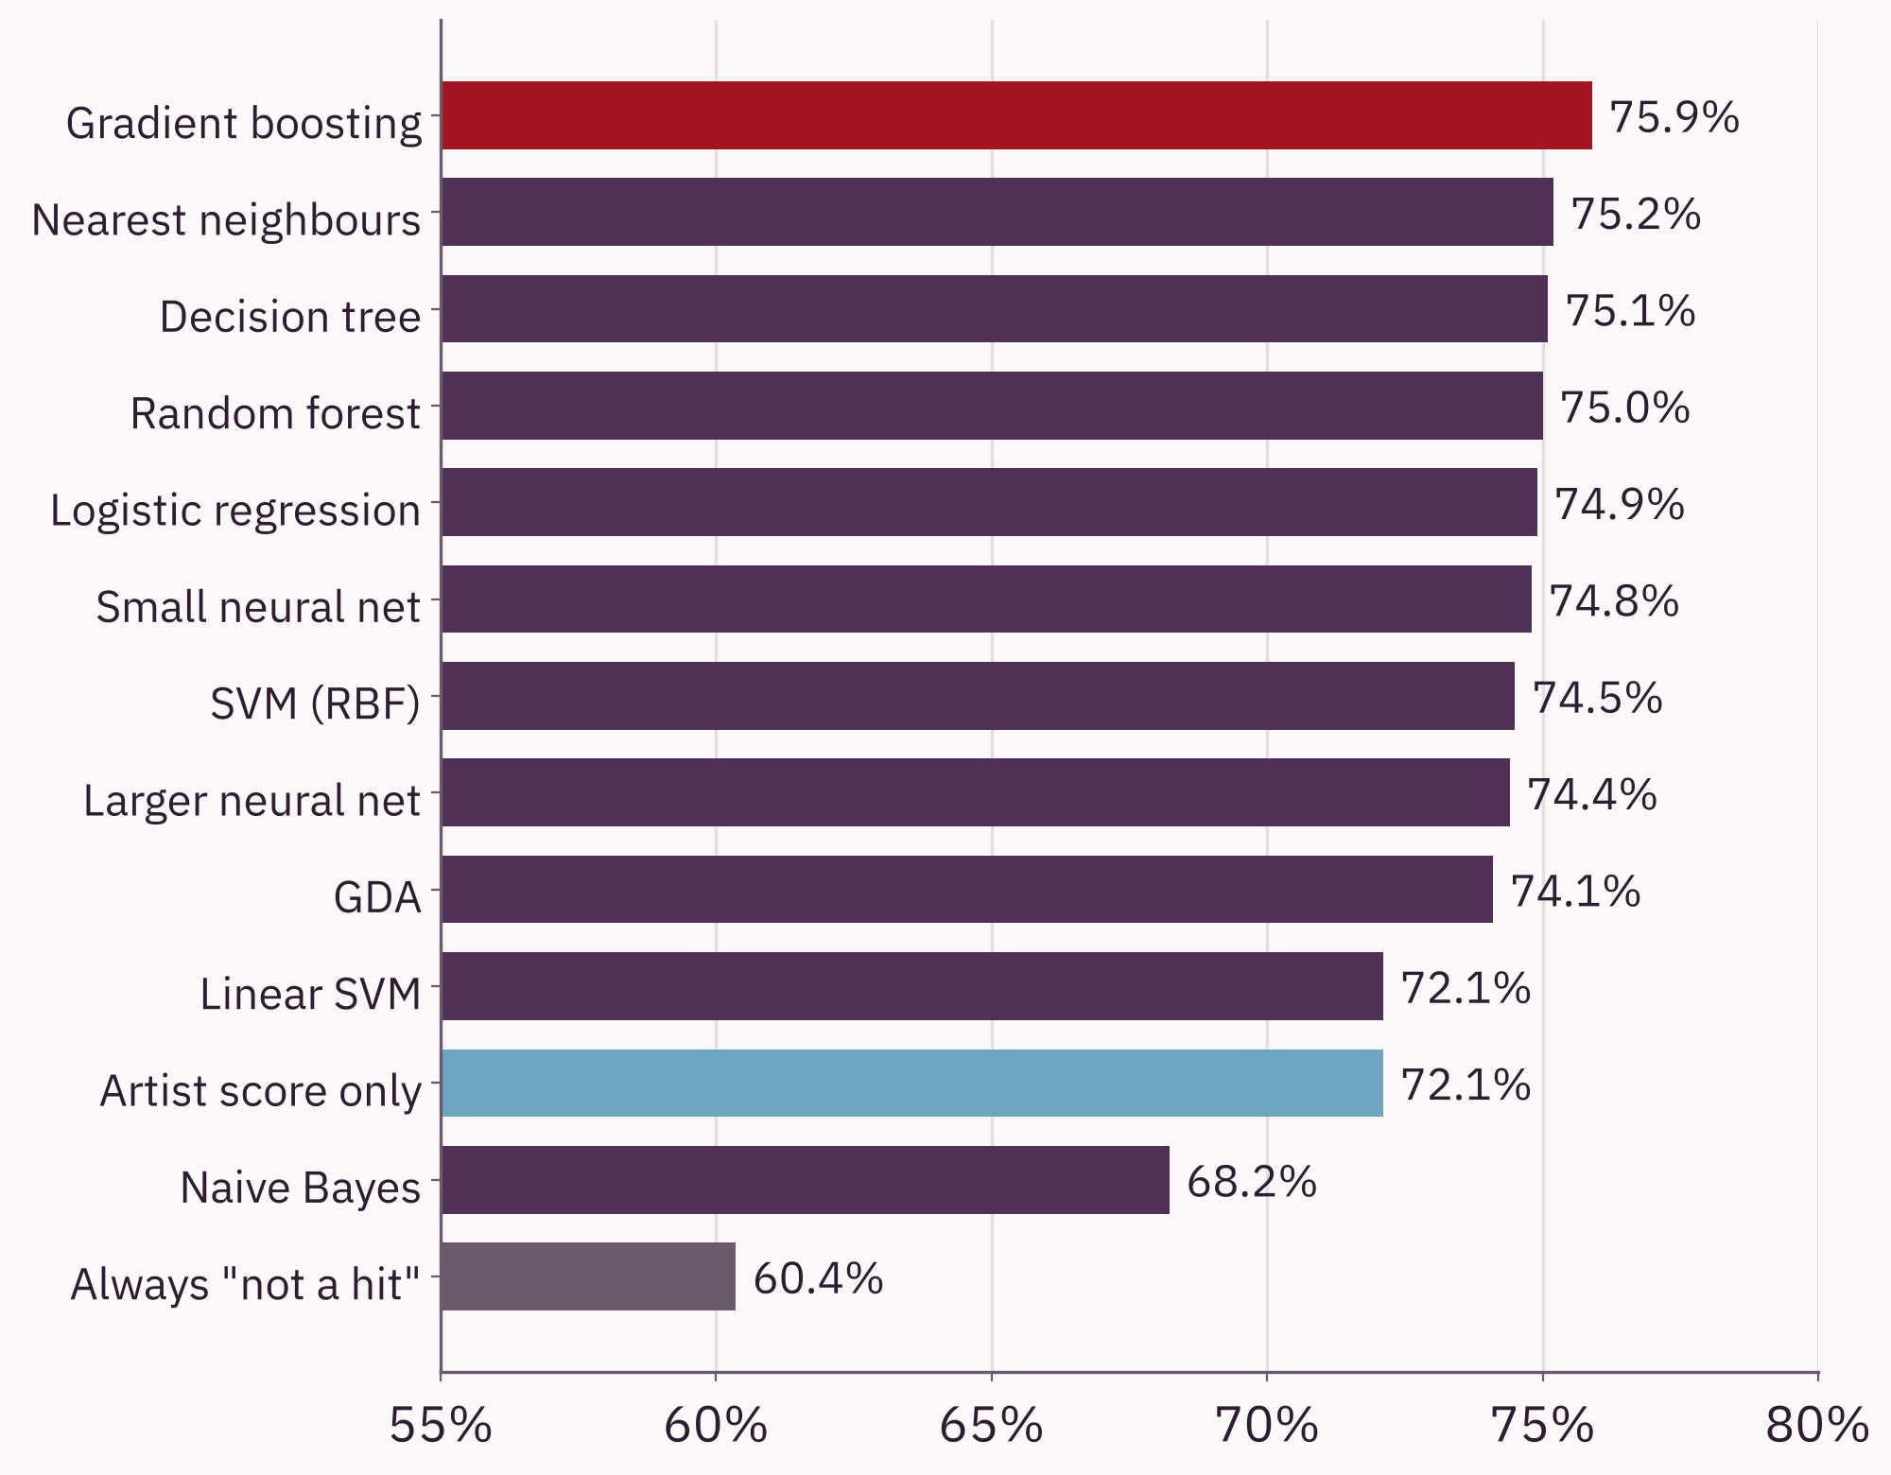
Thirteen models, one narrow race
EXPERIMENT 4: COMPARE MODELS
75.9%
Best: gradient boosting, many small decision trees added together
72.1%
Just asking "has the artist had a hit before?"
9
models finish within 2 points of each other
HitPredict revisited
10 / 16
Notes:
Next we compared thirteen methods, all tuned and tested the same fair way on artists they had never seen. The bottom bar is the laziest possible guess, always say "not a hit", which is right 60 percent of the time. The light blue bar is a one-line rule: say "hit" whenever the artist has had a hit before. That alone gets 72.1 percent. The best method, gradient boosting, reaches 75.9 percent. And nine methods finish within two points of each other. So the honest message is that the sound of a song adds only a few points on top of the artist's track record, and the choice of method matters less than you might expect. We picked the best model using practice rounds, not the test, and it also happened to be top on the test.

Slide 11
Where the model still goes wrong
HONEST LOOK
Model says "hit"
Model says "no"
263
135
248 of 1,004 test songs are wrong, about 1 in 4
119 of the 135 missed hits are by new artists
It finds 90% of hits by artists with a past hit, but only 48% by newcomers
For a newcomer, the sound is the only clue it has
Really a hit
found
missed
113
493
Not a hit
false alarms
correctly rejected
HitPredict revisited
11 / 16
Notes:
Here is where our final model still goes wrong, on the 1,004 test songs. Green boxes are right answers, pink boxes are mistakes. It gets 248 songs wrong, about one in four. There are two kinds of mistake. 135 real hits were missed, and 113 songs were called hits but were not. The interesting part is who the missed hits are: 119 of the 135 come from new artists with no previous hit. For artists who already had a hit, the model finds 90 percent of their hits. For newcomers it finds only 48 percent. That makes sense: for a new artist, the sound measurements are the only clue, and they are weak clues. To do better on newcomers we would need other signals, like early playlist or radio data.

Slide 12
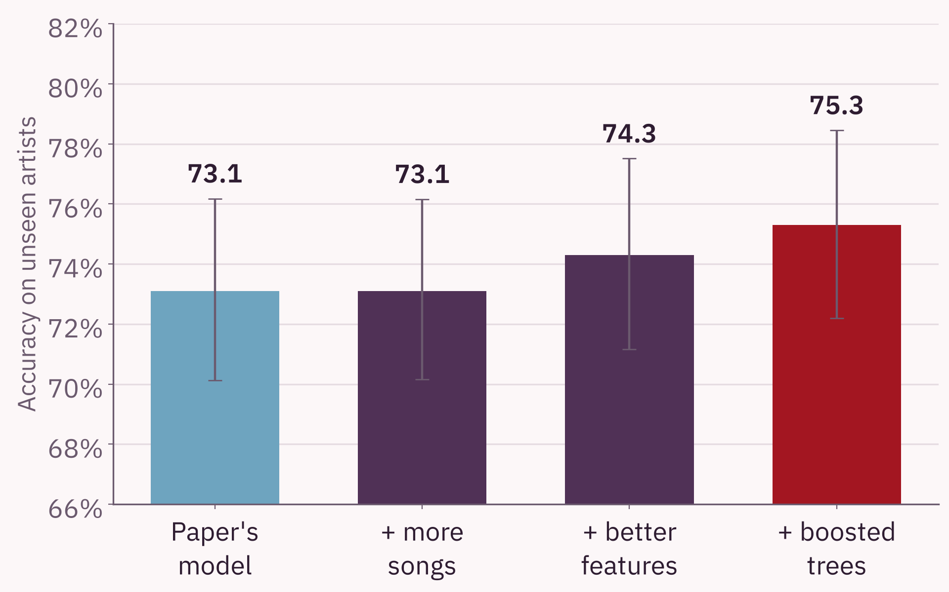
Four changes, added one at a time
BEYOND THE PAPER
More songs
No change: 73.1% stays 73.1%
Better features
+1.2 points
Boosted trees
+1.0 point
Cautious mode
Right 77.5% of the time it says "hit", up from 69.9%
Error bars show the 95% range. The total gain, +2.2 points, is still inside it.
HitPredict revisited
12 / 16
Notes:
These are our own additions, each tested on the same unseen artists. We started from the paper's model at 73.1 percent. First, we trained on 813 extra songs the paper had left out. That changed nothing, which tells us the simple model was limited by its design, not by the amount of data. Second, better features: we rescaled some lopsided measurements and let the model treat new and established artists differently. That added 1.2 points. Third, boosted trees, which can learn step-like rules, for example that very instrumental songs are rarely hits. That added one more point, to 75.3 percent. Fourth, a cautious mode for a record label: it only says "hit" when it is fairly sure, so when it does say hit it is right 77.5 percent of the time instead of 69.9, at the cost of missing more hits. To be honest about it: the total gain is 2.2 points, and the error bars show that is still within the margin of chance on a test of this size.

Slide 13




What you will see
LIVE DEMO
One test song
Cautious call
Pick a real song the model never saw. See its chance of a hit and the true answer.
Says "hit" only when the model is fairly sure, for a label that hates false alarms.
Browse mistakes
Try your own song
List every test song the model gets wrong, with one click.
Move a slider for each sound feature and watch the chance change.
Backup if the app fails: the same predictions from the command line.
HitPredict revisited
13 / 16
Notes:
Now we will switch to the live demo. It is a small web app that loads our saved models. First, we pick a real song from the test set, one the model has never seen, and show its chance of being a hit next to what really happened. Second, the cautious call, which only says "hit" when the model is fairly sure. Third, we can list every test song the model gets wrong, which shows its weak spots honestly. Finally, we can make up a song with sliders and watch the prediction move, for example by switching the artist's previous hit on and off. If the app has any trouble, we have the same predictions ready from the command line. To launch: streamlit run app/streamlit_app.py. Backup: python -m hitpredict.predict --random 5.

Slide 14
Three numbers to remember
RESULTS AT A GLANCE
75.9%
3
75.3%
The paper's best score, rebuilt exactly
Counting mistakes found in the paper's code, and fixed
Correct on 1,004 songs by unseen artists. The paper's model scores 73.1% on the same test.
HitPredict revisited
14 / 16
Notes:
If you remember three numbers, make it these. 75.9 percent: we rebuilt the paper's best result exactly, so our comparison is on solid ground. Three: we found three counting mistakes in the original code, and fixing them overturns some of the paper's conclusions. And 75.3 percent: our final model's score on 1,004 songs by artists it had never seen, compared with 73.1 percent for the paper's model on the very same songs. That gain is real but small, and we are careful not to oversell it.

Slide 15
Limits and next steps
LOOKING AHEAD
What limits us
What we would do next
Only Spotify's sound measures, and no new ones can be fetched
The non-hits are random songs, not near misses
With 1,004 test songs, gaps under about 3 points are noise
Add signals like playlists, radio play and social media
Compare hits with songs that almost charted
Predict how high a song climbs, not just yes or no
HitPredict revisited
15 / 16
Notes:
We want to be clear about the limits. First, we only have Spotify's sound measurements, and because Spotify closed this data feed we cannot add new ones such as song length. Second, the non-hits in this data are random songs, many of them obscure, so telling them apart from hits is easier than telling a hit from a near miss. A real record label would face harder cases. Third, our test has about a thousand songs, so any difference smaller than about three points could be luck. For next steps, we would add signals that capture buzz, like playlist adds or radio play, compare hits against songs that nearly charted, and predict how high a song climbs rather than a plain yes or no.

Slide 16
Thank you
Questions are welcome.
[Patruni Vishnu , PES1UG24AM187] and [Piyush G Nadgir ,PES1UG24AM190]
Code, results and demo: [GitHub repository link]
Notes:
Thank you for listening. To sum up in one line: we rebuilt the HitPredict paper exactly, found and fixed three counting mistakes in its code, tested fairly on artists the model had never seen, and improved the score from 73.1 to 75.3 percent, while being honest that this gain is small. We are happy to take questions. If a question is about the code, everything is in our repository, and one script reruns all the experiments in about ten minutes.

