Slide 1
GRaph Summarization
Module 3
By Afrin Siddiqui

Slide 2
Outline
Introduction to Graph Density
Why do we require Graph densification?
Vocabulary-based Summarization
Slash Burn Algorithm
TimeCrunch Algorithm
Knowledge graph construction
Why do we need Knowledge graphS?
Example of Knowledge graph
Applications of KG

Slide 3
What is Graph Density?
Graph density represents the ratio between the edges present in a graph and the maximum number of edges that the graph can contain.
Conceptually, it provides an idea of how dense a graph is in terms of edge connectivity.
It is phenomena that usually occurs in a range of real graphs.
First, most of these graphs densify over time, with the number of edges growing super-linearly in the number of nodes.
Second, the average distance between nodes often shrinks over time, in contrast to the conventional wisdom that such distance parameters should increase slowly as a function of the number of nodes

Slide 4
Why do we need GRaph densification?
It’s particularly useful when we have a vast network and want to add new edges to the network. Moreover, graph density gives us an idea of how many edges we can still add to the network.
The concept of graph densification comes from Forest Fire Network Model.
This is a growing network model, which resembles of how the forest fire spreads by igniting trees close by.

Slide 5
IMPORTANT CHARACTERiSTICS OF graph densification
Important characteristics/Rules
Power - Rule Law: This is basically a distribution (plot) of log-lop that looks like a straight line with a descending slope.
E.q: Social Networks, Web graphs, Airline Networks (Real Graphs)
Densification Power-law: The network is densifying in time, according to a power-law rule.
Shrinking Diameter: The diameter of the network decreases in time.

Slide 6
Vocabulary-based Summarization
Increasing data of the web graph make it difficult to identify the data structure and get the information from that large graph. To identify the structure and get the information, some method needed to summarize the large graph into smaller subgraphs, so data structure identification can be conducted on the subgraph. This will make structure identification easier.
Vocabulary based Summarization of Graph (VoG) is a method that can be used to summarize the large graph and identify the subgraph structure.
In the Semantic Web, vocabularies are defined and shared among knowledge workers to describe linked data for scientific, industrial or daily life usage.

Slide 7
Informal Vocabulary-based Summarization
VoG, an efficient and effective method to summarize and understand large real-world graphs. In particular, we aim at understanding graphs beyond the so-called “cavemen” networks that only consist of well-defined, tightly-knit clusters, which are known as cliques and near-cliques in graph terms. The first insight is to best describe the structures in a graph using an enriched set of “vocabulary” terms: cliques and near-cliques (which are typically considered by community detection methods), and also stars, chains, and (near) bipartite cores.
Graph Summarization—Informal
Given: a graph
Find: a set of possibly overlapping subgraphs
to most succinctly describe the given graph, i.e., explain as many of its edges in as simple possible terms,
in a scalable way, ideally linear on the number of edges.

Slide 8
SlashBurn Algorithm
Given a real world graph, how should we lay-out its edges? How can we compress it? These questions are closely related, and the typical approach so far is to find clique-like communities, like the cavemen graph', and compress them. We show that the block-diagonal mental image of the cavemen graph' is the wrong paradigm, in full agreement with earlier results that real world graphs have no good cuts. Instead, we propose to envision graphs as a collection of hubs connecting spokes, with super-hubs connecting the hubs, and so on, recursively.
Based on the idea, we propose the SLASHBURN method to recursively split a graph into hubs and spokes connected only by the hubs. We also propose techniques to select the hubs and give an ordering to the spokes, in addition to the basic SLASHBURN.

Slide 9
TimeCrunch Algorithm
TIMECRUNCH, an effective, scalable and parameter-free method for finding coherent, temporal patterns in dynamic graphs.
How can we describe a large, dynamic graph over time? Is it random? If not, what are the most apparent deviations from randomness -- a dense block of actors that persists over time, or perhaps a star with many satellite nodes that appears with some fixed periodicity? In practice, these deviations indicate patterns -- for example, botnet attackers forming a bipartite core with their victims over the duration of an attack, family members bonding in a clique-like fashion over a difficult period of time, or research collaborations forming and fading away over the years. Which patterns exist in real-world dynamic graphs, and how can we find and rank them in terms of importance?

Slide 10
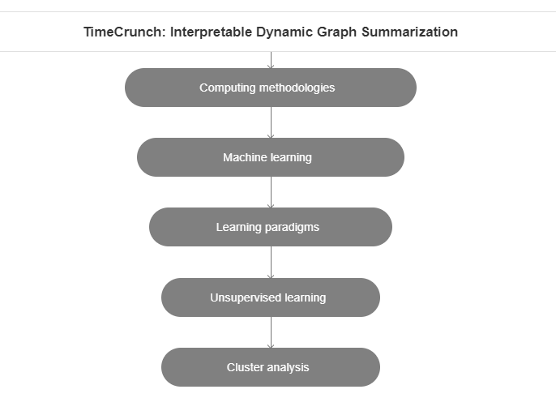
TimeCrunch Algorithm

Slide 11
Knowledge graph construction
In 2012, Google officially proposed the concept of the knowledge graph, which aims to assist intelligent search engines. After the knowledge graph was formally proposed, it was quickly popularized in academia and industry and was widely used in intelligent search, personalized recommendation, intelligence analysis, anti-fraud and other fields.
Essentially, a knowledge graph is a semantic network and knowledge base with a directed graph structure that describes entities (concepts) and their relationships in the physical world in symbolic form.
The knowledge graph is represented in the form of triples (Entity1- Relation-Entity2), where the nodes of the graph represent entities or concepts, and the edges represent the relationships between entities or concepts.

Slide 12
Why do we need Knowledge graphS?
Knowledge graphs are a new method of knowledge representation.
In essence, the semantic web is an early form of the knowledge graph, which is an abstract concept that describes entities and relationships between entities in the objective world and is also a networked knowledge base composed of entities, properties, and relationships.
A knowledge graph is a collection of concepts, entities, and their relationships in the abstract physical world. The knowledge graph has changed the traditional method of information retrieval.
The construction of this knowledge graph can provide services for users of surveying and remote sensing, surveying and remote-sensing experts, and developers of surveying and remote-sensing software.
Users can visualize knowledge through the knowledge graph and discover the relationship between knowledge more easily.

Slide 13
Why do we need Knowledge graphS? (contd...)
Knowledge graphs are a new method of knowledge representation.
Searches conducted through the knowledge graph improve the user’s search efficiency.
Remote-sensing experts gain insights and discover new rules in the field of surveying and remote sensing through the inference function of the knowledge graph.
Software developers can integrate the knowledge graph into the remote-sensing product e-commerce platform, which can not only improve search efficiency, but also accurately recommend products for users. The professional field of surveying and remote sensing is the ladder of social progress.
With the development of social intelligence, it is significant to study professional development technology for intelligent surveying and remote sensing.

Slide 14
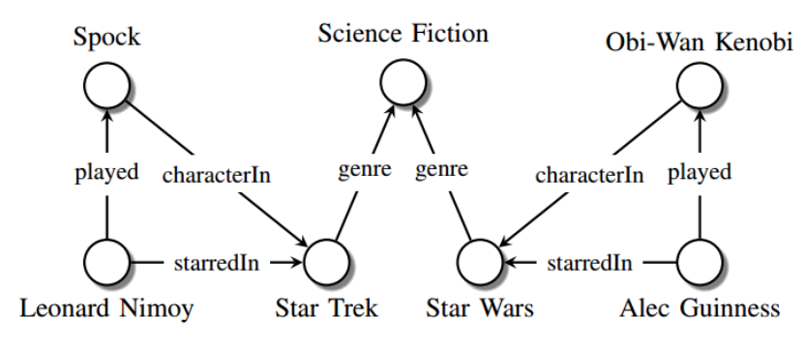
Example of Knowledge graph
The purpose of a KG is to model information in the form of triples or facts. Each triple is composed of a subject, predicate and an object (also referred to as SPO), where the subject and object are called entities and the predicate represents the relationship between them. Then, we can use these triples to build a directed graph, where each node will represent a subject or object entity and directed labeled edges will represent their relationship.

Slide 15
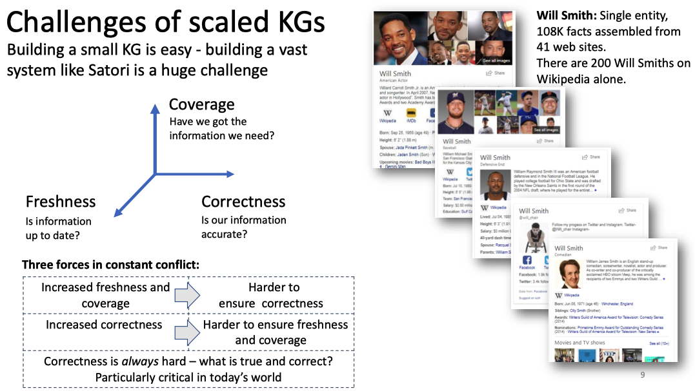
APPLICATIONS
Common NLP techniques, Named Entity Recognition (NER), Relation Extraction (RE), End-to-End Relation extraction.
The goal of these techniques is to get the triple data. For example, (Will Smith, profession, Actor) is an entity-attribute-value triple data. (Will Smith, couple, Jada Pinkett Smith) is an entity-relation-entity triple data.

Slide 16
THANK YOU! :)

