Slide 1

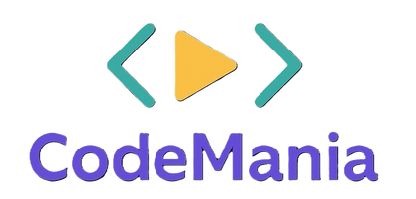


•Problem Statement Title – Web App for Finding Local Community Resources
•Theme –To Create an useful API’s
•Team ID –DHAVMR23
•Team Name –Codemania_2025_VMRS
•Participant Names – D.Vishnu(23D41A6633)
G.Madhursri (23D41A6653)
G Surya Rushmitha (23D41A6659)
J.Rahul kumar(23D41A6664)
Sri Indu College of Engg & Tech - Cyber Club, Department of Cyber Security
Page 01

Slide 2

VMRS
IDEA TITLE
Proposed Solution
App Name: Local Community Resource Finder Purpose:To help users easily locate essential local services (food banks, shelters, clinics) based on their current location and allow them to leave ratings and reviews for others to benefit from.
Automatically detects the user’s location using the browser’s Geolocation API.
Sri Indu College of Engg & Tech - Cyber Club, Department of Cyber Security
Page 02

Slide 3

TECHNICAL APPROACH
VMRS
Frontend Technologies
HTML5, CSS3, JavaScript –
2.Frameworks/Libraries:
React.js / Angular / Vue.js – for building dynamic user interfaces.
Bootstrap / Tailwind CSS – for responsive design.
Backend Technologies
Node.js / Express.js –
Python (Django / Flask) – for scalable and rapid web development.
Java / Spring Boot – for enterprise-grade applications.
Version Control & Collaboration
Git & GitHub / GitLab / Bitbucket – for source control and team collaboration.
Methodology and Process for Implementation
1. Requirement Gathering:Understand business needs and define goals.
2. Planning:Define project scope, timeline, and resources.
3. Design:UI/UX design using tools like Figma / Adobe XD.Wireframes and prototypes for user flows.
Sri Indu College of Engg & Tech - Cyber Club, Department of Cyber Security
Page 03

Slide 4
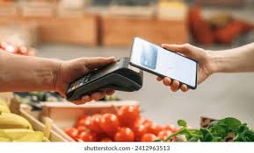
FEASIBILITY AND VIABILITY
VMRS
Feasibility of Web Technology
Technical Feasibility: Google Maps API or alternatives like OpenStreetMap can visualize and display resources.
Operational Feasibility: Organizations can submit or update their listings with proper backend support.
Legal and Ethical Feasibility: Needs terms of service and content moderation for public reviews.
Viability
1. Market Viability: Useful for NGOs, municipalities, and social workers.
2. Scalability: Additional features like filters, categories, or accessibility support can be added later
3. Financial Viability:Initial development costs are moderate if using open-source tools.
Sri Indu College of Engg & Tech - Cyber Club, Department of Cyber Security
Page 04

Slide 5
IMPACT AND BENEFITS
VMRS
Impact of Web Technology
1.Crisis Response Aid
2.Reduced Resource Waste
3.Empowerment through Information
4.Increased Accessibility
Benefits of Web Technology
Mobile Accessibility
Data-Driven Insights
Real-Time Updates
Community Building
Sri Indu College of Engg & Tech - Cyber Club, Department of Cyber Security
Page 05

Slide 6
RESEARCH AND REFERENCES
VMRS
Key Features We’ll Implement: 1. Geolocation – Detect the user’s location. 2. Map Display – Show nearby resources on a map using Leaflet.js and OpenStreetMap. 3. List of Resources – Show details like name, type, distance. 4. Review System – Simple review + rating form saved locally (for demo). 5. Simple UI – Easy-to-use layout with HTML & CSS.
Sri Indu College of Engg & Tech - Cyber Club, Department of Cyber Security
Page 06

Slide 7
VMRS
FUTURE ENHANCEMENTS
User Accounts and Authentication: Allow users to create accounts to save favorite resources, track their reviews, or receive notifications.
Advanced Filtering and Search: Let users filter resources by type (e.g., food, shelter, medical), distance, open hours, accessibility, etc.
Review and Rating System: Enable users to write reviews, add star ratings, and upload photos.
Real-Time Updates and Availability: Show live information like open/closed status or estimated wait times.
Mobile App Version: Build a native Android/iOS version for better offline support and performance.
Sri Indu College of Engg & Tech - Cyber Club, Department of Cyber Security
Page 07

Slide 8
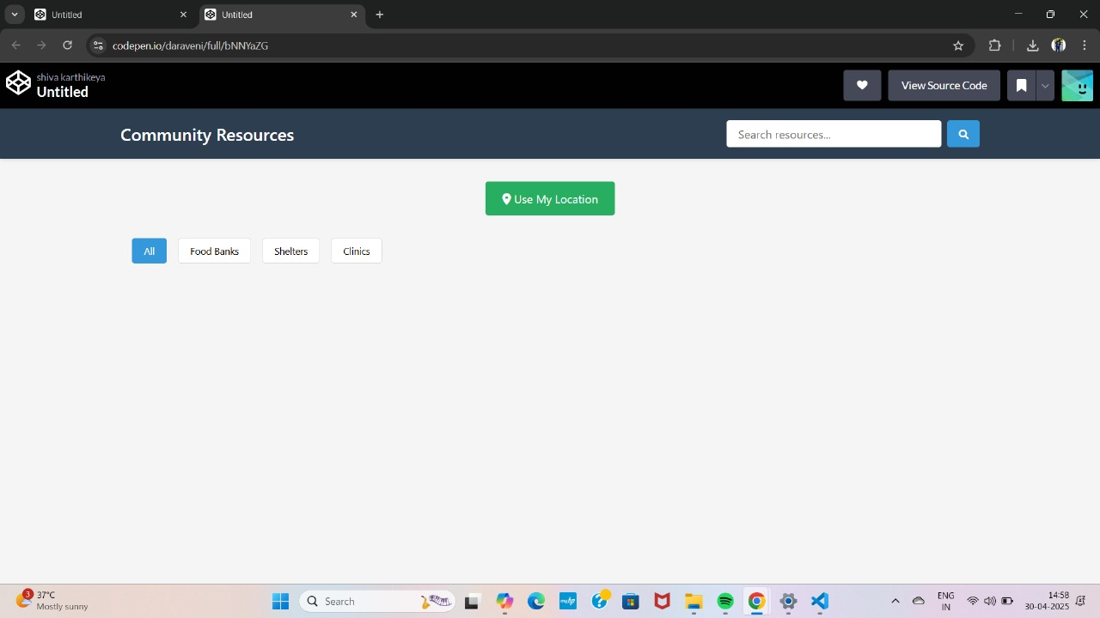
VMRS
DEMO
Sri Indu College of Engg & Tech - Cyber Club, Department of Cyber Security
Page 08

Slide 9
VMRS
CONCLUSION & THANK YOU
Developing a web app that connects people with essential local resources like food banks, shelters, and clinics is both a socially impactful and technologically achievable initiative
As the app evolves, features like user accounts, real-time availability updates, multilingual support, and emergency alerts can further enhance its reach and effectiveness
Its simplicity and accessibility ensure usability for a broad audience, including vulnerable populations.
Sri Indu College of Engg & Tech - Cyber Club, Department of Cyber Security
Page 09

