Slide 1
ACRME
Azure Capacity Reservation Management Engine
Key Architectural Diagrams
Presentation & Infographic Reference
Confidential — Engineering Design • 6 Core Architecture Views

Slide 2
The Six Core Architecture Views
01
System Architecture Overview
End-to-end control plane spanning Prod, NonProd and DR regions
02
Quota Group Architecture
Two quota groups per region and why the NonProd+DR group is Tier-3 quota-neutral
03
Placement Engine Flow
How a placement request is filtered through 7 hard constraints and scored
04
Steady-State Capacity Lifecycle
Auto-increase triggers, debounce guard and approval-gated vs self-managed phases
05
Emergency Capacity Transfer
Three-tier crisis response, only valid when engine_mode == DR_EVENT_ACTIVE
06
VM Disassociation Sequence
Tier-3 execution: safe Path B (VM keeps running) with Path A deallocate fallback

Slide 3
DIAGRAM
01
System Architecture Overview
End-to-end control plane spanning Prod, NonProd and DR regions
3 isolated regions: Prod CRG | NonProd CRG | DR CRG (30–40% of Prod demand)
Engine services: Placement, Reconciliation (5-min), Capacity Transfer
Redis RegionalSnapshot cache (5-min TTL) synced from Cosmos DB control plane
Cosmos DB entities: Assignment, Policy, IncreaseRequest, QuotaGroup, Transfer
ACRME — Azure Capacity Reservation Management Engine

Slide 4
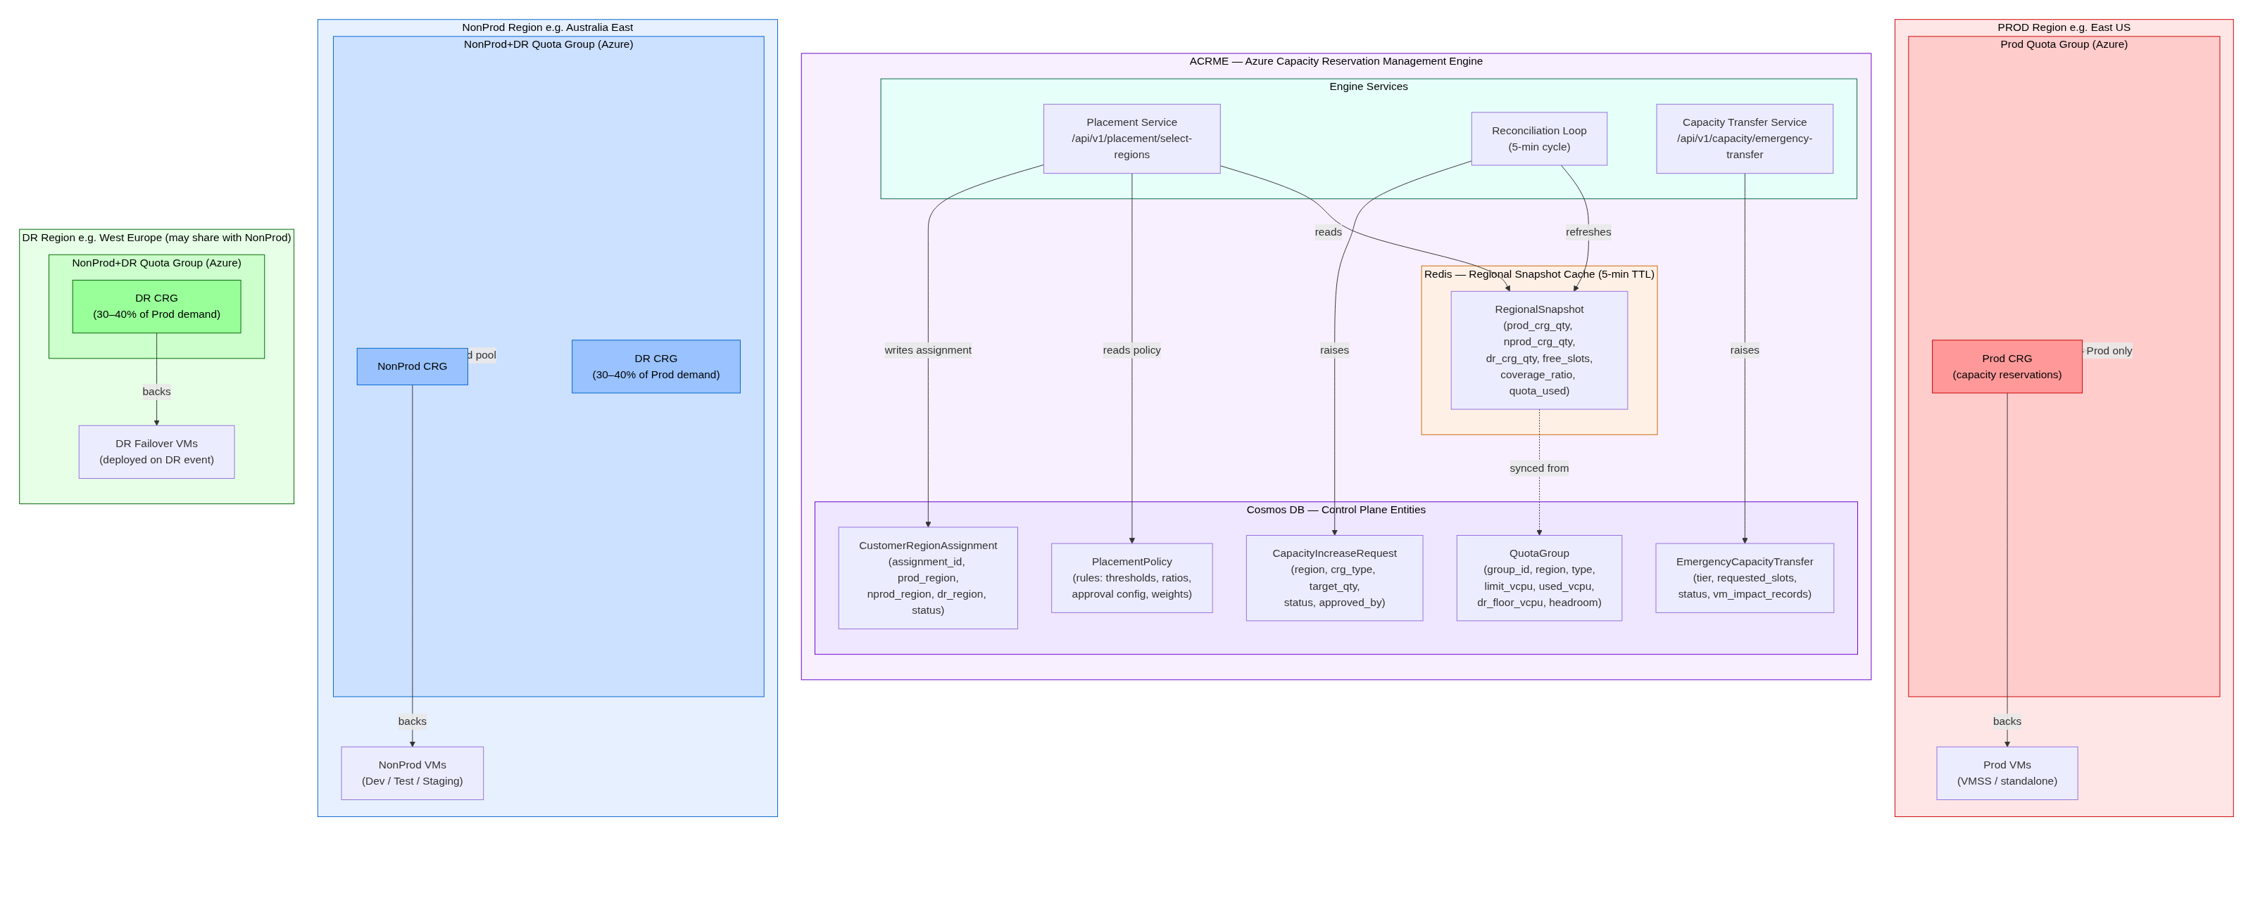
Diagram 01 — System Architecture Overview

Slide 5
DIAGRAM
02
Quota Group Architecture
Two quota groups per region and why the NonProd+DR group is Tier-3 quota-neutral
Group 1 — Prod: HARD isolation, NonProd/DR cannot consume; +20% growth buffer
Group 2 — NonProd+DR: shared vCPU pool (NonProd / DR / Emergency headroom)
DR floor & emergency headroom are engine-enforced sub-limits (no native Azure sub-reservations)
Shared pool → Tier-3 transfers are quota-neutral; RTO gated only by ARM propagation
ACRME — Azure Capacity Reservation Management Engine

Slide 6
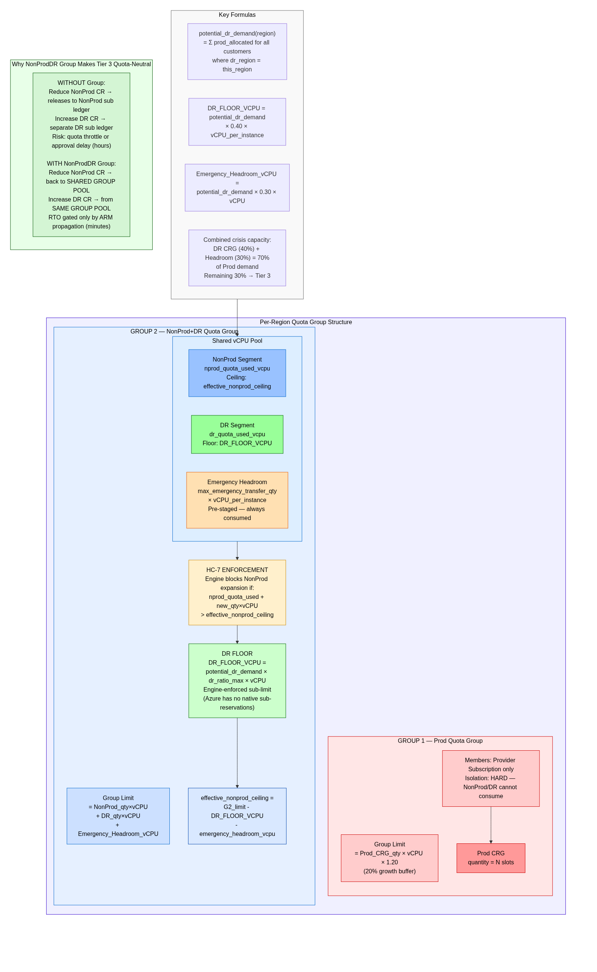
Diagram 02 — Quota Group Architecture

Slide 7
DIAGRAM
03
Placement Engine Flow
How a placement request is filtered through 7 hard constraints and scored
Loads RegionalSnapshot + PlacementPolicy; candidate pool excludes prod_region
HC-1..HC-7 hard filters eliminate regions (no override possible)
Weighted scoring PS = α·CRG + β·Quota + γ·Dist + δ·DR_Buffer + ε·Zone
Selects NonProd & DR regions independently; writes audited CustomerRegionAssignment
ACRME — Azure Capacity Reservation Management Engine

Slide 8
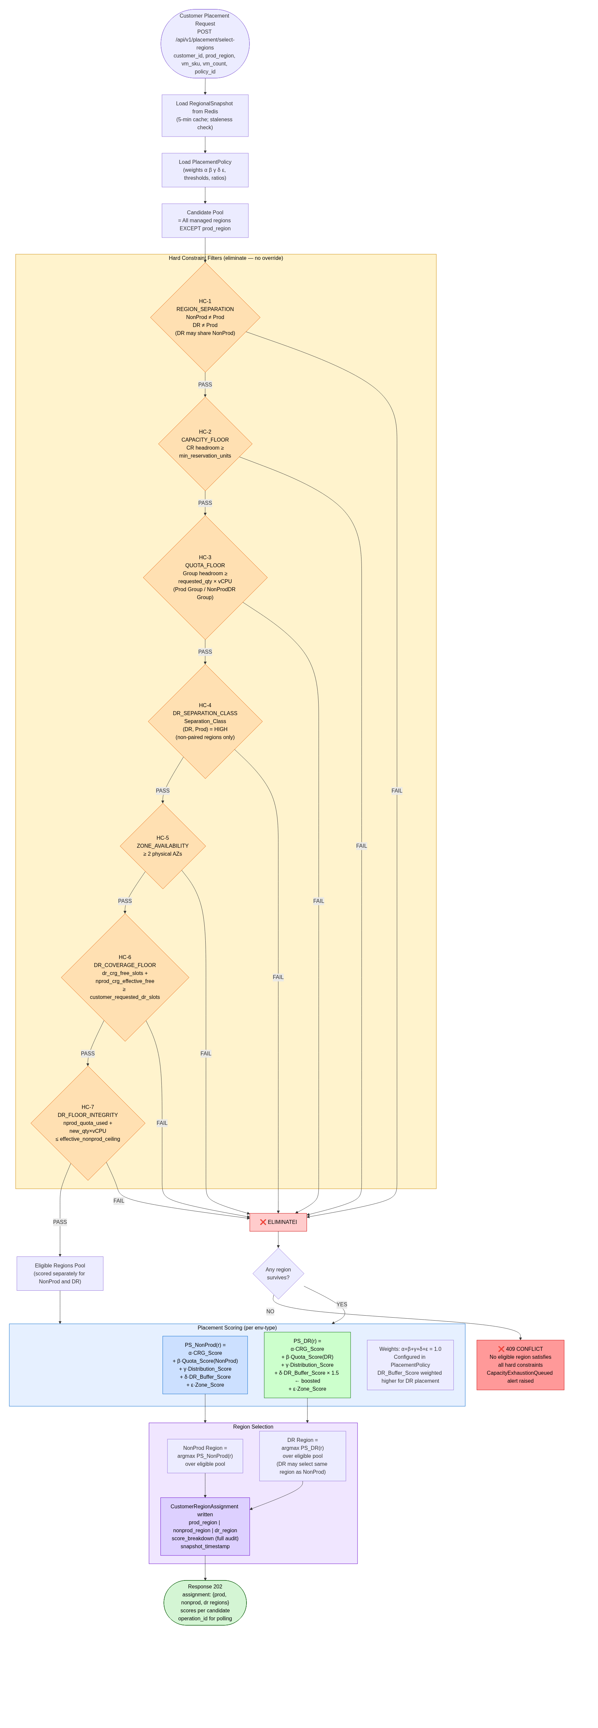
Diagram 03 — Placement Engine Flow

Slide 9
DIAGRAM
04
Steady-State Capacity Lifecycle
Auto-increase triggers, debounce guard and approval-gated vs self-managed phases
Reconciliation loop evaluates DR / Prod / NonProd CRGs against auto-increase thresholds
DR threshold 0.35, Prod/NonProd 0.20; 30-min debounce cooldown per region+CRG type
Phase A (current): approval-gated operator review in ACRME Control Plane
Phase B (future): self-managed auto-approve when quota headroom is sufficient
ACRME — Azure Capacity Reservation Management Engine

Slide 10
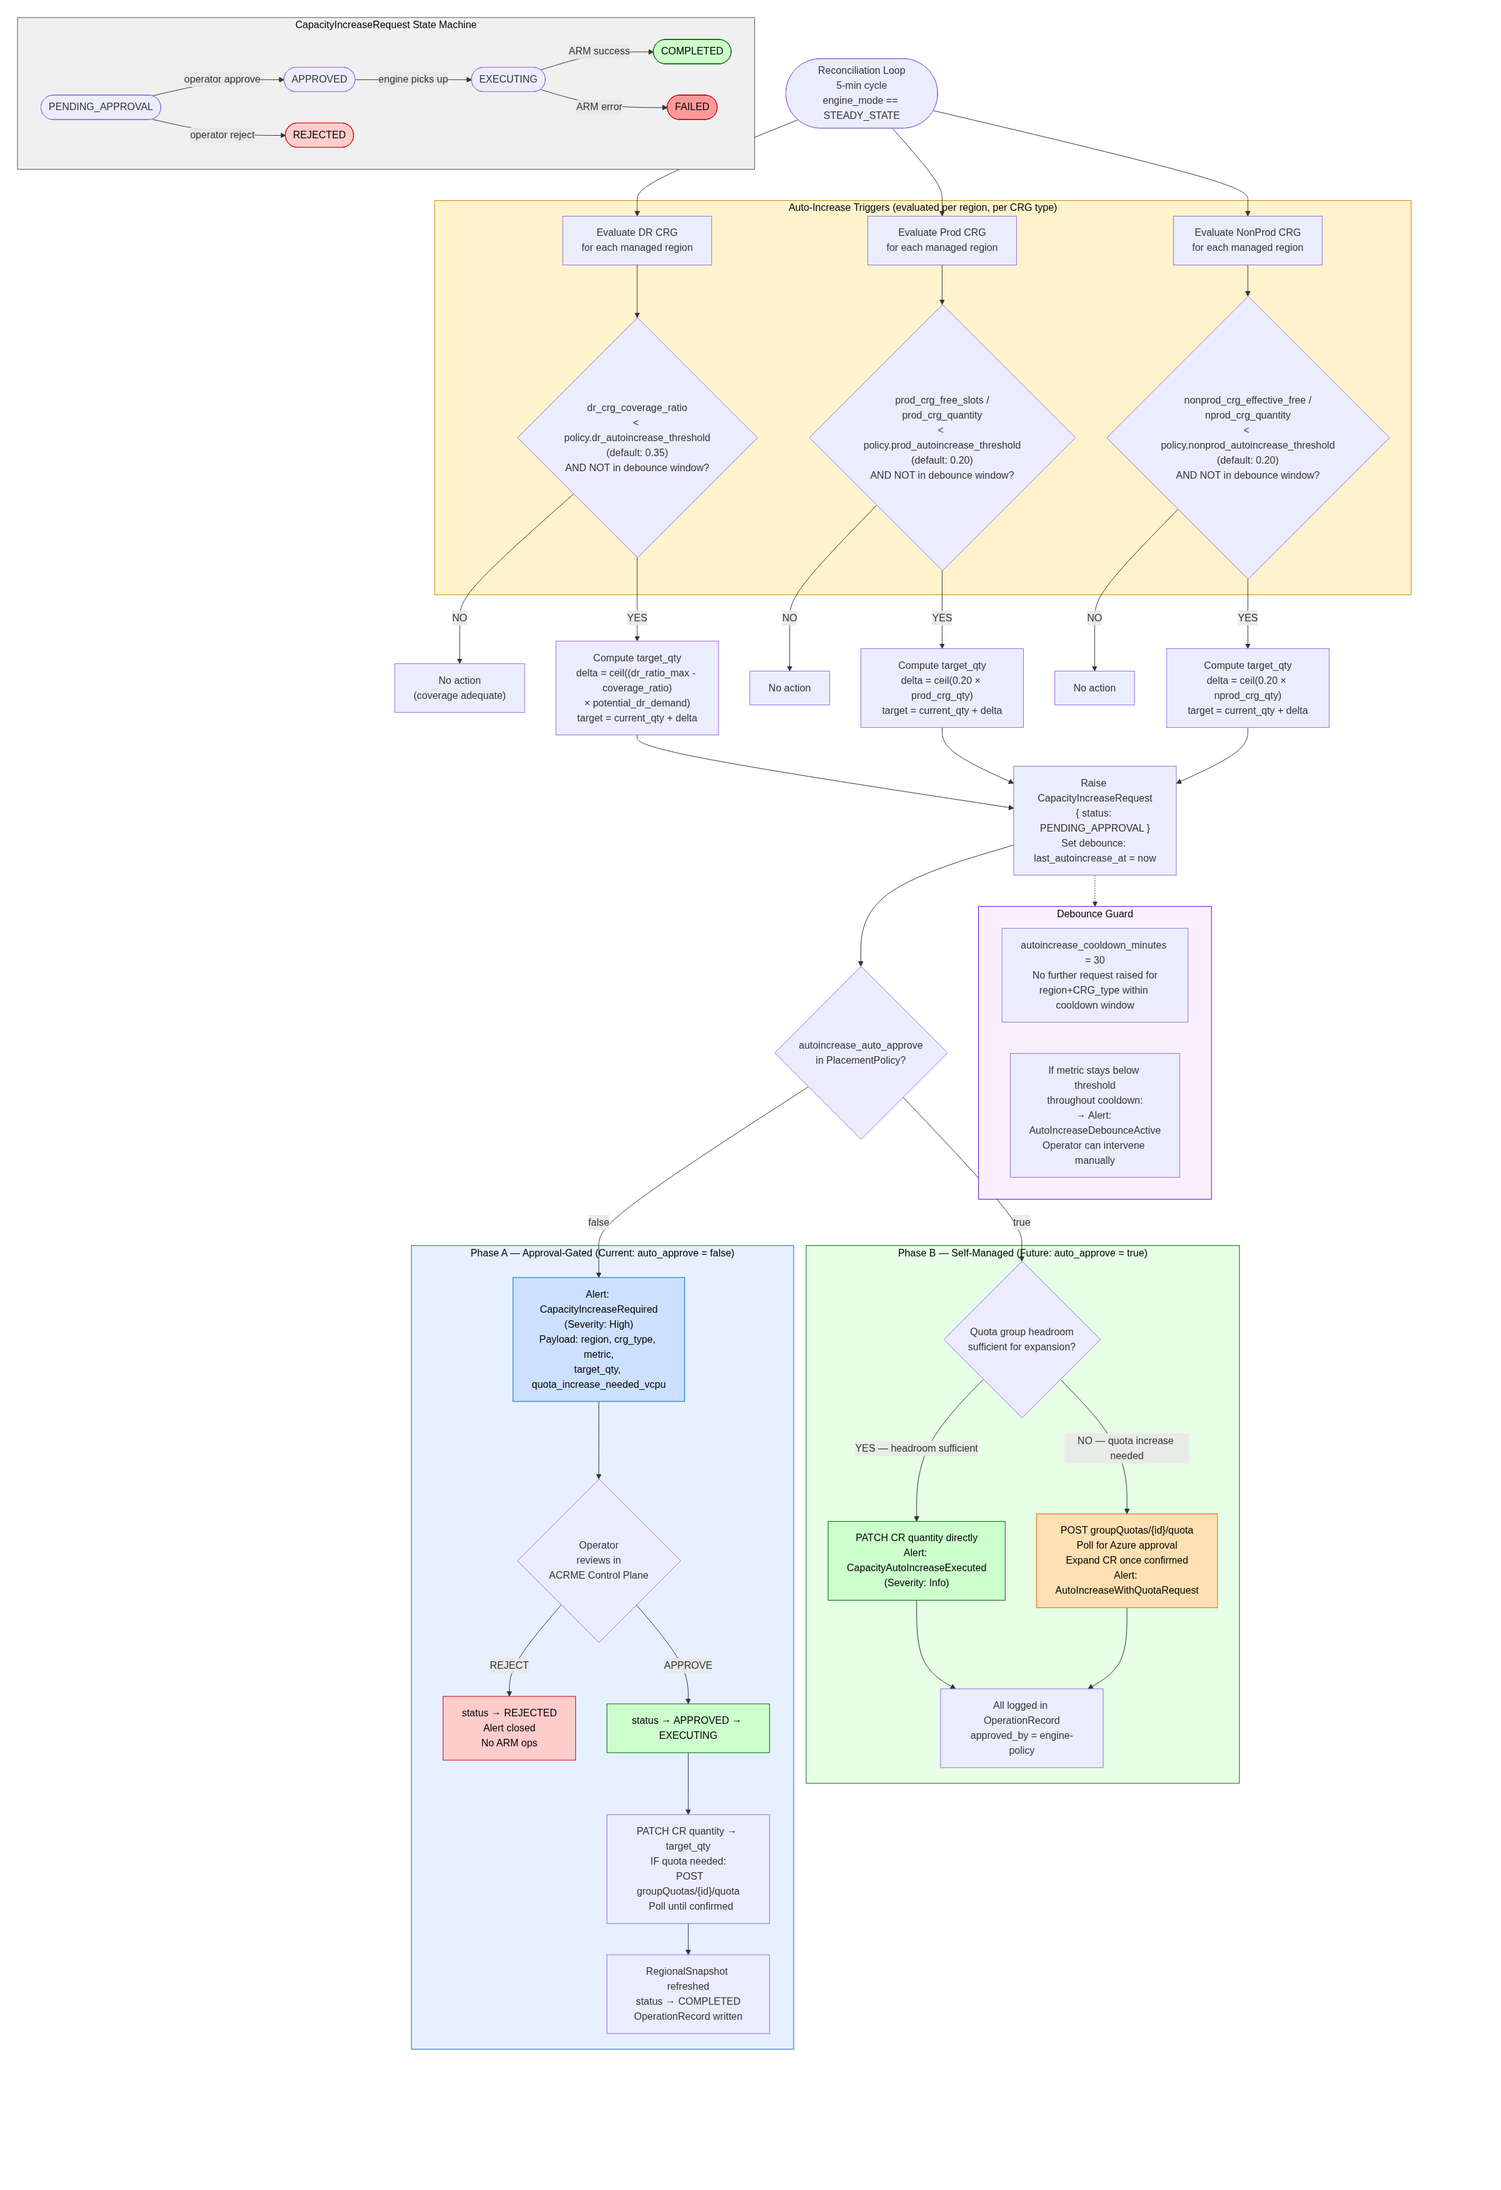
Diagram 04 — Steady-State Capacity Lifecycle

Slide 11
DIAGRAM
05
Emergency Capacity Transfer
Three-tier crisis response, only valid when engine_mode == DR_EVENT_ACTIVE
Tier 1 DirectExpansion: fully automated from pre-staged headroom (RTO = ARM minutes)
Tier 2 QuotaNeutralTransfer: policy-gated, reduce NonProd → expand DR, no downtime
Tier 3 DestructiveTransfer: operator dual-approval; VM disassociation (see Diagram 6)
Sizing: DR 40% + headroom 30% = 70% of Prod demand; remaining 30% → Tier 3
ACRME — Azure Capacity Reservation Management Engine

Slide 12
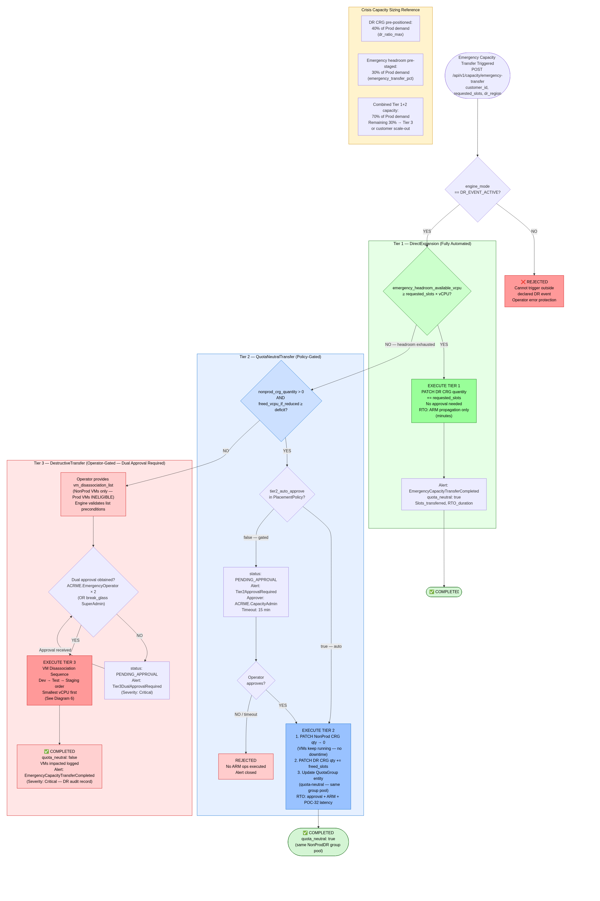
Diagram 05 — Emergency Capacity Transfer

Slide 13
DIAGRAM
06
VM Disassociation Sequence
Tier-3 execution: safe Path B (VM keeps running) with Path A deallocate fallback
Precondition validation: NonProd-only VMs, CRG association & coverage confirmed
Order: Dev → Test → Staging; smallest vCPU first
Path B (default): reduce provider CR → clear VM CRG ref → VM continues running
Path A fallback: deallocate VM (restart required); every step logged as VM_ImpactRecord
ACRME — Azure Capacity Reservation Management Engine

Slide 14
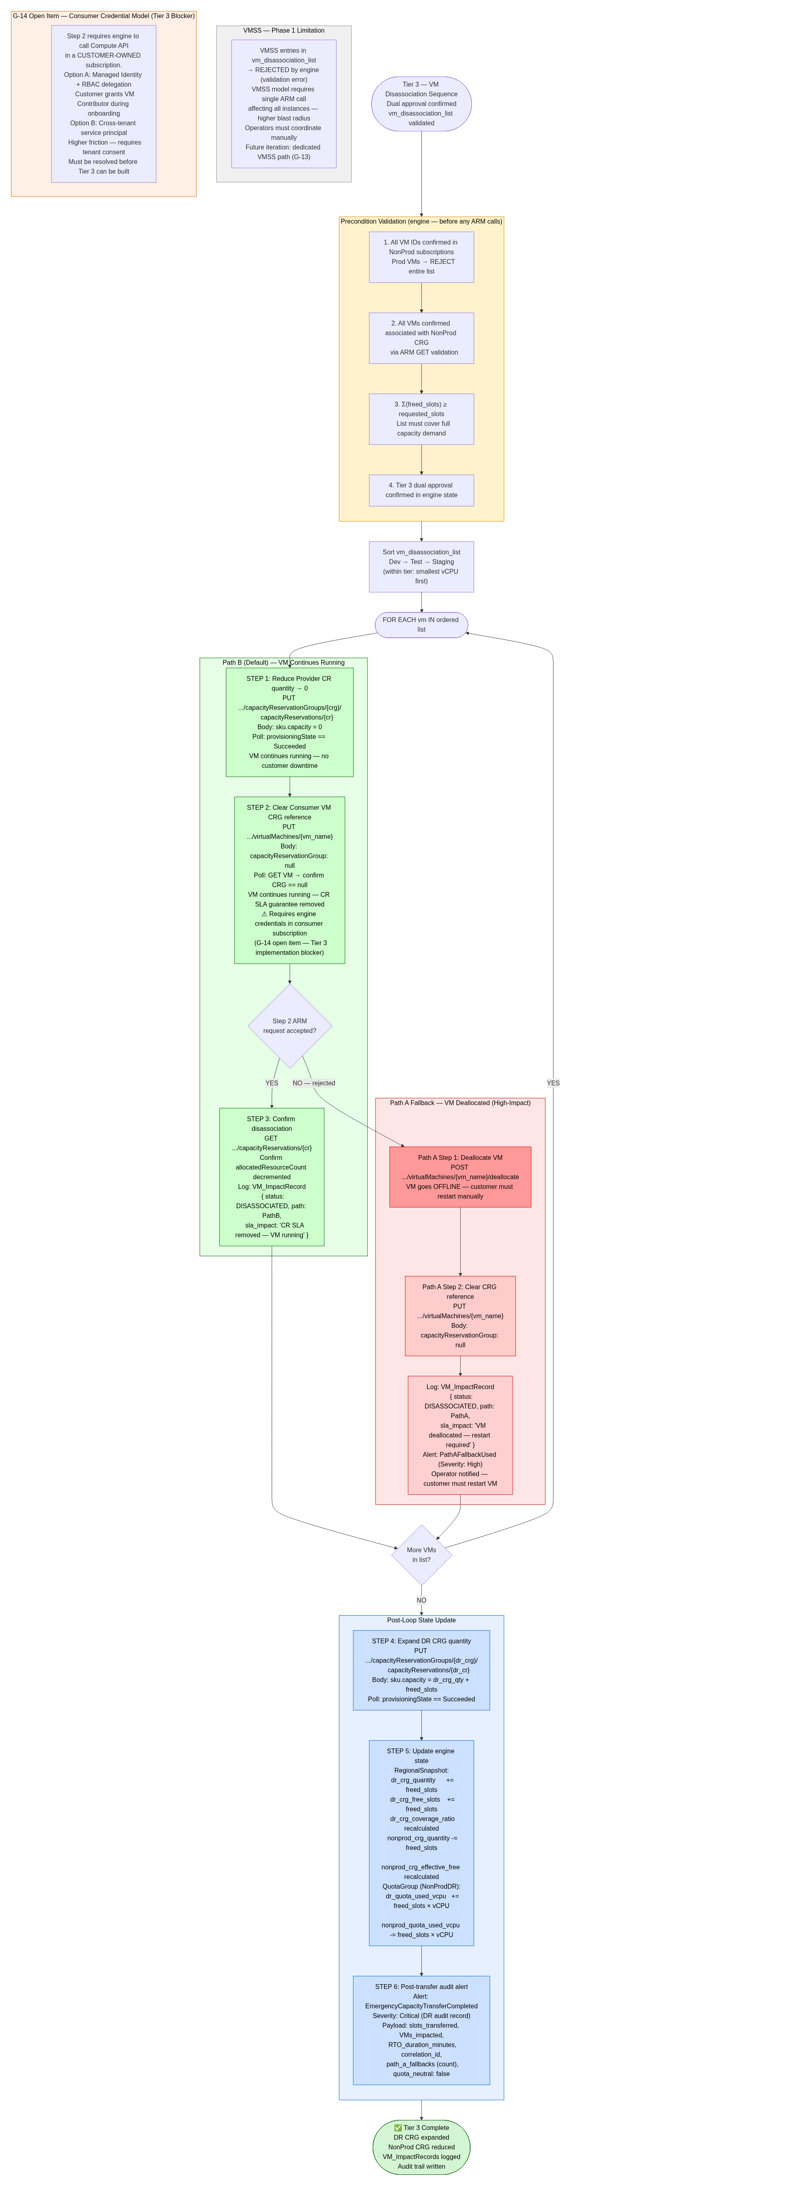
Diagram 06 — VM Disassociation Sequence

Slide 15
Architecture at a Glance
• Hard region isolation: Prod ≠ NonProd ≠ DR, enforced across placement & quota
• Quota-neutral crisis response via shared NonProd+DR pool (Tiers 1–3)
• Deterministic, fully-audited placement through 7 hard constraints + weighted scoring
• Steady-state auto-increase with debounce; DR-safe VM disassociation ordering

