Slide 1
SECTION 01 OF 09 • PROJECT INTRODUCTION
FoodWala — Hyperlocal Food Discovery & Delivery Platform
Built beyond standard requirements for Bengaluru's culinary ecosystem
ONE-LINE PROJECT DEFINITION
FoodWala is an enterprise-grade food discovery and delivery web platform designed for Bengaluru, combining real-time Haversine geolocation, typo-tolerant Levenshtein search, Razorpay sandbox checkout, and OWASP-grade security.
• 📍 Hyperlocal Bengaluru Discovery: Curated 105+ iconic Bengaluru food landmarks (CTR, Vidyarthi Bhavan, MTR, Truffles, Meghana Foods) with live coordinate mapping.
• ⚡ ACID Multi-Table Checkout: Atomic transaction orchestration updating orders, order_item, payment, and cart in a single commit with double-click idempotency locks.
• 🛡️ OWASP-Grade Security: Argon2id cryptographic password hashing, automated 5-attempt account lockout shield, and tamper-proof login audit logging.
Notes:
Speaker Notes (15s): FoodWala is an enterprise-grade food discovery and delivery platform for Bengaluru. Beyond the base project requirements, it integrates real-time Haversine geolocation, typo-tolerant search, Razorpay checkout, and OWASP-grade security.

Slide 2
SECTION 02 OF 09 • TECH STACK
Modern Full-Stack Architecture
Languages, Frameworks, Database, Security & Developer Tooling
💻 Languages
• Java 17 (OOP, Multithreading, Streams)
• JavaScript ES6+ (Async/Await, DOM)
• SQL (MySQL 8.0 DDL/DML, Procedures)
• HTML5 & CSS3 (Semantic, Grid, Flexbox)
⚙️ Backend & Architecture
• Java EE Servlets & JSP (MVC Pattern)
• Node.js & Express (Auth Microservice)
• Apache Tomcat 11.0 App Server
• DAO Abstraction & Connection Pooling
🗄️ Database & Storage
• MySQL 8.0 Relational Database (fudwala)
• 19 Normalized Relational Tables
• ACID Transactions (InnoDB Engine)
• Prepared Statements (Zero SQL Injection)
🎨 Frontend & UI
• Bootstrap 5.3 & Bootstrap Icons
• Leaflet.js (Interactive Geolocation)
• jsPDF (Client-Side Tax Invoices)
• SweetAlert2 & Modern Responsive UI
🔒 Security & Payments
• Argon2id Cryptographic Hashing
• 5-Attempt Account Lockout Protection
• Razorpay Sandbox API (HMAC SHA-256)
• Dual EmailJS Customer/Admin Receipts
🛠️ Tools & DevOps
• Eclipse IDE 2026 & VS Code
• MySQL Workbench & Postman
• Git & GitHub Pages Deployment
• Render / Cloud MySQL Hosting
Notes:
Speaker Notes (25s): Our tech stack leverages Java 17 Servlets and JSP under a clean MVC architecture, paired with MySQL 8.0 containing 19 normalized tables. On the frontend, we use Bootstrap 5.3, Leaflet maps, and jsPDF, backed by Argon2id password hashing and Razorpay sandbox payments.

Slide 3
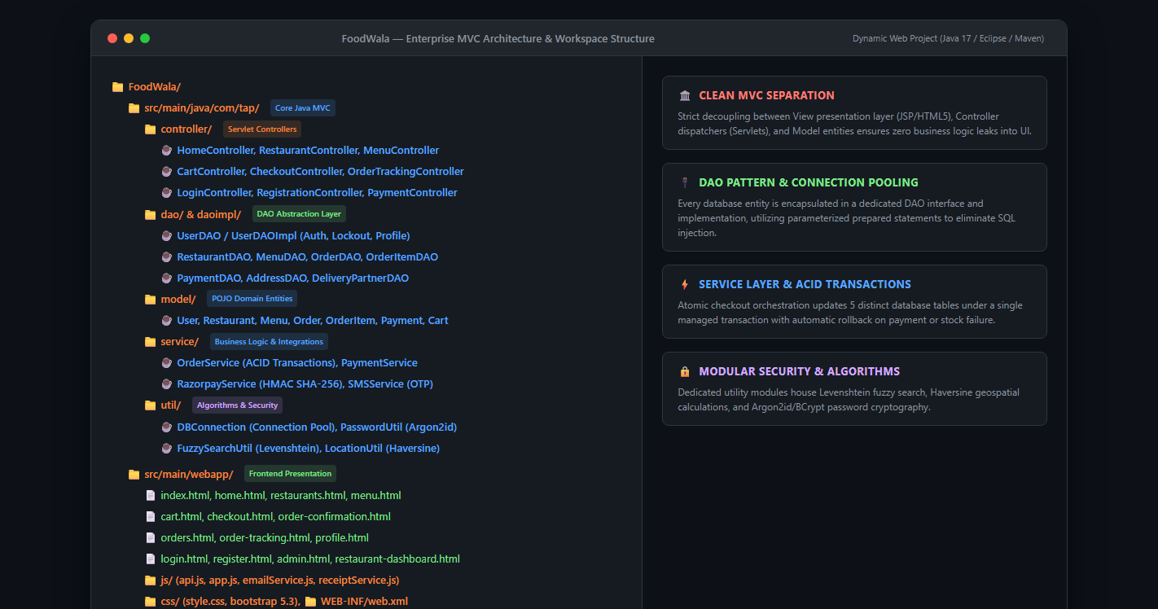
SECTION 03 OF 09 • PROJECT STRUCTURE
Eclipse Dynamic Web App & MVC Package Organisation
Strict separation of Model, View, Controller, DAO, and Service layers
Notes:
Speaker Notes (20s): Here is our project structure organized in Eclipse. Notice the strict MVC separation: controllers in com.tap.controller, data access objects in com.tap.dao and daoimpl, domain models in com.tap.model, and business logic like order placement in com.tap.service.

Slide 4
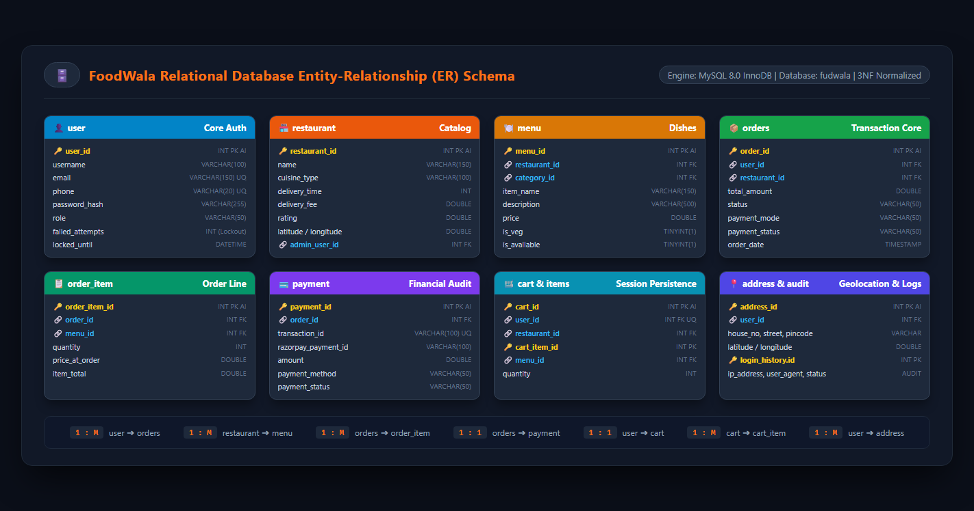
SECTION 04 OF 09 • ER DIAGRAM
Relational Database Schema (fudwala)
3NF normalized schema with foreign key integrity and audit logs
Notes:
Speaker Notes (25s): This is our entity-relationship diagram for the fudwala database. Primary relationships include user to orders, restaurant to menu, orders to order_item, and a one-to-one relationship between orders and payment. All operational data is maintained with strict referential integrity.

Slide 5
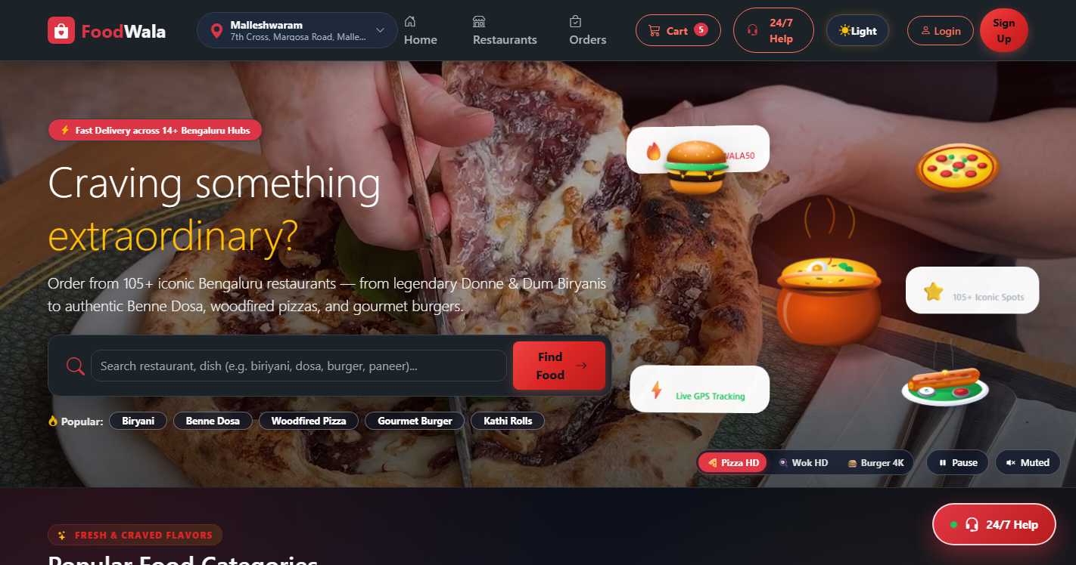
SECTION 05 • PAGE SCREENSHOT 5.1
Home & Food Discovery Page
Hyperlocal Bengaluru curation, 3D animated category cards, trending restaurants, and typo-tolerant search.
Notes:
Speaker Notes (10s): Slide 5.1 shows the Home & Food Discovery Page. As you can see, Hyperlocal Bengaluru curation, 3D animated category cards, trending restaurants, and typo-tolerant search.

Slide 6
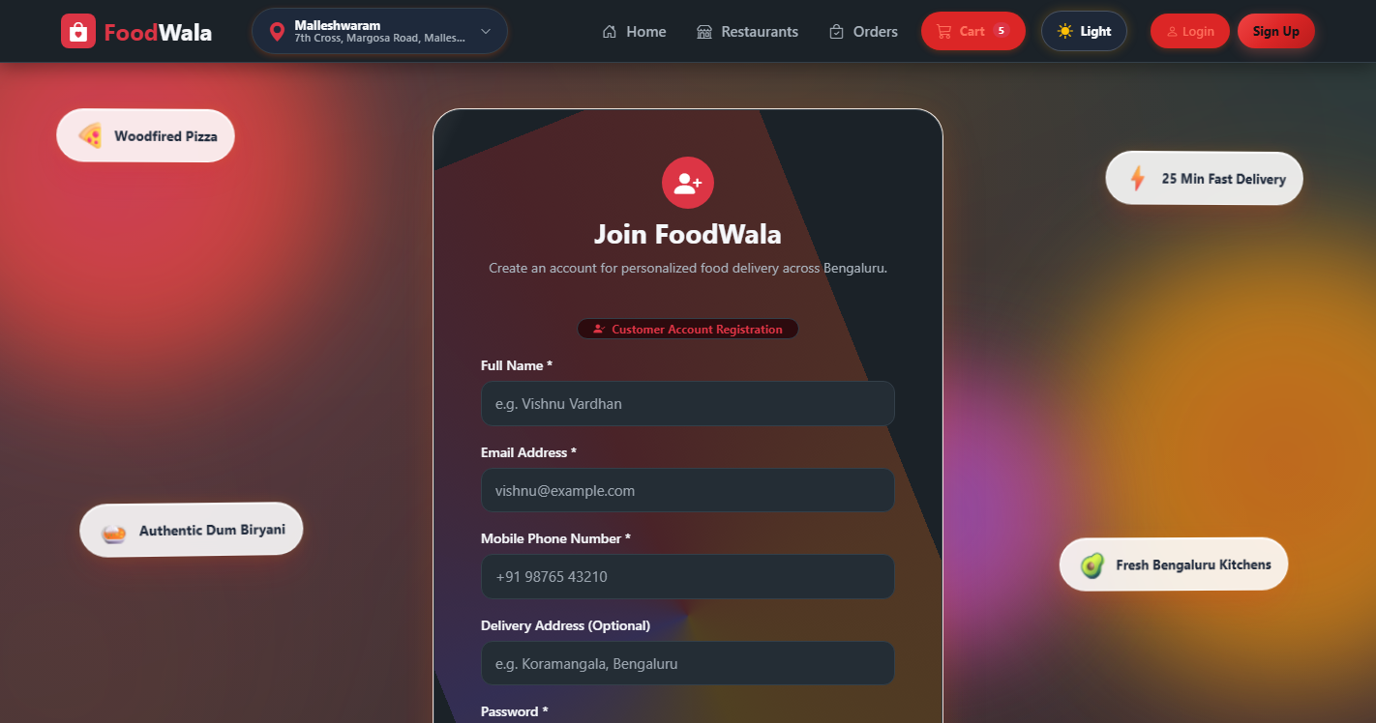
SECTION 05 • PAGE SCREENSHOT 5.2
User Registration Page
Indian 10-digit mobile phone normalization, blur duplicate phone modal, and Argon2id hash storage.
Notes:
Speaker Notes (10s): Slide 5.2 shows the User Registration Page. As you can see, Indian 10-digit mobile phone normalization, blur duplicate phone modal, and Argon2id hash storage.

Slide 7
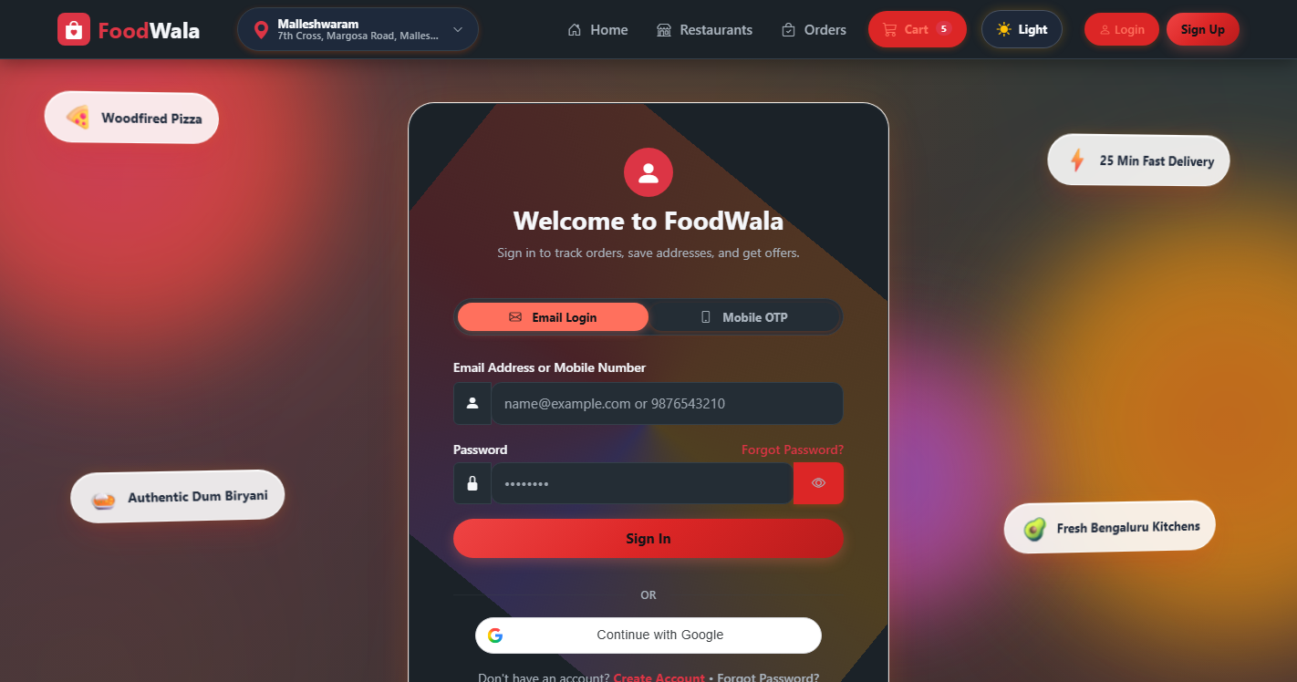
SECTION 05 • PAGE SCREENSHOT 5.3
User Login & Security Shield
Secure sign-in, 5-attempt automated account lockout protection, and self-service password recovery.
Notes:
Speaker Notes (10s): Slide 5.3 shows the User Login & Security Shield. As you can see, Secure sign-in, 5-attempt automated account lockout protection, and self-service password recovery.

Slide 8
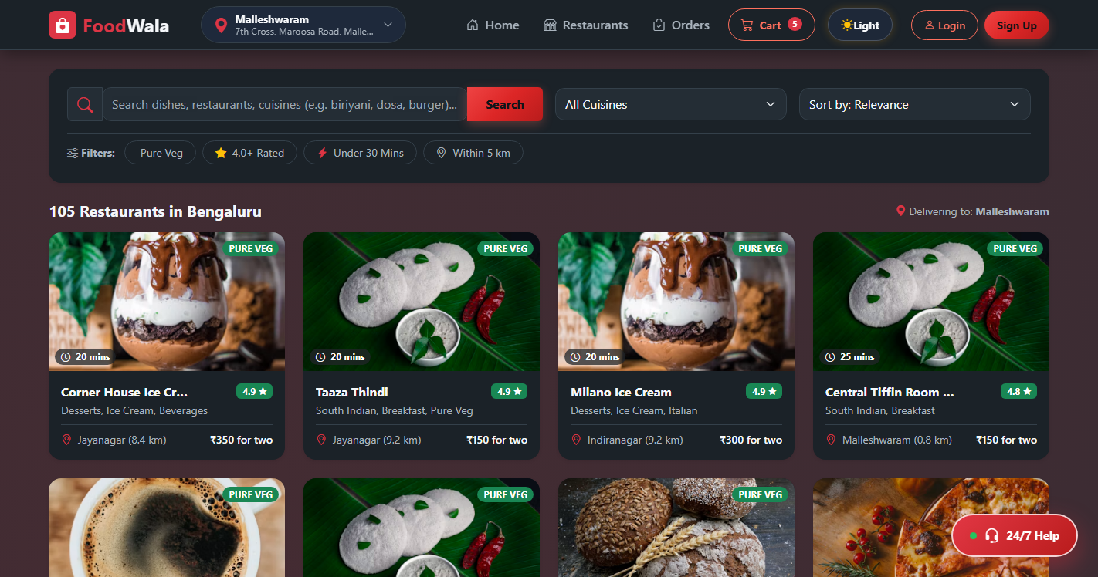
SECTION 05 • PAGE SCREENSHOT 5.4
Restaurant Discovery & Filters
Dynamic cuisine filters (Biryani, Dosa, Continental), rating badges, delivery time indicators, and price sorting.
Notes:
Speaker Notes (10s): Slide 5.4 shows the Restaurant Discovery & Filters. As you can see, Dynamic cuisine filters (Biryani, Dosa, Continental), rating badges, delivery time indicators, and price sorting.

Slide 9
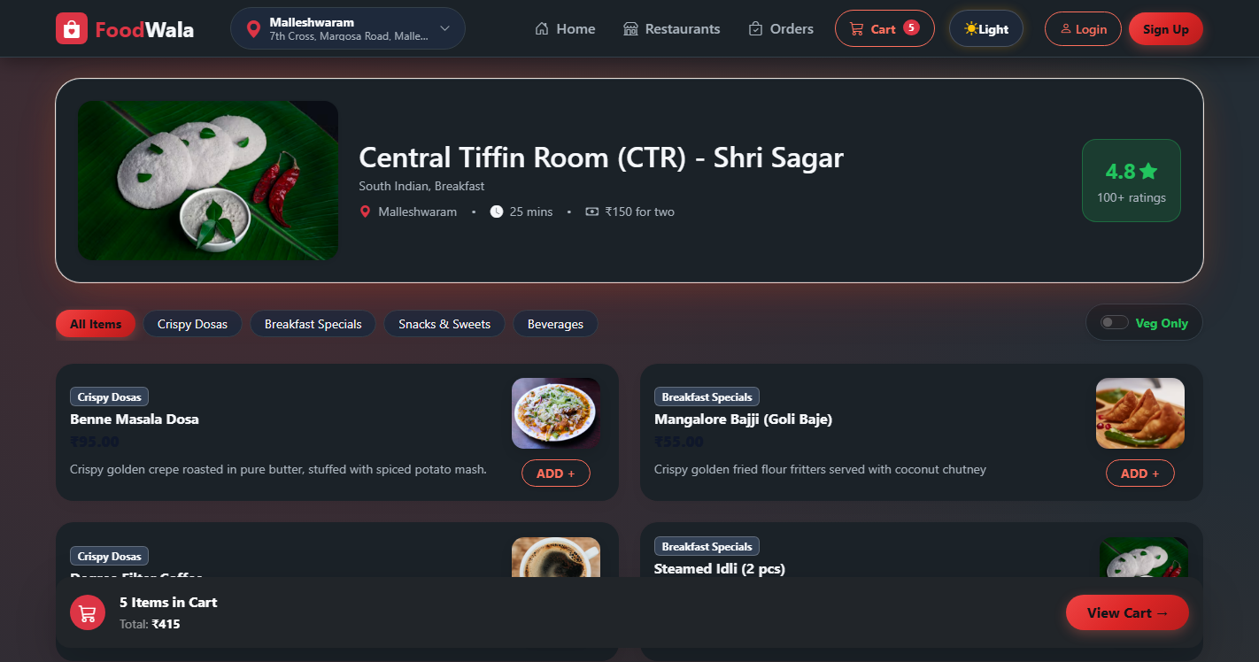
SECTION 05 • PAGE SCREENSHOT 5.5
Restaurant Menu & Customization
Live categorized menu items with veg/non-veg tags, quantity modifiers, and real-time floating cart sync.
Notes:
Speaker Notes (10s): Slide 5.5 shows the Restaurant Menu & Customization. As you can see, Live categorized menu items with veg/non-veg tags, quantity modifiers, and real-time floating cart sync.

Slide 10
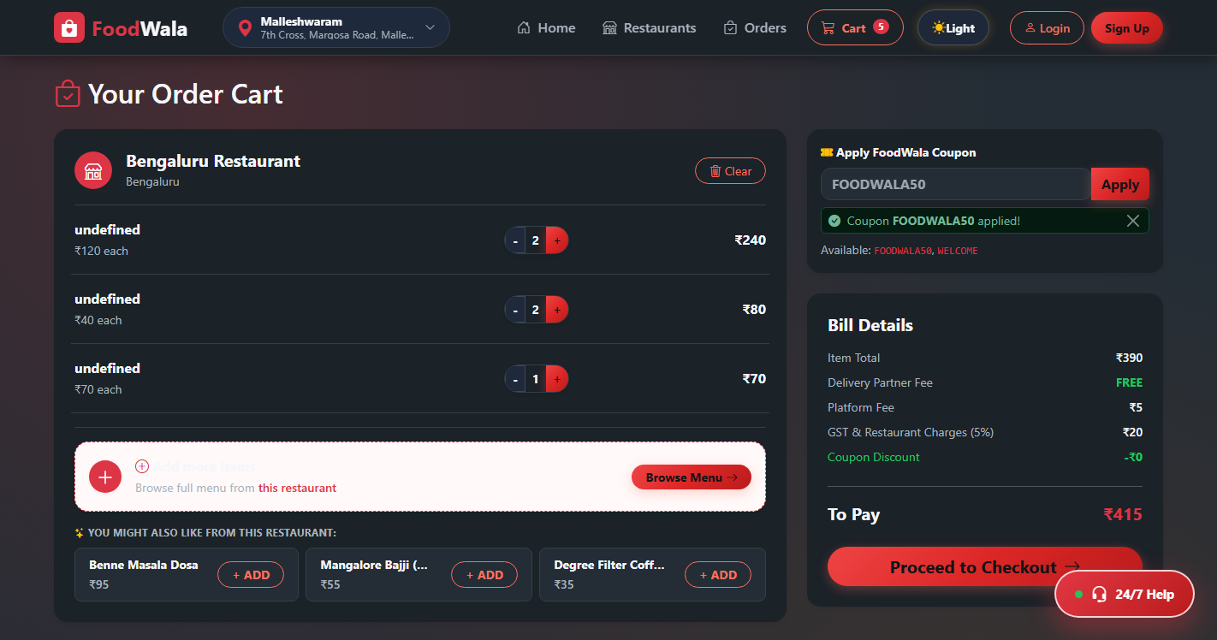
SECTION 05 • PAGE SCREENSHOT 5.6
Interactive Cart & Coupons
Dynamic bill computation, delivery charges, and server-validated promo codes (FOODWALA50, WELCOME).
Notes:
Speaker Notes (10s): Slide 5.6 shows the Interactive Cart & Coupons. As you can see, Dynamic bill computation, delivery charges, and server-validated promo codes (FOODWALA50, WELCOME).

Slide 11
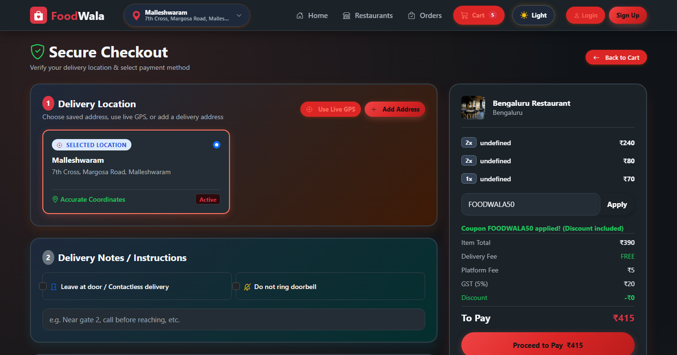
SECTION 05 • PAGE SCREENSHOT 5.7
Delivery Address & Checkout
Saved addresses selector, delivery instructions, Razorpay test sandbox modal, and Cash on Delivery option.
Notes:
Speaker Notes (10s): Slide 5.7 shows the Delivery Address & Checkout. As you can see, Saved addresses selector, delivery instructions, Razorpay test sandbox modal, and Cash on Delivery option.

Slide 12

SECTION 05 • PAGE SCREENSHOT 5.8
Order Confirmation & Token
Atomic transaction summary, order token ID, delivery ETA, and automated Dual EmailJS dispatch.
Notes:
Speaker Notes (10s): Slide 5.8 shows the Order Confirmation & Token. As you can see, Atomic transaction summary, order token ID, delivery ETA, and automated Dual EmailJS dispatch.

Slide 13

SECTION 05 • PAGE SCREENSHOT 5.9
Real-Time Order Tracking
5-stage progress timeline (Placed ➔ Confirmed ➔ Prepared ➔ Out for Delivery ➔ Delivered) and driver map.
Notes:
Speaker Notes (10s): Slide 5.9 shows the Real-Time Order Tracking. As you can see, 5-stage progress timeline (Placed ➔ Confirmed ➔ Prepared ➔ Out for Delivery ➔ Delivered) and driver map.

Slide 14
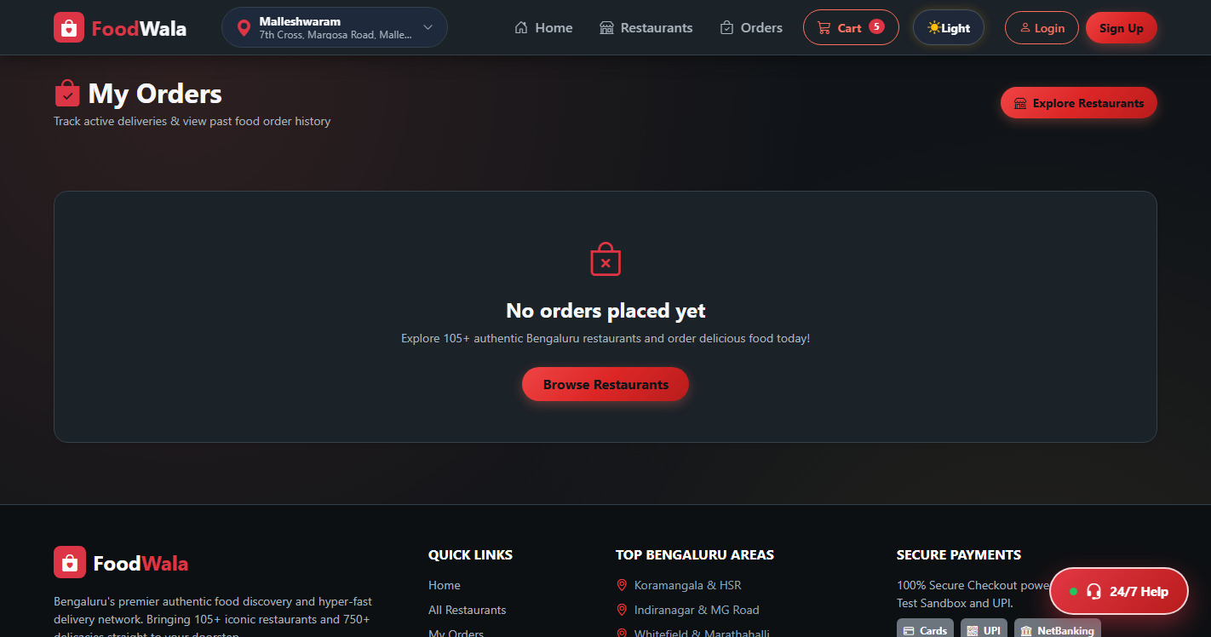
SECTION 05 • PAGE SCREENSHOT 5.10
Order History & Invoices
Past orders dashboard, re-order shortcuts, status audits, and one-click jsPDF downloadable tax invoice.
Notes:
Speaker Notes (10s): Slide 5.10 shows the Order History & Invoices. As you can see, Past orders dashboard, re-order shortcuts, status audits, and one-click jsPDF downloadable tax invoice.

Slide 15
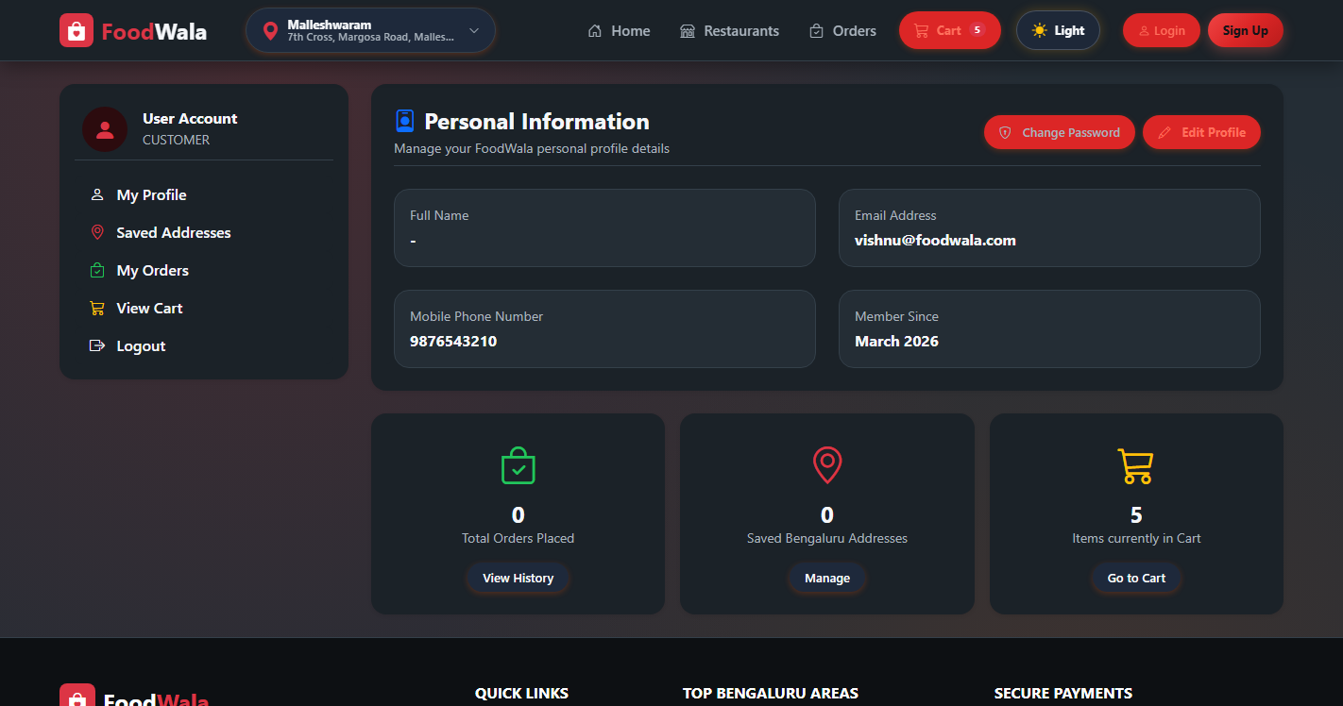
SECTION 05 • PAGE SCREENSHOT 5.11
User Profile & Security Hub
Saved addresses manager, password update with validation rules, notification preferences, and session logs.
Notes:
Speaker Notes (10s): Slide 5.11 shows the User Profile & Security Hub. As you can see, Saved addresses manager, password update with validation rules, notification preferences, and session logs.

Slide 16
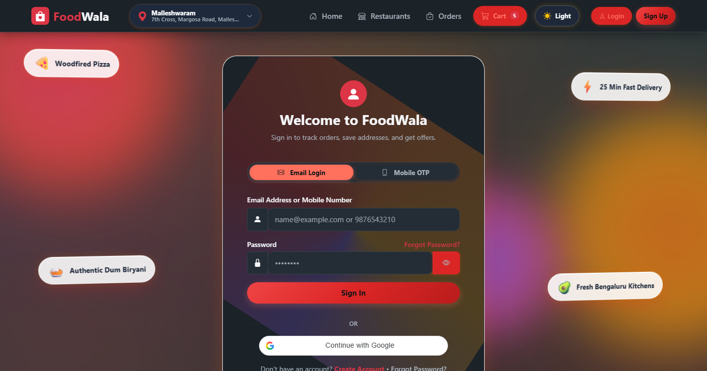
SECTION 05 • PAGE SCREENSHOT 5.12
Restaurant Partner Portal
Live incoming orders pipeline, order state dispatch controls (Accept/Dispatch), and menu inventory toggle.
Notes:
Speaker Notes (10s): Slide 5.12 shows the Restaurant Partner Portal. As you can see, Live incoming orders pipeline, order state dispatch controls (Accept/Dispatch), and menu inventory toggle.

Slide 17
SECTION 05 • PAGE SCREENSHOT 5.13
Operational Admin Portal
Real-time business KPIs (Revenue, Total Orders, Active Users), user lockout management, and security audit log.
Notes:
Speaker Notes (10s): Slide 5.13 shows the Operational Admin Portal. As you can see, Real-time business KPIs (Revenue, Total Orders, Active Users), user lockout management, and security audit log.

Slide 18
SECTION 06 OF 09 • NEW FEATURES YOU ADDED
Advanced Capabilities Beyond Base Requirements
Unique engineering additions implemented in FoodWala
🌐 Hyperlocal Geolocation Engine
Integrated Leaflet.js interactive maps calculating aerial distances between user coordinates and restaurants via the Haversine formula, driving dynamic delivery fees.
🔍 Typo-Tolerant Smart Search
Custom Levenshtein distance algorithm matching dish and restaurant names even with typos (e.g., 'bryani' ➔ 'Biryani', 'vidyarti' ➔ 'Vidyarthi Bhavan').
🛡️ OWASP Enterprise Security
State-of-the-art Argon2id password hashing, real-time client/server duplicate phone detection with HTTP 409 modals, and automated 5-attempt account lockout.
💳 Razorpay & Dual EmailJS Receipts
Complete Razorpay sandbox checkout with SHA-256 HMAC verification, dual EmailJS receipt dispatch (customer + admin), and instant jsPDF tax invoice generation.
Notes:
Speaker Notes (25s): The key extra features we built beyond the base requirements are: first, a Hyperlocal Geolocation Engine calculating dynamic delivery fees; second, a Typo-Tolerant Search using Levenshtein distance; third, OWASP-grade security with Argon2id and brute-force lockout; and fourth, Razorpay sandbox with jsPDF invoices.

Slide 19
SECTION 07 OF 09 • IMPORTANT ALGORITHMS
Tricky & Clever Logic Implemented in Java
Haversine Distance, Levenshtein Fuzzy Matching & ACID Transaction Management
1. Haversine Geodetic Distance (LocationUtil.java)
// Calculates spherical distance between user & restaurant
double dLat = Math.toRadians(lat2 - lat1);
double dLon = Math.toRadians(lon2 - lon1);
double a = Math.sin(dLat/2) * Math.sin(dLat/2) +
Math.cos(Math.toRadians(lat1)) * Math.cos(Math.toRadians(lat2)) *
Math.sin(dLon/2) * Math.sin(dLon/2);
double c = 2 * Math.atan2(Math.sqrt(a), Math.sqrt(1 - a));
return EARTH_RADIUS_KM * c; // In Kilometers
2. Levenshtein Dynamic Programming (FuzzySearchUtil.java)
// Computes edit distance matrix for typo-tolerant search
int[][] dp = new int[s1.length() + 1][s2.length() + 1];
for (int i = 0; i <= s1.length(); i++) dp[i][0] = i;
for (int j = 0; j <= s2.length(); j++) dp[0][j] = j;
for (int i = 1; i <= s1.length(); i++) {
for (int j = 1; j <= s2.length(); j++) {
int cost = (s1.charAt(i-1) == s2.charAt(j-1)) ? 0 : 1;
dp[i][j] = min(dp[i-1][j]+1, dp[i][j-1]+1, dp[i-1][j-1]+cost);
}
}
3. ACID Transaction Isolation with Rollback (OrderService.java)
// Atomic multi-table execution preventing orphaned records
con.setAutoCommit(false);
try {
int orderId = orderDAO.createOrder(order, con);
orderItemDAO.insertItems(orderId, cartItems, con);
paymentDAO.recordPayment(orderId, payment, con);
cartDAO.clearUserCart(userId, con);
con.commit(); // Atomic commit across all 4 tables
} catch (Exception e) {
con.rollback(); // Complete rollback on any failure
throw new OrderProcessingException("Checkout rolled back", e);
}
Notes:
Speaker Notes (30s): Here are our three most critical algorithms: the Haversine formula for computing spherical GPS distance in kilometers; the Levenshtein dynamic programming algorithm for typo-tolerant fuzzy search; and atomic ACID transaction orchestration with con.setAutoCommit(false) ensuring zero orphaned records during checkout.

Slide 20
SECTION 08 OF 09 • MAJOR CHALLENGE FACED
Race Conditions & Multi-Table Transaction Inconsistency
The biggest problem encountered and how we architecturally resolved it
🛑 THE PROBLEM
• Checkout Double-Clicks: Rapid user double-clicks or slow network connections caused duplicate order insertions and repeated payment authorizations.
• Orphaned Records: If network disconnection happened while inserting cart items or recording payment, the order row remained stranded without items.
• Coupon Concurrency Exploits: Users were able to apply single-use promo codes simultaneously on multiple tabs before the usage flag was committed.
✅ THE ARCHITECTURAL SOLUTION
• Atomic ACID Session: Wrapped orders, order_item, payment, and cart_clear inside a single managed connection with con.setAutoCommit(false) and con.rollback().
• Client-Side UI Debounce & Idempotency Key: Disabled checkout buttons immediately on click and passed a unique Razorpay transaction token to enforce database uniqueness.
• Row-Level Coupon Locking: Queried and updated coupon redemption records inside the transactional boundary before final commit.
Notes:
Speaker Notes (25s): The biggest challenge was race conditions and transaction inconsistency during checkout. If a user clicked twice or if payment succeeded but cart clearing failed, data became inconsistent. We solved this by implementing atomic ACID transactions in Java JDBC, coupled with client-side UI debouncing and unique transaction idempotency keys.

Slide 21
SECTION 09 OF 09 • WHAT YOU'LL ADD NEXT
Future Engineering Roadmap
Strategic enhancements planned for upcoming releases
1. Real-Time WebSockets Driver Tracking
Replace simulated ETA updates with bidirectional WebSockets and Redis pub/sub to stream driver GPS coordinates in real time onto Leaflet and Google Maps.
2. AI-Driven Personalized Recommendations
Implement collaborative filtering and matrix factorization to analyze user past order patterns, preferred cuisines, and time-of-day food cravings.
3. Native Cross-Platform Mobile Apps
Build dedicated Android and iOS companion apps using React Native or Flutter, adding background push notifications and biometric FaceID authentication.
4. Automated Multi-City Geofencing
Expand beyond Bengaluru by implementing automated multi-city geofencing, multi-currency support, and instant split payouts to restaurant partners via Razorpay Route.
Notes:
Speaker Notes (20s): Looking ahead, our future roadmap includes: 1) Real-time WebSockets driver GPS tracking; 2) AI-powered recommendation models; 3) Native Flutter mobile apps; and 4) Multi-city geofenced scaling with automated vendor payout settlements. Thank you!

