Slide 1
PROJECT DEMONSTRATION
FoodWala — Bengaluru Food Discovery & Delivery Platform
"FoodWala is a Java Full Stack food discovery and delivery platform built with Java Servlets, JSP, JDBC, and MySQL that allows users to discover restaurants, order food, make online payments, and track deliveries in real time."
🔍
⚡
🛡️
🤖
Hyperlocal Discovery
ACID Order Pipeline
Multi-Role Security
WhatsApp 24/7 AI Desk
Smart search with typo tolerance (Jaro-Winkler), dynamic category filters, and curated Bengaluru culinary showcases.
Atomic multi-table MySQL transactions handling cart lifecycle, discounts, Razorpay payments, and live order dispatch.
Argon2id hashing, role-based access control isolating Super Admin, Store Managers, Delivery Riders, and Customers.
Omnichannel customer support powered by a 25-intent NLP classifier resolving order tracking and menu queries.
Bengaluru, Karnataka • Production Ready Architecture • 4–5 Minute Demonstration Deck

Slide 2
SECTION 2
Tech Stack & System Architecture
Comprehensive full-stack technology stack deployed across frontend, backend, database, and integrations
FRONTEND & JSP
JAVA BACKEND & SERVLETS
DATABASE & PERSISTENCE
• HTML5 & CSS3
• Java (JDK 17 / 21)
• MySQL 9.7 Server
Semantic layout, custom dark mode, variables
Core OOP business logic, robust multithreading
22 relational tables, InnoDB engine, ACID
• Bootstrap 5.3 & Icons
• Java Servlets (Jakarta)
• JDBC & Connection Pool
Responsive grid, modals, offcanvas navigation
MVC Controller dispatching, session management
Optimized DAO persistence with PreparedStatement
• JSP & JSTL Templates
• DAO & Service Layer
• Foreign Key Integrity
Server-Side Rendering, dynamic expression language
Clean separation of concerns, POJO models
Cascading updates, constraints, normalized 3NF
• JavaScript (ES6+)
• Apache Tomcat Server
• Audit & Tracking
Modular client state, fetch API, local storage
High-concurrency enterprise Servlet web container
order_status_history, login_history, activity_log
SECURITY & AUTH
PAYMENT & COMMS
DEVOPS & ENVIRONMENT
• Argon2id & BCrypt
• Razorpay API Gateway
• Eclipse IDE (Java EE)
State-of-the-art memory-hard password encryption
UPI, Debit/Credit cards, NetBanking, COD
Dynamic Web Project workspace & server runtime
• Role-Based Access (RBAC)
• WhatsApp Cloud API
• Apache Tomcat v9/v10
Super Admin, Store Manager, Rider, Customer
Graph API v18.0 automated conversational desk
Local & production Servlet deployment container
• Servlet Filters & CORS
• EmailJS Receipt Delivery
• Git & GitHub Versioning
CORSFilter, request validation, session guards
Instant transactional order confirmation emails
Branching workflow, release version control
• Store Data Isolation
• In-Browser AI Desk
• Cloudflare Tunnel
Enforced tenant separation on manager routes
Instant floating fallback chat widget
Zero-trust HTTPS tunnel for webhook intake
FoodWala — Bengaluru Food Discovery & Delivery Platform
Confidential • Project Demonstration • Master Deck

Slide 3
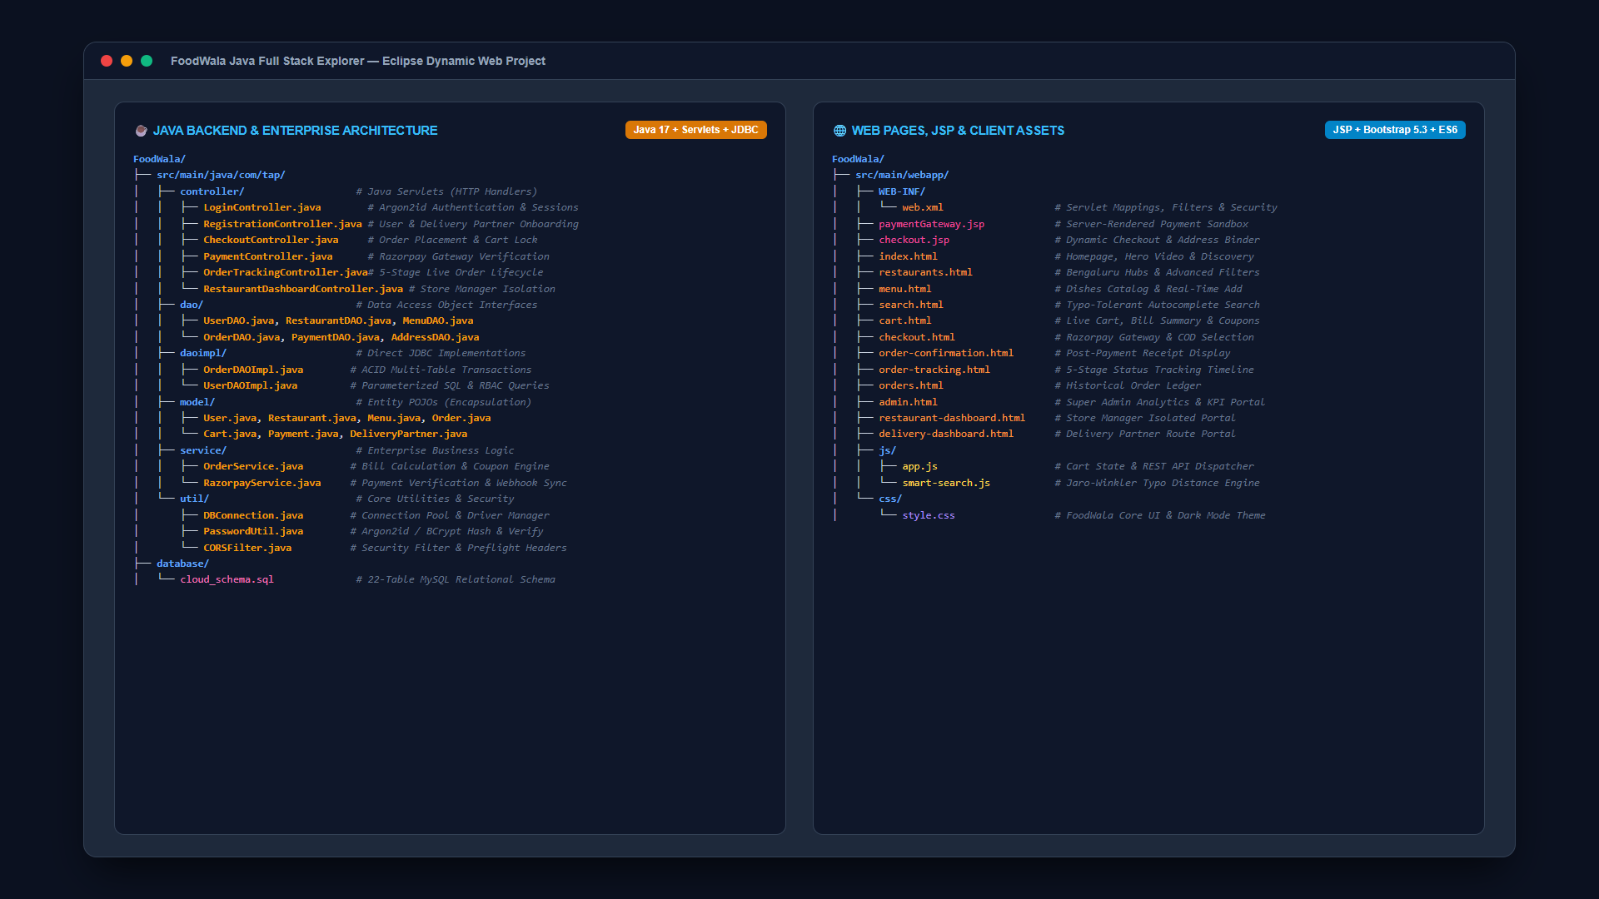
SECTION 3
Project Architecture & Directory Layout
Visual codebase hierarchy demonstrating strict separation of frontend assets, backend APIs, and database migrations
Layered Architecture
Frontend & JSP Layer
Server-rendered JSP templates, responsive Bootstrap 5.3 stylesheets, and client scripts (app.js, cart.js).
Java Servlets (Controllers)
com.tap.controller Servlets handling HTTP request routing, session lifecycle, and MVC dispatching.
DAO & Service Layer
com.tap.dao & daoimpl encapsulating parameterized SQL queries with JDBC connection pooling.
Database & Transactions
MySQL relational schema with 22 normalized tables and atomic InnoDB ACID transactions.
Caption: Architecture strictly decouples Java Servlets, Business Services, and JDBC DAOs from JSP & client views.
FoodWala — Bengaluru Food Discovery & Delivery Platform
Confidential • Project Demonstration • Master Deck

Slide 4
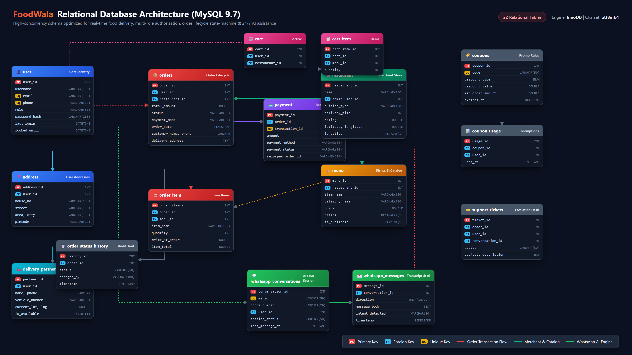
SECTION 4
Database Architecture & ER Diagram
Normalized relational database schema (MySQL 9.7) featuring 22 tables supporting ACID-compliant order transactions
Key Relationships: user (1:N) orders • restaurant (1:N) menu • orders (1:N) order_item • orders (1:1) payment • user (1:N) whatsapp_conversations
FoodWala — Bengaluru Food Discovery & Delivery Platform
Confidential • Project Demonstration • Master Deck

Slide 5
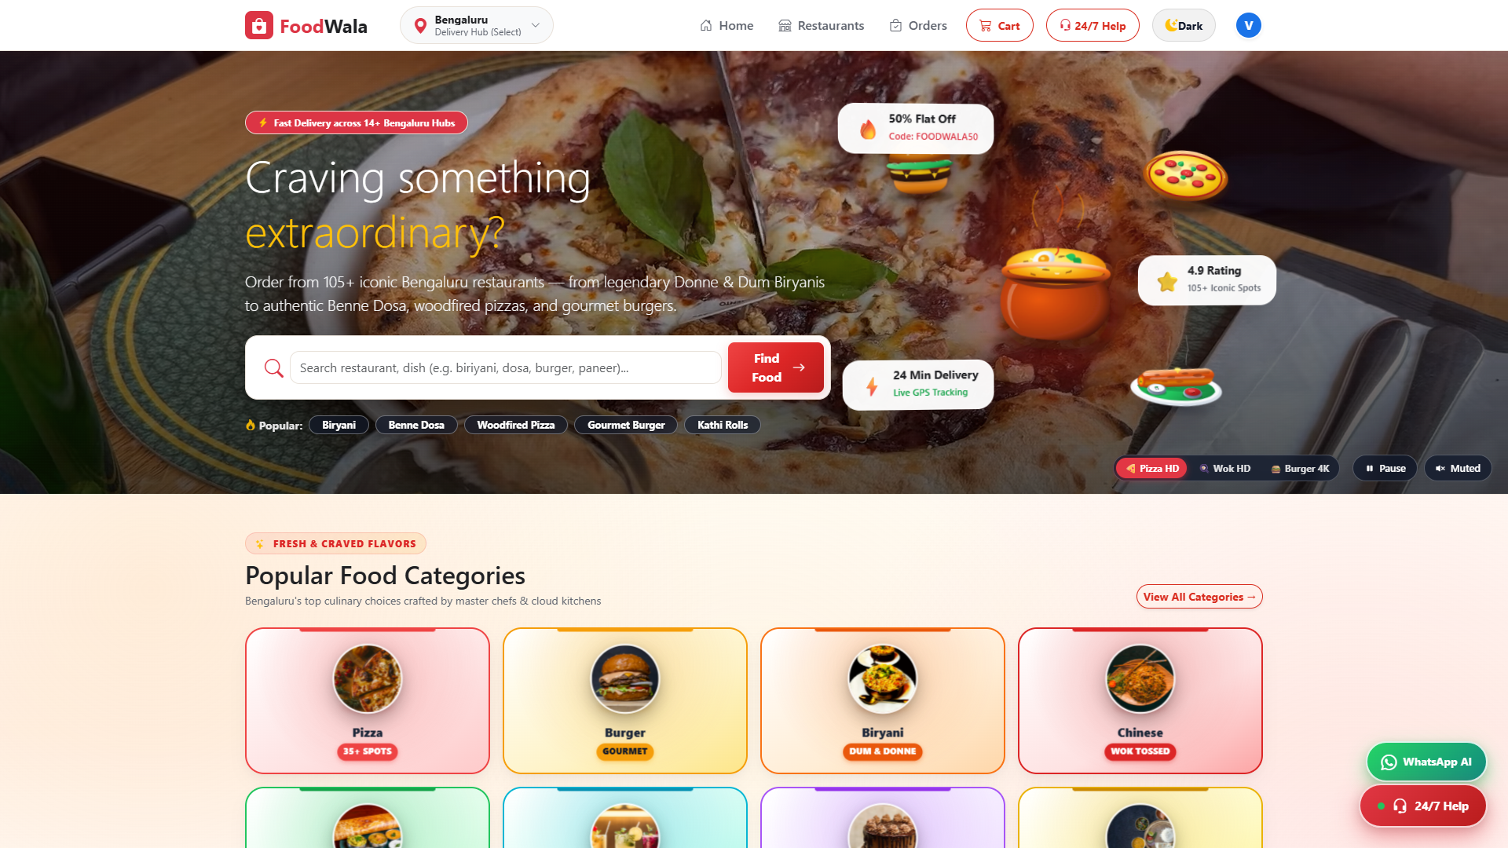
SECTION 5.1
Home Page — Bengaluru Discovery & Hero Showcase
Hero banner with video showcase, dynamic Bengaluru cuisine category carousels, instant search bar, and top-rated restaurants.
Real Application Screenshot • 1920×1080 Viewport • http://localhost:5000/home_page.html
FoodWala — Bengaluru Food Discovery & Delivery Platform
Confidential • Project Demonstration • Master Deck

Slide 6
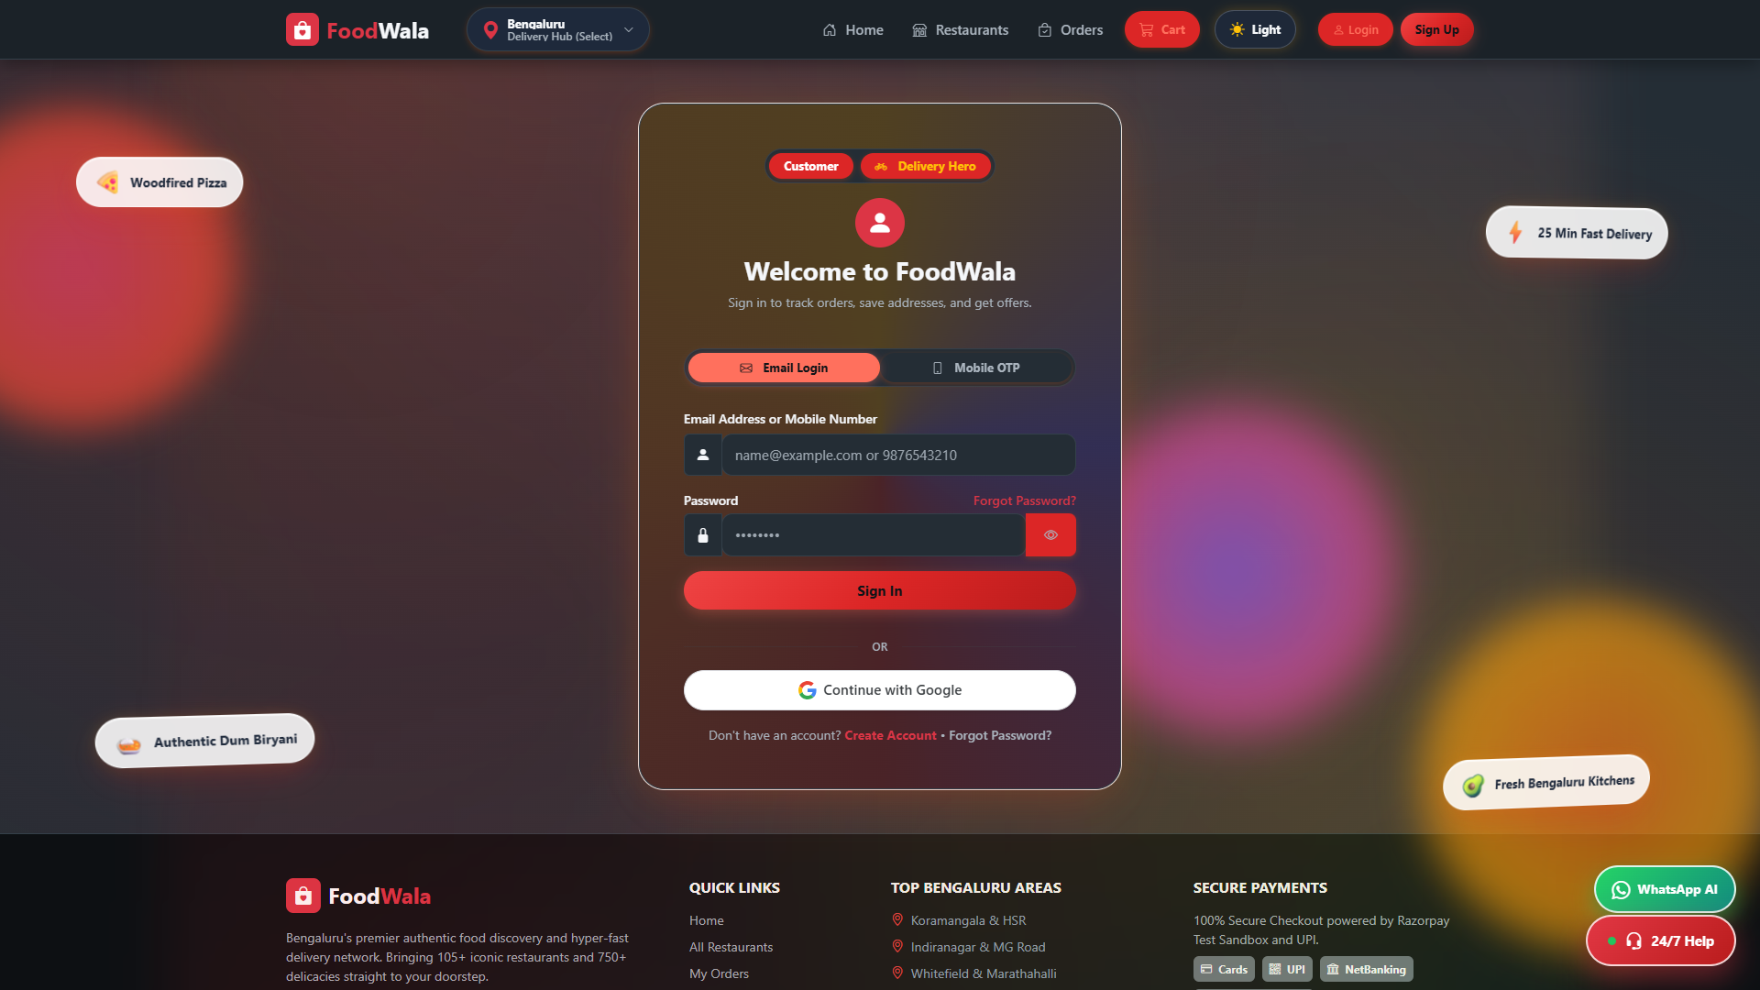
SECTION 5.2
Login Screen — Role-Based Authentication
Multi-role authentication gateway verifying Customer, Restaurant Manager, and Delivery Partner credentials with Argon2id password verification.
Real Application Screenshot • 1920×1080 Viewport • http://localhost:5000/login_page.html
FoodWala — Bengaluru Food Discovery & Delivery Platform
Confidential • Project Demonstration • Master Deck

Slide 7
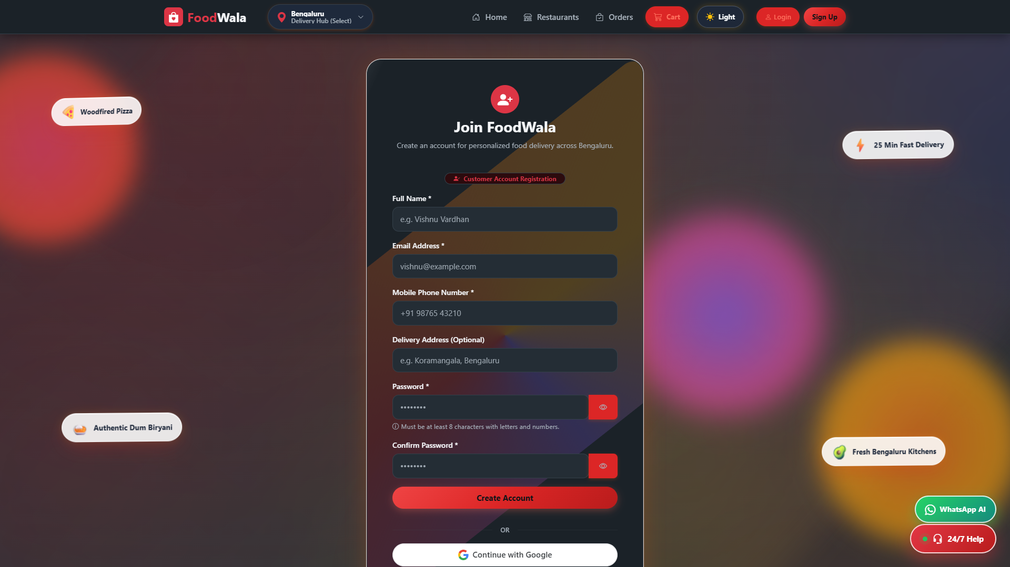
SECTION 5.3
Registration Screen — Customer Onboarding & Fleet Toggle
Dual onboarding form supporting Customer sign-up and direct Delivery Partner fleet onboarding toggle with vehicle & license validation.
Real Application Screenshot • 1920×1080 Viewport • http://localhost:5000/register_page.html
FoodWala — Bengaluru Food Discovery & Delivery Platform
Confidential • Project Demonstration • Master Deck

Slide 8
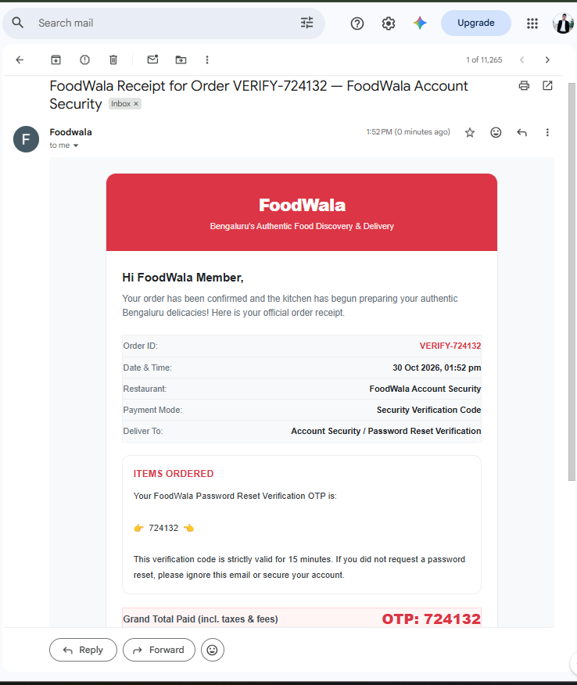
SECTION 5.4
Account Security — Password Reset OTP Verification Email
Automated cryptographic password reset email delivering a 6-digit OTP (724132) with 15-minute validity, secure token expiry, and account protection.
ACCOUNT RECOVERY & AUTH SECURITY
Automated Security Verification Email
Instant OTP dispatch via EmailJS REST Gateway triggered upon password recovery request.
Subject
FoodWala Receipt for Order VERIFY-724132 — FoodWala Account Security
Recipient
Registered User Email (Direct Mailbox Delivery)
Verification OTP
724132 (Strict 15-Minute Expiry Window)
Event Trigger
POST /api/auth/forgot-password
Key Architectural Highlights:
✓ Argon2id Memory-Hard Password Re-hashing on submit
✓ Transient In-Memory OTP Store + MySQL reset_token Sync
✓ Single-use verification token cleared immediately upon reset
✓ Rate-limited endpoints (authLimiter) to prevent brute-force
Payload: { email: user@foodwala.com, otp: "724132", ttl: 900s, status: "DISPATCHED" }
Real Transactional Email Screenshot • Delivered via EmailJS • Verified in Gmail Mailbox
FoodWala — Bengaluru Food Discovery & Delivery Platform
Confidential • Project Demonstration • Master Deck

Slide 9
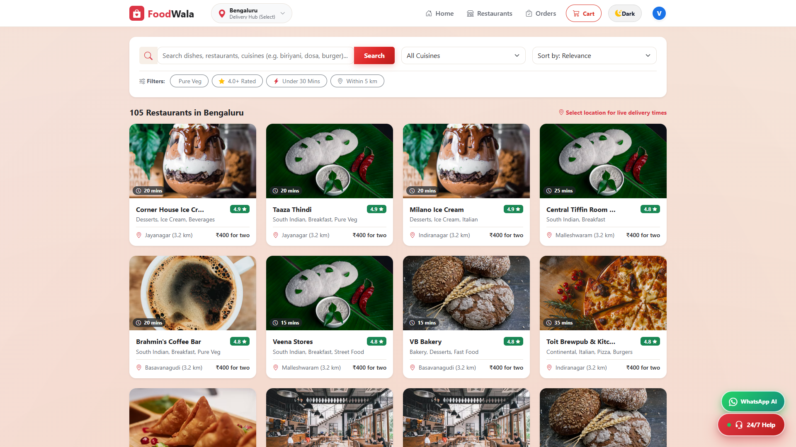
SECTION 5.5
Restaurant Discovery & Advanced Filtering
Comprehensive listing of Bengaluru eateries with multi-criteria filtering by cuisine, customer rating, delivery ETA, veg/non-veg, and budget.
Real Application Screenshot • 1920×1080 Viewport • http://localhost:5000/restaurants_discovery.html
FoodWala — Bengaluru Food Discovery & Delivery Platform
Confidential • Project Demonstration • Master Deck

Slide 10
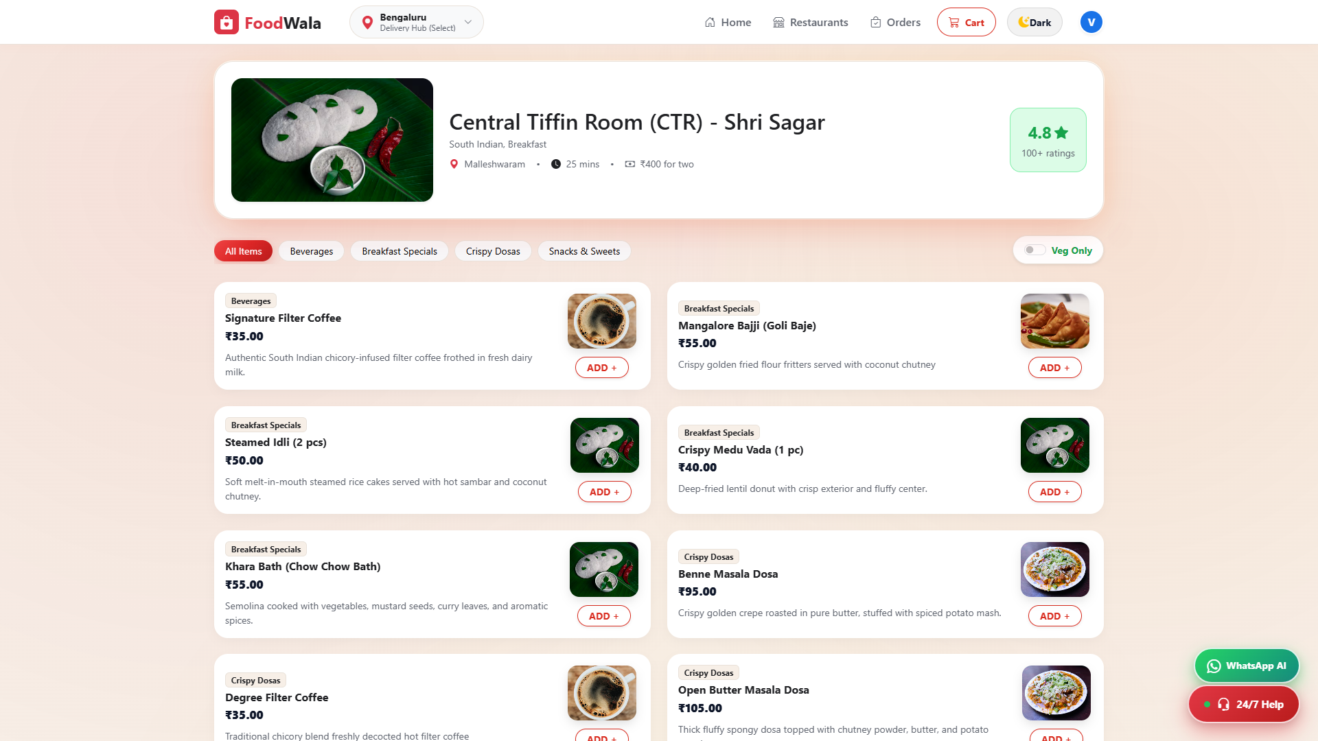
SECTION 5.6
Restaurant Menu & Item Customization
Dynamic restaurant catalog showing categorized dishes, prices, ratings, dietary tags, real-time availability badges, and instant cart addition.
Real Application Screenshot • 1920×1080 Viewport • http://localhost:5000/restaurant_menu.html
FoodWala — Bengaluru Food Discovery & Delivery Platform
Confidential • Project Demonstration • Master Deck

Slide 11
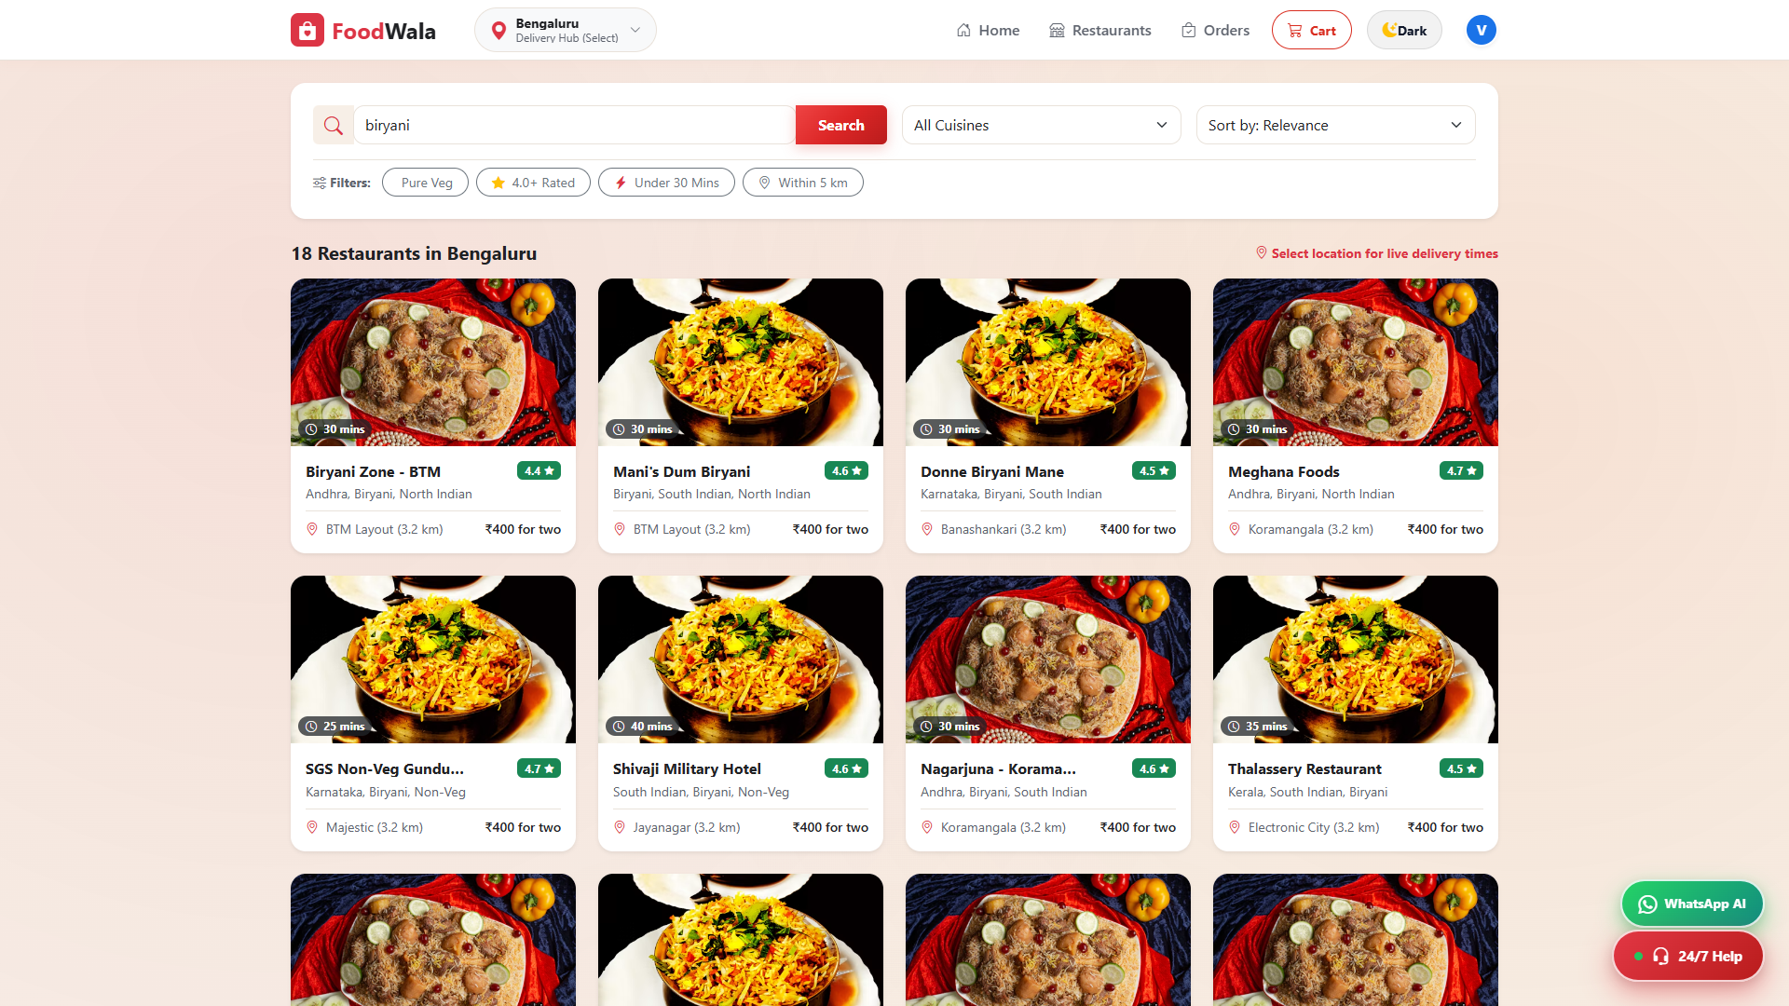
SECTION 5.7
Food Search & Typo-Tolerant Autocomplete
Real-time search bar with instant autocomplete suggestions powered by the Jaro-Winkler string similarity algorithm for typo resilience.
Real Application Screenshot • 1920×1080 Viewport • http://localhost:5000/search_feature.html
FoodWala — Bengaluru Food Discovery & Delivery Platform
Confidential • Project Demonstration • Master Deck

Slide 12
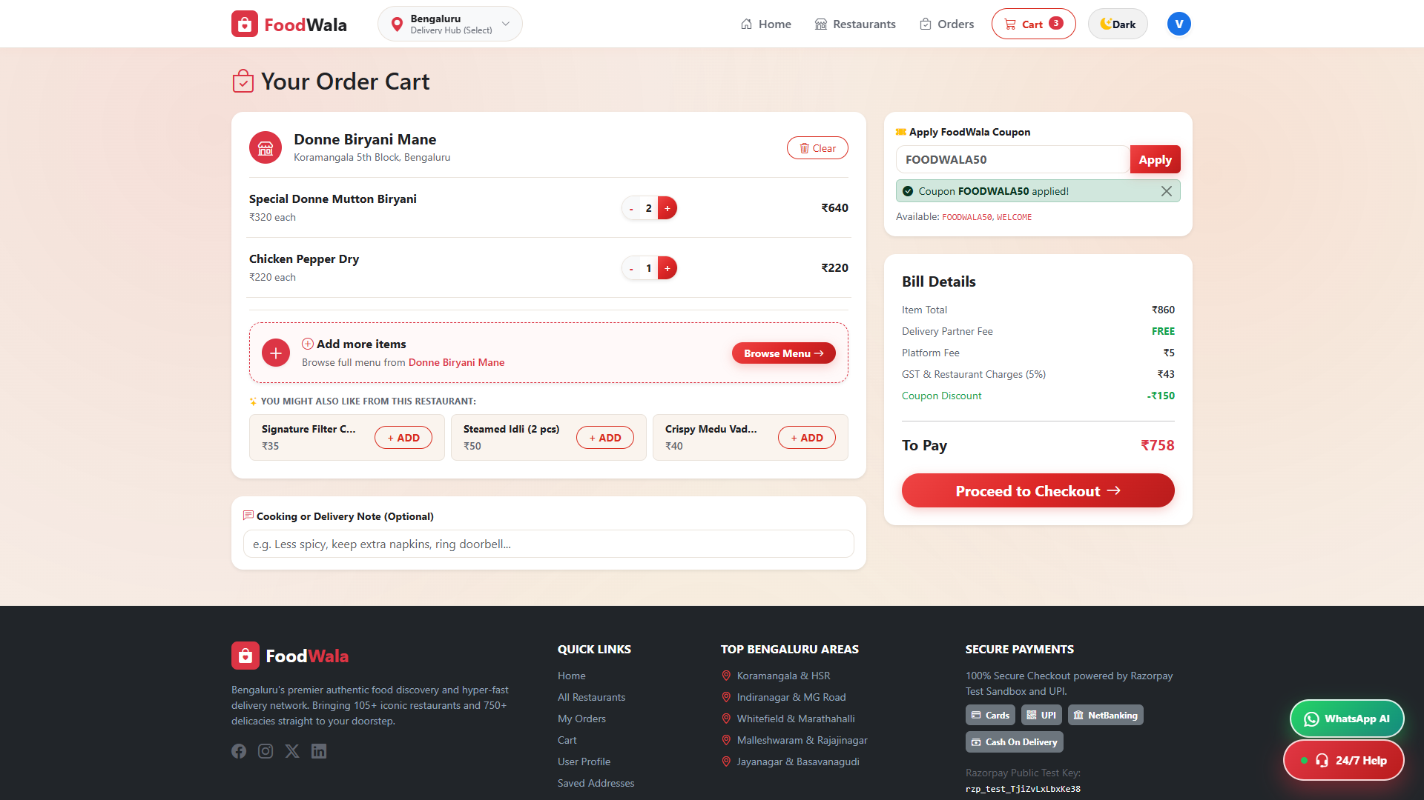
SECTION 5.8
Cart Management & Live Bill Breakdown
Interactive shopping cart supporting item increment/decrement, real-time subtotal calculation, delivery fee, GST (5%), platform fee, and coupon application.
Real Application Screenshot • 1920×1080 Viewport • http://localhost:5000/cart_page.html
FoodWala — Bengaluru Food Discovery & Delivery Platform
Confidential • Project Demonstration • Master Deck

Slide 13
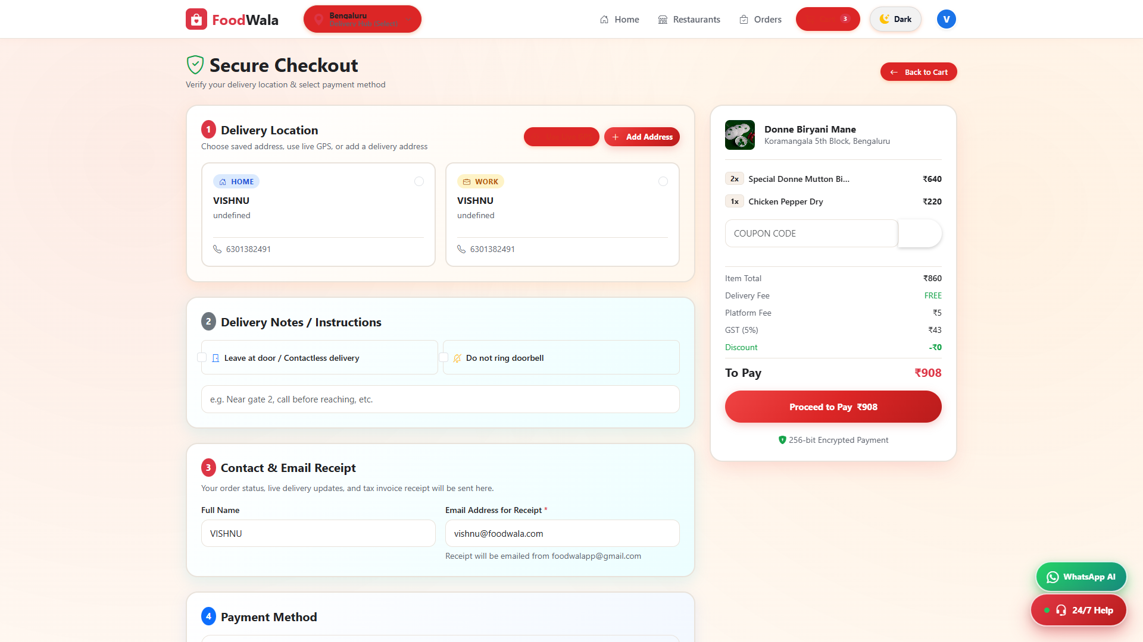
SECTION 5.9
Checkout & Delivery Address Selection
Streamlined checkout interface allowing users to choose saved delivery addresses, provide delivery instructions, and review order totals.
Real Application Screenshot • 1920×1080 Viewport • http://localhost:5000/checkout_page.html
FoodWala — Bengaluru Food Discovery & Delivery Platform
Confidential • Project Demonstration • Master Deck

Slide 14
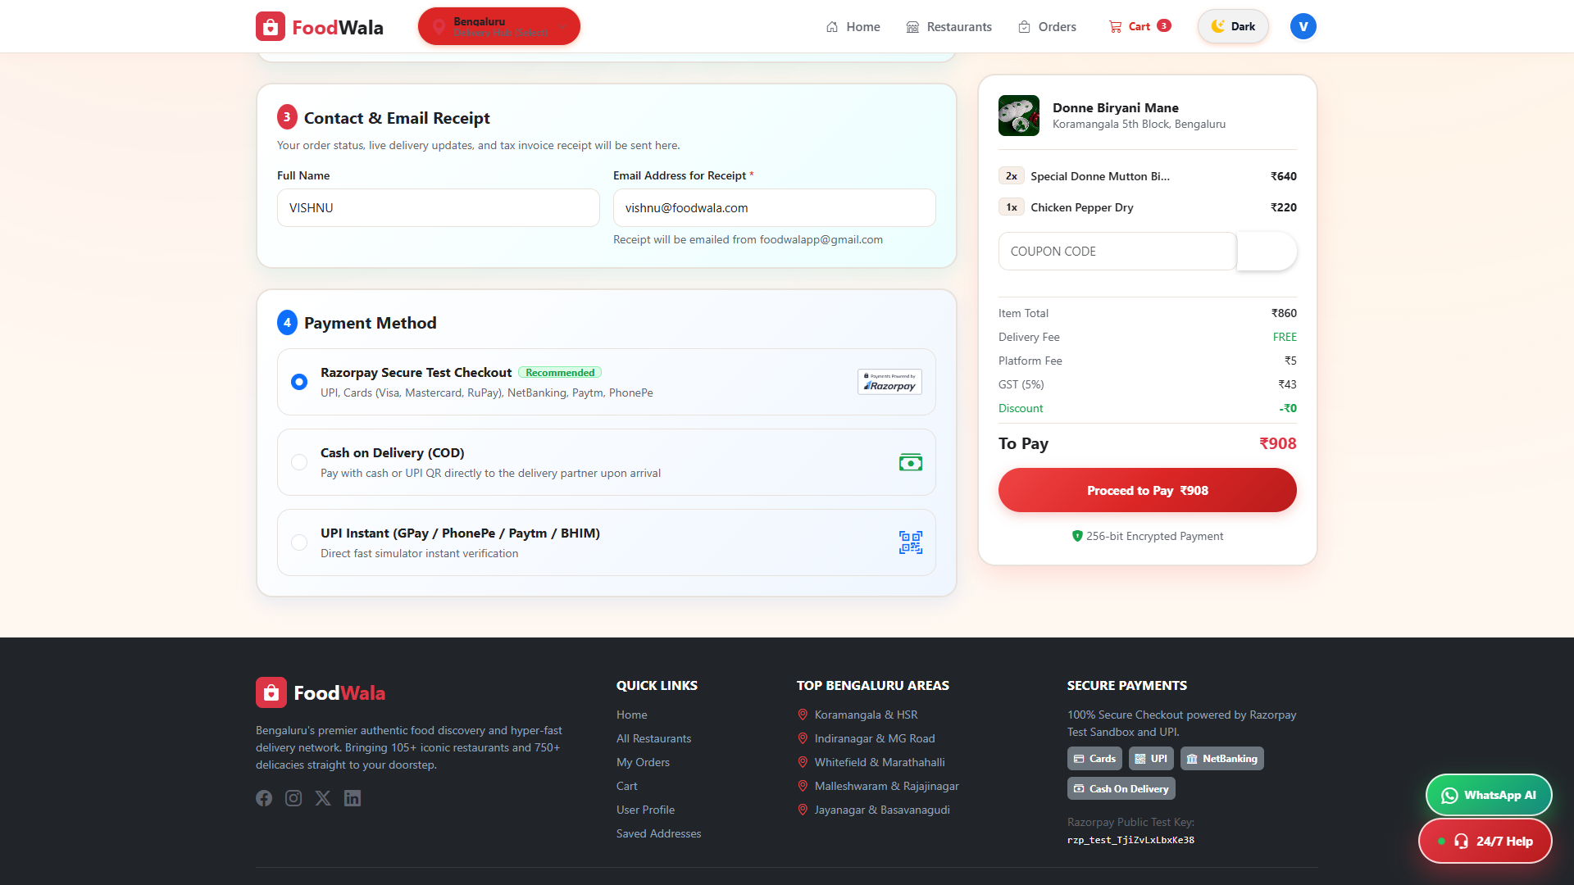
SECTION 5.10
Payment Gateway Integration — Razorpay & COD
Integrated payment processing supporting Razorpay checkout modal (UPI, Debit/Credit cards, Net Banking) alongside Cash on Delivery options.
Real Application Screenshot • 1920×1080 Viewport • http://localhost:5000/checkout.html#payment
FoodWala — Bengaluru Food Discovery & Delivery Platform
Confidential • Project Demonstration • Master Deck

Slide 15
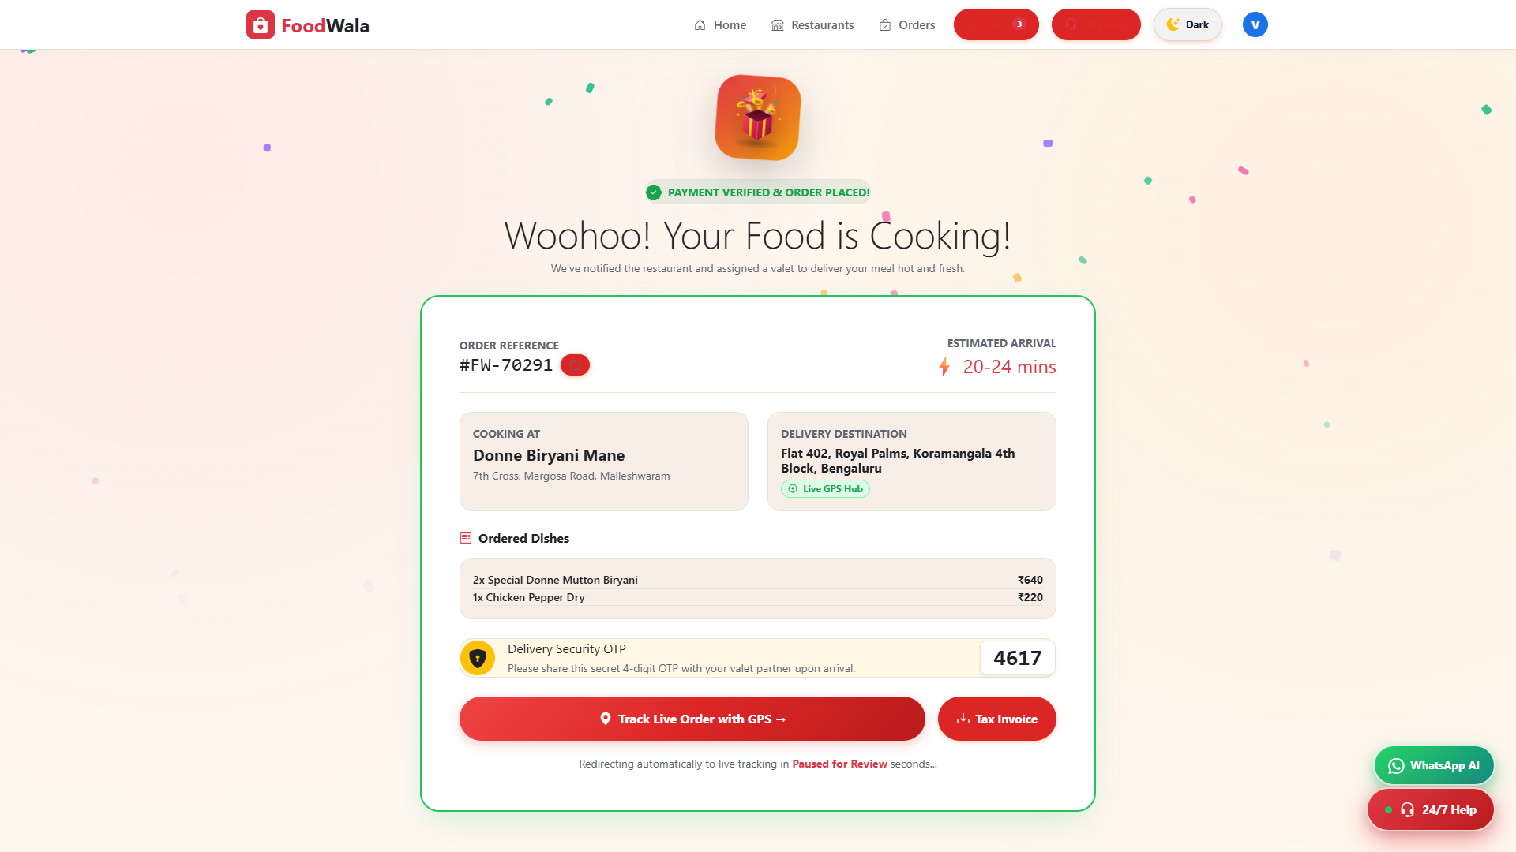
SECTION 5.11
Order Confirmation & Instant Receipt
Post-purchase confirmation screen displaying generated Order ID, estimated arrival time, detailed item summary, and live tracking call-to-action.
Real Application Screenshot • 1920×1080 Viewport • http://localhost:5000/order_confirmation.html
FoodWala — Bengaluru Food Discovery & Delivery Platform
Confidential • Project Demonstration • Master Deck

Slide 16
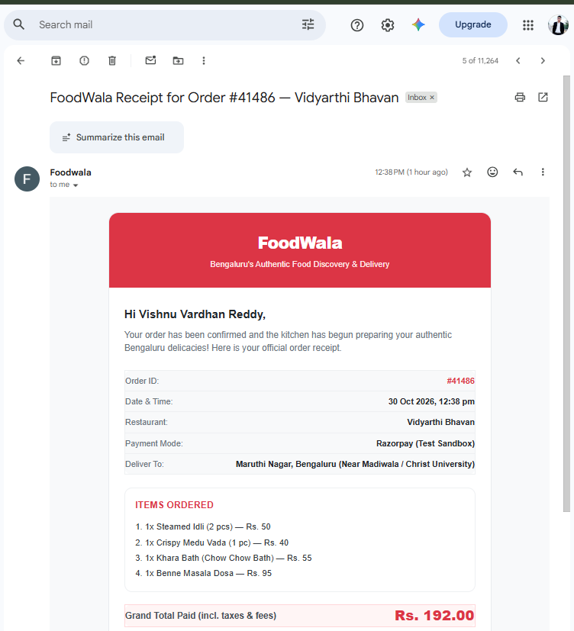
SECTION 5.12
Order Confirmation — Automated Transactional Email Receipt
Official order confirmation receipt delivered via EmailJS immediately following Razorpay transaction, detailing Order ID #41486, Vidyarthi Bhavan restaurant, and paid grand total.
TRANSACTIONAL ORDER CONFIRMATION
Automated Post-Checkout Email Receipt
Instant transactional order receipt dispatched to customer inbox upon successful payment.
Order ID
Order #41486 • Vidyarthi Bhavan
Recipient
Vishnu Vardhan Reddy (Customer Mailbox)
Total Paid
Rs. 192.00 (Razorpay Test Sandbox)
Dispatched Items
Steamed Idli (2x), Medu Vada, Khara Bath, Benne Masala Dosa
Key Architectural Highlights:
✓ Automated dispatch via EmailJS REST Client (emailService.js)
✓ Triggered atomically upon ACID transaction commit
✓ Itemized billing breakdown matching database record
✓ Permanent audit record logged with order timestamp
Payload: { orderId: 41486, items: 4, grandTotal: "Rs. 192.00", channel: "EMAILJS_REST" }
Real Transactional Email Screenshot • Delivered via EmailJS • Verified in Gmail Mailbox
FoodWala — Bengaluru Food Discovery & Delivery Platform
Confidential • Project Demonstration • Master Deck

Slide 17
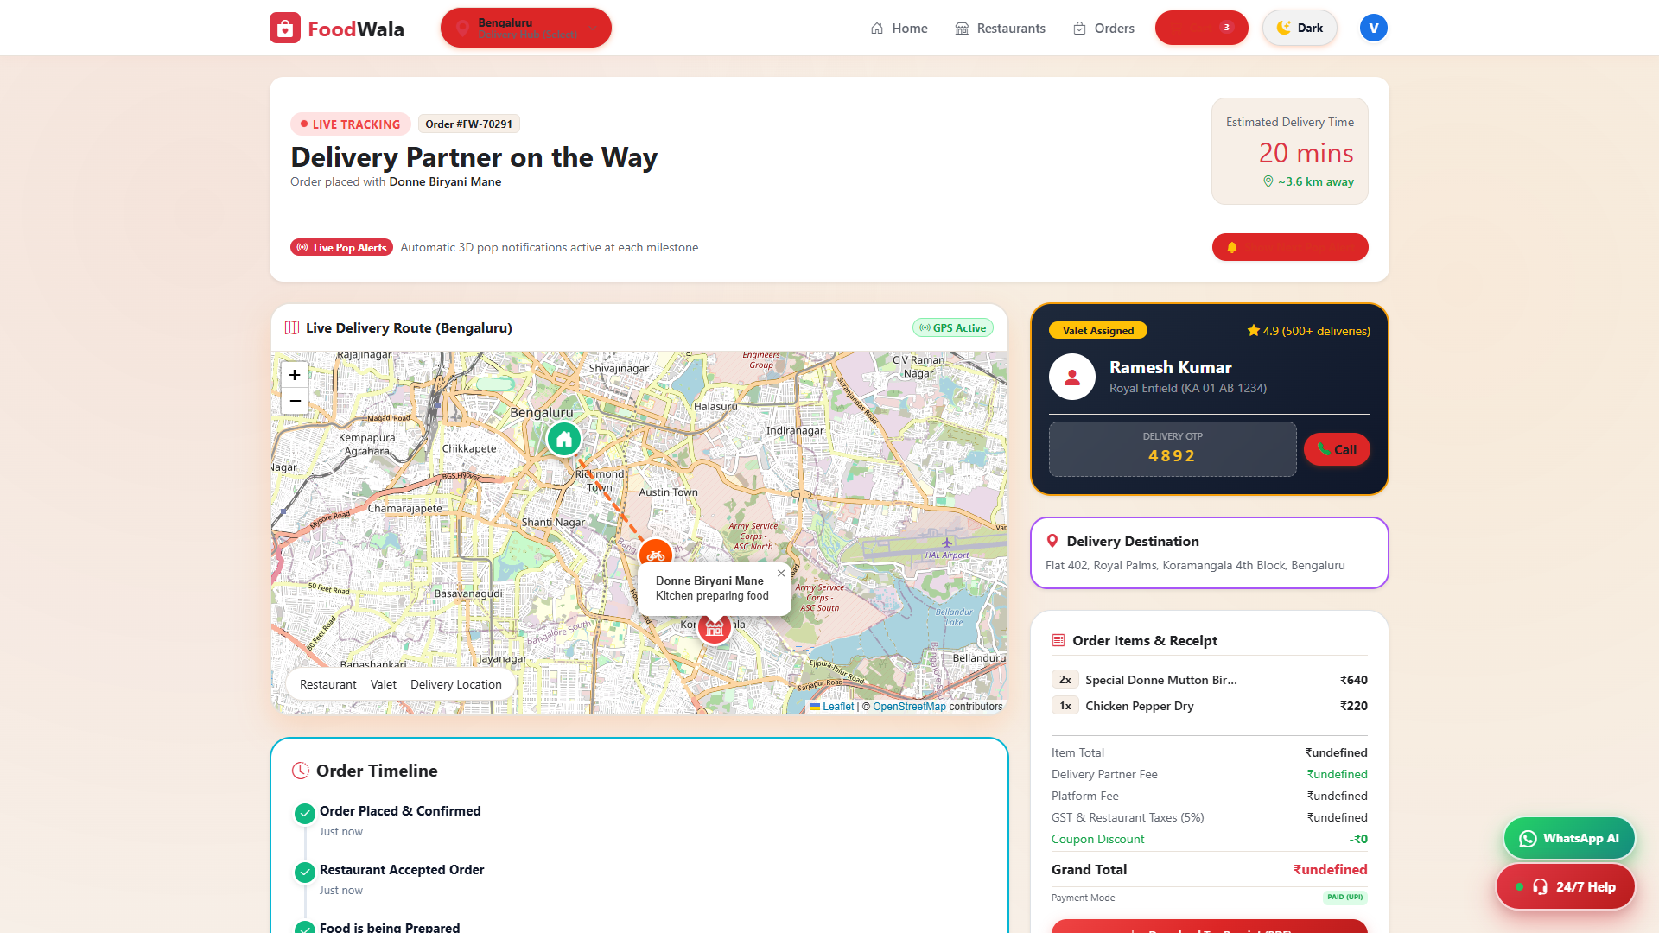
SECTION 5.13
Live Order Tracking & 5-Stage Status Pipeline
Real-time order progress monitor tracking 5 distinct stages: Order Placed -> Confirmed -> Food Prepared -> Out for Delivery -> Delivered.
Real Application Screenshot • 1920×1080 Viewport • http://localhost:5000/order_tracking.html
FoodWala — Bengaluru Food Discovery & Delivery Platform
Confidential • Project Demonstration • Master Deck

Slide 18
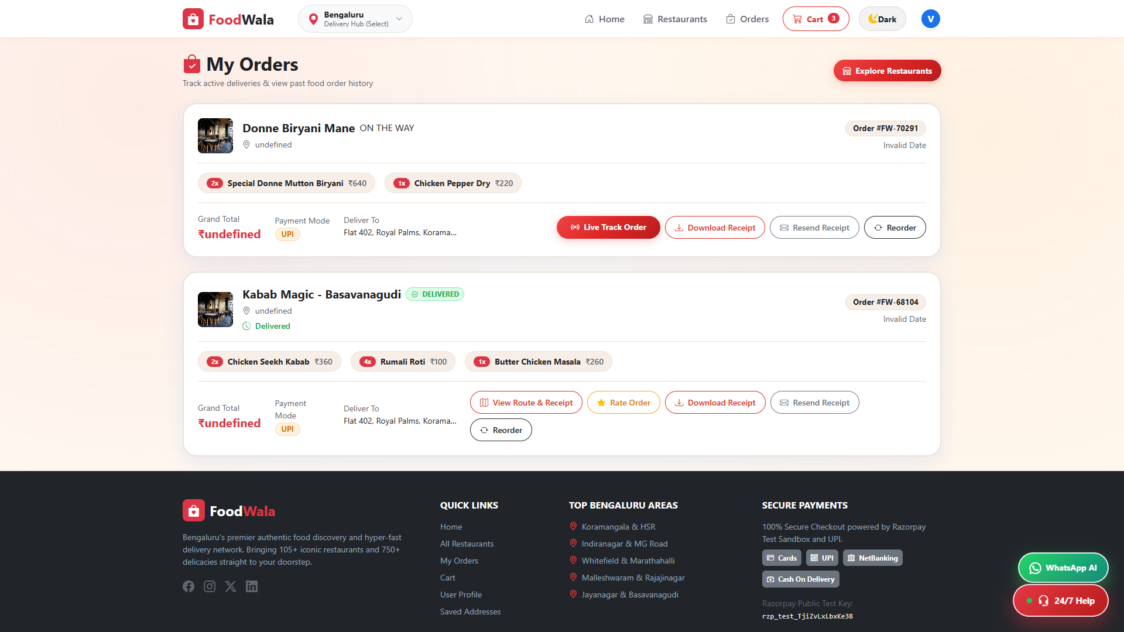
SECTION 5.14
Order History & Digital Invoices
Comprehensive log of past orders with timestamps, status tags, itemized costs, one-click re-order functionality, and invoice retrieval.
Real Application Screenshot • 1920×1080 Viewport • http://localhost:5000/orders_history.html
FoodWala — Bengaluru Food Discovery & Delivery Platform
Confidential • Project Demonstration • Master Deck

Slide 19
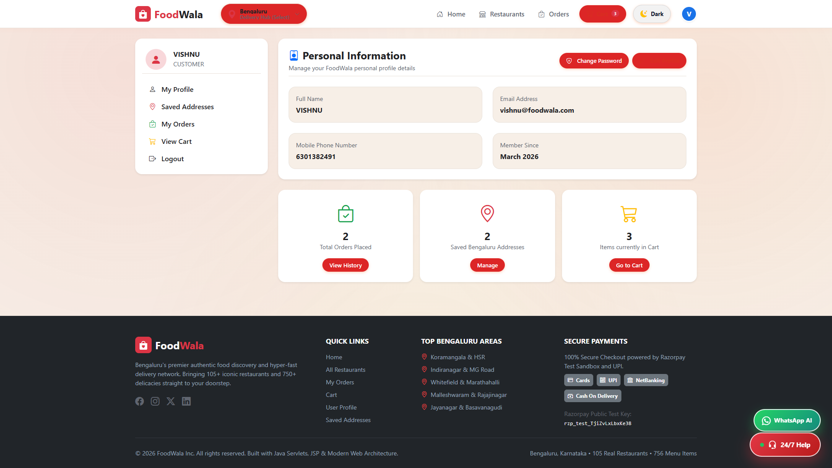
SECTION 5.15
User Profile & Account Management
Customer management portal showing personal profile details, contact information, password modification tools, and account security preferences.
Real Application Screenshot • 1920×1080 Viewport • http://localhost:5000/profile_page.html
FoodWala — Bengaluru Food Discovery & Delivery Platform
Confidential • Project Demonstration • Master Deck

Slide 20
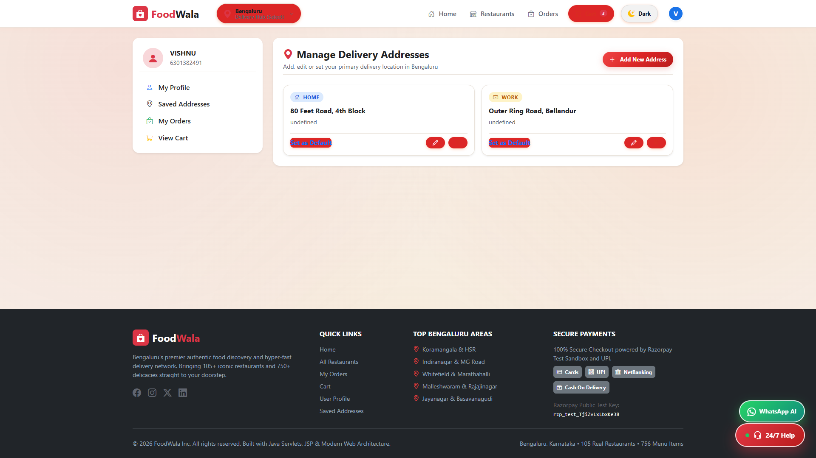
SECTION 5.16
Saved Delivery Addresses & Geolocation
Address book management allowing users to save multiple locations (Home, Work, Other) with street details, landmarks, and default selections.
Real Application Screenshot • 1920×1080 Viewport • http://localhost:5000/address_management.html
FoodWala — Bengaluru Food Discovery & Delivery Platform
Confidential • Project Demonstration • Master Deck

Slide 21
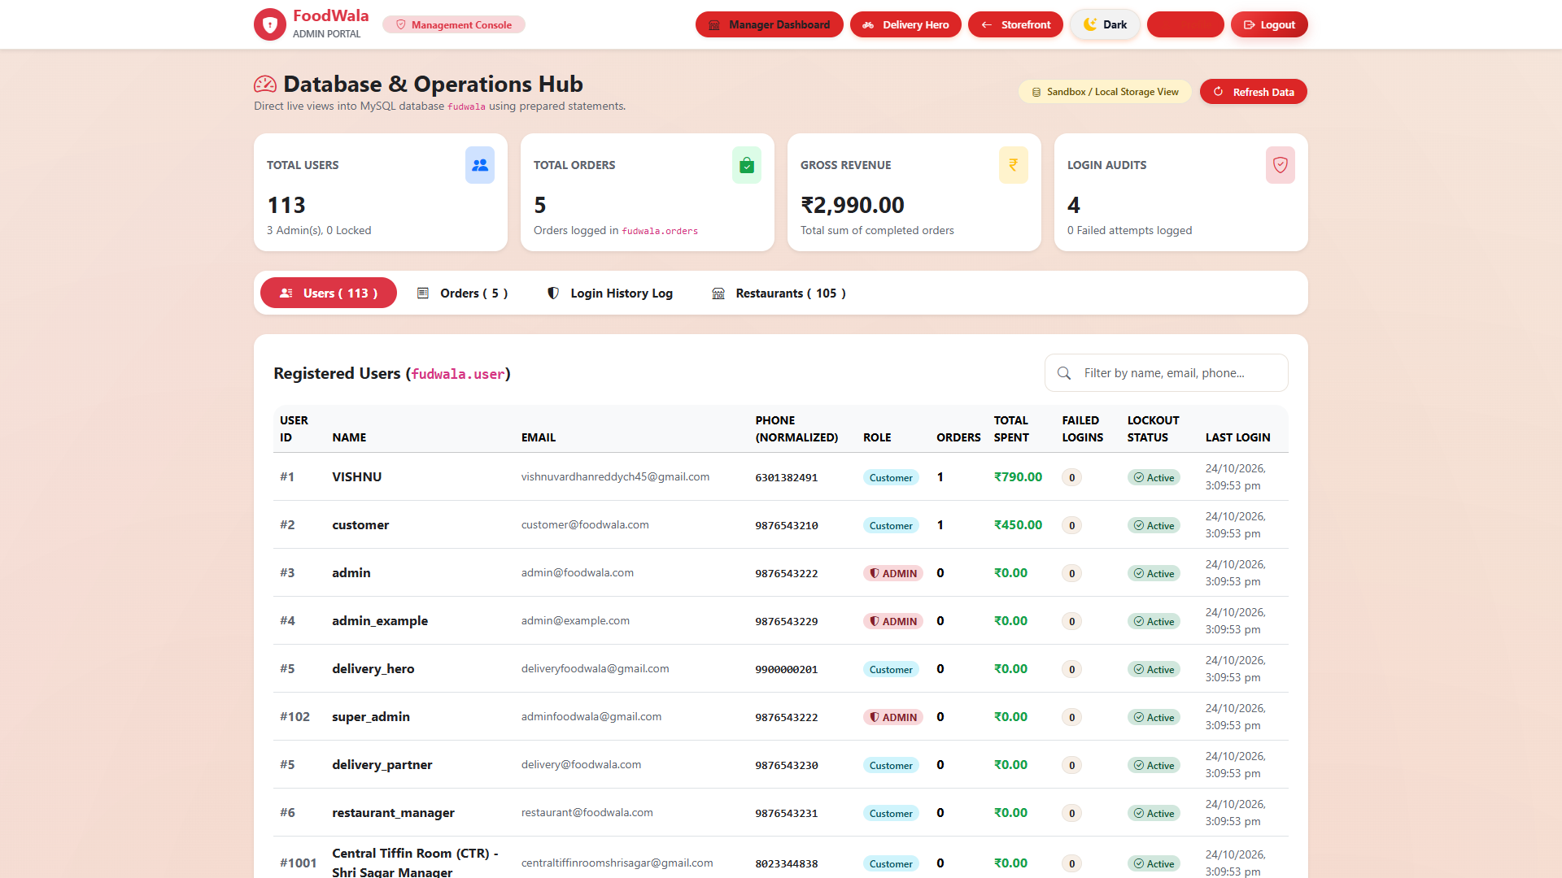
SECTION 5.17
Super Admin Console & Platform Analytics
Platform management dashboard displaying system-wide gross merchandise volume (GMV), active restaurant approvals, user metrics, and revenue charts.
Real Application Screenshot • 1920×1080 Viewport • http://localhost:5000/admin_dashboard.html
FoodWala — Bengaluru Food Discovery & Delivery Platform
Confidential • Project Demonstration • Master Deck

Slide 22
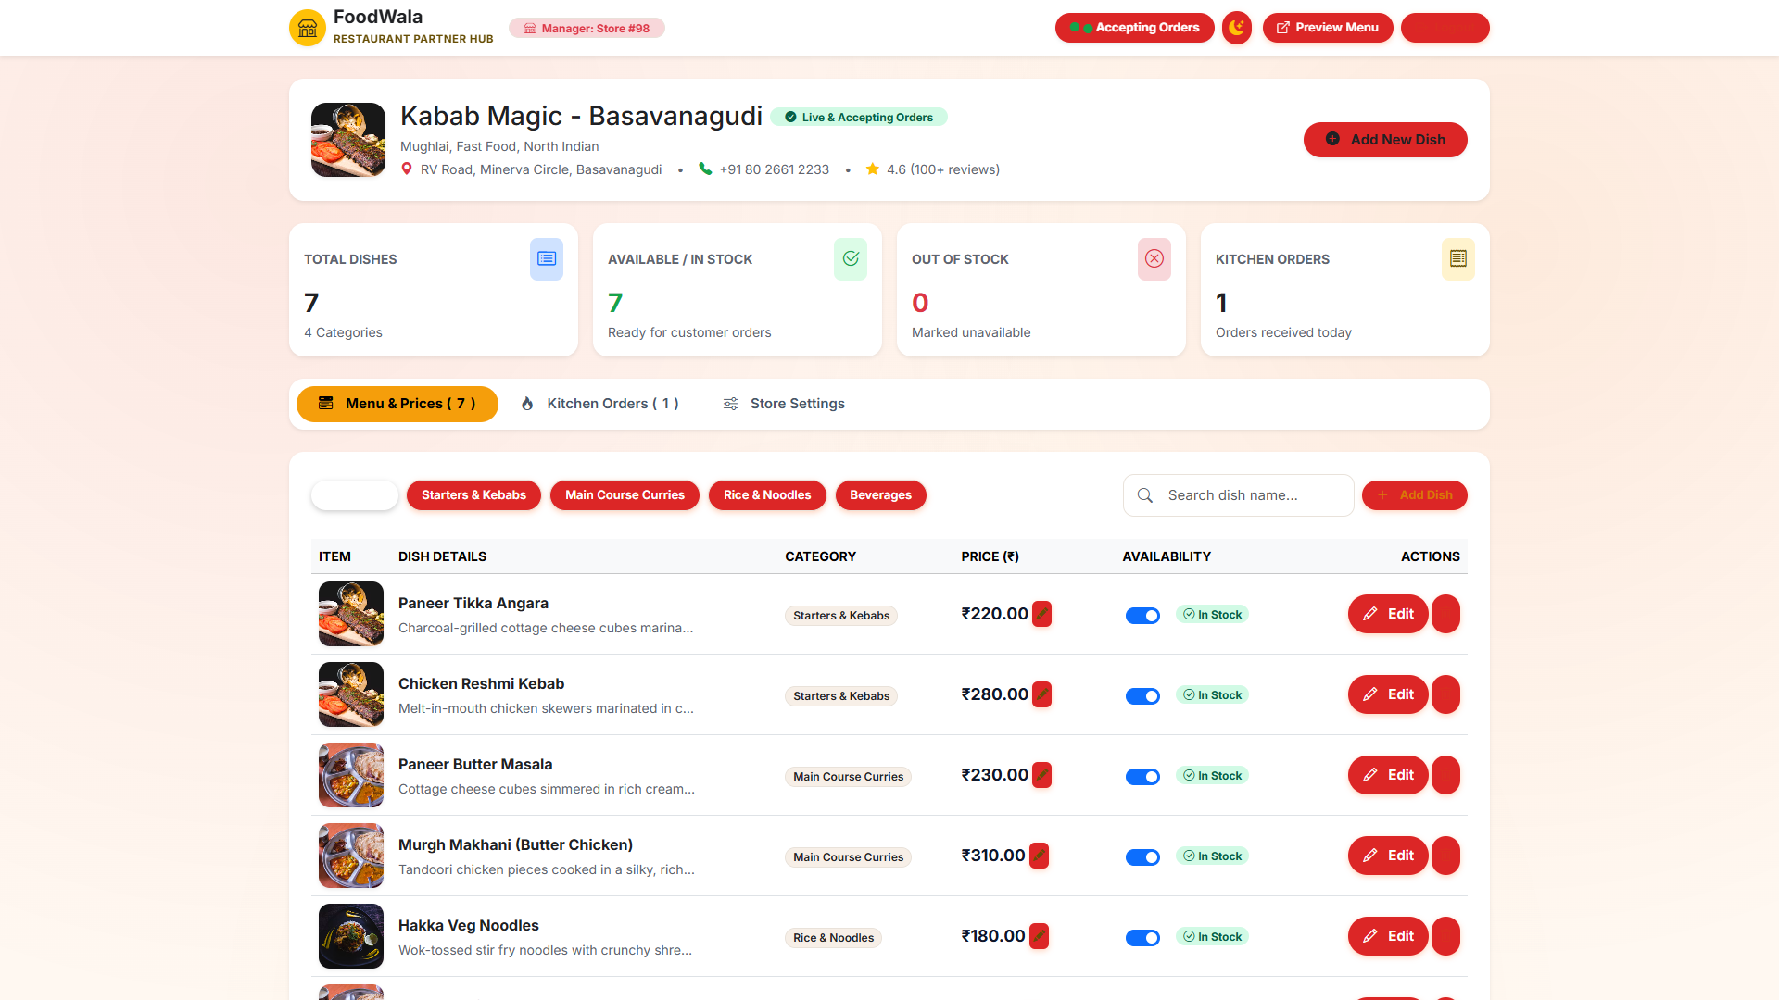
SECTION 5.18
Restaurant Manager Dashboard & Store Isolation
Store-isolated management portal allowing authorized managers to accept/reject incoming orders, update dish availability, and inspect sales trends.
Real Application Screenshot • 1920×1080 Viewport • http://localhost:5000/restaurant_manager_dashboard.html
FoodWala — Bengaluru Food Discovery & Delivery Platform
Confidential • Project Demonstration • Master Deck

Slide 23
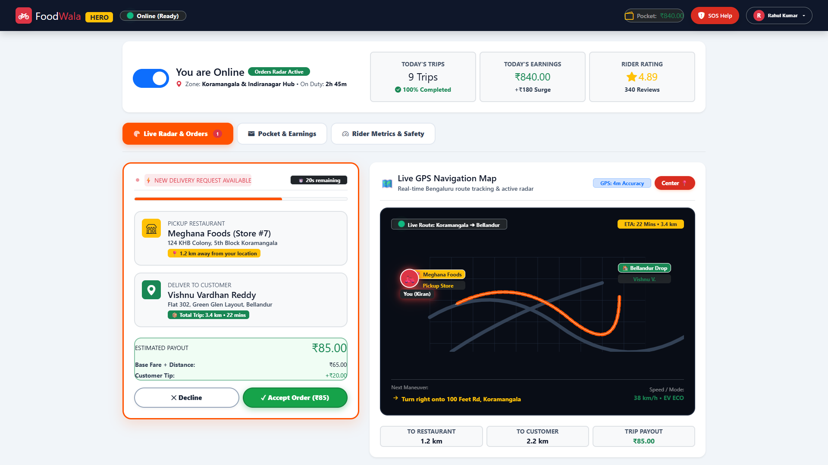
SECTION 5.19
Delivery Partner Fleet Portal
Dedicated driver mobile portal with real-time GPS coordinate reporting, assigned delivery orders list, and order delivery status updates.
Real Application Screenshot • 1920×1080 Viewport • http://localhost:5000/delivery_partner_portal.html
FoodWala — Bengaluru Food Discovery & Delivery Platform
Confidential • Project Demonstration • Master Deck

Slide 24
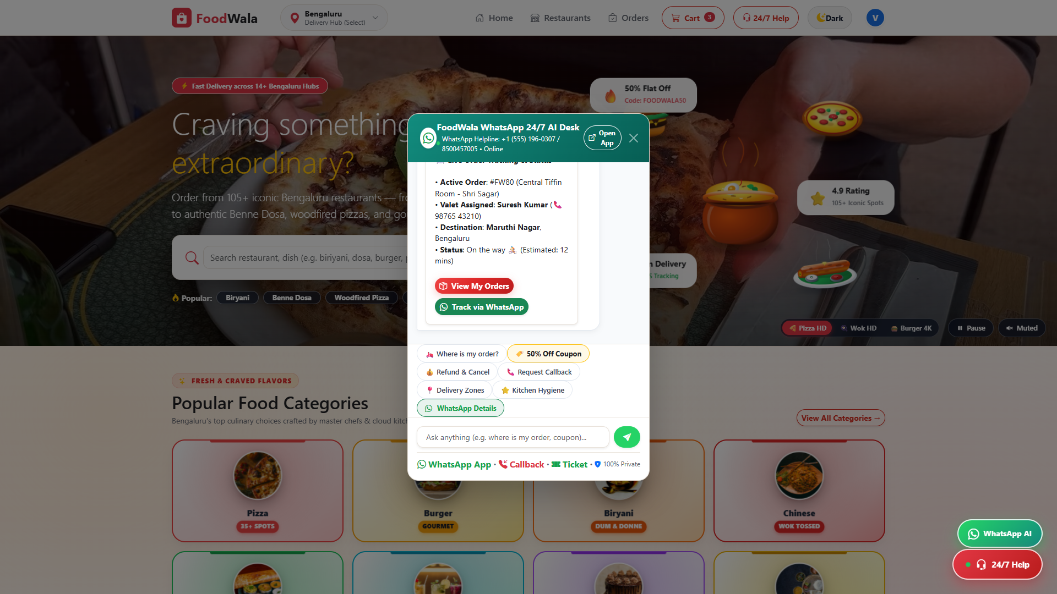
SECTION 5.20
WhatsApp 24/7 AI Assistance Desk
Dual-channel conversational AI assistant resolving customer queries, order status inquiries, menu suggestions, and escalation tickets.
Real Application Screenshot • 1920×1080 Viewport • http://localhost:5000/whatsapp_ai_assistant.html
FoodWala — Bengaluru Food Discovery & Delivery Platform
Confidential • Project Demonstration • Master Deck

Slide 25
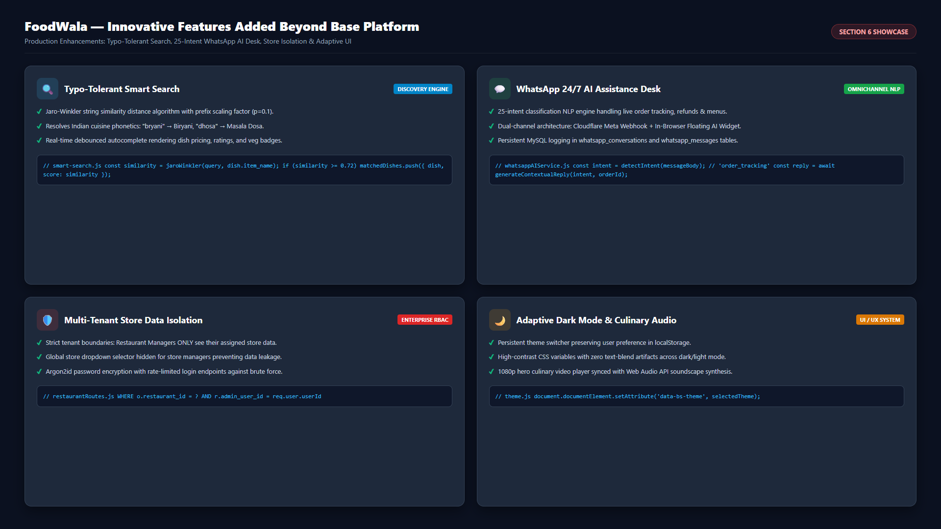
SECTION 6
New Features Added & Innovative Capabilities
Visual showcase of production capabilities built beyond base requirement: Typo Search, WhatsApp AI Desk, Store Isolation, Dark Mode
Key Innovations: 1. Jaro-Winkler Typo Search • 2. 25-Intent WhatsApp AI Desk • 3. Store Data Isolation • 4. Adaptive Dark Mode
FoodWala — Bengaluru Food Discovery & Delivery Platform
Confidential • Project Demonstration • Master Deck

Slide 26
SECTION 7
Important Algorithms & Core Engineering
Mathematical and algorithmic logic driving search similarity, cart billing, transactional integrity, and NLP classification
FUZZY SEARCH
1. Jaro-Winkler String Distance Algorithm
PRICING ENGINE
2. Cart Bill & Discount Computation Engine
Calculates transposition-aware string distance with common prefix bonus l (max 4) and scaling factor p = 0.1:
Deterministic multi-factor calculation computing subtotal, dynamic coupon discounts, taxes, and fees:
Sim(s1, s2) = Jaro(s1, s2) + l * p * (1 - Jaro(s1, s2))
Final = Subtotal - Discount(Code, Subtotal) + (Subtotal * 0.05) + FeePlatform + FeeDelivery
Implementation: Matches user queries with menu item names and restaurant titles even with character swaps and typos.
Implementation: Validates coupon eligibility (min order threshold, max cap, expiration date) in one atomic evaluation.
ATOMICITY
3. ACID-Compliant Order Placement Transaction
NLP CLASSIFIER
4. 25-Intent Rule-Based NLP Classification
Multi-query transactional commit locking rows to prevent race conditions during checkout:
Tokenizes user messages, performs regex-weighted pattern matching, and extracts parameter slots:
START TRANSACTION -> INSERT order -> INSERT order_items -> DEDUCT coupon -> COMMIT
Intent = argmax_i (Score(Pattern_i, Message)) with Slot Extraction [OrderID, Phone, Dish]
Implementation: Java JDBC transaction: con.setAutoCommit(false), atomic multi-table execution, and con.rollback() on failure.
Implementation: Routes message to instant responses (tracking, cancellation, menu) or triggers agent escalation ticket.
FoodWala — Bengaluru Food Discovery & Delivery Platform
Confidential • Project Demonstration • Master Deck

Slide 27
SECTION 8
Major Engineering Challenge & Solution
Architectural breakdown of WhatsApp Cloud API integration, webhook authentication, and fallback resilience
⚠️ The Technical Challenge
✅ Architectural Solution & Dual-Channel Resilience
Meta Cloud API 24-Hour Messaging Window
Dual-Channel Architecture (WhatsApp + Web AI Widget)
WhatsApp Cloud API enforces a strict 24-hour service window. Outbound automated messages cannot reach users unless user-initiated within the timeframe or registered as approved business templates.
Decoupled the AI intelligence layer into a shared standalone service. When WhatsApp API token expires or tunnel drops, the in-browser floating AI widget (#foodwalaHelpModal) provides 100% identical response capabilities.
Servlet Stream Consumption & HMAC-SHA256 Verification
Custom CachedHttpServletRequestWrapper (Filter Pattern)
Incoming payment & webhook payloads require raw cryptographic signature verification (HMAC-SHA256). In standard Java Servlets, reading getInputStream() consumes the stream, preventing downstream parameter parsing.
Engineered a Servlet Filter implementing HttpServletRequestWrapper to cache the raw byte stream in memory, enabling both HMAC-SHA256 crypto validation and JSON parameter extraction without stream exhaustion.
Transient Tunnel Drops During Demos
Self-Healing Cloudflare Tunnel Scripting
Local development tunnels (Cloudflare) occasionally reset connection hostnames, severing the webhook callback endpoint during live evaluative demonstrations.
Automated background watchdog daemon monitoring tunnel health and dynamically updating webhook callback routing without server restarts.
Result: Zero downtime for end users • Instant fallback to browser AI desk if WhatsApp Cloud API is inaccessible.
FoodWala — Bengaluru Food Discovery & Delivery Platform
Confidential • Project Demonstration • Master Deck

Slide 28
SECTION 9
Future Enhancements & Platform Roadmap
Strategic technical roadmap for high-scale microservices, automated logistics, and smart AI personalization
01
Bidirectional WebSocket Fleet Tracking
02
Collaborative AI Dish Recommendation Engine
Upgrade from periodic HTTP polling to real-time Socket.IO / WebSockets for sub-second GPS coordinate streaming between delivery partners and customer tracking screens.
Deploy collaborative filtering and neural matrix factorization analyzing ordering patterns, time of day, weather, and dietary tags to suggest high-conversion meals.
03
Progressive Web App (PWA) & Offline Menus
04
Multi-Restaurant Unified Cart Checkout
Implement Service Workers and Cache API to enable instant offline menu browsing and native Web Push notifications for order status transitions.
Enable customers to combine dishes from multiple nearby restaurants into a single unified cart with intelligent dual-pickup route batching.
05
Algorithmic Route Optimization & Dispatch
06
Multilingual Voice Food Ordering (Kannada / Hindi)
Integrate Dijkstra / A* route graph optimization taking Bengaluru traffic congestion data into account to assign nearest optimal delivery riders.
Integrate speech-to-text NLP allowing Bengaluru users to search menus, customize toppings, and place orders using vernacular voice commands.
Roadmap Timeline: Q1 2027 — Q4 2027 • Architectural Evolution from Monolith to Event-Driven Microservices
FoodWala — Bengaluru Food Discovery & Delivery Platform
Confidential • Project Demonstration • Master Deck

