Slide 1


Slide 2
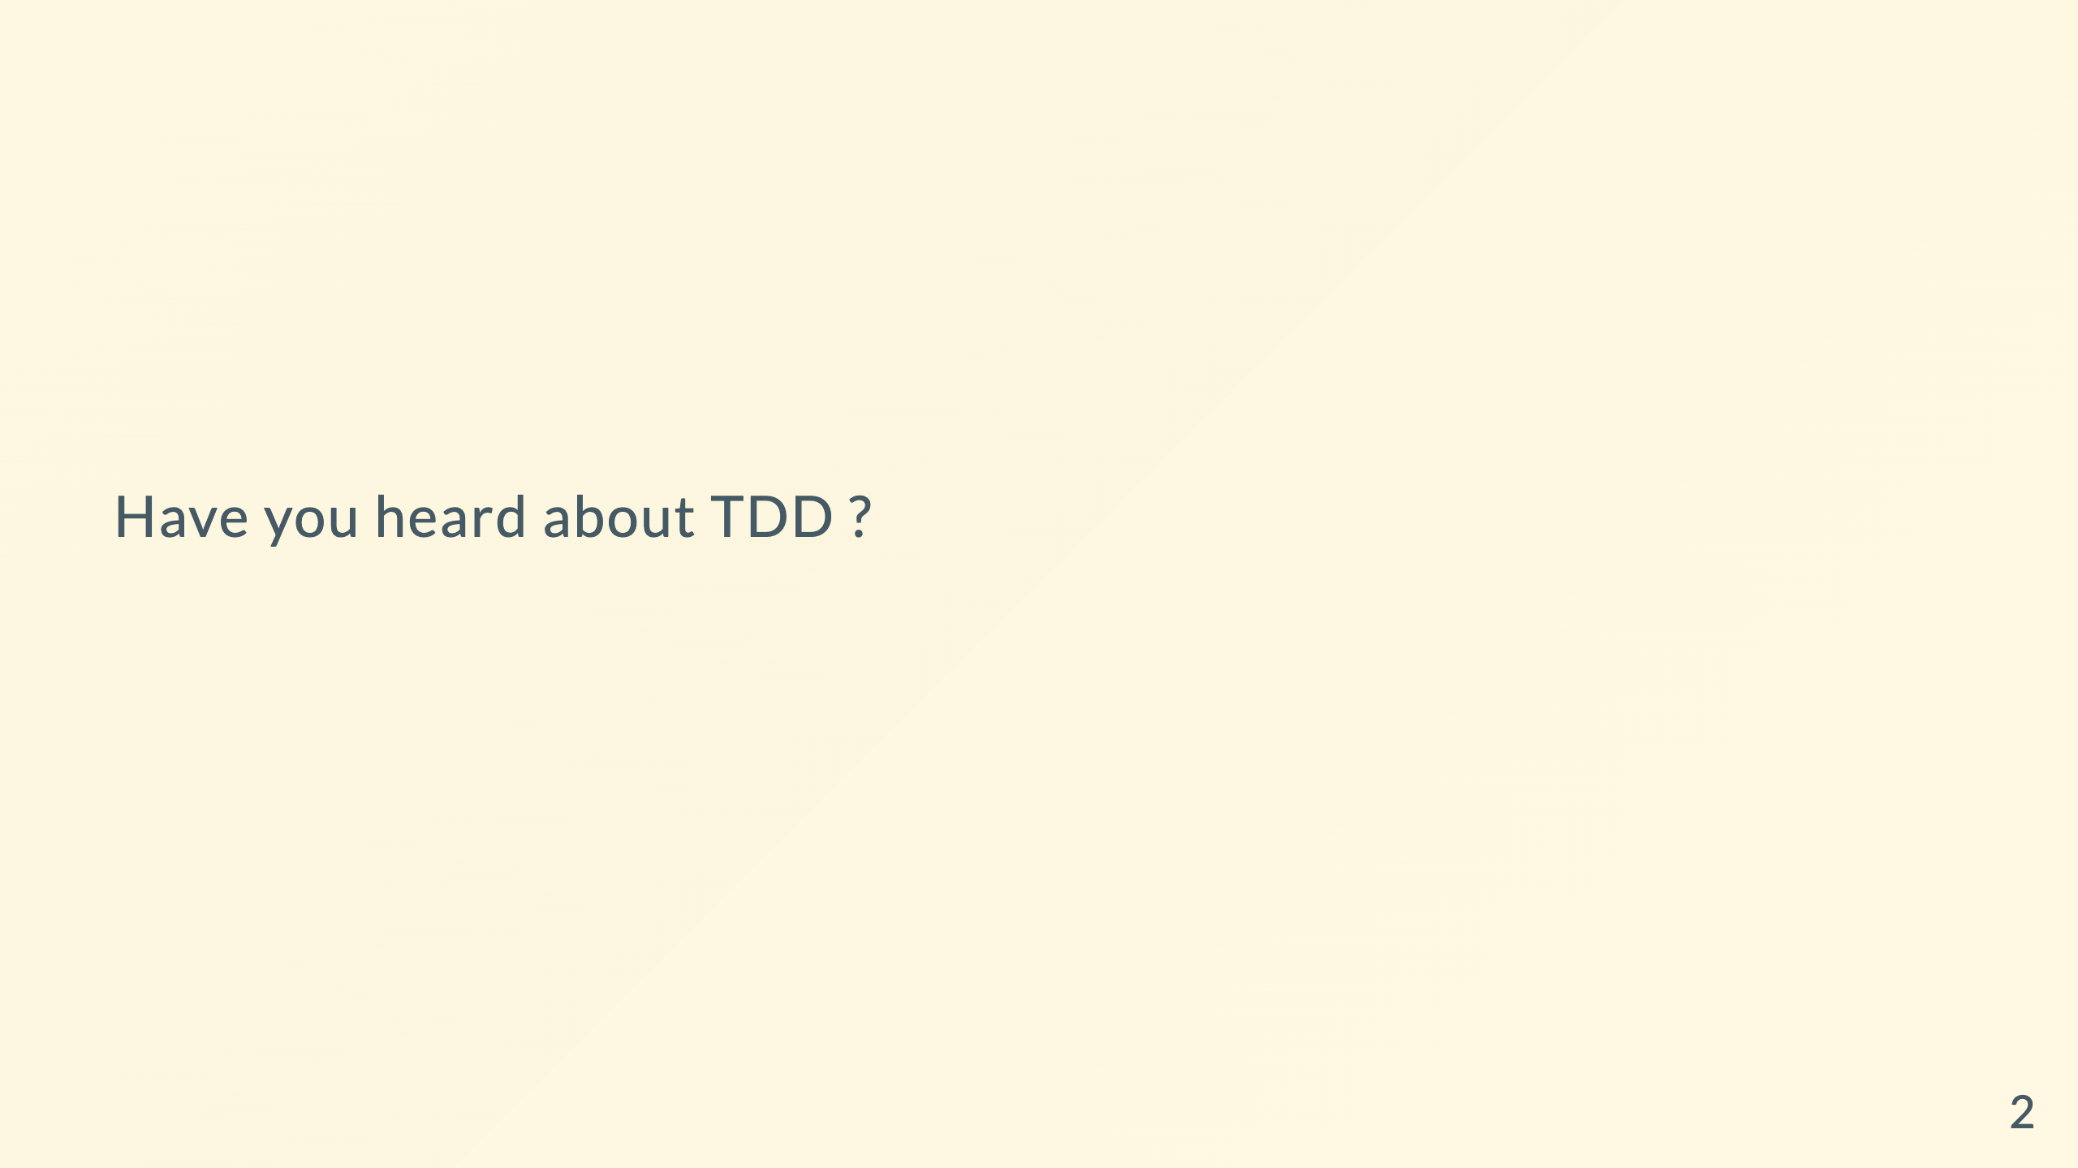

Slide 3
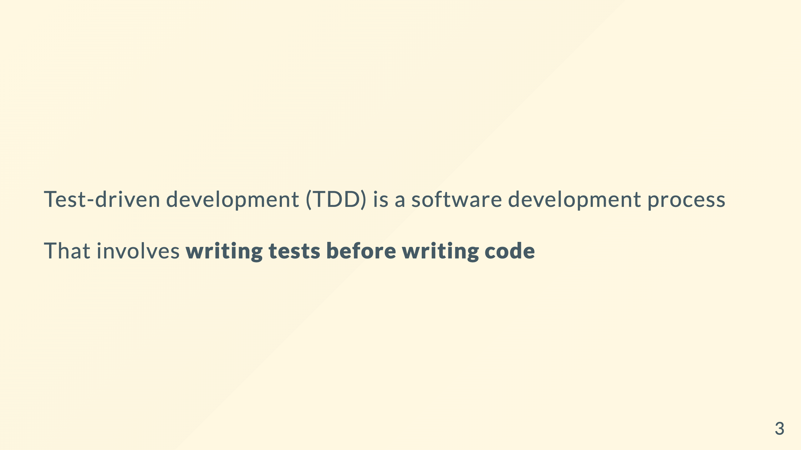

Slide 4
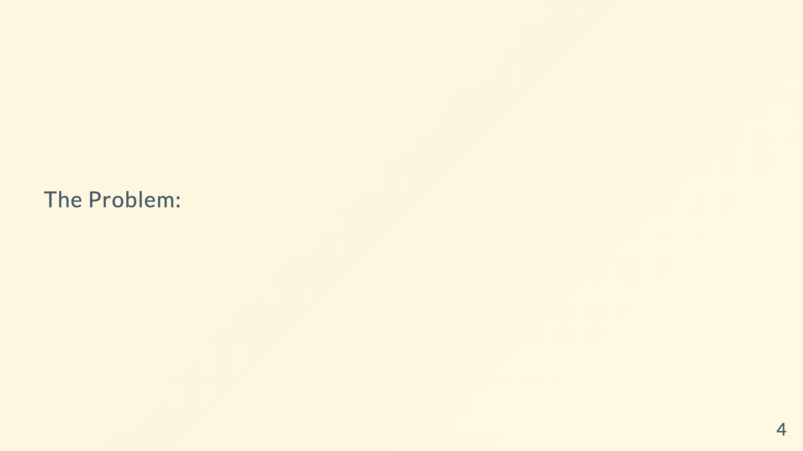
Notes:
Most Developers don't stay in a project long enough that they have found mistakes in what they did.

Slide 5
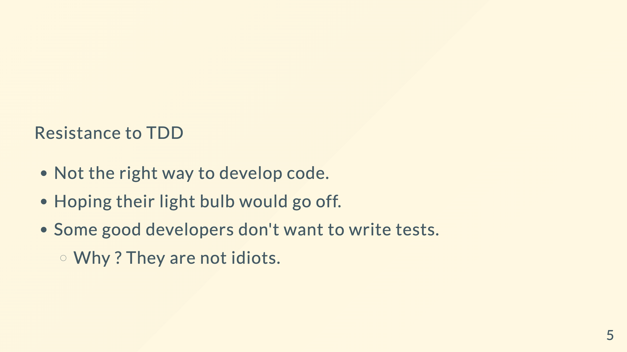
Notes:
Notes: Junior dev's need tdd. Experienced dev's don't need it.

Slide 6
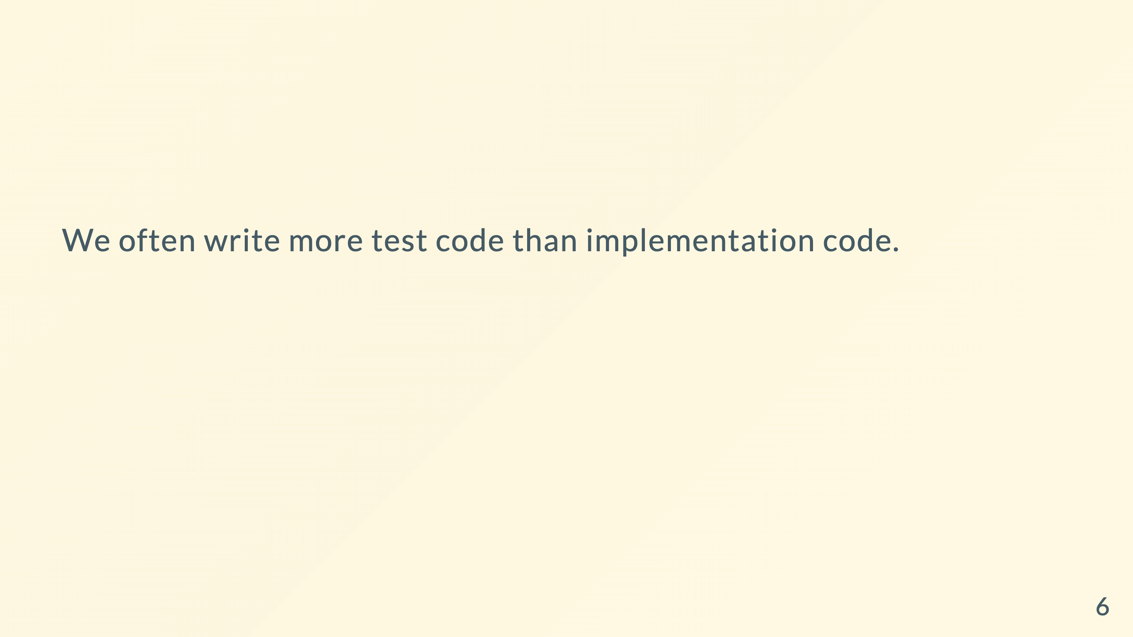
Notes:
Product don't like us writing tests.

Slide 7

Notes:
Writing the tests
Refactoring : When we change existing code we have a lot of breaking tests
Test with lot of mocks

Slide 8

Notes:
We should be able to refactor our code keep it clean. And it does not have to rot.
Our tests will enable us to refactor
Refactoring keeps the code healthy
The tests became our obstacles.

Slide 9
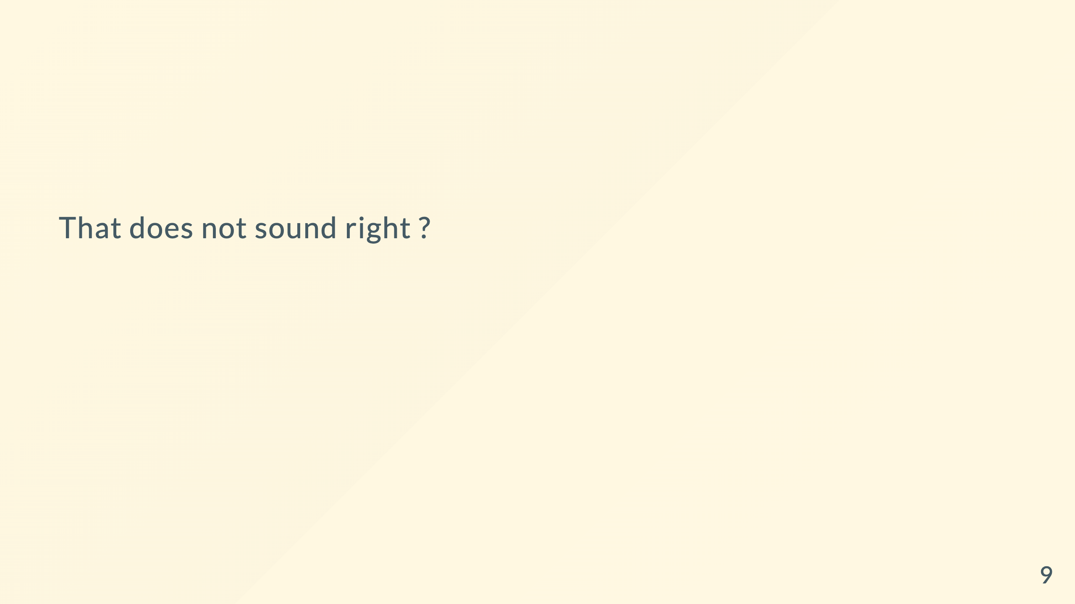
Notes:
Surely what Martin Fowler and kent were telling us about refactoring was that refactoring was changing the implementation details without breaking tests
2009-2010: Papers and book talking about Don't do Test Driven development.

Slide 10
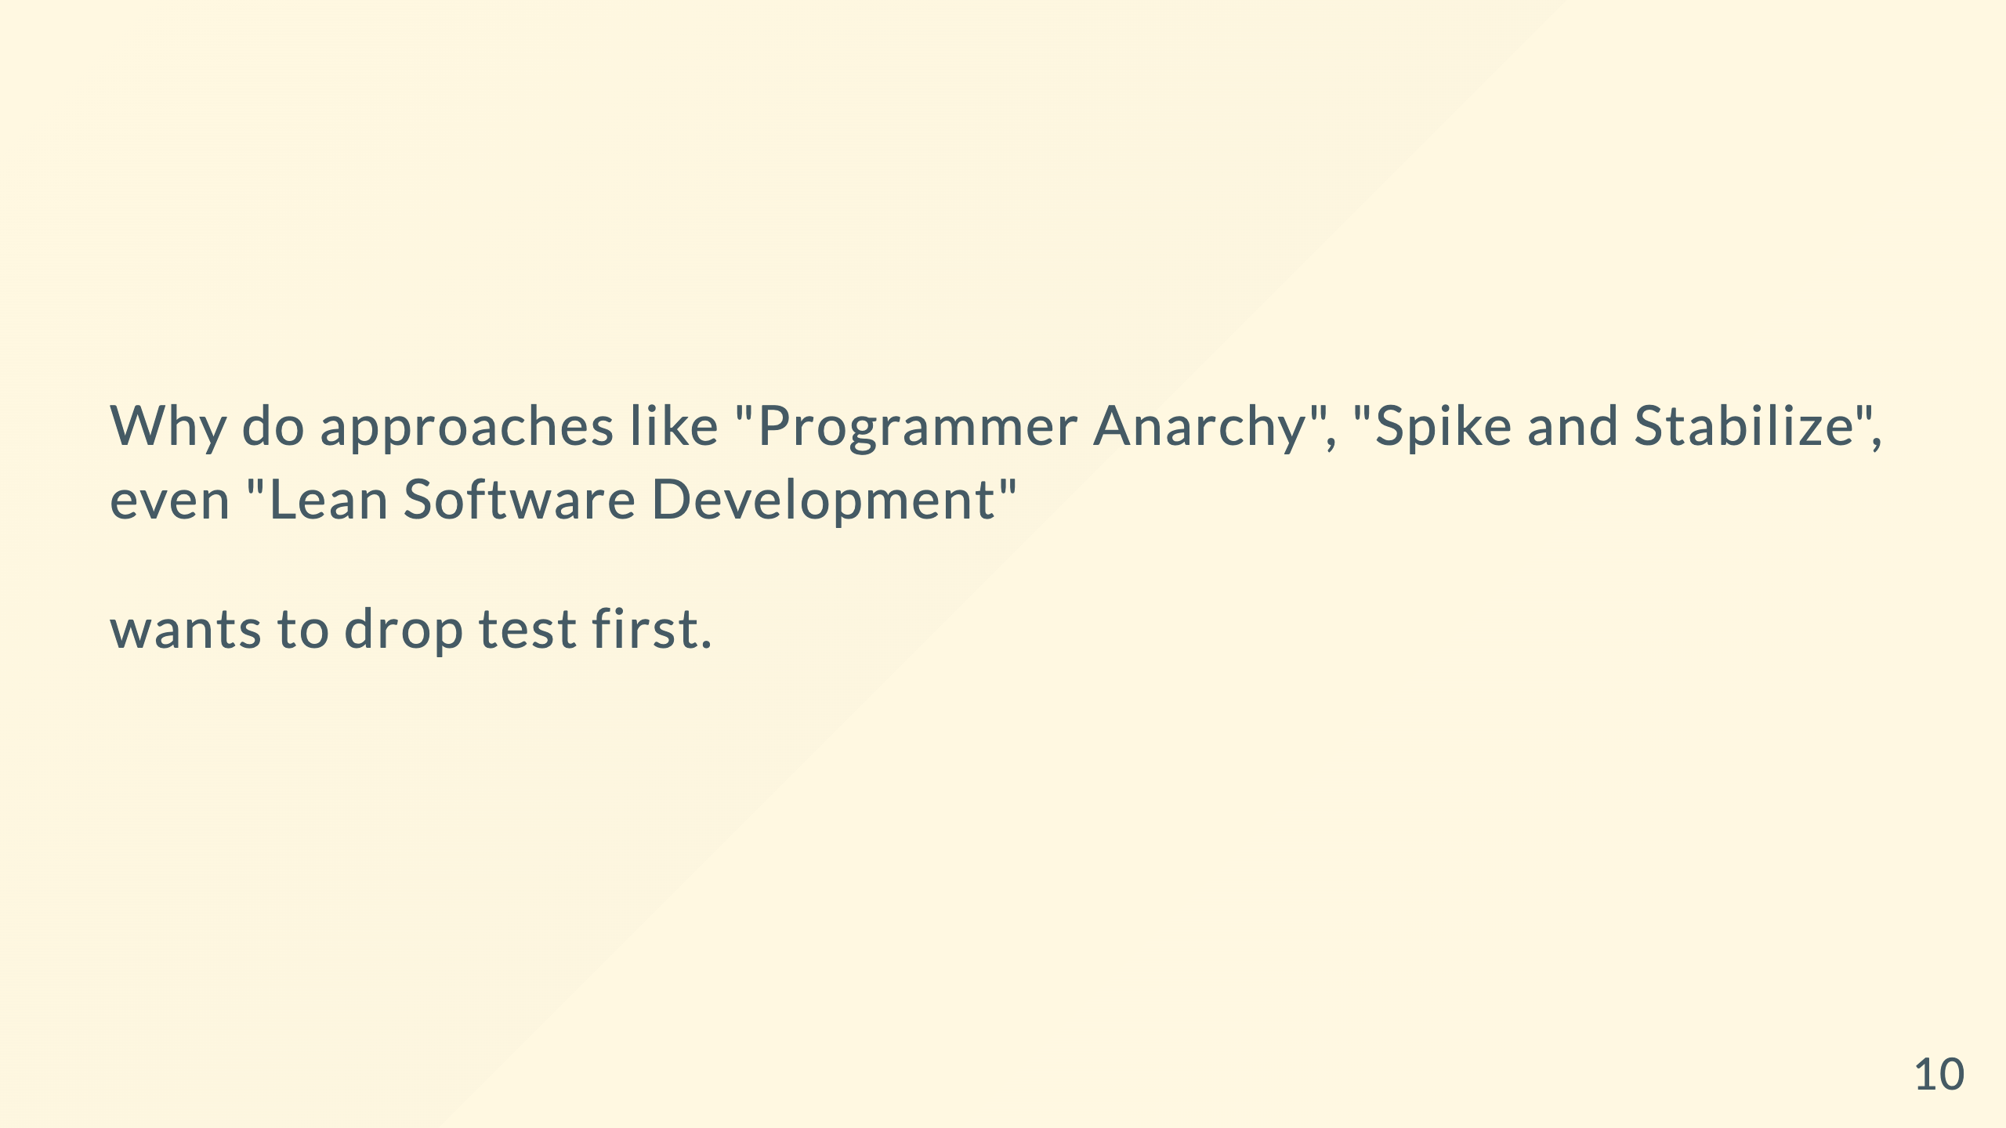
Notes:
Startups going the Ship code faster let it break and we'll fix it even faster

Slide 11
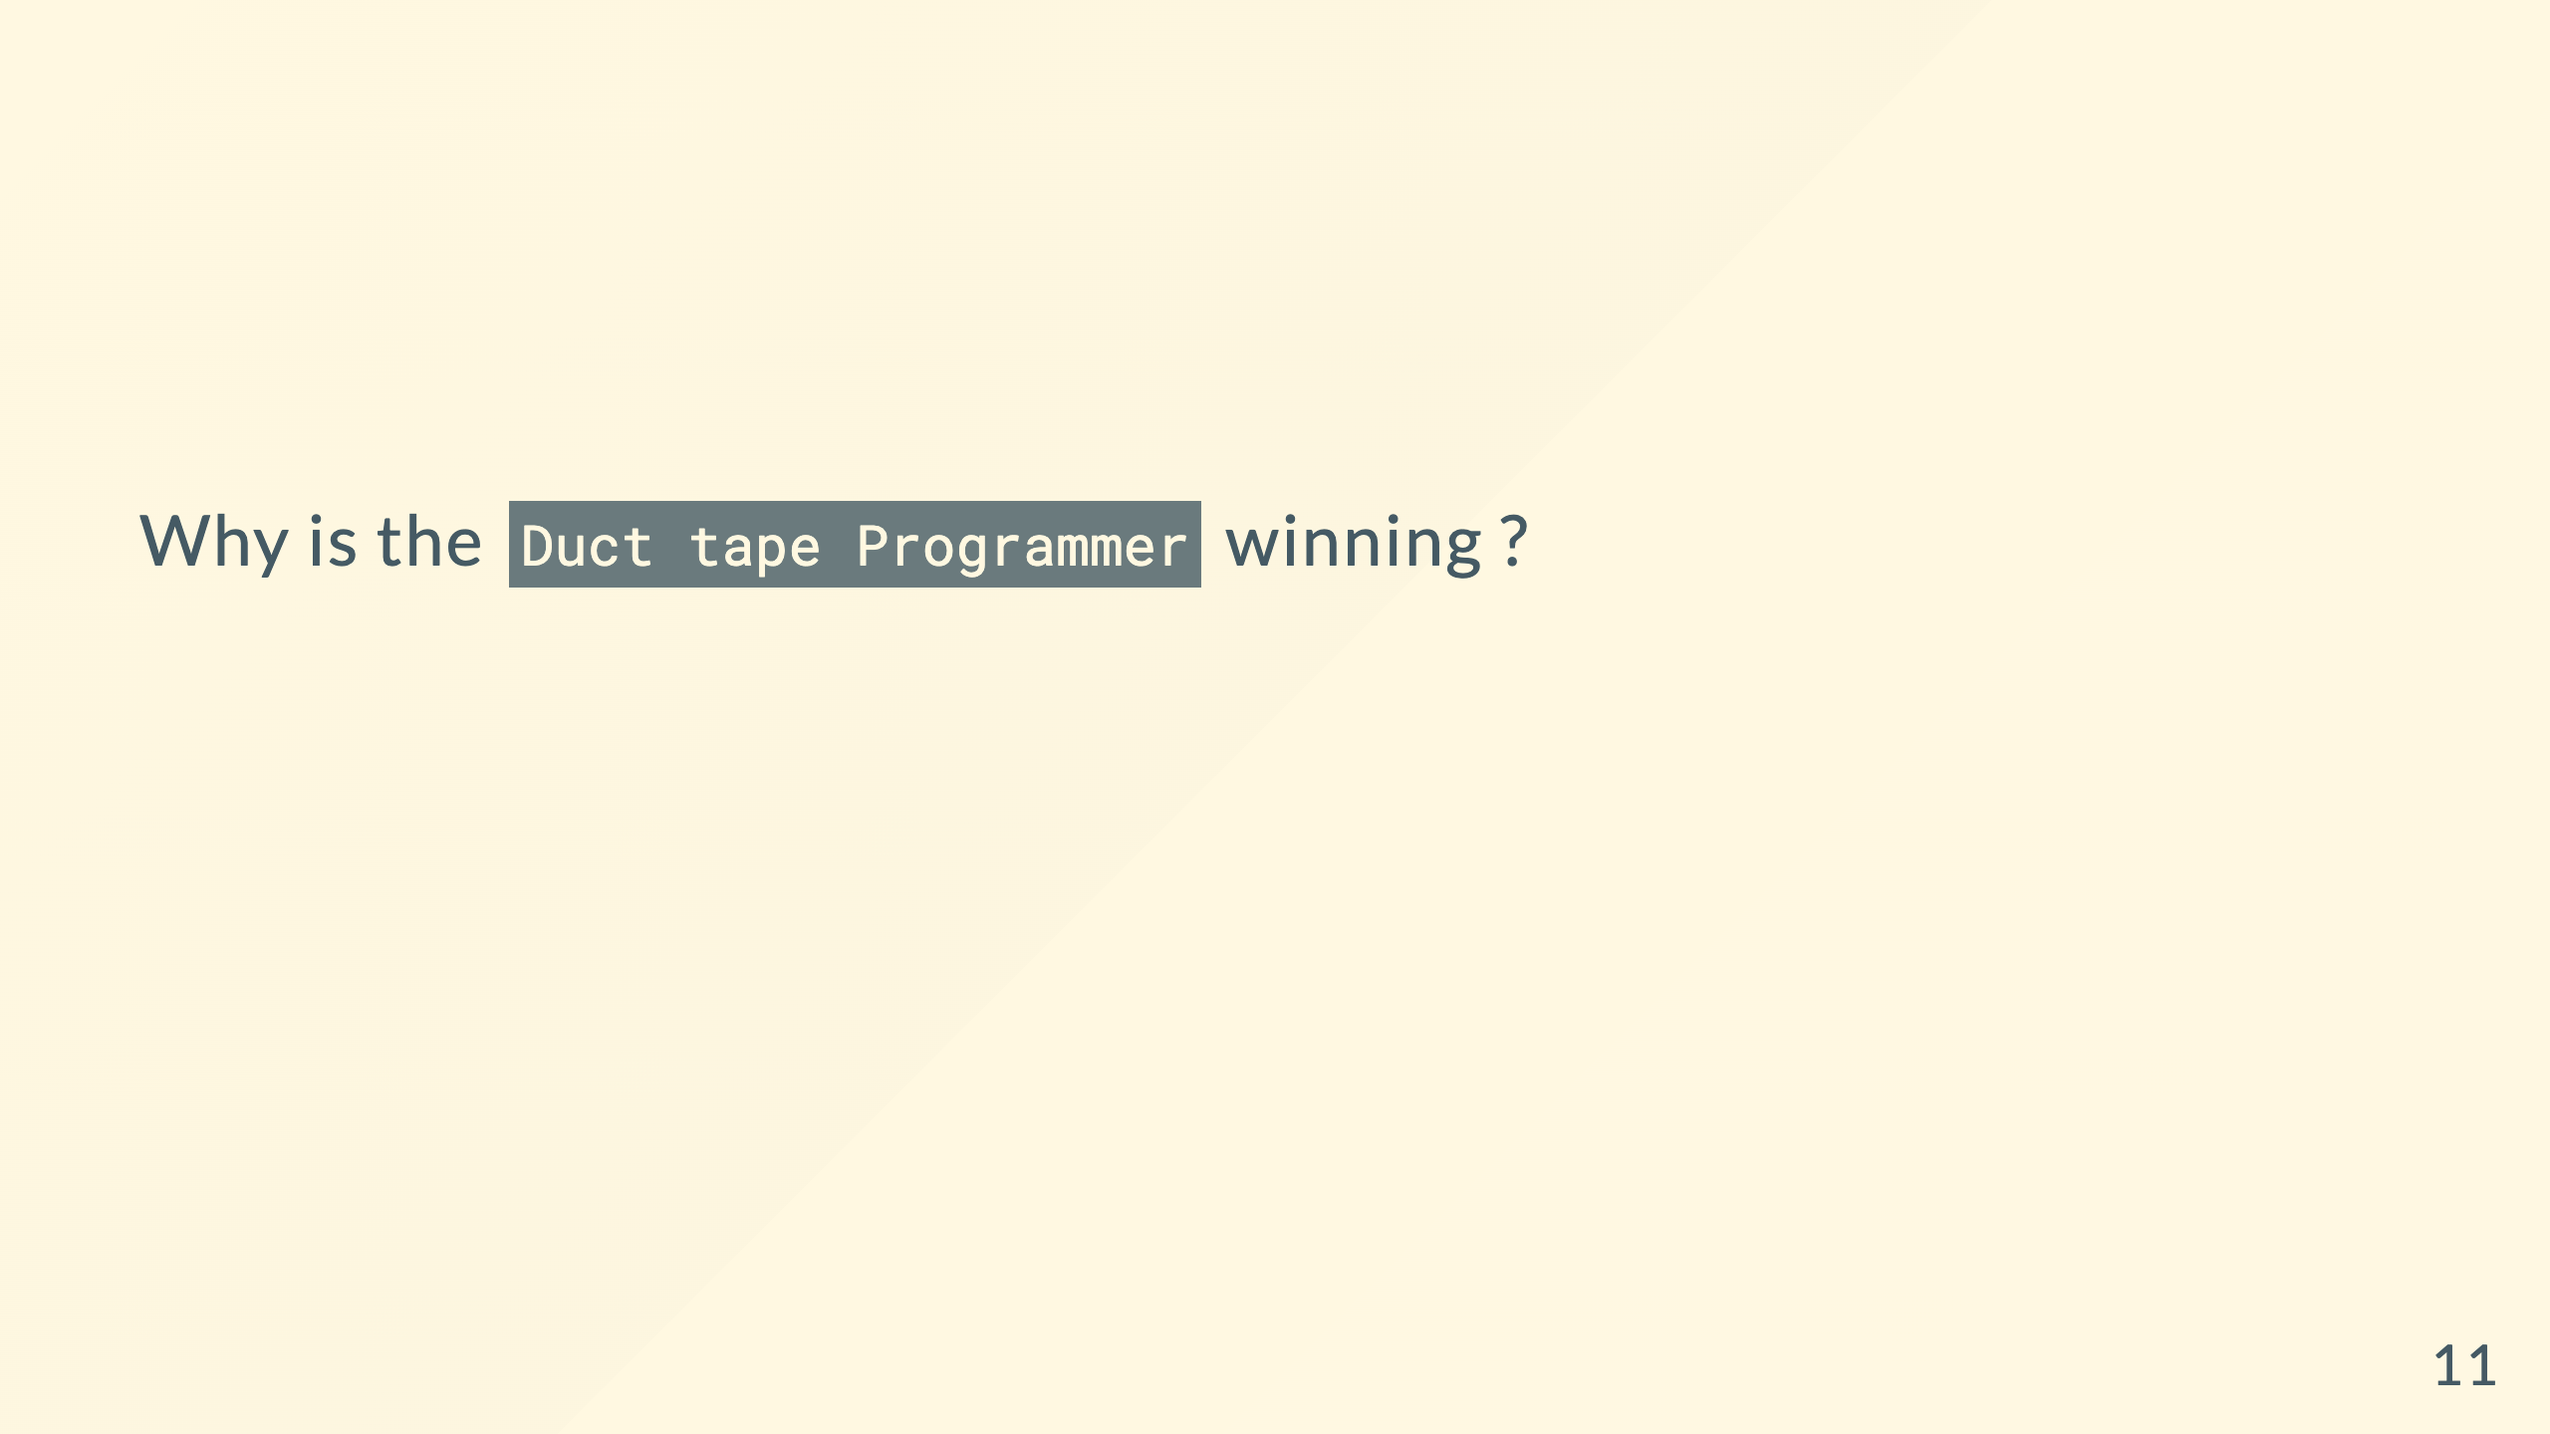
Notes:
What is duct tape programmer
Product likes Bob
Bob ships code
Others have to maintain Bob's code

Slide 12
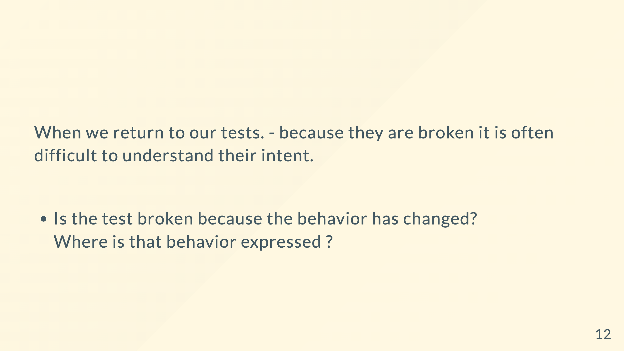
Notes:
What is actually under test ?
Only the mock is being tested ?
Should we just delete them

Slide 13
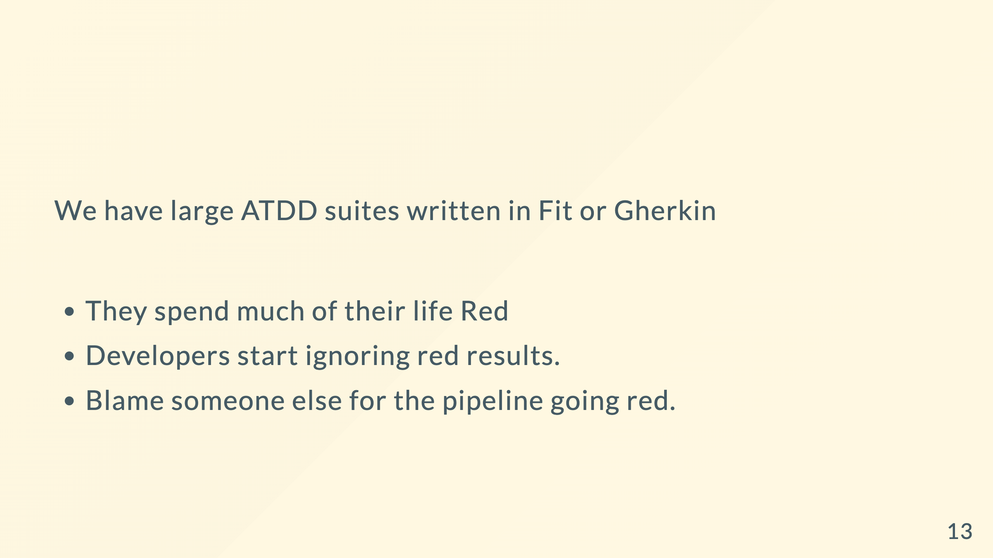
Notes:
ATDD : Acceptance Test-Driven Development
cucumber etc
They are slow, Interruptions
Dev's hate it and never check them

Slide 14
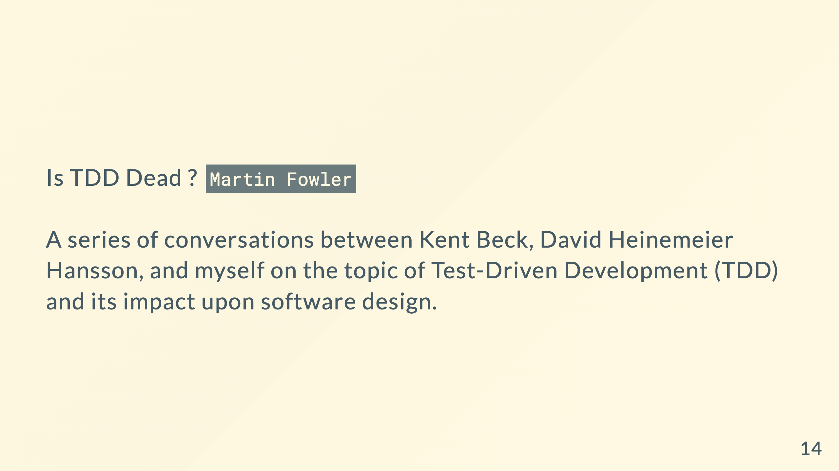

Slide 15


Slide 16

Notes:
More people preach tdd than ones who have read the book
It covers more than just the basics with topics on patterns, smells, mocks etc.

Slide 17
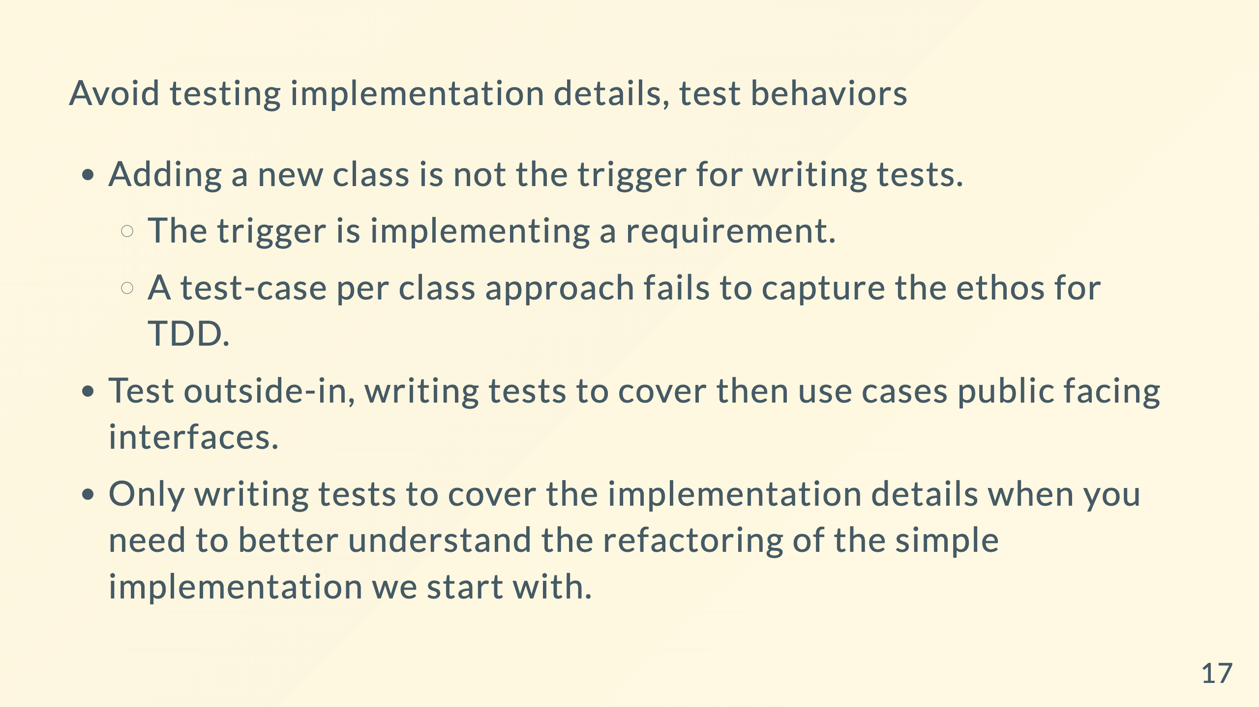

Slide 18
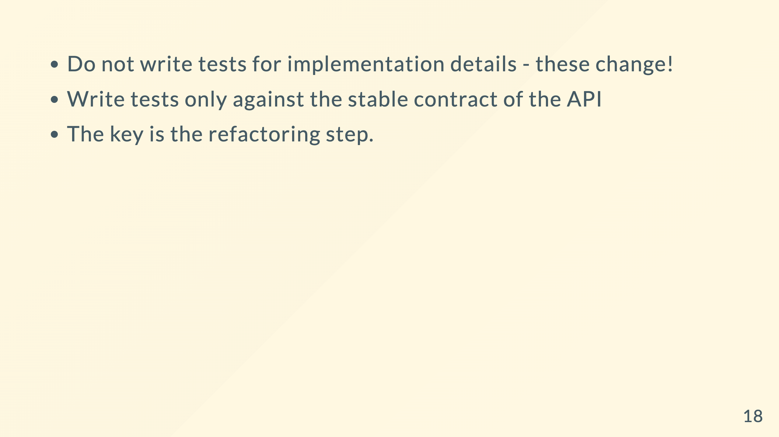
Notes:
Refactoring is the goal

Slide 19
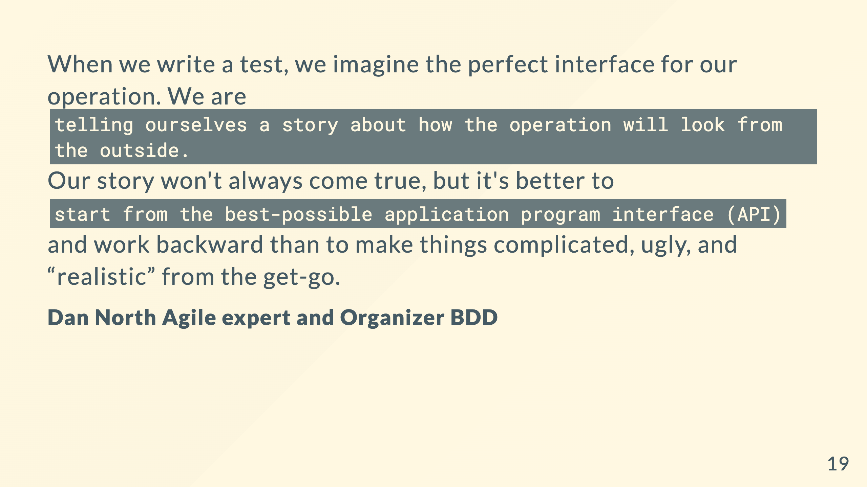
Notes:
Objective of TDD : What should this look like and how it should work?

Slide 20
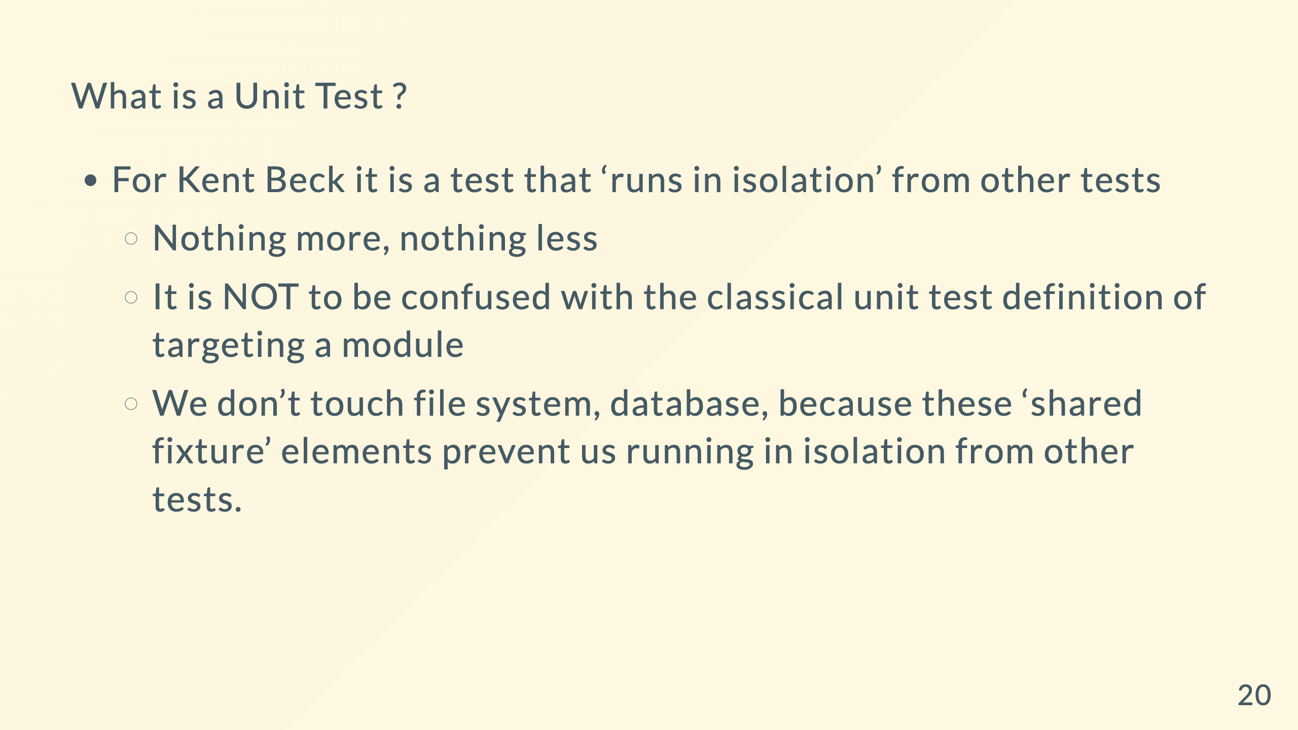
Notes:
If no shared Fixture problem its totally fine to talk to a database etc.

Slide 21
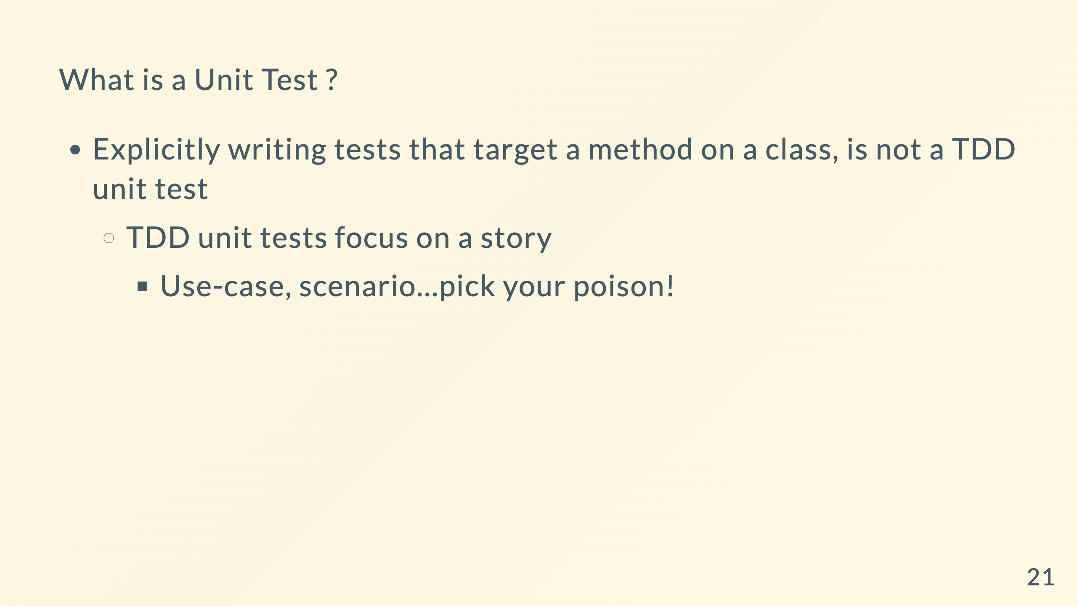

Slide 22
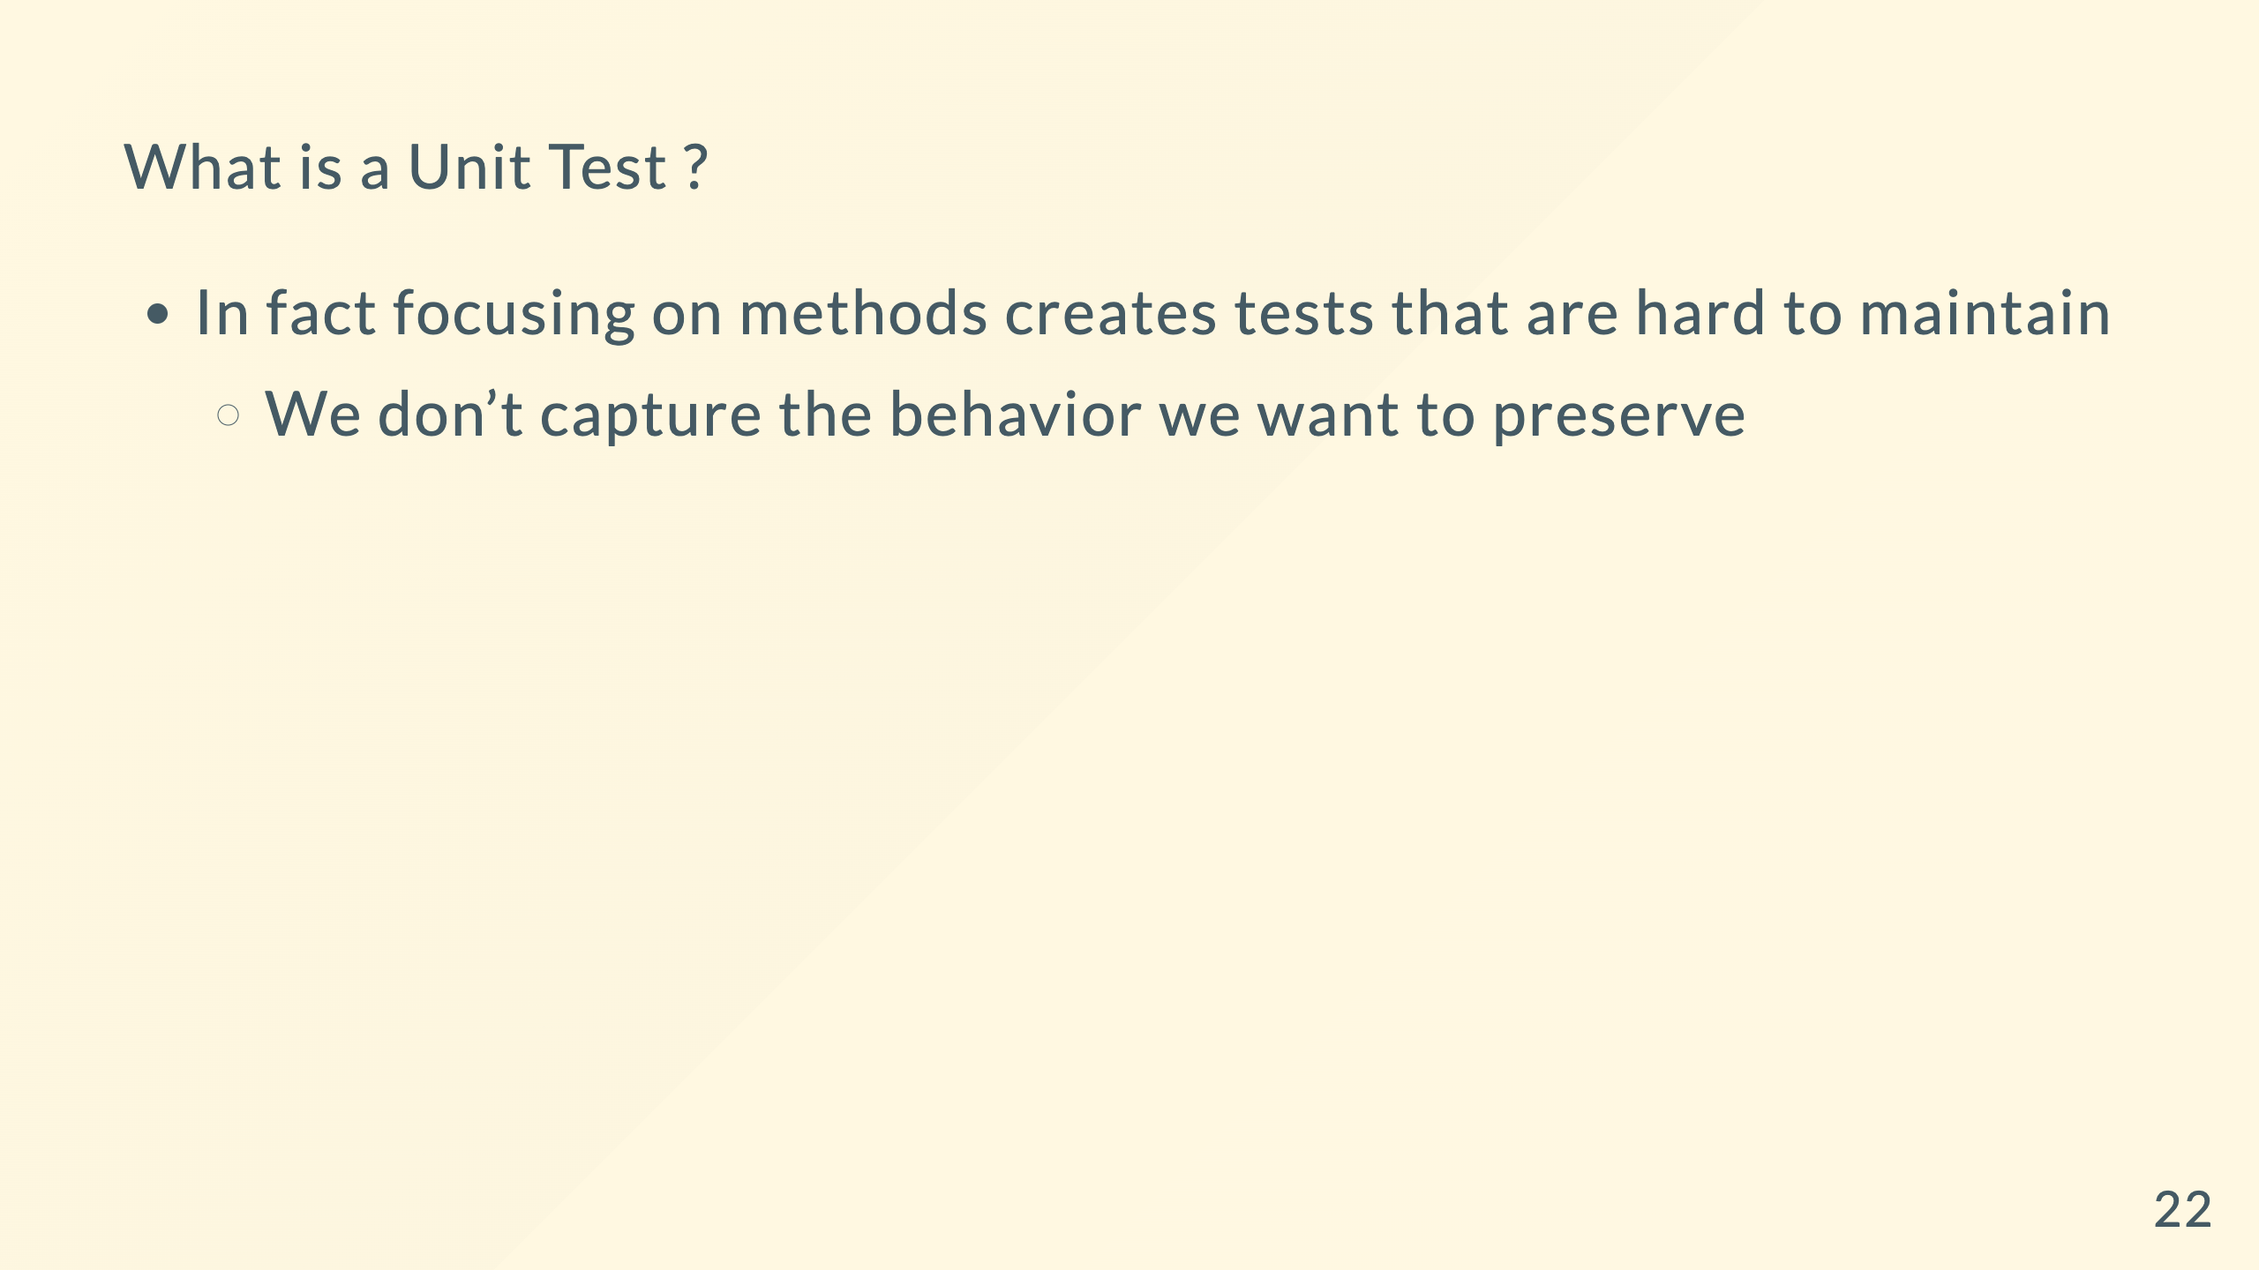
Notes:
But touching is fine in a developer test - with the shared fixture and slow constraint

Slide 23
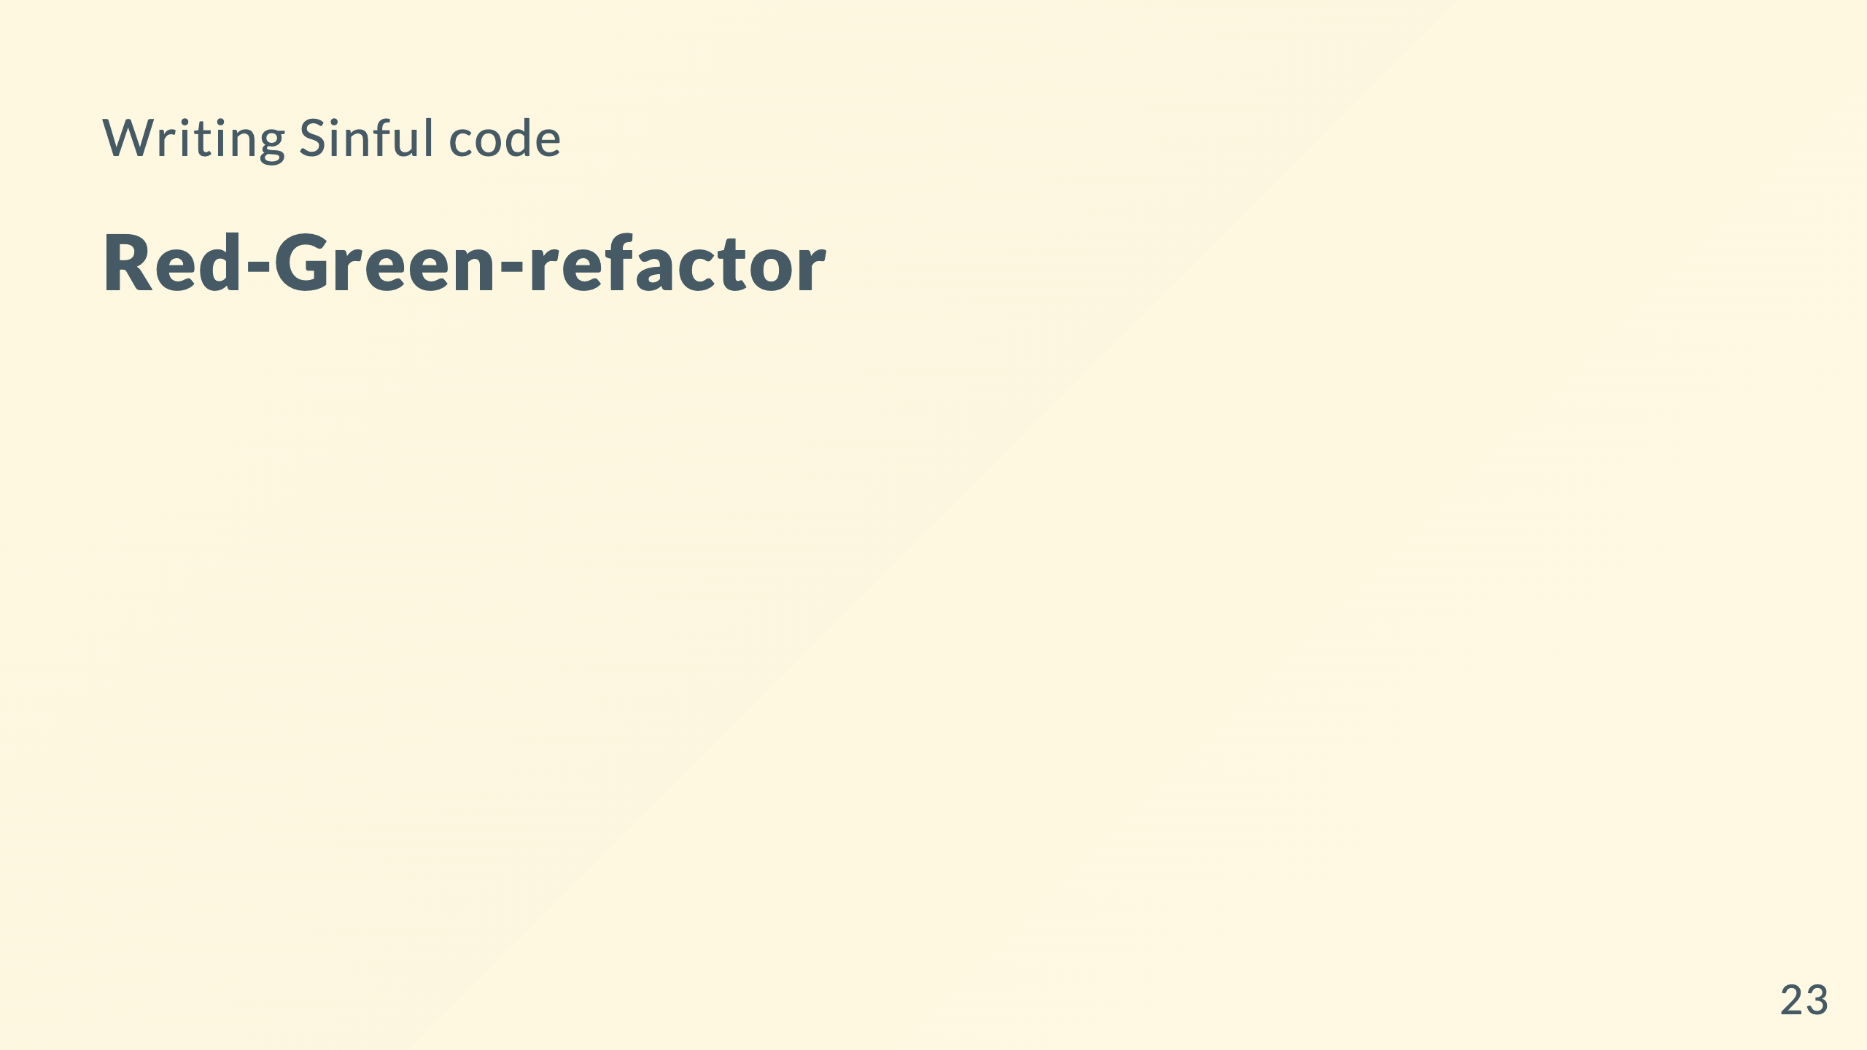

Slide 24
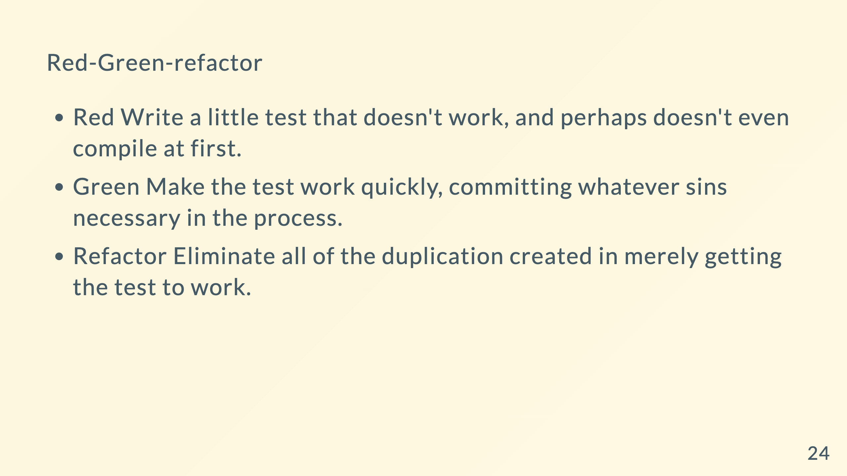
Notes:
Green Be a duct tape programmer

Slide 25
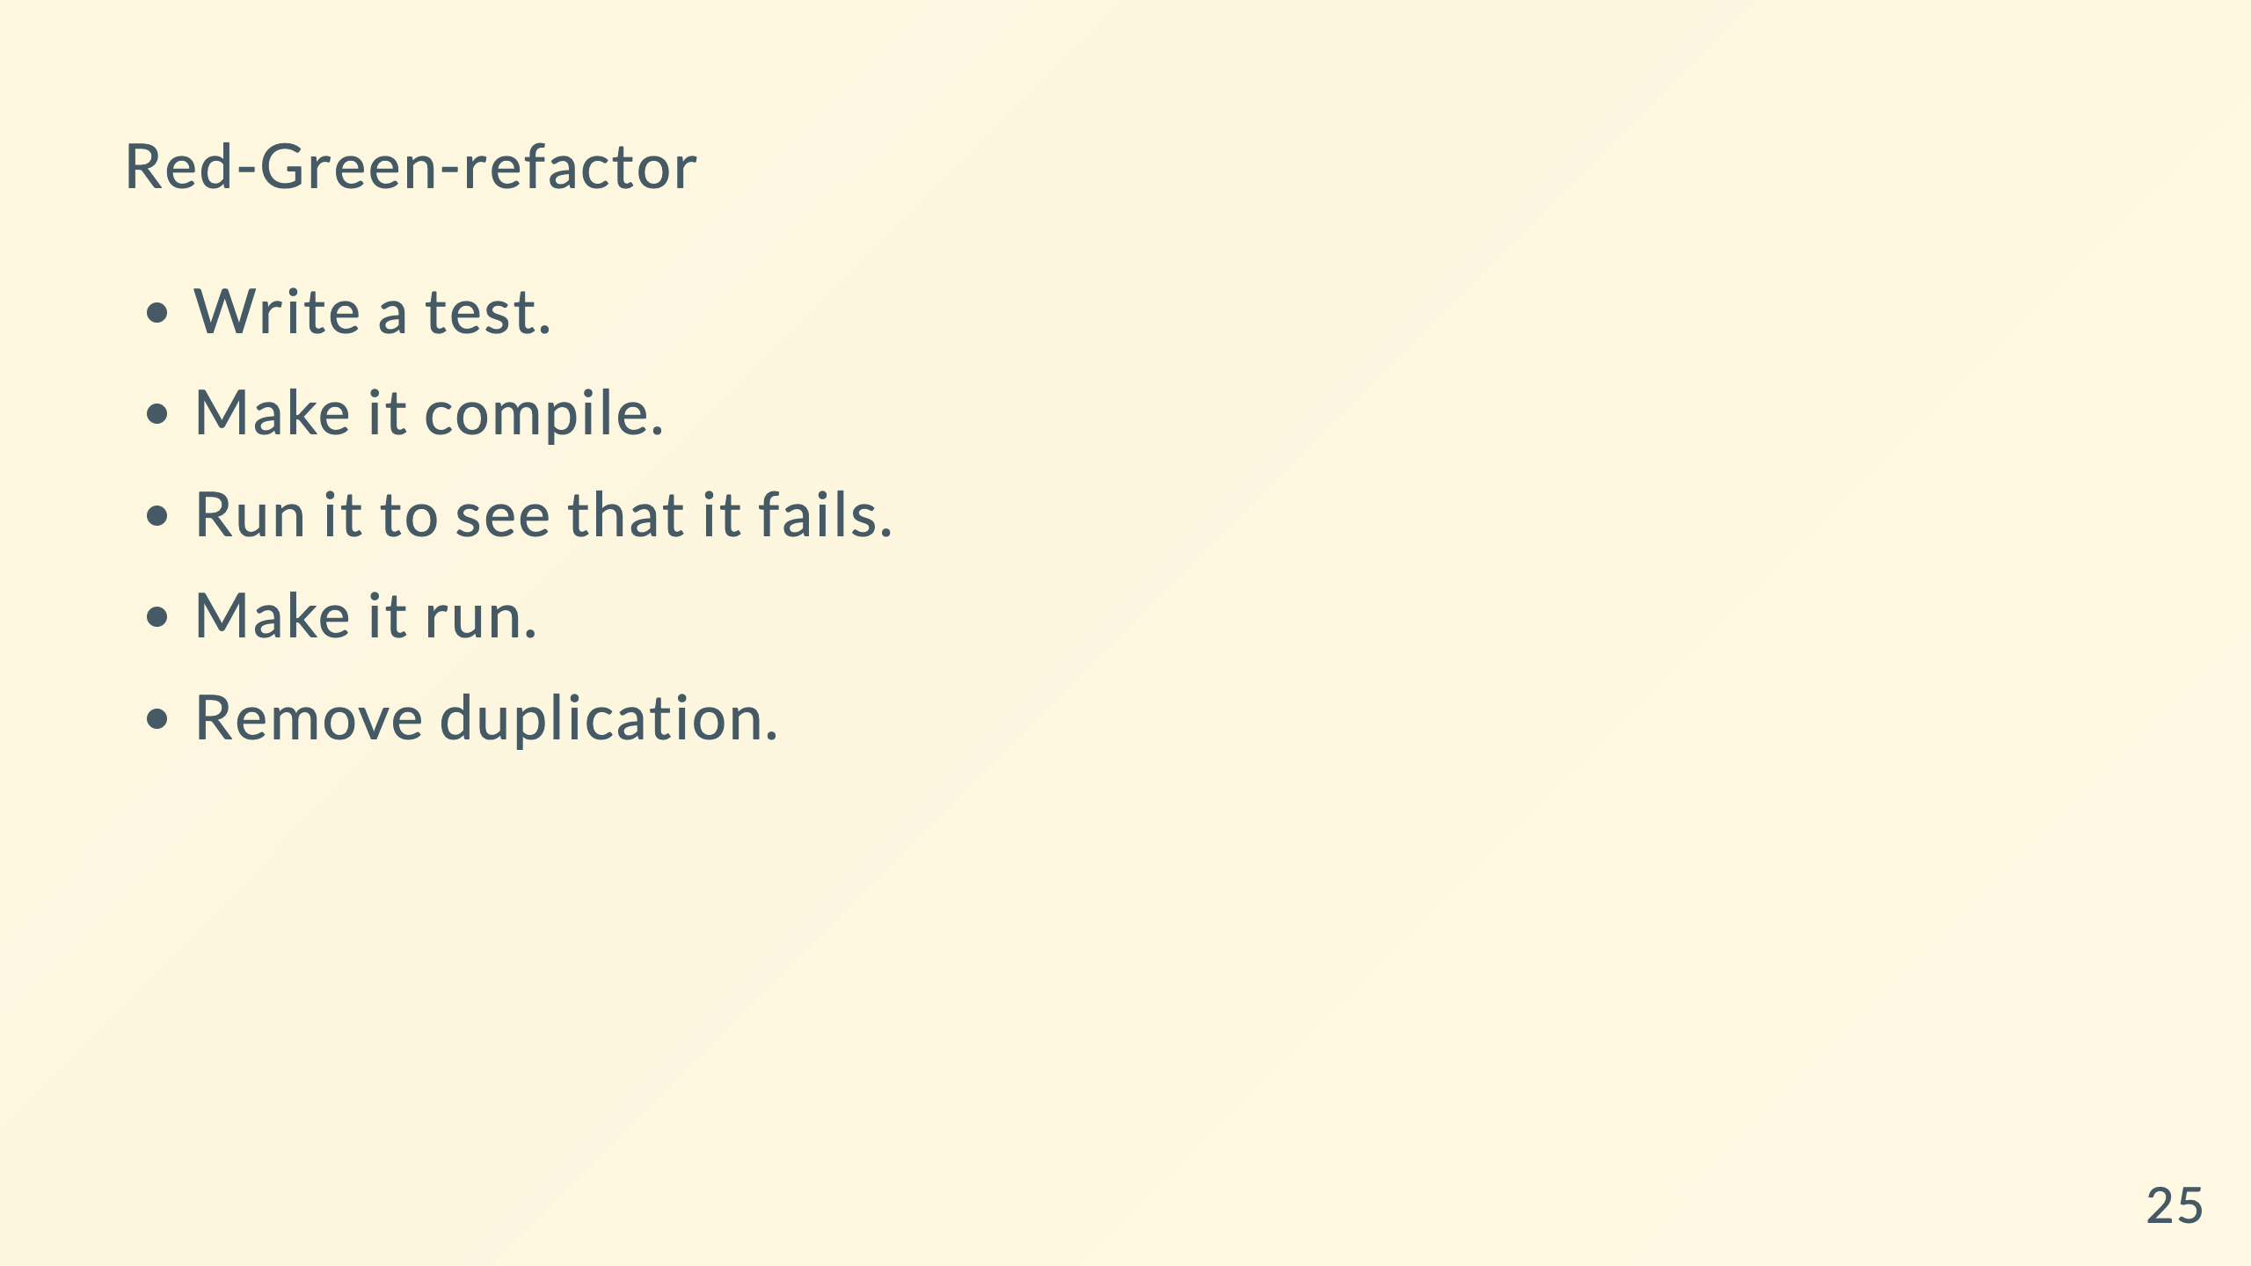

Slide 26
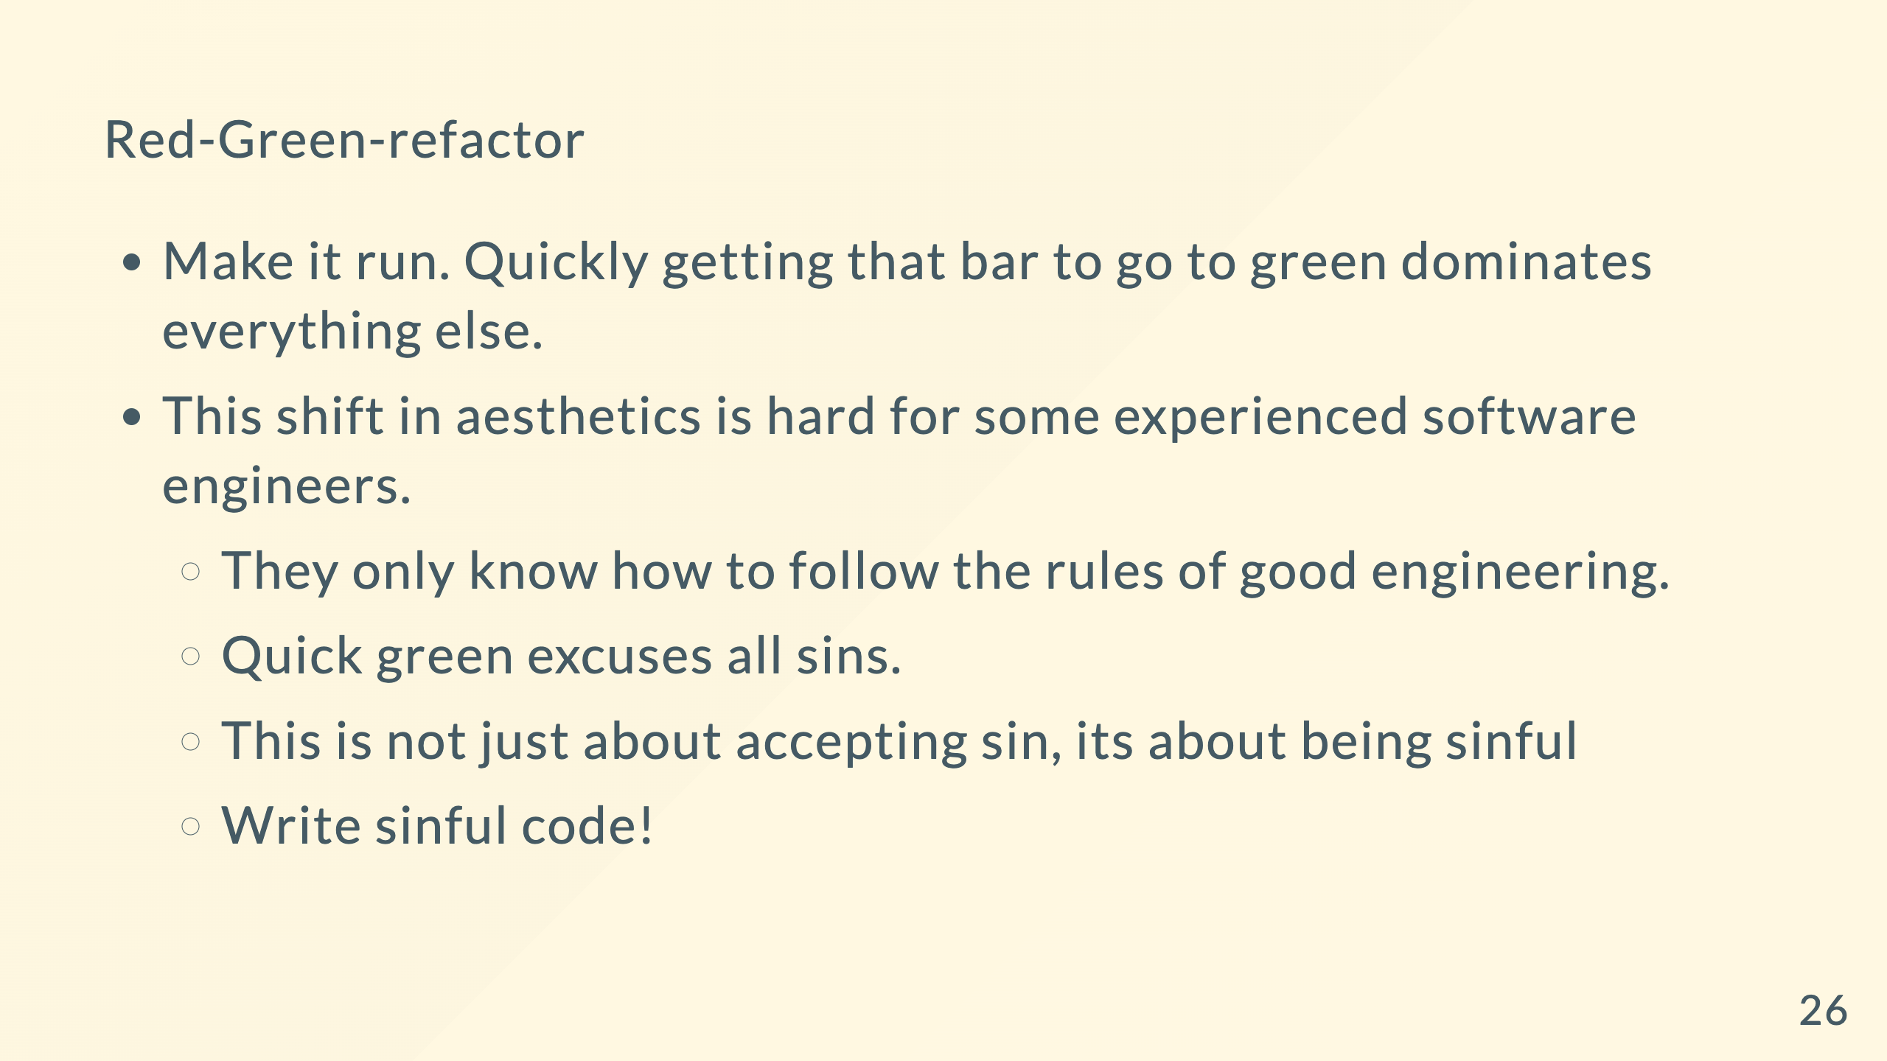
Notes:
Speed trumps design, just for that brief moment

Slide 27
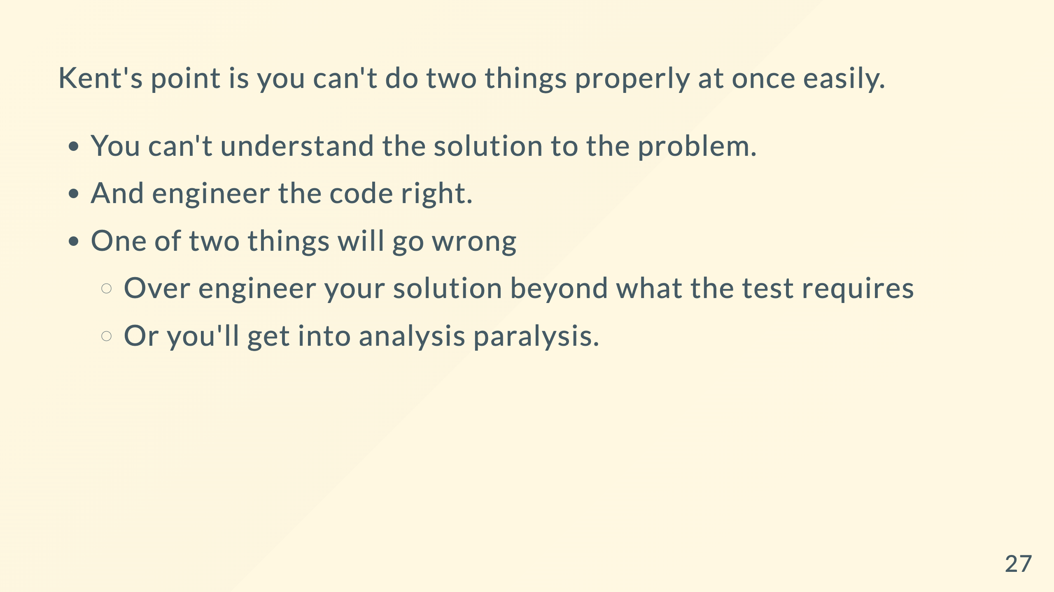
Notes:
First thing we do is solve the problem with some code

Slide 28

Notes:
We don't want duct programming code all along

Slide 29
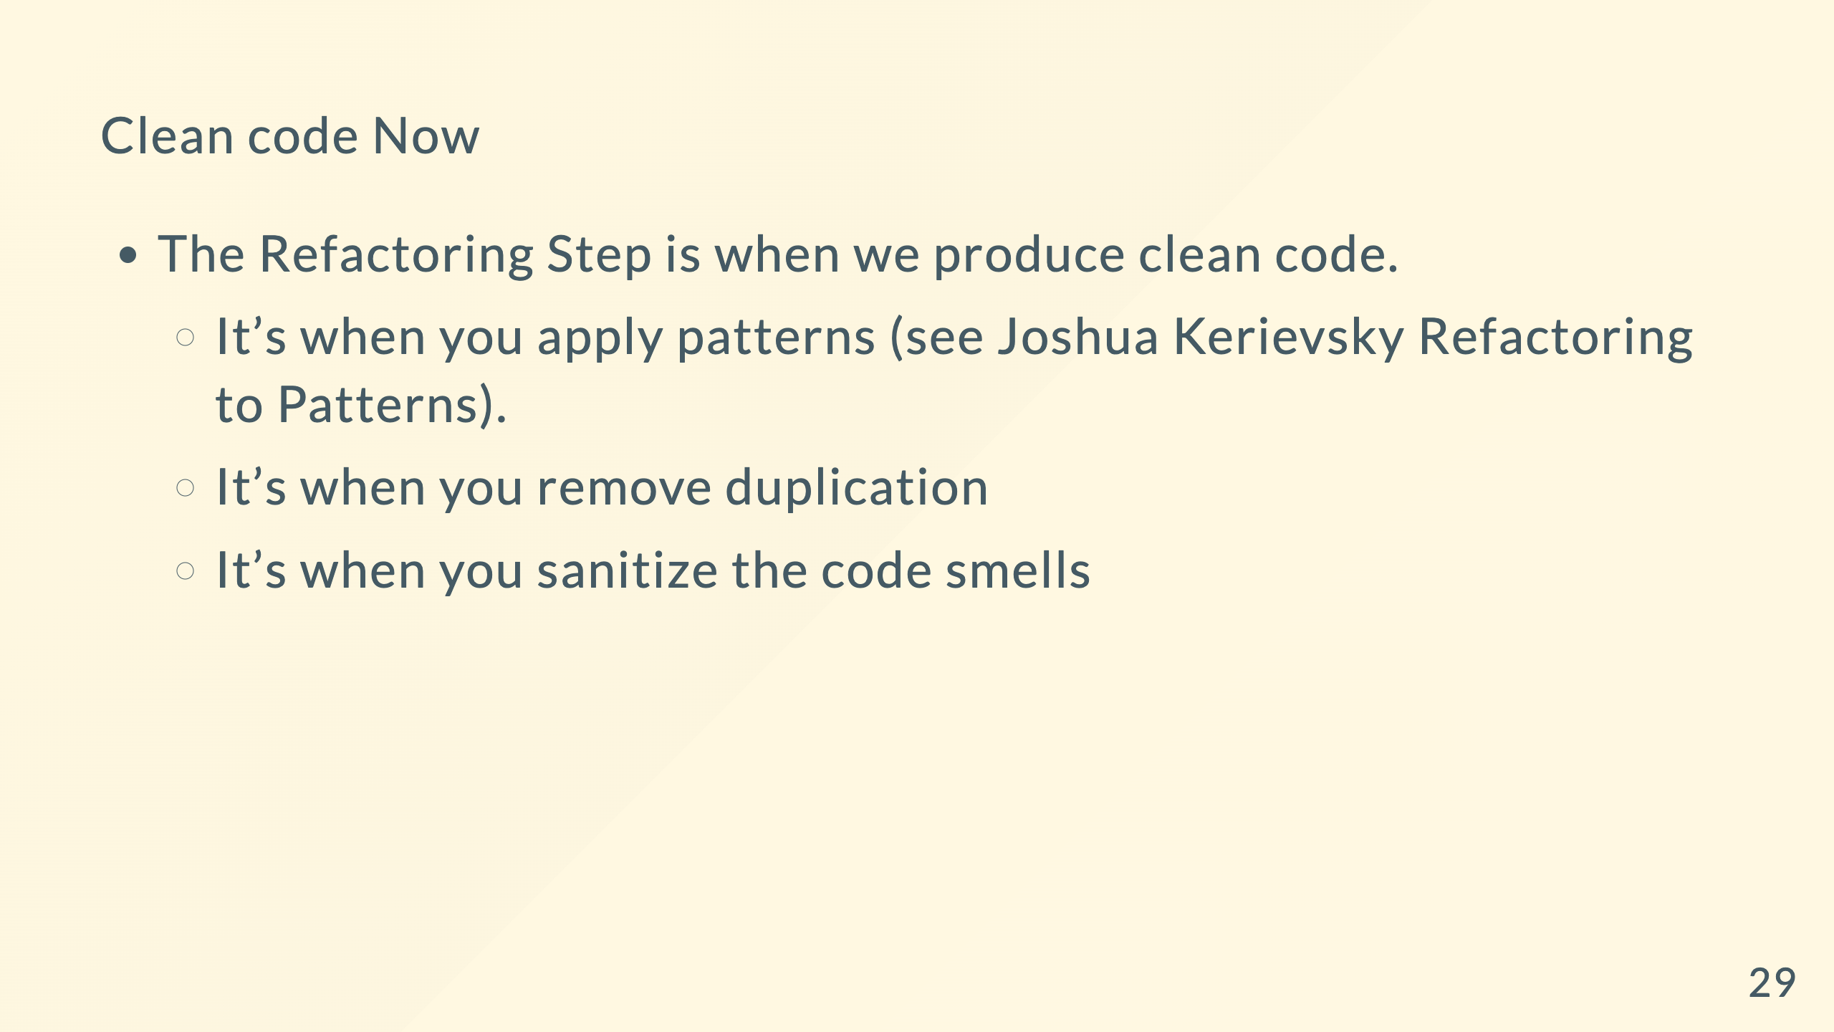

Slide 30
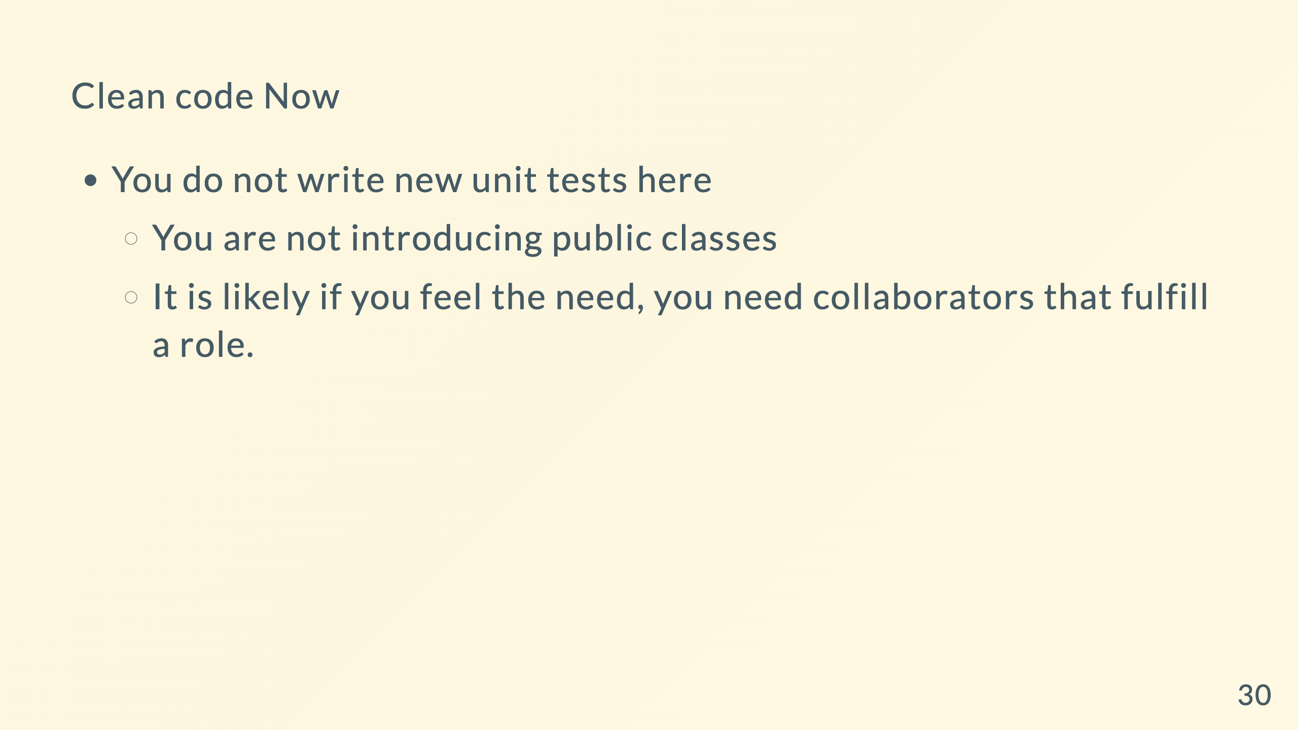

Slide 31
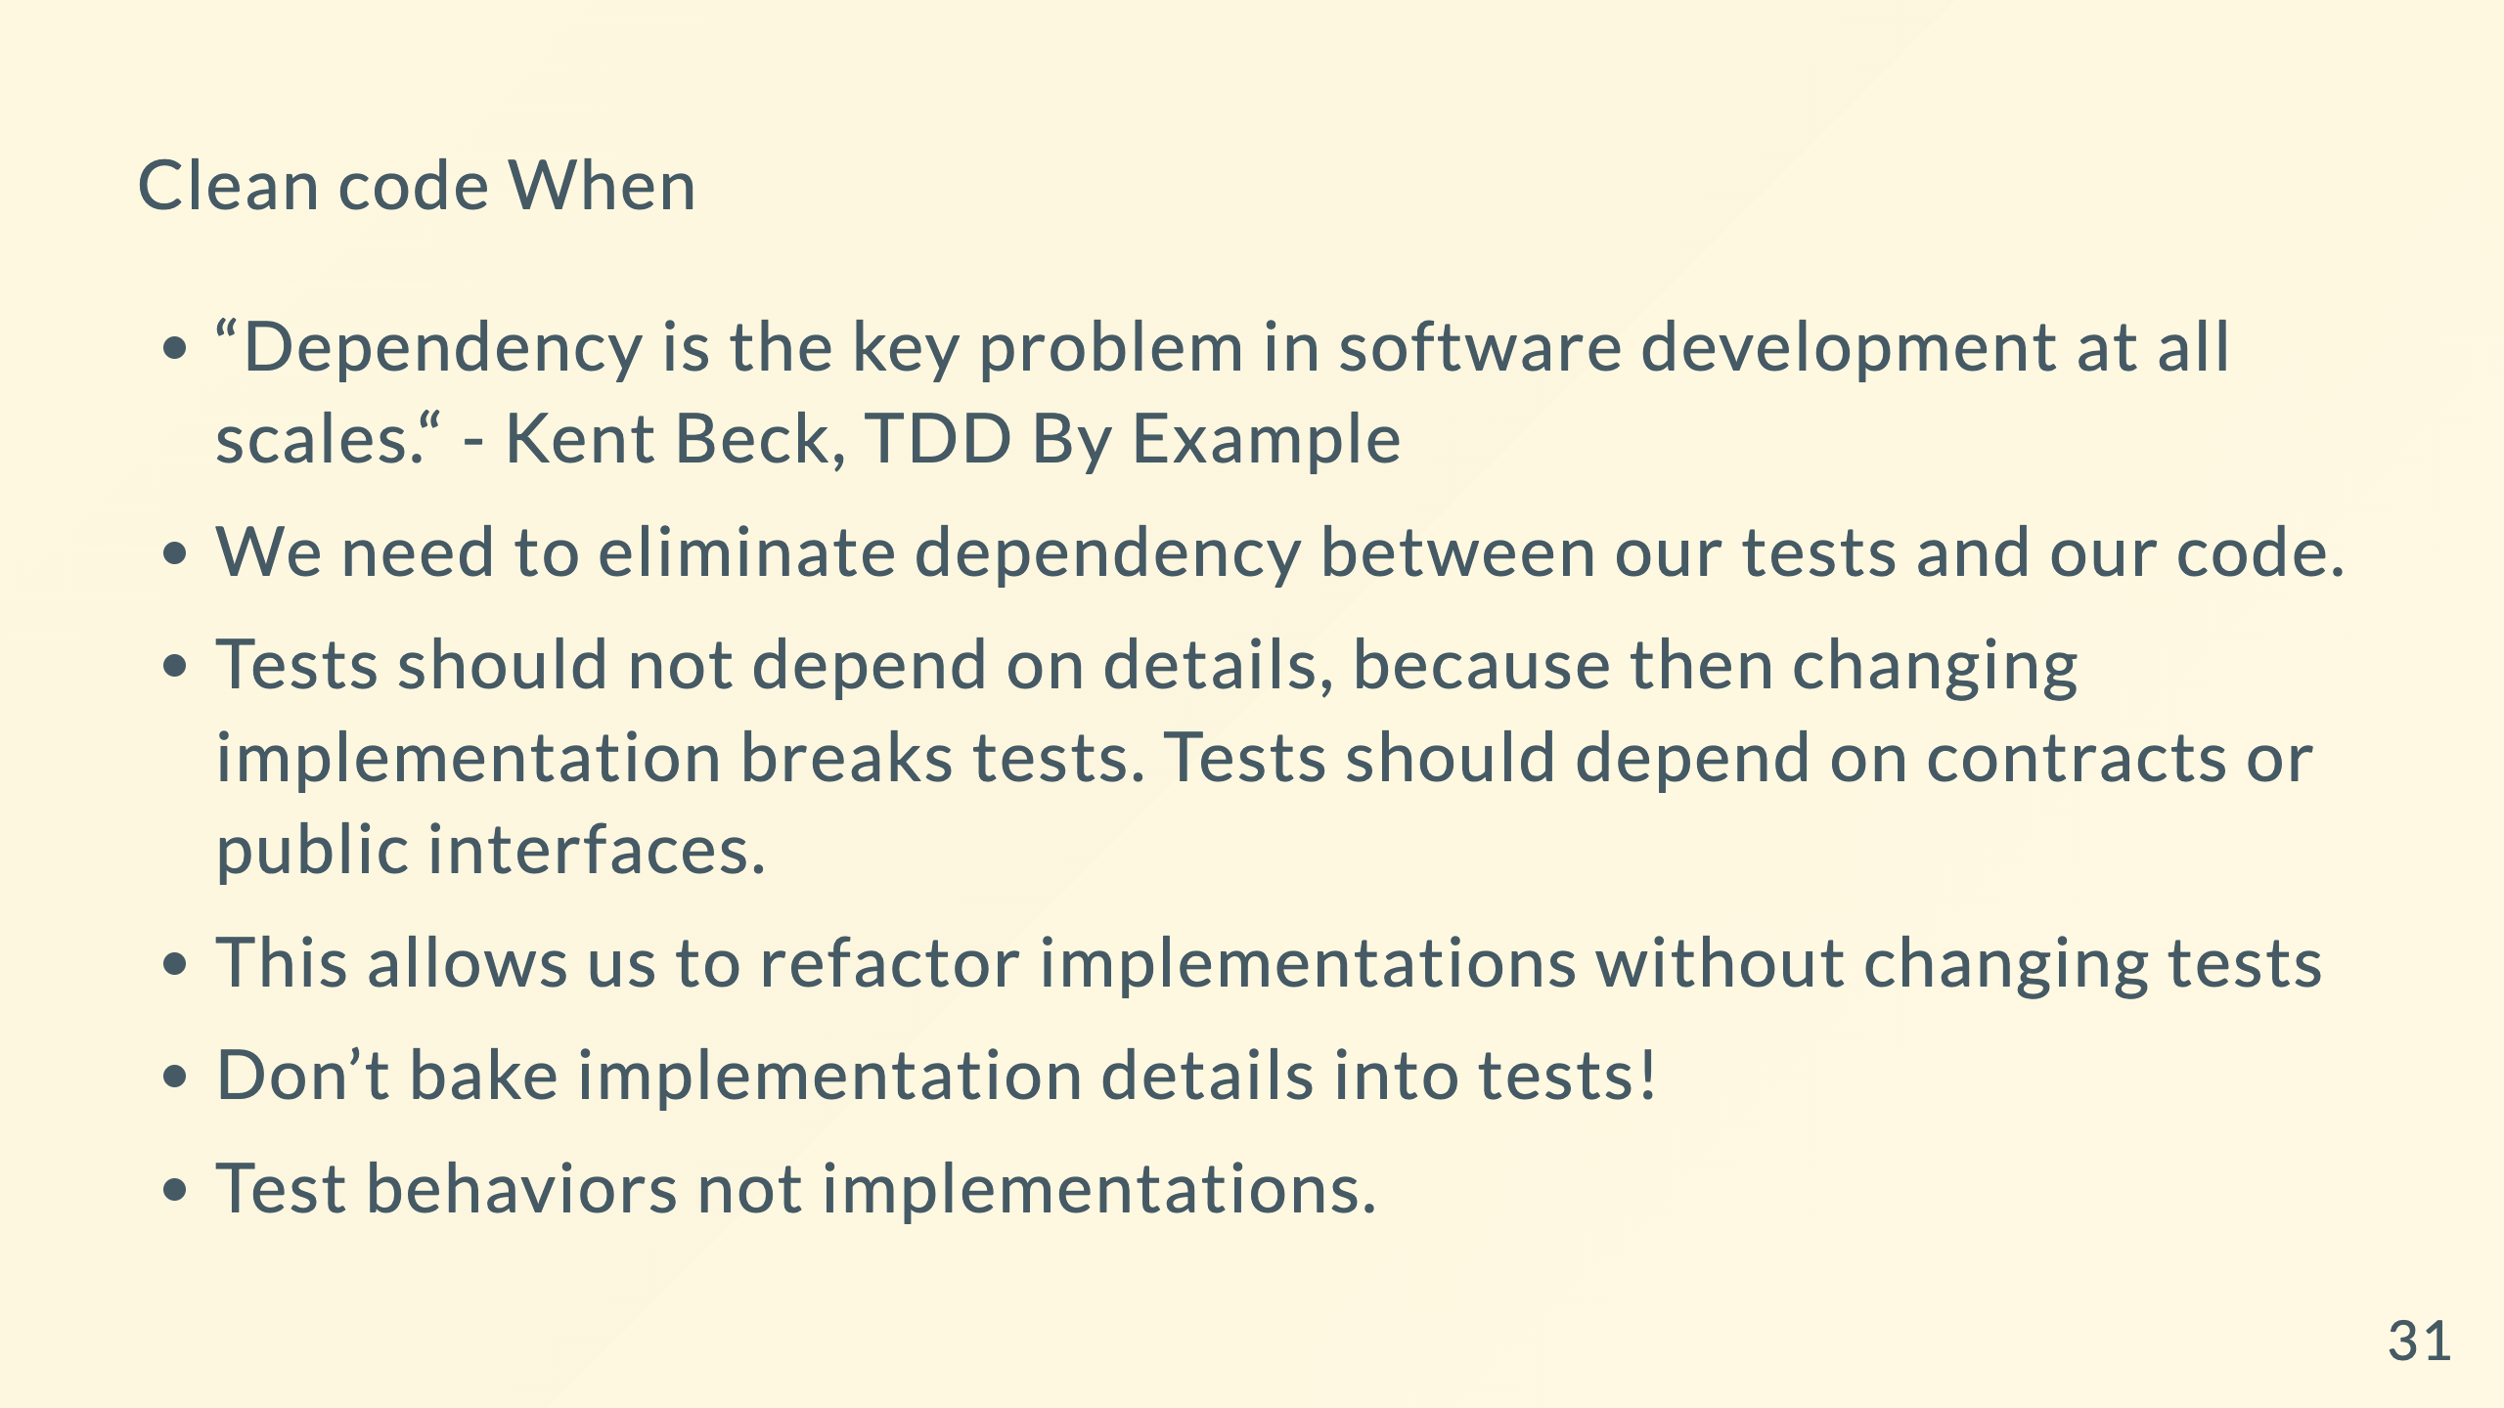

Slide 32
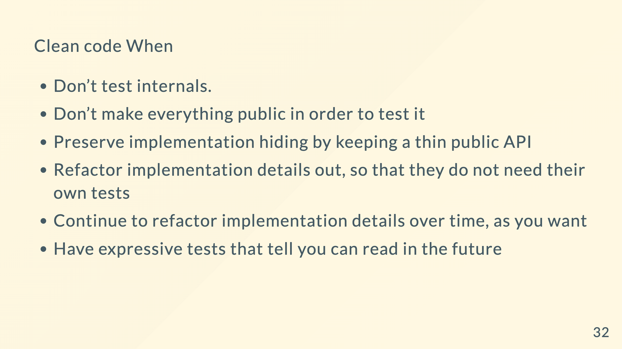

Slide 33
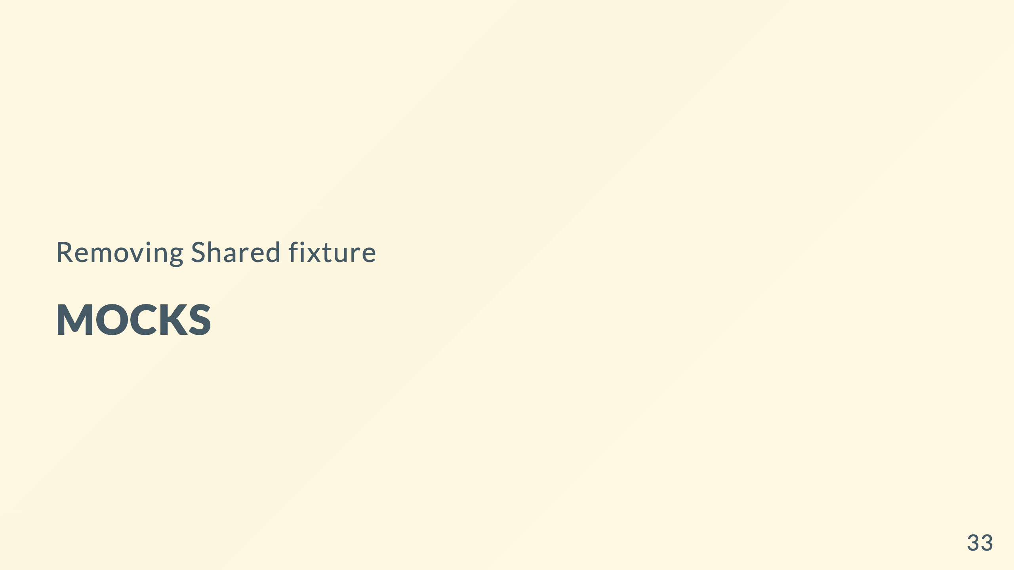

Slide 34
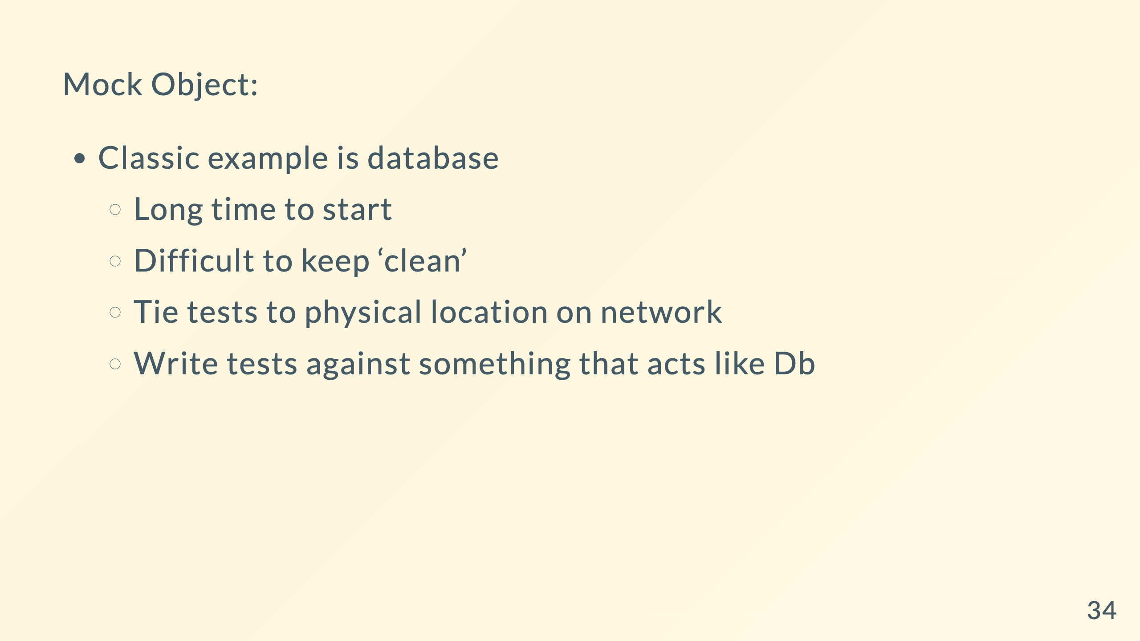

Slide 35
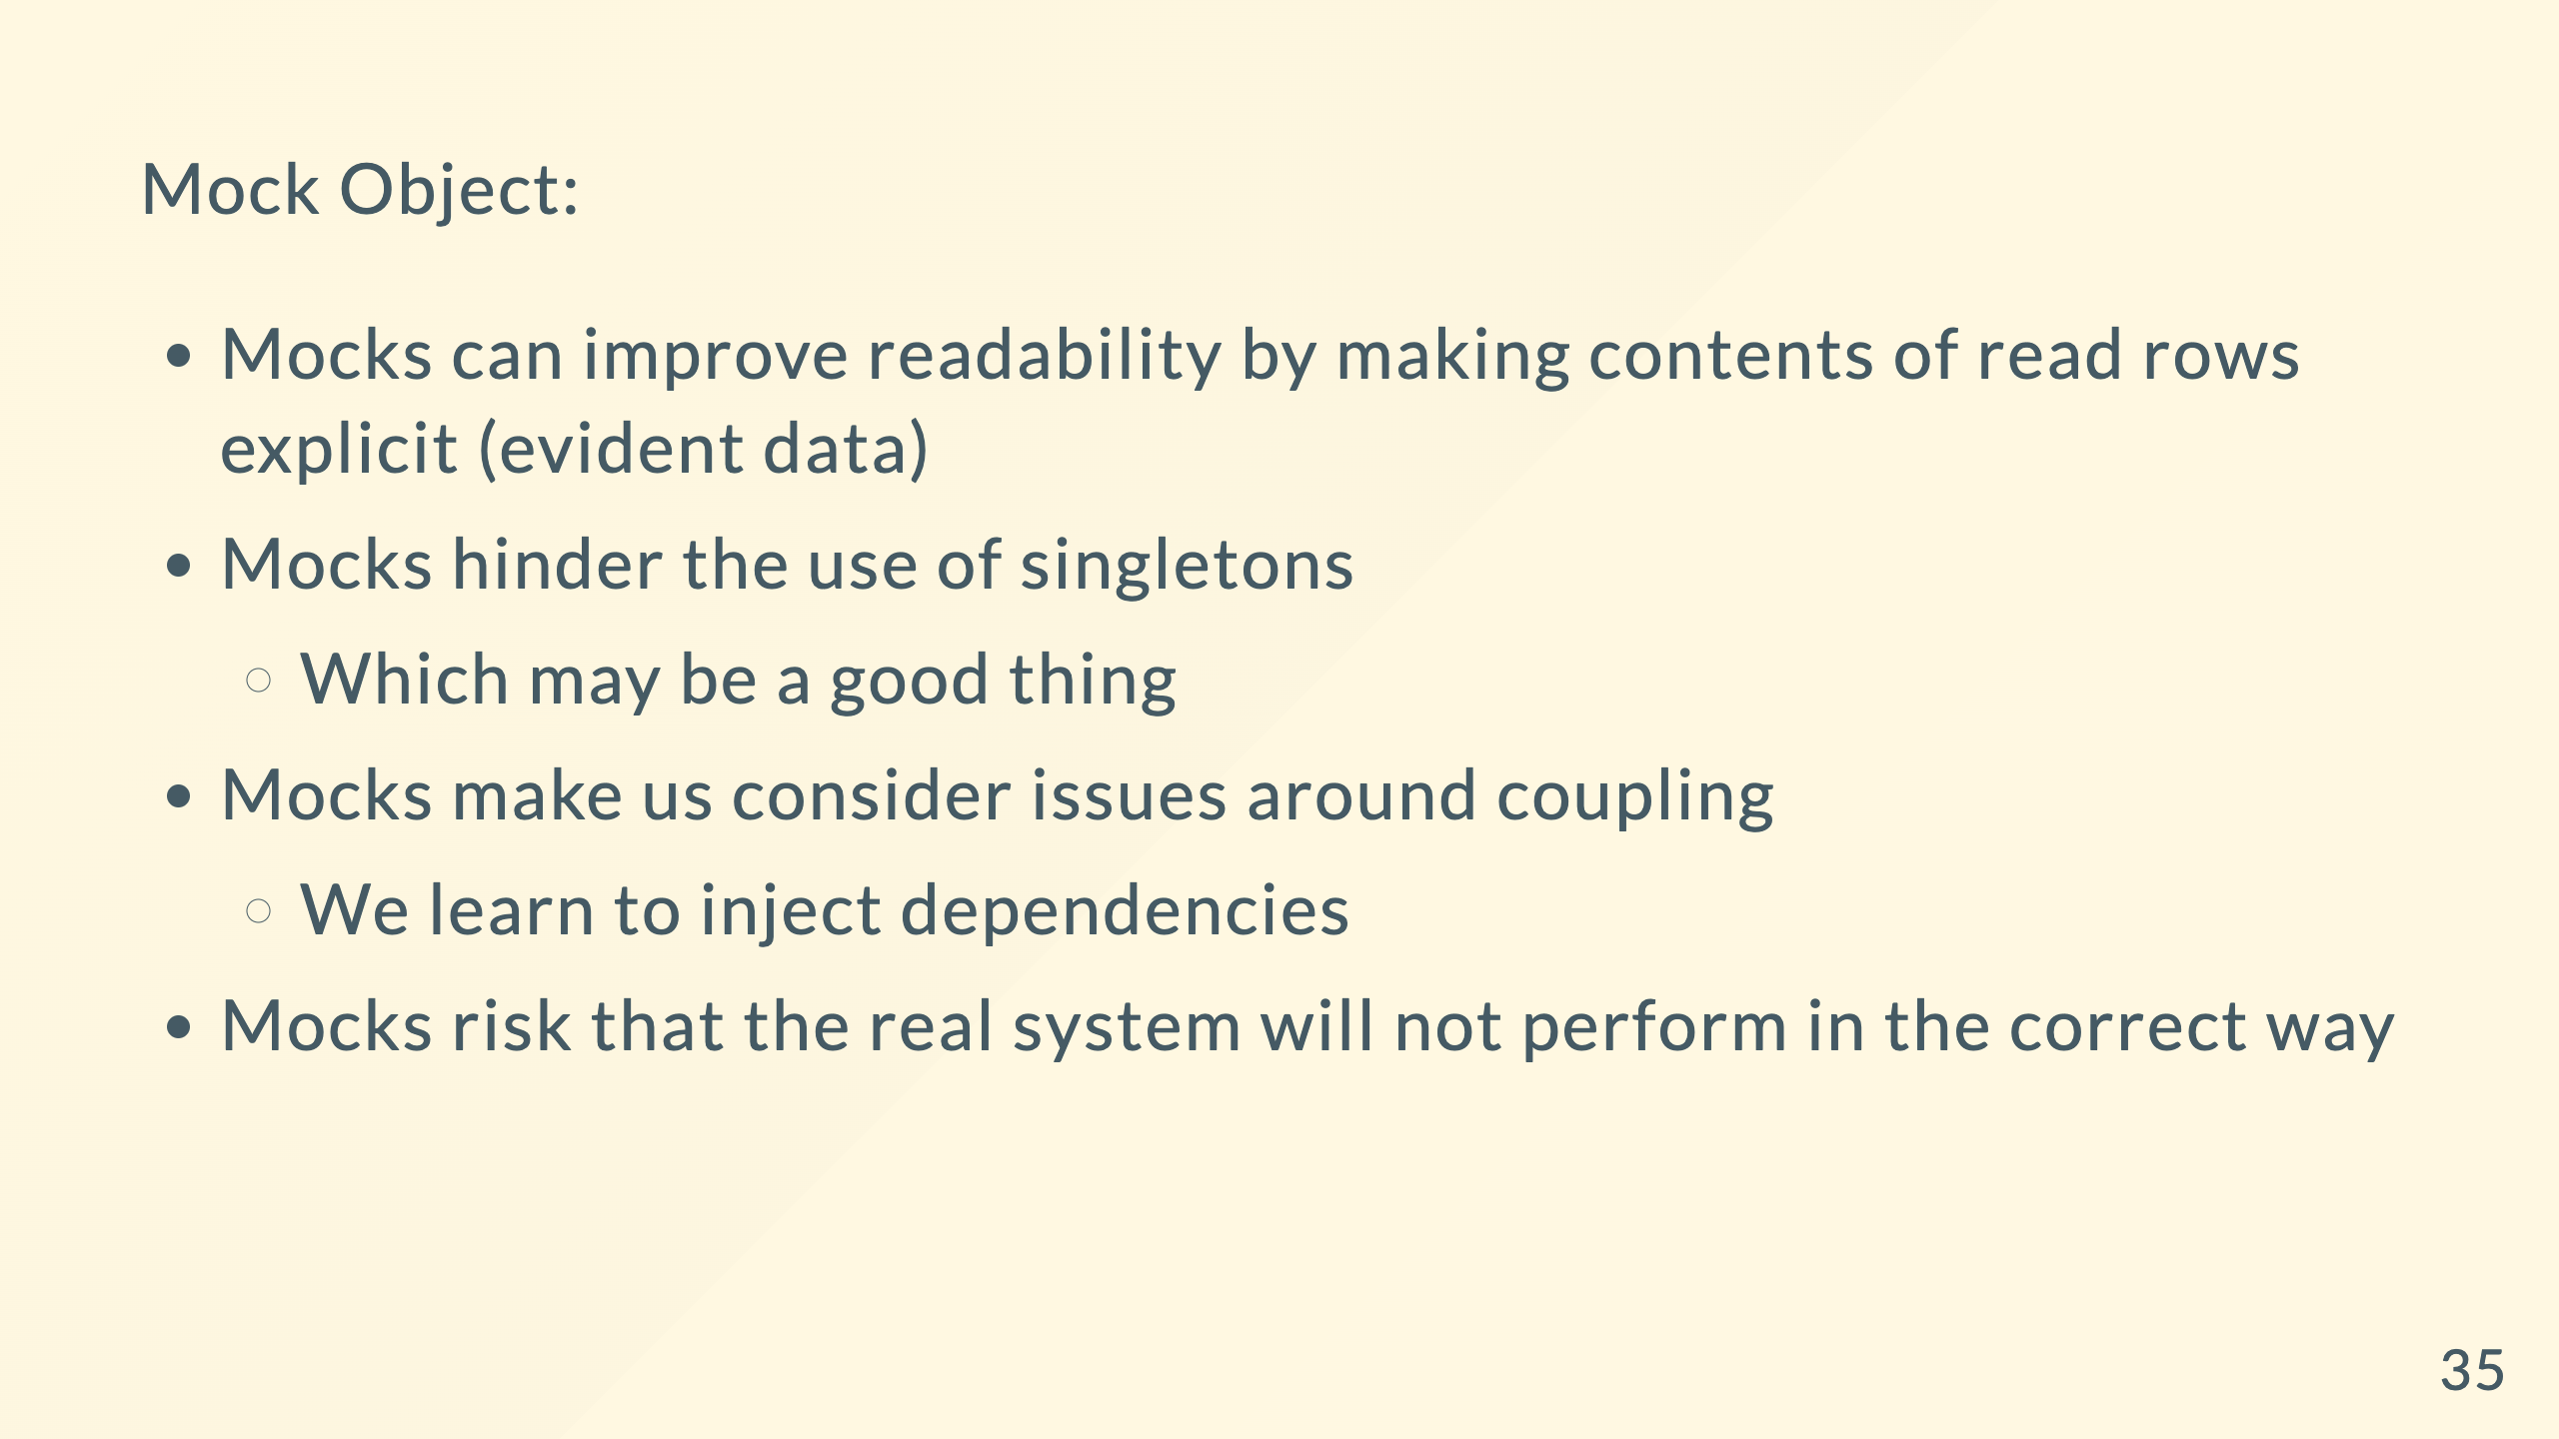

Slide 36
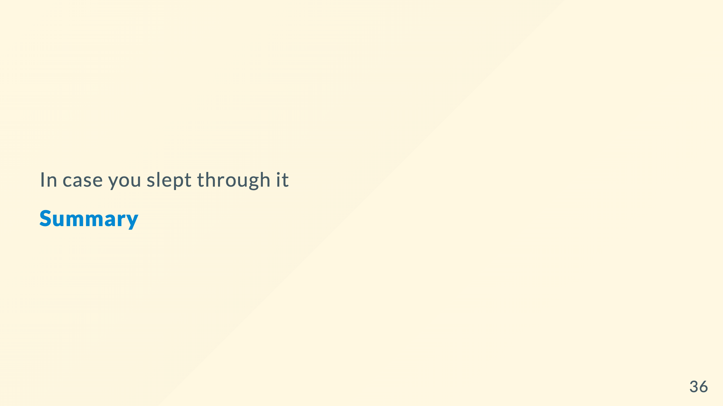

Slide 37
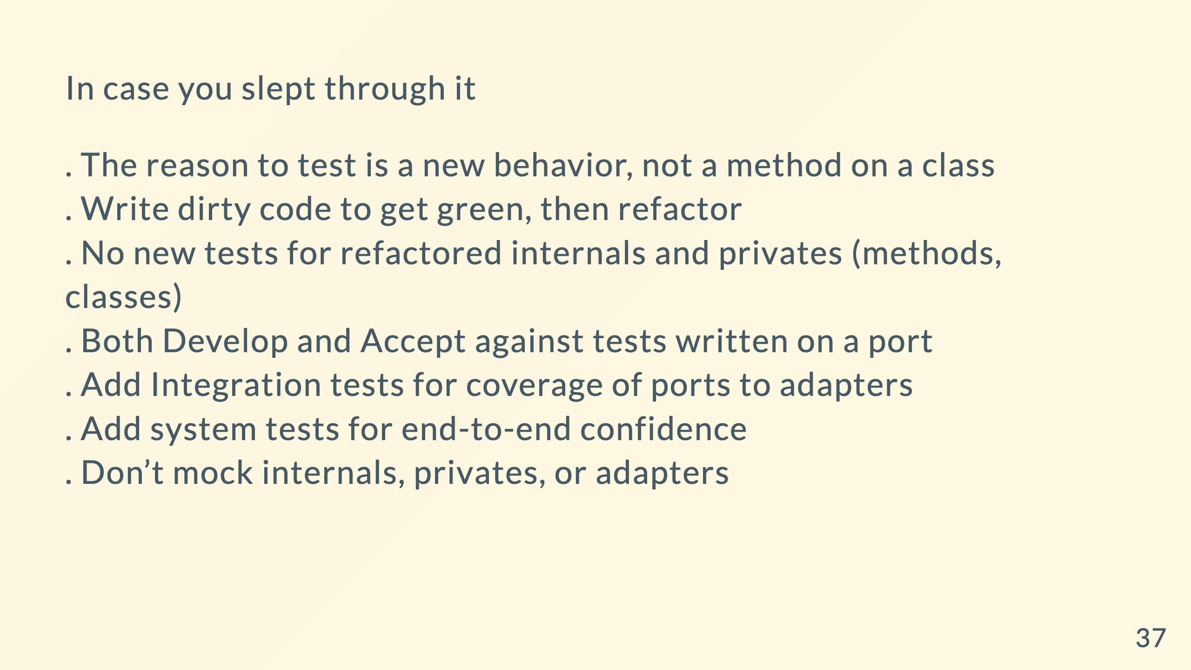

Slide 38


Slide 39


